Slide 1
Understanding
RFID Counting Protocols
Binbin Chen# Ziling Zhou^# Haifeng Yu^
# Advanced Digital Sciences Center
^ National University of Singapore
MobiCom 2013

Slide 2
Many applications need counting
RFID technology
enables
large-scale counting

Slide 3
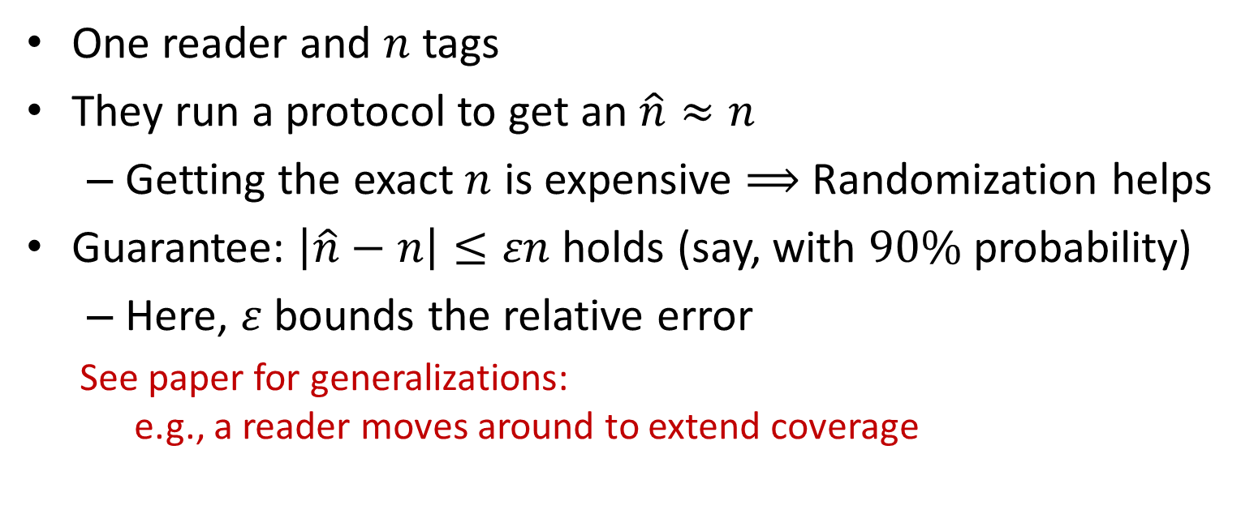
RFID counting problem
(a simple single-set version)
One reader and $n$ tags
They run a protocol to get an $\hat{n}≈n$
  Getting the exact $n$ is expensive $⟹$ Randomization helps
Guarantee: $\left|\hat{n}−n\right|≤εn$ holds (say, with $90\%$ probability)
  Here, $ε$ bounds the relative error
  See paper for generalizations:
  e.g., a reader moves around to extend coverage
Legends:
RFID tag
RFID reader

Slide 4
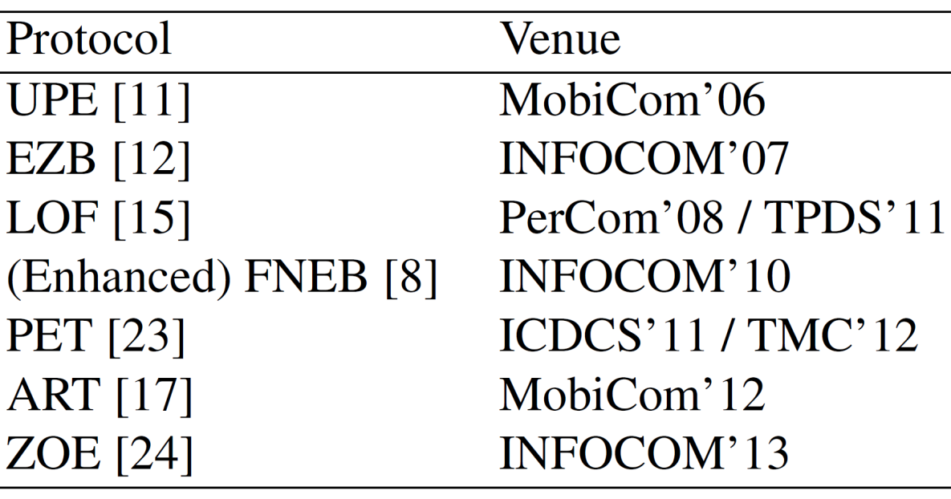
Existing RFID counting research
An impressive arsenal of techniques
The central design goal:
Reduce time overhead & provide the guarantee

Slide 5
Existing RFID counting research
Call for fundamental understanding
Diverse views on which design aspects are important
Should we combine all these techniques
despite the resulting complexity?
Novel statistical gauges
Optimization of parameters
Adaptive iterations
……

Slide 6


Our central thesis for RFID counting
The overlooked key is to have two phases:
Other techniques proposed in the literature
are less important than originally thought
Rough
estimate
2nd phase
$$O\left(\frac{1}{ε^{2}}\right)$$
Final estimate
1st phase
$$O(\log{n})$$
Note:
the $\log{n}$ term can be reduced to a $\operatorname{loglog}{n}$ term

Slide 7

The inspiration
Novel lower bounds for RFID counting protocols:
(Rough) Theorem:
For single-set RFID counting, no protocol can estimate with $<ε$ relative error while
incurring $o\left(\log{\log{n}}+\frac{1}{ε^{2}log\frac{1}{ε}}\right)$ overhead
Our proof leverages a recent breakthrough result in communication complexity [Chakrabarti & Regev, STOC’11]
  They proved GHD (Gap Hamming Distance) problem is hard
  We connect RFID counting and GHD by a novel reduction
  Details in paper

Slide 8
Validating our thesis
Examine the importance of other techniques
Apply our thesis to design better protocols

Slide 9
Existing literature: diverse views about what are important
Novel statistical gauges
Optimization of parameters
Adaptive iterations
……

Slide 10
Let us step back, and take
an asymptotic view of
existing protocols
Such a comparison has not been done before

Slide 11


Two distinct groups
Multiplicative overhead:
$O\left(\log{n}\frac{1}{ ε^{2}}\right)$
Enhanced
Additive overhead:
$O\left(\log{n}+\frac{1}{ ε^{2}}\right)$
Note:
Some protocols reduce the $\log{n}$ term to a $\operatorname{loglog}{n}$ term

Slide 12

Additive-overhead protocols are better
Enhanced
Additive overhead:
$O\left(\frac{1}{ ε^{2}}+\log{n}\right)$

Slide 13
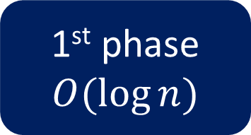
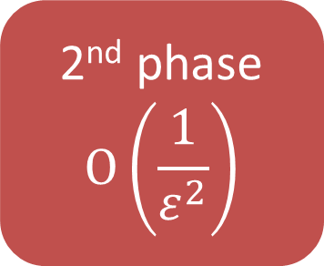
How they achieve additive overhead?
Despite their many differences (as originally emphasized), they all have a two-phase design:
Rough
estimate
2nd phase
$$O\left(\frac{1}{ε^{2}}\right)$$
Final estimate
1st phase
$$O(\log{n})$$

Slide 14
Our thesis has not been discovered
Enhanced FNEB (’10) | Use of a novel gauge: the indices of the first non-empty slots
ART (’12) | Use of a novel gauge: the average run length of non-empty slots
ZOE (’13) | Unique design about the gauge: Each trial has a single slot Two-phase design
They also employ other interesting techniques:
  involved optimizations, adaptive iterations …

Slide 15
Are these other techniques important?
Let us focus on the gauges

Slide 16

An old gauge of the early EZB (’07) protocol
# of empty slots
  More empty slots $⟹$less tags
1
4
5
6
1
2
3
3
4
6

Slide 17
The novel gauges
ART: average run length of non-empty slots
  In the example: (1+2+1)/3
FNEB: index of the first non-empty slot
ZOE: still # of empty slots, but each slot is independent
1
4
5
6
1
2
3
3
4
6

Slide 18
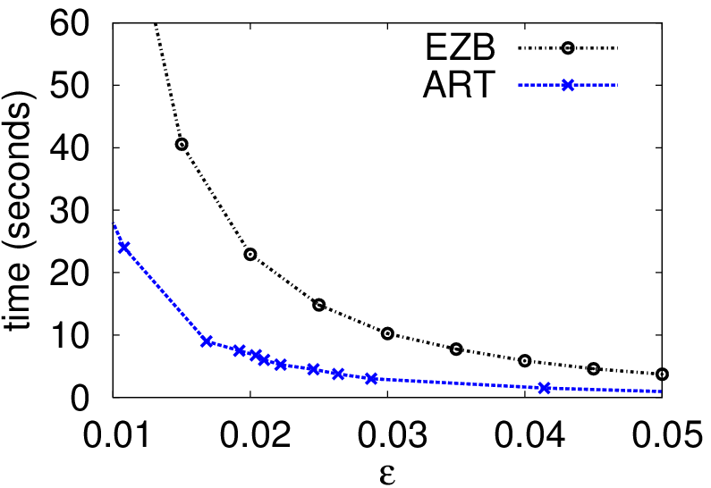
Let us examine ART’s (’12) performance gain
(over the early EZB (’07) protocol)

Slide 19
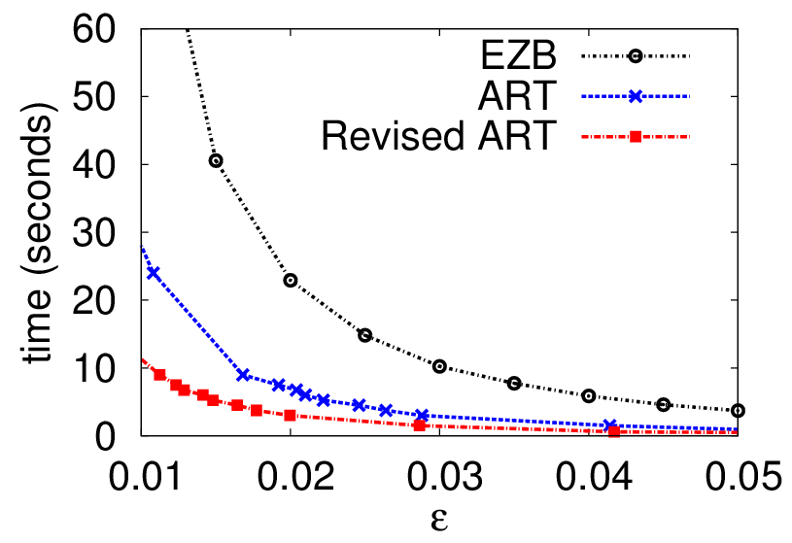
Replace ART’s (’12) gauge by the old
EZB’s (’07) gauge
We keep everything else unmodified

Slide 20
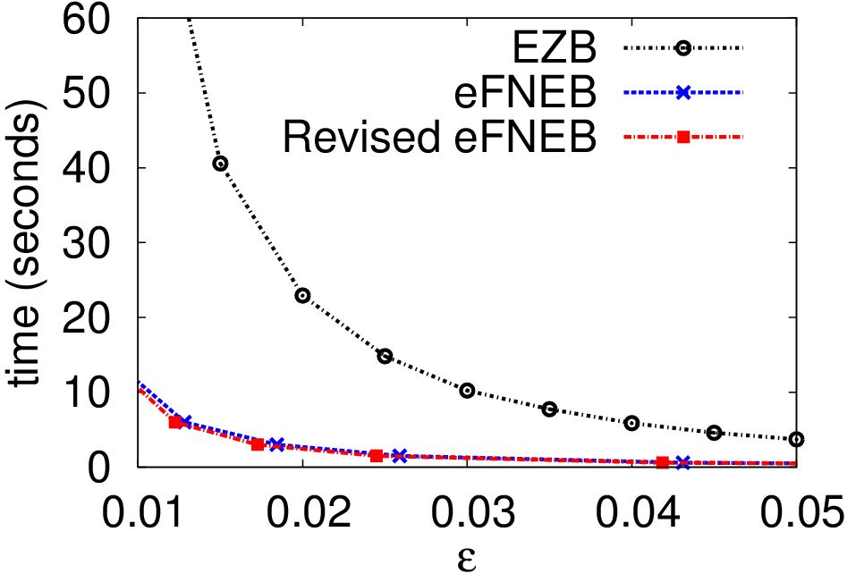
Similarly …
FNEB’s gauge seems not help
Neither does ZOE’s

Slide 21
Validating our thesis
Examine the importance of other techniques
Apply our thesis to design better protocols

Slide 22
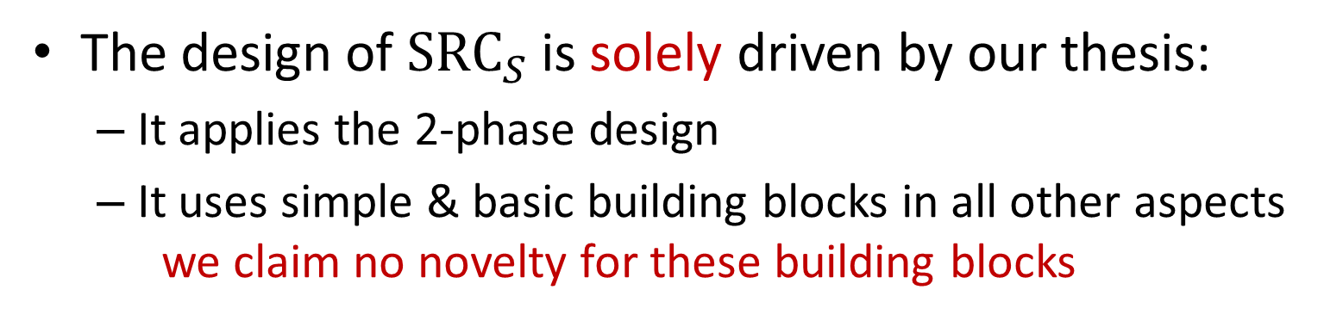
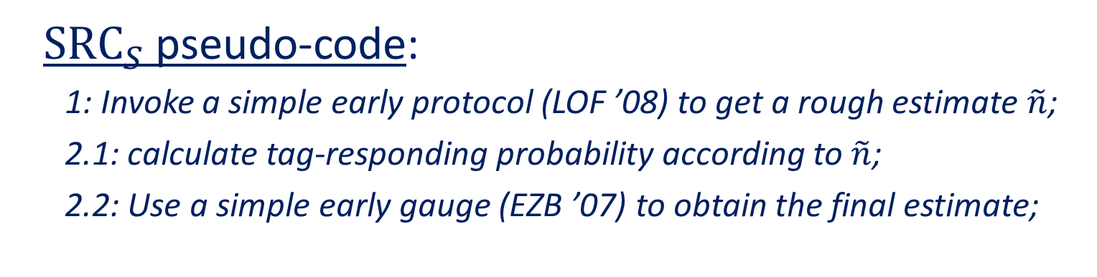
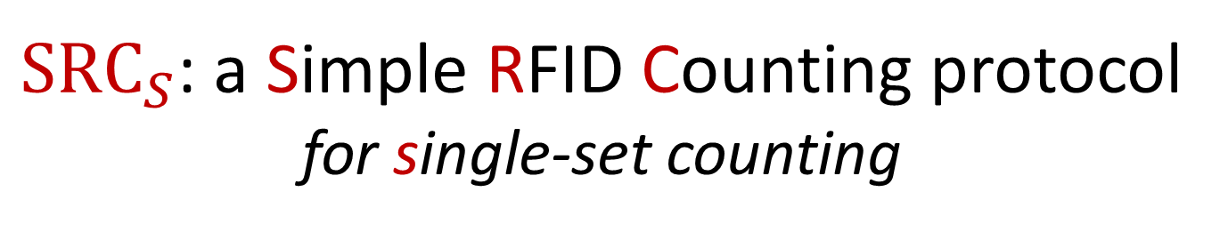
${SRC}_{S}$: a Simple RFID Counting protocol for single-set counting
The design of ${SRC}_{S}$ is solely driven by our thesis:
  It applies the 2-phase design
  It uses simple & basic building blocks in all other aspects
  we claim no novelty for these building blocks
${SRC}_{S}$ pseudo-code:
  1: Invoke a simple early protocol (LOF ’08) to get a rough estimate $\tilde{n}$;
  2.1: calculate tag-responding probability according to $\tilde{n}$;
  2.2: Use a simple early gauge (EZB ’07) to obtain the final estimate;

Slide 23
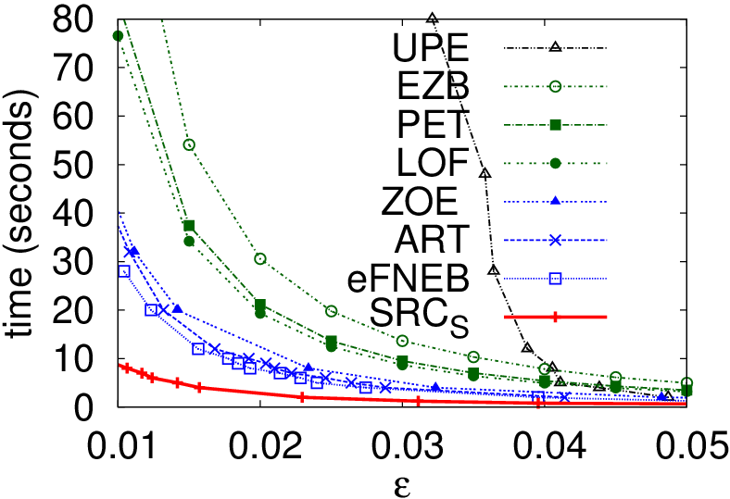


${SRC}_{S}$ is $≥100\%$ faster
$${SRC}_{S}$$
Note: We have done extensive experiments under different settings
Please see our paper for more details

Slide 24

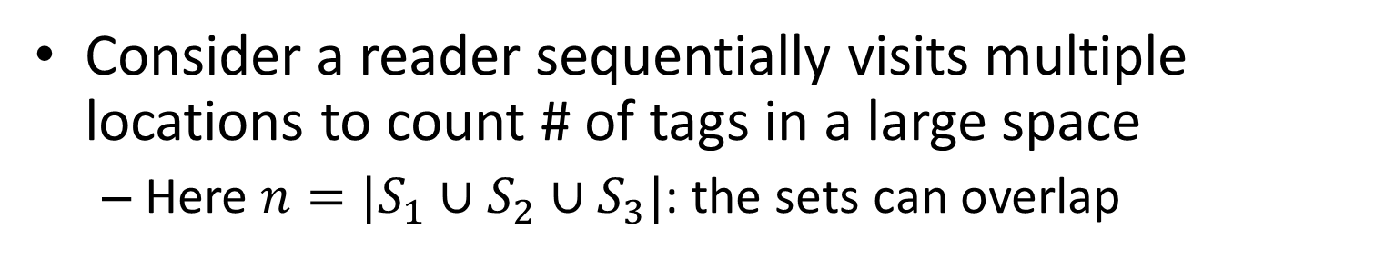


How about multiple-set RFID counting?
Consider a reader sequentially visits multiple locations to count # of tags in a large space
  Here $n=|S_{1}∪S_{2}∪S_{3}|$: the sets can overlap
$$S_{1}$$
$$S_{3}$$
$$S_{2}$$

Slide 25
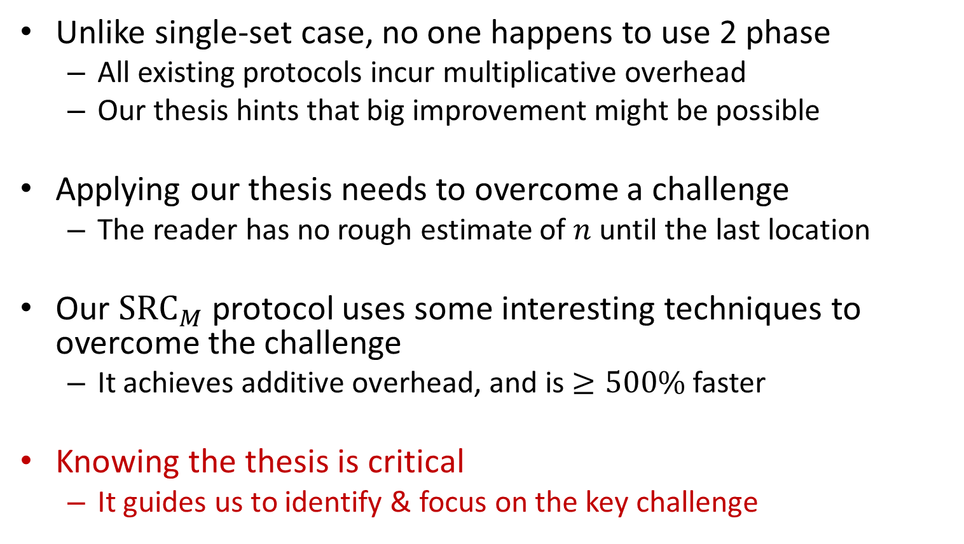
Apply our thesis
Unlike single-set case, no one happens to use 2 phase
  All existing protocols incur multiplicative overhead
  Our thesis hints that big improvement might be possible
Applying our thesis needs to overcome a challenge
  The reader has no rough estimate of $n$ until the last location
Our ${SRC}_{M}$ protocol uses some interesting techniques to overcome the challenge
  It achieves additive overhead, and is $≥500\%$ faster
Knowing the thesis is critical
  It guides us to identify & focus on the key challenge

Slide 26
Summary
Inspired by our RFID counting lower bound results,
we find the overlooked key is a 2-phase design
All other techniques are less important
Our thesis leads to better protocols
Rough
estimate
2nd phase
$$O\left(\frac{1}{ε^{2}}\right)$$
Final estimate
1st phase
$$O(\log{n})$$

