Slide 1
CodeCrunch
Getting Started

Slide 2
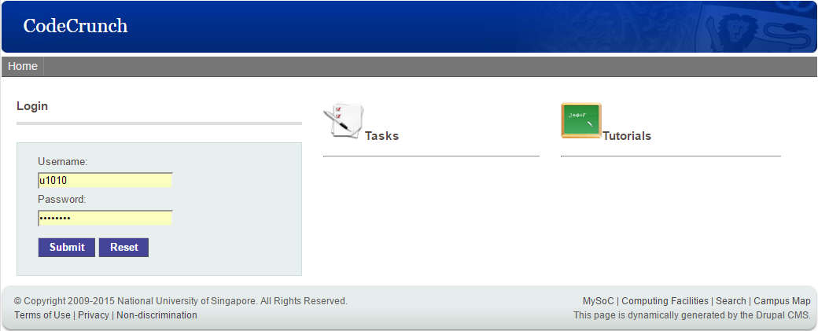
Logging in
Point your browser to https://codecrunch.comp.nus.edu.sg/
The recommended browser is IE. Other browsers may not be fully compatible with CodeCrunch.
Use your NUSNET id and password to login.

Slide 3
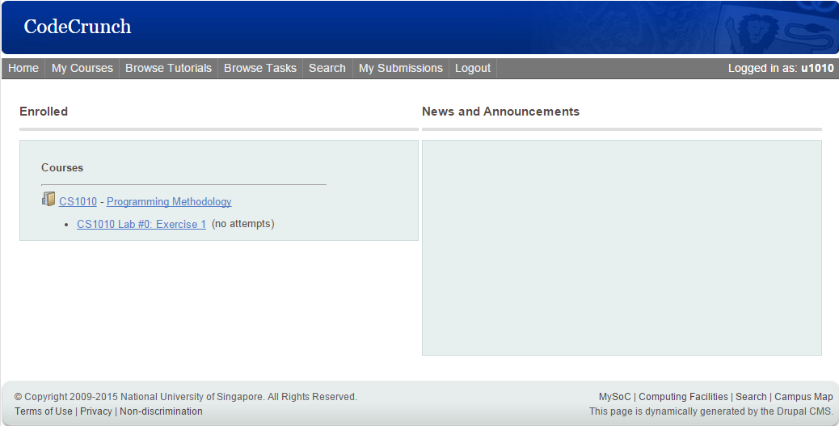
Selecting a task (1/3)
Click the course name from dashboard

Slide 4
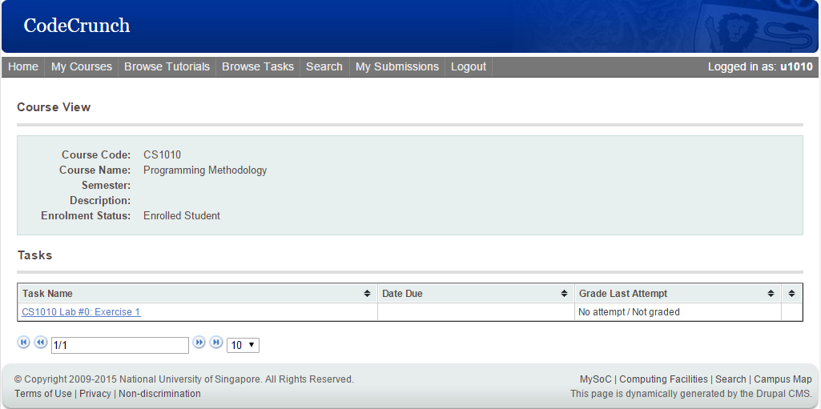
Selecting a task (2/3)
Click the task name

Slide 5
Selecting a task (3/3)
Shortcut for selecting an uncompleted task: Click the task name from dashboard

Slide 6
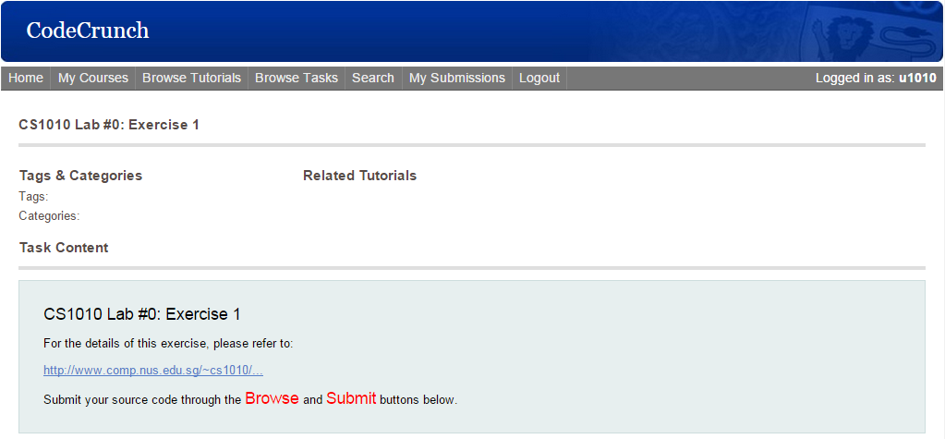
Solving a task (1/4)
Click the URL for the problem description page

Slide 7
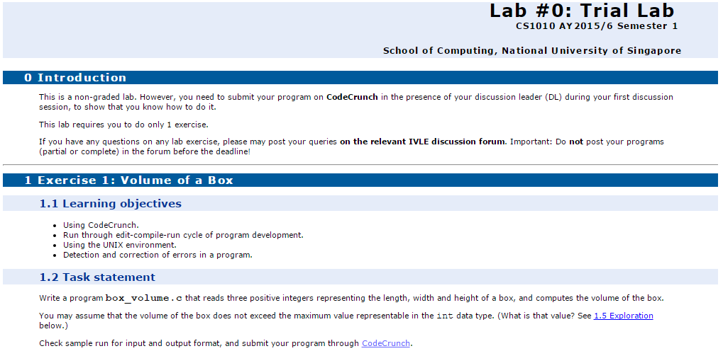
Solving a task (2/4)
Read and understand the problem

Slide 8
Solving a task (3/4)
Download skeleton files, and/or sample input and output files from the problem description page

Slide 9
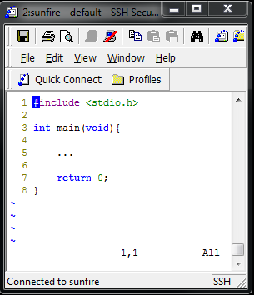
Solving a task (4/4)
Write your program and test it thoroughly before submission.
You are encouraged to use the editor vim in your UNIX account.
After testing your program, you may transfer it to your hard-disk for submission to CodeCrunch.

Slide 10
Submitting a task (1/3)
Once you are done, scroll down the page to the Submission (Course) section
Click Browse and select your solution file.
Take care to submit the correct file – some exercises have limited number of submissions.

Slide 11
Submitting a task (2/3)
Wait for the loading box to appear
Click Submit
The progress bar will start to fill only after you click Submit.

Slide 12
Submitting a task (3/3)
You should see a green box indicating that your program has been submitted successfully.
Click My Submissions to see the grade awarded for that submission
Alternatively, click My Submissions from the navigation bar to get to the same page for the result.

Slide 13
Reviewing a submission (1/3)
You should see the following table containing the details of your submission.
If you are awarded a grade of A, then congratulations, you have completed the task successfully!
If no grade is shown and the submission status is pending, please refresh the page in a few seconds.

Slide 14
Reviewing a submission (2/3)
If you did not succeed, click View details to check your output.

Slide 15
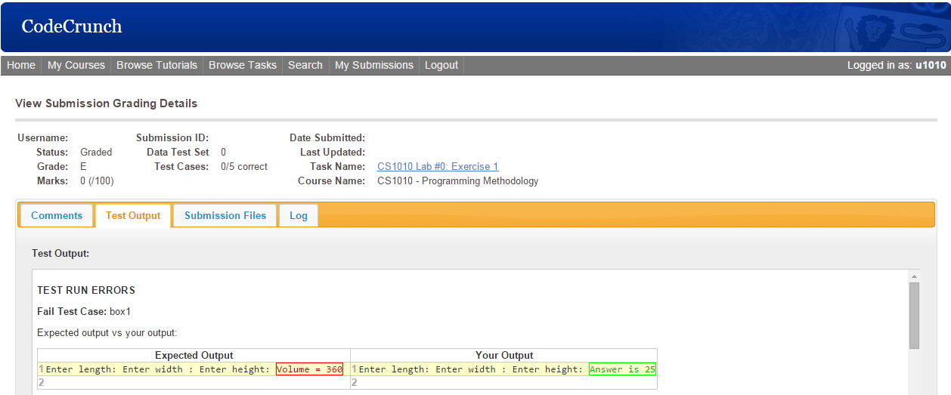
Reviewing a submission (3/3)
Click Test Output and check the errors in the output of your submission
What’s wrong with this output?

Slide 16
Grading
Note that CodeCrunch is used to provide you instant feedback on the correctness of your programs based on a few sets of test data made known to you.
You programs will be tested on more test data that are unknown to you, so you are to thoroughly test your programs yourself.
The last submitted program for each exercise will be manually graded on style and design besides correctness.
You may refer to the Lab Guidelines document http://www.comp.nus.edu.sg/~cs1010/labs/2017s1/labguide.html which also includes the general grading guidelines.

Slide 17
Additional Information
The next three slides contain additional information/tips which you may skip for now, until you are more familiar with CodeCrunch.

Slide 18
Input and Output Files
Your program works on interactive inputs (for now), but CodeCrunch executes your program by redirecting the input data from a text file.
This way, it can test your program by reading input data from different text files, one at a time.
You can do this in UNIX using input redirection <
Assuming that you have copied the input text file set1.in into your own directory, you can type: a.out < set1.in
Likewise, you may also use output redirection > to redirect output to a text file instead of to the screen: a.out < set1.in > myset1.out

Slide 19
Using the ‘diff’ command
You may then use the diff command in UNIX to compare your own output file myset1.out with the correct output file set1.out provided on the CS1010 website diff myset1.out set1.out
If the two files (myset1.out and set1.out) are identical, no output will be produced by the diff command.
This is handy in cases where the differences between your output and the model output are not visible to the eyes, for example, trailing spaces in an output line.

Slide 20
Program that fails all test cases
Q: I tested my program and it works well, but when I submit it to CodeCrunch, it fails all the test cases! Why?
This is a very commonly encountered problem once students start to submit their programs to CodeCrunch
A verly likely reason is that you have forgotten to initialise some variable properly. Remember that an uninitialised numeric variable may not contain zero.
Correct your program and resubmit to CodeCrunch!
Some students just ignored CodeCrunch feedback and did nothing to correct their program when it fails all test cases. Don’t do this!

Slide 21
THE END

