Slide 1
http://www.comp.nus.edu.sg/~cs2100/
Recitation-1
C Programming and Number Systems
L1 and L2 videos
Prabhu NATARAJAN

Slide 3
Agenda
Summary
Quiz Questions
Q/A
Extra Excercises

Slide 5
Summary of L1 and L2

Slide 6
L1 - Overview of C Programming

Slide 7
L2 – Number Systems

Slide 8
L2 – Number Systems

Slide 9
L2 – Number Systems

Slide 10
Quiz Questions

Slide 11
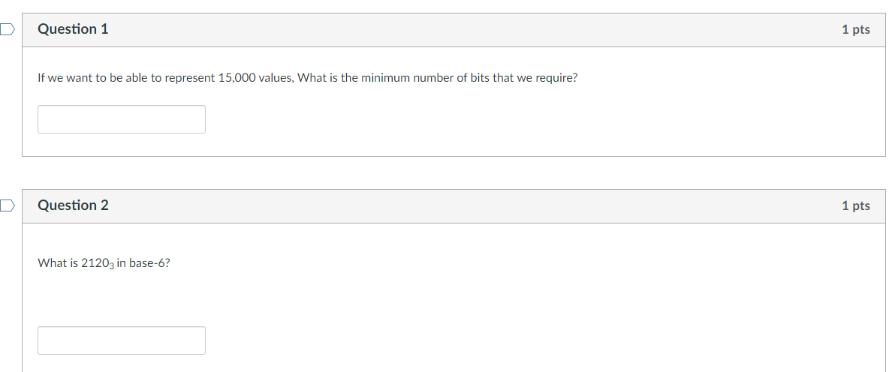
Week-1 Quiz-1

Slide 12
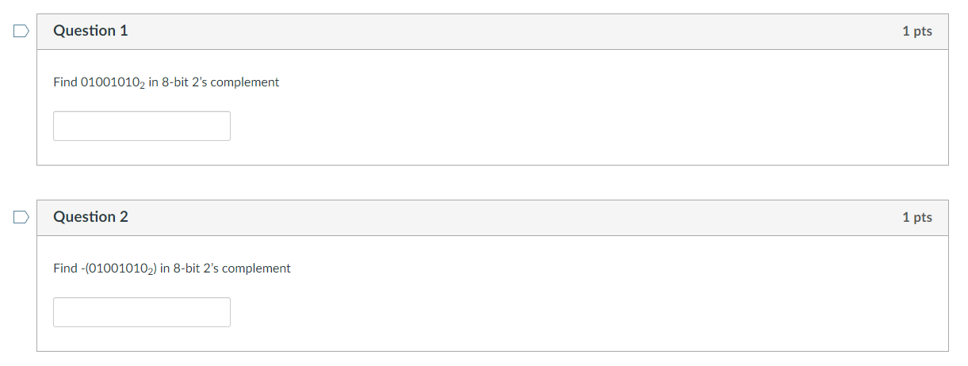
Week-1 Quiz-2

Slide 13
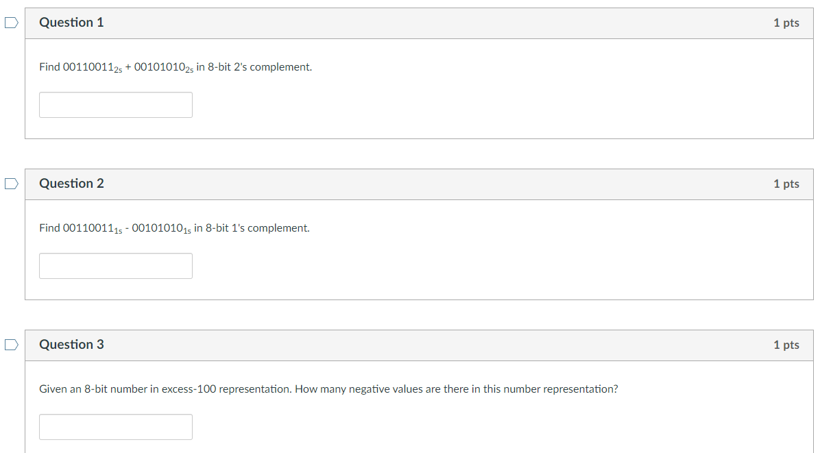
Week-1 Quiz-3

Slide 15
Week-1 Quiz-4

Slide 17
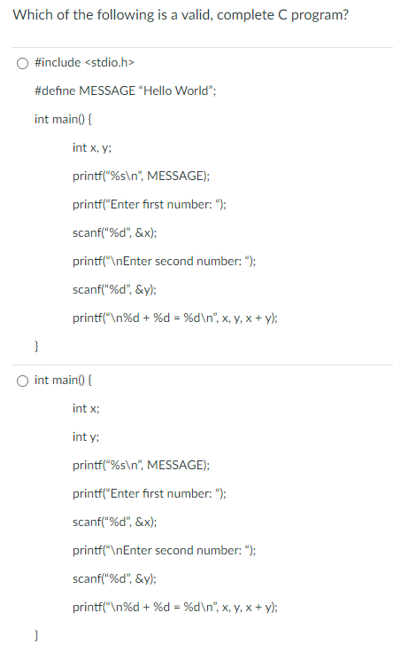
Week-1 Quiz- C Programming 1

Slide 18
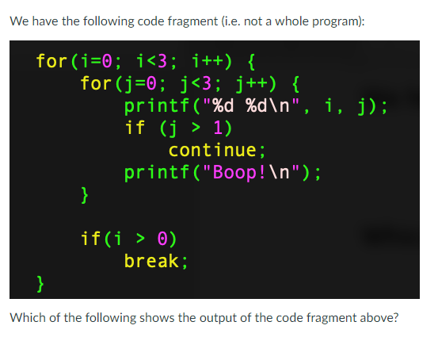
Week-1 Quiz- C Programming 1

Slide 19
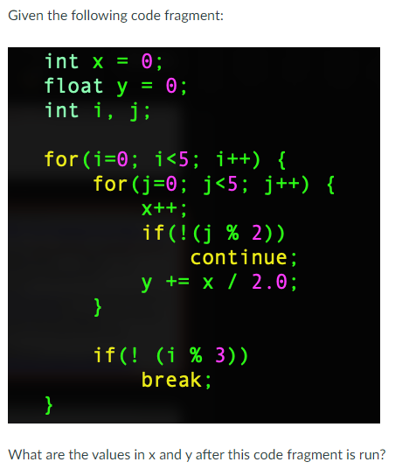
Week-1 Quiz- C Programming 2

Slide 20
Q/A from Netlify

Slide 21
Q/A from Netlify
Hi Prof, may I ask why the range of a 8-bit sign-and-magnitude representation is -127 and -127 in Base 10? I would've thought it was -128 to +128 since 2^7 as 7 bits are used for magnitude.
Notes:
The most positive value it can represent is 01111111, which is +127. The most negative value it can represent is 11111111, which is -127. (8 bits can represent 2^8 or 256 values. 127 positive values and 127 negative values can be presented, and there are 2 representations for zero: 00000000 and 10000000.)
Q:For an n-bit sign-and-magnitude representation, what is the range of values that can be represented?
A:To calculate the range more precisely, you can use the following formulas:
The most negative value (min) is -2^(n-1) + 1.
The most positive value (max) is 2^(n-1) - 1.

Slide 22
Q/A from Netlify
Can we store true 0 in floating point rep if there is an implicit leading bit 1 in the mantissa? 0 00000000 00000000000000000000000 would still be 1 * 2^(-127), or is that the best we can do?
Notes:
If you are referring to the IEEE 754 floating-point representation, there are special representations for values such as zero, NAN (not-a-number), etc. which do not follow the usual rule. For example, for the value zero, its IEEE754 floating-point representation is all zeroes, which does not follow the normalization rule.

Slide 23
Q/A from Netlify
Hi prof,on the integer overflow on sunfire. https://stackoverflow.com/questions/3679047 shows that there's no defined behaviour when an integer overflows. Unless compiler flags are provided, the behaviour is not guaranteed?

Slide 24
Extra Exercises

Slide 25
Extra Exercises Exercise 1 – Simple Calculator
Write a program that:
Asks for an operator (+, -, *, / or q).
If the operator is +, -, * or /, ask for two floating point numbers.
Prints “Unrecognized operation” if the operator entered is not +, -, *, / or q.
If the person enters ”q” the program says “Bye!” and exits. If the user enters +, -, *, /, the program performs the operation on the two numbers entered and prints the result in two decimal places.
If the user did not enter “q”, go to 1.
The next slide shows some sample runs.

Slide 26
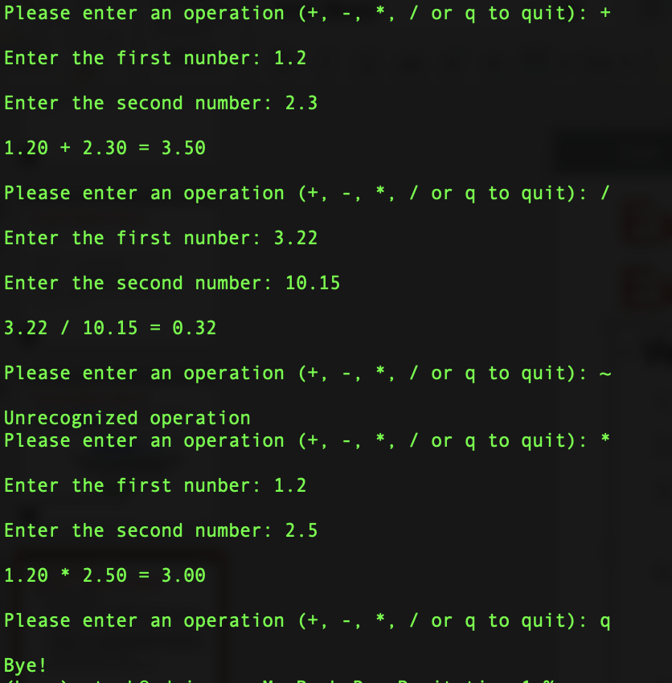
Extra Exercises Exercise 1 – Simple Calculator

Slide 27
Extra Exercises Exercise 2 – Number Systems
Using what you know about number systems and C, show why this while loop may never end: float x = 0.0; while(x != 1.0) x += 0.1;

Slide 28
Extra Exercises Exercise 2 – Number Systems
Let’s convert 0.1 to binary:
$0.1 × 2=0.2$ carry = 0
$0.2 × 2=0.4$ carry = 0
$0.4 × 2=0.8$ carry = 0
$0.8 ×2=1.6$ carry = 1
$0.6 × 2=1.2$ carry = 1
$0.2 × 2=0.4$ carry = 0
$0.4 × 2=0.8$ carry = 0
$0.8 × 2=1.6$ carry = 1
$0.6 × 2=1.2$ carry = 1
…
So $0.1=0.00011001100110011…_{2}$, and it is impossible to represent 0.1 exactly in binary.

Slide 29
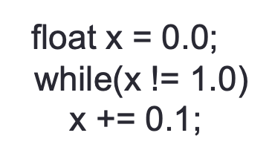
Extra Exercises Exercise 2 – Number Systems
If we used 32 bits to represent 0.1, the closest we would get is 0.0999999998603016.
After adding 10 of these, would get 0.99999999860316.
After adding again, we would get 1.09999999846332. i.e., x will never become 1 and the loop will never terminate.
Note: IEEE-754 format uses only 23 bits for the mantissa and would be even less accurate.

Slide 30
End of File

