Slide 1
Project – The Last Mile
V1.5 and Week 13 Evaluation

Slide 2
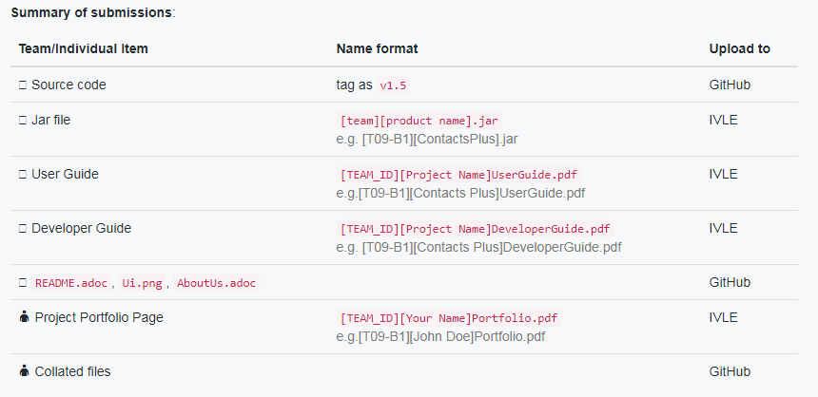
15th April (Sunday), 2359, Submissions

Slide 3
Tutorial Timeslot, Demo
Schedule | Start at B1: 00min, B2:15min, B3:30min, B4: 45min Arrive at least 15 minutes early to setup and prepare
Duration | 1+ (Team Size x 3) minutes 1 min for overview 3 min each for features by individual member
Focus | User profile and features (Not to evaluate implementation strategy / quality)

Slide 4
Lecture Timeslot, i3 Aud, Evaluation
Phase A [~40 Minutes] User Acceptance Test
Phase B [~40 minutes] Other Evaluations
Similar as user testing in week 11
Differences:
Product download from IVLE (tentative)
Actual bugs will affect target team's score
Evaluate Documentation, Features and Estimate Effort
Submit report using TEAMMATES
Tester ID will be anonymized

Slide 5
Why Peer Evaluation? How is it used?
The only practical way to test 50+ products with different features
Each product are tested with 3-4 dedicated testers
Learn and apply testing skill in actual setting
You acquire a different perspective
How your result is used?
The testing result is used heavily for the implementation quality
Documentation, Features and Effort estimation will be used as a factor only
Quality of both will be reflected for your personal milestones

Slide 6
Until Wed 25th April, 2359, Aftermath
Team should meet and review all issues / bugs raised:
Response [Accepted, Rejected, CannotReproduce, IssueUnclear]
Classify accepted bug [Functionality, Documentation]
Decide severity [low, medium, high]
Assign fixer [which team member (if any)should take responsibility]
TA will verify all issues afterwards

