Slide 1
You Can’t Be Me: Enabling Trusted Paths and User Sub-origins in Web Browsers
Enrico Budianto* Yaoqi Jia* Xinshu Dong‡
Prateek Saxena* Zhenkai Liang*
*School of Computing, National University of Singapore
‡Advanced Digital Sciences Center

Slide 2
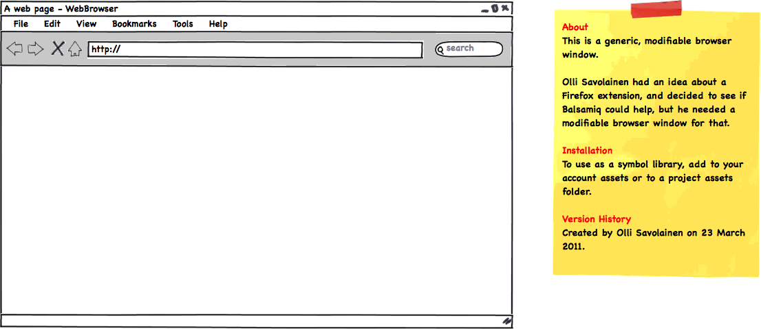




Motivation (1)
xyz.com
Bank XYZ
Welcome, Alice
Account No: 123-55
sessionID = 12345abc
“The scripts can be me”
Target 1 : Sensitive user-owned data
Target 2 : Privileged requests tied to a user
Notes:
In the present web, the authority of a user is represented by an origin and a web session
However, due to script injection attacks, the attacker has unfettered access to do any malicious activities inside the user’s session
For example : sensitive user owned data, or some privileged actions

Slide 3
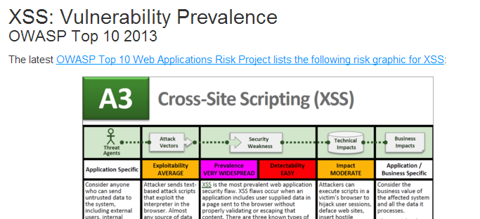
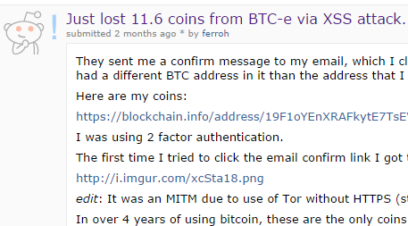
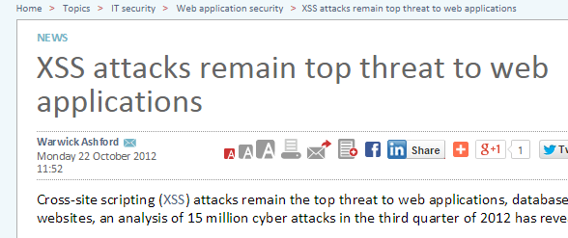
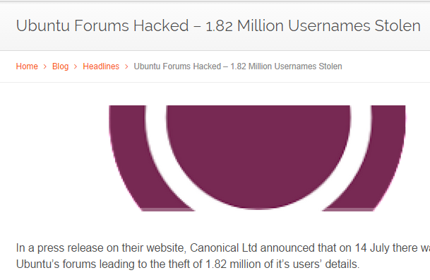
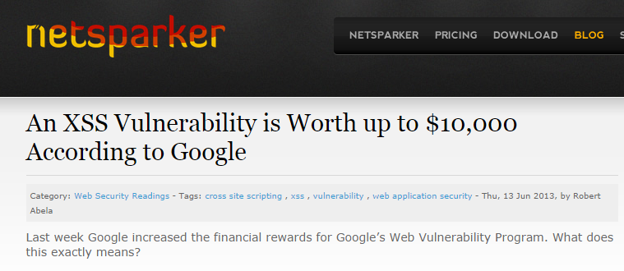
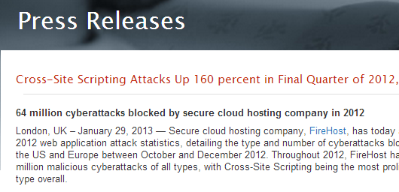
Motivation (2)
Prevalence
Damage
9.6%
25%
websites vulnerable
to DOM-XSS
reported bugs
are XSS
(CCS, 2013)
(Cenzic, 2014)
Notes:
There have been many reports suggested the prevalence and damage that it costs
-- reference use italic and smaller

Slide 4
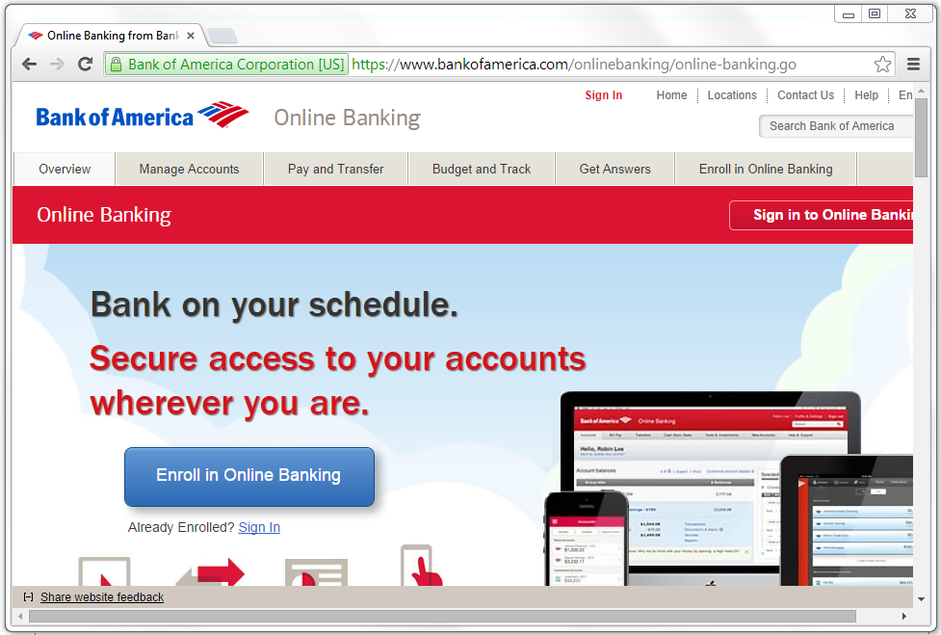

Insufficiency of Existing Solutions
First-line defenses
SSL indicator for Mixed
Content Vulnerability
Same-origin policy
Sanitization
XSS Auditor
Second-line defenses
Content Security Policy
(Not sufficient)
How can we protect sensitive user-owned
resources effectively?
Notes:
To prevent script injection attack, the web has first line defenses such as…
Unfortunately, these first line defenses aim at preventing script injection attacks, and it is not sufficient to protect user’s data in the presence of a script already running
We have to resort to second line of defense
CSP doesn’t protect sensitive data from malicious extension, as it can inject script or simply modify header info for incoming response

Slide 5
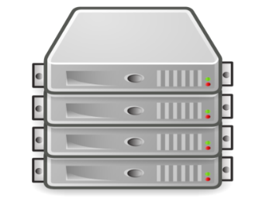


Vulnerable Channels on the Web
Origin O
Request
Channel
4
2
Display Channel
100000
Amount
20000
Bank Acct No
SEND
Web Server
1
Input Channel
3
Session Data
Channel
123-445
Browser Services
Notes:
The answer for the question is yes we can
This has been a challenging problem because many channels are available for the attacker to steal sensitive data
We offer second line of defenses to protect sensitive user-owned resources by systematically analyze all channels that can be compromised
To steal the data, and build defenses around these channels
Soon, we’ll see how our design works, but let me first give you an idea on how an attacker compromises channels on the web to
Steal user-owned data

Slide 6
Our Approach & Contributions
❶
Missing notions on the web
  User Authority: adds a notion of “user” principal besides web origin
  Sub-origin: isolate privilege data state/code within a web origin
  Trusted path: secure data channel between web user to the web server
  Our approach achieves
  High compatibility & easy adoption (149 LOC)
  High TCB reduction (8x – 264x)
  Negligible performance overhead (2.3%)
❷

Slide 7
Scope & Assumptions
In-scope
  Web attacker
  Uncompromised server [SP’09][ASIACCS’11]
  Benign user
  JS-based attacks
Out of scope
  Uncompromised web browser
  Flash and JAVA-based attacks
Notes:
Here is the scope of our problem
What is in-scope is the following

Slide 8
Solution Overview
Notes:
Given this scenario, how do we solve this? Let’s take a look

Slide 9


Protecting User Credentials (1)
Problem : Attacker compromises the input data
Solution : Tamper proof HTML element for input data
xyz.com
Bank XYZ
Authentication Page
Username
Password
LOGIN
Browser
Services
Notes:
First,
- When a user shares a session with the attacker, there is no protection over input data, attacker can intercept input
- As a solution, we build a secure input channel which can reliably transmit user data into the kernel, and not accessible to the attacker

Slide 10
Protecting User Credentials (2)
Problem: Spoofing for user credentials
Solution: Special display element with color indicator
xyz.com
Username
Username
Password
CVV
LOGIN
Browser
Services
Notes:
Build a secure channel is not enough, because the attacker can compromised the content that is displayed

Slide 11
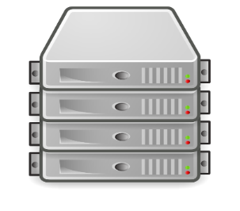
Protecting User Credentials (3)
Problem: Leaking credentials to the bad websites
xyzi.com
Web
Server
Bank XYZ
Authentication Page
Username
Password
LOGIN
Browser
Services
Notes:
This is not enough, in the present web, the username and password is sent as a plaintext to the web
PAKE protocol will be successful only if both the parties own the credential info

Slide 12

Protecting User Credentials (3)
Solution : Mutual authentication using zero-knowledge
proof protocol
xyz.com
Web
Server
Bank XYZ
Authentication Page
Username
PAKE
Protocol
Password
LOGIN
Ks
Browser
Services
Ks
Notes:
This is not enough, in the present web, the username and password is sent as a plaintext to the web
PAKE protocol will be successful only if both the parties own the credential info

Slide 13


Secure Authority Delegation (1)
Present web: origin manages user-owned resources
Problem: injected scripts have access to user-owned resources
Ks
Web
Server
xyz.com
Account No : 123-445
Ks
HTML+JS
Browser
Services
123-445
Notes:
After successfully logged in, the next step is to delegate the authority of user-owned data from the web server to the browser
In the present web, origin is the only authority to access sensitive user-owned data
Since malicious script running under the same origin as the benign javascript → BAM

Slide 14

Secure Authority Delegation (2)
Solution: Separate sensitive data and trusted code
Solution: Component with higher privilege than origin
Web
Server
Data + Code
xyz.com
Ks
Account No :
123-445
HTML+JS
Ks
Browser
Services
123-445
Notes:
The malicious script has the same privilege with the user, since the script run in the same origin
Sensitive data / trusted code needs to be checked on its authenticity and integrity, with respect to Ks
Problem : both
We need : component that has more privilege and run under this origin
has the user authority to access user-owned data, able to run code
Able to render secure web elements

Slide 15





End-to-end Trusted Path
Solution: Authorized HTTP request
Problem : Fake HTTP request from the attacker
xyz.com
Web Server
Name : Alice Bob
Account No : 123-445
Balance : USD 100000
Ks
Ks
Browser
Services
Notes:
Idea : some HTTP request needs to be authorized by trusted component on the client-side before being sent
Only component that has user authority can authorize an HTTP request → every request will be tagged with a secret value,
Which is derived from Ks … why? Ks signifies user authority
Ks represents the authority → every time when \\

Slide 16
UserPath Implementation
Notes:
Lets see how this is implemented

Slide 17

Establishing Secure Channels (1)
Origin O
xyz.com
Username
Password
Secure Display Channel
Secure Input Channel
Browser Services
Notes:
We design the browser to have trusted path, which is a secure channel for inputting data and displaying a content

Slide 18

Establishing Secure Channels (2)
Origin O
xyz.com
UFrame = User authority + Sub-origin
Amount
100000
Bank Acct No
SEND
Secure Session Data Channel
Secure Input / Display Channel
Browser Services
Notes:
Secondly, We add a novel primitive called Uframe for secure authority delegation, we need a component
that isolates trusted data state and code, and also more privileged than the origin

Slide 19
Establishing Secure Channels (3)
Origin O
xyz.com
UFrame
Web Server
Amount
100000
Bank Acct No
SEND
Secure Request Channel
Browser Services
Notes:
Secure request channel → token is derived from Ks, which malicious scripts don’t have access to

Slide 20

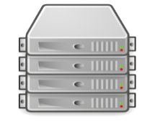



Establishing Secure Channels (4)
Origin O
Origin O
Web Server
Username
UFrame
Password
Secure Request
Secure Input
Secure Display
Secure Session Data
Browser Kernel
Browser Kernel
Building four secure channels
Trusted Path on the web
User + Sub-Origin + Trusted Path = UserPath

Slide 21
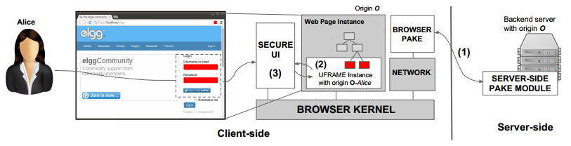

Implementation Summary
Patched Chromium v12 → added 475 lines of C++ code
Client-side
PAKE plug-in
Server-side
PAKE module

Slide 22
UserPath Evaluation

Slide 23
Evaluation
Questions to be answered (w.r.t web applications):
How many lines of code to adopt UserPath? (Adoption effort)
How big is TCB reduction after adopting UserPath? (TCB reduction)
How big is the performance overhead after adopting UserPath? (Performance)

Slide 24
Evaluation Setup
Application | LOC # | Application | LOC #
Elgg | 114375 | Magento | 928991
Friendica | 144555 | ZenCart | 95381
Roundcube | 109663 | osCommerce | 60081
OpenEMR | 495987 | StoreSprite | 30350
OwnCloud | 337192 | CubeCart | 11942
HotCRP | 36333 | WordPress | 135540
OpenConf | 17589 | Joomla | 227351
PrestaShop | 250660 | Drupal | 43835
OpenCart | 93770 | Piwigo | 143144
AstroSpaces | 6972 | X2CRM | 747261
Phone number, e-mail data, Admin options (set user as admin, add new user)

Slide 25
Reported Vulnerabilities
Sensitive user-owned data protected from 325 reported XSS and CSRF Vulnerabilities (CVE)
325 Vulnerabilities

Slide 26
Adoption Effort
Successfully retrofitted 20 applications
Modify web page that contains sensitive user-owned resources
Measure the LOC number of PHP code (mostly JS code)
Application Category | UserPath LOC (PHP)
Social Network App | 188.3
E-mail App | 96
Health Information System | 141
File Management System | 161
Conference Mgmt System | 145
E-Commerce | 158.1
Content Mgmt System | 87
CRM | 217
# LOC : 149

Slide 27
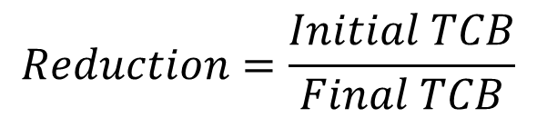
TCB Reduction
Initial TCB : Size of web page without UserPath
Final TCB : Size of the UFrame Code (size in KB)
TCB Reduction : 8x – 264x
$$Reduction=\frac{Initial TCB}{Final TCB}$$
Notes:
TCB reduction = Final TCB / Initial TCB

Slide 28
Performance
Performance testing conducted on Chromium v.12
Time taken during login with and without UserPath
Measured in seconds
Performance overhead: 2.3%

Slide 29



Conclusion
Augment the web with the three missing notions:
  User authority || Sub-origins || Trusted Path
Complete second line of defense to protect sensitive user-owned resources
Practical Applications → evaluated on 20 PHP applications
Adoption Effort
TCB Reduction
Performance

Slide 30



Enrico Budianto
enricob@comp.nus.edu.sg
https://github.com/ebudianto/UserPath

Slide 31
References
[SP’09] B. Parno, J. McCune, D. Wendlandt, et.a.
CLAMP: Practical Prevention of Large-Scale Data Leaks
[ASIACCS’11] A.P. Felt, M. Finifter, J. Weinberger, and D. Wagner
Diesel: Applying Privilege Separation to Database Access
[CCS’13] S. Lekies, B. Stock, M. Johns.
25 Million Flows Later: Large-scale Detection of DOM-based XSS

Slide 32
References
[ESORICS’13] D. Akhawe, F. Li, W. He, et.al.
Data-confined HTML5 Applications
[SEC’12] M Dietz, A. Czeskis, D. Balfanz, and D.S. Wallach
Origin-Bound Certificates: A Fresh Approach to Strong Client Authentication for the Web
[NDSS’12] Y. Cao, V. Yegneswaran, P. Porras, and Y. Chen
PathCutter: Severing the Self-Propagation Path of XSS JavaScript Worms in Social Web Networks
[ICECCS’13] X. Dong, K. Patil, J. Mao, and Z. Liang
A Comprehensive Client-side Behavior Model for Diagnosing Attacks in Ajax Applications
[NDSS’97] T. Wu
The Secure Remote Password Protocol
[WWW’09] Y. Oiwa, H. Watanabe, and H. Takagi
PAKE-based mutual HTTP authentication for preventing phishing attacks

Slide 33
UserPath : Secure Login
How to securely login
and authenticate user
to a web application?
Bank XYZ
Authentication Page
PAKE
Protocol
Username
Password
Web
Server
Ks
Browser kernel
Ks
Notes:
Session workflow : 2 separate ideas : PAKE & secure credential boxes

Slide 34


Attack Channels 1:
Input & Display Channel
Input Channel
Bank XYZ
Authentication Page
Username
Alice Bob
123-4456
Display Channel
Password
No secure channel for data → Trusted path

Slide 35



Attack Channels 2:
Session Data Channel
Bank XYZ
Money Transfer
Receiving Party : Charles
Alice Bob
Amount : USD 10000
SEND
Browser
Kernel
Charles – Acct No: 155-246
Charles – Acct No: 155-246
No isolation of sensitive data & trusted code within an origin → Sub-origins

Slide 36

Attack Channels 3:
Request Channel
OK!
Web Server
Bank XYZ
Money Transfer
Bank Acct No : 145-222
Amount : USD 10000
Alice Bob
SEND
“Please send to Mallory’s
account with amount =
USD 20”
XHR API
Browser
Kernel
Bank Acct No : 145-222
Amount : USD 10000
Binding Token for Network Request
No End-to-end user authority → Trusted path, Sub-origins ,User authority

Slide 37
UserPath Design

Slide 38
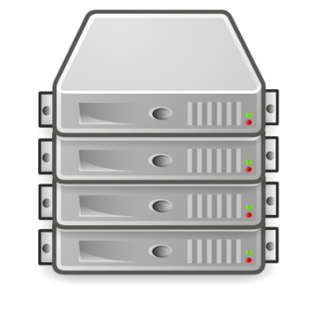

UserPath: Overview
Bank XYZ
Money Transfer
Bank Acct No : 145-222
Web Server
Alice Bob
Amount : USD 10000
SEND
Web Page Instance
Secure
UI
UFrame
User-authority + Sub-Origins
= UFrame (1)
Building secure data channels
from browser I/O to program
at web server → Trusted Path
(2)
Browser
Kernel

Slide 39
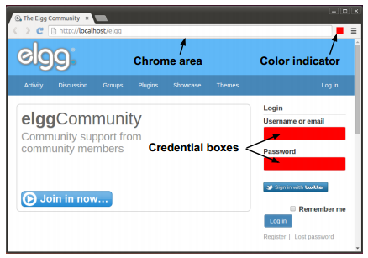
UserPath : Secure Login
How to securely login
and authenticate user
to a web application?
PAKE
Protocol
Web
Server
Ks
Browser kernel
Ks
Notes:
Session workflow : 2 separate ideas : PAKE & secure credential boxes

Slide 40
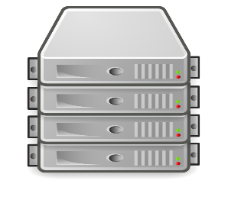


Illustration of a UFrame
Origin O
<html>
</html>
Bank XYZ
<uframe>
sign = abcdefgh
</uframe>
Money Transfer
Bank Acct No : 145-222
Alice
Amount : USD 10000
SEND
Web Server
❶
UFrame code won’t be accessible to any scripts running outside UFrame
❷
UFrame code is verified by web browser on its authenticity and integrity

Slide 41
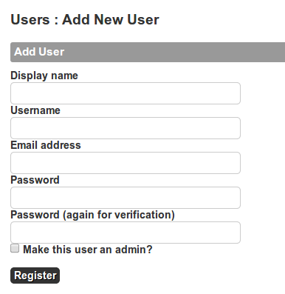
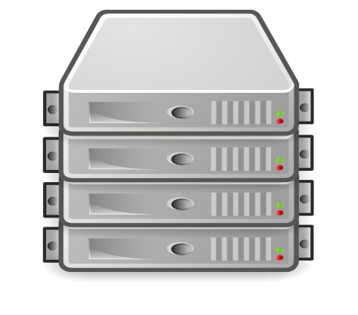



Use Case: Creating Authenticated HTTP Request
HTML
Origin O
<uframe>
Token = ‘qvrz1clw’
Token = ‘qvrz1clw’
O_{Alice}
xhr.send()
<body>
…
</body>
Web Server
Secure
UI
Display name,
username, e-mail,
Etc.
Browser
Kernel

Slide 42

Sensitive User-owned Resources
Profile Picture
Phone No
User’s Bio
Welcome Alice Bob,
Bank Acct No. 123-3456
Credit Card No
Balance $10000
Inputted Data : Username, password
Display Data : Bank account #, phone number
Binding Token : Request token

Slide 43
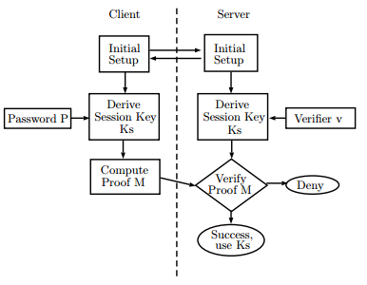

A PAKE Protocol
Verifier v
Browser
Kernel
Server-side
Module
Ks
Ks
Zero-knowledge Protocol
[NDSS’97] [WWW’09]

Slide 44
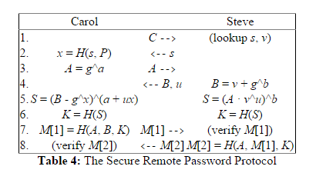
A PAKE Protocol
1. Carol sends Steve her username, (e.g. carol).
2. Steve looks up Carol's password entry and fetches her password verifier
v and her salt s. He sends s to Carol. Carol computes her long-term
private key x using s and her real password P.
3. Carol generates a random number a, 1 < a < n, computes her
ephemeral public key A = g^a, and sends it to Steve.
4. Steve generates his own random number b, 1 < b < n, computes his
ephemeral public key B = v + g^b, and sends it back to Carol, along
with the randomly generated parameter u.
5. Carol and Steve compute the common exponential value S = g^(ab + bux)
using the values available to each of them. If Carol's password P entered
in Step 2 matches the one she originally used to generate v, then both
values of S will match.
6. Both sides hash the exponential S into a cryptographically strong session key.
7. Carol sends Steve M[1] as evidence that she has the correct session key. Steve
computes M[1] himself and verifies that it matches what Carol sent him.
8. Steve sends Carol M[2] as evidence that he also has the correct session key.
Carol also verifies M[2] herself, accepting only if it matches Steve's value.

Slide 45



Security Analysis of UserPath
Compromise UFrame content
HTML
Web Server O
❶
<uframe
token = ‘qvrz1clwo90xiud’
sign = ‘8d4f9a3112e70043’>
</uframe>
xhr.send()
O_{Alice}
❷
❸
❹
Phish and intercept UI
Access session or
other sensitive date

