Slide 1
HyperLogLog on Windowed Streams
Robin Christopher Yu
Sidhant Bansal
CS5234 — Algorithms at Scale

Slide 2
The Windowed Streaming Context

Slide 3

The Windowed Streaming Context
Data comes in a stream (i.e., we see each element in order, exactly once).
We’re only interested in some information about the last $N$ elements.
More recent
3
1
4
1
5
9
2
Window size N

Slide 4

The Windowed Streaming Context
Data comes in a stream (i.e., we see each element in order, exactly once).
We’re only interested in some information about the last $N$ elements.
More recent
Expired; will never
be useful again
3
1
4
1
5
9
2
6
Window size N

Slide 5
The Windowed Streaming Context
Data comes in a stream (i.e., we see each element in order, exactly once).
We’re only interested in some information about the last $N$ elements.
More recent
3
1
4
1
5
9
2
6
5
Window size N

Slide 6
The Windowed Streaming Context
Data comes in a stream (i.e., we see each element in order, exactly once).
We’re only interested in some information about the last $N$ elements.
More recent
3
3
1
4
1
5
9
2
6
5
3
Window size N

Slide 7
The Windowed Streaming Context
A few metrics we might care about?
Time complexity
Query
Insert
Space complexity
More recent
3
3
1
4
1
5
9
2
6
5
3
Window size N

Slide 8

The Windowed Streaming Context
We will focus on minimizing space complexity.
Obvious solution for any streaming problem: $O(NM)$ where $M$ is the size of the largest element in the stream.
More recent
3
3
1
4
1
5
9
2
6
5
3
Window size N

Slide 9

The Windowed Streaming Context
For many problems, impossible to get better than $Ω(N)$ performance if we want an exact answer.
We can do better if we are willing to settle for approximations.
More recent
3
3
1
4
1
5
9
2
6
5
3
Window size N

Slide 10
The Windowed Streaming Context
Our problem:
Number of distinct elements in the window.
More recent
3
3
1
4
1
5
9
2
6
5
3
Window size N

Slide 11
LogLog and HyperLogLog

Slide 12
LogLog and HyperLogLog
HyperLogLog solves the problem posed on a streaming context but without windows.
That is, the number of distinct elements across all elements seen.

Slide 13
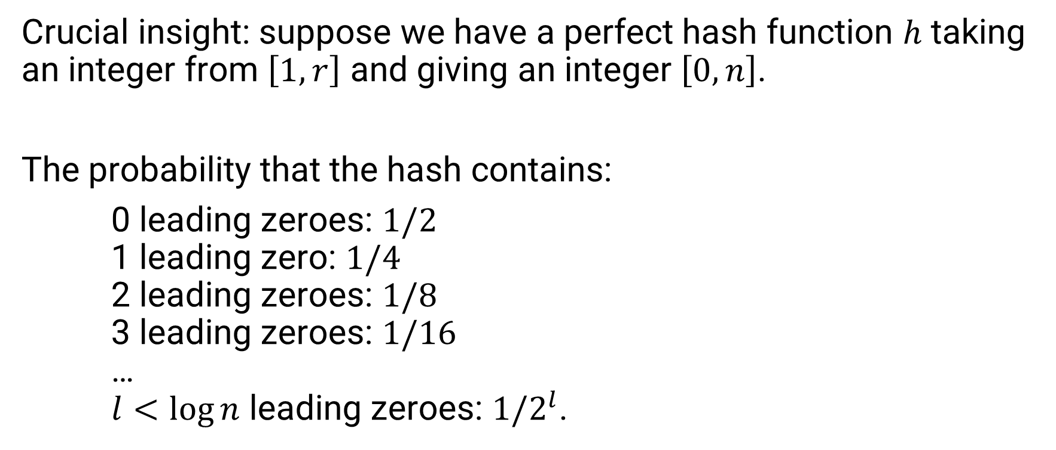
LogLog and HyperLogLog
Crucial insight: suppose we have a perfect hash function $h$ taking an integer from $\left[1,r\right]$ and giving an integer $\left[0, n\right]$.
The probability that the hash contains:
0 leading zeroes: $1/2$
1 leading zero: $1/4$
2 leading zeroes: $1/8$
3 leading zeroes: $1/16$
…
$l<\log{n}$ leading zeroes: $1/2^{l}$.

Slide 14
LogLog and HyperLogLog
7 → 11101100
6 → 11010101
15 → 10110100
8 → 11100110
15 → 10110100
2 → 00100010
2 → 00100010
9 → 01100100
11 → 00011000
8 → 11100110
14 → 10110111
16 → 01001101
12 → 00110110
6 → 11010101
2 → 00100010
Crucial insight: maintaining the largest number of leading zeroes across all hashes allows us to get a (very) rough estimate of the number of distinct elements.
Estimate:
Actual:
2³ = 8
10

Slide 15
LogLog and HyperLogLog
7 → 11101100
6 → 11010101
15 → 10110100
8 → 11100110
15 → 10110100
2 → 00100010
2 → 00100010
9 → 01100100
11 → 00000010
8 → 11100110
14 → 10110111
16 → 01001101
12 → 00110110
6 → 11010101
2 → 00100010
Problem: variance is ridiculously high; one bad hash can spoil the entire estimate.
Estimate:
Actual:
2⁶ = 64
10

Slide 16
LogLog and HyperLogLog
7 → 11101100
6 → 11010101
15 → 10110100
8 → 11100110
15 → 10110100
2 → 00100010
2 → 00100010
9 → 01100100
11 → 00000010
8 → 11100110
14 → 10110111
16 → 01001101
12 → 00110110
6 → 11010101
2 → 00100010
Problem: variance is ridiculously high; one bad hash can spoil the entire estimate.
Solution: take multiple independent hashes for each element, average them out?
Possible, but costlier
How to ensure independent
hashes?
Estimate:
Actual:
2⁶ = 64
10

Slide 17
LogLog and HyperLogLog
7 → 11101100
6 → 11010101
15 → 10110100
8 → 11100110
15 → 10110100
2 → 00100010
2 → 00100010
9 → 01100100
11 → 00000010
8 → 11100110
14 → 10110111
16 → 01001101
12 → 00110110
6 → 11010101
2 → 00100010
Problem: variance is ridiculously high; one bad hash can spoil the entire estimate.
HyperLogLog solution: split the stream into multiple streams, average each estimate out.
Estimate:
Actual:
2⁶ = 64
10

Slide 18
LogLog and HyperLogLog
7 → 11101100
6 → 11010101
15 → 10110100
8 → 11100110
15 → 10110100
2 → 00100010
2 → 00100010
9 → 01100100
11 → 00000010
8 → 11100110
14 → 10110111
16 → 01001101
12 → 00110110
6 → 11010101
2 → 00100010
Use the first few bits of the hash to determine which stream it should go to.

Slide 19
LogLog and HyperLogLog
Use the first few bits of the hash to determine which stream it should go to.
00 stream
10 stream
2 → 00100010
2 → 00100010
11 → 00000010
12 → 00110110
2 → 00100010
15 → 10110100
15 → 10110100
14 → 10110111
11 stream
01 stream
7 → 11101100
6 → 11010101
8 → 11100110
8 → 11100110
6 → 11010101
9 → 01100100
16 → 01001101

Slide 20
LogLog and HyperLogLog
Use the first few bits of the hash to determine which stream it should go to.
Now, determine the largest number of leading zeroes in each stream.
00 stream
10 stream
2 → 00100010
2 → 00100010
11 → 00000010
12 → 00110110
2 → 00100010
15 → 10110100
15 → 10110100
14 → 10110111
0
4
11 stream
01 stream
7 → 11101100
6 → 11010101
8 → 11100110
8 → 11100110
6 → 11010101
9 → 01100100
16 → 01001101
2
1

Slide 21
LogLog and HyperLogLog
What should we do next?
00 stream
10 stream
2 → 00100010
2 → 00100010
11 → 00000010
12 → 00110110
2 → 00100010
15 → 10110100
15 → 10110100
14 → 10110111
0
4
11 stream
01 stream
7 → 11101100
6 → 11010101
8 → 11100110
8 → 11100110
6 → 11010101
9 → 01100100
16 → 01001101
2
1

Slide 22
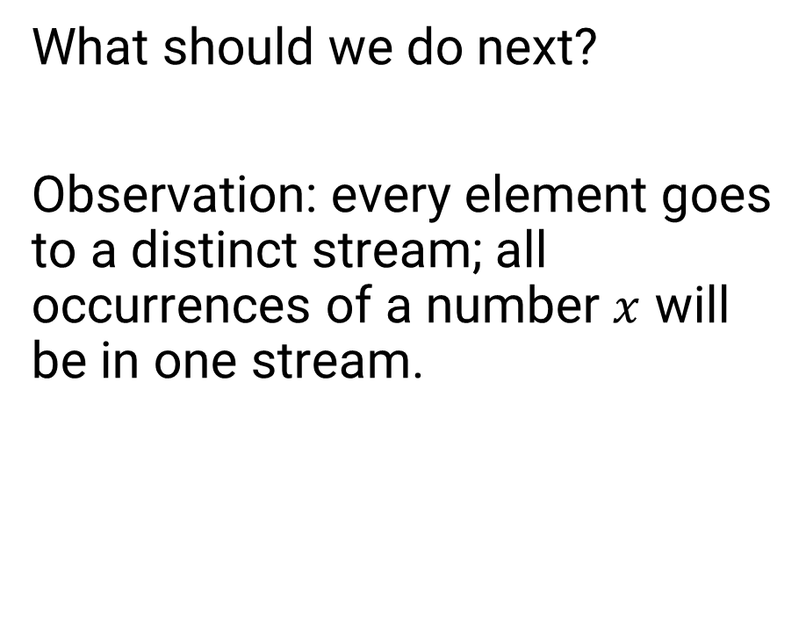
LogLog and HyperLogLog
What should we do next?
Observation: every element goes to a distinct stream; all occurrences of a number $x$ will be in one stream.
00 stream
10 stream
2 → 00100010
2 → 00100010
11 → 00000010
12 → 00110110
2 → 00100010
15 → 10110100
15 → 10110100
14 → 10110111
0
4
11 stream
01 stream
7 → 11101100
6 → 11010101
8 → 11100110
8 → 11100110
6 → 11010101
9 → 01100100
16 → 01001101
2
1

Slide 23

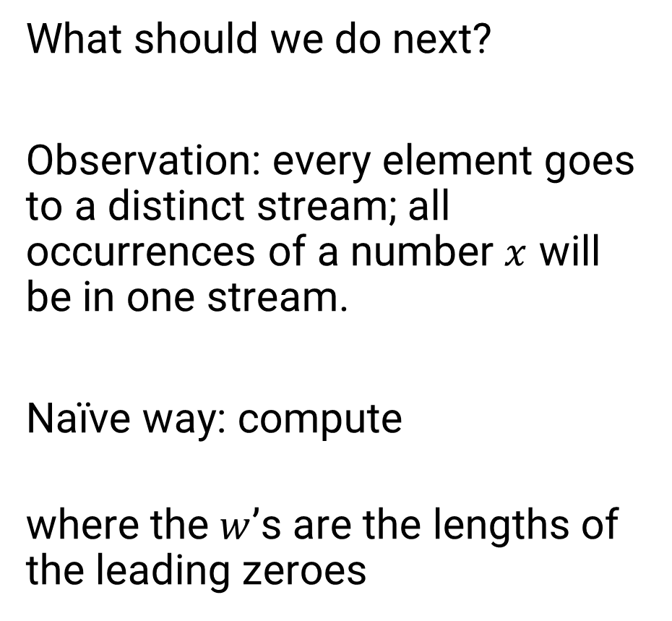
LogLog and HyperLogLog
What should we do next?
Observation: every element goes to a distinct stream; all occurrences of a number $x$ will be in one stream.
Naïve way: compute
where the $w$’s are the lengths of the leading zeroes
00 stream
10 stream
2 → 00100010
2 → 00100010
11 → 00000010
12 → 00110110
2 → 00100010
15 → 10110100
15 → 10110100
14 → 10110111
0
4
11 stream
01 stream
7 → 11101100
6 → 11010101
8 → 11100110
8 → 11100110
6 → 11010101
9 → 01100100
16 → 01001101
$$\sum_{w}{2^{w}}$$
2
1

Slide 24
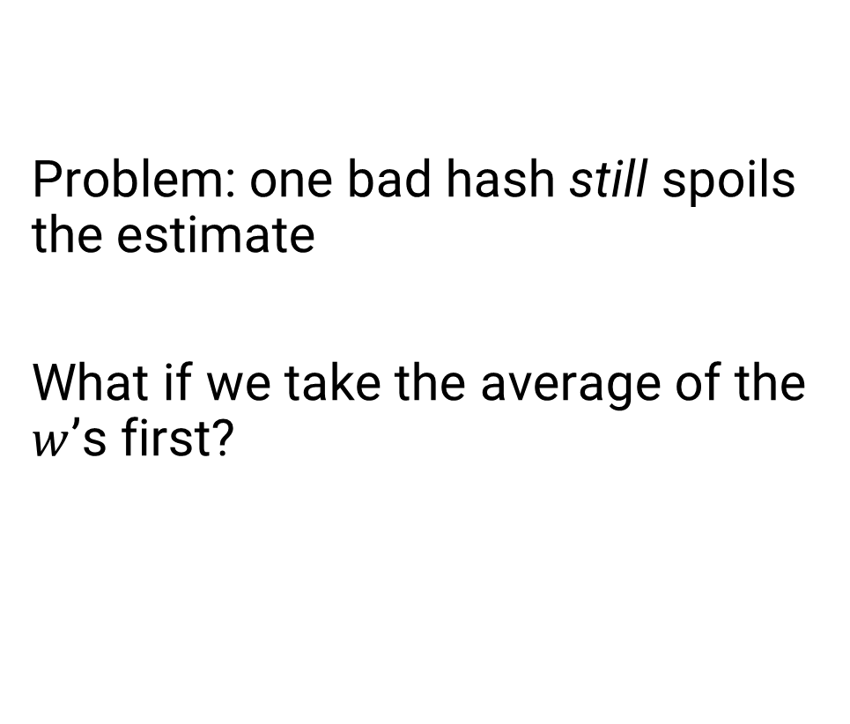
LogLog and HyperLogLog
Problem: one bad hash still spoils the estimate
What if we take the average of the $w$’s first?
00 stream
10 stream
Estimate:
Actual:
2⁴ + 2² + 2⁰ + 2¹ = 23
10
2 → 00100010
2 → 00100010
11 → 00000010
12 → 00110110
2 → 00100010
15 → 10110100
15 → 10110100
14 → 10110111
0
4
11 stream
01 stream
7 → 11101100
6 → 11010101
8 → 11100110
8 → 11100110
6 → 11010101
9 → 01100100
16 → 01001101
2
1

Slide 25

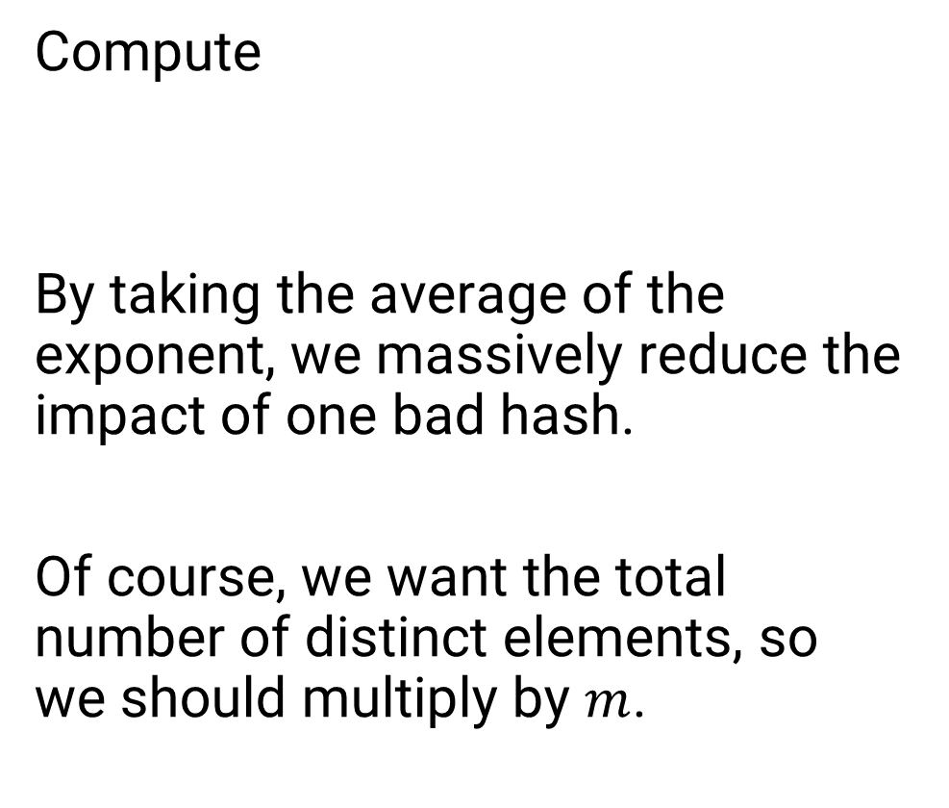


LogLog and HyperLogLog
$$\frac{1}{m}\sum_{w}{w}$$
Compute
By taking the average of the exponent, we massively reduce the impact of one bad hash.
Of course, we want the total number of distinct elements, so we should multiply by $m$.
00 stream
10 stream
$$m⋅2$$
Estimate:
Actual:
4 • 2^{(4+2+0+1)/4} ≈ 13.45
10
2 → 00100010
2 → 00100010
11 → 00000010
12 → 00110110
2 → 00100010
15 → 10110100
15 → 10110100
14 → 10110111
0
4
11 stream
01 stream
7 → 11101100
6 → 11010101
8 → 11100110
8 → 11100110
6 → 11010101
9 → 01100100
16 → 01001101
2
1
($m = 4$ is the number of streams)

Slide 26
LogLog and HyperLogLog
What we have described so far is the crux of the LogLog algorithm.
However, the algorithm as described still has a tendency to overestimate.
For example, running the previous case a million times gave us an average estimate of distinct values of about 15.6, which is significantly greater than the correct value of 10.

Slide 27
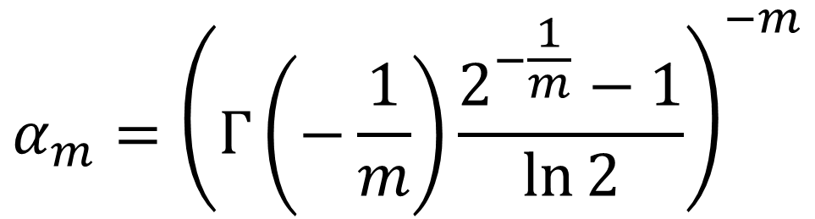
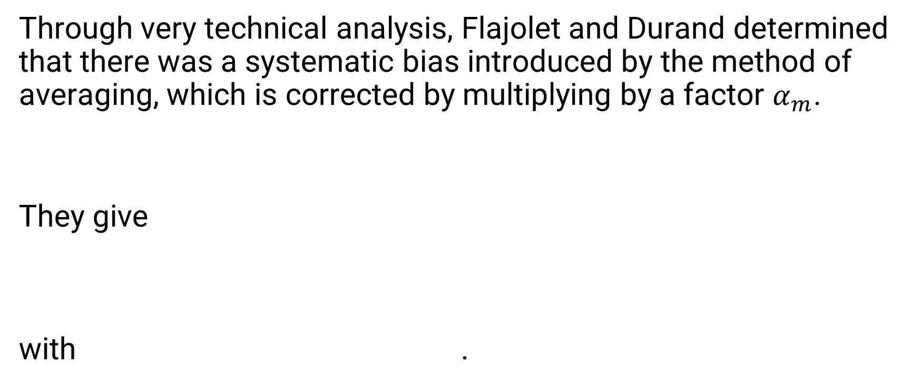
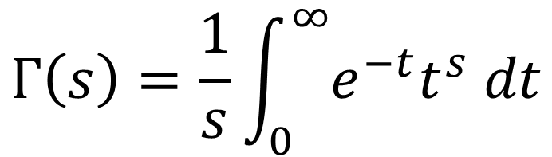
LogLog and HyperLogLog
Through very technical analysis, Flajolet and Durand determined that there was a systematic bias introduced by the method of averaging, which is corrected by multiplying by a factor $α_{m}$.
They give
with .
$$α_{m}={\left(Γ\left(−\frac{1}{m}\right)\frac{2^{−\frac{1}{m}}−1}{\ln{2}}\right)}^{−m}$$
$$Γ\left(s\right)=\frac{1}{s}\int_{0}^{∞}{e^{−t}t^{s} dt}$$

Slide 28
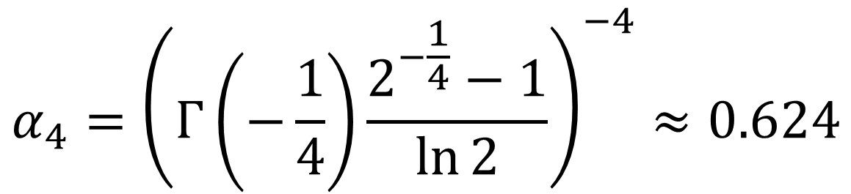

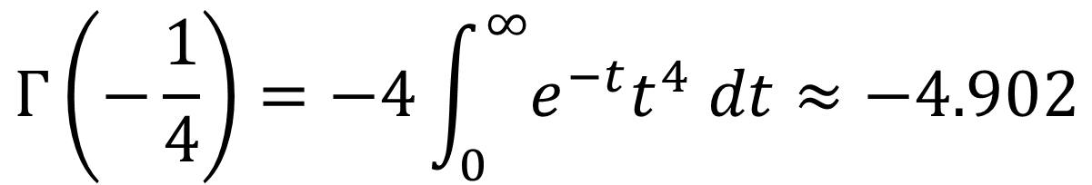
LogLog and HyperLogLog
For $m=4$, this gives us
with
$$α_{4}={\left(Γ\left(−\frac{1}{4}\right)\frac{2^{−\frac{1}{4}}−1}{\ln{2}}\right)}^{−4}≈0.624$$
$$Γ\left(−\frac{1}{4}\right)=−4\int_{0}^{∞}{e^{−t}t^{4} dt}≈−4.902$$

Slide 29
LogLog and HyperLogLog
By multiplying with this constant, we can see that our average estimate is now closer to
0.624 • 15.6 ≈ 9.7
which is much closer to the correct result.

Slide 30



LogLog and HyperLogLog
Note: it is not easy to compute $α_{m}$ explicitly, so in practice we use some known approximations for common values of $m$:
$$α_{m}=\left\{\begin{aligned}0.673, \\ 0.697, \\ 0.709, \\ &\frac{0.7213}{1+\frac{1.079}{m}},\end{aligned}\right.$$
$$m=16 \\ m=32 \\ m=64$$
$$m≥128$$

Slide 31

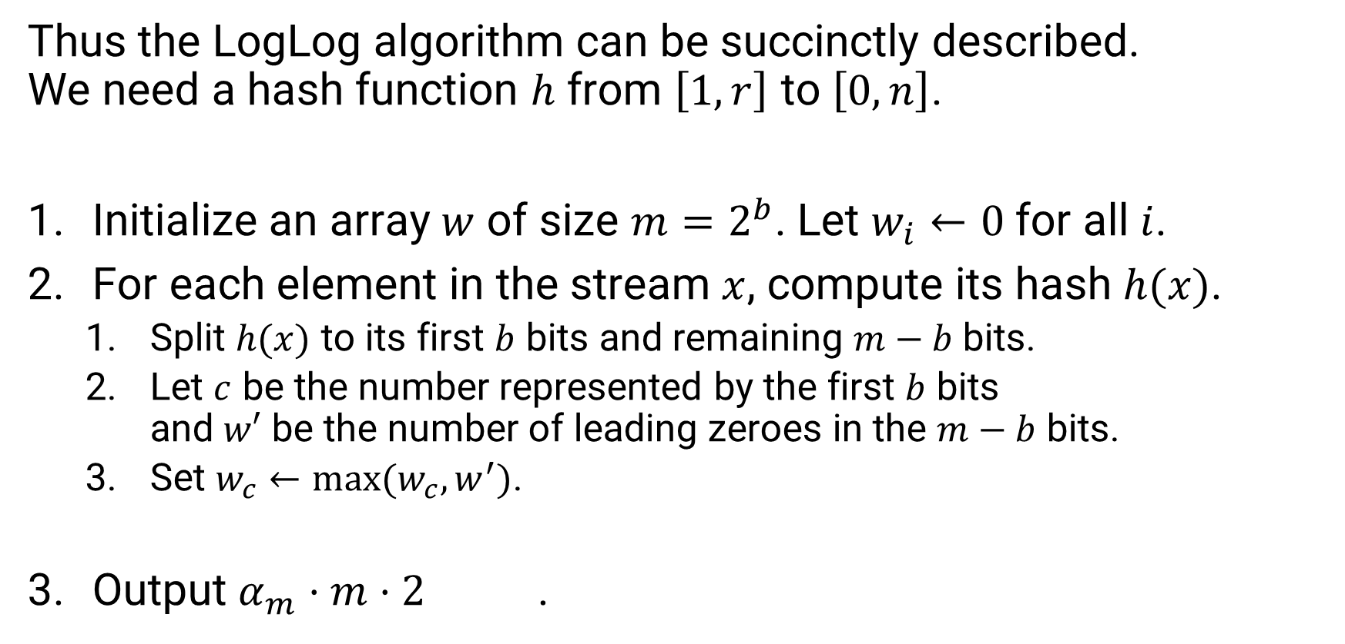
LogLog and HyperLogLog
Thus the LogLog algorithm can be succinctly described.
We need a hash function $h$ from $\left[1,r\right]$ to $\left[0, n\right]$.
Initialize an array $w$ of size $m=2^{b}$. Let $w_{i}←0$ for all $i$.
For each element in the stream $x$, compute its hash $h(x)$.
  Split $h(x)$ to its first $b$ bits and remaining $m−b$ bits.
  Let $c$ be the number represented by the first $b$ bits
  and $w′$ be the number of leading zeroes in the $m−b$ bits.
  Set $w_{c}←max⁡(w_{c}, w^{′})$.
Output $α_{m}⋅m⋅2$ .
$$\frac{1}{m}\sum_{w}{w}$$

Slide 32
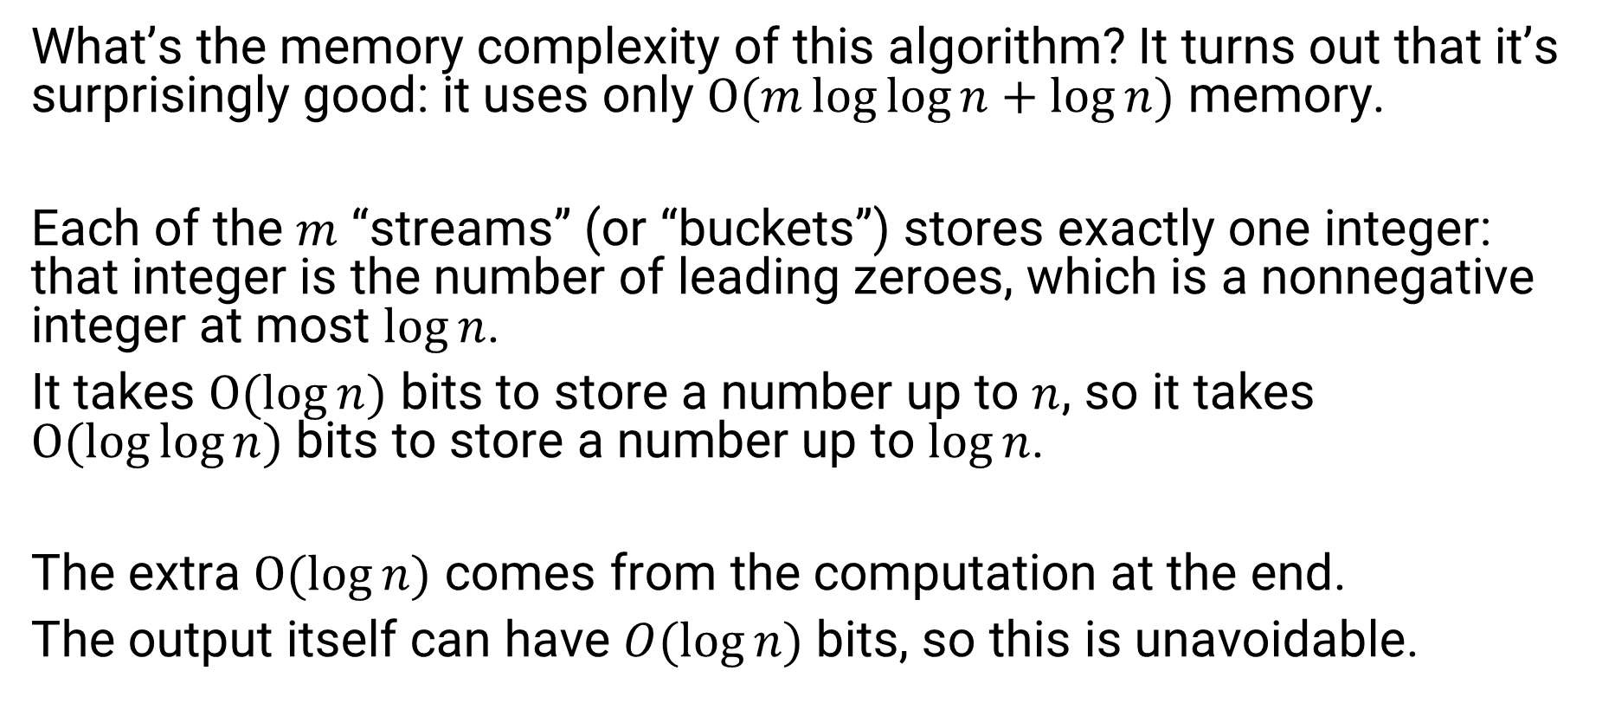
LogLog and HyperLogLog
What’s the memory complexity of this algorithm? It turns out that it’s surprisingly good: it uses only $O(m\log{\log{n}}+\log{n})$ memory.
Each of the $m$ “streams” (or “buckets”) stores exactly one integer: that integer is the number of leading zeroes, which is a nonnegative integer at most $\log{n}$.
It takes $O(\log{n})$ bits to store a number up to $n$, so it takes $O(\log{\log{n})}$ bits to store a number up to $\log{n}$.
The extra $O(\log{n})$ comes from the computation at the end.
The output itself can have $O(\log{n})$ bits, so this is unavoidable.

Slide 33

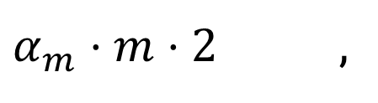

LogLog and HyperLogLog
HyperLogLog is essentially the same as LogLog, with a minor change to the final output. Instead of using the arithmetic mean
it uses an alternative, the harmonic mean
.
$$\frac{1}{m}\sum_{w}{w}$$
$α_{m}⋅m⋅2$ ,
$$α_{m}⋅m^{2}⋅{\left(\sum_{w}{2^{−w}}\right)}^{−1}$$

Slide 34


LogLog and HyperLogLog
The intuition is that the harmonic mean is even better at ignoring outliers than the arithmetic mean.
This simple change reduces the error from
to about
$$\frac{1.30}{\sqrt{m}}$$
$$\frac{1.04}{\sqrt{m}}$$

Slide 35
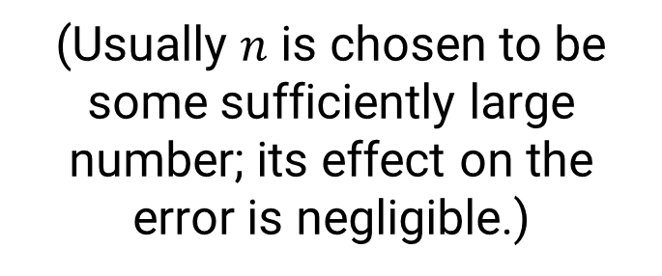
LogLog and HyperLogLog
The intuition is that the harmonic mean is even better at ignoring outliers than the arithmetic mean.
This simple change reduces the error from
to about
$$\frac{1.30}{\sqrt{m}}$$
(Usually $n$ is chosen to be some sufficiently large number; its effect on the error is negligible.)
$$\frac{1.04}{\sqrt{m}}$$

Slide 36
The Exponential Histogram

Slide 37
The Exponential Histogram
So far, we have described a memory-efficient solution to the problem of counting the number of distinct elements.
However, recall that the problem we really want to solve is counting the number of distinct elements in a window.
Even seemingly trivial problems can be hard to solve efficiently in the windowed setting!

Slide 38

The Exponential Histogram
Let’s consider the following much easier problem:
Given a stream of only 0’s and 1’s, report the number of ones in the past $N$ elements.
More recent
1
3
1
0
0
1
1
0
1
0
1
Window size N

Slide 39
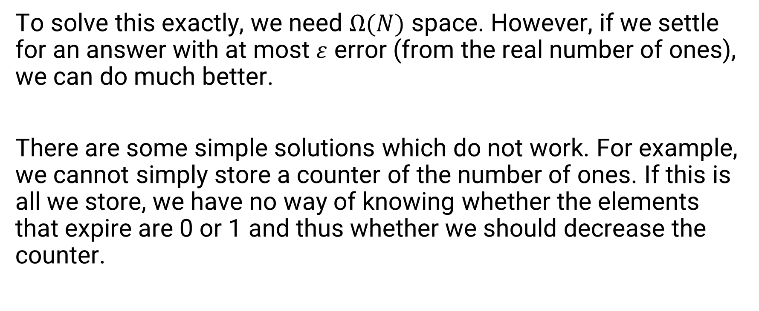
The Exponential Histogram
To solve this exactly, we need $Ω(N)$ space. However, if we settle for an answer with at most $ε$ error (from the real number of ones), we can do much better.
There are some simple solutions which do not work. For example, we cannot simply store a counter of the number of ones. If this is all we store, we have no way of knowing whether the elements that expire are 0 or 1 and thus whether we should decrease the counter.

Slide 40
The Exponential Histogram
Instead, Datar et al. provide a data structure that solves this problem. By maintaining special sorts of histograms, we can keep the error bounded.
We will maintain a number of buckets. Each bucket will represent the locations of a contiguous segment of elements (but we will store only the positions of the 1’s).
We consider the positions relative to the most recent element, so the most recent element has position 1, then the others have positions 2, 3, and so on from latest to oldest.

Slide 41
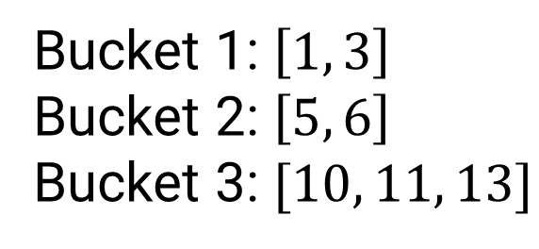
The Exponential Histogram
Example with 3 buckets with 2, 2, 3 elements, respectively:
Bucket 1: $\left[1, 3\right]$
Bucket 2: $\left[5, 6\right]$
Bucket 3: $[10, 11, 13]$
More recent
13
12
11
10
9
8
7
6
5
4
3
2
1
1
0
1
1
0
0
0
1
1
0
1
0
1
Window size N

Slide 42
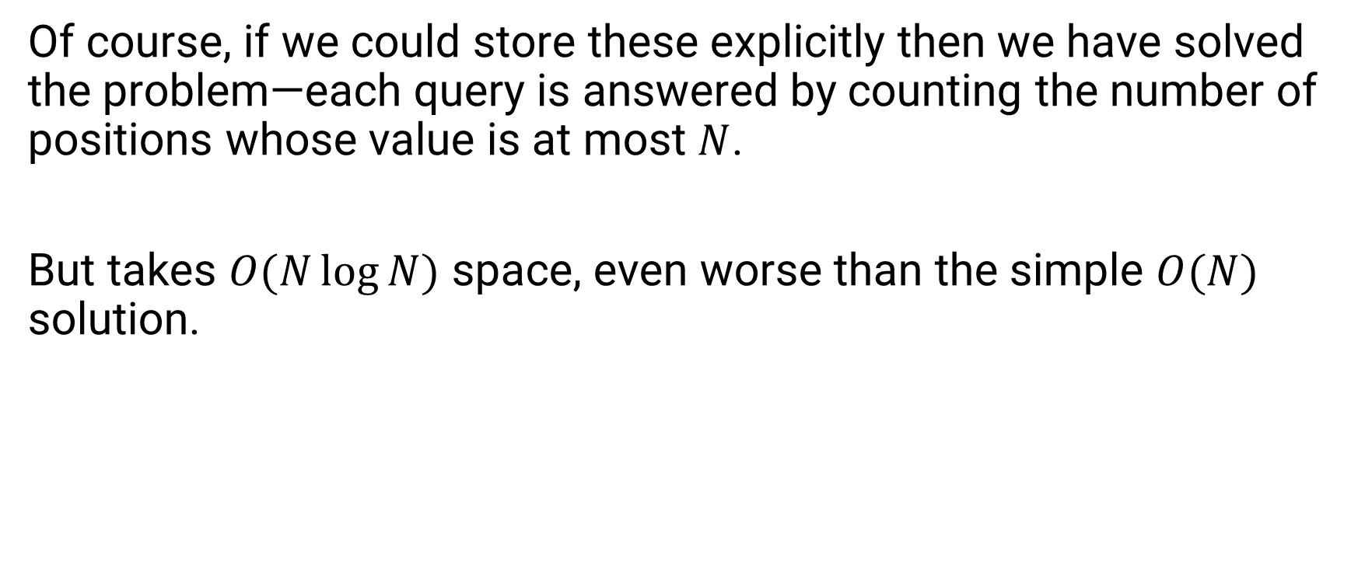
The Exponential Histogram
Of course, if we could store these explicitly then we have solved the problem—each query is answered by counting the number of positions whose value is at most $N$.
But takes $O(N\log{N})$ space, even worse than the simple $O(N)$ solution.
More recent
13
12
11
10
9
8
7
6
5
4
3
2
1
1
0
1
1
0
0
0
1
1
0
1
0
1
Window size N

Slide 43
The Exponential Histogram
To remedy this, we will store only an abstract representation of the bucket. We will store only two things for each bucket:
its timestamp, which is the position of the most recent 1, and
its size, which is the number of 1’s in the bucket.
This obviously loses some crucial information, but we can make it work with some clever observations.
More recent
13
12
11
10
9
8
7
6
5
4
3
2
1
1
0
1
1
0
0
0
1
1
0
1
0
1
Window size N

Slide 44
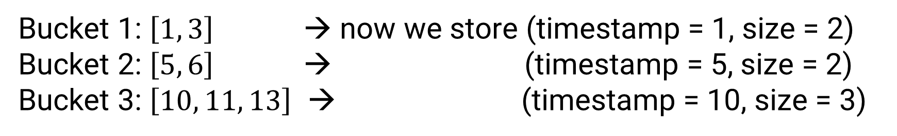
The Exponential Histogram
With the previous example:
Bucket 1: $\left[1, 3\right]$ → now we store (timestamp = 1, size = 2)
Bucket 2: $\left[5, 6\right]$ → (timestamp = 5, size = 2)
Bucket 3: $\left[10, 11, 13\right]$ → (timestamp = 10, size = 3)
More recent
13
12
11
10
9
8
7
6
5
4
3
2
1
1
0
1
1
0
0
0
1
1
0
1
0
1
Window size N

Slide 45

The Exponential Histogram
Observation 1.
If the timestamp of a bucket is $>N$, all elements in it are expired and we can directly remove it from the range.
e.g. Bucket: (timestamp = 11, size = 2)
More recent
13
12
11
10
9
8
7
6
5
4
3
2
1
1
0
1
1
0
0
0
1
1
0
1
0
1
Window size N

Slide 46
The Exponential Histogram
Observation 2.
If we remove all expired buckets, then for all buckets except the last, the number of 1’s in the bucket is exactly equal to its size.
Bucket 1: (timestamp = 1, size = 2) ✔
Bucket 2: (timestamp = 5, size = 2) ✔
Bucket 3: (timestamp = 10, size = 3)
e.g.
More recent
13
12
11
10
9
8
7
6
5
4
3
2
1
1
0
1
1
0
0
0
1
1
0
1
0
1
Window size N

Slide 47

The Exponential Histogram
Observation 3.
If the sizes of the buckets are $C_{1},C_{2},…, C_{f}$ from newest to oldest then by reporting $C_{1}+C_{2}+…+C_{f}/2$ the error is at most $C_{f}/2$.
Bucket 1: (timestamp = 1, size = 2) ✔
Bucket 2: (timestamp = 5, size = 2) ✔
Bucket 3: (timestamp = 10, size = 3)
Estimate: 2 + 2 + 1.5 = 5.5
Actual: 5
e.g.
More recent
13
12
11
10
9
8
7
6
5
4
3
2
1
1
0
1
1
0
0
0
1
1
0
1
0
1
Window size N

Slide 48
The Exponential Histogram
So, if we can keep the size of the last bucket bounded, we can get a good estimate.
More recent
13
12
11
10
9
8
7
6
5
4
3
2
1
1
0
1
1
0
0
0
1
1
0
1
0
1
Window size N

Slide 49
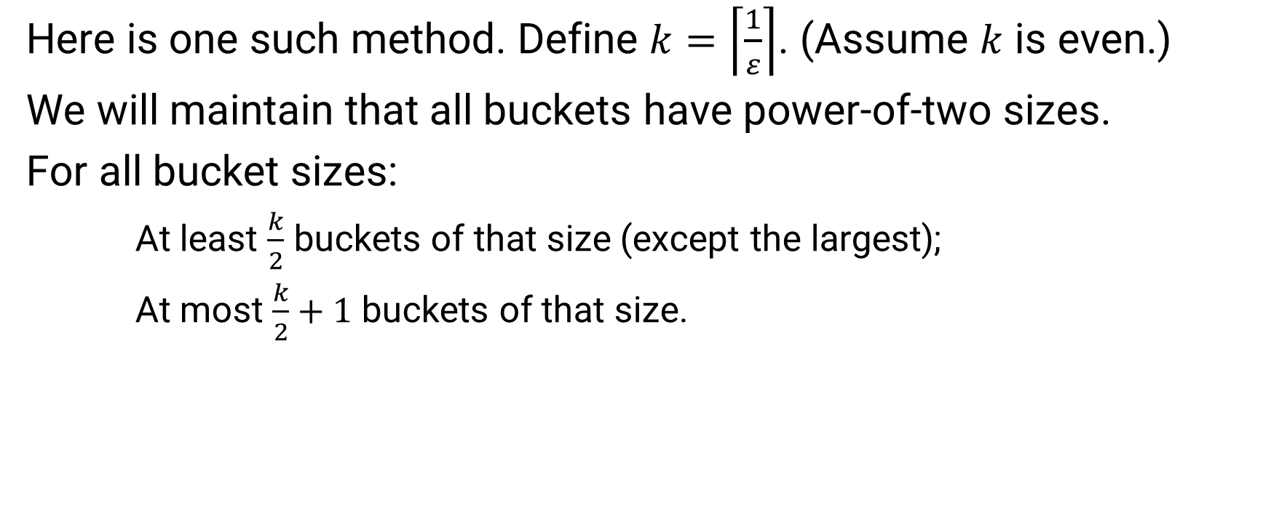
The Exponential Histogram
Here is one such method. Define $k=\left\lceil \frac{1}{ε}\right\rceil$. (Assume $k$ is even.)
We will maintain that all buckets have power-of-two sizes.
For all bucket sizes:
At least $\frac{k}{2}$ buckets of that size (except the largest);
At most $\frac{k}{2}+1$ buckets of that size.
More recent
13
12
11
10
9
8
7
6
5
4
3
2
1
1
0
1
1
0
0
0
1
1
0
1
0
1
Window size N

Slide 50

The Exponential Histogram
Example, $\frac{k}{2}=1$:
timestamp 6
size 4
timestamp 3
size 2
timestamp 1
size 1
More recent
13
12
11
10
9
8
7
6
5
4
3
2
1
1
0
1
1
0
0
0
1
1
0
1
0
1
Window size N

Slide 51

The Exponential Histogram
Example, $\frac{k}{2}=1$:
Next element is 1
timestamp 7
size 4
timestamp 4
size 2
timestamp 2
size 1
timestamp 1
size 1
More recent
14
13
12
11
10
9
8
7
6
5
4
3
2
1
1
0
1
1
0
0
0
1
1
0
1
0
1
1
Window size N

Slide 52

The Exponential Histogram
Example, $\frac{k}{2}=1$:
Next element is 0
timestamp 8
size 4
timestamp 5
size 2
timestamp 3
size 1
timestamp 2
size 1
More recent
15
14
13
12
11
10
9
8
7
6
5
4
3
2
1
1
0
1
1
0
0
0
1
1
0
1
0
1
1
0
Window size N

Slide 53
The Exponential Histogram
Example, $\frac{k}{2}=1$:
Next element is 1
We can’t have 3 buckets of the same size!
timestamp 9
size 4
timestamp 6
size 2
timestamp 4
size 1
timestamp 3
size 1
timestamp 1
size 1
More recent
15
14
13
12
11
10
9
8
7
6
5
4
3
2
1
0
1
1
0
0
0
1
1
0
1
0
1
1
0
1
Window size N

Slide 54
The Exponential Histogram
Example, $\frac{k}{2}=1$:
Merge two oldest ones
timestamp 9
size 4
timestamp 6
size 2
timestamp 4
size 1
timestamp 3
size 1
timestamp 1
size 1
More recent
15
14
13
12
11
10
9
8
7
6
5
4
3
2
1
0
1
1
0
0
0
1
1
0
1
0
1
1
0
1
Window size N

Slide 55
The Exponential Histogram
Example, $\frac{k}{2}=1$:
Merge two oldest ones
timestamp 9
size 4
timestamp 6
size 2
timestamp 3
size 2
timestamp 1
size 1
More recent
15
14
13
12
11
10
9
8
7
6
5
4
3
2
1
0
1
1
0
0
0
1
1
0
1
0
1
1
0
1
Window size N

Slide 56
The Exponential Histogram
Example, $\frac{k}{2}=1$:
timestamp 9
size 4
timestamp 6
size 2
timestamp 3
size 2
timestamp 1
size 1
More recent
15
14
13
12
11
10
9
8
7
6
5
4
3
2
1
0
1
1
0
0
0
1
1
0
1
0
1
1
0
1
Window size N

Slide 57
The Exponential Histogram
Example, $\frac{k}{2}=1$:
Next element is 0
timestamp 10
size 4
timestamp 7
size 2
timestamp 4
size 2
timestamp 2
size 1
More recent
15
14
13
12
11
10
9
8
7
6
5
4
3
2
1
1
1
0
0
0
1
1
0
1
0
1
1
0
1
0
Window size N

Slide 58
The Exponential Histogram
Example, $\frac{k}{2}=1$:
Next element is 0
timestamp 11
size 4
timestamp 8
size 2
timestamp 5
size 2
timestamp 3
size 1
Expired
More recent
15
14
13
12
11
10
9
8
7
6
5
4
3
2
1
1
0
0
0
1
1
0
1
0
1
1
0
1
0
0
Window size N

Slide 59
The Exponential Histogram
Example, $\frac{k}{2}=1$:
timestamp 8
size 2
timestamp 5
size 2
timestamp 3
size 1
More recent
15
14
13
12
11
10
9
8
7
6
5
4
3
2
1
1
0
0
0
1
1
0
1
0
1
1
0
1
0
0
Window size N

Slide 60
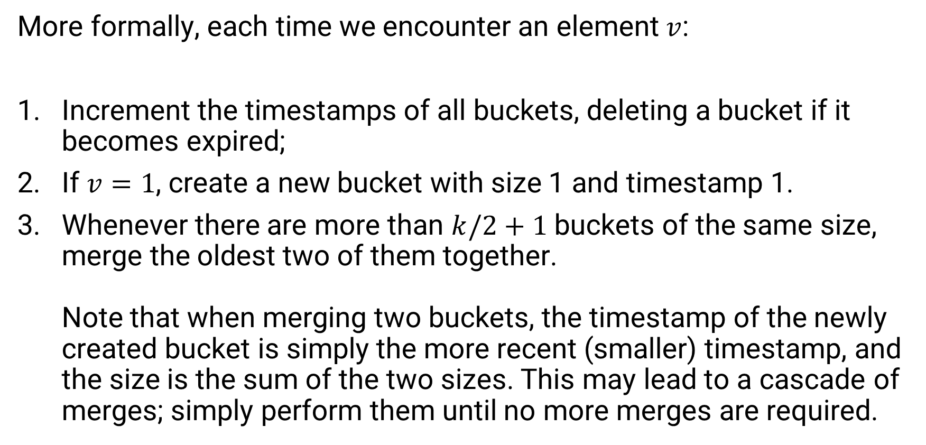
The Exponential Histogram
More formally, each time we encounter an element $v$:
Increment the timestamps of all buckets, deleting a bucket if it becomes expired;
If $v=1$, create a new bucket with size 1 and timestamp 1.
Whenever there are more than $k/2+1$ buckets of the same size, merge the oldest two of them together.
Note that when merging two buckets, the timestamp of the newly created bucket is simply the more recent (smaller) timestamp, and the size is the sum of the two sizes. This may lead to a cascade of merges; simply perform them until no more merges are required.

Slide 61
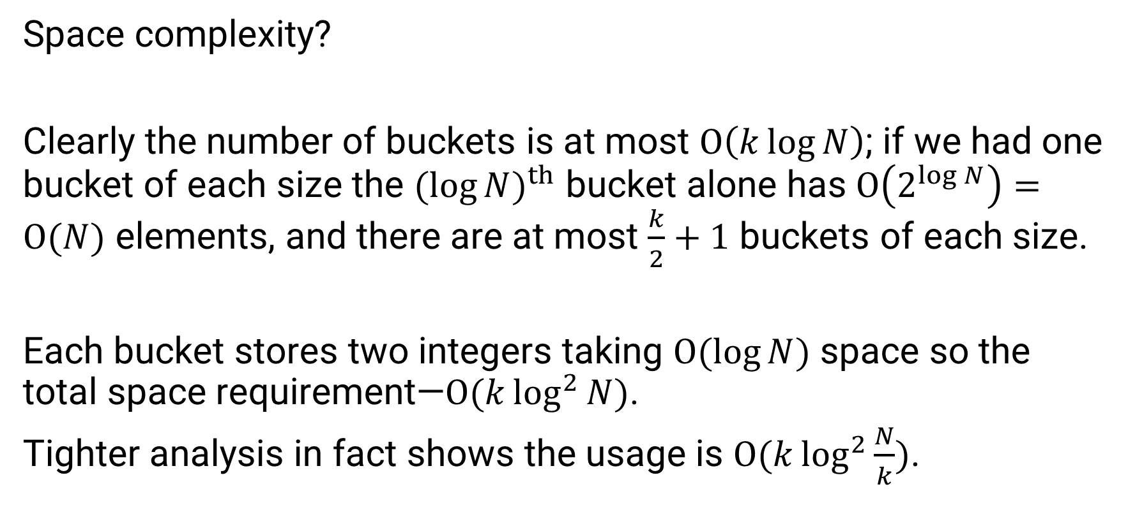
The Exponential Histogram
Space complexity?
Clearly the number of buckets is at most $O\left(k\log{N}\right)$; if we had one bucket of each size the ${(\log{N})}^{th}$ bucket alone has $O\left(2^{\log{N}}\right)=O(N)$ elements, and there are at most $\frac{k}{2}+1$ buckets of each size.
Each bucket stores two integers taking $O(\log{N})$ space so the total space requirement—$O(k\log^{2}{N})$.
Tighter analysis in fact shows the usage is $O(k\log^{2}{\frac{N}{k}})$.

Slide 62
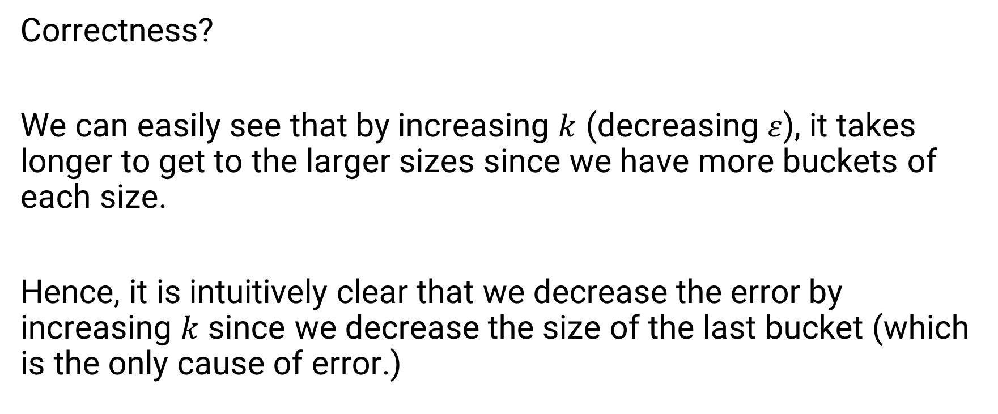
The Exponential Histogram
Correctness?
We can easily see that by increasing $k$ (decreasing $ε$), it takes longer to get to the larger sizes since we have more buckets of each size.
Hence, it is intuitively clear that we decrease the error by increasing $k$ since we decrease the size of the last bucket (which is the only cause of error.)

Slide 63
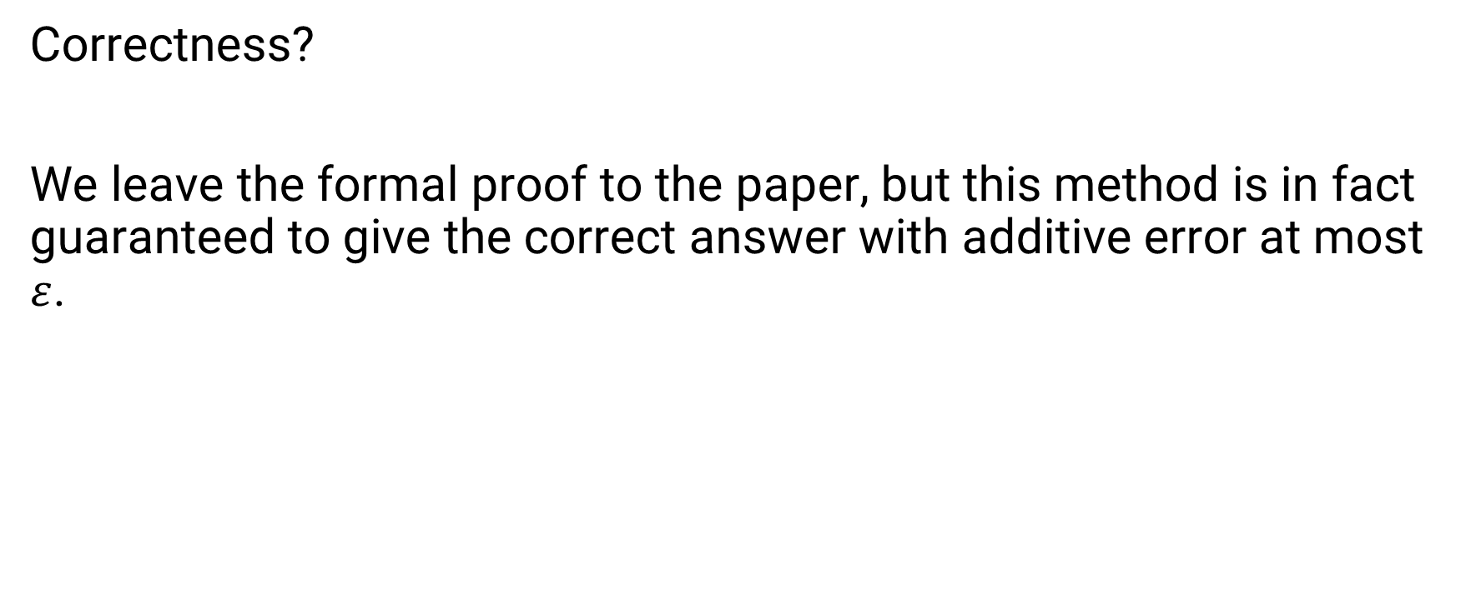
The Exponential Histogram
Correctness?
We leave the formal proof to the paper, but this method is in fact guaranteed to give the correct answer with additive error at most $ε$.

Slide 64
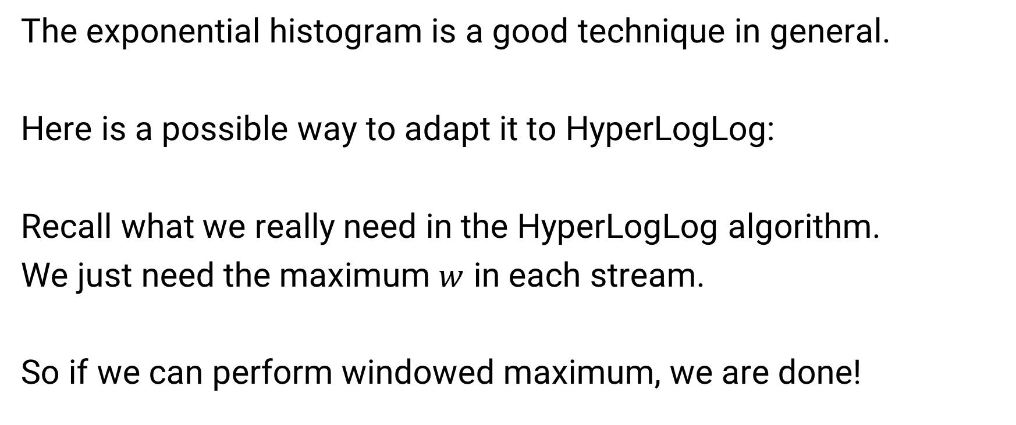
The Exponential Histogram
The exponential histogram is a good technique in general.
Here is a possible way to adapt it to HyperLogLog:
Recall what we really need in the HyperLogLog algorithm.
We just need the maximum $w$ in each stream.
So if we can perform windowed maximum, we are done!

Slide 65
The Exponential Histogram
Let’s store the maximum in each bucket:
timestamp 8
size 8
maximum 8
timestamp 4
size 4
maximum 9
timestamp 2
size 2
maximum 2
timestamp 1
size 1
maximum 2
More recent
15
14
13
12
11
10
9
8
7
6
5
4
3
2
1
4
7
2
3
8
5
3
2
5
6
9
3
2
1
2
Window size N

Slide 66
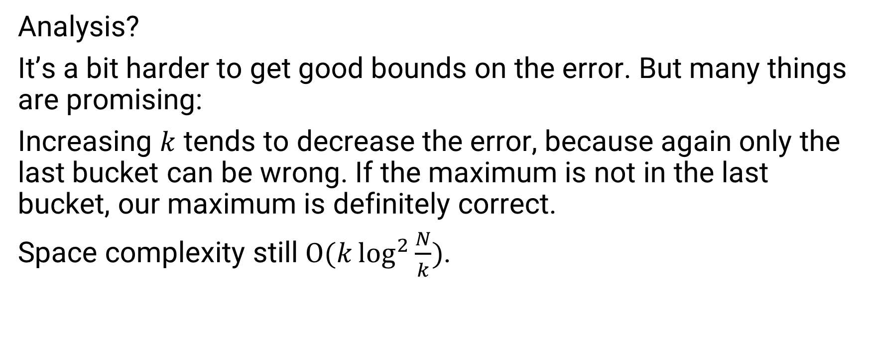
The Exponential Histogram
Analysis?
It’s a bit harder to get good bounds on the error. But many things are promising:
Increasing $k$ tends to decrease the error, because again only the last bucket can be wrong. If the maximum is not in the last bucket, our maximum is definitely correct.
Space complexity still $O(k\log^{2}{\frac{N}{k}})$.

Slide 67
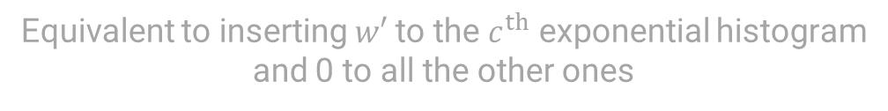
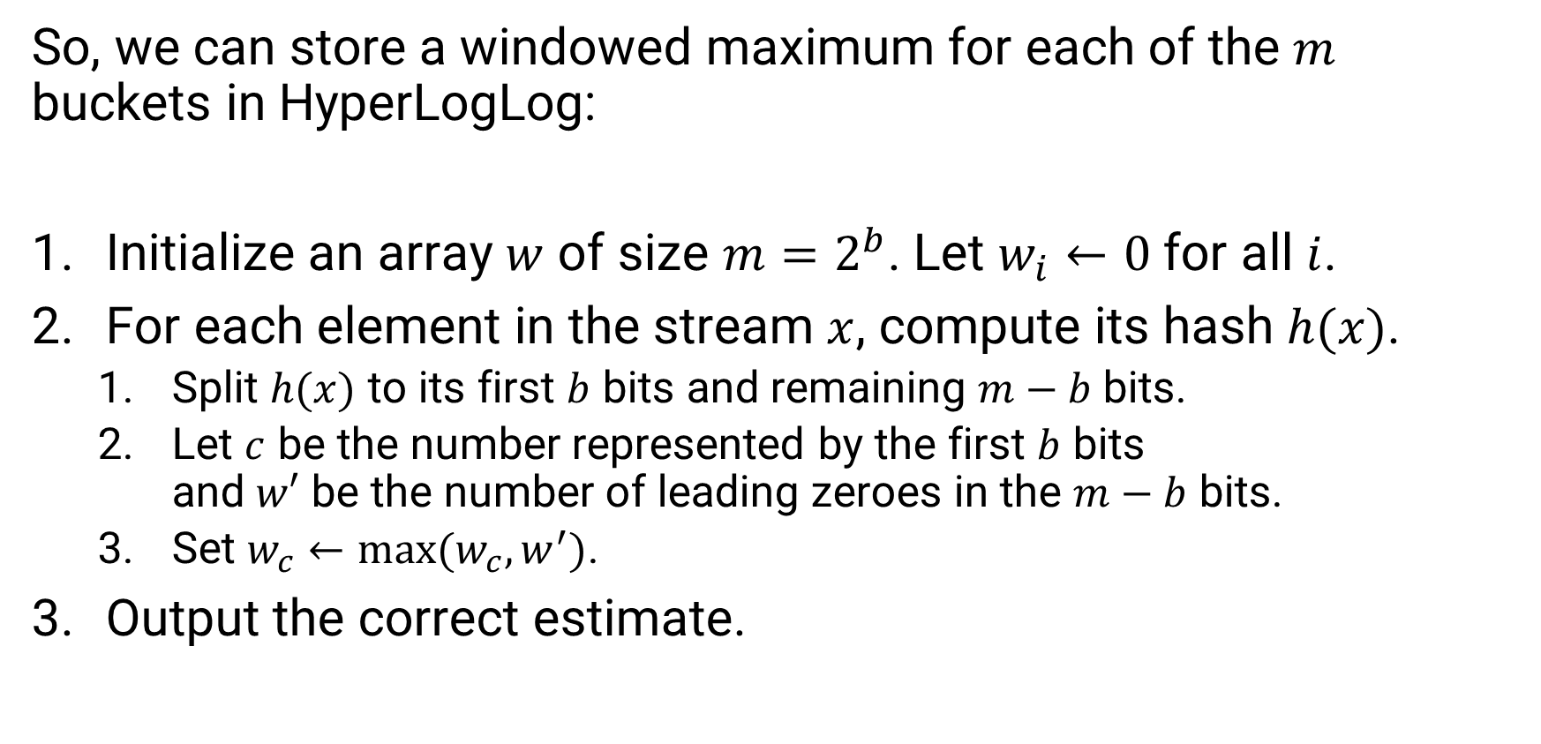

The Exponential Histogram
So, we can store a windowed maximum for each of the $m$ buckets in HyperLogLog:
Initialize an array $w$ of size $m=2^{b}$. Let $w_{i}←0$ for all $i$.
For each element in the stream $x$, compute its hash $h(x)$.
  Split $h(x)$ to its first $b$ bits and remaining $m−b$ bits.
  Let $c$ be the number represented by the first $b$ bits
  and $w′$ be the number of leading zeroes in the $m−b$ bits.
  Set $w_{c}←max⁡(w_{c}, w^{′})$.
Output the correct estimate.
Replace these with exponential histograms
Equivalent to inserting $w′$ to the $c^{th}$ exponential histogram
and 0 to all the other ones
The correct value of $w_{c}$ is just a query

Slide 68


The Exponential Histogram
The exponential histogram dominates the memory, and we need
$$O(mk\log^{2}{\frac{N}{k}}+\log{n})$$
space.
Recall:
$m$ number of streams in HyperLogLog
$n$ number of bits in $h$’s output
$N$ window size
$k$ proportional to number of buckets; $k=\left\lceil \frac{ε}{2}\right\rceil$

Slide 69
The Exponential Histogram
What about the accuracy of HyperLogLog?
It definitely becomes worse, because the Exponential Histograms introduce more error.
But it turns out there is a much simpler solution for this case that:
Doesn’t introduce more error;
Uses less memory!

Slide 70
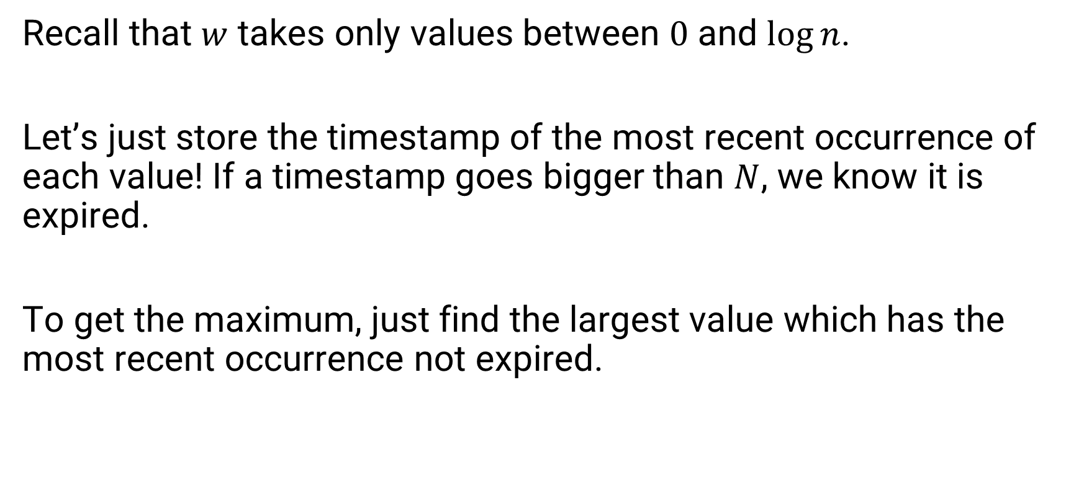
The Exponential Histogram
Recall that $w$ takes only values between $0$ and $\log{n}$.
Let’s just store the timestamp of the most recent occurrence of each value! If a timestamp goes bigger than $N$, we know it is expired.
To get the maximum, just find the largest value which has the most recent occurrence not expired.

Slide 71
The Exponential Histogram
Store the most recent position of each element:
0
1
2
3
3
1
4
10
More recent
15
14
13
12
11
10
9
8
7
6
5
4
3
2
1
0
3
2
1
1
3
0
2
2
1
0
2
0
1
1
Window size N

Slide 72
The Exponential Histogram
Store the most recent position of each element:
Next element is 2
0
1
2
3
4
2
1
11
Expired
More recent
15
14
13
12
11
10
9
8
7
6
5
4
3
2
1
3
2
1
1
3
0
2
2
1
0
2
0
1
1
2
Window size N

Slide 73
The Exponential Histogram
Store the most recent position of each element:
0
1
2
3
4
2
1
-
More recent
15
14
13
12
11
10
9
8
7
6
5
4
3
2
1
3
2
1
1
3
0
2
2
1
0
2
0
1
1
2
Window size N

Slide 74

The Exponential Histogram
Space complexity?
It is clear that the space complexity is $O(\log{n}\log{N})$; there are $O(\log{n})$ values to keep track of, and each can store an integer between $1$ and $N$, which requires $O(\log{N})$ bits.
This is better than $O\left(k\log^{2}{\frac{N}{k}}\right)$, as it has no dependence on $k$, which usually needs to be set reasonably large to get a good result.

Slide 75

The Exponential Histogram
Moreover, it is always correct!
Hence we can directly apply this to HyperLogLog without increasing the error.
This gives us the final space complexity for windowed HyperLogLog:
$$O(m\log{n}\log{N})$$
.

Slide 76
Applications and Extensions

Slide 77
Applications and Extensions
One of the most common applications of distinct counting in a windowed streaming setting is analysing web traffic.
It is possible to identify some common types of web attacks in real-time by analysing IP addresses:
Few distinct hits; could be a sign of a denial of service attack!
137.132.228.213
137.132.228.213
137.132.228.213
172.58.221.140
137.132.228.213
137.132.228.213

Slide 78
Applications and Extensions
In such scenarios we only care about the most recent hits; hits from one or two days ago are not very useful.
The window of concern can be quite large, so it is usually infeasible to use linear memory. Here algorithms such as sliding HyperLogLog would be suitable.

Slide 79
Applications and Extensions
In real applications, we will probably want to optimize time complexity as well to make sure we can respond in real-time.
We did not analyse here the time complexity of most of our operations. If the operations are performed exactly as stated, they can be rather slow.
There are many possible optimizations in terms of implementation which we encourage the interested reader to discover for themselves.
For example, it is not necessary to maintain the timestamps explicitly; we did this for ease of discourse, but it is quite slow.
There are of course many other such optimizations.

