Slide 1
Write-Optimized Data Structures
CS5234 – Algorithms at Scale
Foo Guo Wei
Kuan Wei Heng

Slide 2



Recap – B-trees
Node size a multiple of B
=> $O(\frac{N}{B})$ leaves
=> $O\left(\log_{B}{N}\right)$ tree height
B
pivots
B
pivots
… ≈B children…
B
pivots
$$O(\log_{B}{N})$$
B
elements
… ≈$\frac{N}{B}$ leaves…
B
elements

Slide 3

Recap – B-trees search
$O(\log_{B}{N})$ amortized
B
pivots
B
pivots
… ≈B children…
B
pivots
$$O(\log_{B}{N})$$
B
elements
… ≈$\frac{N}{B}$ leaves…
B
elements

Slide 4

Recap – B-trees update
$O(\log_{B}{N})$ amortized
  Find leaf node to insert into
  Insert into leaf node
  Recursively split/share/merge up the tree
B
pivots
B
pivots
… ≈B children…
B
pivots
$$O(\log_{B}{N})$$
B
elements
… ≈$\frac{N}{B}$ leaves…
B
elements

Slide 5










Recap – $B^{ε}$-trees
Addition of a buffer – Batch operations
Buffer is flushed to children when full
B-tree when $ε=1$
Buffer tree when $ε=0$
$${B −B}^{ε}$$
buffer
$$B^{ε}$$
pivots
$${B −B}^{ε}$$
buffer
$${B −B}^{ε}$$
buffer
$$O(\log_{B^{ε}}{N})$$
$$B^{ε}$$
pivots
$$B^{ε}$$
pivots
… ≈$B^{ε}$ children…
B
elements
… ≈$\frac{N}{B}$ leaves…
B
elements

Slide 6


Recap – $B^{ε}$-trees search
Dependent on height of tree
=> $O(\log_{B^{ε}}{N})$
$${B −B}^{ε}$$
buffer
$$B^{ε}$$
pivots
$${B −B}^{ε}$$
buffer
$${B −B}^{ε}$$
buffer
$$O(\log_{B^{ε}}{N})$$
$$B^{ε}$$
pivots
$$B^{ε}$$
pivots
… ≈$B^{ε}$ children…
B
elements
… ≈$\frac{N}{B}$ leaves…
B
elements

Slide 7

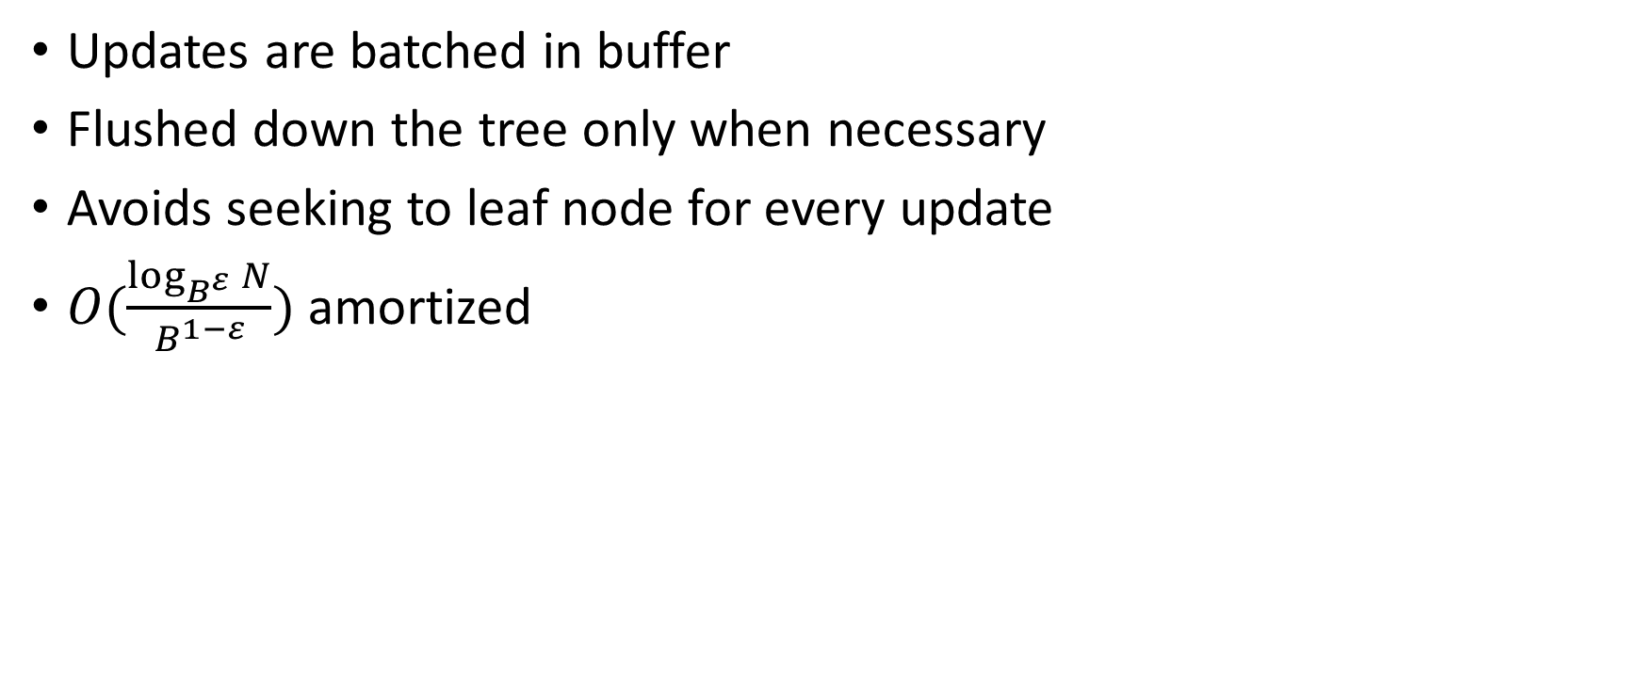
Recap – $B^{ε}$-trees update
Updates are batched in buffer
Flushed down the tree only when necessary
Avoids seeking to leaf node for every update
$O(\frac{\log_{B^{ε}}{N}}{B^{1−ε}})$ amortized
$${B −B}^{ε}$$
buffer
$$B^{ε}$$
pivots
$${B −B}^{ε}$$
buffer
$${B −B}^{ε}$$
buffer
$$O(\log_{B^{ε}}{N})$$
$$B^{ε}$$
pivots
$$B^{ε}$$
pivots
… ≈$B^{ε}$ children…
B
elements
… ≈$\frac{N}{B}$ leaves…
B
elements

Slide 8
Log-Structured Merge Tree

Slide 9
Interface
Operations
  insert(k, v)
  update(k, v)
  delete(k)
  get(k)
Keys are unique

Slide 10
Implementation
Operations
  insert(k, v)
  update(k, v)
  delete(k)
  get(k)
Keys are unique
insert/update/delete are blind writes (no check to see if key is in tree)

Slide 11
Implementation
Operations
  insert(k, v)
  update(k, v) Same as insert
  delete(k) Implemented by inserting tombstone
  get(k)
Keys are unique
insert/update/delete are blind writes (no check to see if key is in tree)

Slide 12
B-Tree writes
1
2
3
4
5
6
7
8

Slide 13
B-Tree writes
Update key 6
1
2
3
4
5
6
7
8

Slide 14
Structure of LSM Tree
“Log-structured”: organised into levels
Level 0: in main memory
Level >0: on disk
Each level is k times larger than previous level
Keys in a level are unique

Slide 15
Structure of LSM Tree
Main memory
Level 0
Disk
Level 1
log_{k} (n) levels
Level 2
Exponentially increasing size

Slide 16
How it works
Insert
Insert into level 0
When a level is full, merge it into the next level
If next level is full, repeat
Search
Search for key within each level, from top to bottom
Return value of first key

Slide 17
Merging
Main memory
Level 0 is full
Disk

Slide 18
Merging
Main memory
Level 1 is read into memory
Disk

Slide 19
Merging
Merge while removing duplicate keys
Main memory
Disk

Slide 20
Merging
Main memory
Disk
Write to disk
Reads and writes during merge are done concurrently!

Slide 21
How levels are stored
Merging needs to be efficient
Nice if searching is also efficient
Original paper uses B-Tree
Many implementations use SSTable

Slide 22
Sorted String Table (SSTable)
Contiguous sequence of key-value pairs
Keys are sorted
Values are variable-length strings
Key
Value
Key
Value
...

Slide 23
SSTable usage
Building level 0: Can sort efficiently
Can be streamed and merged efficiently
Effectively immutable on disk

Slide 24
Search?
Keys are sorted but positions unknown
Cannot binary search
Linear search may have to load entire level into memory

Slide 25
Cache-Oblivious Lookahead Array

Slide 26
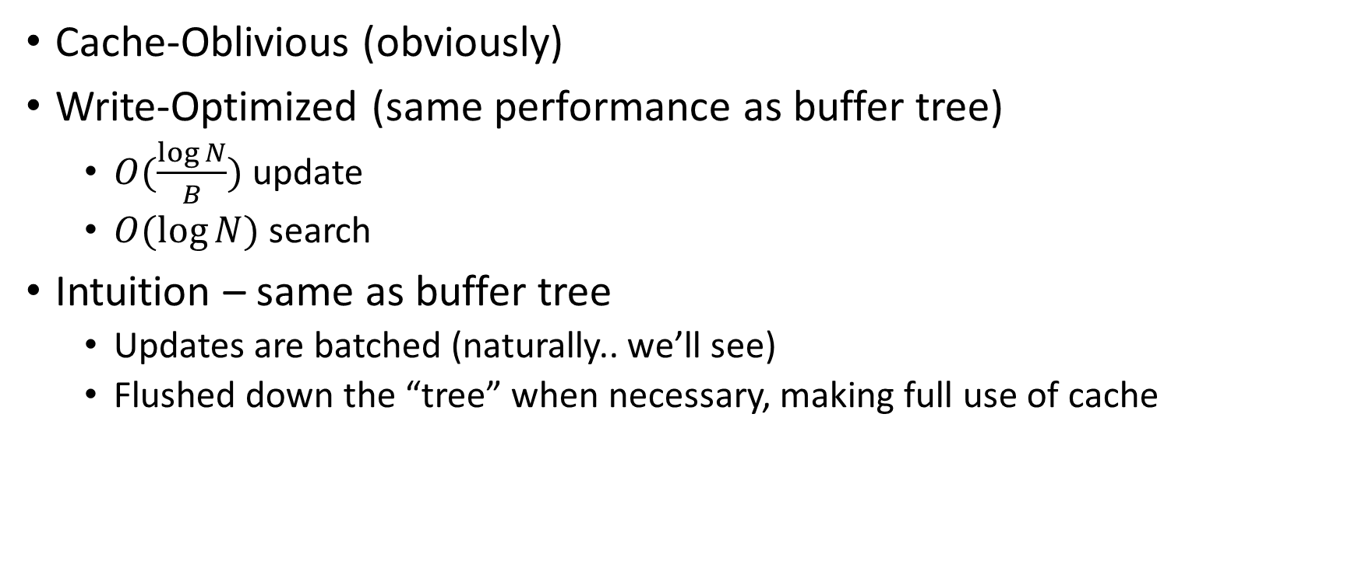
Cache-Oblivious Lookahead Array (COLA)
Cache-Oblivious (obviously)
Write-Optimized (same performance as buffer tree)
  $O(\frac{\log{N}}{B})$ update
  $O(\log{N})$ search
Intuition – same as buffer tree
  Updates are batched (naturally.. we’ll see)
  Flushed down the “tree” when necessary, making full use of cache

Slide 27

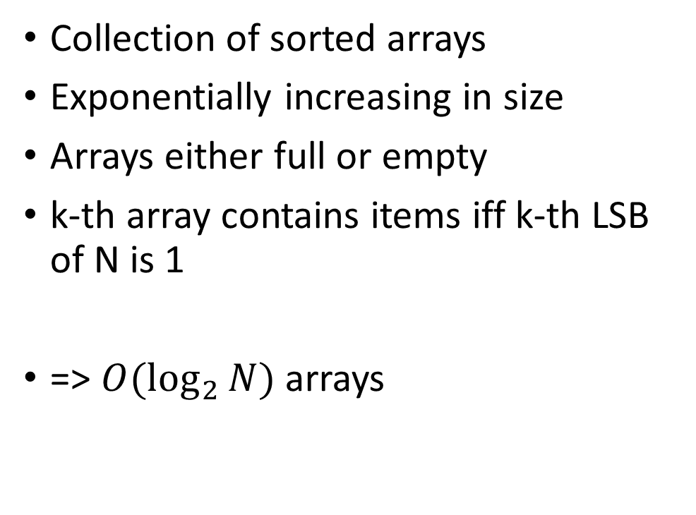


Cache-Oblivious Lookahead Array
Collection of sorted arrays
Exponentially increasing in size
Arrays either full or empty
k-th array contains items iff k-th LSB of N is 1
=> $O(\log_{2}{N})$ arrays
level 0
1
50
level 1
2
45
78
level 2
4
…
level k
$$2^{k}$$
…
…
level $\log_{2}{N−1}$
$$\frac{N}{2}$$
…

Slide 28
Cache-Oblivious Lookahead Array
Level
Filled
0
1
50
N = 11
1
1
45
78
2
0
3
1
5
8
14
42
56
72
91
99
Notice how this is the binary representation of N

Slide 29
Cache-Oblivious Lookahead Array
Insert(6)
6
Insert at level 0
Level
Filled
0
1
50
N = 12
1
1
45
78
2
0
3
1
5
8
14
42
56
72
91
99
Notice how we basically perform a carry operation

Slide 30
Cache-Oblivious Lookahead Array
Insert(6)
While 2 arrays of same size exist:
Merge
Level
Filled
0
0
=>
6
50
N = 12
1
1
45
78
2
0
3
1
5
8
14
42
56
72
91
99
Notice how we basically perform a carry operation

Slide 31
Cache-Oblivious Lookahead Array
Insert(6)
While 2 arrays of same size exist:
Merge
Level
Filled
0
0
N = 12
1
0
=>
6
45
50
78
2
0
3
1
5
8
14
42
56
72
91
99
Notice how we basically perform a carry operation

Slide 32
Cache-Oblivious Lookahead Array
Insert(6)
While 2 arrays of same size exist:
Merge
Level
Filled
0
0
N = 12
1
0
2
1
6
45
50
78
3
1
5
8
14
42
56
72
91
99
New binary representation of N

Slide 33
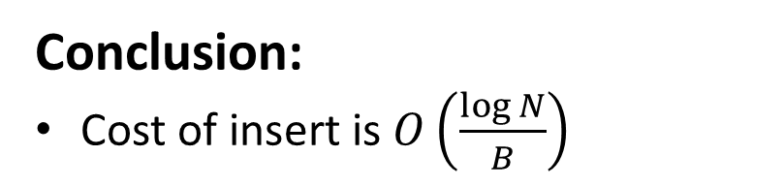
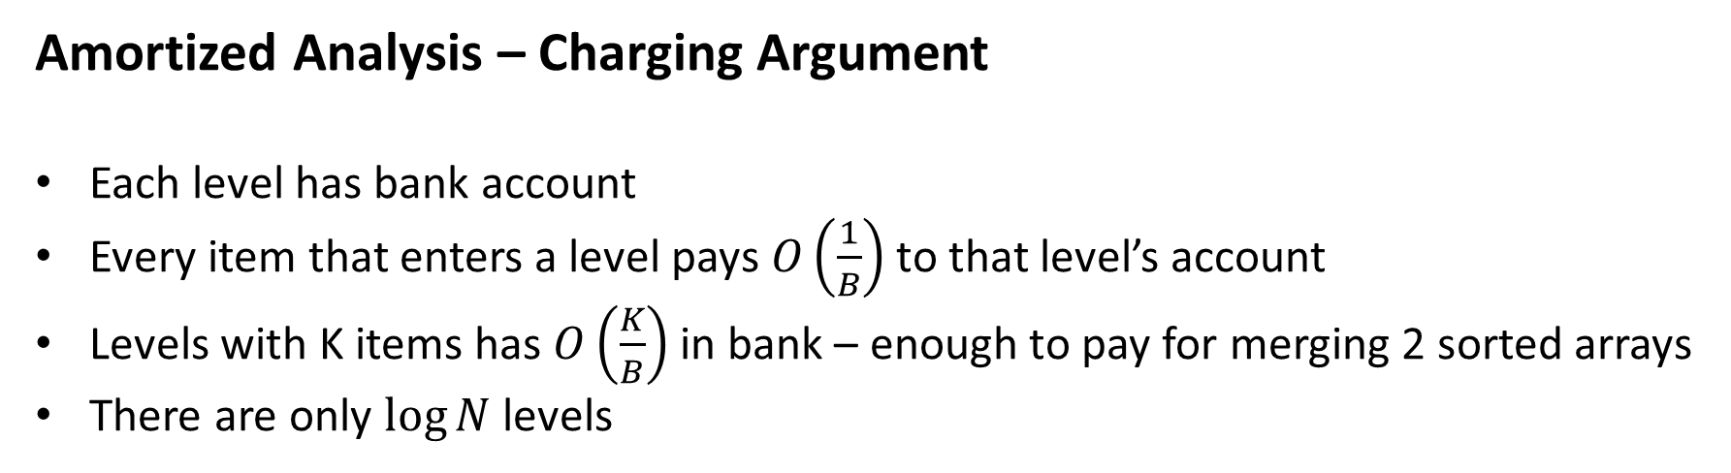
Cache-Oblivious Lookahead Array
Amortized Analysis – Charging Argument
Each level has bank account
Every item that enters a level pays $O\left(\frac{1}{B}\right)$ to that level’s account
Levels with K items has $O\left(\frac{K}{B}\right)$ in bank – enough to pay for merging 2 sorted arrays
There are only $\log{N}$ levels
Level
Filled
Conclusion:
Cost of insert is $O\left(\frac{\log{N}}{B}\right)$
0
0
N = 12
1
0
2
1
6
45
50
78
3
1
5
8
14
42
56
72
91
99

Slide 34
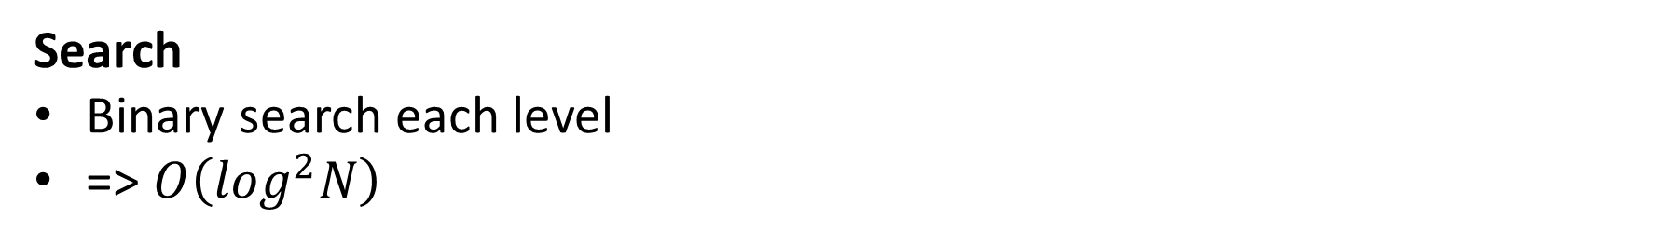
Cache-Oblivious Lookahead Array
Search
Binary search each level
=> $O\left(\log^{2}N\right)$
Level
Filled
0
0
N = 12
1
0
2
1
6
45
50
78
3
1
5
8
14
42
56
72
91
99

Slide 35
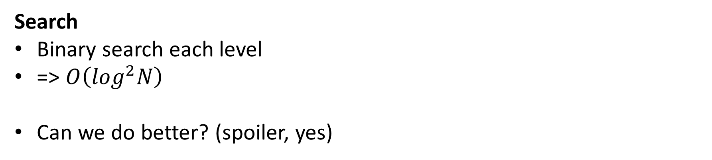
Cache-Oblivious Lookahead Array
Search
Binary search each level
=> $O\left(\log^{2}N\right)$
Can we do better? (spoiler, yes)
Level
Filled
0
0
N = 12
1
0
2
1
6
45
50
78
3
1
5
8
14
42
56
72
91
99

Slide 36
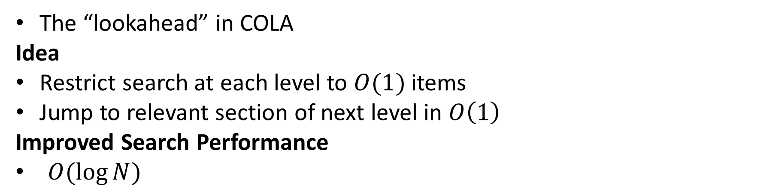
Fractional Cascading
The “lookahead” in COLA
Idea
Restrict search at each level to $O(1)$ items
Jump to relevant section of next level in $O\left(1\right)$
Improved Search Performance
$O(\log{N})$

Slide 37
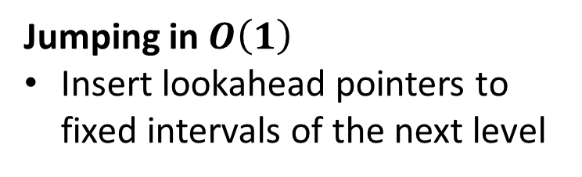
Fractional Cascading
Jumping in $O\left(1\right)$
Insert lookahead pointers to fixed intervals of the next level
Lookahead Pointers
Contains pointer to target item
Has same logical value as target item
  Can be compared with (and sorted amongst) other items
-∞
3
L5
58
L69
72
83
91
99
+∞
-∞
5
8
14
42
48
53
65
67
69
81
86
88
92
95
97
98
+∞
Interval = 8

Slide 38
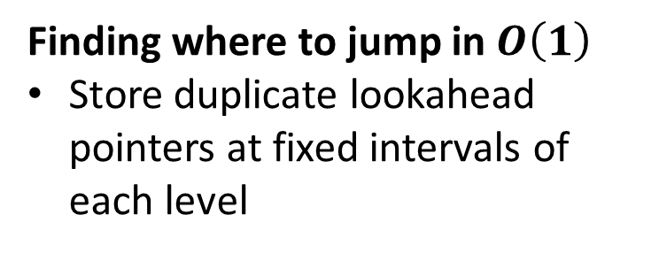
Fractional Cascading
Finding where to jump in $O\left(1\right)$
Store duplicate lookahead pointers at fixed intervals of each level
Duplicate Lookahead Pointers
Points to nearest lookahead pointers on left and right of the same level
-∞
<D>
L5
58
L69
<D>
83
91
99
+∞
Interval = 4
-∞
5
8
14
42
48
53
65
67
69
81
86
88
92
95
97
98
+∞
Interval = 8

Slide 39
Fractional Cascading
Bookkeeping Overhead
Half the space at each level
-∞
<D>
L5
58
L69
<D>
83
91
99
+∞
Interval = 4
-∞
5
8
14
42
48
53
65
67
69
81
86
88
92
95
97
98
+∞
Interval = 8

Slide 40
Fractional Cascading
Find(92)
While current section exist
  Search current section
-∞
<D>
L5
58
L69
<D>
83
91
99
+∞
-∞
5
8
14
42
48
53
65
67
69
81
86
88
92
95
97
98
+∞

Slide 41
Fractional Cascading
Find(92)
While current section exist
  Search current section
  If found, return
  Else we have located insertion point
-∞
<D>
L5
58
L69
<D>
83
91
99
+∞
-∞
5
8
14
42
48
53
65
67
69
81
86
88
92
95
97
98
+∞

Slide 42
Fractional Cascading
Find(92)
While current section exist
  Search current section
  If found, return
  Else we have located insertion point
  Use duplicate lookahead pointers to find nearest lookahead pointers
-∞
<D>
L5
58
L69
<D>
83
91
99
+∞
-∞
5
8
14
42
48
53
65
67
69
81
86
88
92
95
97
98
+∞

Slide 43
Fractional Cascading
Find(92)
While current section exist
  Search current section
  If found, return
  Else we have located insertion point
  Use duplicate lookahead pointers to find nearest lookahead pointers
-∞
<D>
L5
58
L69
<D>
83
91
99
+∞
-∞
5
8
14
42
48
53
65
67
69
81
86
88
92
95
97
98
+∞

Slide 44
Fractional Cascading
Find(92)
While current section exist
  Search current section
  If found, return
  Else we have located insertion point
  Use duplicate lookahead pointers to find nearest lookahead pointers
  Search next section
-∞
<D>
L5
58
L69
<D>
83
91
99
+∞
-∞
5
8
14
42
48
53
65
67
69
81
86
88
92
95
97
98
+∞

Slide 45
Fractional Cascading
Find(92)
While current section exist
  Search current section
  If found, return
  Else we have located insertion point
  Use duplicate lookahead pointers to find nearest lookahead pointers
  Search next section
-∞
<D>
L5
58
L69
<D>
83
91
99
+∞
-∞
5
8
14
42
48
53
65
67
69
81
86
88
92
95
97
98
+∞

Slide 46

COLA – Conclusion
$O(\frac{\log{N}}{B})$ update
$O(\log{N})$ search

