Slide 1
Genotype and SNP Calling from Next-generation Sequencing Data
Authors:
Rasmus Nielsen, et al.
Published in Nature Reviews, Genetics, 2011.
Presented by:
Jiangbin Lu
jiangbin.lu@nus.edu.sg
National University of Singapore
Oct 31, 2012

Slide 2
Outline
I: Background and Motivations
II: Genotype and SNP Calling
III: Recommendations and Conclusions

Slide 3
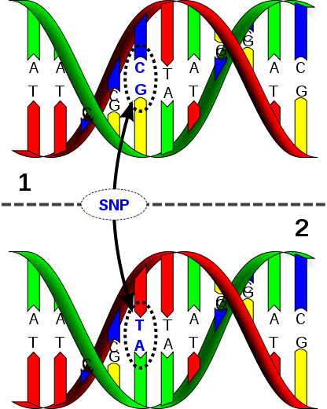
I: Background and Motivations
SNP (Single Nucleotide Polymorphism):
is a DNA sequence variation occurring when a single nucleotide — A, T, C or G — in the genome (or other shared sequence) differs between members of a biological species or paired chromosomes in an individual.

Slide 4
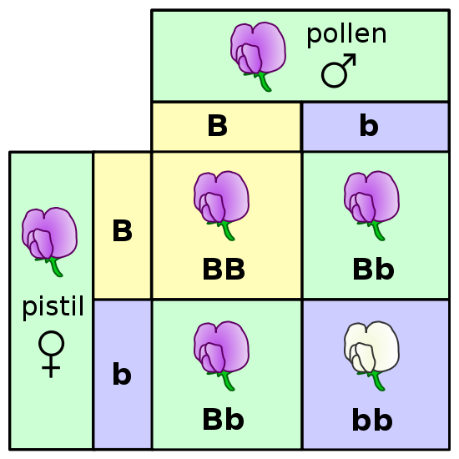
I: Background and Motivations
Genotype:
the genetic makeup of a cell, an organism, or an individual (i.e. the specific allele makeup of the individual) usually with reference to a specific character under consideration.

Slide 5
I: Background and Motivations
NGS (Next Generation Sequencing):
NGS methods provide cheap and reliable large-scale DNA sequencing.
Used for de novo sequencing, disease mapping, quantifying expression levels through RNA sequencing, population genetic studies, etc.
In NGS method, a whole genome, or targeted regions of the genome, is randomly digested into small fragments (or short reads) that get sequenced and are then either aligned to a reference genome or assembled.
Notes:
“Calling” means the estimation of one unique SNP or genotype.

Slide 6
I: Background and Motivations
Base Calling:
The main principle underlying NGS is sequencing by synthesis.
The synthesis process is captured in a series of fluorescence images, and base calling infers the actual nucleotide information from the obtained fluorescence-intensity data for each cluster of DNA templates.
Assign a measure of uncertainty (quality score) to each base call.
Assemble and alignment:
The resulting short-read data are then assembled into a genome.
When a reference genome is available, the basic task is to align each short read onto this reference genome.

Slide 7
I: Background and Motivations
SNP calling:
Having aligned the fragments of one or more individuals to a reference genome, ‘SNP calling’ identifies variable sites.
Genotype calling:
Determines the genotype for each individual at each site.
Notes:
“Calling” means the estimation of one unique SNP or genotype.

Slide 8
I: Background and Motivations
Challenges:
NGS data can suffer from high error rates due to multiple factors, including base-calling and alignment errors.
Many NGS studies rely on low-coverage sequencing (<5x), for which there is high probability that only one or two chromosomes of a diploid individual has been sampled at a specified site.
The above circumstances make accurate SNP and genotype calling difficult, and there is considerable uncertainty associated with the results.
Such uncertainty influences downstream analyses based on the inferred SNPs and genotypes, e.g., identification of rare mutations, estimation of allele frequency and association mapping.
Notes:
“Calling” means the estimation of one unique SNP or genotype.

Slide 9
I: Background and Motivations
Probabilistic Framework for Genotype and SNP calling:
Incorporate errors introduced in base calling, alignment and assembly.
Coupled with prior information, such as allele frequencies and patterns of linkage disequilibrium.
Reduce and quantify the uncertainty associated with SNP and genotype calling.
Notes:
“Calling” means the estimation of one unique SNP or genotype.

Slide 10
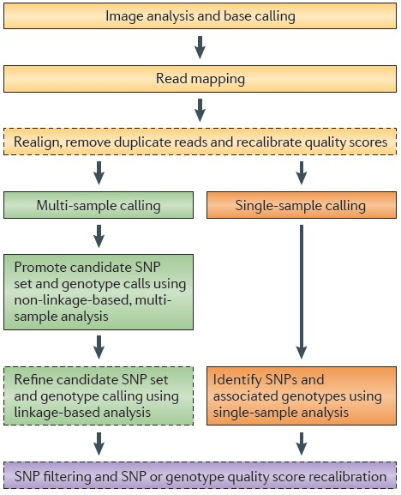
I: Background and Motivations
Steps for converting raw NGS data into a final set of SNP or genotype calls
Notes:
“Calling” means the estimation of one unique SNP or genotype.

Slide 11
II: Genotype and SNP Calling
Early Methods for Calling SNP and Genotypes:
Genotype and SNP calling can proceed, as in early studies, by counting alleles at each site of each individual separately, and using simple cutoff rules for when to call a SNP or genotype.
Typically, analyses would first involve a filtering step in which only high-confidence bases would be kept.
The most common cutoff used would be a Phred-type quality score of of Q20 , which corresponds to 1% error rate in base calling.
Genotype calling would then proceed for each individual by counting the number of times each allele is observed and using fixed cutoffs.
SNP calling would be based on the inferred genotypes.

Slide 12
II: Genotype and SNP Calling
Example for Early Methods:
First, use a Q20 filter to get high-confidence bases.
Second, count alleles at each site.
Call a heterozygous genotype if the proportion of the non-reference allele is between 20% and 80%;
Otherwise, a homozygous genotype would be called.
Terms:
Zygosity: the degree of similarity of the alleles for a trait in an organism. If both alleles are the same, the organism is homozygous for the trait. If both alleles are different, the organism is heterozygous for that trait.
Non-reference Allele: the allele that is different from the reference allele.
Notes:
板书画图说明propotion

Slide 13
III: Genotype and SNP Calling
Example for Early Methods:
This is a fairly standard procedure and works well when the sequencing depth is high (>20×), so that the probability of a heterozygous individual falling outside the 20-80% range is small.
Related methods for genotype calling form the basis for the commercially available soft ware in Roche’s GSMapper, the CLC Genomic Workbench and the DNSTAR Lasergen software.
Terms:
Sequencing depth/coverage: On the genome basis, it means that, on average, each base has been sequenced a certain number of times (10×, 20×, …).
Notes:
Shorter bases lead to higher coverage.

Slide 14
II: Genotype and SNP Calling
Probabilistic Methods :
For moderate or low sequencing depths, genotype calling based on fixed cutoffs will typically lead to under-calling of heterozygous genotypes;
The use of a simple filtering based on quality score leads to a loss of information regarding individual read qualities;
The early methods for genotype calling typically does not provide measures of uncertainty in the genotype inference.
Therefore, probabilistic methods have been developed that use the quality score to provide a posterior probability for each genotype.

Slide 15
II: Genotype and SNP Calling
Probabilistic Methods:
In brief, it is assumed that one can compute a genotype likelihood, p(X|G), for a genotype G.
The symbol X represents, in this generic notation, all of the read data for a particular individual at a particular site.
In conjunction with a genotype prior, p(G), Bayes’ formula is used to calculate p(G|X), which is the posterior probability of genotype G.
Finally, the genotype with the highest posterior probability is generally chosen, and this probability, or perhaps the ratio between the highest and the second highest probabilities, is used as a measure of confidence.

Slide 16
II: Genotype and SNP Calling
Calculating genotype likelihoods p(X|G):
Use the quality scores for each read.
Let Xi be the data in read i for a particular individual and a particular site with genotype G. p(Xi|G) is then given by a simple rescaling of the quality score of Xi.
Genotype likelihood p(X|G) can be calculated by take the product of p(Xi|G) over all i.
Can be improved by recalibrating the per-base quality scores using empirical data.

Slide 17
II: Genotype and SNP Calling
Assigning priors using single samples:
In probabilistic methods, a prior probability for each genotype must be assumed in order to produce posterior probabilities for the genotypes.
Suppose a single individual is sequenced. The prior-genotype probability, p(G), may be chosen to assign equal probability to all genotypes, or it can be based on external information.
For example, in the analysis of human data in SOAPsnp, a prior is chosen by the use of dbSNP.

Slide 18
II: Genotype and SNP Calling
Assigning priors using multiple samples:
Prior-genotype probabilities can be improved by jointly analyzing multiple individuals.
This can be done by considering allele frequencies, or genotype frequencies, estimated from larger data sets.

Slide 19
II: Genotype and SNP Calling
Incorporating LD information:
The approaches discussed so far assume that genotype calling is done independently for each site.
Further improve by using pattern of LD (Linkage Disequilibrium) at nearby sites.
For example, consider a population in which the only haplotypes observed are ATA and CGC at three sites. If an individual is sampled with genotypes A or C in the first site, A or C in the third site, but an unknown genotype in the second site, we might think it to be T or G, respectively.
The use of LD patterns is a cornerstone of the 1000 Genomes Project, and it leads to significant genotype calling accuracy improvement.
Notes:
Terms:
Linkage Disequilibrium (LD): In population genetics, linkage disequilibrium is the non-random association of alleles at two or more locus, that may or may not be on the same chromosome.

Slide 20
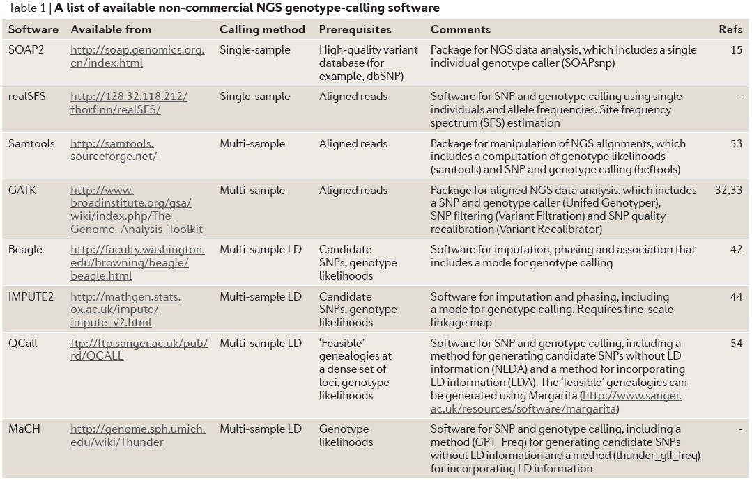
II: Genotype and SNP Calling
A comparison of genotype-call accuracies:

Slide 21
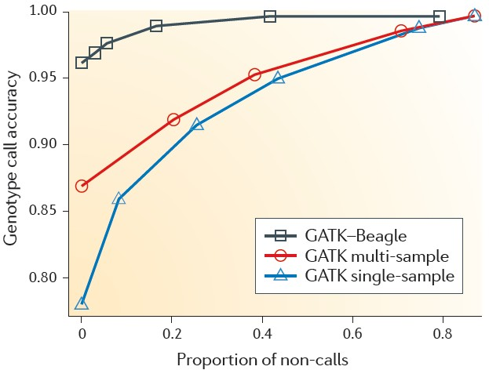
II: Genotype and SNP Calling
A comparison of genotype-call accuracies:

Slide 22
II: Genotype and SNP Calling
Advantages of Probabilistic Methods:
Provide measures of statistical uncertainty when calling genotypes;
Lead to higher accuracy of genotype calling;
Provide a natural framework for incorporating information regarding allele frequencies and patterns of Linkage Disequilibrium.

Slide 23
III: Recommendations and Conclusions
Recommendations
Base calling and calculation of quality scores should be carried out using methods that have been thoroughly tested and benchmarked.
Recalibration of per-base quality scores as in GATK or SOAPsnp.
Use sensitive aligner such as Novoalign or Stampy, for algning short reads to a reference genome.
SNP calling should proceed by using methods that can incorporate data from all individuals in the sample simultaneously, e.g., use likelihood ratio tests or Bayesian procedures.
Genotype calling should combine data from multiple individuals in a Bayesian framework.
If possible, use LD-based methods to improve accuracy.

Slide 24
III: Recommendations and Conclusions
Conclusions
Genotype and SNP calling for NGS data have matured from simple methods based on counting alleles to sophisticated methods that provide probabilistic measures of uncertainty.
Incorporate information from many individuals and linked sites.
Rely on accurate calculations of genotype likelihood that incorporate information regarding alignment or assembly uncertainty and base-calling uncertainty.
More research is needed in development of LD-based methods and in methods for incorporating genotype probabilities into downstream analyses.
NGS will be central in genomic and medical genetic studies. Genotype and SNP calling would be essential foundations.
Notes:
Linkage Disequilibrium (LD): In population genetics, linkage disequilibrium is the non-random association of alleles at two or more locus, that may or may not be on the same chromosome.

Slide 25
Thank You!
Jiangbin Lu
jiangbin.lu@nus.edu.sg
National University of Singapore

