Slide 1
Graph test cases
Test cases generation and use.

Slide 2
Benchmark Graph-- planted L-partition model

Slide 3
Benchmark Graph-- LFR benchmark graphs

Slide 4
LFR Benchmark Graph – Graph Generation Process
Input
LFR Generator
Output Graph

Slide 5
LFR Benchmark Graph – Five different Generators
LFR Generator
Undirected, unweighted
Undirected, weighted
Directed, unweighted
Directed, weighted
Hierarchical

Slide 6
LFR Benchmark Graph -- Generator Input (Part 1)
Inputs are the graph specifications.
The components of inputs (take undirected, unweighted graph as an example)
number of nodes
average in-degree
maximum in-degree
mixing parameter
minus exponent for the degree sequence
minus exponent for the community size distribution
minimum for the community sizes
maximum for the community sizes
number of overlapping nodes
number of memberships of the overlapping nodes

Slide 7
LFR Benchmark Graph -- Generator Input (Part 2)
Input format
Example: we use flags to represent the components of input for undirected unweighted LFR Graph Generator
-N number of nodes
-k average in-degree
-maxk maximum in-degree
-mu mixing parameter
-t1 minus exponent for the degree sequence
-t2 minus exponent for the community size distribution
-minc minimum for the community sizes
-maxc maximum for the community sizes
-on number of overlapping nodes
-om number of memberships of the overlapping nodes

Slide 8
LFR Benchmark Graph – How to run the program
Step 1: Compile
Navigate to the generator file directory
Type in “make” and enter.
Step 2: Execute
Method 1: directly type in the parameters
Example: ./benchmark -N 1000 -k 15 -maxk 50 -mu 0.1 -minc 20 -maxc 50
Method2: put all parameters inside the flag.dat file (RECOMMENDED)
Example2: ./benchmark -f flags.dat -t1 3

Slide 9
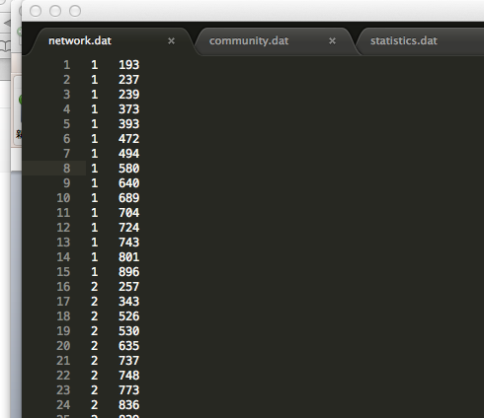
LFR Benchmark Graph – How to use the output graph. (Part 1/3)
The program will produce three files (except for Hierarchical Graph):
1) network.dat contains the list of edges (nodes are labeled from 1 to the number of nodes; the edges are ordered and repeated once, i.e. source-target).

Slide 10
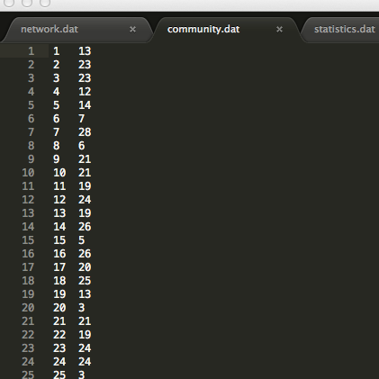
LFR Benchmark Graph – How to use the output graph. (Part 2/3)
2) community.dat contains a list of the nodes and their membership (memberships are labeled by integer numbers >=1).

Slide 11
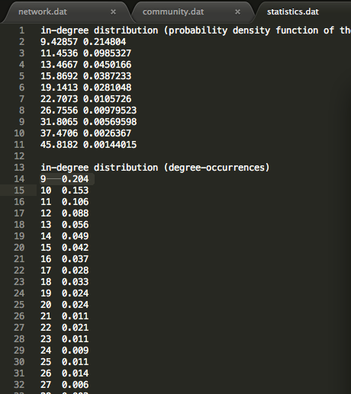
LFR Benchmark Graph – How to use the output graph. (Part 3/3)
3) statistics.dat contains the in and out-degree distribution (in logarithmic bins), the community size distribution, and the distribution of the mixing parameter (in and out).

Slide 12
Notice…
For each test case provided, I put the generator executable file together with it, for future customization use.
There are four most important files in each test cases: flag.dat, network.dat, community.dat, statistics.dat
Do read the readme.txt file in each generator file if you have any problems!

Slide 13
In addition…
There are many other famous benchmark graphs!
For getting those dataset, this link might help: http://www-personal.umich.edu/~mejn/netdata/
For getting those visualized graph: http://studiy.tu-cottbus.de/~clustering/evaluation:comparison_to_literature

Slide 14
Questions?

