Slide 1
SINGA and Rafiki
Deep Learning Platform as a Service
The SINGA Team
Nov 2, 2016

Slide 2
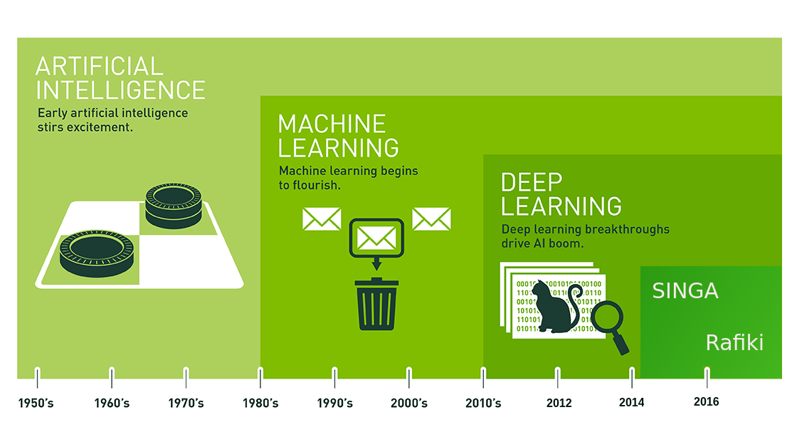
Artificial Intelligence, Machine Learning and Deep Learning
Figure from blogs.nvidia.com

Slide 3
OUTLINE
Deep Learning Platform：Apache SINGA
Deep Learning as a Service：Rafiki
Demo

Slide 4
Deep Learning Platform： Apache SINGA

Slide 5
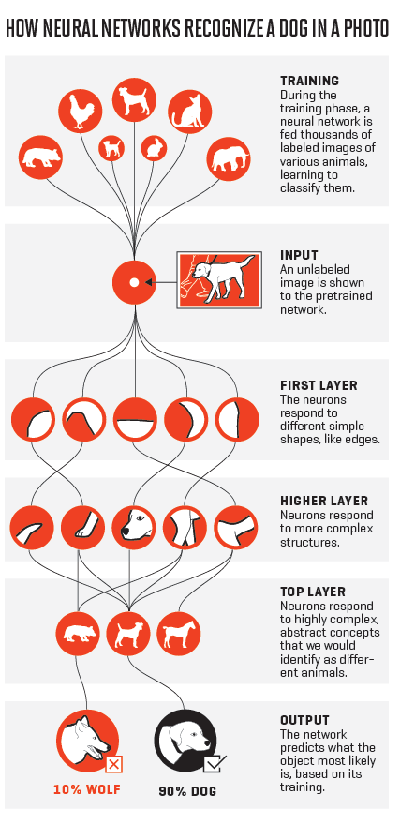
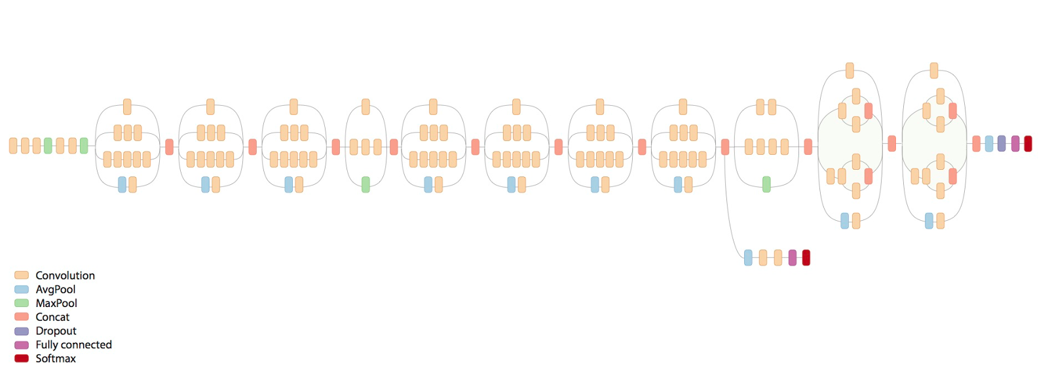
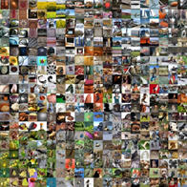
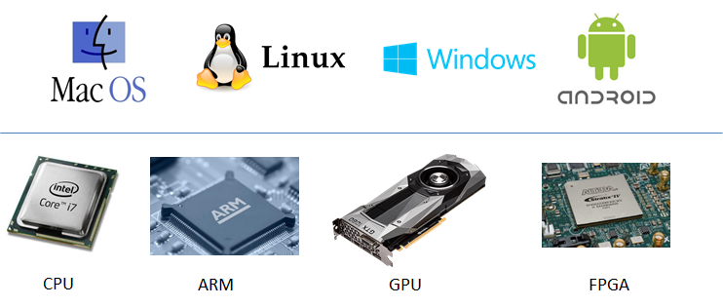
The True Story of Deep Learning
Model, data and hardwares co-create deep understandings
Figure from fortune.com/ai-artificial-intelligence-deep-machine-learning/

Slide 6
The Challenges of Deep Learning
Model Size | 150+ layers
Parameter Size | 100,000,000+
Time Cost | Up to Weeks
Hardware | GPU, DL Machine
Framework | Distributed
Deep Model
Large Dataset
Hard to Design
Hard to Train
Hard to
Deploy

Slide 7
We Built SINGA
A General Distributed Deep Learning Library
The ONLY ASF (Apache Software Foundation) project in Singapore.
We started at 2014 and have released several versions:
V1.0.0 - SEP, 2016
V0.3.0 - APR, 2016
V0.2.0 - JAN, 2016
V0.1.0 - OCT, 2015
General
Extensible
Distributed
Efficient
Notes:
we released the first distributed version on CPU cluster before them. Google and Microsoft have so much resources and so many people -- definitely we cannot compete
directly. Our system is nevertheless as fast, and could be more flexible.
We have been trying to create our niche. 1) we port Caffe models onto SINGA. Caffe is one of the oldest deep learning open sources, but it is slow and has limited functionality. However, as it has been around much longer than others, it has many users. So, we hope to attract the uers over.
2) we want to have a niche in certain application areas. We have chosen Healthcare and Finance as areas of focus. We will consciously build up the model Zoo, for example, HealthcareZoo for models that have been proposed for healthcare research.
difference: 1. programming style, singa uses declerative programming like c++, which is easier for most programmers, and is easy to debug;
TF uses declarative programming. which is good for optimization but not easy for debugging.
2. extensiblility. With the tensor and device, we can add new optimization strategies and new hardware
3. applications. we have a focus on health-care models. TF has no focus on applications.

Slide 8
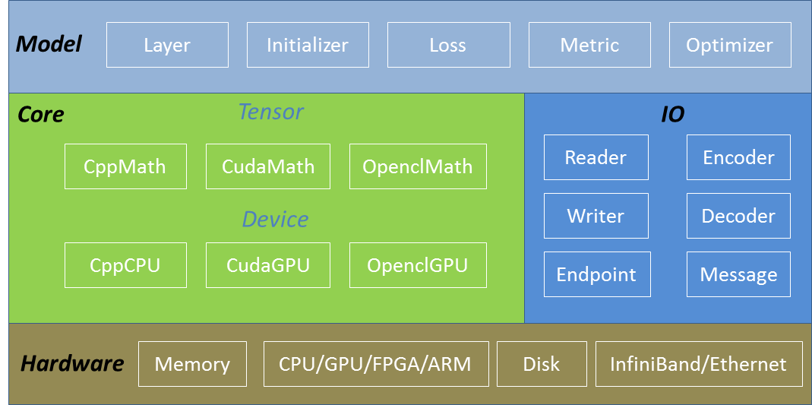
SINGA Overview
Customized by users for research and applications
Making hardwares and system architecture transparent to deep learning model developers
Heterogenous computing devices and networks

Slide 9
Deep Learning as a Service： Rafiki

Slide 10
The Practice of Deep Learning
Still hard to develop from scratch and build applications by non-experts
Three challenges: Design, Train and Deploy
Model Zoo: Design from reference models provided by experts
SINGA: Train deep learning models at scale transparently with hardwares
Rafiki: Deploy deep learning models as a service for applications

Slide 11
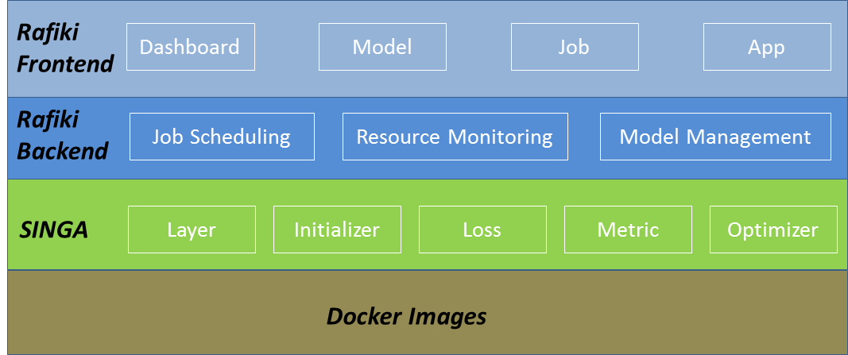
Rafiki’s System Overview

Slide 12
Rafiki Work Flow
Rafiki
run
run
load
load
run
create
download
copy
upload
modify
Model Zoo （Gist）
Normal User
Expert

Slide 13
Demo Time!
GO

Slide 14
Thank You!

