Slide 1
CS6234 Advanced Algorithms
-
Convex hull

Slide 2
Convex hull
Terminologies –
Convex hull of a set Q of points is the smallest convex polygon P for which each point in Q is either on the boundary of P or in its interior
Convex Polygon -
Line joining any two points S1 and S2, lying inside or on the Polygon P should lie completely inside the polygon.
Three or more than three collinear points are removed from the contention.

Slide 3
Convex hull
Polar angle two line segments
Angle between two line segments assuming them to be the sides of a parallelogram.
Estimated via cross products of the line segments.

Slide 4
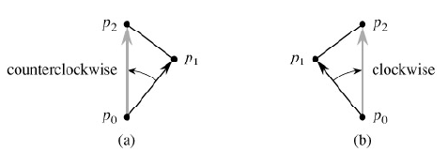
Convex hull
Left or right turn –
Moving along the line, if a person have to move left or right while transferring to the other line.
Formal definition – Angle less than180.
Turn of two consecutive line segments at the meeting point (P0-P1 and P1-P2).

Slide 5
Convex Hull
Applications
Computational Geometry
Enclosure of two intersecting objects
Image processing
GPS system

