Slide 1
Polynomial Time Approximation Schemes for Euclidean TSP
Ankush Sharma A0079739H
Xiao Liu A0060004E
Tarek Ben Youssef A0093229

Slide 2
Agenda
Reference
Terminologies – TSP & PTAS (Polynomial Time Approximation Schemes)
Algorithm – A PTAS for Euclidian TSP (2D)
Preposition and key elements
Structure Theorem & Complexity Analysis
Proof of Structure Theorem
PTAS for R^{d} (d dimensional space) – Optional
Future works
References cited

Slide 3
Reference

Slide 4
Reference
Polynomial Time Approximation Schemes for Euclidean TSP by Sanjeev Arora.

Slide 5
TSP & its Variants
&
PTAS

Slide 6
TSP & its Variants
TSP –
Given a set of n nodes and for each pair { i, j } a distance d(i, j) , TSP aims at calculating a closed path that visits each node exactly once and incurs the least cost (sum of distances along the path).
The problem is NP-hard, so is the approximation of optimum within a constant factor.

Slide 7
TSP & its Variants

Slide 8
TSP & its Variants
Metric TSP –
TSP where distances/costs satisfy the Triangle Inequality.
For all u, v, and w: d(u,w) $≤$ d(u,v) + d(v,w).
Problem is NP-hard
Euclidian TSP –
TSP in which the nodes lie in a plane R² and distance between the nodes are the Euclidian distance.
Problem is NP-hard.

Slide 9
PTAS – Polynomial time approximation scheme

Slide 10
Algorithm
-
PTAS for Euclidian TSP

Slide 11
PTAS for Euclidian TSP
Every TSP instance in R² has a $\left(1+ε\right)$approximate tour having a simple structure that “there is way to recursively partition the plane (rectangle enclosing the nodes) so that very few edges of the tour cross each line of partition”.
Computes a $(1 +ε)$approximate tour of the optimal tour in $n^{O(1/ε)}$ time.
A tour with such structure can be found using Dynamic Programming.

Slide 12
PTAS for Euclidian TSP
Definitions –
A rectangle in the analysis means an “axis aligned rectangle”.
Size of the rectangle means the longest side of the rectangle.
Bounding box of a set of nodes is the smallest rectangle enclosing the nodes.
A line separator of a rectangle is a line segment parallel to the shorter side that partitions the rectangle into two rectangles of at least 1/3rd of the area. In other words, the separator lies in the middle 1/3rd area of the rectangle.

Slide 13
PTAS for Euclidian TSP
Definitions Contd..
(1/3:2/3 tiling) – A 1/3 : 2/3-tiling of a rectangle R is a binary tree (i.e., a hierarchy) of sub-rectangles of R. The rectangle R is at the root. If the size of R <=1, than the hierarchy contains nothing. Otherwise the root contains a line separator of R and has and has two sub trees that are 1/3 : 2/3-tilings of the two rectangles into which the line separator divides.
Can think as “beginning with a rectangle, keep on partitioning the rectangle using separators recursively till the size is >1”

Slide 14
PTAS for Euclidian TSP
Definitions Contd..
Portals – A portal in a 1/3 : 2/3-tiling is any point that lies on the edge of some rectangle in the tiling. If m is any positive integer, than a set of portals P is called m-regular for the tiling if there are exactly m equidistant portals on the line separator of each rectangle of the tiling. (Assuming the end points to be portals, the line separator is partitioned in m-1 equal parts by portals on it)

Slide 15
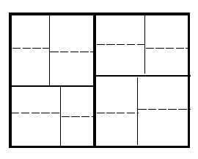
PTAS for Euclidian TSP
1/3 : 2/3 Tiling

Slide 16
PTAS for Euclidian TSP
Propositions
Let $n, e$be such that $n > 10/ε$. Than the problem of computing a $(1 +ε)$approximation to the optimum tour length in an n-node instance can be reduced in poly(n) time to problem of computing a $\left(1+9ε/10\right)$ approximation in an instance in which the size of the smallest inter-node distance is 1 unit and the bounding box is at most 1.5n².
If the length of MST is T, than optimum tour lies between T and1.5T .
Size of the bounding box is <= .75T.

Slide 17
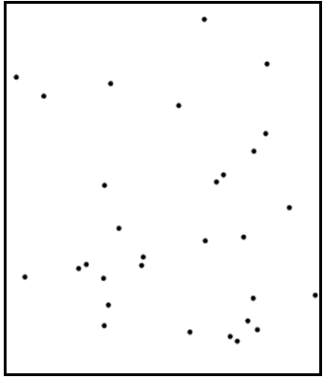
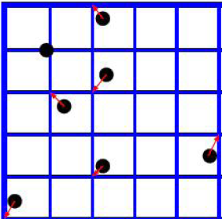
PTAS for Euclidian TSP
T/2n²
T/2n²
Updated Instance
Input Instance

Slide 18
Designing the PTAS
Intuition -
A (1 + e`) approximation algorithm can be formulated for the reduced instance. Considering the fact that the reduced instance is differing only by a factor e/10 from the reduced instance, there should lie an (1+e``) approximation algorithm for the original input instance.

Slide 19
PTAS for Euclidian TSP
Proposition Contd..
If a rectangle has width W and height H then its every 1/3 : 2/3 tilling has depth of order O(log_{1.5}(W) +log_{1.5}(H)) or O(log_{1.5}(W). (W > H so the second factor can be ignored)
If a salesman path is m-light w.r.t a 1/3:2/3 tilling of a bounding box, then the perimeter of every rectangle in the tiling is crossed by the path at most 4m times.

Slide 20
Designing the PTAS

Slide 21
Designing the PTAS
Due to Proposition 1, we w.l.o.g assume
distance of any two nodes is at least 1
bounding box has size at most $O\left(n^{2}\right)$
Structure Theorem guarantees the existence of a path $π$ such that
$π$ is a $\left(1+ε\right)$-approximation of optimal solution
$π$ is $m$-light w.r.t some tiling $S$, where $m=O\left(\frac{\log{n}}{ε}\right)$

Slide 22
Designing the PTAS
An example of 3-light tour

Slide 23
Designing the PTAS
But, how can we actually find it?
Using dynamic programming
solving the original problem by solving some smaller sub-problems
sub-problem: subtour problem
Subtour Problem

Slide 24
Designing the PTAS
Intuition: Assuming a little birdie that tells us
where is the line separator (we know immediately where the portals are when the separator is given)
the portals that are actually crossed by $π$
the order in which $π$ across these portals

Slide 25
Designing the PTAS
However we don’t have such a birdie in reality
Simulate the birdie by brute-force calculation!

Slide 26
Designing the PTAS
An instance of subtour problem can be specified by following 3 things
(a) the rectangle
(b) multi-set of the 2k portals (that are actually used) on its perimeter
(c) a partition of the 2k portals into k pairs
Each table entry corresponds to an instance of subtour problem

Slide 27
Designing the PTAS
Bound the table size: how many subtour problem do we have?
# of combinatorially distinct rectangle: $\left(\begin{matrix}n \\ 4\end{matrix}\right)$
# of $2k$ portals on the perimeter of rectangle: $O\left(n^{8}\right)×2^{4m+2k}$
# of pairing $2k$ portals: valid pairing corresponds to balanced arrangement of parentheses, which is $k$th Catalan number and $≤2^{2k}≤2^{4m}$
table size: $n^{O\left(\frac{1}{ε}\right)}$

Slide 28
Designing the PTAS
Building the table from bottom to up
Rectangles contain $≤4m$ nodes: brute-force
Any other rectangles: enumerate all sub-problems
all $≤n$possible combinatorially distinct line separators
all $j≤m$ portals on the line separator that the path crosses them
all possible orders of portals

Slide 29
Designing the PTAS
The # of possible sub-problems is bounded by $poly\left(n\right)×2^{O(m)}$
Each sub-problems can be determined by looking up table
Thus the time to build one entry is $poly\left(n\right)×2^{O(m)}=n^{O\left(\frac{1}{ε}\right)}$
The total time is $n^{O\left(\frac{1}{ε}\right)}×table size=n^{O\left(\frac{1}{ε}\right)}$

Slide 30
Cited References
http://www.corelab.ntua.gr/courses/approx-alg/material/Euclidean%20TSP.pdf
http://faculty.math.tsinghua.edu.cn/~jxie/courses/algorithm/TSP-PTAS.ppt
http://www.cse.yorku.ca/~aaw/Zambito/TSP_Euclidean_PTAS.pdf

