Slide 1
Stream Codes for Data Compression
Yehong, Wang Wei, Wang Sheng, Jinyang, Gordon

Slide 2
Outline
Introduction
Overview of Huffman Coding
Arithmetic Coding
Encoding and Decoding
Probabilistic Model
(break)
Loss Analysis
Lempel-Ziv Coding
Summary

Slide 3
Why Data Compression?
Make optimal use of limited storage space
Save time and help to optimize resources
In sending data over communication line: less time to transmit and less storage to host

Slide 4
Data Compression
Encoding information using fewer bits than the original representation
Data Compression
Lossless methods
(text, image)
Lossy methods
(audio, video, image)
Huffman
Arithmetic
Lempel-Ziv
JPEG
MPEG
MP3

Slide 5
Outline
Introduction
Overview of Huffman Coding
Arithmetic Coding
Encoding and Decoding
Probabilistic Model
(break)
Loss Analysis
Lempel-Ziv Coding
Summary

Slide 6
Huffman Coding
The key idea
Assign fewer bits to symbols that occur more frequently
Assign more bits to symbols appear less often
Algorithm:
Make a leaf node for each code symbol
Add the generation probability of each symbol to the leaf node
Take the two leaf nodes with the smallest probability and connect them into a new node
Add 1 or 0 to each of the two branches
The probability of the new node is the sum of the probabilities of the two connecting nodes
If there is only one node left, the code construction is completed. If not, go back to (2)

Slide 7
Huffman Coding
Example:
Character | a | b | c | d | e
Probability | 0.08 | 0.25 | 0.12 | 0.24 | 0.31
0.44
0.20
a
b
c
d
e
a
c
b
d
e
a
c
d
b
e
0.08
0.25
0.12
0.24
0.31
0.08
0.12
0.25
0.24
0.31
0.08
0.12
0.24
0.25
0.31
(a)
(b)
(c)
1.00
0
1
a: 000
b: 10
c: 001
d: 01
e: 11
0.44
0.56
0
1
0
1
a
c
d
b
e
a
c
d
b
e
0
1
d
b
e
0.08
0.12
0.24
0.25
0.31
0.08
0.12
0.24
0.25
0.31
a
c
(d)
(d)

Slide 8
Huffman Coding
For an ensemble, the Huffman algorithm produces an optimal symbol code

Slide 9
Disadvantages of Huffman Coding
For an ensemble, the Huffman algorithm produces an optimal symbol code
Unchanging ensemble: Huffman code is optimal
In practical, ensemble changes
Brute-force approach: recompute
Code remain fixed: suboptimal

Slide 10
Disadvantages of Huffman Coding
For an ensemble, the Huffman algorithm produces an optimal symbol code
Unchanging ensemble: Huffman code is optimal
In practical, ensemble changes
Brute-force approach: recompute
Code remain fixed: suboptimal
Symbol code: encode one source symbol at a time
At least one bit per character
Extra bit problem

Slide 11
Disadvantages of Huffman Coding
The extra bit
Long strings of characters maybe highly predictable
For example: in the context “strings of ch”, one might predict the next symbols to be ‘aracters’ with a probability of 0.99
Traditional Huffman code : at least one bit per character
For ‘aracters’, 8 bits, but no information is being conveyed

Slide 12
Data Compression
Lossless methods
(text, image)
Lossy methods
(audio, video, images)
Huffman
Arithmetic
Lempel-Ziv
JPEG
MPEG
MP3
Stream code:
encode huge strings of N source symbols
dispenses with the restriction that each symbol must be translated into an integer number of bits
Symbol code: encode one source symbol at a time
We don’ t want a symbol code !

Slide 13
Outline
Introduction
Overview of Huffman Coding
Arithmetic Coding
Encoding and Decoding
Probabilistic Model
(break)
Loss Analysis
Lempel-Ziv Coding
Summary

Slide 14
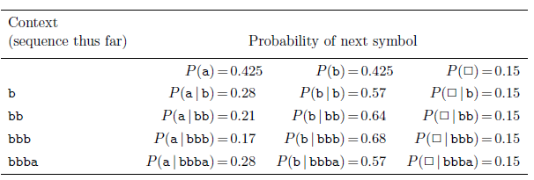
Arithmetic Coding
Assume we have a probability model, which gives the probability for all possible strings.
Arithmetic encoding is to find a bit code according to the probability of the input string.

Slide 15
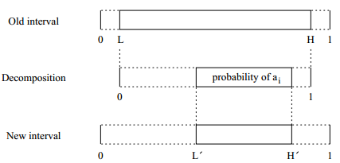
Arithmetic Encoding
Basic algorithm:
Find an interval for the probability of the input string, then get a shortest binary code for that interval.
Steps:
We begin with a current interval [L, H) initialized to [0, 1).
For each input symbol, we perform two steps :
(a) Subdivide the current interval into subintervals, one for each possible symbol. The a subinterval is proportional to the probability that the symbol will come next.
(b) Select the subinterval of the symbol that actually occurs next, and make it the new current interval.
Output enough bits to distinguish the final current interval from all other possible final intervals.
P(a₁,a₂,…a_{i-1})
P(a_{i}|a₁,a₂,…a_{i-1})
P(a₁,a₂,…a_{i-1}, a_{i})=
P(a₁,a₂,…a_{i-1}) *P(a_{i}|a₁,a₂,…a_{i-1})

Slide 16
Arithmetic Encoding
Example:
Input : bbba
1
0.15
0.85
0.425
b
0.425
0.425
a
0

Slide 17
Arithmetic Encoding
Example:
Input : bbba
1
0.15
0.85
0.85
0.425*0.15
0.78625
0.425
b
b
0.425*0.57
0.425
0.544
0.425*0.28
a
0.425
a
0.425
0

Slide 18
Arithmetic Encoding
Example:
Input : bbba
1
0.15
0.85
0.85
0.425*0.15
0.78625
0. 78625
b
0.425*0.57*0.15
0.425
0.7499125
b
0.425*0.57
0.425*0.57*0.64
b
0.425
0.544
0.425*0.28
a
0.5948725
0.425
a
0.425
0.425*0.57*0.21
a
0. 544
0

Slide 19
Arithmetic Encoding
Example:
Input : bbba
1
0.15
0.85
0.85
0.425*0.15
0.78625
0. 78625
b
0.425*0.57*0.15
0.425
0.7499125
b
0.425*0.57
0.7499125
0.425*0.57*0.64
0.7266565
b
0.425
0.544
b
0.425*0.28
a
0.5948725
a
0.6212293
0.425
0.425
0.425*0.57*0.21
a
a
0. 544
0.5948725
0

Slide 20
Arithmetic Encoding
Example:
Input : bbba
1
0.15
0.85
0.85
0.425*0.15
0.78625
0. 78625
b
0.425*0.57*0.15
0.425
0.7499125
b
0.425*0.57
0.7499125
0.7266565
0.6212293
0.425*0.57*0.64
b
0.425
0.544
0. 61727578
b
b
0.425*0.28
a
0.5948725
a
0.6212293
a
0.425
0.425
0.425*0.57*0.21
a
a
0. 544
0.5948725
0
[0. 61727578,0.6212293)

Slide 21
Arithmetic Encoding
Interval for binary code
0110:[0.01100,0.01101]=[0.0110,0.0111)
0.01: [0.010,0.011]=[0.01,0.10)
Find a shortest binary code whose interval is inside the final interval
[0.100111101,0.100111110) [0. 61727578 ,0.6212293)
Final binary code:100111101
In practice, the bit code is computed on the fly. Otherwise, we have to compute the probability of the whole file to get the bit code[1].

Slide 22
Arithmetic Decoding
Example:
Input : [0.100111101,0.100111110) = [0.619140625, 0.62109375)
1
0.15
0.85
0.85
0.425*0.15
0.78625
0. 78625
b
0.425*0.57*0.15
0.425
0.7499125
b
0.425*0.57
0.7499125
0.7266565
0.6212293
0.425*0.57*0.64
b
0.425
0.544
0. 61727578
b
b
0.425*0.28
a
0.5948725
a
0.6212293
a
0.425
0.425
0.425*0.57*0.21
a
a
0. 544
0.5948725
0

Slide 23
Outline
Introduction
Overview of Huffman Coding
Arithmetic Coding
Encoding and Decoding
Probabilistic Model
(break)
Loss Analysis
Lempel-Ziv Coding
Summary

Slide 24
Why does it Work
More bits are needed to express a number in a smaller interval
When a new symbol is encoded
Interval becomes smaller
High-prob symbol do not decrease interval size significantly, therefore need fewer bits than low-prob symbols
A good probabilistic model is important
The decoded messages will match the number of bits given by entropy, which for long messages is very close to optimal

Slide 25
Separation between modeling and coding
Given an interval [a,b] and a probability function P(x)
For any possible symbol x as the next symbol, the sub-interval [a’,b’] can be determined
Function P(x) could be adjusted at any point of time
P(x) can be a static distribution of all symbols
P(x) can also be a function of encountered symbols
The change of P(x) will not affect encode or decode
Since the same P(x) can be calculated in both encode and decode phase

Slide 26
Choices of Probabilistic Model
Two types of probabilistic models can be used
Static probabilistic model
Adaptive probabilistic model
Static probabilistic model
Preprocess the data and calculate symbol statistics
Calculated probabilities reflecting the occurance of each symbol in the whole data set

Slide 27
Choices of Probabilistic Model
What if we have no idea about the distribution of incoming data?
Since the probabilities can change over time, we can make it predictive to meet the distribution of incoming data
Adaptive probabilistic model
Give equal initial probability for each symbol
Adjust when a new symbol comes

Slide 28
Adaptive Probabilistic Model
Input Stream
Output Stream
Probability Adjustment
Input Symbol
Probabilistic Model
New Interval
Current Interval

Slide 29
Efficiency of Dynamic Probabilistic Model
The amount of computation is linear to the input size
For a input string of length N
There are N rounds of probability adjustment
In each round, |A| probabilities are needed
In total, N|A| conditional probabilities are computed
The probabilities are computed only when the context actually encountered

Slide 30
A Simple Bayesian Model
Bayesian model is a natural choice to predict
If the source alphabet only have {a,b,□}
Assign a probability of 0.15 to □
Assign remaining 0.85 to {a,b}, following Laplace’s rule:
is the number of times that a has occurred

Slide 31
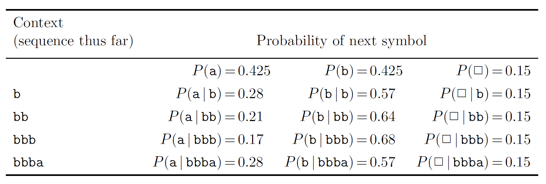
A Simple Bayesian Model
is the number of times that a has occurred

Slide 32
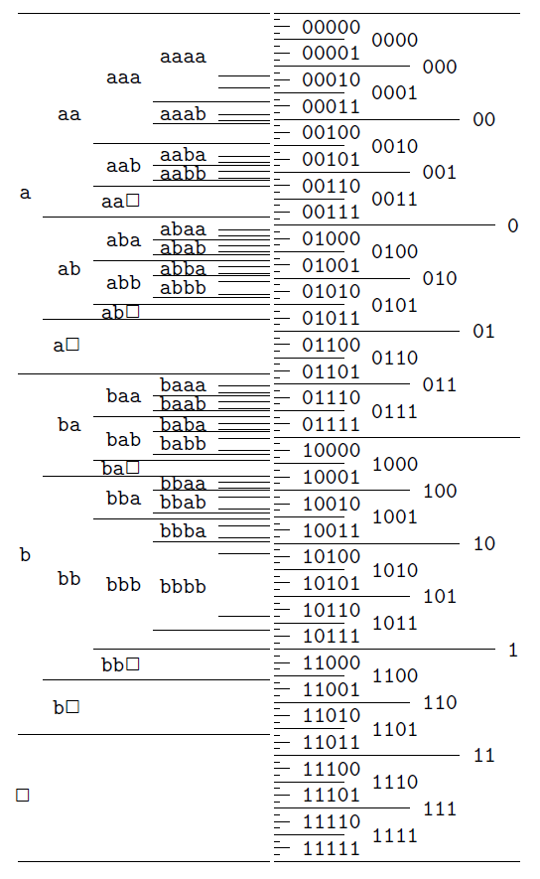
A Simple Bayesian Model
Every possible message has a unique interval representation
Shorter messages have larger interval, need fewer bits
High-probability symbols have large interval

Slide 33
Flexibility of Arithmetic Code
Can handle any source alphabet and encoded alphabet
The size of source alphabet and encoded alphabet can change over time
Simply divide interval into one more sub-interval when a new type of symbol comes
Can use any probability distribution, which can change utterly from context to context
Adaptive probabilistic model

Slide 34
Other Adaptive Probabilistic Model
Symbol distribution changes over time
Symbols occurred too long ago have no help
distribution of recent symbols can help to predict
Count the frequency of last m symbols
Utilize context information
In most real-world cases, symbols have high correlation
Probability differs with different context information
Use the conditional probability of current context to predict

Slide 35
Context Information
In English, the probability of h is relatively low. However, if the last letter is t, then the probability is very high.
See what is the next letter after abl in NewYork Times

Slide 37
1(n)-order Arithmetic Coding
Using the conditional probability under the observation of the last 1(n) letter(s)
$P\left(h\right)=0.0457$
$P\left(h|t\right)=0.273$
$P\left(u\right)=0.0228$
$P\left(u|q\right)≈1$

Slide 38
Smoothing Method
Similar to 0-order arithmetic coding, but data may be sparser.
Using a combination of 0-order and 1-order observations
Encoding and decoding should use the same probability estimation algorithm

Slide 39
Combination Estimation
One possible final estimation of $\hat{P(a|b)}$:
$\hat{P(a|b)}\text{=}\frac{M}{M+n∗\hat{P(b)}}\hat{P\left(a\right)}+\frac{n∗\hat{P(b)}}{M+n∗\hat{P(b)}}\hat{\frac{P(a,b)}{\hat{P(b)}}}$
Number of observation is $n∗\hat{P(b)}$
More observations, $\hat{\frac{P(a,b)}{\hat{P(b)}}}$ is more accurate
Change from $\hat{P\left(a\right)}$ to $\hat{\frac{P(a,b)}{\hat{P(b)}}}$ with the increment of observations

Slide 40
Outline
Introduction
Overview of Huffman Coding
Arithmetic Coding
Encoding and Decoding
Probabilistic Model
(break)
Loss Analysis
Lempel-Ziv Coding
Summary

Slide 41
Loss Analysis
Fix Length (with distribution knowledge)
At most 1 bits than Shannon Optimal
Uncertain Length
Lower Bound O(log n)
O(log n) for arithmetic coding
Using O(log n) present the length
End of File symbol

Slide 42
Fix Length Loss Analysis
No End of File Symbol here
Source alphabet $A_{X}=\{a_{1},…,a_{m}\}$
With distribution knowledge $P(a_{1}) \text{...}P(a_{m})$
For a string $a_{i_{1}}a_{i_{2}}a_{i_{3}}…a_{i_{n}}$ where $i_{j}∈\left[1,m\right]$
The length of interval is : $1∗\prod_{j=1}^{n}{P(a_{i_{j}}) }$

Slide 43
Fix Length Loss Analysis
Bit Presentation for $1∗\prod_{j=1}^{n}{P(a_{i_{j}}) }$
To find a point in the interval
Using $\left\lceil −log⁡(\prod_{j=1}^{n}{P(a_{i_{j}})})\right\rceil$bits
We can present $2^{\left\lceil −log⁡(\prod_{j=1}^{n}{P\left(a_{i_{j}}\right) })\right\rceil }$ points with equal interval in $[0,1)$
The interval is small than $1∗\prod_{j=1}^{n}{P\left(a_{i_{j}}\right) }$
At least one point is in the string interval

Slide 44
Fix Length Loss Analysis
Shannon Entropy:
$−\sum_{i=1}^{n}{\log{P(a_{i_{j}})}}$
Arithmetic code:
$\left\lceil −log⁡(\prod_{j=1}^{n}{P(a_{i_{j}})})\right\rceil$
$=\left\lceil −\sum_{i=1}^{n}{\log{P(a_{i_{j}})}}\right\rceil$
The best integer number of bits

Slide 45
Lower Bound for Uncertain Length String
Consider a string with alphabet $A_{X}=\{a_{1}\}$
Shannon entropy is zero
However, we have to present the number of characters
The number of characters has information!
At least log n bits to represent the number of characters for string of length n

Slide 46
Arithmetic Coding
Solution 1: Represent the length of string in the first
$O(\log{n})$
$2\log{n}+1$ bits
$\underset{\log{n}}{\underbrace{11…1}}+0+\underset{\log{n}}{\underbrace{binary presentation for n}}$
$2\log{\log{n}}+1+\log{n}$
Represent the first $\log{n}$ $1$ using the same strategy
$\underset{\log{\log{n}}}{\underbrace{11…1}}+0+\underset{\log{\log{n}}}{\underbrace{binary for\log{n}}}+\underset{\log{n}}{\underbrace{binary for n}}$

Slide 47
Arithmetic Coding
Solution 2: Using the End of File Symbol $∎$
The probability of $∎$ in each step:
$\frac{1}{M},\frac{1}{M+1},\frac{1}{M+2},…\frac{1}{M+n−1},$
Interval Length Loss in each non-stop step i(compare the interval length):
$\frac{M+i−2}{M+i−1} ∗length without ∎$
Interval Length Loss in all non-stop step:
$\prod_{i=1}^{n}{\frac{M+i−2}{M+i−1}=}\frac{M}{M+n−1}$

Slide 48
Arithmetic Coding
Solution 2: Using the End of File Symbol $∎$
Interval Length Loss in the final stop step:
$\frac{1}{M+n}$
Total Interval Length:
$\frac{1}{M+n}\frac{M}{M+n−1}∗no ∎ length$
Total Bit Loss:
$−\log\left(\frac{1}{M+n}\frac{M}{M+n−1}\right)=O(\log{n})$

Slide 49
Outline
Introduction
Overview of Huffman Coding
Arithmetic Coding
Encoding and Decoding
Probabilistic Model
(break)
Loss Analysis
Lempel-Ziv Coding
Summary

Slide 50
Introduction
Lempel-Ziv coding is a lossless data compression algorithm
Algorithm is easy to implement
The compression is universal. It does not need to know any extra information before hand. The receiver does not need to know the table constructed by the transmitter as well
Belongs to the category of dictionary coders for lossless compression technique.

Slide 51
Applications
Compression of data in most computers. zip , gzip , etc…
GIF images are compressed using the Lempel-Ziv encoding techniques to reduce the file size without decreasing the quality of the visual quality
It may also be used in PDF files

Slide 52
Principle
Works on the concept that there will be repetition in phrases, words and parts of word
Extract out these repetitions and then assign a codeword to them
Use this codeword to represent other occurrences in the future

Slide 53
Algorithm
w = “”
while (there is input)
{ K = next symbol from input
if (wK is in the dictionary){ w = wK; } else { output (index(w),K); add wK to the dictionary; w = “”; } }

Slide 54
Encoding Example
Consider the sequence : AABABBBABAABABBBABBABB
A|ABABBBABAABABBBABBABB
A|AB|ABBBABAABABBBABBABB
A|AB|ABB|BABAABABBBABBABB
A|AB|ABB|B|ABAABABBBABBABB

Slide 55
Encoding Example
A|AB|ABB|B|ABAABABBBABBABB
A|AB|ABB|B|ABA|ABABBBABBABB
A|AB|ABB|B|ABA|ABAB|BBABBABB
A|AB|ABB|B|ABA|ABAB|BB|ABBABB
A|AB|ABB|B|ABA|ABAB|BB|ABBA|BB

Slide 56
Encoding Example
Dictionary Construction at sender’s end
Number | Input | Output | Binary Output
0 | - | - | -
1 | A | (0,0) | (0,0)
2 | AB | (1,1) | (1,1)
3 | ABB | (2,1) | (10,1)
4 | B | (0,1) | (0,1)
5 | ABA | (2,0) | (10,0)
6 | ABAB | (5,1) | (101,1)
7 | BB | (4,1) | (100,1)
8 | ABBA | (3,0) | (11,0)
9 | BB | (7) | (111)

Slide 57
Decoding Example
Consider the sequence that was compressed earlier : (0,0) , (1,1) , (10,1) , (0,1) , (10,0) , (101,1) , (100,1) , (11,0) , (111)
This sequence will be received at the receiver’s end
We will decompress the sequence to retrieve the original message

Slide 58
Decoding Example
Dictionary Construction at receiver’s end : Recall that A = 0 and B = 1
Number | Input | Output | Message
0 | - | - | -
1 | (0,0) | (0,0) | A
2 | (1,1) | (1,1) | AB
3 | (10,1) | (2,1) | ABB
4 | (0,1) | (0,1) | B
5 | (10,0) | (2,0) | ABA
6 | (101,1) | (5,1) | ABAB
7 | (100,1) | (4,1) | BB
8 | (11,0) | (3,0) | ABBA
9 | (111) | (7) | BB

Slide 59
Does compression occur ?
Of course , after all this , we want to really ask ourselves , does it really compress at all ?
Let n denote the length of the message that we want to send
Let c(n) denote the number of phrases in the sequence. Think of phrases as the number of entry in the constructed dictionary
Then the total number of bits m in the dictionary is given by : m = c(n) [log c(n) + 1]

Slide 60
Does compression occur ?
Lemma 1 (Lempel-Ziv) : C(n) satisfies the following :
as

Slide 61
Proof of Lemma
Let’s take a look at the maximum number of distinct parses that a string of length n can be parsed into
These are the ones in which the phrases are all the possible strings of length at most k
E.g., for k = 1 , we have 0|1
For k = 2 , one of them is 0|1|00|01|10|11 with length 10
For k =3 , one of them is 0|1|00|01|10|11|000|001|010|011|100|101|110|111 which has length 34

Slide 62
Proof of Lemma (Cont)
In general we have
Therefore if we let C(n_{k}) to denote the number of distinct phrases in the string of length n_{k}, we have :
where 2^{i} denotes the number of partitions with string of length i

Slide 63
Proof of Lemma (Cont)
Then we bound C(n_{k}) as follows :
Now let n be arbitrary and k be such that and let

Slide 64
Proof of Lemma (Cont)
We will now try to bound k in terms of n

Slide 65
Proof of Lemma (Cont)

Slide 66
Weakness of Lempel-Ziv
Generally efficient for long messages or files
When short messages or messages that are too random, we might end up sending more bits than contained in the original message

Slide 67
Outline
Introduction
Overview of Huffman Coding
Arithmetic Coding
Encoding and Decoding
Probabilistic Model
(break)
Loss Analysis
Lempel-Ziv Coding
Summary

Slide 68
Summary
Huffman coding (symbol code)
Two problems:
Can not handle changing ensemble
Need extra bit
Stream code
Arithmetic coding
Lempel-Ziv coding

Slide 69
Summary
 | Arithmetic Code | Lempel-Ziv Code
Code Types | Stream Code (Large numbers of source symbols are coded into a smaller number of bits)
Basic Idea | Divide Interval | Build dictionary
Modeling and Coding | Separated Any model can be coded | No opportunity for explicit modeling
Context Information | Can be considered Not forced | Highly dependent on context

Slide 70
References
http://www-math.mit.edu/~shor/PAM/lempel_ziv_notes.pdf
http://www.cmlab.csie.ntu.edu.tw/~itct/slide/Data_Compression_Lempel-Ziv_Coding.pdf
Information Theory, Inference, and Learning Algorithms. David J.C. Maykay. Cambridge University Press

Slide 71
Q & A

