Slide 1
Streaming Algorithms
CS6234 – Advanced Algorithms
NARMADA SAMBATURU
SUBHASREE BASU
ALOK KUMAR KESHRI
RAJIV RATN SHAH
VENKATA KIRAN YEDUGUNDLA
VU VINH AN

Slide 2
Overview
Introduction to Streaming Algorithms
Sampling Techniques
Sketching Techniques
Break
Counting Distinct Numbers
Q&A

Slide 3
Overview
Introduction to Streaming Algorithms
Sampling Techniques
Sketching Techniques
Break
Counting Distinct Numbers
Q&A

Slide 4
What are Streaming algorithms?
Algorithms for processing data streams
Input is presented as a sequence of items
Can be examined in only a few passes (typically just one)
Limited working memory

Slide 5
Same as Online algorithms?
Similarities
decisions to be made before all data are available
limited memory
Differences
Streaming algorithms – can defer action until a group of points arrive
Online algorithms - take action as soon as each point arrives

Slide 6
Why Streaming algorithms
Networks
Up to 1 Billion packets per hour per router. Each ISP has hundreds of routers
Spot faults, drops, failures
Genomics
Whole genome sequences for many species now available, each megabytes to gigabytes in size
Analyse genomes, detect functional regions, compare across species
Telecommunications
There are 3 Billion Telephone Calls in US each day, 30 Billion emails daily, 1 Billion SMS, IMs
Generate call quality stats, number/frequency of dropped calls
Infeasible to store all this data in random access memory for processing.
Solution – process the data as a stream – streaming algorithms

Slide 7
Basic setup
Data stream: a sequence A = <a₁, a₂,..., a_{m}>, where the elements of the sequence (called tokens) are drawn from the universe [n] = {1, 2, ..., n}
Aim - compute a function over the stream, eg: median, number of distinct elements, longest increasing sequence, etc.
Target Space complexity
Since m and n are “huge,” we want to make s (bits of random access memory) much smaller than these
Specifically, we want s to be sublinear in both m and n.
The best would be to achieve

Slide 8
Quality of Algorithm

Slide 9
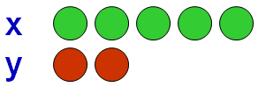
Streaming Models - Cash Register Model
Time-Series Model
Only x-th update is processed
i.e., A[x] = c[x]
Cash-Register Model: Arrivals-Only Streams
c[x] is always > 0
Typically, c[x]=1
Example: <x, 3>, <y, 2>, <x, 2> encodes the arrival of
3 copies of item x,
2 copies of y,
2 copies of x.
Could represent, packets in a network, power usage

Slide 10
Streaming Models – Turnstile Model
Turnstile Model: Arrivals and Departures
Most general streaming model
c[x] can be >0 or <0
Example:
<x, 3>, <y,2>, <x, -2> encodes final state of <x, 1>, <y, 2>.
Can represent fluctuating quantities, or measure differences between two distributions

Slide 11
Overview
Introduction to Streaming Algorithms
Sampling Techniques
Sketching Techniques
Break
Counting Distinct Numbers
Q&A

Slide 12
Sampling
Idea
A small random sample S of the data is often enough to represent all the data
Example
To compute median packet size
Sample some packets
Present median size of sampled packets as true median
Challenge
Don’t know how long the stream is

Slide 13
Reservoir Sampling - Idea
We have a reservoir that can contain k samples
Initially accept every incoming sample till reservoir fills up
After reservoir is full, accept sample $k+i$ with probability $k/k+i$
This means as long as our reservoir has space, we sample every item
Then we replace items in our reservoir with gradually decreasing probability

Slide 14
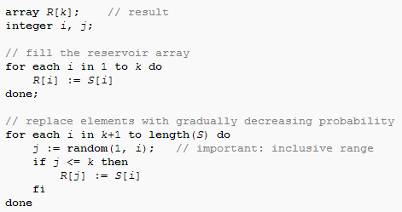
Reservoir Sampling - Algorithm

Slide 15
Probability Calculations

Slide 16
Probability of any element to be included at round t
Let us consider a time t > N.
Let the number of elements that has arrived till now be N_{t}
Since at each round, all the elements have equal probabilities, the probability of any element being included in the sample is N/ N_{t}
Observation:
Hence even though at the beginning a lot of elements get replaced, with the increase in the stream size, the probability of a new record evicting the old one drops.

Slide 17
Probability of any element to be chosen for the final Sample
Let the final stream be of size N_{T}
Claim:
The probability of any element to be in the sample is N/ N_{T}

Slide 18
Probability of survival of the initial N elements
Let us choose any particular element out of our$N$initial elements.($eN$ say)
The eviction tournament starts after the arrival of the $(N+1)st$element
Probability that $(N+1)st$element is chosen is $N/(N+1)$
Probability that if$(N+1)st$element is chosen by evicting $eN$is $1/N$
Hence probability of$eN$being evicted in this case is
$$(1/N) X (N/(N+1)) = 1/N+1$$
Probability that $eN$ survives $= 1−(1/(N+1))= N/(N+1)$
Similarly the case e_{N} survives when (N+2)^{nd} element arrives = (N+1)/ (N+2)
The probability of e_{N} surviving two new records
= (N/(N+1)) X ((N+1)/ (N+2))
The probability of e_{N} surviving till the end
= (N/(N+1)) X ((N+1)/ (N+2)) X ……. X ((N_{T} -1)/ N_{T}) = N/ N_{T}

Slide 19
Probability of survival of the elements after the initial N
For the last arriving element to be selected, the probability is N/ N_{T}
For the element before the last, the probability of selection
= N/ (N_{T} -1)
The probability of the last element replacing the last but one element
= (N/ N_{T}) X (1/N) = 1/ N_{T}
The probability that the last but one element survives = 1- 1/ N_{T} = (N_{T} -1)/ N_{T}
The probability that the last but one survives till the end
= (N/( N_{T} -1)) X (N_{T} -1)/ N_{T} = N/ N_{T}
Similarly we can show that the probability of survival of any element in the sample is N/ N_{T}

Slide 20
Calculating the Maximum Reservoir Size

Slide 21
Some Observations
Initially the reservoir contains N elements
Hence the size of the reservoir space is also N
New records are added to the reservoir only when it will replace any element present previously in the reservoir.
If it is not replacing any element, then it is not added to the reservoir space and we move on to the next element.
However we find that when an element is evicted from the reservoir, it still exists in the reservoir storage space.
The position in the array that held its pointer, now holds some other element’s pointer. But the element is still present in the reservoir space
Hence the total number of elements in the reservoir space at any particular time ≥ N.

Slide 22
Maximum Size of the Reservoir
The new elements are added to the reservoir with initial probability N/N+1
This probability steadily drops to N/ N_{T}
The statistical expectation of the size S of the reservoir space can thus be calculated as
N + (N/N+1) + ……. + (N/ N_{T})
Overestimating it with an integral the reservoir size can be estimated as
$$\int_{x=N}^{x=NT}{\frac{N dx}{x}=N\ln{(NT/N)}}$$
Thus, reservoir estimate is:
S = N[1 + ln (N_{T}/N)]
Hence we find that the space needed is O(N log(N_{T}))

Slide 23
Priority Sample for Sliding Window

Slide 24
Reservoir Sampling Vs Sliding Window
Reservoir Sampling
Works well when we have only inserts into a sample
The first element in the data stream can be retained in the final sample
It does not consider the expiry of any record
Sliding Window
Works well when we need to consider “timeliness” of the data
Data is considered to be expired after a certain time interval
“Sliding window” in essence is such a random sample of fixed size (say k) “moving” over the most recent elements in the data stream

Slide 25
Types of Sliding Window
Sequence-based
-- they are windows of size k moving over the k mist recently arrived data. Example being chain-sample algorithm
Time-stamp based
-- windows of duration t consist of elements whose arrival timestamp is within a time interval t of the current time. Example being Priority Sample for Sliding Window

Slide 26
Principles of the Priority Sampling algorithm
As each element arrives, it is assigned a randomly-chosen priority between 0 and 1
An element is ineligible if there is another element with a later timestamp and higher priority
The element selected for inclusion in the sample is thus the most active element with the highest priority
If we have a sample size of k, we generate k priorities p₁ , p₂ , …… p_{k} for each element. The element with the highest p_{i} is chosen for each i

Slide 27
Memory Usage for Priority Sampling
We will be storing only the eligible elements in the memory
These elements can be made to form right spine of the datastructure “treap”
Therefore expected memory usage is O(log n), or O(k log n) for samples of size k
Ref:
C. R. Argon and R.G. Seidel, Randomised Search Trees, Proc of the 30th IEEE Symp on Foundations of Computer Science, 1989, pp 540-545
K. Mulmuley, Computational Geometry: An Introduction through Ramdomised Algorithms, Prentice Hall

Slide 28
References
Crash course - http://people.cs.umass.edu/~mcgregor/slides/10-jhu1.pdf
Notes
http://www.cs.mcgill.ca/~denis/notes09.pdf
http://www.cs.dartmouth.edu/~ac/Teach/CS49-Fall11/Notes/lecnotes.pdf
http://en.wikipedia.org/wiki/Streaming_algorithm
Reservoir Sampling
Original Paper - http://www.mathcs.emory.edu/~cheung/papers/StreamDB/RandomSampling/1985-Vitter-Random-sampling-with-reservior.pdf
Notes and explanations
http://en.wikipedia.org/wiki/Reservoir_sampling
http://blogs.msdn.com/b/spt/archive/2008/02/05/reservoir-sampling.aspx
Paul F Hultquist, William R Mahoney and R.G. Seidel, Reservoir Sampling, Dr Dobb’s Journal, Jan 2001, pp 189-190
B Babcock, M Datar, R Motwani, SODA '02: Proceedings of the thirteenth annual ACM-SIAM symposium on Discrete algorithms, January 2002
Zhang Longbo, Li Zhanhuai, Zhao Yiqiang, Yu Min, Zhang Yang , A priority random sampling algorithm for time-based sliding windows over weighted streaming data , SAC '07: Proceedings of the 2007 ACM symposium on Applied computing, May 2007

Slide 29
Overview
Introduction to Streaming Algorithms
Sampling Techniques
Sketching Techniques
Break
Counting Distinct Numbers
Q&A

Slide 30
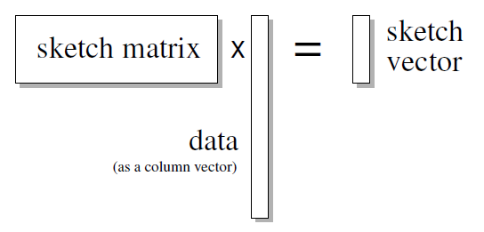
Sketching
Sketching is another general technique for processing stream
Fig: Schematic view of linear sketching

Slide 31
How Sketching is different from Sampling
Sample “sees” only those items which were selected to be in the sample whereas the sketch “sees” the entire input, but is restricted to retain only a small summary of it.
There are queries that can be approximated well by sketches that are provably impossible to compute from a sample.

Slide 32
Bloom Filter

Slide 33
Set Membership Task
x: Element
S: Set of elements
Input: x, S
Output:
True (if x in S)
False (if x not in S)

Slide 34
Bloom Filter
Consists of
vector of n Boolean values, initially all set false
k independent hash functions, $h_{0}$, $h_{1},$ … , $h_{k−1},$
each with range {0, 1, … , n-1}
F | F | F | F | F | F | F | F | F | F
0 | 1 | 2 | 3 | 4 | 5 | 6 | 7 | 8 | 9
n = 10

Slide 35
Bloom Filter
For each element s in S, the Boolean value with positions $h_{0}\left(s\right)$, $h_{1}\left(s\right)$, … , $h_{k−1}\left(s\right)$ are set true.
$$s_{1}$$
$h_{0}\left(s_{1}\right)$ = 1
$h_{2}\left(s_{1}\right)$ = 6
$h_{1}\left(s_{1}\right)$ = 4
F | T | F | F | T | F | T | F | F | F
0 | 1 | 2 | 3 | 4 | 5 | 6 | 7 | 8 | 9
k = 3

Slide 36
Bloom Filter
For each element s in S, the Boolean value with positions $h_{0}\left(s\right)$, $h_{1}\left(s\right)$, … , $h_{k−1}\left(s\right)$ are set true.
$$s_{1}$$
$$s_{2}$$
$h_{0}\left(s_{2}\right)$ = 4
$h_{2}\left(s_{2}\right)$ = 9
$h_{1}\left(s_{2}\right)$ = 6
F | T | F | F | T | F | T | T | F | T
0 | 1 | 2 | 3 | 4 | 5 | 6 | 7 | 8 | 9
k = 3

Slide 37
Error Types
False Negative
Never happens for Bloom Filter
False Positive
Answering “is there” on an element that is not in the set
Notes:
http://billmill.org/bloomfilter-tutorial/

Slide 38
Probability of false positives
A
G
F | T | F | T | F | F | T | F | T | F
n = size of table
m = number of items
k = number of hash functions
K
Consider a particular bit 0 <= j <= n-1
Probability that $h_{i}\left(x\right)$ does not set bit j: $P_{h_{i}\sim H}\left(h_{i}\left(x\right)≠j\right)=\left(1−\frac{1}{n}\right)$
Probability that bit j is not set $P_{h_{1}…{ h}_{k}\sim H}\left(Bit\left(j\right)=F\right)≤{\left(1−\frac{1}{n}\right)}^{km}$
We know that, ${\left(1−\frac{1}{n}\right)}^{n}≈\frac{1}{e}=e^{−1}$
$⇒$ ${\left(1−\frac{1}{n}\right)}^{km}$= ${\left({\left(1−\frac{1}{n}\right)}^{n}\right)}^{km/n}≈{\left(e^{−1}\right)}^{km/n}=e^{−km/n}$

Slide 39
Probability of false positives
A
G
F | T | F | T | F | F | T | F | T | F
n = size of table
m = number of items
k = number of hash functions
K
Probability of false positive = ${\left(1−e^{− km/n}\right)}^{k}$
Note: All k bits of new element are already set
False positive probability can be minimized by choosing k = $\log_{e}\left(2\right)⋅n/m$
Upper Bound Probability would be ${\left(1−e^{−\log_{e}\left(2\right)⋅(n/{m) }{⋅(m}/{n)}}\right)}^{\log_{e}\left(2\right)⋅n/m}$
$⇒$ ${\left(0⋅5\right)}^{\log_{e}\left(2\right) ⋅ n/m}$

Slide 40
Bloom Filters: cons
Small false positive probability
No deletions
Can not store associated objects

Slide 41
References
Graham Cormode, Sketch Techniques for Approximate Query Processing, ATT Research
Michael Mitzenmacher, Compressed Bloom Filters, Harvard University, Cambridge
Notes:
http://people.cs.umass.edu/~mcgregor/711S12/sketches1.pdf
http://www.eecs.harvard.edu/~michaelm/NEWWORK/postscripts/cbf2.pdf

Slide 42
Count Min Sketch
The Count-Min sketch is a simple technique to summarize large amounts of frequency data.
It was introduced in 2003 by G. Cormode and S. Muthukrishnan, and since then has inspired many applications, extensions and variations.
It can be used for as the basis of many different stream mining tasks
Join aggregates, range queries, frequency moments, etc.
F_{k} of the stream as ∑_{i} (f_{i})^{k} – the k’th Frequency Moment, where f_{i} be the frequency of item i in the stream
F₀ : count 1 if f_{i} ≠ 0 – number of distinct items
F₁ : length of stream, easy
F₂ : sum the squares of the frequencies – self join size
F_{k} : related to statistical moments of the distribution
F∞ : dominated by the largest f_{k}, finds the largest frequency
The space complexity of approximating the frequency moments by Alon, Matias, Szegedy in STOC 1996 studied this problem
They presented AMS sketch estimate the value of F₂
Estimate a[i] by taking
Guarantees error less than F1 in size O( * )
Probability of more error is less than
Count Min Sketch gives best known time and space bound for Quantiles and Heavy Hitters problems in the Turnstile Model.

Slide 43
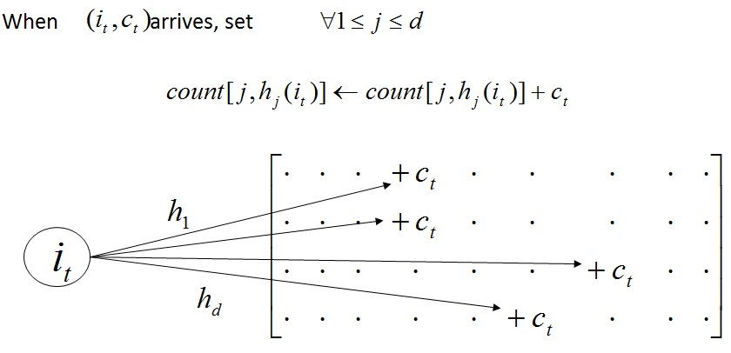
Count Min Sketch
Model input data stream as vector Where initially
The $t^{th}$ update is
A Count-Min (CM) Sketch with parameters is represented by a two-dimensional array (a small summary of input) counts with width and depth .
Given parameters , set and . Each entry of the array is initially zero.
hash functions are chosen uniformly at random from a pairwise independent family which map vector entry to [1…w]. i.e.
⬇ Update procedure :

Slide 44
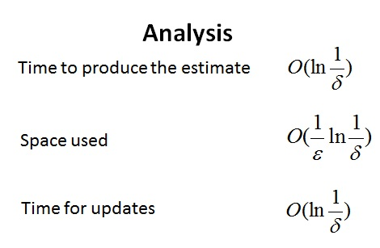
Count Min Sketch Algorithm

Slide 45
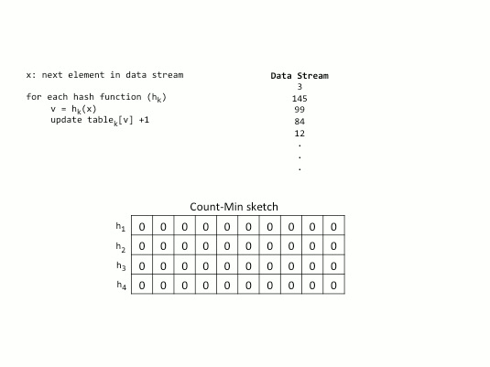
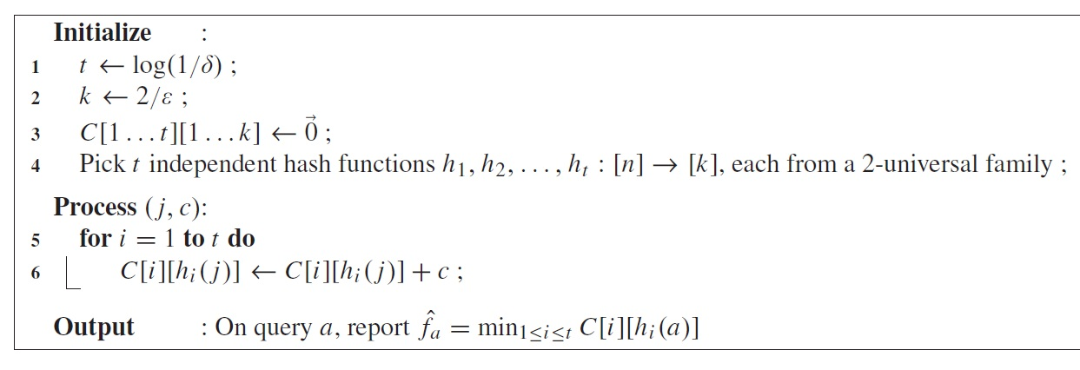
Example

Slide 46
Approximate Query Answering
approx.
• point query
approx.
• range queries
approx.
• inner product queries

Slide 47
Point Query
• Non-negative case ( )
Theorem 1
PROOF : Introduce indicator variables
1 if
0 otherwise
Define the variable
By construction,

Slide 48
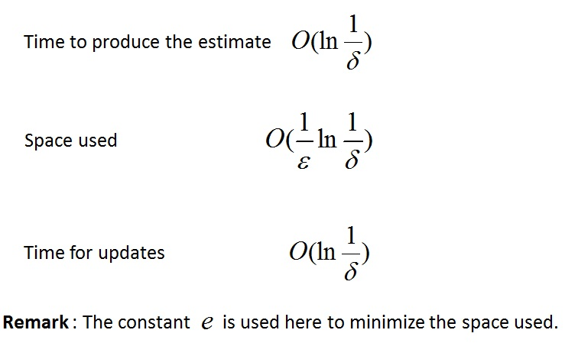
For the other direction, observe that
Markov inequality
Analysis
■

Slide 49
Range Query
• Dyadic range:
for parameters
• range query
(at most)
dyadic range queries
single point query
For each set of dyadic ranges of length
a sketch is kept
CM Sketches
SELECT COUNT (*) FROM D
WHERE D.val >=l AND D.val <=h
Compute the dyadic ranges (at most ) which canonically cover the range
Pose that many point queries
to the sketches
Sum of queries

Slide 50
Range Sum Example
AMS approach to this, the error scales proportional to $\sqrt{\text{F}\text{2}(f) \text{F}\text{2}(f′)}$
So here the error grows proportional to the square root of the length of the range.
Using the Count-Min sketch approach, the error is proportional to $\text{F}\text{1}$(h−l +1), i.e. it grows proportional to the length of the range
Using the Count-Min sketch to approximate counts, the accuracy of the answer is proportional to ($\text{F}\text{1}$ log n)/w. For large enough ranges, this is an exponential improvement in the error.
e.g. To estimate the range sum of [2…8], it is decomposed into the ranges [2…2], [3…4], [5…8], and the sum of the corresponding nodes in the binary tree as the estimate.

Slide 51
Theorem 4
Proof :
Theorem 1
E(Σ error for each estimator)
E(error for each estimator)
■

Slide 52
Inner Product Query
Set
Theorem 3
Analysis
Time to produce the estimate
Space used
Time for updates
Application
The application of inner-product computation to Join size estimation
Corollary
The Join size of two relations on a particular attribute can be approximated up to with probability by keeping space

Slide 53
Resources
Applications
Compressed Sensing
Networking
Databases
Eclectics (NLP, Security, Machine Learning, ...)
Details
Extensions of the Count-Min Sketch
Implementations and code
List of open problems in streaming
Open problems in streaming

Slide 54
References for Count Min Sketch
Basics
G. Cormode and S. Muthukrishnan. An improved data stream summary: The count-min sketch and its applications. LATIN 2004, J. Algorithm 58-75 (2005) .
G. Cormode and S. Muthukrishnan. Summarizing and mining skewed data streams. SDM 2005.
G. Cormode and S. Muthukrishnan. Approximating data with the count-min data structure. IEEE Software, (2012).
Journal
Alon, Noga; Matias, Yossi; Szegedy, Mario (1999), "The space complexity of approximating the frequency moments", Journal of Computer and System Sciences 58 (1): 137–147.
Surveys
Network Applications of Bloom Filters: A Survey. Andrei Broder and Michael Mitzenmacher. Internet Mathematics Volume 1, Number 4 (2003), 485-509.
Article from "Encyclopedia of Database Systems" on Count-Min Sketch Graham Cormode 09. 5 page summary of the sketch and its applications.
A survey of synopsis construction in data streams. Charu Aggarwal.
Coverage in Textbooks
Probability and Computing: Randomized Algorithms and Probabilistic Analysis. Michael Mitzenmacher, Eli Upfal. Cambridge University Press, 2005. Describes Count-Min sketch over pages 329--332
Internet Measurement: Infrastructure, Traffic and Applications. Mark Crovella, Bala Krishnamurthy. Wiley 2006.
Tutorials
Advanced statistical approaches for network anomaly detection. Christian Callegari. ICIMP 10 Tutorial.
Video explaining sketch data structures with emphasis on CM sketch Graham Cormode.
Lectures
Data Stream Algorithms. Notes from a series of lectures by S. Muthu Muthukrishnan.
Data Stream Algorithms. Lecture notes, Chapter 3. Amit Chakrabarti. Fall 09.
Probabilistic inequalities and CM sketch. John Byers. Fall 2007.

Slide 55
Overview
Introduction to Streaming Algorithms
Sampling Techniques
Sketching Techniques
Break
Counting Distinct Numbers
Q&A

Slide 56
Overview
Introduction to Streaming Algorithms
Sampling Techniques
Sketching Techniques
Break
Counting Distinct Numbers
Q&A

Slide 57
Stream Model of Computation
1
1
0
0
Main Memory
(Synopsis Data Structures)
1
0
Increasing time
1
1
Memory: poly(1/ε, log N)
Query/Update Time: poly(1/ε, log N)
N: # items so far, or window size
ε: error parameter
1
0
1
Data Stream

Slide 58
Counting Distinct Elements -Motivation
Motivation: Various applications
Port Scanning
DDoS Attacks
Traffic Accounting
Traffic Engineering
Quality of Service
8MB
SRAM
IP1
IP2
IP1
IP3
IP1
IP2
40 Gbps
Packet Filtering:
No of Packets – 6 (n)
No of Distinct Packets – 3 (m)

Slide 59
Counting Distinct Elements - Problem
Problem: Given a stream $X = <x1, x2, ……., xm >∈\left[n\right]m$of values. Let $F0$be the number of distinct elements in $X$. Find $F0$ under the constraints for algorithms on data streams.
Constraints:
Elements in stream are presented sequentially and single pass is allowed.
Limited space to operate. Expected space complexity $O(log⁡(min⁡(n,m))$or smaller.
Estimation Guarantees : With Error $ε < 1$ and high proability

Slide 60
Naïve Approach
Counter C(i) for each domain value i in [n]
Initialize counters C(i)← 0
Scan X incrementing appropriate counters
Solution: Distinct Values = Number of C(i) > 0
Problem
Memory size M << n
Space O(n) – possibly n >> m
(e.g., when counting distinct words in web crawl)
Time O(n)

Slide 61
Algorithm History
Flajolet and Martin introduced problem
O(log n) space for fixed ε in random oracle model
Alon, Matias and Szegedy
O(log n) space/update time for fixed ε with no oracle
Gibbons and Tirthapura
O(ε⁻² log n) space and O(ε⁻²) update time
Bar-Yossef et al
O(ε⁻² log n) space and O(log 1/ε) update time
O(ε⁻² log log n + log n) space and O(ε⁻²) update time, essentially
Similar space bound also obtained by Flajolet et al in the random oracle model
Kane, Nelson and Woodruff
O(ε⁻² + log n) space and O(1) update and reporting time
All time complexities are in unit-cost RAM model

Slide 62
Flajolet-Martin Approach
Hash function h: map n elements to$L=log2n$bits (uniformly distributed over the set of binary strings of length L)
For y any non-negative integer, define bit(y, k) = k^{th} bit in the binary representation of y
$y=\sum_{k≥0}{bit\left(y,k\right).2^{k}}$
$ρ\left(y\right)=\min_{k≥0}\left[bit\left(y,k\right)\right]≠0$ if y >0
$ρ\left(y\right)=L$ if y = 0
$ρ(y)$ represents the position of the least significant –bit in the binary representation of y

Slide 63
Flajolet-Martin Approach
for (i:=0 to L-1) do BITMAP[i]:=0;
for (all x in M) do
begin
index:=ρ(h(x));
if BITMAP[index]=0 then
BITMAP[index]:=1;
end
R := the largest index in BITMAP whose value equals to 1
Estimate := 2^{R}

Slide 64
Examples of bit(y, k) & ρ(y)
int y | binary format | ρ(y)
0 | 0000 | 4 (=L)
1 | 0001 | 0
2 | 0010 | 1
3 | 0011 | 0
4 | 0100 | 2
5 | 0101 | 0
6 | 0110 | 1
7 | 0111 | 0
8 | 1000 | 3
y=10=(1010)₂
bit(y,0)=0 bit(y,1)=1 bit(y,2)=0 bit(y,3)=1

Slide 65
Flajolet-Martin Approach – Estimate Example
Part of a Unix manual file M of size 26692 lines is loaded of which 16405 are distinct.
If the final BITMAP looks like this:
0000,0000,1100,1111,1111,1111
The left most 1 appears at position 15
We say there are around 2¹⁵ distinct elements in the stream. But 2¹⁴ = 16384.
Estimate $F0$ $≈\log_{2}{φn}$ where$φ=0.77351$ is the correction factor.

Slide 66
Flajolet-Martin* Approach
Pick a hash function h that maps each of the n elements to at least log₂n bits.
For each stream element a, let r (a ) be the number of trailing 0’s in h (a ).
Record R = the maximum r (a ) seen.
Estimate = 2^{R}.
* Really based on a variant due to AMS (Alon, Matias, and Szegedy)

Slide 67
Why It Works
The probability that a given h (a ) ends in at least r 0’s is 2^{-r}.
If there are m different elements, the probability that R ≥ r is 1 – (1 - 2^{-r} )^{m}.
Prob. all h(a)’s
end in fewer than
r 0’s.
Probability any
given h(a) ends in
fewer than r 0’s.

Slide 68
Why It Works (2)
-r
Since 2^{-r} is small, 1 - (1-2^{-r})^{m} ≈ 1 - e ^{-m2} .
If 2^{r} >> m, 1 - (1 - 2^{-r})^{m} ≈ 1 - (1 - m2^{-r})
≈ m /2^{r} ≈ 0.
If 2^{r} << m, 1 - (1 - 2^{-r})^{m} ≈ 1 - e ^{-m2} ≈ 1.
Thus, 2^{R} will almost always be around m.
First 2 terms of the
Taylor expansion of e ^{x}
-r

Slide 69
Algorithm History
Flajolet and Martin introduced problem
O(log n) space for fixed ε in random oracle model
Alon, Matias and Szegedy
O(log n) space/update time for fixed ε with no oracle
Gibbons and Tirthapura
O(ε⁻² log n) space and O(ε⁻²) update time
Bar-Yossef et al
O(ε⁻² log n) space and O(log 1/ε) update time
O(ε⁻² log log n + log n) space and O(ε⁻²) update time, essentially
Similar space bound also obtained by Flajolet et al in the random oracle model
Kane, Nelson and Woodruff
O(ε⁻² + log n) space and O(1) update and reporting time
All time complexities are in unit-cost RAM model

Slide 70
An Optimal Algorithm for the Distinct Elements Problem
Daniel M. Kane, Jelani Nelson, David P. Woodruff

Slide 71
Overview
Computes a $(1±ε)$ approximation using an optimal Θ(ε⁻² + log n) bits of space with 2/3 success probability, where 0 < ε < 1 is given
Process each stream update in Θ(1) worst-case time

Slide 72
Foundation technique 1
If it is known that R=Θ(F₀) then $(1±ε)$ estimation becomes easier
Run a constant-factor estimation at the end of the stream to achieve R before the main estimation algorithm → ROUGH ESTIMATOR

Slide 73
Foundation technique 2
Balls and Bins Approach: use truly random function f to map A balls into K bins and count the number of non-empty bins X
$$E\left[X\right]=K(1−{\left(1−\frac{1}{K}\right)}^{A})$$
Instead of using f, use $Ο\left(\frac{log\frac{K}{ε}}{loglog\frac{K}{ε}}\right)$- wise independent mapping g then the expected number of non-empty bins under g is the same as under f, up to a factor of (1 ± ε)

Slide 74
Rough Estimator (RE)
With probability 1 - o(1), the output $\tilde{F_{0}}$ of RE satisfies
$F_{0}\left(t\right)≤\tilde{F_{0}}\left(t\right)≤8F_{0}(t)$
for every t $∈$ [m] with $F_{0}(t)≥K_{RE}$ simultaneously
The space used is O(log(n))
Can be implemented with O(1) worst-case update and reporting times

Slide 75
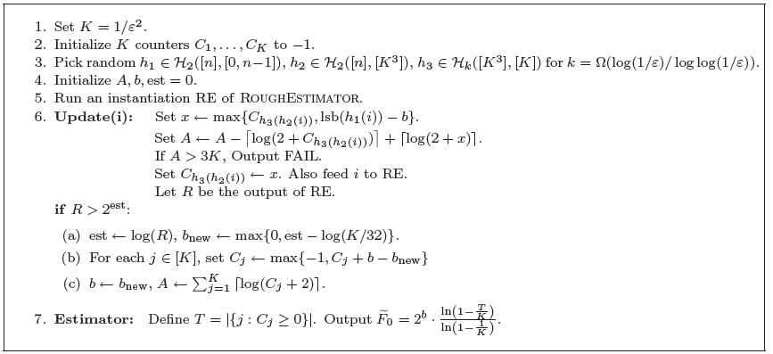
Main Algorithm(1)
The algorithm outputs a value which is $\left(1±ε\right)F_{0}$ with probability at least 11/20 as long as $F_{0}≥\frac{K}{32}$

Slide 76
Main Algorithm (2)
A: keeps track of the amount of storage required to store all the $C_{i}$
est: is such that $2^{est}$ is a $Θ(1)$-approximation to $F_{0}$, and is obtained via Rough Estimator
b: is such that we expect $F_{0}(t)/2^{b}$ to be $Θ(K)$ at all points t in the stream.

Slide 77
Main Algorithm (3)
Subsample the stream at geometrically decreasing rates
Perform balls and bins at each level
When i appears in stream, put a ball in cell [g(i), h(i)]
For each column, store the largest row containing a ball
Estimate based on these numbers

Slide 78
Prove Space Complexity
The hash functions h1, h2 each require $Ο(log⁡n)$bits to store
The hash function h3 takes $Ο(klogK)$= O($\log^{2}(\frac{1}{ε}$)) bits to store
The value b takes $Ο(loglogn)$ bits
The value A never exceeds the total number of bits to store all counters, which is $Ο(ε^{−2}logn)$, and thus A can be represented in $Ο(\log\left(\frac{1}{ε}\right)+loglogn)$ bits
The counters $C_{j}$ never in total consume more than $Ο(\frac{1}{ε^{2}})$ bits by construction, since we output FAIL if they ever would
The Rough Estimator and est use O(log(n)) bits
→ Total space complexity: $Ο(ε^{−2}+logn)$

Slide 79
Prove Time Complexity
Use high-performance hash functions (Siegel, Pagh and Pagh) which can be evaluated in O(1) time
Store column array in Variable-Length Array (Blandford and Blelloch). In column array, store offset from the base row and not absolute index → giving O(1) update time for a fixed base level
Occasionally we need to update the base level and decrement offsets by 1
Show base level only increases after Θ(ε⁻²) updates, so can spread this work across these updates, so O(1) worst-case update time (Use deamortization)
Copy the data structure, use it for performing this additional work so it doesn’t interfere with reporting the correct answer
When base level changes, switch to copy
For reporting time, we can maintain T during updates, and thus the reporting time is the time to compute a natural logarithm, which can be made O(1) via a small lookup table

Slide 80
References
Blandford, Blelloch. Compact dictionaries for variable-length keys and data with applications. ACM Transactions on Algorithms. 2008.
D. M. Kane, J. Nelson, and D. P. Woodruff. An optimal algorithm for the distinct elements problem. In Proc. 29th ACM Symposium on Principles of Database Systems, pages 41-52. 2010.
Pagh, Pagh. Uniform Hashing in Constant Time and Optimal Space. SICOMP 2008.
Siegel. On Universal Classes of Uniformly Random Constant-Time Hash Functions. SICOMP 2004.

Slide 81
Summary
We introduced Streaming Algorithms
Sampling Algorithms
Reservoir Sampling
Priority Sampling
Sketch Algorithms
Bloom Filter
Count-Min Sketch
Counting Distinct Elements
Flajolet-Martin Algorithm
Optimal Algorithm

Slide 82
Q & A

