Slide 1
Streaming Algorithm
Presented by: Group 7
Min Chen
Zheng Leong Chua
Anurag Anshu
Samir Kumar
Nguyen Duy Anh Tuan
Hoo Chin Hau
Jingyuan Chen
Advanced Algorithm
National University of Singapore

Slide 2

Motivation
Google gets 117 million searches per day
Facebook get 2 billion clicks per day
Huge amount of data
How to do queries on this huge data set?
e.g, how many times a particular page has
been visited
Impossible to load the data into the random access memory

Slide 3




Streaming Algorithm
$$a_{0}$$
$$a_{1}$$
$$a_{2}$$
…
$$a_{n}$$
Access the data sequentially
Data stream:
A data stream we consider here is a sequence of data that is usually too large to be stored in available memory
E.g, Network traffic, Database transactions, and Satellite data
Streaming algorithm aims for processing such data stream. Usually, the algorithm has limited memory available (much less than the input size) and also limited processing time per item
A streaming algorithm is measured by:
Number of passes of the data stream
Size of memory used
Running time

Slide 4


Simple Example: Finding the missing number
There are ‘n’ consecutive numbers, where ‘n’ is a fairly large number
1
2
3
…
n
A number ‘k’ is missing now
Now the data stream becomes like:
1
2
…
n
…
k-1
k+1
Suppose you only have $log⁡(n)$ size of memory
Can you propose a streaming algorithm to find k?
which examine the data stream as less times as possible

Slide 5







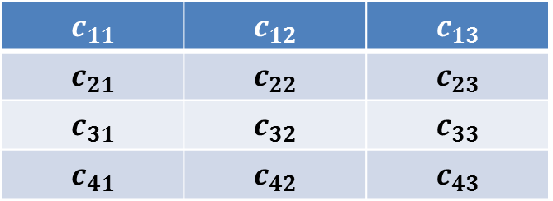



Two general approach for streaming algorithm
1.
Sampling
$$a_{0}$$
$$a_{1}$$
…
$$a_{n}$$
$$a_{i}$$
$$a_{j}$$
…
$$a_{k}$$
m samples, $m≤n$
Choose part of the stream to represent the whole stream
2.
Sketching
$$c_{11}$$ | $$c_{12}$$ | $$c_{13}$$
$$c_{21}$$ | $$c_{22}$$ | $$c_{23}$$
$$c_{31}$$ | $$c_{32}$$ | $$c_{33}$$
$$c_{41}$$ | $$c_{42}$$ | $$c_{43}$$
$$a_{0}$$
$$a_{1}$$
…
$$a_{n}$$
Mapping the whole stream into some data structures
Difference between these two approach:
Sampling: Keep part of the stream with accurate information
Sketching: Keep the summary of the whole streaming but not accurately

Slide 6
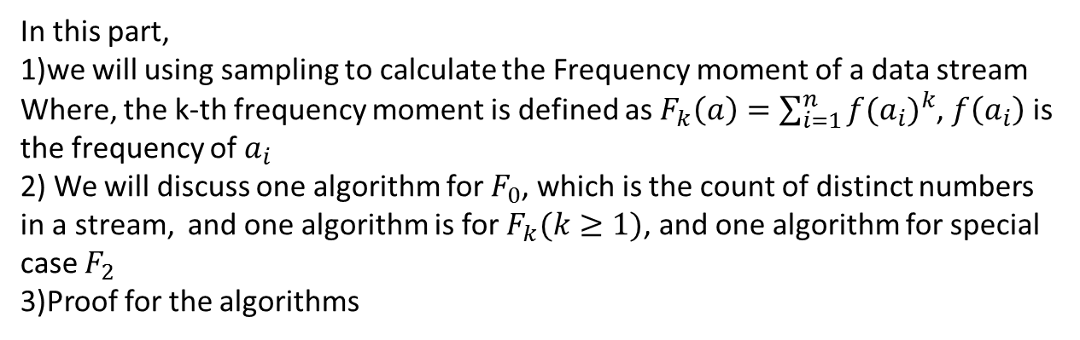
Outline of the presentation
1. Sampling - (Zheng Leong Chua, Anurag anshu)
In this part,
1)we will using sampling to calculate the Frequency moment of a data stream
Where, the k-th frequency moment is defined as $F_{k}\left(a\right)=\sum_{i=1}^{n}{{f(a_{i})}^{k}}$, $f\left(a_{i}\right)$ is the frequency of $a_{i}$
2) We will discuss one algorithm for $F_{0}$, which is the count of distinct numbers in a stream, and one algorithm is for $F_{k}(k≥1)$, and one algorithm for special case $F_{2}$
3)Proof for the algorithms
2. Sketching - (Samir Kumar, Hoo Chin Hau, Tuan Nguyen)
In this part,
1)we will formally introduce sketches
2)implementation for count-min sketches
3)Proof for count-min sketches
3. Conclusion and applications - (Jingyuan Chen)

Slide 7
Approximating Frequency Moments
Chua Zheng Leong & Anurag Anshu
Alon, Noga; Matias, Yossi; Szegedy, Mario (1999), "The space complexity of approximating the frequency moments", Journal of Computer and System Sciences 58 (1): 137–147,

Slide 8
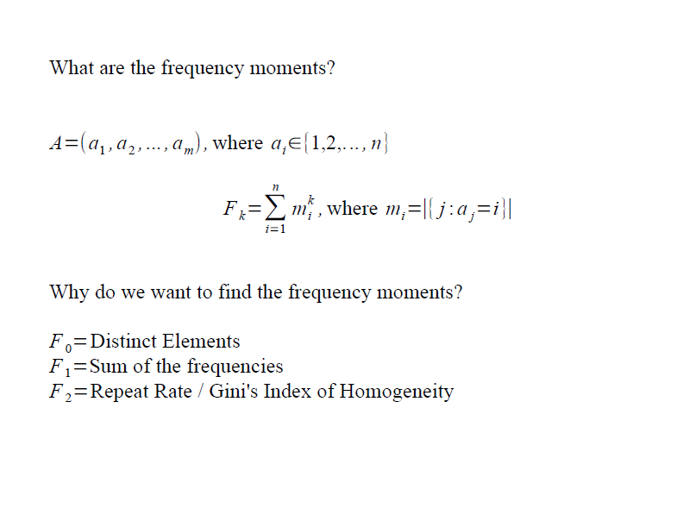

Slide 9
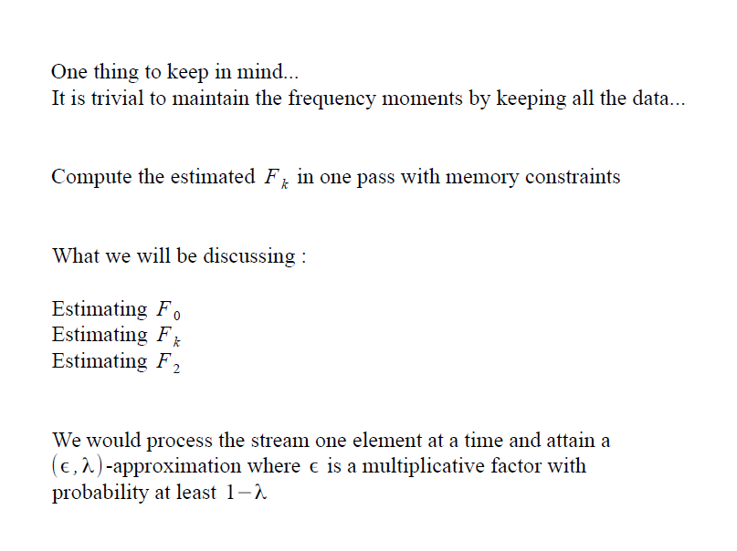

Slide 10
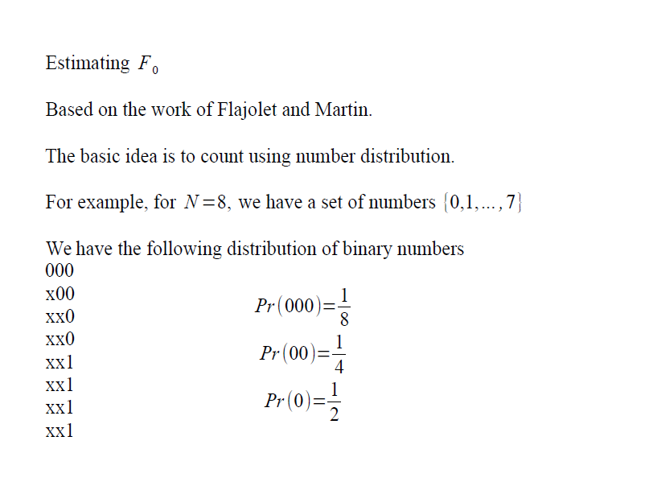

Slide 11
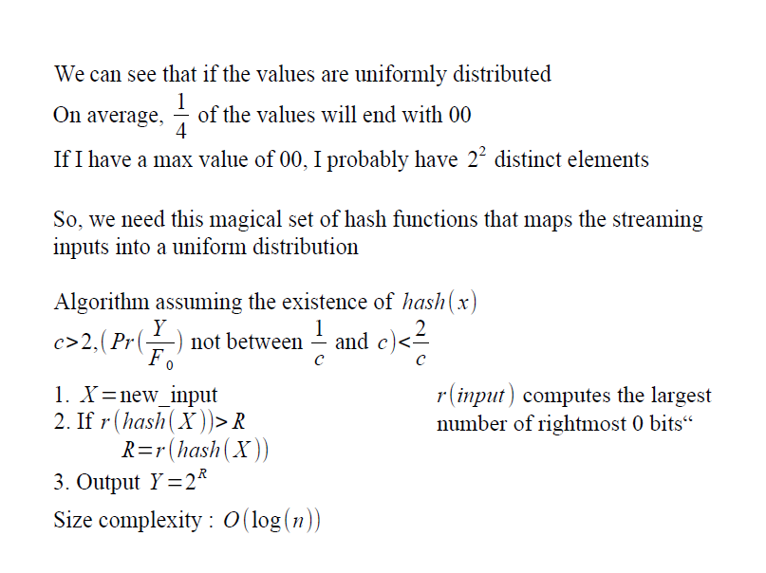

Slide 12
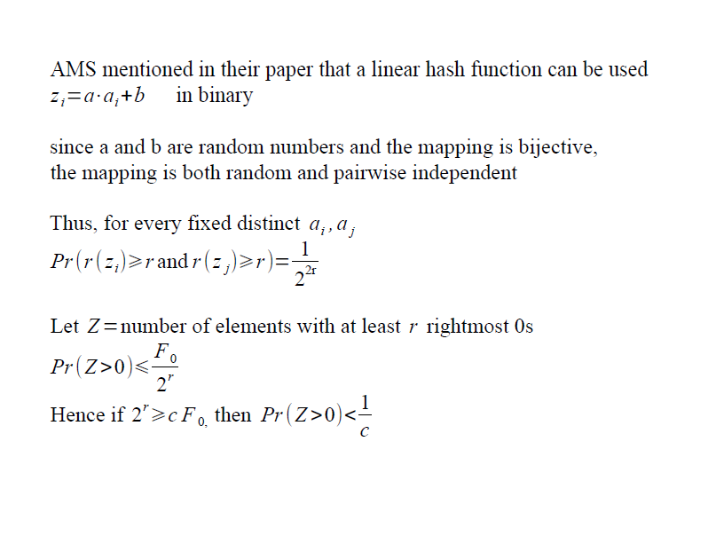

Slide 13
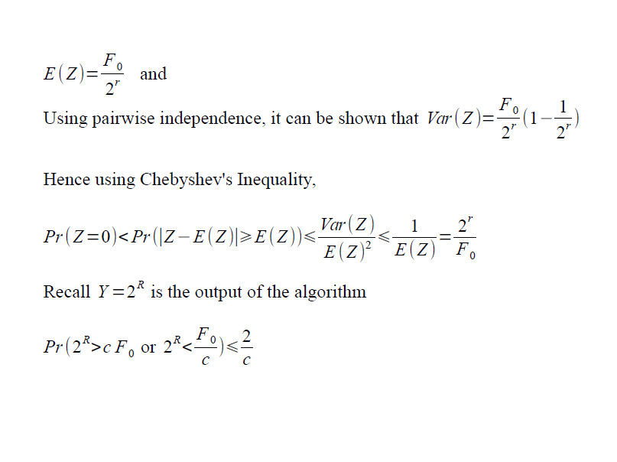

Slide 14
Estimating F_{k}
Input: a stream of integers in the range {1…n}
Let m_{i} be the number of times ‘i’ appears in the stream.
Objective is to output F_{k}= Σ_{i} m_{i}^{k}
Randomized version: given a parameter λ, output a number in the range [(1-λ)F_{k},(1+λ)F_{k}] with probability atleast 7/8.

Slide 15
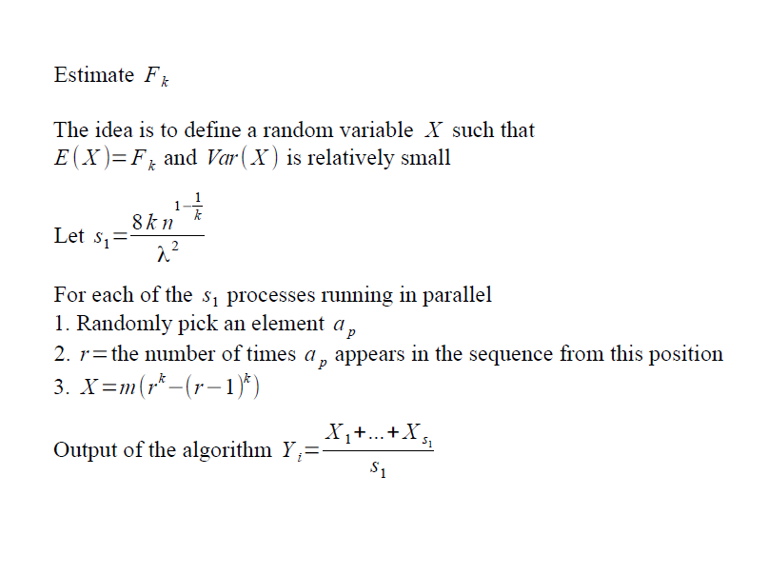

Slide 16
Analysis
Important observation is that E(X) = F_{k}
Proof:
Contribution to the expectation for integer ‘i’ is m/m ((m_{i}^{k})-(m_{i}-1)^{k} + (m_{i}-1)^{k} – (m_{i}-2)^{k} … 2^{k} – 1^{k} + 1^{k}) = m_{i}^{k}.
Summing up all the contributions gives F_{k}

Slide 17
Analysis
Also E(X²) is bounded nicely.
E(X²) = m(Σ_{i} (m_{i})^{2k} – (m_{i}-1)^{2k} + (m_{i}-1)^{2k} – (m_{i}-2) ^{2k} … 2^{2k} – 1^{2k} + 1^{2k})
< kn^{(1-1/k)}F_{k}²
Hence given the random variable Y = X₁+..X_{s}/s
E(Y) = E(X) = F_{k}
Var(Y) = Var(X)/s < E(X²)/s = kn^{(1-1/k)}F_{k}²/s

Slide 18
Analysis
Hence Pr (|Y-F_{k}|> λF_{k}) < Var(Y)/λ²F_{k} < kn^{(1-1/k)}/sλ² < 1/8
To improve the error, we can use yet more processors.
Hence, space complexity is:
O((log n + log m)kn^{(1-1/k)}/λ²)

Slide 19
Estimating F₂
Algorithm (bad space-inefficient way):
Generate a random sequence of n independent numbers: e₁,e₂…e_{n}, from the set [-1,1].
Let Z=0 .
For the incoming integer ‘i’ from stream, change Z-> Z+e_{i} .

Slide 20
Hence Z= Σ_{i} e_{i}m_{i}
Output Y=Z².
E(Z²) = F₂, since E(e_{i})=0 and E(e_{i}e_{j})=E(e_{i})E(e_{j}), for i ≠ j
E(Z⁴) – E(Z²)² < 2F₂², since E(e_{i}e_{j}e_{k}e_{l})=E(e_{i})E(e_{j})E(e_{k})E(e_{l}), when all i,j,k,l are different.

Slide 21
Same process is run in parallel on s independent processors. We choose s= 16/λ²
Thus, by Chebysev’s inequality, Pr(|Y-F₂|>λF₂) < Var(Y)/λ²F₂² < 2/sλ² =1/8

Slide 22
Estimating F₂
Recall that storing e₁,e₂…e_{n} requires O(n) space.
To generate these numbers more efficiently, we notice that only requirement is that the numbers {e₁,e₂…e_{n}} be 4-wise independent.
In above method, they were n-wise independent…too much.

Slide 23
Orthogonal array
We use `orthogonal array of strength 4’.
OA of n-bits, with K runs, and strength t is
an array of K rows and n columns and entries in 0,1 such that in any set of t columns, all possible t bit numbers appear democratically.
So simplest OA of n bits and strength 1 is
000000000000000
111111111111111

Slide 24
Strength > 1
This is more challenging. Not much help via specializing to strength ‘2’. So lets consider general strength t.
A technique: Consider a matrix G, having k columns, with the property that every set of t columns are linearly independent. Let it have R rows.

Slide 25
Technique
Then OA with 2^{R} runs and k columns and strength t is obtained as:
For each R bit sequence [w₁,w₂…w_{R}], compute the row vector [w₁,w₂..w_{R}] G.
This gives one of the rows of OA.
There are 2^{R} rows.

Slide 26
Proof that G gives an OA
Pick up any t columns in OA.
They came from multiplying [w₁,w₂…w_{R}]to corresponding t columns in G. Let the matrix formed by these t columns of G be G’.
Now consider [w₁,w₂…w_{R}]G’ = [b₁,b₂..b_{t}].
For a given [b₁,b₂..b_{t}], there are 2^{R-t} possible [w₁,w₂…w_{R}], since G’ has as many null vectors.
Hence there are 2^{t} distinct values of [b₁,b₂..b_{t}].
Hence, all possible values of [b₁,b₂..b_{t}] obtained with each value appearing equal number of times.

Slide 27
Constructing a G
We want strength = 4 for n bit numbers. Assume n to be a power of 2, else change n to the closest bigger power of 2.
We show that OA can be obtained using corresponding G having 2log(n)+1 rows and n columns
Let X₁,X₂…X_{n} be elements of F(n).
Look at X_{i} as a column vector of log(n) length.

Slide 28
G is
X₁ X₂ X₃ X₄ X_{n}
X₁³ X₂³ X₃³ X₄³ X_{n}³
Property: every 5 columns of G are linearly independent.
Hence the OA is of strength 5 => of strength 4.

Slide 29
Efficiency
To generate the desired random sequence e₁,e₂…e_{n}, we proceed as:
Generate a random sequence w₁,w₂…w_{R}
If integer ‘i’ comes, compute the i-th column of G, which is as easy as computing i-th element of F(n), which has efficiency O(log(n)).
Compute vector product of this column and random sequence to obtain e_{i}.

Slide 30
Sketches
Samir Kumar

Slide 31
What are Sketches?
“Sketches” are data structures that store a summary of the complete data set.
Sketches are usually created when the cost of storing the complete data is an expensive operation.
Sketches are lossy transformations of the input.
The main feature of sketching data structures is that they can answer certain questions about the data extremely efficiently, at the price of the occasional error (ε).

Slide 32
How Do Sketches work?
The data comes in and a prefixed transformation is applied and a default sketch is created.
Each update in the stream causes this synopsis to be modified, so that certain queries can be applied to the original data.
Sketches are created by sketching algorithms.
Sketching algorithms preform a transform via randomly chosen hash functions.

Slide 33
Standard Data Stream Models
Input stream a_{1,} a_{2,} . . . . arrives sequentially, item by item, and describes an underlying signal A, a one-dimensional function A : [1...N] → R.
Models differ on how a_{i} describe A
There are 3 broad data stream models.
  Time Series
  Cash Register
  Turnstile

Slide 34
Time Series Model
The data stream flows in at a regular interval of time.
Each a_{i} equals A[i] and they appear in increasing order of i.

Slide 35
Cash Register Model
The data updates arrive in an arbitrary order.
Each update must be non-negative.
A_{t}[i] = A_{t-1}[i]+c where c ≥ 0

Slide 36
Turnstile Model
The data updates arrive in an arbitrary order.
There is no restriction on the incoming updates i.e. they can also be negative.
A_{t}[i] = A_{t-1}[i]+c

Slide 37
Properties of Sketches
Queries Supported:- Each sketch supports a certain set of queries. The answer obtained is an approximate answer to the query.
Sketch Size:-Sketch doesn’t have a constant size. The sketch is inversely proportional to ε and δ(probability of giving inaccurate approximation).

Slide 38
Properties of Sketches-2
Update Speed:- When the sketch transform is very dense, each update affects all entries in the sketch and so it takes time linear in sketch size.
Query Time:- Again is time linear in sketch size.

Slide 39
Comparing Sketching with Sampling
Sketch contains a summary of the entire data set.
Whereas sample contains a small part of the entire data set.

Slide 40
Count-min Sketch
Nguyen Duy Anh Tuan & Hoo Chin Hau

Slide 41
Introduction
Problem:
  Given a vector a of a very large dimension n.
  One arbitrary element a_{i} can be updated at any time by a value c: a_{i} = a_{i} + c.
  We want to approximate a efficiently in terms of space and time without actually storing a.

Slide 42
Count-min Sketch
Proposed by Graham and Muthukrishnan [1]
Count-min (CM) sketch is a data structure
  Count = counting or UPDATE
  Min = computing the minimum or ESTIMATE
The structure is determined by 2 parameters:
  ε: the error of estimation
  δ: the certainty of estimation
[1] Cormode, Graham, and S. Muthukrishnan. "An improved data stream summary: the count-min sketch and its applications." Journal of Algorithms 55.1 (2005): 58-75.

Slide 43
Definition
A CM sketch with parameters (ε, δ) is represented by two-dimensional d-by-w array count: count[1,1] … count[d,w].
In which:
(e is the natural number)

Slide 44
Definition
In addition, d hash functions are chosen uniformly at random from a pair-wise independent family:

Slide 45
Update operation
UPDATE(i, c):
  Add value c to the i-th element of a
  c can be non-negative (cash-register model) or anything (turnstile model).
Operations:
  For each hash function h_{j}:

Slide 46
Update Operation
UPDATE(23, 2)
23
h₁
h₂
h₃
 | 1 | 2 | 3 | 4 | 5 | 6 | 7 | 8
1 | 0 | 0 | 0 | 0 | 0 | 0 | 0 | 0
2 | 0 | 0 | 0 | 0 | 0 | 0 | 0 | 0
3 | 0 | 0 | 0 | 0 | 0 | 0 | 0 | 0
d = 3
w = 8

Slide 47
Update Operation
UPDATE(23, 2)
23
h₁
h₂
h₃
3
1
7
 | 1 | 2 | 3 | 4 | 5 | 6 | 7 | 8
1 | 0 | 0 | 2 | 0 | 0 | 0 | 0 | 0
2 | 2 | 0 | 0 | 0 | 0 | 0 | 0 | 0
3 | 0 | 0 | 0 | 0 | 0 | 0 | 2 | 0
d = 3
w = 8

Slide 48
Update Operation
UPDATE(99, 5)
99
h₁
h₂
h₃
 | 1 | 2 | 3 | 4 | 5 | 6 | 7 | 8
1 | 0 | 0 | 2 | 0 | 0 | 0 | 0 | 0
2 | 2 | 0 | 0 | 0 | 0 | 0 | 0 | 0
3 | 0 | 0 | 0 | 0 | 0 | 0 | 2 | 0
d = 3
w = 8

Slide 49
Update Operation
UPDATE(99, 5)
99
h₁
h₂
h₃
5
1
3
 | 1 | 2 | 3 | 4 | 5 | 6 | 7 | 8
1 | 0 | 0 | 2 | 0 | 0 | 0 | 0 | 0
2 | 2 | 0 | 0 | 0 | 0 | 0 | 0 | 0
3 | 0 | 0 | 0 | 0 | 0 | 0 | 2 | 0
d = 3
w = 8

Slide 50
Update Operation
UPDATE(99, 5)
99
h₁
h₂
h₃
5
1
3
 | 1 | 2 | 3 | 4 | 5 | 6 | 7 | 8
1 | 0 | 0 | 2 | 0 | 5 | 0 | 0 | 0
2 | 7 | 0 | 0 | 0 | 0 | 0 | 0 | 0
3 | 0 | 0 | 5 | 0 | 0 | 0 | 2 | 0
d = 3
w = 8

Slide 51
Queries
Point query, Q(i), returns an approximation of a_{i}
Range query, Q(l, r), returns an approximation of:
Inner product query, Q(a,b), approximates:

Slide 52
Queries
Point query, Q(i), returns an approximation of a_{i}
Range query, Q(l, r), returns an approximation of
Inner product query, Q(a,b), approximates:

Slide 53
Point Query - Q(i)
Cash-register model (non-negative)
Turnstile (can be negative)

Slide 54
Q(i) – Cash register
The answer for this case is:
Eg:
h₁
h₂
h₃
 | 1 | 2 | 3 | 4 | 5 | 6 | 7 | 8
1 | 0 | 0 | 2 | 0 | 5 | 0 | 0 | 0
2 | 7 | 0 | 0 | 0 | 0 | 0 | 0 | 0
3 | 0 | 0 | 5 | 0 | 0 | 0 | 2 | 0

Slide 55
Complexities
Space: O(ε⁻¹ lnδ ⁻¹ )
Update time: O(lnδ ⁻¹)
Query time: O(lnδ ⁻¹)

Slide 56
Accuracy
Theorem 1: the estimation is guaranteed to be in below range with probability at least 1-δ:

Slide 57
Proof
Let
Since the hash function is expected to be able to uniformly distribute i across w columns:

Slide 58
Proof
Define
By the construction of array count

Slide 59
Proof
The expected value of

Slide 60
Proof
By applying the Markov inequality:
We have:

Slide 61
Q(i) - Turnstile

Slide 62
Q(i) - Turnstile
The answer for this case is:
Eg:
h₁
h₂
h₃
 | 1 | 2 | 3 | 4 | 5 | 6 | 7 | 8
1 | 0 | 0 | 2 | 0 | 5 | 0 | 0 | 0
2 | 7 | 0 | 0 | 0 | 0 | 0 | 0 | 0
3 | 0 | 0 | 5 | 0 | 0 | 0 | 2 | 0

Slide 63
Why it works
Since the estimations returned from d rows of sketch can be negative, the minimum method can provide an estimation which is far away from true value.
By sorting the values in the increasing order, the bad values will be placed in the upper/lower half (too high/too low), while the good values will be placed in the middle → median

Slide 64
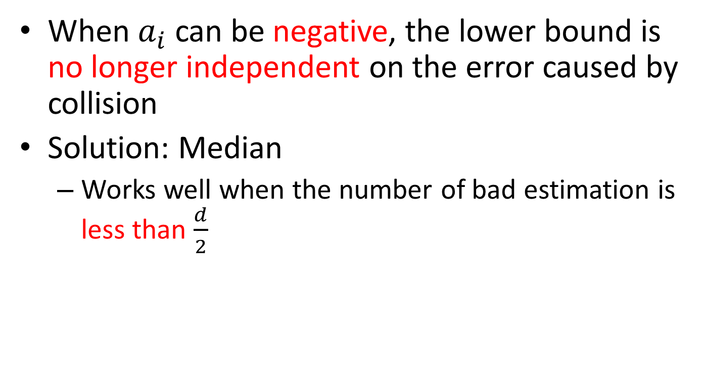
Why min doesn’t work?
When $a_{i}$ can be negative, the lower bound is no longer independent on the error caused by collision
Solution: Median
  Works well when the number of bad estimation is less than $\frac{d}{2}$

Slide 65
Bad estimator
Definition:
How likely an estimator is bad:
We know:

Slide 66
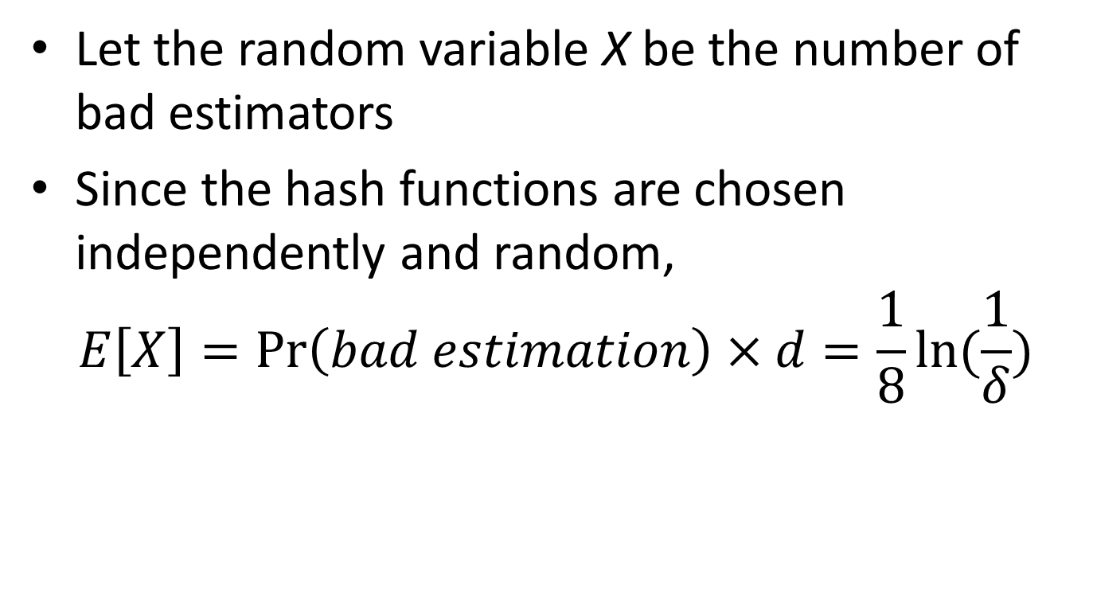
Number of bad estimators
Let the random variable X be the number of bad estimators
Since the hash functions are chosen independently and random,
$$E\left[X\right]=\operatorname{Pr}\left(bad estimation\right)×d=\frac{1}{8}ln⁡(\frac{1}{δ})$$

Slide 67

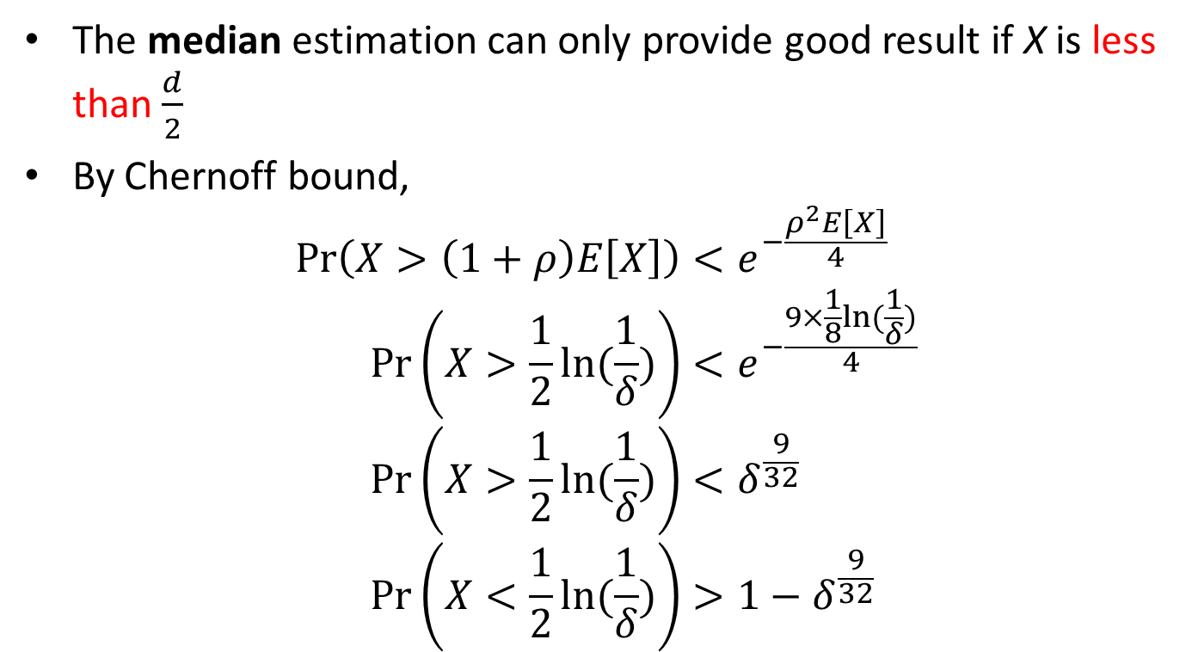
Probability of a good median estimate
The median estimation can only provide good result if X is less than $\frac{d}{2}$
By Chernoff bound,
$$\operatorname{Pr}\left(X>\left(1+ρ\right)E\left[X\right]\right)<e^{−\frac{ρ^{2}E\left[X\right]}{4}} \\ \operatorname{Pr}\left(X>\frac{1}{2}ln⁡(\frac{1}{δ})\right)<e^{−\frac{9×\frac{1}{8}ln⁡(\frac{1}{δ})}{4}} \\ \operatorname{Pr}\left(X>\frac{1}{2}ln⁡(\frac{1}{δ})\right)<δ^{\frac{9}{32}} \\ \operatorname{Pr}\left(X<\frac{1}{2}ln⁡(\frac{1}{δ})\right)>1−δ^{\frac{9}{32}}$$
$$\left(1+ρ\right)E\left[X\right]=\frac{d}{2} \\ ∴ρ=3$$

Slide 68
Count-Min Implementation
Hoo Chin Hau

Slide 69
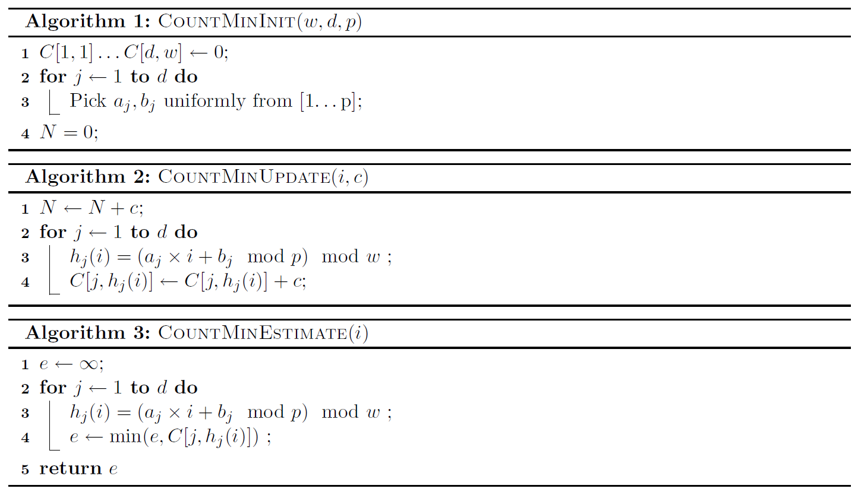
Sequential implementation
Replace with shift & add for certain choices of p
Replace with bit masking if w is chosen to be power of 2

Slide 70
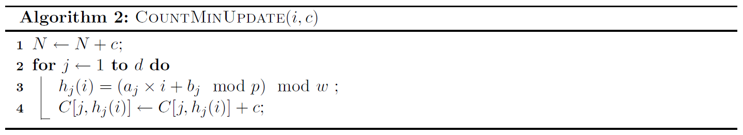
Parallel update
for each incoming update, do in parallel:
Rows updated in parallel
Thread
Thread

Slide 71
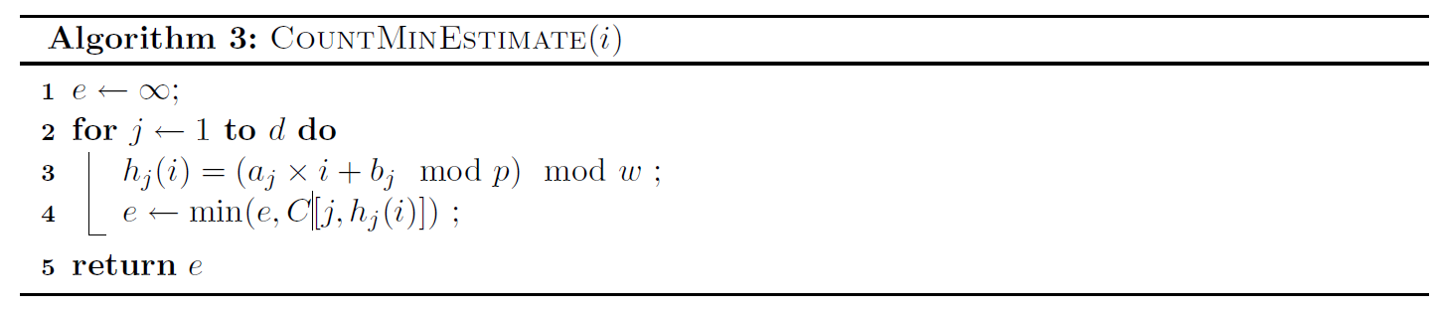
Parallel estimate
in parallel
Thread
Thread

Slide 72
Application and Conclusion
Chen Jingyuan

Slide 73
Summary
Frequency Moments
  Providing useful statistics on the stream
Count-Min Sketch
  Summarizing large amounts of frequency data
  size of memory accuracy
Applications
73

Slide 74
Frequency Moments
The frequency moments of a data set represent important demographic information about the data, and are important features in the context of database and network applications.

Slide 75

Frequency Moments
F2: the degree of skew of the data
  Parallel database: data partitioning
  Self-join size estimation
  Network Anomaly Detection
F0: Count distinct IP address
IP1
IP2
IP1
IP3
IP3

Slide 76
Count-Min Sketch
A compact summary of a large amount of data
A small data structure which is a linear function of the input data

Slide 77
Join size estimation
Used by query optimizers, to compare costs of alternate join plans.
Used to determine the resource allocation necessary to balance workloads on multiple processors in parallel or distributed databases.
StudentID | ProfID
1 | 2
2 | 2
3 | 3
4 | 1
… | …
ModuleID | ProfID
1 | 3
2 | 2
3 | 1
4 | 2
… | …
equi-join
SELECT count(*)
FROM student JOIN module
ON student.ProfID = module.ProfID;

Slide 78
a
b
StudentID | ProfID
ModuleID | ProfID
1 | 3
2 | 2
3 | 1
4 | 2
… | …
1 2
2 2
3 3
4 1
... ...

Slide 79
Join size of 2 database relations on a particular attribute :
Join size = the number of items in the cartesian product of the 2 relations which agree the value of that attribut
: the number of tuples which have value

Slide 80
Approximate Query Answering Using CM Sketches
approx.
• point query
approx.
• range queries
approx.
• inner product queries

Slide 81
Heavy Hitters
Heavy Hitters
Items whose multiplicity exceeds the fraction
Consider the IP traffic on a link as packet representing pairs where is the source IP address and is the size of packet.
Problem: Which IP address sent the most bytes? That is find such that is maximum

Slide 82
Heavy Hitters
For each element, we use the Count-Min data structure to estimate its count, and keep a heap of the top k elements seen so far.
  On receiving item ,
  Update the sketch and pose point query
  If estimate is above the threshold of :
  If is already in the heap, increase its count;
  Else add to the heap.
  At the end of the input, the heap is scanned, and all items in the heap whose estimated count is still above are output.
added
to a heap

Slide 83
Thank you!

