Slide 1
Convex Hulls
Guo Qi, Chen Zhenghai, Wang Guanhua, Shen Shiqi, Himeshi De Silva

Slide 2
Outline
Introduction: Background & Definition of convex hull
Three algorithms
Graham’s Scan
Jarvis March
Chan’s algorithm
Proof of these algorithms
Application

Slide 3
Introduction
Shen Shiqi

Slide 4
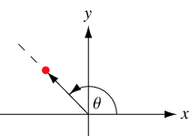
Polar angle
In the plane, the polar angle θ is the counterclockwise angle from x-axis at which a point in the x-y plane lies.

Slide 5
Orientation
b
Calculating Orientation
Three kinds of orientation for three points (a, b, c)
Clockwise (CW): right turn
Counterclockwise (CCW): left turn
Collinear (COLL): no turn
CW
a
c
c
CCW
a
b
The orientation can be characterized by the sign of the determinant △(a,b,c)
If △(a,b,c)<0 ⇒ clockwise
If △(a,b,c)=0 ⇒ collinear
If △(a,b,c)>0 ⇒ counterclockwise
c
b
COLL
a

Slide 6
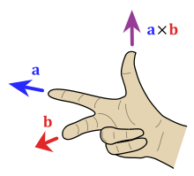
Why?
Cross product
Direction: right hand rule
Magnitude: the area of the parallelogram that the vectors span
is the scalar of

Slide 7
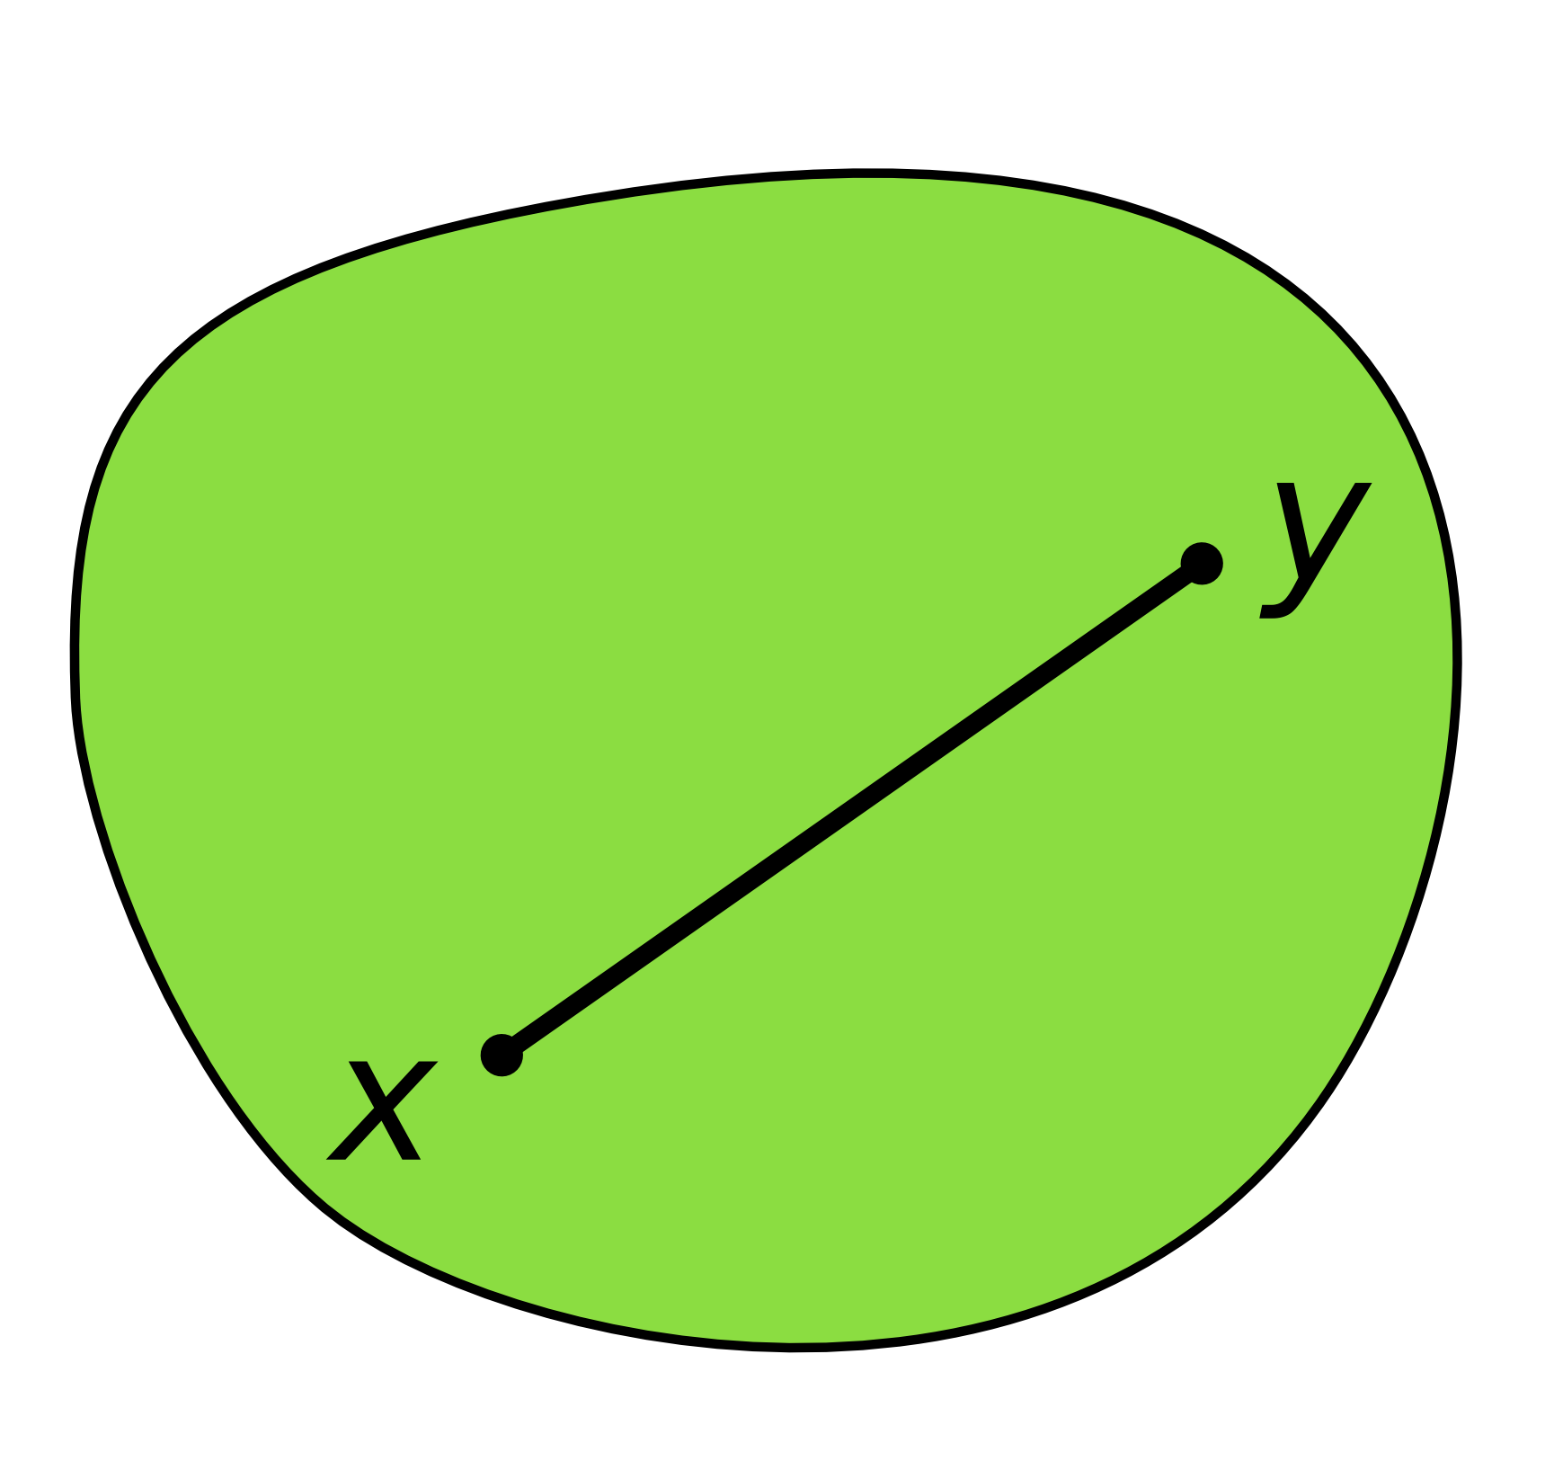
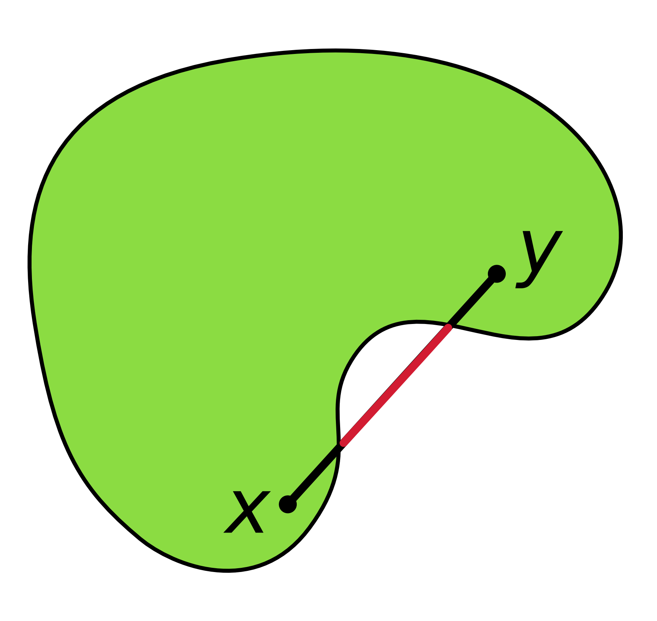
Convexity
A shape or set is convex :
If for any two points that are part of the shape, the whole connecting line segment is also part of the shape.
convex
non-convex

Slide 8
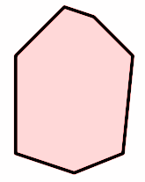
Convex hull
Convex hull of a point set P, CH(P):
Smallest convex set containing P
Intersection of all convex sets containing P
b
a
i
c
h
m
d
g
k
j
f
e

Slide 9
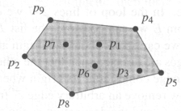
Convex hull problem
Give an algorithm that computes the convex hull of any given set of n points in the plane efficiently.
Inputs: location of n points
Outputs: a convex polygon ⇒ a sorted sequence of the points, clockwise (CW) or counterclockwise (CCW) along the boundary
inputs= a set of point
p₁,p₂,p₃,p₄,p₅,p₆,p₇,p₈,p₉
outputs= representation of the convex hull
p₄,p₅,p₈,p₂,p₉

Slide 10
How to develop an algorithm?
Properties:
The vertices of the convex hull are always points from the input
a
b
c
The supporting line of any convex hull edge has all input points to one side
f
d
e

Slide 11
Simple method
1
2
3
4
5
7
6
O(n²*n)=O(n³)

Slide 12
Graham's Scan and Jarvis March
Wang Guanhua

Slide 13
Graham's Scan Algorithm
Step 1. Find the lowest point p (guaranteed to be in)
Step 2. Sort points around p (in polar angle) in increasing angle
Step 3. Walk around to remove concave angle.
(keep points with left turns, & drop those with right turns)

Slide 14
Graham's Scan

Slide 15
Step1: Select a start point
Select a extreme point as a start point with the minimum y-coordinate.
If there are more than one points have minimum y-coordinate, select the leftmost one.
Start point: with minimum y-coordinate and leftmost

Slide 16
Step 2: Sort points by polar angle
Y
Sort the points by polar angle in counterclockwise order.
If more than one point has the same angle, remove all but the one that is farthest from the start point.
This algorithm will work in this sorting order.
Angle can be calculated by vector cosine law
6
7
4
5
3
2
1
0
X

Slide 17
Step3: Push first 3 points
Add first 3 points into the result set. Let S be the result set.
Push(p0, S)
Push(p1, S)
Push(p2, S)
6
7
4
5
3
2
1
0
Stack S: <p0, p1, p2>

Slide 18
Step4: Work around all points by sorting order
1->2->3 is left turn.
Push (p3, S)
6
7
4
5
3
top[S]
2
1
0
Next -to -top[S]
Stack S: <p0, p1, p2>

Slide 19
Step4: Work around all points by sorting order
Y
2->3->4 is left turn.
Push (p4, S)
6
7
4
5
3
2
1
0
Stack S: <p0, p1, p2, p3>

Slide 20
Step4: Work around all points by sorting order
Y
3->4->5 is left turn.
Push (p5, S)
6
7
4
5
3
2
1
0
Stack S: <p0, p1, p2, p3, p4>

Slide 21
Step4: Work around all points by sorting order
4->5->6 is non-left turn.
Pop (p5, S)
6
7
4
5
3
2
1
0
Stack S: <p0, p1, p2, p3, p4, p5>

Slide 22
Step4: Work around all points by sorting order
3->4->6 is non-left turn.
Pop (p4, S)
6
7
4
5
3
2
1
0
Stack S: <p0, p1, p2, p3, p4>

Slide 23
Step4: Work around all points by sorting order
Collinear
2->3->6 is non-left turn.
Pop (p3, S)
6
7
4
5
3
2
1
0
Stack S: <p0, p1, p2, p3>

Slide 24
Step4: Work around all points by sorting order
2->6->7 is left turn.
Push (p6, S)
6
7
4
5
3
2
1
0
Stack S: <p0, p1, p2>

Slide 25
Step4: Work around all points by sorting order
6->7->0 is left turn.
Push (p7, S)
6
7
4
5
3
2
1
0
Set S: <p0, p1, p2, p6, p7>

Slide 26
Finally, we get a Convex hull.
6
7
4
5
3
2
1
0

Slide 27
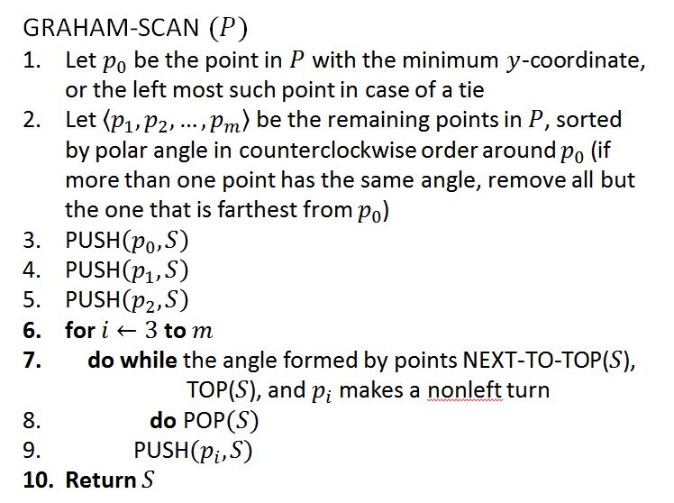
Complexity of Graham’s Scan
Phase 1: select a start point O(n)
Phase 2: Sorting
O(n*log n)
Phase 3: O(n)
Each point is inserted into the sequence exactly once, and
Each point is removed from the sequence at most once
O(n*logn)

Slide 28
Jarvis March
Also named as Gift Wrapping
6
7
4
5
3
2
8
1
0

Slide 29
Jarvis March

Slide 30
Find an extreme point
Choose a leftmost point as start point, if there are more than one points, choose the point with minimum y-coordinate.
6
7
4
5
3
2
8
1
0
Leftmost point with minimum y coordinate

Slide 31
Jarvis March
Y
Find a next point P that virtual point, start point and this point can form the biggest angle.
pv, p0, p7 form the biggest angle.
6
7
4
5
3
2
8
1
0
virtual point pv (0, -∞)

Slide 32
6
Point 6 forms the biggest angle with point 7 and 0
7
4
5
3
2
8
1
0

Slide 33
Collinear
6
Point 2 forms the biggest angle with point 6 and 7.
7
4
5
3
2
8
Farthest
1
0

Slide 34
6
Point 1 forms the biggest angle with point 2 and 6.
7
4
5
3
2
8
1
0

Slide 35
6
Point 0 forms the biggest angle with point 2 and 1.
7
4
5
3
2
8
1
0

Slide 36
6
It returns to start point 0, the algorithm ends here.
7
4
5
3
2
8
1
0

Slide 37
Time complexity
Order of n
Order of h
h : The number of points on convex hull
Time complexity: O(nh)

Slide 38
Graham Scan vs. Jarvis March
Time complexity of Jarvis March not necessarily worse than Graham’s scan
Is better in the case of small h (h < logn)
Which to use depends on,
The application
What usually happens in practice

Slide 39
Chan’s algorithm
Himeshi De Silva

Slide 40
Chan’s algorithm
Aims to improve the time complexity to a better value than that of Graham’s Scan and Jarvis March
Output sensitive
Key idea: The wrapping step of the Jarvis March can be made faster by performing some preprocessing on the points

Slide 41
Chan’s algorithm
P - a set of n ≥ 3 points in 2D

Slide 42
Chan’s algorithm: Phase 1

Slide 43
Chan’s algorithm: Phase 2
8)
7)
p₁
p₁
p₀
p₀

Slide 44
Chan’s algorithm: Example
Phase 1
n = 20
m = 5

Slide 45
Chan’s algorithm: Example
p₁
p₀

Slide 46
Chan’s algorithm: Example
p₁
p₀

Slide 47
Chan’s algorithm: Example
p₂
p₁
p₀

Slide 48
Chan’s algorithm: Example
p₃
p₂
p₁

Slide 49
Chan’s algorithm: Example
p₃
p₄
p₂
p₅
p₁
The wrapping must happen h times
p₆
p₈
p₇

Slide 50
Selecting H
The wrapping is done H times
The algorithm will only return the convex hull when H ≥ h
Therefore how can the desired answer be obtained?

Slide 51
Selecting H
Since the value of h is not known in advance, we use a sequence of H's to "guess" its value

Slide 52
Time complexity of Chan’s algorithm

Slide 53
Time complexity of Chan’s algorithm
Because this is done up to h times,

Slide 54
Time complexity of Chan’s algorithm
Since h is H in the algorithm
When

Slide 55
Time complexity of Chan’s algorithm
This procedure stops with the list of hull vertices as soon as the value of H in the for-loop reaches or exceeds h.
Therefore the number of iterations of the loop is
The t^{th} iteration of the loop takes
Therefor the total time complexity is,

Slide 56
Algorithms Correctness
Guo Qi

Slide 57
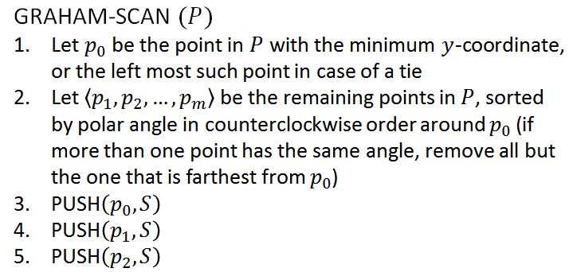
Correctness of Graham’s Scan
The correctness of Graham’s scan lies in two situations.
Part 1 deals with nonleft turns;
Part 2 deals with left turns.
Claim 1: The points on stack always form the vertices of a convex polygon.
Proof: The claim holds immediately after line 5.
Points p₀, p₁, and p₂ form a triangle.
p₂
p₁
p₀

Slide 58
Correctness of Graham’s Scan
Proof (cont’d): Note stack changes in two ways:
Case i: When points are popped from the stack S.
Case ii: When points are pushed onto the stack S.
Case i. Here we rely on the geometric property: If a vertex is removed from a convex polygon, then the resulting polygon is convex.
p_{i}
p_{k}
p_{j}
p_{j}
p_{k}
...
p₁
p₀
p_{k}
...
p₁
p₀
p₂
p₁
p₀

Slide 59
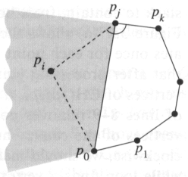
Correctness of Graham’s Scan
Proof (cont’d): Note stack changes in two ways:
Case i: When points are popped from the stack S.
Case ii: When points are pushed onto the stack S.
Case ii. If p_{i} is pushed onto the stack:
By the choice of p₀ and p₁, p_{i} lies above the extension of the line p₀p₁.
By the fact, a left turn occurs at p_{j}, p_{i} lies below the extension of the line joining p_{k} and p_{j}.
By the order of polar angle, p_{i} lies left of the line joining p₀ and p_{j}.
p_{i}
p_{j}
p_{k}
...
p₁
p₀
p_{j}
p_{k}
...
p₁
p₀

Slide 60
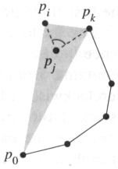
Correctness of Graham’s Scan
Claim 2: Each point popped from the stack is not a vertex of CH(P) and lies inside new convex hull.
Proof: Suppose that point p_{j} is popped from the stack because angle p_{k}p_{j}p_{i} makes a nonleft turn as shown in the figure.
Since points are ordered in increasing polar angle around anchor p₀, there exists a triangle Δp₀p_{i}p_{k} with p_{j} either in the interior of the triangle or on the line segment joining p_{i} and p_{k}. In either case, point p_{j} cannot be a vertex of CH(P).
p_{j}
p_{k}
...
p₁
p₀
p_{i}
p_{k}
...
p₁
p₀
p_{k}
...
p₁
p₀

Slide 61
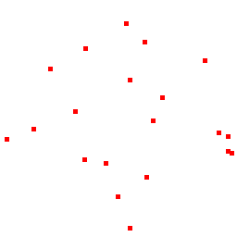
Correctness of Graham’s Scan
Conclusion
Since each point popped from the stack is not a vertex of CH(P) (by Claim 2). And the points on stack always form the vertices of a convex polygon (by Claim 1). Therefore, Graham’s Scan is correct.

Slide 62
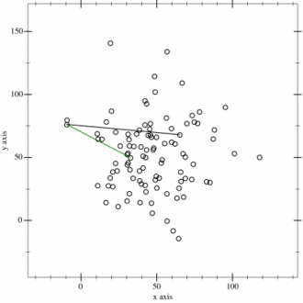
Correctness of Jarvis March
Jarvis March relies on the following two facts:
The leftmost point must be one vertex of the convex hull;
If point p is a vertex of the convex hull, then the points furthest clockwise and counterclockwise are also vertices of the convex hull.

Slide 63
Correctness of Jarvis March
If point p is a vertex of the convex hull, then p’s furthest counterclockwise is also a vertex of the convex hull.
p_{i}
p_{k}
Proof (by contradiction):
W.L.O.G, consider the case at p_{i} .
Then, p_{k} is the furthest counterclockwise.
Suppose p_{k} is not a vertex of the convex hull. However, since p_{i} is a vertex of the convex hull, it must connect with one other vertex.
In this case, vertices will fall on two sides of the edge. Contradiction!
p_{j}
p₂
p₁
p₀

Slide 64
Correctness of Jarvis March
Conclusion
Since we start at a vertex which must be one of the convex hull (the leftmost vertex). And each iteration we add a vertex which must be one of the convex hull (the counterclockwise of current vertex).
Since the convex hull has at most h vertices. Thus, Jarvis March is correct.

Slide 65
Algorithms Correctness and Application
Chen Zhenghai

Slide 66
Correctness of Chan’s Algorithm
Proof:
This algorithm preprocesses the input points and then uses Jarvis March to find the convex hull.
Both algorithms have the same starting points: visual point and leftmost point.
Every iteration, it gets the same point as Jarvis March gets. (Assume that H is big enough)
So it is correct because Jarvis March is correct.

Slide 67
Applications
Fast collision detection
Costly exact collision detection
Need to handle 2 polygons with
18 vertices even if they stay far away from each other

Slide 68
Applications
Fast collision detection
If compute convex hull
Handle 2 polygons with 10 vertices
Failing convex hull intersection test means two objects definitely don't collide and we can skip the costly exact collision detection step.
Thus speed up

Slide 69
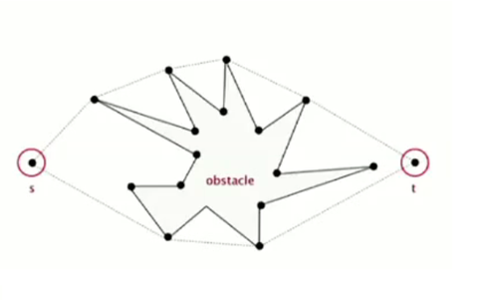
Applications
Shortest path
Computing the convex hull of all points (including s and t).
In order to get from s to t, the shortest path will either be the straight line from s to t (if the obstacle doesn't intersect it)
or one of the two polygonal chains of the convex hull.

Slide 70
Applications
Creating new mixture
We have some existing mixtures with known ingredient quantities.
Two ingredients: A and B
We want to create a new mixture with specific ingredient quantities.
 | A | B
1 | 10 | 10
2 | 30 | 20
3 | 35 | 40
…...
10 | 5 | 35

Slide 71
Applications
Creating new mixture
Assuming that new mixture can be created by the linear combination of existing mixtures.
Given a finite number of points in a real vector space.
where the real numbers satisfy and

Slide 72
Applications
Creating new mixture
How to test whether we can create the new mixture or not?
First, we compute the convex hull of all existing mixture points
Then, test if the new mixture point is inside the convex hull.
A
3
2
1
4
B

Slide 73
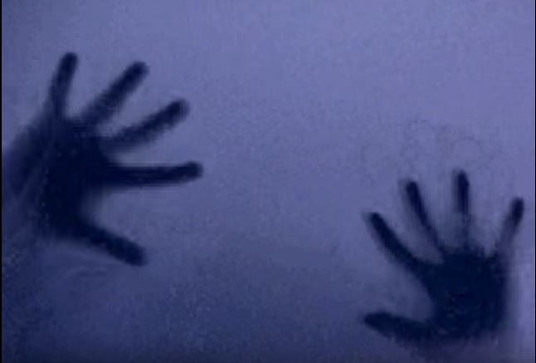
Applications
Hand tracking
https://www.youtube.com/watch?v=eHLHNaGQUos

Slide 74
Appendix

Slide 75
Divide & Conquer
hull(S) = smallest convex set that contains S (points are stored in ccw order)
Sort all points of S with increasing x-coordinates
Algorithm conv(S, n)
if n < 4, then trivially solved
else
DIVIDE: S_{l} & S_{r}
RECUR: conv(S_{l}, n/2), conv(S_{r}, n/2)
MERGE: combine hull(S_{l}) and hull(S_{r})

Slide 76
Divide & Conquer
Algorithm conv(S, n)
if n < 4, then trivially solved
else
DIVIDE: S_{l} & S_{r}
RECUR: conv(S_{l}, n/2), conv(S_{r}, n/2)
MERGE: combine hull(S_{l}) and hull(S_{r})

Slide 77
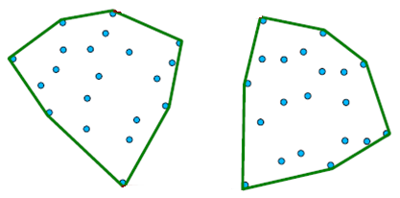
Divide & Conquer
Algorithm conv(S, n)
if n < 4, then trivially solved
else
DIVIDE: S_{l} & S_{r}
RECUR: conv(S_{l}, n/2), conv(S_{r}, n/2)
MERGE: combine hull(S_{l}) and hull(S_{r})
S_{l}
S_{r}

Slide 78
Divide & Conquer
upper bridge
Algorithm conv(S, n)
if n < 4, then trivially solved
else
DIVIDE: S_{l} & S_{r}
RECUR: conv(S_{l}, n/2), conv(S_{r}, n/2)
MERGE: combine hull(S_{l}) and hull(S_{r})
lower bridge

Slide 79
Divide & Conquer
u : rightmost of hull(S_{l})
v : leftmost of hull(S_{r})
succ : next point in ccw
prec : next point in cw
w lies below uv means cw(uvw)
succ(u)
pred(v)
u
v
pred(u)
u
succ(v)
v
w

Slide 80
Divide & Conquer
Procedure Find-lower-Bridge
u : rightmost of hull(S_{l})
v : leftmost of hull(S_{r})
while either pred(u) or succ(v) lies below uv
if pred(u) lies below then u:=pred(u)
else v = succ(v)
endwhile
return uv
u
v

Slide 81
Divide & Conquer
Procedure Find-lower-Bridge
u : rightmost of hull(S_{l})
v : leftmost of hull(S_{r})
while either pred(u) or succ(v) lies below uv
if pred(u) lies below then u:=pred(u)
else v = succ(v)
endwhile
return uv
u
v
u

Slide 82
Divide & Conquer
Procedure Find-lower-Bridge
u : rightmost of hull(S_{l})
v : leftmost of hull(S_{r})
while either pred(u) or succ(v) lies below uv
if pred(u) lies below then u:=pred(u)
else v = succ(v)
endwhile
return uv
v
u
u

Slide 83
Divide & Conquer
Procedure Find-lower-Bridge
u : rightmost of hull(S_{l})
v : leftmost of hull(S_{r})
while either pred(u) or succ(v) lies below uv
if pred(u) lies below then u:=pred(u)
else v = succ(v)
endwhile
return uv
v
u
v

Slide 84
Divide & Conquer
Procedure Find-lower-Bridge
u : rightmost of hull(S_{l})
v : leftmost of hull(S_{r})
while either pred(u) or succ(v) lies below uv
if pred(u) lies below then u:=pred(u)
else v = succ(v)
endwhile
return uv
u
v
lower bridge

Slide 85
Divide & Conquer
Procedure Find-upper-Bridge
u : rightmost of hull(S_{l})
v : leftmost of hull(S_{r})
while either succ(u) or pred(v) lies below uv
if succ(u) lies below then u:=succ(u)
else v = prev(v)
endwhile
return uv
u
v
lower bridge

Slide 86
Divide & Conquer
Procedure Find-upper-Bridge
u : rightmost of hull(S_{l})
v : leftmost of hull(S_{r})
while either succ(u) or pred(v) lies below uv
if succ(u) lies below then u:=succ(u)
else v = prev(v)
endwhile
return uv
v
u
v
lower bridge

Slide 87
Divide & Conquer
Procedure Find-upper-Bridge
u : rightmost of hull(S_{l})
v : leftmost of hull(S_{r})
while either succ(u) or pred(v) lies below uv
if succ(u) lies below then u:=succ(u)
else v = prev(v)
endwhile
return uv
u
v
u
lower bridge

Slide 88
Divide & Conquer
upper bridge
Procedure Find-upper-Bridge
u : rightmost of hull(S_{l})
v : leftmost of hull(S_{r})
while either succ(u) or pred(v) lies below uv
if succ(u) lies below then u:=succ(u)
else v = prev(v)
endwhile
return uv
u
v
lower bridge

Slide 89
Divide & Conquer
upper bridge
Algorithm conv(S, n)
if n < 4, then trivially solved
else
DIVIDE: S_{l} & S_{r}
RECUR: conv(S_{l}, n/2), conv(S_{r}, n/2)
MERGE: combine hull(S_{l}) and hull(S_{r})
u₁
v₁
u₀
v₀
lower bridge

Slide 90
Divide & Conquer
upper bridge
T(n) = 2T(n/2) + cn
2T(n/2): Recursion
cn: Combine conv(S_{l}) and conv(S_{r})
Master theorem
Easily calculate the running time without
doing an expansion
lower bridge

Slide 91
Divide & Conquer
T(n) = 2T(n/2) + cn
a=2, b=2
f(n) = cn ∈ ⊝(n)
d=1
T(n)=⊝(n log n) (a=b^{d} =2)

Slide 92
Applications
Fundamental content to computational geometry;
(e.g. Voronoi diagrams)
Computer visualization, ray tracing;
(e.g. video games, replacement of bounding boxes)
Path finding;
(e.g. embedded AI of Mars mission rovers)
Visual pattern matching;
(e.g. detecting car license plates)
Verification methods;
(e.g. bounding of Number Decision Diagrams)

Slide 93
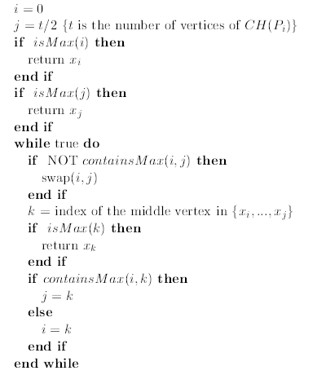
How to perform the binary search in Chan’s

Slide 94
Intuition of binary search in Chan’s

Slide 95
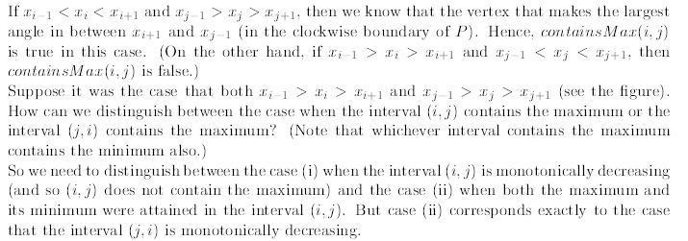
Intuition of binary search in Chan’s

Slide 96
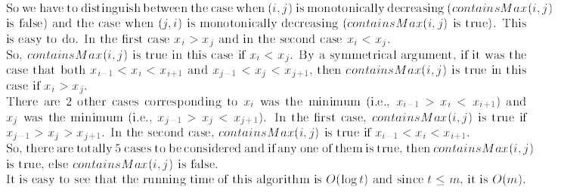
Intuition of binary search in Chan’s

