Slide 1
Randomized Algorithms
Hung Dang, Zheyuan Gao, Irvan Jahja, Loi Luu, Divya Sivasankaran

Slide 2
Agenda
DNF Counting Problem
Approximating the Permanent
Reduction to near uniform generation
Near-Uniform Generation of Matchings
Canonical Path Argument

Slide 3
Introduction
Hung Dang

Slide 4
Our problem
Counting the number of Perfect Matchings in a (dense) bipartite graph.
Each vertex has a degree of at least n/2 (n is number of vertices).
Number of perfect matching in a bipartite graph is equal to the permanent of the adjacency matrix representing the graph

Slide 5
Background
Counting problem
asks for the number of solutions to a given decision problem
as hard as the corresponding decision problem
#P Problem
Counting problem associated with the decision problems in NP
#P-complete Problem
A problem is #P-complete if any other problem in #P can be reduced to it in polynomial time
Notes:
Unfortunately, we do not know of a good deterministic approximation algorithms for any #P-­complete problem.
However, the situation changes appreciably if we permit ourselves the use of randomization in the approximation algorithm.

Slide 6
Background
Randomized Algorithm
employs a degree of randomness as part of its logic
uses uniformly random bits as an auxiliary input
good performance in the "average case"
Probabilistic Algorithm
A randomized algorithm which may output incorrect result or even fail to give an answer
Approximation Algorithm
Return the solutions to optimization problem
Approximation ratio is that the ratio between the result obtained by the algorithm and the optimal solution
Notes:
One has to distinguish between algorithms that use the random input to reduce the expected running time or memory usage, but always terminate with a correct result in a bounded amount of time (given an array with “a” in it - find “a”. This first types randomly picks an element until “a” is found), and probabilistic algorithms, which, depending on the random input, have a chance of producing an incorrect result or fail to produce a result either by signalling a failure or failing to terminate (randomly pick an element for upto k times or until “a” is found).
bounded-error is on false positive: output Yes, but it was actually a No

Slide 7
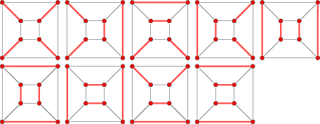
Perfect Matching
A matching (aka independent edge set) on a graph G = (V, E) is a subset of E such that no two edge in the subset share a vertex in common.
A perfect matching (aka complete matching or 1-factor) of a graph is a matching in which every vertex of the graph is incident to exactly one edge of the matching.
containing n/2 edges (the largest possible)
finding a perfect matching is in P
Notes:
A maximal matching is a matching M of a graph G with the property that if any edge not in M is added to M, it is no longer a matching
A maximum matching (also known as maximum-cardinality matching^{[1]}) is a matching that contains the largest possible number of edges. Note that every maximum matching is maximal, but not every maximal matching is a maximum matching.
Perfect matching is maximum and thus maximal.

Slide 8
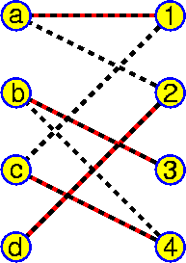
Perfect Matching in Bipartite Graph
Nevertheless, finding the number of perfect matching is not believed to be in P. Rather, it is #P-complete to count this number.
Interestingly, number of perfect matching in a bipartite graph is equal to the permanent of the adjacency matrix representing the graph
bipartite graph: vertices can be divided into two disjoint sets U and V such that every edge connects a vertex in U to one in V.
Notes:
Application: suppose that a set P of people are all seeking jobs from among a set of J jobs, with not all people suitable for all jobs. This situation can be modeled as a bipartite graph (P,J,E) where an edge connects each job-seeker with each suitable job. A perfect matching describes a way of simultaneously satisfying all job-seekers and filling all jobs

Slide 9
Permanent of a matrix
The sum here extends over all elements σ of the symmetric group Sn

Slide 10
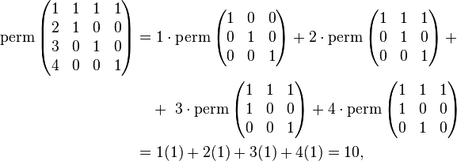
Permanent of a matrix
Expanding along the first column

Slide 11
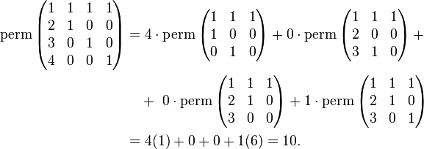
Permanent of a matrix
Expanding along the last row

Slide 12
Definitions
A polynomial approximation scheme (PAS) for a counting problem is a deterministic algorithm that takes an input instance I and a real number ε > 0, and in time polynomial in n = |I| produces an output A(I) such that
(1 - ε) #(I) ≤ A(I) (1 + ε) #(I)
A fully polynomial approximation scheme (FPAS) is a PAS whose running time is polynomially bounded in both n and 1/ε.
Notes:
Again, we do not know of a good deterministic approximation algorithms for any #P­complete problem. However, the situation changes appreciably if we permit ourselves the use
of randomization in the approximation algorithm

Slide 13
Definitions
A polynomial randomized approximation scheme (PRAS) for a counting problem is a randomized algorithm that takes an input instance I and a real number ε > 0, and in time polynomial in n = |I| produces an output A(I) such that
Pr[(1 - ε) #(I) ≤ A(I) ≤ (1 + ε) #(I)] ≥ 1-δ
A fully polynomial randomized approximation scheme (ε,δ)-FPRAS is a PRAS whose running time is polynomially bounded in n, 1/ε, and log 1/δ
Notes:
Notice that when #(I) is not in the range [A(I)(1 – ε), A(I)(1 + ε )], an event that occurs with probability at most 1/4, we assume nothing about how far A(I) is from #(I).

Slide 14
DNF Counting
Zheyuan Gao

Slide 15
The DNF Counting Problem
Disjunctive normal form(DNF): F(X₁ ,X₂...X_{n})=C₁ ∨C₂...∨C_{n}, C_{i}=L₁ ∧L₂...∧L_{ri,} L_{j} is either X_{k}or
Truth assignment: x=(x_{1,...,}x_{n}) satisfies F(x₁ ,x₂...x_{n})=1 or True.
#F: Number of distinct satisfying assignments of formula F(0<#F⩽2^{n})
DNF Counting Problem: Compute the value of #F.
Attemption of construct (ε,δ)-FPRAS for this problem.

Slide 16
An Unsuccessful Attempt
Abstract Problem: Let G be the set of all true assignments for F. We need to estimate |G|
Solution:Classical Monte Carlo Method：
Z$=|U|\sum_{i=1}^{N}{\frac{Y_{i}}{N}}$
Monte Carlo works by
Sampling from a distribution Y to estimate it’s mean
Higher sampling leads to higher accuracy
How many samples do we need to take to guarantee 1-δ accuracy?
Z: Estimation of size of truth assignments.
U: Set of all assignments. F:U➡{0,1}
Y_{i}: equals 1 if F(u₁)=1, and 0 otherwise.
N: Number of total attemption of assignment tests.

Slide 17
An Unsuccessful Attempt
How many samples do we need to take to guarantee 1-δ accuracy?
Let ρ=|G|/|U|, using Chernoff bound, we can derive that:
$N≥\frac{4}{ε^{2}ρ}\ln\left(\frac{2}{δ}\right)$ with probability at least 1-δ provided

Slide 18
An Unsuccessful Attempt
Chernoff bound for the sum of independent Bernoulli trials:
Let $X=\sum_{i=1}^{n}{x_{i}}$ where X_{i}=1 with probability p_{i} and X_{i}=0 with probability 1-p_{i}
Upper Tail: $P\left(X≥\left(1+δ\right)μ\right)≤e^{−\frac{δ^{2}}{2+δ}μ}$Lower Tail: $P\left(X≤\left(1−δ\right)μ\right)≤e^{−\frac{δ^{2}}{2}μ}$
Using Chernoff bound we can derive that
$\operatorname{Pr}\left[\left(1−ε\right)\left|G\right|≤Z≤\left(1+ε\right)\left|G\right|\right]$
$$=\operatorname{Pr}\left[\left(1−ε\right)Nρ≤Z≤\left(1+ε\right)Nρ\right]$$
$$=1−P\left(Z≥\left(1+ε\right)Nρ\right)−P\left(Z≤\left(1−ε\right)Nρ\right)≥1−2∗e^{−\frac{Nρε^{2}}{4}}$$

Slide 19
An Unsuccessful Attempt
1.­ It has a running time of at least N, where N ≥ 1/ρ, but we don’t know ρ. (ρ=|G|/|U|)
2. The running time is inversely proportional to ρ, and at least for the DNF counting problem this could be exponentially large.

Slide 20
Why naive Monte Carlo doesn’t work?
1.­ When the fraction of true assignments is very small compared to all assignments(e.g., 2-n fraction), then it is unlikely that we will ever successfully sample a true assignment.
2. We will incorrectly approximate the number of true assignments to be zero.
3. According to (ε,δ)-FPRAS, 0 is an incorrect approximation to any positive value.

Slide 21
Fundamental Issue with Monte Carlo
1. Does not work if the fraction we want to approximate may be extremely small.
2. We will later use Monte Carlo to approximate something else that will either be zero, or be not very small.
3. In this case, Monte Carlo method will yield good approximation.

Slide 22
The Coverage Algorithm
Reducing the size of sample space?
We will solve a slightly different problem: Union of sets and use it to estimate ρ
Let V be a finite universe, giving n subsets H₁H₂...H_{m}⊆V
For all i, |H_{i}| is computable in polynomial time.
It is possible to sample uniformly at random from any H_{i}
For all v ∈V, it can be determined in polynomial time whether v∈ H_{i}
Target: Estimate the size of H₁UH₂U...UH_{m}

Slide 23
The Coverage Algorithm
Multiset union which contains as many copies as v∈V.
$$\left|U^{′}\right|=\sum_{i=1}^{m}{\left|H_{i}\right|≥|H|}$$
Adopt the ordered pairs:$U^{′}=\{(v,i)|v∈H_{i}\}$
For all v∈H, the coverage set of v; is defined by:$f\left(\left(v,i\right)\right)=\left\{\begin{aligned}1 if i=min⁡\{j|v∈H_{j}\} \\ 0 otherwise\end{aligned}\right.$
We define G’: $G^{′}=\{(v,j)∈U|f\left(\left(v,i\right)\right)=1\}$

Slide 24
Monte Carlo with Coverage Algorithm
Assume that we know the number of samples N (for now)
Sample from U’, and estimate number |G’|/|U’|
This fraction will be at least 1/m (since one assignment can be in at most m sets)
From the estimate of this ratio, we can estimate |G’|

Slide 25
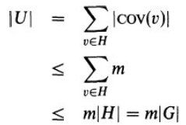
Finding N
In the union of sets problem:
Proof:
Conclusion:

Slide 26
Relating back to DNF counting problem
Pose the DNF problem as a Coverage problem where H_{i} is the set of assignments for which C_{i} is true.
Estimating |G| in the DNF problem is the same as estimating |G’| in coverage algorithm

Slide 27
Approximating the Permanent using Monte Carlo
Irvan Jahja

Slide 28
Perfect Matching Approximation
Define m_{k} to be the number of matchings with k edges in the graph G
Works iteratively.
Calculate m1
For i= 0..k. Calculate m_{i+1} using m_{i}
m_{n} is the answer.

Slide 29
Calculating mi+1 from mi
If we know the ratio between m_{i+1} and m_{i} and we know m_{i}, we can use this ratio to calculate m_{i+1} from m_{i}.
Let r be this ratio.
Assuming we have a uniform generator that can generate a uniformly random matching from m_{i+1} and m_{i}, we can use this generator to approximate this ratio via monte carlo.
m₁ is easy to calculate (equal to |E|)

Slide 30
Ratio guarantees
In order to use Monte Carlo to approximate the ratio, we need the guarantee that the ratio cannot be too small or too big.
Otherwise, we will only get samples from either mi or m_{i+1}.
This is the reason we need the n/2 degree assumption.

Slide 31
Ratio guarantees
Theorem 11.5: Let G be a bipartite graph with minimum degree at least n/2. Then, for all k, 1/(n²) ≤ r ≤ n²
Proof:
Given a matching with i edges, the number of matches with i+1 edges that contain this matching as a subset will be at most n².
Under the n/2 degree assumption, every matching with i edges has an augmenting path of length 3.
Given a matching with i+1 edges, there are at most n² matchings with i edges that is a subset of this matching.

Slide 32
Summary so far
Given a black box to uniformly sample a matching from m_{i} or m_{i+1} exist, we can get a good approximation to the number of perfect matchings
How does one write such a black box?

Slide 33
Near Uniform Generation of Perfect Matchings
Loi Luu

Slide 34
Near uniform generation of matching
Input
A bipartite graph G = (V₁, V₂, E) with minimum degree of n/2
Step 2: Ultimate goal
Counting m_{n}=|M_{n}|
Step 1: Estimate r_{k}=m_{k}/m_{k-1}
Given r₁=m₁=|E|, can estimate m_{n}=r₁r₂...r_{n}
Step 0: Uniformly samples in M_{k}U M_{k-1}
Can estimate r_{k}

Slide 35
Near uniform generation of matching
Goal: Find a near-uniform random matching generator for M_{k} U M_{k-1}
Input: A bipartite graph G = (V₁, V₂, E) with minimum degree of n/2
Output: A matching m which is almost uniformly chosen at random
Requirement: error rate r < 1/n⁴
Approach
Devise a Markov chain model
Each matching m for G is a state
Each edge in E is a transition
Start from an arbitrary matching m
Use random walk in polynomial number of steps to reach a matching m’ at uniformly random

Slide 36
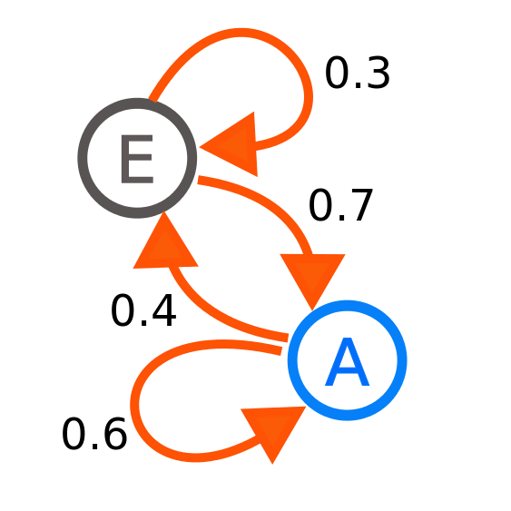
Background: Markov Chain
Chain of states
Markov property
The state of the system at time t depends only on the state of the system at time t-1
Stationary Assumption (memoryless property)
Transition probabilities are independent of time (t)
B

Slide 37
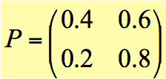
Markov Chain: Weather Example
Vector X^{(t)} is a distribution at day t
X^{(t)}[i]: probability of reaching state i at time t
X⁽⁰⁾[0]: probability of having rain when the Earth was “born”
X^{(t)}[0]: probability of having rain in day t
X^{(t)}=X^{(t-1)}P
 | 0-Rain (day t+1) | 1-No Rain (day t+1)
0-Rain (day t) | 40% | 60%
1-No Rain (day t) | 20% | 80%
Stochastic Matrix

Slide 38
Observation
If X^{(t)} is uniformly distributed for all t > T
Regardless of the starting state, we’ll reach to a state S at uniformly random after T times
Back to our problem
We start with some arbitrary m
We want to sample some matching m’ at uniformly random
We will be able to do this easily once we show that the distribution is almost stationary.
Whether T exists? How large?

Slide 39
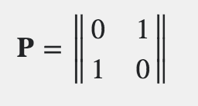
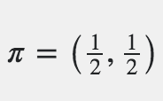
Background: Markov Chain
Stationary distribution: A vector 𝛑
If 𝛑 is uniform
All states can be reached with the same probability
If the Markov chain is irreducible and aperiodic
There is a unique stationary distribution
Reach stationary distribution 𝛑 from any X⁽⁰⁾
𝛑 = 𝛑*P
Notes:
A state i has period k if any return to state i must occur in multiples of k time steps. If k = 1, then the state is said to be aperiodic.
A Markov chain is said to be irreducible if its state space is a single communicating class; in other words, if it is possible to get to any state from any state.

Slide 40
Stationary distribution & random walk
A random walk
The next state is chosen uniformly random among all possible states
If a Markov chain is in its stationary distribution
After a random walk still in stationary distribution
Take random walks of length T in a Markov chain C
T must large enough to reach C’s stationary distribution
End up in a state chosen uniformly at random
Problem
T may reach ∞
Intuition: trade off efficiency vs. accuracy
only take some polynomial steps T
nearly uniform

Slide 41
Building Markov Chain C_{k} from G
Given: Graph G = (V₁, V₂, E)
Devise a Markov chain C_{k}
Each matching in M_{k} U M_{k-1} is a state in C_{k}
Each edge e=(u, v) is a transition

Slide 42
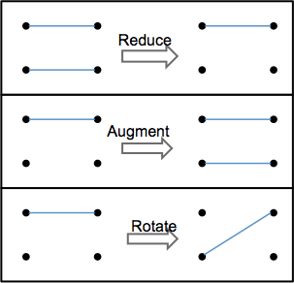
Markov Chain C_{k}: transition of state m
p=½ remains at m
p=½ randomly choose an edge e=(u, v) of E
Reduce: if m in M_{k}, e in m, move to state (matching) m’ = m-e
Augment: If m in M_{k-1} with u, v are not matched in m, move to m’ = m+e
Rotate: If m in M_{k-1} with u is matched by edge f, v is not matched, move to m’=(m+e)-f
Idle: otherwise

Slide 43
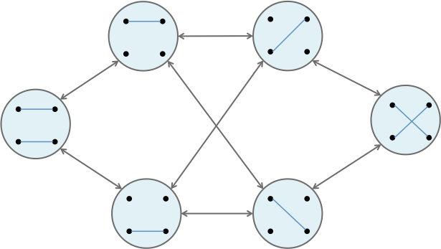
Example of C₂

Slide 44
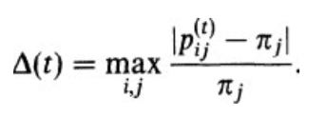
Properties of C_{n}
C_{n} has uniform stationary distribution
Starting from any initial state, will reach stationary distribution
Goal:
Within some polynomial steps t: X^{(t)} resembles 𝛑
Call p_{ij}^{(t)}: probability of reaching j from state i after t steps
p_{ij}^{(t)} = 𝛑[j] if t is infinite, i.e. stationary distribution
Pointwise distance: how close to reaching the stationary distribution
In stationary 𝚫(t) = 0
We want to show after some polynomial step t: 𝚫(t)<= 1/n⁴ (error rate)

Slide 45
Supporting theorem
ƛ₂: second eigenvalue
Theorem 11.7
Pick t as
We get 𝚫(t) ≤ 1/n⁴
What’s remaining?
Show 1/(1-ƛ₂) is bounded by a polynomial of n
N: number of states of C_{n}
N = O(n²)

Slide 46
Supporting lemma
Assume for now: Φ is a magic number in C_{n}
What’s remaining
Show that Φ’s lower bound is some polynomial of n
1/(1-ƛ₂) is bounded by a polynomial of n! QED!
Coming up: Divya
Define what Φ is
Show that $Φ$≥ $\frac{1}{12n6}$ by canonical argument!

Slide 47
Canonical Path Argument
Divya Sivasankaran

Slide 48
Background
Input graph G = (V, E)
Graph underlying the markov chain C_{n} = H
We show only for C_{n} – For C_{k} the same proof works with minor modification.
Number of nodes in H: N
The second eigen value of the transition matrix $λ_{2}$
Prove: $\frac{1}{1−λ_{2}}$ is polynomially upper-bounded in n
Lemma: $λ_{2}≤1−\frac{Φ^{2}}{2}$
$\frac{1}{1−λ_{2}}≤\frac{2}{Φ^{2}}$
Sufficient to prove 1/ $Φ$ has an upper bound polynomial in n

Slide 49
Conductance
What is $Φ$?
Let S be a subset of the set of states of C_{n} such that Ø⊂S⊂M_{n}∪M_{n-1}with complement $\overline{S}$
Capacity of S: $∁_{S}=\sum_{i∈S}{π_{i}}$
Ergodic flow out of S: $F_{s}=\sum_{i∈S,j∈\overline{S}}{w_{ij}}$
Conductance of S: $Φ_{S}=F_{S}/∁_{S}$
Where $π$ is the stationary distribution and ${ w}_{ij}$ = $π_{i}$ p_{ij} is the stationary probability of transition i->j
Notes:
Capacity is the probability that the markov chain in a state of S
Ergodic flow is the probability that it will leave S
Conductance is the probability that it will leave S conditional upon being inside a state in S
Higher the conductance, the lower the chance for the chain to get stuck inside S. If all sets S have high conductances, then the Markov chain will be rapidly mixing

Slide 50
Conductance
Conductance of Markov chain with state space $Q$, is defined as
$Φ= \min_{∅⊂S⊂Q,∁_{S}≤1/2}{Φ_{S}}$
Intuitively, conductance is the probability that it will leave S conditional upon being inside a state in S during the random walk
Theorem (Jerrum and Sinclair):
For the Markov chain C_{n}, $Φ$≥$\frac{1}{12n6}$
Notes:
n = size of perfect match (i.,e number of vertices in each group of the bi-partite graph)
By proving the lower bound being polynomial in n, we indirectly prove the upper bound polynomial in n, which proves that the number of steps in polynomial in n

Slide 51
Canonical path
For every pair of states $X,Y∈Q$ define a path
$\left(X,Y\right)=\left(X=P_{0,}P_{1,}P_{2,},…,P_{m,}=Y\right)$
where the probability of going from $P_{i}$ to $P_{i+1}$ is nonzero
Remember this is only a theoretical exercise!!
P₁
P₀
P₂
X
Y
Notes:
Remember that this is purely a theoretical exercise to prove the upper bound on the number of steps needed for the Markov chain to approximate a near uniform generation. We do NOT need to calculate the following during run-time.

Slide 52
Proof for lower bound on conductance
Theorem (Jerrum and Sinclair):
For the Markov chain C_{n}, $Φ$≥$\frac{1}{12n6}$
Proof:
Assumption (1)
0 < |S| ≤ N/2
Specify a canonical path between every pair of vertices in H, such that no oriented edge of H occurs in more than bN of these paths
For every such S, # of paths crossing from S to $\overline{S} :$|S|(N-|S|)
Notes:
n = size of perfect match (i.,e number of vertices in each group of the bi-partite graph)
By proving the lower bound being polynomial in n, we indirectly prove the upper bound polynomial in n, which proves that the number of steps in polynomial in n

Slide 53
Proof
From (1), N-|S| ≥ N/2
Hence # of paths
|S|(N-|S|) ≥ $\frac{|S|N }{2}$
# of edges from S to $\overline{S}$ ≥ $\frac{|S|N }{2bN}$ = $\frac{\left|S\right| }{2b}$
Proposition: 2.11¹ (2)
For any subset S⊆ V, Γ(S) is the cut set defined by S (edges connecting S and $\overline{S}$);
the edge magnification μ(H) = min _{0<|S|≤|V|/2} $\frac{|\text{Γ}\text{(}\text{S}\text{)}\text{|}}{|S|}$
then, $Φ$ = P_{ij} μ(H); where P_{ij} is the transition probability.
The only thing we don’t know to comupte $Φ$ is P_{ij}
Notes:
Each edge = 1 transition

Slide 54
Proof
Transition probability for each transition in H: P_{ij} = $\frac{1}{2|E|}$
Substituting the values for P_{ij} and μ(H) in (2)
$Φ$ ≥$\frac{1}{2|E|}$ $\frac{|S|}{2b|S|}$
$Φ$ ≥ $\frac{1}{4b|E|}$ ≥ $\frac{1}{4bn2}$ [∵ the maximum value for |E| = n²]
To prove that$Φ$≥ $\frac{1}{12n6}$ ; we need to prove that b ≤ 3n⁴
Recall that bN is the maximum number of paths per edge
Notes:
½ probability that it will not transition (x->x)
½ probability that it will pick e from |E| and perform an augment, reduce or rotate.

Slide 55
How do we estimate the bound on b?
We will show that there exists a set of canonical paths, such that b ≤ 3n⁴
This is sufficient to guarantee $Φ$≥ $\frac{1}{12n6}$
Notes:
Remember that this is purely a theoretical exercise to prove the upper bound on the number of steps needed for the Markov chain to approximate a near uniform generation. We do NOT need to calculate the following during run-time.

Slide 56
Constructing canonical paths
For every node $s∈M_{n−1}∪M_{n}$, associate it with any one partner node
$\overline{s}∈$ $M_{n}$ that is close to s
Choose a canonical path between $s$ and $\overline{s}$, If $s$ is in $M_{n}$, then we set $s$ =$\overline{ s}.$
In general, canonical paths between nodes $s$, $t$ $∈M_{n−1}∪M_{n}$ consists of three consecutive segments, s to $\overline{s}$, $\overline{s}$ to $\overline{t}$ and $\overline{t}$ to t .
Two types of paths/segments
Type A : paths between a node $s∈M_{n−1}∪M_{n}$ and its partner $\overline{s}∈M_{n}$ (s to $\overline{s}$ & $\overline{t}$ to t)
Type B : paths between pairs of nodes in $M_{n}$ ($\overline{s}$ to $\overline{t}$)
Notes:
Case 2: Augment
Case 3: Rotate & Augment

Slide 57
Canonical Path Argument
Type A, 3 cases
s $∈M_{n}$ ; empty path, $s$ =$\overline{ s}$
s $∈$ $M_{n−1}$, and there exists an edge e (from graph G), such that $\overline{ s}$ = s + {e} $∈$ $M_{n}$
s $∈$ $M_{n−1}$ with no augmenting path. Recall that since degree is at least N/2, the maximum augmenting length is 3. ∴ maximum transitions needed is 2.

Slide 58
Canonical Path Argument
Type B:
Fix any 2 perfect matchings, s,t ∈ M_{n} , d = s ⊕ t
⊕ : symmetric difference operator
d: disjoint, alternating cycles
Arbitrarily order the vertices in these cycles and pick a start vertex
Unwind each of the cycles in d, to obtain a canonical set of transitions in H from s to t

Slide 59
Unwinding a cycle C_{k}
Starting at vertex v_{i}, remove the edge that belongs to s, move to the next vertex v_{i+1}
If there is no edge of s connecting v_{i+2}, add the edge that belongs to t (Augment)
Else, Rotate to add the edge that belongs to t and move to the next vertex

Slide 60
Unwinding a cycle

Slide 61
Canonical Path Argument
For all $s$, $t$ $∈M_{n−1}∪M_{n}$, there exists a set of canonical paths in H.
Let m $∈$M_{n} ; k(m) – set of all nodes $s∈M_{n}∪M_{n−1}$ such that $\overline{s}=m and s≠m$
Lemma: For any $m∈M_{n}, \left|k\left(m\right)\right|<n^{2}$
Proof
Only perfect matching that chooses m as a partner is itself.
For any near perfect matching of distance 1, there are exactly n possible nodes s incident on m
For any near perfect matching of distance 2, there are n(n-1) possible nodes to m
Maximum number of near-perfect matchings that could pick m as it’s partner = n+n(n-1) = n²
Notes:
The only perfect matching that chooses m as its partner is m itself. It requires n Reduce operations to reach any near near perfect matching adjacent to m. The number of near perfect matchings at distance exactly 2 from m is at most n(n-1).
Thus, there are at most n+n(n-1) different near perfect matchings within distance of two of m.

Slide 62
Proof of upper bound on b
For all $s$, $t$ $∈M_{n−1}∪M_{n}$, there exists a set of canonical paths in H as s to $\overline{s}$, $\overline{s}$ to $\overline{t}$ and $\overline{t}$ to t .
We defined the maximum such paths a particular transition/edge can be a part of as bN
Lemma: Any transition T in H lies on at most 3n⁴N distinct canonical paths
Proof
Fix a path T (u,v) in H. T can lie in 2 types of canonical segments
Type A Paths (first and last segments)
s to $\overline{s}$, s must be in the set k($\overline{s}$); maximum number of paths |k($\overline{s}$)| N (N = number of nodes possible for s)
$\overline{t}$ to t, $\overline{t}$ must be in the set k(t); maximum number of paths |k(t)| N

Slide 63
Proof of upper bound on b ctd..
Type B Paths (middle segment, $\overline{s} to \overline{t}$)
Number of paths that T can lie in: |k($\overline{s}$)| |k($\overline{t}$)| N
∴ Maximum number of paths T can be a part of bN = Type A + Type B
bN = |k($\overline{s}$)| |k($\overline{t}$)| N + |k(t)| N + |k($\overline{s}$)| N
= n⁴N + 2n²N ≤ 3n⁴N
∴ b ≤ 3n⁴

Slide 64
Conclusion
DNF Counting Problem
Approximating the Permanent
Reduction to near uniform generation
Near-Uniform Generation of Matchings
Canonical Path Argument
Applications
Network reliability
Statistical Physics

