Slide 1

A Peek at Programming or, problem solving in Computer Science
Aaron Tan
http://www.comp.nus.edu.sg/~tantc/bingo/

Slide 2

Contents
What is Computer Science (CS)?
What is Problem Solving?
What is Algorithmic Problem Solving?
What is Programming?
  Control structures
  Recursion

Slide 3





What is Computer Science?
Computing Curricula 2001 (Computer Science) Report identifies 14 knowledge focus groups
  Discrete Structures (DS)
  Programming Fundamentals (PF)
  Algorithms and Complexity (AL)
  Architecture and Organization (AR)
  Operating Systems (OS)
  Net-Centric Computing (NC)
  Programming Languages (PL)
  Human-Computer Interaction (HC)
  Graphics and Visual Computing (GV)
  Intelligent Systems (IS)
  Information Management (IM)
  Social and Professional Issues (SP)
  Software Engineering (SE)
  Computational Science (CN)
O(n²)
P = NP ?
3

Slide 4

Problem Solving Exercises
The exercises in the next few slides are of varied nature, chosen to illustrate the extent of general problem solving.
Different kinds of questions require different domain knowledge and strategies.
Apply your problem solving skills and creativity here!

Slide 5


Warm-up #1: Glasses of milk
Six glasses are in a row, the first three full of milk, the second three empty. By moving only one glass, can you arrange them so that empty and full glasses alternate?

Slide 6

Warm-up #2: Bear
A bear, starting from the point P, walked one mile due south. Then he changed direction and walked one mile due east. Then he turned again to the left and walked one mile due north, and arrived at the point P he started from. What was the colour of the bear?

Slide 7

Warm-up #3: Mad scientist
A mad scientist wishes to make a chain out of plutonium and lead pieces. There is a problem, however. If the scientist places two pieces of plutonium next to each other, KA-BOOM!!!
In how many ways can the scientist safely construct a chain of length 6?
General case: What about length n?

Slide 8
Warm-up #4: Silver chain
A traveller arrives at an inn and intends to stay for a week. He has no money but only a chain consisting of 7 silver rings. He uses one ring to pay for each day spent at the inn, but the innkeeper agrees to accept no more than one broken ring.
How should the traveller cut up the chain in order to settle accounts with the innkeeper on a daily basis?

Slide 9
Warm-up #5: Dominoes
Figure 1 below shows a domino and Figure 2 shows a 4×4 board with two squares at opposite corners removed. How do you show that it is not possible to cover this board completely with dominoes?
Figure 1. A domino.
Figure 2. A 4×4 board with 2 corner squares removed.
General case: How do you show the same for an n×n board with the two squares at opposite corners removed, where n is even?
Special case: How do you show the same for an n×n board with the two squares at opposite corners removed, where n is odd?

Slide 10
Warm-up #6: Triominoes
Figure 3 below shows a triomino and Figure 4 shows a 4 × 4 board with a defect (hole) in one square. How do you show that the board can be covered with triominoes?
Figure 3. A triomino.
Figure 4. A 4×4 board with a hole.
General case: How do you show that a 2^{n} × 2^{n} board (where n ≥ 1) with a hole in one square (anywhere on the board) can be covered with triominoes?

Slide 11
Problem Solving Process (1/5)
Analysis
Design
Implementation
Testing
Determine the inputs, outputs, and other components of the problem.
  Description should be sufficiently specific to allow you to solve the problem.

Slide 12
Problem Solving Process (2/5)
Analysis
Design
Implementation
Testing
Describe the components and associated processes for solving the problem.

Slide 13
Problem Solving Process (3/5)
Analysis
Design
Implementation
Testing
Develop solutions for the components and use those components to produce an overall solution.

Slide 14
Problem Solving Process (4/5)
Analysis
Design
Implementation
Testing
Test the components individually and collectively.

Slide 15
Problem Solving Process (5/5)
Determine problem features
Analysis
Rethink as appropriate
Write algorithm
Design
Produce code
Implementation
Check for correctness and efficiency
Testing

Slide 16
Algorithmic Problem Solving
An algorithm is a well-defined computational procedure consisting of a set of instructions, that takes some value or set of values, as input, and produces some value or set of values, as output.
Input
Algorithm
Output
Exact
Terminate
Effective
General

Slide 17






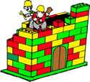
Programming
Java constructs
Problem solving
Program

Slide 18
A Java Program (Bingo.java)
Comment
// Display a message.
public class Bingo {
public static void main(String[] args) {
System.out.println("B I N G O !");
}
}
Class name
Method name
Method body
Output

Slide 19
Another Java Program (Welcome.java)
API package
// Author: Aaron Tan
// Purpose: Ask for user’s name and display a welcome message.
import java.util.*;
public class Welcome {
public static void main(String[] args) {
Scanner scanner = new Scanner(System.in);
System.out.print("What is your name? ");
String name = scanner.next();
System.out.println("Hi " + name + ".");
System.out.println("Welcome!");
}
}
Creating a Scanner object
Input
An object of class String

Slide 20
Control Structures
Sequence
(default)
Branching/
Selection
if-else
switch
Loop/
Repetition
for
while
do while
20
Control structures determine the flow of control in a program, that is, the order in which the statements in a program are executed/evaluated.

Slide 21
Algorithm: Example #1
A possible algorithm:
enter values for num1, num2, num3
ave ← ( num1 + num2 + num3 ) / 3
print ave
Variables used:
num1
num2
num3
ave
Another possible algorithm:
enter values for num1, num2, num3
total ← ( num1 + num2 + num3 )
ave ← total / 3
print ave
Variables used:
num1
num2
num3
total
ave
21
Compute the average of three integers.

Slide 22
Algorithm: Example #2
Algorithm A:
enter values for num1, num2
// Assign smaller number into final1,
// larger number into final2
if ( num1 < num2 )
then final1 ← num1
final2 ← num2
else final1 ← num2
final2 ← num1
// Transfer values in final1, final2 back to num1, num2
num1 ← final1
num2 ← final2
// Display sorted integers
print num1, num2
Variables used:
num1
num2
final1
final2
22
Arrange two integers in increasing order (sort).

Slide 23
Algorithm: Example #2 (cont.)
Algorithm B:
enter values for num1, num2
// Swap the values in the variables if necessary
if ( num2 < num1 )
then temp ← num1
num1 ← num2
num2 ← temp
// Display sorted integers
print num1, num2
Variables used:
num1
num2
temp
23
Arrange two integers in increasing order (sort).

Slide 24
Algorithm: Example #3
Algorithm:
enter value for n
// Initialise a counter count to 1, and ans to 0
count ← 1
ans ← 0
while ( count ≤ n ) do
ans ← ans + count // add count to ans
count ← count + 1 // increase count by 1
// Display answer
print ans
Variables used:
n
count
ans
24
Find the sum of positive integers up to n (assuming that n is a positive integer).

Slide 25



Algorithmic Problem Solving #1: Maze
25

Slide 26
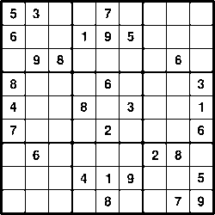
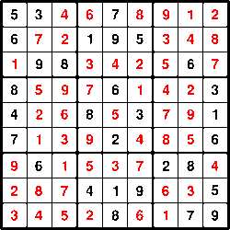
Algorithmic Problem Solving #2: Sudoku
26

Slide 27
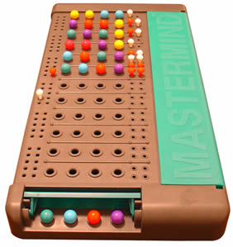






Algorithmic Problem Solving #3: MasterMind (1/2)
Sink: Correct colour, correct position
Hit: Correct colour, wrong position
Secret code
Sinks
Hits
Secret code
Sinks
Hits
Guess #1
1
1
Guess #1
1
0
Guess #2
1
2
Guess #2
0
1
Guess #3
2
2
Guess #3
1
0
Guess #4
4
0
Guess #4
1
1
27

Slide 28
Algorithmic Problem Solving #3: MasterMind (2/2)
6 colours:
    R: Red
    B: Blue
    G: Green
    Y: Yellow
    C: Cyan
    M: Magenta
Given a secret code (secret) and a player’s guess (guess), how do we compute the number of sinks and hits?
28

Slide 29
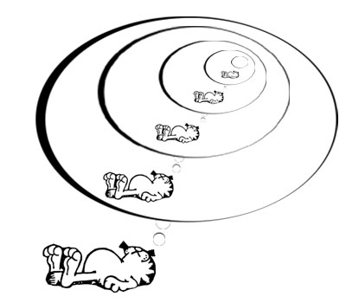
Recursion
29

Slide 30
Recursive Definitions
30
A definition that defines something in terms of itself is a recursive definition.
  The descendants of a person are the person’s children and all of the descendants of the person’s children.
  A list of numbers is
    A number, or
    A number followed by a list of numbers.
A recursion algorithm is one that invokes itself to solve smaller or simpler instance(s) of the problem.

Slide 31
Factorial
Can be defined as:
Or, by recursive definition:
31

Slide 32
Recursive Methods
A recursive method generally has 2 parts:
  A termination part that stops the recursion
    This is called the base case
    Base case should have simple solution
    Possible to have more than one base case
  One or more recursive calls
    This is called the recursive case
    The recursive case calls the same method but with simpler or smaller arguments
  if ( base case satisfied ) {
  return value;
  }
  else {
  make simpler recursive call(s);
  }
32

Slide 33
Recursive Method for Factorial
public static int factorial(int n) {
if (n == 0)
return 1;
else
return n * factorial(n-1);
}
Base case.
Recursive case deals with a simpler (smaller) version of the same task.
33

Slide 34
Recursive Method for Factorial
A recursive method generally has 2 parts:
  A termination part that stops the recursion
    This is called the base case
    Base case should have simple solution
    Possible to have more than one base case
  One or more recursive calls
    This is called the recursive case
    The recursive case calls the same method but with simpler or smaller arguments
34

Slide 35
Exercise: North-East Paths (1/2)
Find the number of north-east paths between two points.
North-east (NE) path: you may only move northward or eastward.
How many NE-paths between A and C?
C
A
A
ne(1, 1) = 2
ne(1, 2) = 3
ne(2, 2) = ?
ne(4, 6) = ?
A
A
Let x and y be the rows and columns apart between the two points.
Write recursive method ne(x, y)
35

Slide 36
Exercise: North-East Paths (2/2)
public static int ne(int x, int y) {
}
public static void main(String[] args) {
Scanner scanner = new Scanner(System.in);
System.out.print("Enter rows and columns apart: ");
int rows = scanner.nextInt();
int cols = scanner.nextInt();
System.out.println("Number of North-east paths = "
+ ne(rows, cols));
}
+
36

Slide 37

Towers of Hanoi (1/10)
37
The classical “Towers of Hanoi” puzzle has attracted the attention of computer scientists more than any other puzzles.
Invented by Edouard Lucas, a French mathematician, in 1883.
There are 3 poles (A, B and C) and a tower of disks on the first pole A, with the smallest disk on the top and the biggest at the bottom. The purpose of the puzzle is to move the whole tower from pole A to pole C, with the following rules:
  Only one disk can be moved at a time.
  A bigger disk must not rest on a smaller disk.

Slide 38
Towers of Hanoi (2/10)
We attempt to write a program to generate instructions on how to move the disks from pole A to pole C.
Example: A tower with 3 disks.
Output generated by program is as follows. It assumes that only the top disk can be moved.
Move disk from A to C
Move disk from A to B
Move disk from C to B
Move disk from A to C
Move disk from B to A
Move disk from B to C
Move disk from A to C
38

Slide 39
Towers of Hanoi (3/10)
Move disk from A to C
Move disk from A to B
Move disk from C to B
Move disk from A to C
Move disk from B to A
Move disk from B to C
Move disk from A to C
A
B
C
39

Slide 40
Towers of Hanoi (4/10)
Move disk from A to C
Move disk from A to B
Move disk from C to B
Move disk from A to C
Move disk from B to A
Move disk from B to C
Move disk from A to C
A
B
C
40

Slide 41
Towers of Hanoi (5/10)
Move disk from A to C
Move disk from A to B
Move disk from C to B
Move disk from A to C
Move disk from B to A
Move disk from B to C
Move disk from A to C
A
B
C
41

Slide 42
Towers of Hanoi (6/10)
Move disk from A to C
Move disk from A to B
Move disk from C to B
Move disk from A to C
Move disk from B to A
Move disk from B to C
Move disk from A to C
A
B
C
42

Slide 43
Towers of Hanoi (7/10)
Move disk from A to C
Move disk from A to B
Move disk from C to B
Move disk from A to C
Move disk from B to A
Move disk from B to C
Move disk from A to C
A
B
C
43

Slide 44
Towers of Hanoi (8/10)
Move disk from A to C
Move disk from A to B
Move disk from C to B
Move disk from A to C
Move disk from B to A
Move disk from B to C
Move disk from A to C
A
B
C
44

Slide 45
Towers of Hanoi (9/10)
Move disk from A to C
Move disk from A to B
Move disk from C to B
Move disk from A to C
Move disk from B to A
Move disk from B to C
Move disk from A to C
VIOLA!
A
B
C
45

Slide 46
Towers of Hanoi (10/10)
public static void towers(int n,
char source, char temp, char dest) {
}
public static void main(String[] args) {
Scanner scanner = new Scanner(System.in);
System.out.print( "Enter number of disks: " );
int disks = scanner.nextInt();
towers(disks, 'A', 'B', 'C');
}
Check this out: http://www.mazeworks.com/hanoi/
+
46

Slide 47
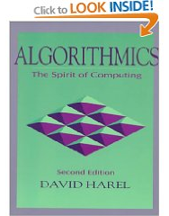
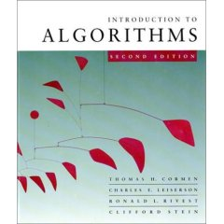
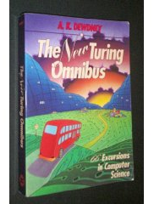

Books on Computer Science/Algorithms
Some recommended readings
  How to Think about Algorithms
  Jeff Edmonds, Cambridge, 2008
  Algorithmics: The Spirit of Computing
  David Harel, 2nd ed, Addison-Wesley (3rd ed. available)
  Introduction to Algorithms
  T.H. Cormen, C.E. Leiserson, R.L. Rivest, C. Stein, 2nd ed, MIT Press
  The New Turing Omnibus: 66 Excursions in Computer Science
  A.K. Dewdney, Holt
47

Slide 48

THE END

