Slide 1

Computing 2D Constrained Delaunay Triangulation Using the GPU
Speaker: Meng Qi
co-authors : Thanh-Tung Cao, Tiow-Seng Tan
March 9, 2012
Notes:
1
1

Slide 2
Outline
Background
Motivation & Algorithm Overview
GPU-CDT
Proof & Analysis
Experiment Results

Slide 3
Background
Delaunay Triangulation (DT)
In DT(P), no point is inside the circumcircle of any triangle
Maximize the minimum angle
Finite element method
Notes:
All of us know that DT is one of the most important geometric structures. It can avoid long, skinny triangles, so It has many practical applications in different fields. For example, people use it to build triangle mesh in finite element applications.

Slide 4
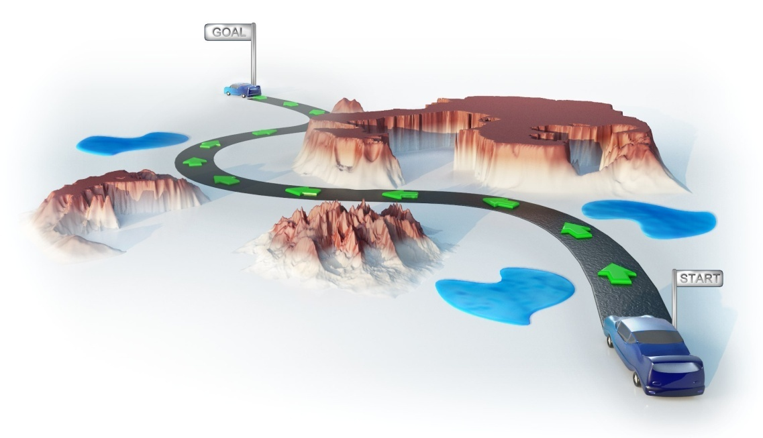
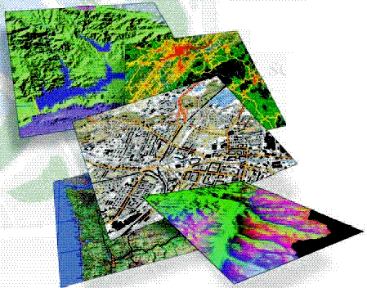
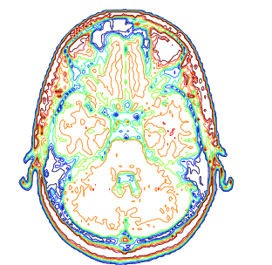
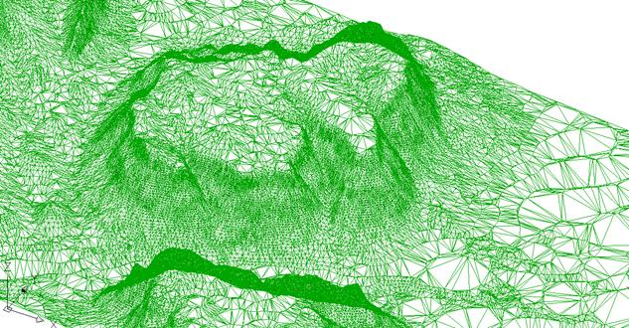
Background
Constraints occur naturally in many applications
  path planning
  GIS
  surface reconstruction
  terrain modeling
Notes:
But in practice, only DT is not enough, because it can only handle points.
…..
In path planning, they are obstacles
In GIS, they are boundaries between cities.
In surface reconstruction and terrain modeling, they can be contours

Slide 5
Background
Include all constraints
As close to the DT as possible
Points contained in the circumcircle of any triangle are invisible from its interior
Constrained Delaunay triangulation (CDT)
Notes:
CDT is an extension of DT, which can handle constraints. In CDT….

Slide 6
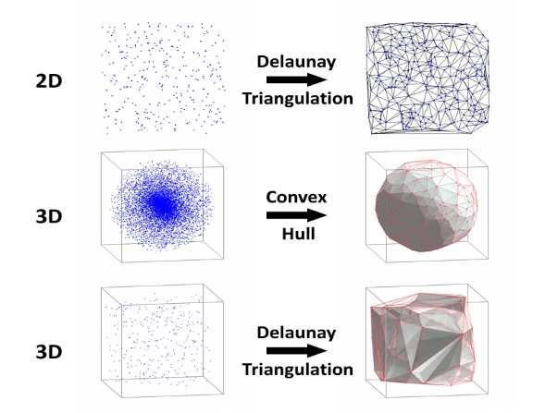
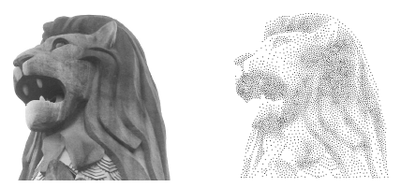
Background
PBA
GPU-DT
GPU-3DDT
gHull
The 2010 ACM Symposium on Interactive 3D Graphics and Games, 19-21 Feb, Maryland, USA, pp. 83--90.
The 2008 ACM Symposium on Interactive 3D Graphics and Games, 15-17 Feb, Redwood City, CA, USA, pp. 89 --97.
Work in progress, 10 times speedup
The 2011 ACM Symposium on Interactive 3D Graphics and Games, 18-20 Feb, San Francisco, USA.
Parallel Banding Algorithm to Computing
Exact Distance Transform with the GPU
School of Computing G³ Lab
GPU in computational geometry
  Our previous works include:
Notes:
Recently, GPU has been used for general purpose computation in many fields, including CG.
Our lab spent a lot of time to do research on such purpose. Our previous works include …..
Since we already have some experience on computing geometry problems using the GPU, so here we try to compute CDT using the GPU

Slide 7
Background
CDT algorithm using the GPU (GPU-CDT)
Input: planar straight line graph (PSLG)
Output: CDT
Contributions:
  The first GPU solution
  Numerically robust,
  Speedup (an order of magnitude)
Notes:
The input is PSLG, which is a set of points and segments, or called constraints. All constraints don’t cross each other unless in the endpoints.

Slide 8
Background
Simultaneously (CDT) | Separately (DT -> CDT)
Hard to implement | Easy to implement
Divide-and conquer Sweep-line
Re-triangulate intersection regions
Flip ( Triangle & CGAL)
Literature review
  According to how to processing points and constraints, there are two strategies

Slide 9
Background
Simultaneously (CDT) | Separately (DT -> CDT)
Hard to implement | Easy to implement
Divide-and conquer Sweep-line
Re-triangulate intersection regions
Flip ( Triangle & CGAL)
Literature review
  According to how to processing points and constraints, there are two strategies

Slide 10
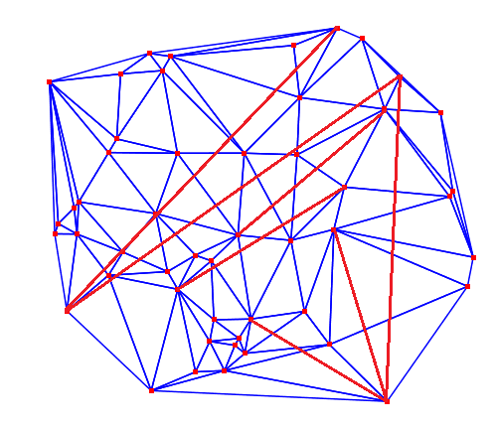
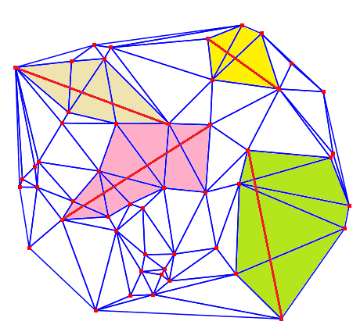
Motivation
How to insert constraints using flipping method in parallel ?
The natural approach :
  One thread handle one constraint
  Limitations (conflict; balance)
Notes:
There are many limitations for this approach.
For example, sometimes, many constraints may intersection some common triangles, like the case in the right. Under such situation, only part of constraints can be inserted at the same time. The rest need to wait. Even if most of constraints are distributed very well, don’t affect each other like the case in the left. Under this situation, some constraints are very long, and some are very short, different constraints need different time to be inserted. This may lead to unbalanced work.
From such simple analysis, we can see such naïve approach cannot contribute to high speedup.

Slide 11
Motivation
Inserting constraints in parallel ?
Our approach:
  flip all flippable pairs in parallel
Notes:
Our approach is focus on triangle pairs which be flipped together to decrease the intersections between constraints and triangulation until there’s no intersection, all constraints are inserted into the triangulation successfully.
We observe that, when constraints don’t affect each other, for example, assume there’s only one constraint. In the sequential method, in order to insert it, we need walk from one side to the other side, and perform flipping one by one. But actually, some triangle pairs can be flipped together to speedup the whole insertion processing.
When constraints affect each other, i.e., some constraints have common intersected triangles, some triangle pairs can be flipped together without affecting the final result.

Slide 12
Motivation
Inserting constraints in parallel ?
Our approach:
  flip all flippable pairs in parallel
Notes:
Our approach is focus on triangle pairs which be flipped together to decrease the intersections between constraints and triangulation until there’s no intersection, all constraints are inserted into the triangulation successfully.
We observe that, when constraints don’t affect each other, for example, assume there’s only one constraint. In the sequential method, in order to insert it, we need walk from one side to the other side, and perform flipping one by one. But actually, some triangle pairs can be flipped together to speedup the whole insertion processing.
When constraints affect each other, i.e., some constraints have common intersected triangles, some triangle pairs can be flipped together without affecting the final result.

Slide 13
Motivation
Inserting constraints in parallel ?
Our approach:
  flip all flippable pairs in parallel
Difficulties
  Ensure parallel flipping stage can terminate
  Do not waste too many flippings
Notes:
So our approach is started by finding as many triangle pairs as possible, and flip them in parallel.
Naturally, we may worry about whether the algorithm can terminate correctly. Even if the algorithm can terminate correctly, if we do too many useless flipping, that’s still not good. We should avoid flipping some triangle pairs back and force.

Slide 14
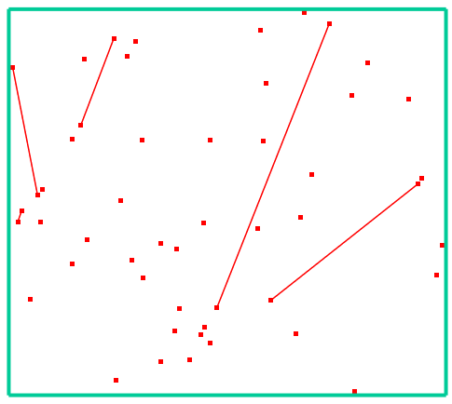
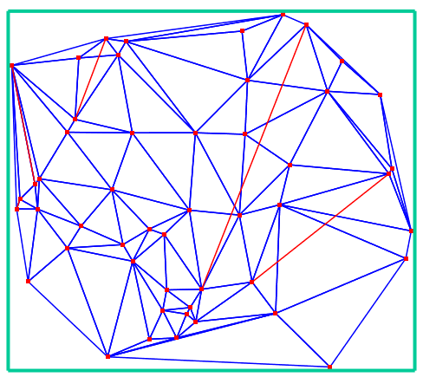
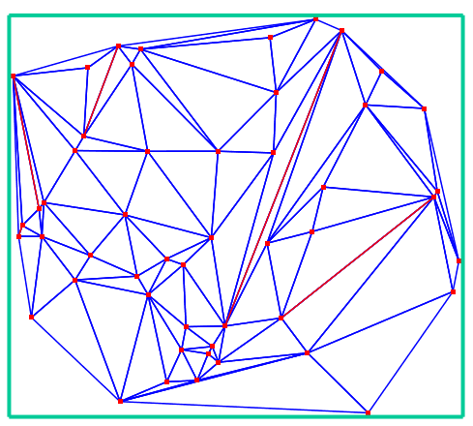
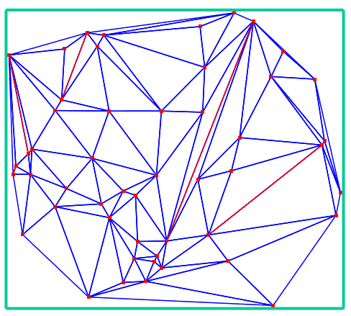
Algorithm Overview
input
step1
step2
step3
Refer to the paper for how to compute DT using the GPU (6 times speedup compared to CGAL)
Algorithm for GPU-CDT
  Step 1*. Compute a triangulation T for all points
  Step 2. Insert constraints into T in parallel
  Step 3. Verify the empty circle property for each edge (that is not constraint), and perform edge flipping if necessary.
Notes:
As for the first step, we utilize our previous work which can generate DT using the GPU. When using it, we do some optimization for this code, because of the time limitation, if you are interested in it, you can go into our paper or website. Here using our previous work, we generate a triangulation in the first step. Actually, since we need to do flipping at the end to verify the CDT property, in the fist step, we only need a triangulation, a DT is unnecessary.

Slide 15

Algorithm Overview
Algorithm for GPU-CDT
  Step 1*. Compute a triangulation T for all points
  Step 2. Insert constraints into T in parallel
    outer loop coarse-grained parallelism
      Find constraint-triangle intersections
    inner loop fine-grained parallelism
      Remove intersections
  Step 3. Verify empty circle property for each (non-constraint) edge, and perform edge flipping if needed.
outer loop
inner loop
15
Notes:
As for the first step, we utilize our previous work which can generate DT using the GPU. When using it, we do some optimization for this code, because of the time limitation, if you are interested in it, you can go into our paper or website. Here using our previous work, we generate a triangulation in the first step. Actually, since we need to do flipping at the end to verify the CDT property, in the fist step, we only need a triangulation, a DT is unnecessary.

Slide 16
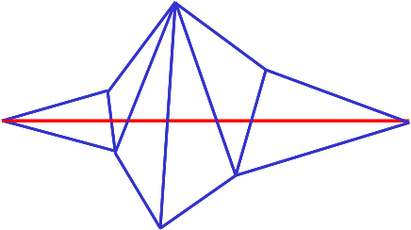
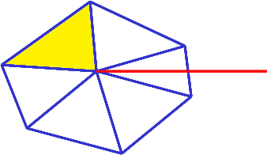
Algorithm for GPU-CDT
Outer loop: Finding constraint-triangle intersections
Find the first triangle
Find the other triangles
Mark triangles with the constraint of minimum index using atomicMin

Slide 17
Algorithm for GPU-CDT
Inner loop: Removing constraint-triangle intersections
  A pair of triangles can be classified as
zero
single
double
concave
Notes:
In order to find all flippable triangle pairs, we classify all triangle pairs into 4 cases. In the zero configuration, after edge flip, none of the new triangles are intersected any more. In the single configuration, after edge flip, only one new triangle is still intersected by the constraint. The similar definition for the double configuration. Clearly, in the concave configuration, this pair of triangle cannot be flipped.

Slide 18
Algorithm for GPU-CDT
Inner loop: Removing constraint-triangle intersections
  Pair (A, C) is flippable in one of the following cases
C’
A
C
C
C’
A
A’
A’
case 1a
case 1b
B
C
B
C’
B’
A
B’
C’
A
C
A’
A’
case 2
case 3
Notes:
After carefully consideration, we conclude 3 cases.
….

Slide 19
Algorithm for GPU-CDT
Inner loop: Removing constraint-triangle intersections
  Key techniques
    One-step look-ahead, multiple iterations
    Introduce priority to different flippable cases
Notes:
Before we introduce how to find as many flippable triangle pairs as possible. When performing flipping in practice, we apply some techniques, for example, we ………..and use one-step ………to do the flipping. More implement details can be found in our paper. I have no time to explain here.

Slide 20
Proof of correctness
Claim1. The inner loop can always successfully insert a constraint into the triangulation.
  Proof. Flipping does not go on forever
    Having a base 3 number, N, to record triangle chains.
      E.g. m triangles → m – 1 bits

Slide 21
Proof of correctness
Claim1. The inner loop can always successfully insert a constraint into the triangulation.
  Proof. Flipping does not go on forever
    Assign different pair of triangles different number
      zero/single := 0
      double := 1
      concave := 2
0
1
2
1
1
2
21

Slide 22
Proof of correctness
Claim1. The inner loop can always successfully insert a constraint into the triangulation.
  Proof. Flipping does not go on forever
    Assign different pair of triangles different number
      case 1 : delete a digit in N
      case 2: turn digits 11 into 01
      case 3: turn digits 21 into 11
N decreases !
0
1
0
2
1
1
0
2
1
0
22

Slide 23
Proof of correctness
Claim1. The inner loop can always successfully insert a constraint into the triangulation.
  Proof. Flipping does not go on forever
    Assign different pair of triangles different number
      case 1 : delete a digit in N
      case 2: turn digits 11 into 01
      case 3: turn digits 21 into 11
N decreases !
0
1
0
2
1
0
0
0
23

Slide 24
Proof of correctness
Claim1. The inner loop can always successfully insert a constraint into the triangulation.
  Proof. Flipping does not go on forever
    Assign different pair of triangles different number
      case 1 : delete a digit in N
      case 2: turn digits 11 into 01
      case 3: turn digits 21 into 11
N decreases !
0
0
24

Slide 25
Proof of correctness
Claim1. The inner loop can always successfully insert a constraint into the triangulation.
  Proof. Flipping does not go on forever
    Assign different pair of triangles different number
      case 1 : delete a digit in N
      case 2: turn digits 11 into 01
      case 3: turn digits 21 into 11
N decreases !
0
25

Slide 26
Complexity analysis
Claim 2. The total number of flipping performed by the inner loop to add one constraint is O(k²) where k is the number of triangles intersecting the constraint.
Proof… please refer to our paper

Slide 27
Experimental Results
Hardware: Intel i7 2600K 3.4GHz CPU, 16GB of DDR3 RAM and NVIDIA GTX 580 Fermi graphics card with 3GB memory
Compare to the most popular softwares available for CPU: Triangle & CGAL software (Triangle is faster than CGAL)
Synthetic Dataset
Real-world dataset

Slide 28
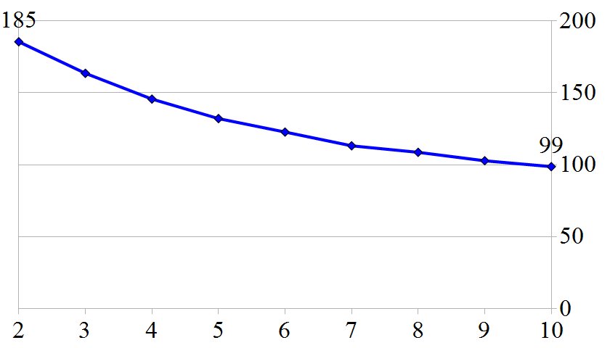
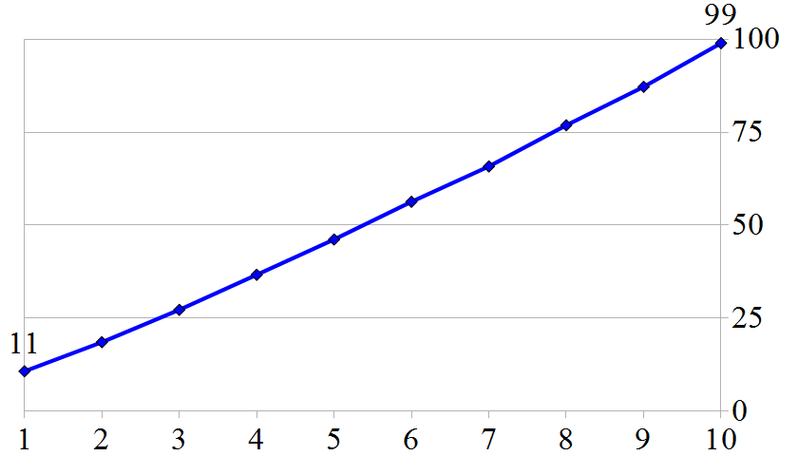
Experimental Results
Synthetic Dataset
Speedup over Triangle
1M constraints, points (10⁶)
10M points, constraints (10⁵)
Notes:
Clearly, the more constraints there are, the higher is the speedup we can achieve.
Our algorithm scales well with the aount of work available.
Larger size, the number of constriant-triangle intersections decreases, due to the starting triangulaiton is closer to the DT.

Slide 29
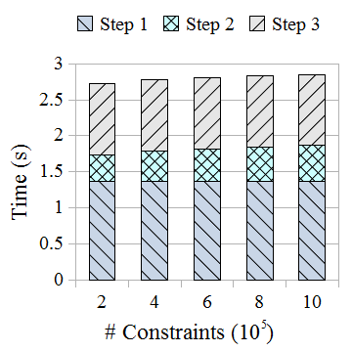
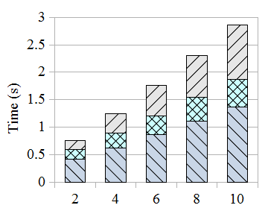
Experimental Results
Synthetic Dataset
Running time for different steps
1M constraints, points (10⁶)
10M points, constraints (10⁵)
Notes:
The time for inserting constraints for our program occupies less than 20% of the total time. While for the triangle software, they use more than 70% time for constraints insertion.
Total time, 10-45 times speedup

Slide 30
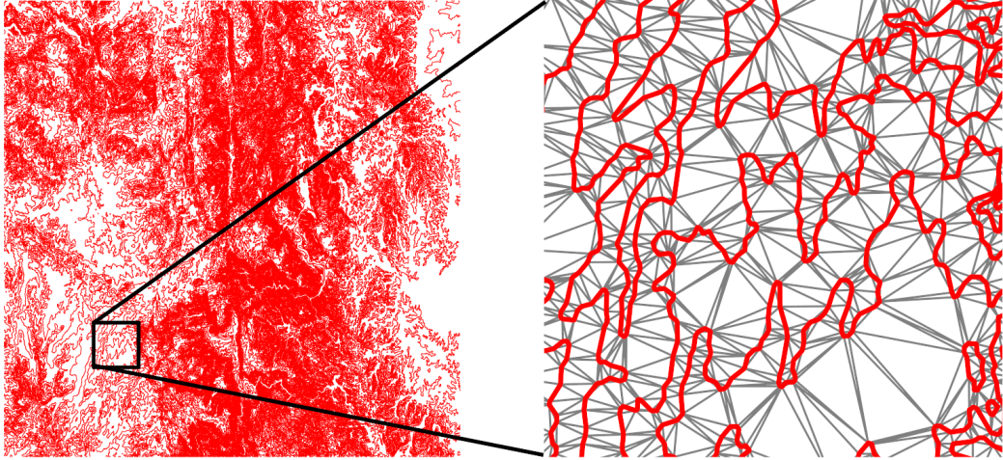
Experimental Results
Real-world dataset
Example | # Points | # Constraints | Constraints insertion (sec) |  | Speedup
 |  |  | Triangle | GPU-CDT
a | 1,177,332 | 1,176,943 | 0.665 | 0.046 | 14×
b | 3,180,037 | 3,179,251 | 10982 | 0.071 | 28×
c | 4,461,519 | 4,460,506 | 2.526 | 0.097 | 26×
d | 5,721,142 | 5,719,895 | 3.181 | 0.133 | 24×
e | 8,569,881 | 8,568,121 | 4.755 | 0.245 | 19×
f | 9,546,638 | 9,544,461 | 6.036 | 0.244 | 24×
Notes:
The figure shows an example of the contour map we used for our experiment.
In real world data, most constraints are very short and do not intersect many triangles.
Due to our fine-grained approach, our program can easily process both long and short constraints with similar parallelism

Slide 31

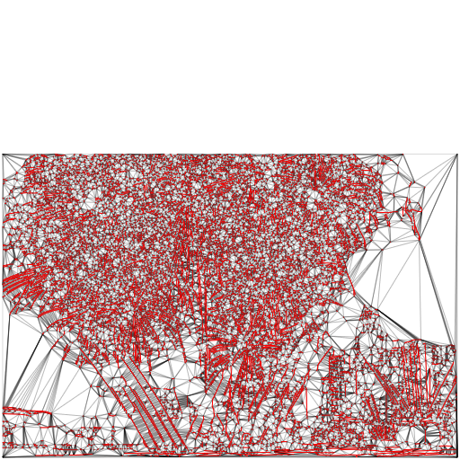
Application
Image vectorization
A raster image and CDT for its edge map, which is useful for image vectorization

Slide 32
Project website
http://www.comp.nus.edu.sg/~tants/cdt.html
Source code
http://www.comp.nus.edu.sg/~tants/delaunay2DDownload.html
Q & A

Slide 33
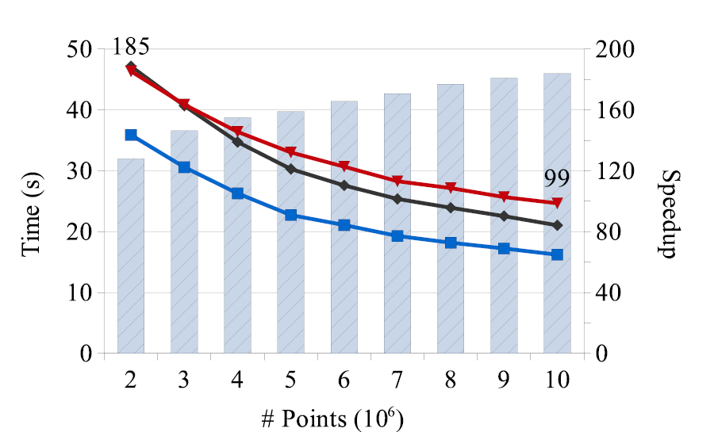
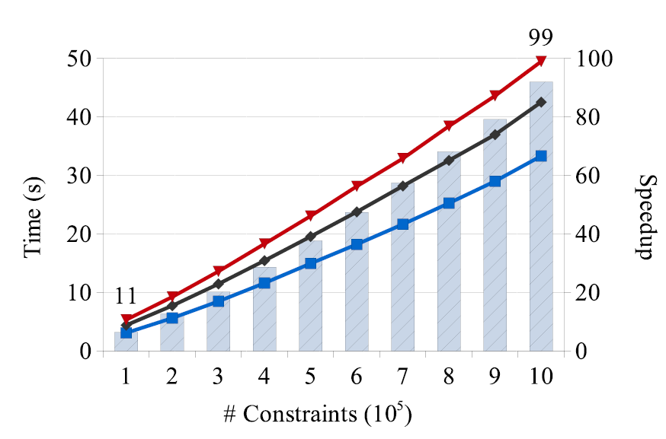
Experimental Results
Synthetic Dataset
Speedup over Triangle
1M constraints
10M points
Notes:
Clearly, the more constraints there are, the higher is the speedup we can achieve.
Our algorithm scales well with the aount of work available.
Larger size, the number of constriant-triangle intersections decreases, due to the starting triangulaiton is closer to the DT.

