Slide 1
CS5248: Systems Support for Continuous Media

Slide 2
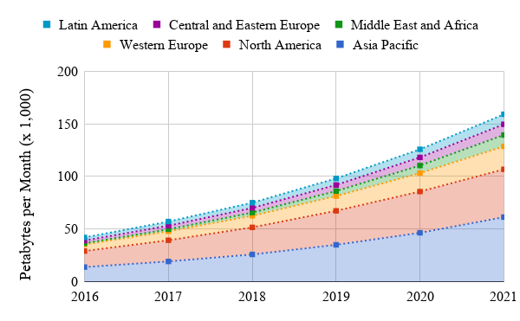
Why Learn about Continuous Media?
Video is Predominant on the Internet!
Cisco reported in their annual VNI:
  In 2016, 67% of the global Internet traffic was video, with a projection to reach 80% by 2021
Popular services:
  YouTube (14.0%)
  Netflix (34.9%)
  Amazon Video (2.6%)
  Hulu (1.4%)
All these are delivered as OTT
Notes:
VNI: Visual Networking Index

Slide 3
Scope of this class
Systems Support:
  Application
  Middleware
  Operating System
  Architecture
Continuous Media:
  Video, audio, animation

Slide 4
Local Media Applications
Watch Movies
Listen to Music
Video Editing
:

Slide 5
Network Media Applications
Live Webcast and IPTV
Pre-recorded Webcast
  YouTube, …
Video Conferencing
Video on Demand

Slide 6
Categories
 | Interactive | Non-Interactive
Live | Video Conferencing | U@live, NUS Webcasts
Pre-recorded |  | Lecture/Video on Demand

Slide 7
Streaming Media Requires
Reliable networks
Low latency
Bounded latency
Plenty of bandwidth
Internet was designed as a best-effort medium
However

Slide 8
Overview
Encoder
Decoder
Middlebox
Sender
Receiver
Network

Slide 9
We will NOT
Design new codec
Study media processing
  CS6212/CS5342
Attempt to improve the Internet
  CS5224/CS5229

Slide 10
Summary of Topics
Covered

Slide 11
Sample of Topics Covered
Review of Media Compression
Network Communication Model
Encoder
Decoder
Middlebox
Sender
Receiver
Network

Slide 12
Sample of Topics Covered
Adaptation
Video on Demand, MPEG-DASH
Encoder
Decoder
Middlebox
Sender
Receiver
Network

Slide 13
Sample of Topics Covered
Buffering
Audio/Video Synchronization
Packet Loss Recovery
Encoder
Decoder
Middlebox
Sender
Receiver
Network

Slide 14
Sample of Topics Covered
Caching
Application-Level Multicast
Encoder
Decoder
Middlebox
Sender
Receiver
Network

Slide 15
Lecture Philosophy
Cover breadth, rather than depth
Classic papers, rather than recent papers

Slide 16
Class Organization

Slide 17
Goals
Learn about existing techniques and systems
Learn about current research efforts

Slide 18
Philosophy
Students are expected to be
  Mature
  Independent
  Resourceful
What you learn is (should be) more important than your grade

Slide 19
Academic Honesty
No copying among students
No copying from published work
ZERO TOLERANCE to Plagiarism

Slide 20
Discussion?
Strongly encouraged,
but
  must acknowledge all contributions
  write up solutions independently

Slide 21
Continuous Assessments

Slide 22
Continuous Assessments
This module is graded with 100% CA
  No final exam!
Project, Writeup & Presentation (40%)
Midterm Exam (35%)
2 Quizzes (2 × 10%)
Participation (5%)

Slide 23

Project (40%)
Planned topic: Dynamic Adaptive Streaming over HTTP (DASH) in a client-server environment
Implement client on Android (Java)
More details will be
given in Lecture 3
TA: Abdelhak Bentaleb
Email:
bentaleb@comp.nus.edu.sg

Slide 24
Project (cont.)
Project will be done in teams of 3.
⇒ Please start to form groups!
Email info to Raj. As soon as groups are formed we can distribute the tablets.
Deliverables
  At due date:
    4-6 pages project report in scientific writing style
    Source code
    Demo of completed project in class

Slide 25
Midterm Exam (35%)
Open ended questions
Essay style
Previous final exam questions are available in the library

Slide 26
Quizzes (20%)
Quizzes (2 × 10%)
  Open ended (essay-style) questions
  30 minutes at the beginning of lectures

Slide 27
eLearning Week
None this semester!
Goal: Preparations for disruptions to business continuity
Lectures will be conducted on an eLearning platform (TBD)
Students must access materials online

Slide 28


Online Resources
Main Website
  http://www.comp.nus.edu.sg/~cs5248
The class schedule is also on the web site.
The module is also hosted on LumiNUS.
We’ll be using Slack for project
communications
To form groups use LumiNUS Forum or Slack: http://bit.do/join-cs5248-slack
Channel #team-formation

Slide 29
Special Dates
30 Aug (Lecture 3)
TA: Introduction to Project and Android Programming
20 Sep (Lecture 6)
Quiz 1 – in class
11 Oct (Lecture 8)
Quiz 2 – in class
25 Oct (Lecture 10 - ACM Multimedia 2019)
Midterm Exam – in class

Slide 30
Q & A

