Slide 1
Media Compression

Slide 2
You are Here
Encoder
Decoder
Middlebox
Sender
Receiver
Network

Slide 3
Demo
Sinéad O'Connor (Nothing Compares 2U)

Slide 4
Why compress?
“Bandwidth Not Enough”
“Disk Space Not Enough”
Size of Uncompressed DVD Movie =

Slide 5
Why compress?
“Bandwidth Not Enough”
“Disk Space Not Enough”
Size of Uncompressed DVD Movie = (720 x 576) pixels x 3 bytes x 25 fps x 60 sec/min x 120 min = 208.6 GB
NTSC: 29.97 fps (30/1.001); PAL 25 fps

Slide 6



Optical Disc Formats (1)
CD: ~650 MB
VideoCD: codec MPEG-1
1X max. read speed: 1.5 Mb/s
DVD:
4.7 (4.38) GB (single layer)
8.5 (7.92) GB (dual layer)
Single and dual sided (up to 18 GB)
1X max. read speed: ~10 Mb/s
Video codec: MPEG-2

Slide 7

Optical Disc Formats (2)
Blu-ray
Capacity: 25 GB and 50 GB
1X speed: 36 Mb/s
Video codec: VC-1, H.264, MPEG-2

Slide 8
JPEG Compression

Slide 9

Original Image (1153KB)
1:1

Slide 10

Original Image (1153KB)
3.5:1

Slide 11

Original Image (1153KB)
17:1

Slide 12

Original Image (1153KB)
27:1

Slide 13

Original Image (1153KB)
72:1

Slide 14

Original Image (1153KB)
192:1

Slide 15
Compression Ratio
Quality | Size | Ratio
Raw TIFF | 1153KB | 1:1
Zipped TIFF | 982KB | 1.2:1
Q=100 | 331KB | 3.5:1
Q=70 | 67KB | 17:1
Q=40 | 43KB | 27:1
Q=10 | 16KB | 72:1
Q=1 | 6KB | 192:1

Slide 16
Magic of JPEG
Throw away information we cannot see, i.e., based on human visual system:
Color information
“High frequency signals”
Rearrange data for good compression
Use standard compression algorithms

Slide 17



Discard color information
Y
V
U
Notes:
YUV is also known as LUV or YCbCr

Slide 18
Color Sub-sampling
The subsampling scheme is commonly expressed as a three part ratio (e.g. 4:2:2). The parts are (in their respective order):
Luma (Y) horizontal sampling reference (originally, as a multiple of 3.579 MHz in the NTSC television system).
Cr (U) horizontal factor (relative to first digit).
Cb (V) horizontal factor (relative to first digit), except when zero. Zero indicates that Cb horizontal factor is equal to second digit, and, in addition, both Cr and Cb are subsampled 2:1 vertically. Zero is chosen for the bandwidth calculation formula to remain correct.
To calculate required bandwidth factor relative to 4:4:4, one needs to sum all the factors and divide the result by 12.

Slide 19
Color Sub-sampling
4:4:4
4:2:0
4:2:2
4:1:1
Notes:
420 is used by MPEG. 411 is used by DV.

Slide 20
4:2:2 Sub-sampling
Y
V
U
Notes:
YUV is also known as LUV or YCbCr

Slide 21

Original Image (1153KB)
4:2:0

Slide 22

Original Image (1153KB)
“4:1:0”

Slide 23
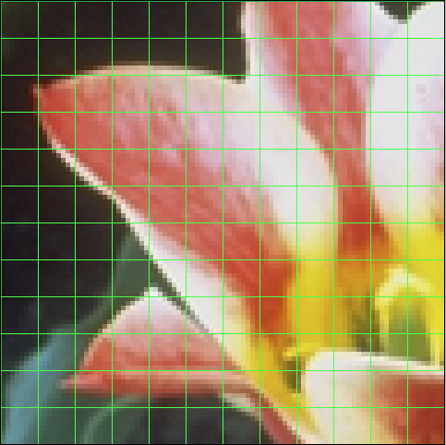

Slide 24
Discrete Cosine Transform
Demo

Slide 25
Quantization
DC
242
65
23
5
8
8
8
8
30
8
2
0
-54
-10
-4
-2
8
8
8
16
-6
-1
0
0
/
=
13
6
3
5
8
8
16
32
1
0
0
0
2
1
-1
-2
8
16
32
64
0
0
0
0
Quantization
Table
AC

Slide 26
Differential Coding
30
8
2
0
25
3
1
0
27
3
1
0
6
-1
0
0
2
1
0
0
2
1
0
0
1
0
0
0
4
0
1
0
4
0
1
0
0
0
0
0
0
0
0
0
0
0
0
0
30
8
2
0
-5
3
1
0
2
3
1
0
6
-1
0
0
2
1
0
0
2
1
0
0
1
0
0
0
4
0
1
0
4
0
1
0
0
0
0
0
0
0
0
0
0
0
0
0

Slide 27
Zig-zag ordering
27
3
1
0
2
1
0
0
4
0
1
0
0
0
0
0
27, 3, 2, 4, 1, 1, 0, 0, 0, 0, 0, 1, 0, 0, 0, 0

Slide 28
Run-Length Encoding
27
3
1
0
2
1
0
0
4
0
1
0
0
0
0
0
27, 3, 2, 4, 1, 1, 0, 0, 0, 0, 0, 1, 0, 0, 0, 0
(27, 1) (3, 1) (2, 1), (4, 1), (1, 2), (0, 5), (1, 1), (0, 4)

Slide 29
Idea: Motion JPEG
Compress every frame in a video as JPEG
DVD-quality video = 208.6GB
Reduction ratio = 27:1
Final size = 7.7GB

Slide 30
Video Compression

Slide 31





Slide 32

Original Frame 1
By (c) copyright 2006, Blender Foundation / Netherlands Media Art Institute / www.elephantsdream.org - Screenshot from "Elephants Dream" http://orange.blender.org/download, CC BY 2.5, https://commons.wikimedia.org/w/index.php?curid=7395123

Slide 33

Difference Between 2 Frames
By (c) copyright 2006, Blender Foundation / Netherlands Media Art Institute / www.elephantsdream.org - Screenshot from "Elephants Dream" http://orange.blender.org/download, CC BY 2.5, https://commons.wikimedia.org/w/index.php?curid=7395129

Slide 34
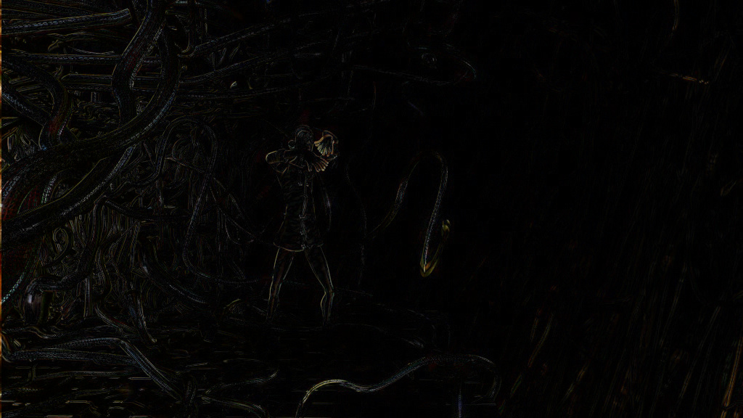
Motion Compensated Difference
By (c) copyright 2006, Blender Foundation / Netherlands Media Art Institute / www.elephantsdream.org - Screenshot from "Elephants Dream" http://orange.blender.org/download, CC BY 2.5, https://commons.wikimedia.org/w/index.php?curid=7395132

Slide 36

Temporal Redundancy

Slide 37


Motion Estimation

Slide 38
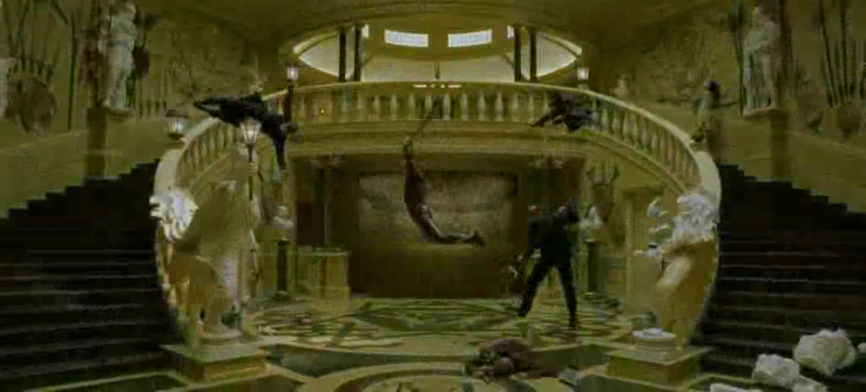
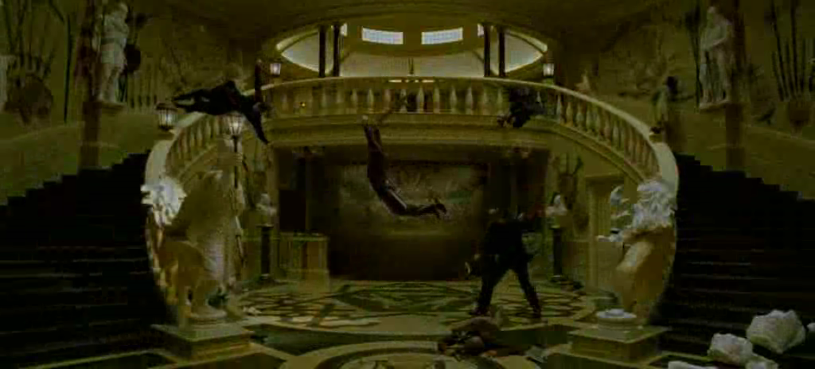
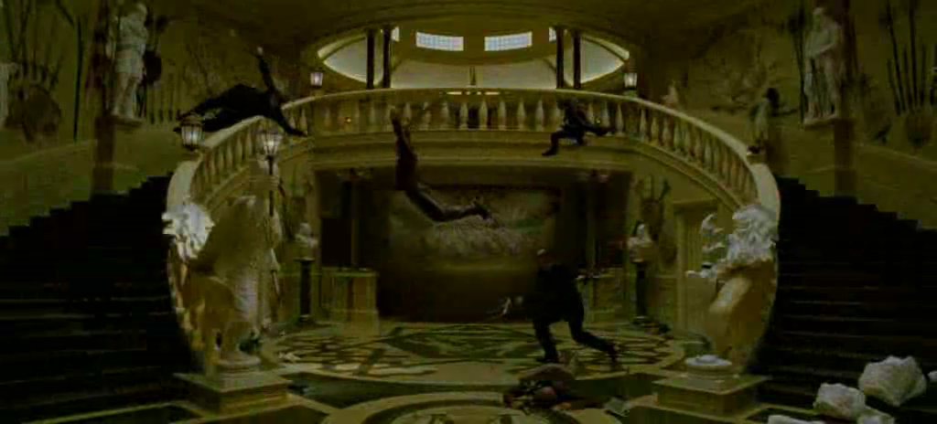
Bi-directional Prediction

Slide 39
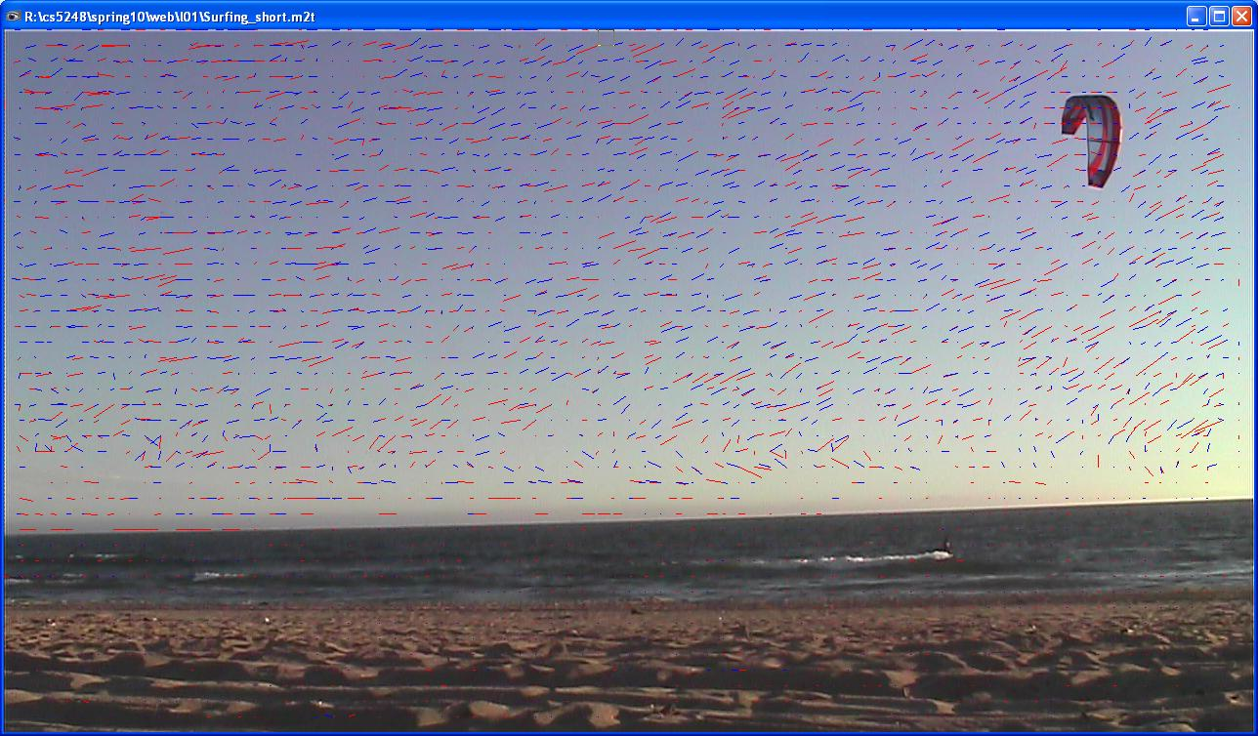
Motion Vectors

Slide 40
Watch for Motion Vectors
Demo

Slide 41
H.261
P-Frame
I-Frame

Slide 42
MPEG-1
B-Frame

Slide 43
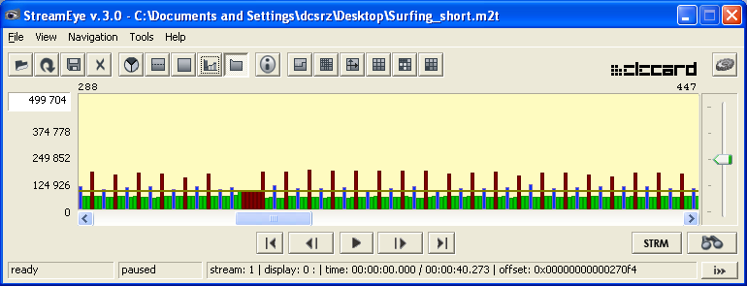
MPEG Frame Pattern (1)
HDV GOP example

Slide 44
MPEG Frame Pattern (2)
Example display sequence:
IBBPBBP …
Example encoding sequence:
IPBBPBB

Slide 45
Compression Ratio
Frame Type | Typical Ratio
I | 10:1
P | 20:1
B | 50:1

Slide 46
Sequence
sequence header:
width
height
frame rate
bit rate
:

Slide 47
GOP: Group of Picture
gop header:
time
:

Slide 48
Picture
pic header:
number
type (I,P,B)
:

Slide 49
Picture

Slide 50
Slice

Slide 51
Slice
Slices are important in the handling of errors. If the bitstream contains an error, the decoder can skip to the start of the next slice.
Having more slices in the bitstream allows better error concealment, but uses bits that could otherwise be used to improve picture quality (worse compression).

Slide 52
Macroblock

Slide 53
Block
Y
Y
U
1 Macroblock =
Y
Y
V

Slide 54
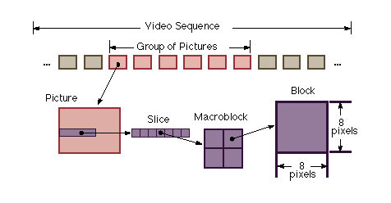
Structure Summary

Slide 55
For I-Frame
Every macroblock is encoded independently (“I-macroblock”)

Slide 56
For P-Frame
Every macroblock is either
I-macroblock
a motion vector + error terms with respect to a previous I/P-frame (“P-macroblock”)

Slide 57
For B-Frame
Every macroblock is either
I-macroblock
P-macroblock
a motion vector + error terms wrt a future I/P-frame
2 motion vectors + error terms wrt a previous/future I/P-frame

Slide 58
MPEG-1/2 File Formats
(Packetized) Elementary streams, ES & PES
Program streams PS (reliable mediums, e.g., DVD)
Transport streams TS (for lossy mediums, e.g., on-air broadcast)
Video
Source
MPEG-2 Elementary Encoder
PES: *.m2v
TS: *.ts
*.m2t
*.mpg
Packetizer
MPEG encoded streams
PES: *.m2a
Systems Layer
MUX
Transport Stream
Audio
Source
MPEG-2 Elementary Encoder
Packetizer
Data
Source
Packetizer
Flow chart © Manish Karir

Slide 59
Review: MPEG structure
ES, PS, TS: elementary stream, program stream, transport stream
Sequence
GOP: group of pictures
Picture
Slice
Macroblock
Block
Important:
Codec standards are
essentially defined by
their bitstreams!

Slide 60
Container Formats
Two common container formats:
MPEG-2 TS (Transport Stream)
ISO Base Media File Format (ISOBMFF)
Container formats encapsulate the actual media streams and can contain various actual media types.
E.g., TS is still used today with H.264
Container (ISOBMFF)
Media data, e.g., video and audio (H.264)

Slide 61
MPEG Decoding (I-Frame)
Entropy
Decoding
Dequantize
101000101
IDCT

Slide 62
MPEG Decoding (P-Frame)
Entropy
Decoding
Dequantize
101000101
IDCT
Prev
Frame
+

Slide 63
MPEG Decoding (B-Frame)
Entropy
Decoding
Dequantize
101000101
Future
Frame
IDCT
AVG
Prev
Frame
+

Slide 64
There is much more …
Half-pel motion prediction
Skipped macroblock
Different sizes of macroblocks
Motion vectors across multiple frames
etc.

Slide 65
Codecs in Daily Life (1)
MPEG Standards | Bit-rate | Usage
MPEG-1 | 1.5Mbps | VCD
MPEG-2 | 3-45 Mbps | DVD, SVCD, HDTV
MPEG-4/ H.264/AVC | Scalable, ½ MPEG-2 | QuickTime, DivX, AVCHD, Cable TV, YouTube, …
H.265/HEVC | Scalable, ½ H.264 | New generation, 4K content
“H.266” | Scalable, ½ H.265 | Next generation, 8K content

Slide 66
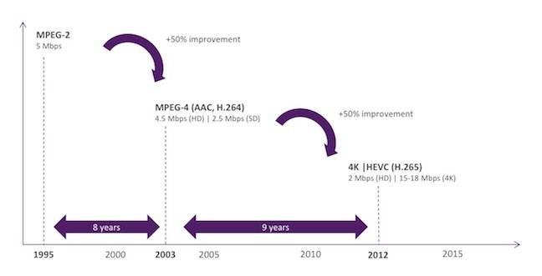
Codecs in Daily Life (2)
© The Register, 16 Sep 2015, Nigel Whitfield

Slide 67
Camcorders in Daily Life
Tape-based: DV25 (MiniDV, DVCAM, DVCPRO)
Capacity: 1 hour ~ 13 GB
Bitrate: 25 Mb/s (user data)
Color sampling: 4:1:1
Compression ratio: ~10:1
Disk/Flash-based: AVCHD 1.0 & 2.0
H.264: 24 Mb/s, HD, high compression

Slide 68
Codec Comparison
“M-JPEG” (e.g., DV) versus “MPEG”
No “perfect” codec -> application dependent
Compression Technique | “M-JPEG” (I-frames only) | “MPEG” (Temporal compression)
Compression ratio | Low (10:1 to 30:1) | High (>100:1)
Editing (frame-accurate) | Easy | Difficult
Encoding/decoding complexity | Symmetric | Asymmetric
Processing latency | Low to Medium | High
Multi-generation loss | Medium | High

Slide 69
High-Definition
Standard by ATSC
18 different sub-formats
720p and 1080i are the most interesting
1280x720x60p, 1920x1080x60i (30p)
1080p is non-standard, but available
1.4 Gb/s raw bandwidth
10 – 20 Mb/s compressed (distribution, broadcast)
100 – 135 Mb/s compressed (pro tapes: DVCPROHD, HDCAM; for editing)

Slide 70

Consumer HD
HDV: MPEG-2
19 (720p) / 25 Mb/s (1080i)
Tape format
http://www.hdv-info.org
AVCHD: H.264
5 to 25 Mb/s
Hard disk format
http://www.avchd-info.org/

Slide 71
Current Popular Codec: H.264
“Same quality at half the rate”
Encoding complexity: ~4X
How:
Variable block size motion compensation
Multiple reference frames
Deblocking filter, …
Also called MPEG-4 Part 10 or AVC or MPEG-4/AVC

Slide 72
Open Codec: VP8
Google bought On2 Technologies in 2010, which developed VP8.
Open-source license. (H.264 needs to be licensed for use)
Similar coding efficiency and quality as H.264.
Uses the WebM file format.

Slide 73
Current Codec: H.265/HEVC
High Efficiency Video Coding (HEVC).
“Same quality at half the rate” (over H.264/MPEG-4 AVC).
Very high encoding complexity.
Supports progressive scanned frame rates and display resolutions from QVGA (320x240) up to 1080p (1920x1080) and Ultra HDTV (7680x4320).

Slide 74
Current Codec: H.265/HEVC
At WWDC 2017, Apple introduced two new camera formats that are included in iOS 11: HEVC and HEIF.
Starting with iPhone 6, HEVC was the format for FaceTime.

Slide 75
Open Codecs: VP9, AV1
VP9 is an open and royalty free video coding format developed by Google.
Successor to VP8.
Supported by most web browsers (except Safari).
Used by YouTube.
Successor: AV1 (2019).

Slide 76
H.265/HEVC Primary Changes
Expansion of the pattern comparison and difference-coding areas from 16×16 pixel to sizes up to 64×64.
Improved variable-block-size segmentation, improved "intra" prediction within the same picture.
Improved motion vector prediction and motion region merging.
Improved motion compensation filtering.
An additional filtering step called sample-adaptive offset filtering.

Slide 77
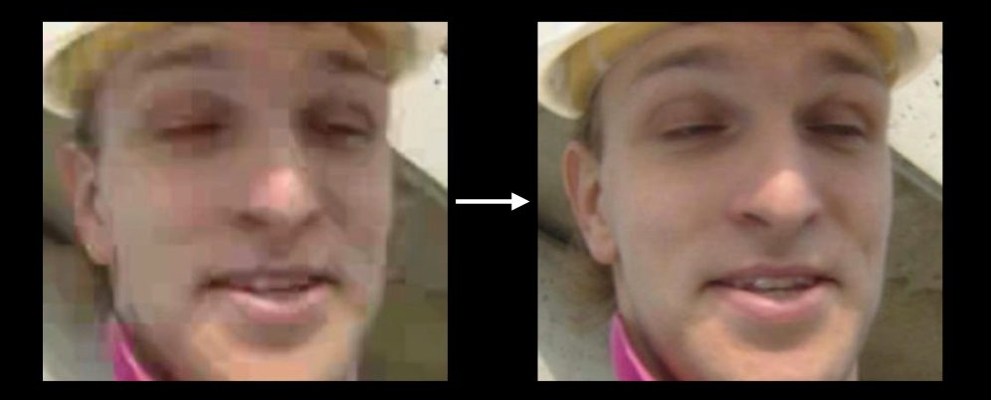
Deblocking Filter
With heavy compression, blocking artifacts become visible. Deblocking filters are used in both H.264 and H.265.

Slide 78
Next Gen Codec: H.266/FVC
Future Video Codec (FVC), expected in 2021.
Further improvements to 4K and enable “even 8K, 12K and 16K”.
Compression ratio target >50% over HEVC.

Slide 79
Hands-On
Download source code, compile and play with
ffmpeg
mpeg_stat
Video ‘Surfing_short.m2t’ from course web site (98 MB, HDV, transport stream)
Try different MPEG-1/2 encoding parameter

Slide 80
Impact on Systems Design
How to package data into packets?
How to deal with packet loss?
How to deal with bursty traffic?
How to predict decoding time?
:
:

Slide 81
Summary
Compression removes data for which the human visual system (HVS) is not sensitive.
Current codecs are mostly based on DCT and motion compensation.
Container formats (MPEG-2 TS, ISOBMFF) are important for system designers.
Codec standards are essentially defined by their bitstreams.

