Slide 1
Introduction to DASH
Dynamic Adaptive Streaming over HTTP

Slide 2
Summary of DASH (L3)
Dynamic Adaptive Streaming over HTTP

Slide 3
DASH (1)
RTP/RTSP/RTCP streaming faces several challenges
  Special-purpose server for media (complex)
  Protocols use TCP and UDP transmissions (firewalls)
  Difficult to cache data (no “web caching”)
Advantage
  Short end-to-end latency

Slide 4
DASH (2)
Main idea of DASH
  Use HTTP protocol to “stream” media
  Divide media into small chunks, i.e., streamlets
Advantages
  Server is simple, i.e., regular web server
  No firewall problems (use port 80 for HTTP)
  Standard (image) web caching works

Slide 5

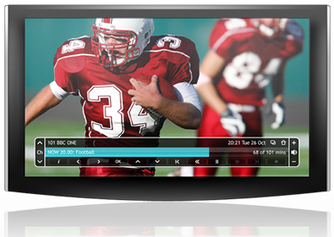
DASH (3)
Original DASH implementation by Move Networks
  Introduced concept of streamlets
  Additional idea: make playback adaptive
    Encode media into
    multiple different
    streamlet files, e.g.,
    a low, medium, and
    high quality version
    (different bandwidth)

Slide 6
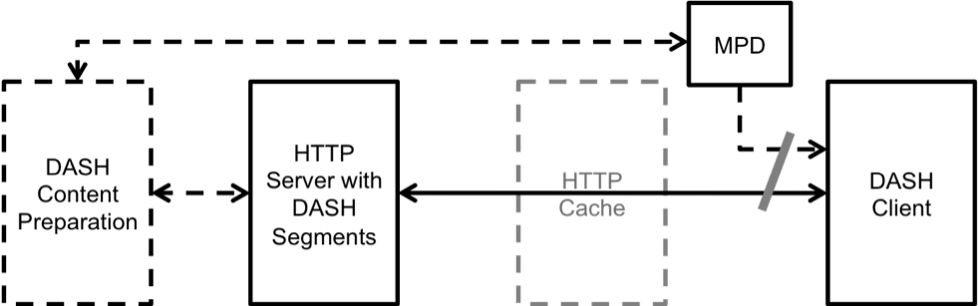
DASH (4)
MPD: Media Presentation Description
ISO/IEC Standard:
  “Information technology — MPEG systems technologies — Part 6: Dynamic adaptive streaming over HTTP (DASH)”
  JTC 1/SC 29; FCD 23009-1

Slide 7
DASH (5)
Web server provides a playlist
  The playlist is a file in a specific format that lists all the available qualities and all the streamlets for each quality
  Playlist file extension is .m3u8/.mpd
  Content preparation:
    Original media file needs to be split into streamlets
    Streamlets need to be transcoded into different qualities

Slide 8
DASH (6)
HTTP protocol is stateless!
  Server remembers “nothing” about session
Scheduling logic, etc., is in media player!

Slide 9
DASH (7)
DASH media player
  Loads .m3u8/.mpd file and then starts to download streamlets
  All the scheduling logic is in the player
    Render current streamlet while downloading the next streamlet before playback is done
    Measure bandwidth and switch between different qualities (i.e., adapt)
    Switch servers ⇒ can be done easily

Slide 10
DASH (8)
Many media players now understand DASH streaming format
Many companies use HTTP streaming:
  Apple, Microsoft, Adobe, Netflix, …
CDNs like this approach
  No need to run QuickTime, Windows Media, RealNetworks, and Flash streaming servers
    Just use web server for everything!
Notes:
Apples HLS
Microsoft Smooth Streaming
Adobe HDS (HTTP Dynamic Streaming)
YouTube DASH Guidelines: https://developers.google.com/youtube/v3/live/guides/encoding-with-dash

Slide 11
DASH (9)
TS versus ISOBMFF file formats
MPD validator:
http://www-itec.uni-klu.ac.at/dash/?page_id=605
Notes:
ISOBMFF: ISO base media file format. e.g. mp4, 3gp
TS:

Slide 12
Project
Create a DASH-compliant (Dynamic Adaptive Streaming over HTTP) (live) streaming system

Slide 13
Goals (1)
Capture video on an Android tablet and store it as an MP4 file.
Split the MP4 file into streamlets, i.e., 3 second long video files.
Upload the streamlets to a web server.
Transcode the streamlets into 3 different streamlets (e.g., low, medium, high quality).
Create a playlist MPD on the web server.

Slide 14
Goals (2)
Implement a simple dash.js DASH media player that streams the uploaded video.
Advanced Goal: enable an end-to-end live streaming system, i.e., all the above goals in an on-the-fly fashion.
Notes:
- Take an incremental approach with actual implementation. But keep in mind the advanced goal while working out the design.

Slide 15
Tools and platforms
Samsung S2 8.0 running Android 7.x (Nougat).
Programming on Android is done in Java or Kotlin with the Android Studio IDE.
Programming for dash.js is done in JavaScript.
On the web server, create scripts in PHP (default) or any web framework of your choice (e.g., node.js).

Slide 16
Project Homepage
Descriptions and web links
Some utilities and some library source codes
Documentation (RFCs, etc.)
LumiNUS Forums, Slack (cs5248.slack.com)
TA: Abdelhak Bentaleb
(bentaleb@comp.nus.edu.sg)

Slide 17
Logistics (1)
An account will be created for each group on our server: monterosa.d2.comp.nus.edu.sg
Your username and password will be emailed to you. Change the password!
Use ssh or PuTTy or Bitvise SSH or something similar to log in. The machine runs Linux (Ubuntu 18.04.2 LTS).
You will need to know some minimal Linux commands: ls, mv, cd, chmod, …

Slide 18
Logistics (2)
For your HTML and Python/PHP web server code you need to create a subdirectory called public_html.
  chmod 755 on your public_html directory
  (done for you this time!)
  chmod 644 on all web files (e.g., *.html, *.php)
The public link will be:
http://monterosa.d2.comp.nus.edu.sg/~yourteam
Notes:
Note that these instructions are for the default setup

Slide 19
Logistics (3)
Below the public_html you need another directory (e.g., video_repo) to store your video files. This directory needs to have write permissions for group users.
(already set for a new directory on Ubuntu)
This is because www-data is added to your user group.

Slide 20
Logistics (4)
Every team will be given a MySQL account. The database name, username and password will be emailed to you.
Use mysql command-line or phpMyAdmin GUI for database administration.
phpMyadmin: monterosa.d2.comp.nus.edu.sg/phpmyadmin/

Slide 21
Logistics (5)
Tools are accessible in /usr/local/bin:
MP4Box, ffmpeg, mp4info, MP42TS
Need any other tools? → email the TA
Use Slack (or LumiNUS Forum) for discussions and questions: cs5248.slack.com

Slide 22

Advice and Actions (1)
Form a team (3 persons).
Note: You will need to explore and learn a LOT. Your programming effort will be small.
  HTTP POST command structure
  MP4Parser/MediaCodec usage
  FFmpeg transcoder usage
  Playlist .mpd format in XML
Start early (i.e., this week)!

Slide 23
Actions (2): Get your Tablet
Check out your loan tablet for the project from Mr. Chow from SoC Technical Services Counter (COM1-01-06).
There is one tablet per team (3 students).
Please loan your tablet on 11/9 or 12/9, 10:00-12:00 or 13:00-17:00.
Email: chowcm@comp.nus.edu.sg.
Tell Mr. Chow your team number and names of team members.
Notes:
- Tablets would be issued only if you have registered your team with the TA. Without team registration, you would not be issued any tablet.

Slide 24
More Advice (1)
Design with ‘live’ in mind, but implement incrementally.
Work in parallel
  Capture client
  Server-side
  dash.js DASH player client
Use version-control and code backups

Slide 25
More Advice (2)
The teaching team is there to help, BUT …
We will NOT:
  debug your code
  answer queries that could be easily Googled
We will:
  advise you on system design
  provide pointers to what in your system might be going wrong
Notes:
- Google and StackOverflow would be more useful than us for debugging your code

Slide 26
Information on dash.js
JavaScript DASH player from the DASH Industry Forum (IF)

Slide 27

dash.js (1)
dash.js is a web-based, open source media player application, maintained by the DASH Industry Forum.
It is written in JavaScript.
It is quite modular (v.2.9.3; the latest release is 3.0.0).
New ABR rules can be added (this is your task for the player).

Slide 28
dash.js (2)
To add/change adaptation algorithms, it is necessary for users to edit 5 files in the DASH.js folder.
The following slides show an example for a new rule: BBA0 [1]
[1] Te-Yuan Huang, Ramesh Johari, Nick McKeown, Matthew Trunnell, and Mark Watson. 2014. A buffer-based approach to rate adaptation: evidence from a large video streaming service. In Proceedings of the 2014 ACM SIGCOMM (SIGCOMM '14). ACM, New York, NY, USA, 187-198. DOI: https://doi.org/10.1145/2619239.2626296

Slide 29
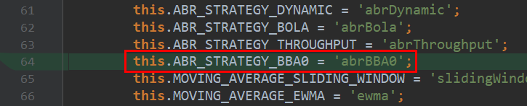
dash.js (3)
1. Constants.js
  Add ABR_STRATEGY_…

Slide 30
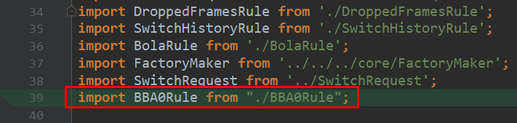
dash.js (4)
2. ABRRulesCollection.js
  Import BBARule class.

Slide 31
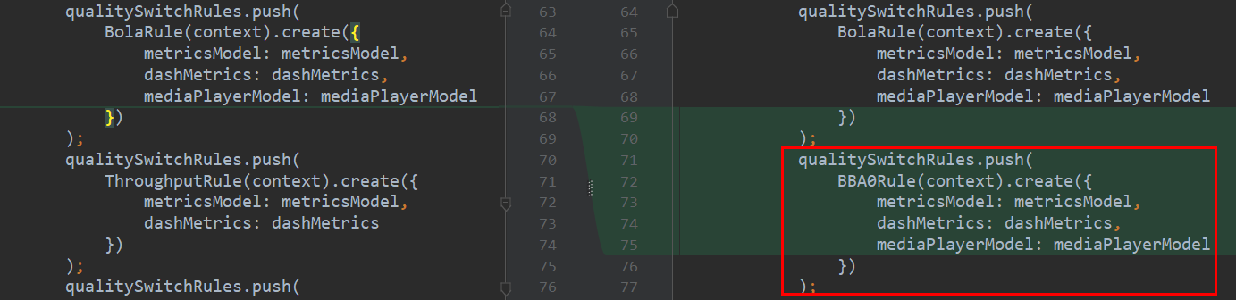
dash.js (5)
  Push BBARule class to qualitySwitchRules.
  Remove other classes pushed by qualitySwitchRules if not needed.

Slide 32
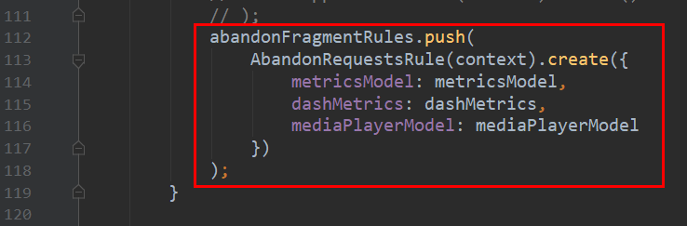
dash.js (6)
  Remember to keep abandonFragmentRules for sudden fragment switching on the occasion that the current segment cannot be downloaded properly due to a sudden bandwidth change.
  Of course, abandonFragmentRules can be customized.

Slide 33
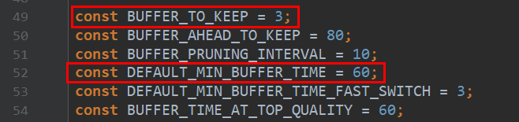
dash.js (7)
3. MediaPlayerModel.js
  Change BUFFER_TO_KEEP to set the required buffer length to run again after player stops.
  Change DEFAULT_MIN_BUFFER_TIME to set max buffer length.

Slide 34
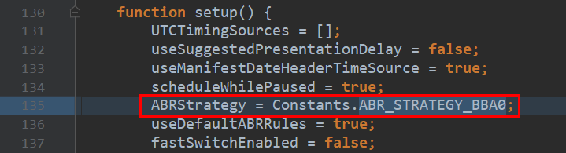
dash.js (8)
  Change ABRStrategy to customize default strategy if needed.

Slide 35
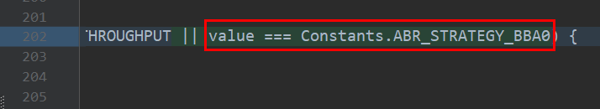
dash.js (9)
  Add options condition to value.

Slide 36
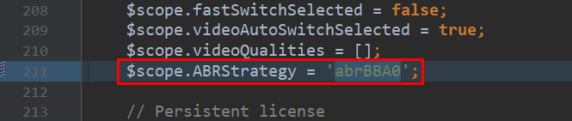
dash.js (10)
4. samples/dash-if-reference-player/app/main.js
  Change ABRStrategy to customize default strategy if needed.

Slide 37
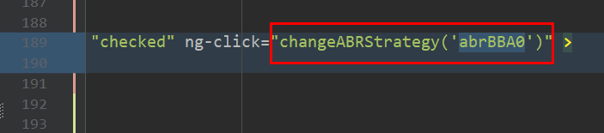
dash.js (11)
4. samples/dash-if-reference-player/index.html
  Change ng-click of targeted button, which will trigger proper algorithm if selected.
  May also need to change other texts of the button if needed.

Slide 38
dash.js (12)
Get the code for dash.js here:
https://reference.dashif.org/dash.js/
You can run the code directly from the above link, but if you want to modify it you will must make a local copy.

Slide 39




