Slide 1
Streaming Protocol Suite
RTP, RTCP, RTSP

Slide 2
Notes on HTTP Streaming (1)
On-Demand video streaming increasingly uses HTTP streaming
DASH: Dynamic Adaptive Streaming over HTTP
  ISO/IEC Standard:
    “Information technology — MPEG systems technologies — Part 6: Dynamic adaptive streaming over HTTP (DASH)”
    JTC 1/SC 29; FCD 23001-6

Slide 3
Notes on HTTP Streaming (2)
DASH has a number of advantages
  Server is simple, i.e., regular web server
  No firewall problems (use port 80 for HTTP)
  Standard (image) web caching works
However, DASH is based on media segment transmissions, typically 2-10 seconds in length

Slide 4
Notes on HTTP Streaming (3)
By buffering a few segments at the client side, DASH does not:
  Provide low latency for interactive, two-way applications (e.g., video conferencing)

Slide 5
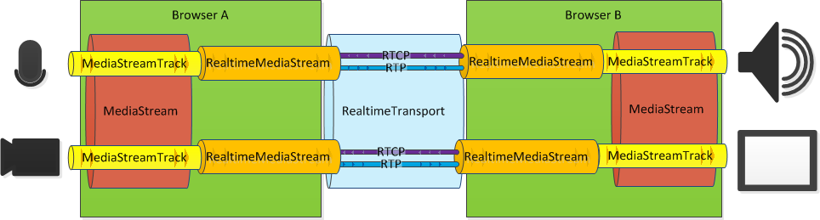
WebRTC (www.webrtc.org)
Web browsers with Real-Time Communications (RTC) capabilities via simple JavaScript APIs.
Pipeline for video conferencing in WebRTC (only one-way shown):
© Muaz Khan
RTP/RTCP

Slide 6

WebRTC (Demo)

Slide 7
Streaming Protocol Suite (1)
RTP: Real-Time Transport Protocol
RTCP: RTP Control Protocol
  Published in 1996 as RFC 1889, and superseded by RFC 3550 in 2003
  UDP, binary
  Transmission direction:
    RTP: from server to client (receiver)
    RTCP: either way (SR, RR)

Slide 8
Streaming Protocol Suite (2)
RTSP: Real-Time Streaming Protocol
  Published as RFC 2326 in 1998
  TCP, text
  Transmission direction:
    Initiation from client, response by server
  “VCR”-type commands: PLAY, PAUSE, RECORD, TEARDOWN, …
  Session initiation: DESCRIBE, SETUP

Slide 9
Streaming Protocol Suite (3)
Flow diagram: RTP, RTCP, RTSP
status information,
transmission statistics,
quality of service (QoS)
RTCP
Sender
RTP
Receiver
media flow
RTSP
e.g.: “Play”

Slide 10
RTCP
Real-Time Transport Control Protocol

Slide 11
RTCP
Real-Time Control Protocol
Provides
  receiver’s feedback
  network conditions
  time synchronization
  receiver’s description

Slide 12
RTCP Packet Types
Sender’s Report (SR)
Receiver’s Report (RR)
Source Description (SDES)
Application Specific (APP)
BYE

Slide 13
Fields in SR
NTP and RTP Timestamp
  relate media timestamp to real time
Sender’s stats
  byte count, packet count

Slide 14
Fields in SR + RR
Receiver Report (RR)
  Number of lost packets
  % of lost packets
  Inter-arrival jitter
  Timestamp of last SR
  Delay since last SR
SR
t_{lsr}
t_{dlsr}
RR

Slide 15
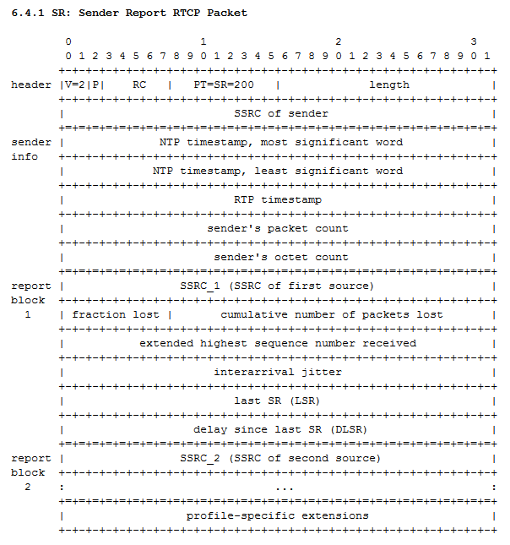
SR Packet
RFC 3550

Slide 16
Deducing Network Conditions
Packet Loss Rate
Interarrival Jitter
Round Trip Time

Slide 17
Calculating Packet Loss Ratio (1)
For each source, keep
  first sequence number S₀
  last sequence number S_{last}
Expected packets = S_{last} – S₀ + 1
Count how many received packets
Note: RTP start sequence number can be random

Slide 18
Calculating Packet Loss Ratio (2)
Example:
  S₀ = 53,466
  S_{last} = 1,349
  Expected packets C_{e} = S_{last} – S₀ + 1 =
  Received packets C_{r} = 13,150
  Packet loss rate: 1 - C_{r}/C_{e} =

Slide 19
Calculating Packet Loss Ratio (2)
Example:
  S₀ = 53,466
  S_{last} = 1,349
  Expected packets C_{e} = S_{last} – S₀ + 1 = 13,420
  (2¹⁶ + 1,349 – 53,466 +1) = 65,536 + 1,349 – 53,465
  Received packets C_{r} = 13,150
  Packet loss rate: 1 - C_{r}/C_{e} ≈ 0.02 (or 2%)

Slide 20
Calculating Interarrival Jitter
Variance in packet spacing
Define:
  P_{i}.arrival_time
  P_{i}.media_timestamp
  P_{i}.transit_time

Slide 21
Calculating Interarrival Jitter
P_{i}.transit_time =
  P_{i}.arrival_time - P_{i}.media_timestamp
Difference in transit time for two consecutive packets = D(i,i-1) =
  |P_{i}.transit_time – P_{i-1}.transit_time|

Slide 22
Calculating Interarrival Jitter
Jitter after packet i = J_{i}
(i.e., this is a continuously updated value)
J_{i} = (1-a) × J_{i-1} + a × |D(i,i-1)|
a: “weight” of most recent value vs. history
RFC 1889:
J_{i} = J_{i-1} + ( |D(i,i-1)| − J_{i-1})/16

Slide 23
Calculating RTT (1)
SR
Calc RTT
t_{lsr}
t_{dlsr}
RR

Slide 24
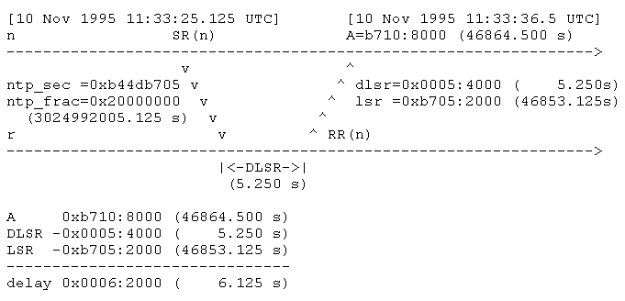
Calculating RTT (2)
RTT: 6.125 s – 5.250 s =
0.875 s

Slide 25
Calculating ???
P_{i}.sender_byte_count
P_{i}.sender_packet_count

Slide 26
RTCP Scaling (1)
RTCP RR, SR
Receiver
Receiver
Sender
Receiver
media flow
Receiver
Receiver

Slide 27
RTCP Scaling (2)
RTCP session reports should scale from a few to thousands of participants
Constant rate control traffic: linear growth with the number of participants
Recommendation: limit RTCP traffic to 5% of bandwidth; limit RR to 1.25%
Vary report timing with random factor [0.5, 1.5] to calculated value t

Slide 28
RTCP Scaling (2)
B: Fix RTCP bandwidth
N: Number of participants
S: Mean RTCP packet size
Sending interval =

Slide 29
RTCP Scaling (2)
B: Fixed RTCP bandwidth
N: Number of participants
S: Mean RTCP packet size
Sending interval = (N × S) / B

Slide 30
RTP
Real-Time Transport Protocol

Slide 31
RTP Packet Format
12 bytes
4-12 bytes
≤ Rest of IP packet
RTP Header
RTP Payload
Header
RTP Payload

Slide 32
RTP Header
9 bits: protocol version, alignment, header extension, CSRC length, marker

Slide 33
RTP Header
Payload type: 7 bits
  Identify content
  E.g. 14: mp3; 32: MPEG-1

Slide 34
RTP Header
Sequence number: 16 bits
  Packet sequence number

Slide 35
RTP Header
Media timestamp: 32 bits
  The instant when the first byte in this packet was captured
  90 kHz timestamp (90,000 = 1 second)

Slide 36
RTP Header
SSRC: 32 bits
  Random, unique in a session
  Identifies a source (not host!)

Slide 37
RTP Header
Marker bit:
  Depends on payload
  E.g. beginning of frame

Slide 38
On Receiving RTP packet
Check SSRC
  New source?
  Existing source? which one?
Check payload type
  Has format been changed?
  Which decoder should I use?

Slide 39
RTSP
Real-Time Streaming Protocol

Slide 40
RTSP (1)
Application-level protocol for establishing and controlling media sessions with real-time properties between end points control
Simple, text-based
Published in RFC 2326 (1998)
Uses TCP
Standard port: 554

Slide 41
RTSP (2)
Allows VCR-type commands:
  DESCRIBE, SETUP, PLAY, TEARDOWN, PAUSE, RECORD, OPTIONS
On next slides:
  Black text – server command
  Blue text – client response

Slide 42
RTSP Example
DESCRIBE rtsp://genesis/hackers.mov RTSP/1.0
RTSP/1.0 200 OK
Server: QTSS/v96
Cseq:
Content-Type: application/sdp
Content-Base: rtsp://genesis/hackers.mov/
Content-length: 179
v=0
s=hackers.mov
u=http://genesis.usc.edu/
e=admin@genesis.usc.edu
c=IN IP4 128.125.163.19
a=control:/
a=range:npt=0-3714.90167
m=audio 0 RTP/AVP 10
a=control:trackID=2

Slide 43
RTSP Example
SETUP rtsp://genesis/hackers.mov
Transport: RTP/AVP;unicast;client_port=3000-3001
RTSP/1.0 200 OK
Server: QTSS/v96
Cseq:
Session: 4862038713701816342;timeout=6000
Transport: rtp/avp;server_port=2000-2001;client_port=3000-3001
PLAY rtsp://genesis/hackers.mov
Session: 4862038713701816342
RTSP/1.0 200 OK
Server: QTSS/v96
Cseq:
Session: 4862038713701816342
RTP-Info:url=hackers.mov;seq=59970;ssrc=477987946;rtptime=263102960

Slide 44
RTSP Example
…
[Session plays]
…
TEARDOWN rtsp://genesis/hackers.mov
Session: 4862038713701816342
RTSP/1.0 200 OK
Server: QTSS/v96
Cseq:
Session: 4862038713701816342
Connection: Close

Slide 45
SIP
Session Initiation Protocol

Slide 46
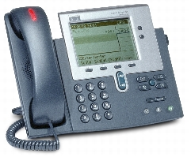
SIP
Application-layer control (signaling) protocol for creating, modifying, and terminating sessions with one or more participants.
Text-based
RFC 3261
Has been accepted as
a standard for VoIP
(Note: Skype does not use SIP)

Slide 47
WebRTC
Web Real-Time Communications

Slide 48
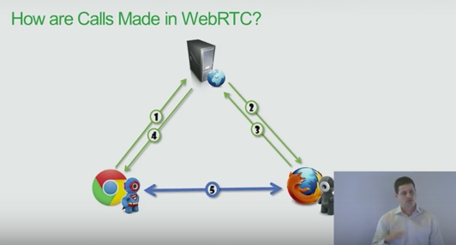
WebRTC (1)
Offers real time communication natively from a web browser
It is a media engine with a JavaScript APIs

Slide 49
WebRTC (2)
Allows media or other data to be sent directly between two browsers
3 Main APIs:
  GetUserMedia: access to camera, mic, display
  PeerConnection: does everything – encode/decode media, transmit, NAT, etc.
  DataChannel: send arbitrary data between browsers

Slide 50
WebRTC (3)
Uses SRTP: Secure Real-Time Transport Protocol or Secure RTP
Different codecs: G.711, Opus, VP8
VoIP implementation using STUN, TURN and ICE for NAT traversal
  STUN: Session Traversal Utilities for NAT
  TURN: Traversal Using Relays around NAT
  ICE: Interactive Connectivity Establishment

Slide 51
Application-Level Framing
Expose details to applications
Let application decide what to do with a packet, not transport protocol

Slide 52
MPEG + RTP
Application-Level Framing

Slide 53
Previously, in CS5248
MPEG Compression
  Sequence, GOP, Picture, Slice, Macroblock, Block, DC/AC Coefficient
  I-Frame, P-Frame, B-Frame

Slide 54
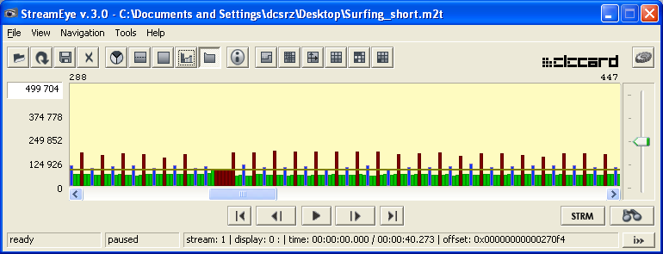
MPEG Frame Sizes
Constant Bitrate (CBR) vs. Variable Bitrate (VBR)

Slide 55
Previously, on CS5248
RTP headers
  SSRC, Media Timestamp, Marker Bit, Payload Type ..
  Application-Level Framing

Slide 56
You are Here
Encoder
Decoder
Middlebox
Sender
Receiver
Network

Slide 57
Application-Level Framing

Slide 58
How to send/recv?
Let the application decide, not the protocol stack.
Tennenhouse + Clark

Slide 59
Application Knows Best
How to reorder packets
Whether to ignore loss
Which packet to retransmit

Slide 60
Application Data Unit (ADU)
Can be processed individually, even out-of-order
Unit of error-recovery
  If part of an ADU is lost, the whole ADU is considered lost
8-Bit PCM audio: 1 ADU = 1 Byte
MPEG1 Video: 1 ADU =

Slide 61
Application Data Unit (ADU)
Can be processed individually, even out-of-order
Unit of error-recovery
  If part of an ADU is lost, the whole ADU is considered lost
8-Bit PCM audio: 1 ADU = 1 Byte
MPEG1 Video: 1 ADU = 1 Slice

Slide 62
How to chop data into packets?
Every received packet should be useful (even in very lossy environments)
Ideally, 1 ADU in 1 packet

Slide 63
RTP Payload Header
12 bytes
4-12 bytes
≤ Rest of IP packet
RTP Header
RTP Payload
Header
RTP Payload
MPEG Video-specific Header (32 bits)
MPEG-1? 2?
Temporal Reference
I? P? B?
Begin of Slice? End of Slice?

Slide 64
RTP Header (Summary)
4 bytes
4 bytes
4 bytes
Ver: version, P: padding, X: extension, CC: CSRC count, M: marker, PT: payload type, sequence number, media timestamp, SSRC

Slide 65
RTP Header
Media Timestamp: 32 bits
  the instant the first byte in this packet is captured
  90 kHz timestamp (90,000 = 1 second)

Slide 66
RTP Header
Marker Bit:
  1 if packet contains the last byte of a frame

Slide 67
RTP Header
Payload Type: 7 bits
  32 for MPEG-1 video; 14 for MPEG audio

Slide 68
MPEG Video-specific Header
MBZ (5 bits)
  Unused. Must be 0.

Slide 69
MPEG Video-specific Header
T (1 bit)
  1 if there is a MPEG-2 Extension Header after this header.

Slide 70
MPEG Video-specific Header
Temporal Reference (10 bits)
  The ‘frame number’ of the current frame within the GOP.

Slide 71
MPEG Video-specific Header
AN bit and N bit
  Set to 0 for MPEG-1.

Slide 72
MPEG Video-specific Header
S (1 bit)
  Is there a sequence header in this packet?
  Repetition of sequence header is useful for resynchronization.

Slide 73
MPEG Video-specific Header
BS (1 bit) and ES (1bit)
  BS is 1 iff the ‘first’ byte of this payload is a slice header.
  ES is 1 iff the last byte of this payload is the end of a slice.

Slide 74
MPEG Video-specific Header
Picture Type (3 bits)
  I (1), P (2), B (3), D (4).

Slide 75
MPEG Video-specific Header
Motion Vectors Information
  Get from most recent picture header.

Slide 76
Fragmentation Rules
Sequence header: at the start of payload
GOP header: at the start of a payload (or follows Sequence header)
Picture header: at the start of a payload (or follows Sequence/GOP header)

Slide 77
Fragmentation Rules
A slice must be either
  First data in the packet, or
  Follows integral number of slices
A slice may be fragmented if exceeds the size of a packet

Slide 78
MP3 (MPEG-1, layer 3) Audio
MP3 audio can be encoded in two ways:
  RFC 2250
  RFC 3119
RFC 2250 describes the general MPEG-1 video/audio ADU framing
Problem: MP3 frames are not self-contained!

Slide 79
MP3 Frame Structure
Each frame contains the header (Including the 4 byte MPEG header, optional 2 bytes CRC and 9, 17 or 32 bytes (depending on mono/stereo and MPEG 1 or 2) of side info
MP3 frames have a fixed length
Data of one ADU may span multiple frames
Problem: if one packet lost → multiple ADUs lost

Slide 80
MP3 RFC 3119 Re-Arrangement
Idea: re-arrange data such that each packet is self-contained (i.e., decodable)
Effects:
  Better error resilience, but
  Variable length packets and
  Re-arrangement needs to be undone for decoder

Slide 81
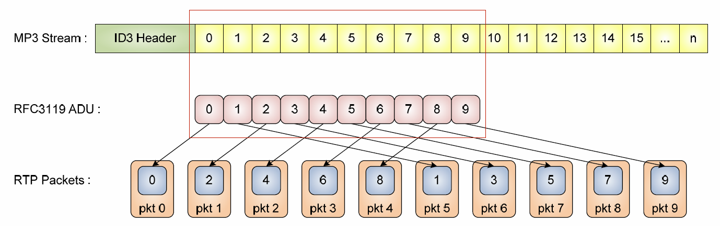
RFC 3119: Interleaving
Interleaving: interleave cycle of size 8
  Advantage: Consecutive packet losses have less effect
  Disadvantage: Send & receive latency is increased

Slide 82
Other Thoughts
Packet losses on the Internet are often correlated, forming lost “packet trains”
What can be done to decorrelate losses?
How to measure audio and video quality?
  Objectively computed: PSNR (in dB)
  Subjective tests: MOS
  (range: 1 – bad to 5 – excellent)

Slide 83
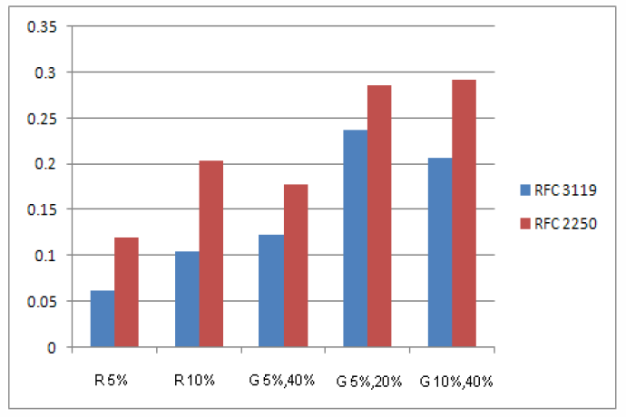
RFC 2250 versus RFC 3119
Frame-level loss simulation
  R: random loss
  G: Gilbert model
Note: Gilbert
model produces
correlated losses
(“packet trains”)

Slide 84
MP3 Sender/Receiver Structure
Server
RFC 2250
MP3 frames
RTP packets
MP3 frames
ADU frames
ADU frames
Client
Interleaved ADU frames
Interleaved ADU frames
RFC 3119
RTP packets

Slide 85
Packet Size
1 MTU is 1500 bytes
IP Header size =
UDP Header size =
RTP Header size =
MPEG Video-specific Header size =
Payload size =

Slide 86
Packet Size
1 MTU is 1500 bytes
IP Header size = 20
UDP Header size = 8
RTP Header size = 12
RTP Payload Header size = 4 to 12
Payload size = 1 to 1456

Slide 87
DASH vs. RTP
 | DASH | RTP
Transport Protocol | HTTP | UDP
Latency | long | short
Media unit | segment | packet
Topology | client-server | peer-to-peer
Codec | many | many
Caching | yes (web caches) | no
Applications | VoD, 1-way live | VoIP, video conferencing

Slide 88
Network Tools
Iperf, Netstat, Tcpdump

Slide 89
Network Tools
Iperf:
  Connection and throughput testing between two computers
Netstat:
  Information about ports and connections
Tcpdump:
  Packet trace information

Slide 90
Iperf
On server:
  Iperf –s
On client:
  Iperf –c <host>
Default is TCP. Other options:
  –u: UDP; –b: bandwidth; –p: port#

Slide 91
Port Numbers
RTSP: 554 (default)
RTP, RTCP: negotiated, e.g., 3000 and 3001
Note:
  Ports below 1024 on *nix require root (i.e., admin) privileges.
  Port numbers for different protocols can be found in file /etc/services.

Slide 92
Iperf Example (TCP, Server)
Server:
$ ./iperf -s -p 8008
------------------------------------------------------------
Server listening on TCP port 8008
TCP window size: 85.3 KByte (default)
------------------------------------------------------------
[ 4] local 137.132.81.189 port 8008 connected with 137.132.81.225 port 40455
[ 4] 0.0-10.0 sec 112 MBytes 94.0 Mbits/sec

Slide 93
Iperf Example (TCP, Client)
Client:
$ ./iperf -p 8008 -c cervino.ddns.comp.nus.edu.sg
------------------------------------------------------------
Client connecting to cervino.ddns.comp.nus.edu.sg, TCP port 8008
TCP window size: 16.0 KByte (default)
------------------------------------------------------------
[ 3] local 137.132.81.225 port 40455 connected with 137.132.81.189 port 8008
[ ID] Interval Transfer Bandwidth
[ 3] 0.0-10.0 sec 112 MBytes 94.3 Mbits/sec
$

Slide 94
Iperf Example (UDP, Server)
Server:
$ ./iperf -u -s -p 8008
------------------------------------------------------------
Server listening on UDP port 8008
Receiving 1470 byte datagrams
UDP buffer size: 108 KByte (default)
------------------------------------------------------------
[ 3] local 137.132.81.189 port 8008 connected with 137.132.81.225 port 46651
[ 3] 0.0-10.0 sec 1.25 MBytes 1.05 Mbits/sec 0.003 ms 0/ 893 (0%)

Slide 95
Iperf Example (UDP, Client)
Client:
$ ./iperf -u -p 8008 -c cervino.ddns.comp.nus.edu.sg
------------------------------------------------------------
Client connecting to cervino.ddns.comp.nus.edu.sg, UDP port 8008
Sending 1470 byte datagrams
UDP buffer size: 126 KByte (default)
------------------------------------------------------------
[ 3] local 137.132.81.225 port 46651 connected with 137.132.81.189 port 8008
[ ID] Interval Transfer Bandwidth
[ 3] 0.0-10.0 sec 1.25 MBytes 1.05 Mbits/sec
[ 3] Sent 893 datagrams
[ 3] Server Report:
[ ID] Interval Transfer Bandwidth Jitter Lost/Total Datagrams
[ 3] 0.0-10.0 sec 1.25 MBytes 1.05 Mbits/sec 0.003 ms 0/ 893 (0%)
$

Slide 96
Netstat
$ netstat
Active Internet connections (w/o servers)
Proto Recv-Q Send-Q Local Address Foreign Address State
tcp 0 0 cervino.ddns.comp.nus.e:ssh rogerz-d960.ddns.comp.:2200 ESTABLISHED
Active UNIX domain sockets (w/o servers)
Proto RefCnt Flags Type State I-Node Path
unix 2 [ ] DGRAM 8356 @/var/run/hal/hotplug_socket
unix 2 [ ] DGRAM 4241 @udevd
unix 11 [ ] DGRAM 7384 /dev/log
unix 2 [ ] DGRAM 22312596
unix 3 [ ] STREAM CONNECTED 22312457
unix 3 [ ] STREAM CONNECTED 22312456
unix 3 [ ] STREAM CONNECTED 22279908
unix 3 [ ] STREAM CONNECTED 22279907

Slide 97
Netstat -l
Option -l: listening ports
$ netstat –l
Active Internet connections (only servers)
Proto Recv-Q Send-Q Local Address Foreign Address State
tcp 0 0 localhost.localdomain:2208 *:* LISTEN
tcp 0 0 *:mysql *:* LISTEN
tcp 0 0 *:ssh *:* LISTEN
tcp 0 0 localhost.localdomain:ipp *:* LISTEN
tcp 0 0 localhost.localdomain:smtp *:* LISTEN
tcp 0 0 *:862 *:* LISTEN
tcp 0 0 *:http-alt *:* LISTEN
tcp 0 0 *:8009 *:* LISTEN
tcp 0 0 *:http *:* LISTEN
tcp 0 0 *:webcache *:* LISTEN
tcp 0 0 *:https *:* LISTEN

Slide 98
Tcpdump
Needs ‘root’ privileges to run
Monitoring/capturing RTP traffic:
  $ tcpdump -T rtp -vvv src <host>

