Slide 1
Rate Adaptations

Slide 2
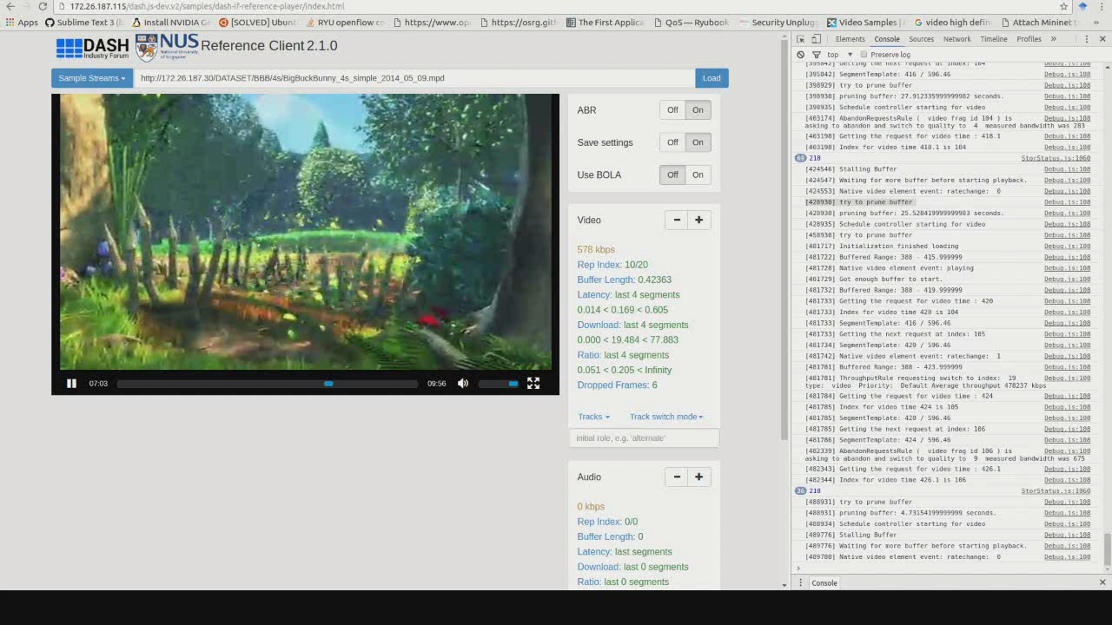
Rate Adaptation – Why?

Slide 3
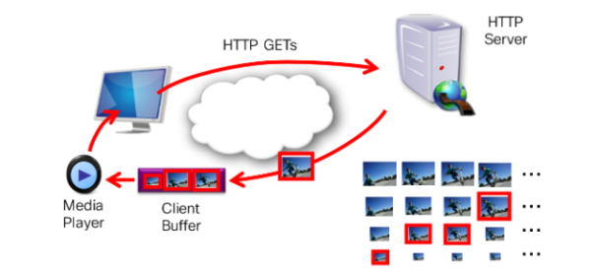

Rate Adaptation – Why?
Adaptation to dynamic network conditions
  Adapts to dynamic conditions anywhere on the path
  through the Internet and/or home network.
    Decrease continual connections between S and C’s while increase scalability of clients.
Transmission rate should match encoding rate
  Otherwise: non-continuous playback (stalls)
Improved end-user Quality of Experience (QoE)
  Enables faster start-up and seeking
  Reduces freezes (stalls) and blocking

Slide 4
Types of Rate Adaptation
Transmission Rate Adaptation
  Adapt data transmission to fluctuating network conditions
Media Rate Adaptation
  Media data rate must match data transmission rate; otherwise stalls, etc.
  Media data rate can be controlled by encoder (parameters) or via scalable coding (SVC, MDC)

Slide 5
Transmission Rate Adaptation
Client-side Rate Adaptation
  Used with DASH
Server-side Rate Adaptation
  Used with RTP/RTCP/RTSP suite (e.g., used in WebRTC)

Slide 6
Client-Side Adaptations
e.g., used with DASH

Slide 7
You are Here
Encoder
Decoder
Middlebox
Sender
Receiver
Network

Slide 8
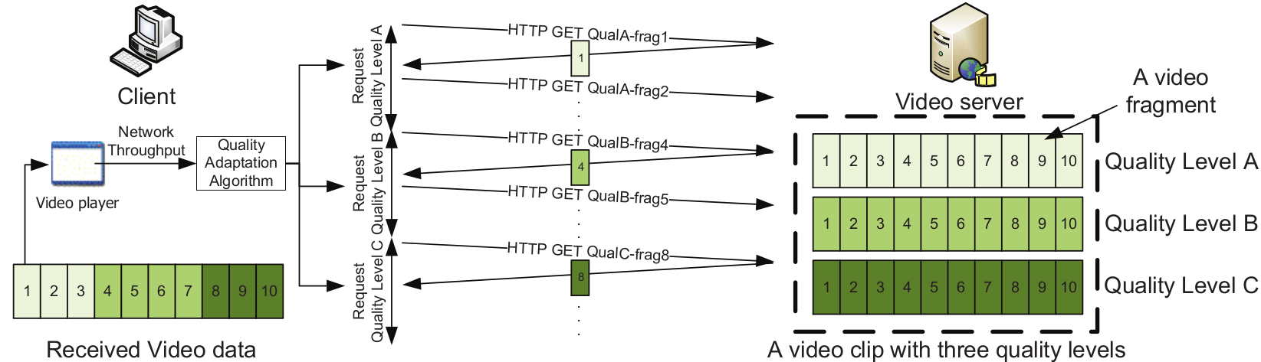
Dynamic Adaptive Streaming over HTTP (DASH)
Fragment the video into small fixed duration (2 to 10s) segments
Encode and store segments at different bitrate and resolution levels
List the encoded segments in a Media Presentation Description (MPD)
Send segments using HTTP POST
Request the MPD
Download segments using HTTP GET
select bitrate based on TCP bandwidth estimation
Adapt to network resources dynamically

Slide 9
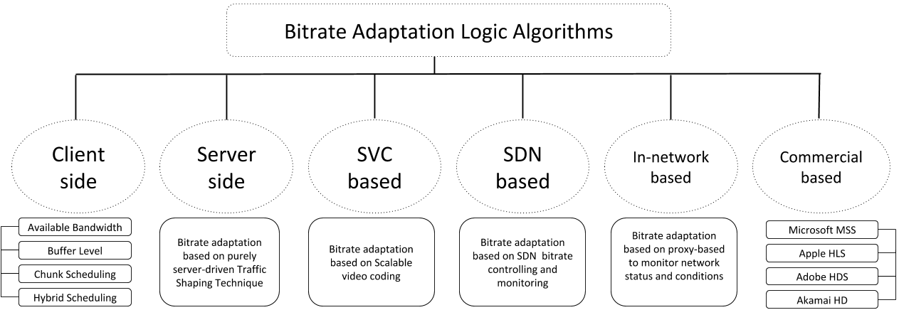
Overview

Slide 10
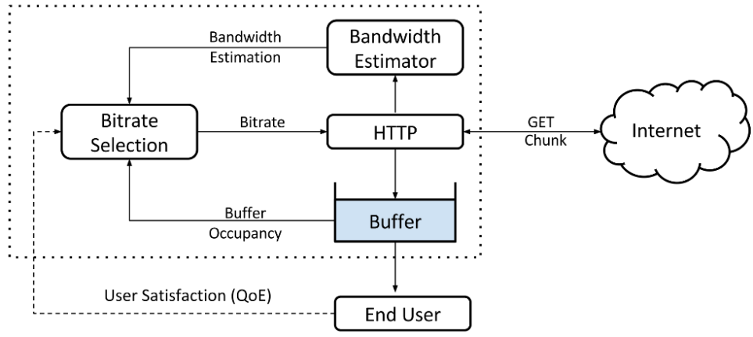
Client-side Bitrate (BR) Adaptation
The bitrate adaptation logic is fully controlled by the client (purely client-driven).
  Bitrate adaptation heuristics based on:
    Available bandwidth
    Playback buffer size
    Chunk scheduling
    Hybrid-based
  Interesting algorithms
  Li et al (2014), Liu et al (2011)
  Huang et al (2014), Mueller et al (2015)
  Jiang et al (2012), Chen et al (2013)
  Yin et al (2015), Li et al. (2014), De Cicco et al. (2013), Miller et al. (2012), Zhou et al. (2012)

Slide 11
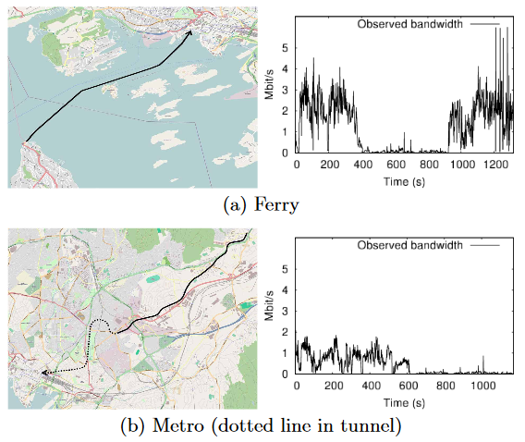
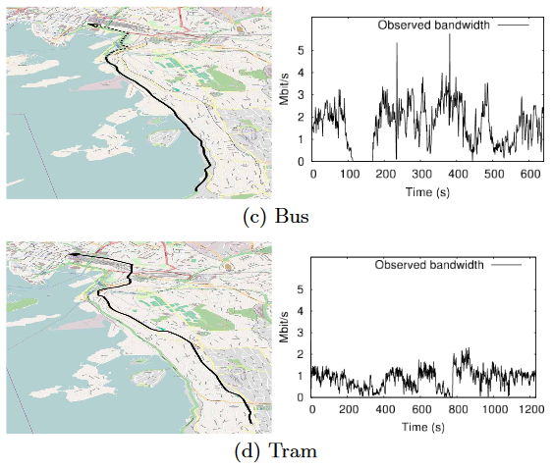
Adaptation Comparison (1)
“A Comparison of Quality Scheduling in Commercial Adaptive HTTP Streaming Solutions on a 3G Network”
Haakon Riiser, Håkon S. Bergsaker, Paul Vigmostad, Pål Halvorsen, Carsten Griwodz, ACM MoVid '12, proceedings of the 4th Workshop on Mobile Video, pp. 25-30.
This paper compares four commuter scenarios:

Slide 12
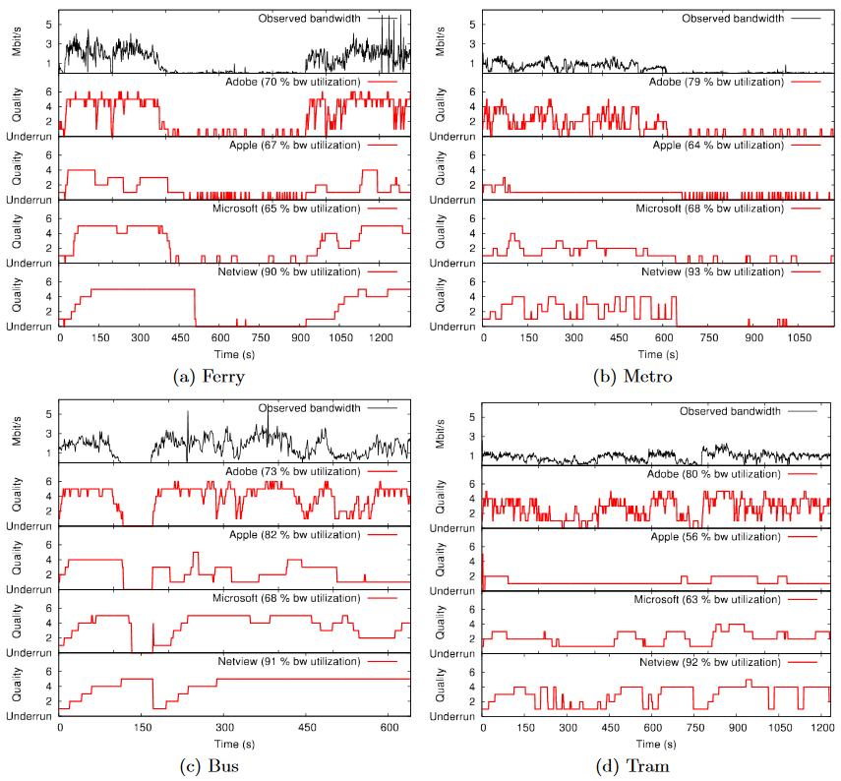






Adaptation Comparison (2)
Netview
Netview

Slide 13
1. Available Bandwidth BR Adaptation
Uses the available bandwidth estimation as an heuristic in the bitrate adaptation logic algorithm.
  Interesting algorithms:
  Li et al. (2014), Liu et al. (2011)
  Challenges and drawbacks:
  Blind available bandwidth sharing between competing clients
    Each client strives to fetch the high chunk bitrate => unfairness, congestion
  Distribute the available bandwidth equally between clients
    Heterogeneous devices with various capabilities case?
  The bandwidth estimation is not accurate ⇒ DASH scalability issues
    Lack of a central manager
  May suffer from buffer starvation and undesirable QoE
  Worst decisions when number of clients increase

Slide 14
2. Buffer Level Size BR Adaptation
Uses the current buffer level size as an criterion in the bitrate adaptation logic algorithm.
  Interesting algorithms:
  Huang et al. (2014), Mueller et al. (2015)
  Challenges and drawbacks:
  Suffer from frequent bitrate switch with a low perpetual quality
    Low end-user QoE
  Can not deal with rapid and/or sudden bandwidth variations
    Very slow detection ⇒ very slow detection, eliminate the available bandwidth estimation
  Can not support many clients

Slide 15
3. Chunk Scheduling BR Adaptation
Divides the bitrate adaptation algorithm into many components and uses scheduling approach to select a suitable bitrate level.
  Interesting algorithms:
  Jiang et al. (2012), Chen et al. (2013)
  Challenges and drawbacks:
  Is exposed to instability issue when the number of players increases
    Inaccurate bandwidth estimation
  Ignored responsiveness to bandwidth fluctuations
    Buffer undershoot issue and stalls
  Achieves unpleasant end-user QoE
  Hard to implement in a real word without any central control manager that schedules bitrate decisions for each client

Slide 16
4. Hybrid BR Adaptation
The client makes its bitrate selection based on combination between available bandwidth and buffer level heuristics.
Interesting algorithms:
  Yin et al. (2015), Li et al. (2014), De Cicco et al. (2013), Miller et al. (2012), Zhou et al. (2012)
  Challenges and drawbacks:
  Supports few number of clients
  Avoid just one or two of scalability issues
    e.g., consistent quality without taking into account fair share of bandwidth
  Lack of optimal bitrate decisions
    Does not consider any metric of user satisfaction
    Suffers from video instability and stalls
    Achieves a poor end-user QoE

Slide 17
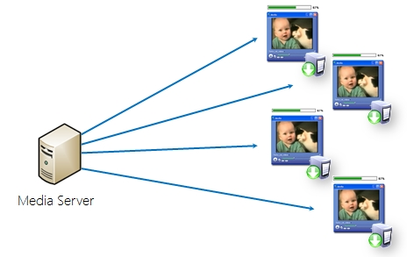

Server-side Bitrate Adaptation
The bitrate adaptation logic is fully controlled by the server (purely server-driven)
  Uses traffic shaping mechanism to assign the bitrate for each client,
    e.g., based on some pricing rules
  Not requiring any cooperation from the client
  Like traditional video streaming systems
Some interesting algorithms
  Akhshabi et al. (2013)
  Houdaille and Gouache (2012)
  De Cicco et al. (2011)
600Kbps
300Kbps
900Kbps
1000Kbps
Traffic Shaper
DASH Server
DASH client

Slide 18
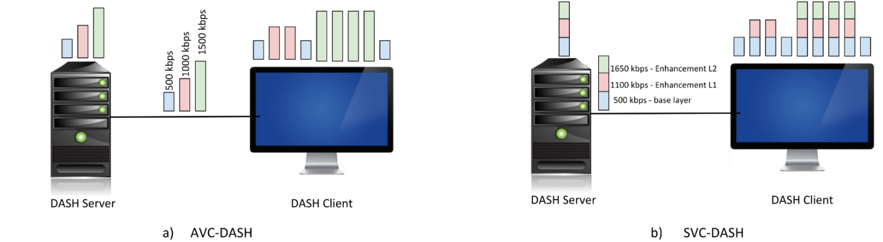
SVC-based Bitrate Adaptation
Each segment can be split into a subset of bit-streams.
The client selects the base layer of the lower quality and increases the quality by downloading more enhancement layers.
  Downloading more layers is based on network conditions.
Interesting algorithms
  Kreuzberger et al. (2015), Sieber et al. (2013), Andelin et al. (2012)

Slide 19
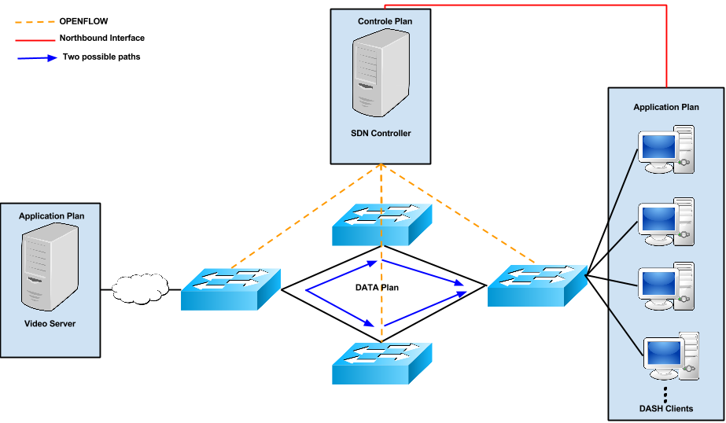
SDN-based Bitrate Adaptation
Software defined networking is used.
  Network resources control and monitoring capabilities
  simplify/rapidity of network resource programming and deployment
  Avoid the purely client-driven bitrate adaptation issues
The bitrate adaptation logic is controlled, monitored and assisted
by a central coordinator called SDN controller.
  QoE improvement => interaction
  between a SDN controller and
  DASH client
All Interesting algorithms:
  Georgopoulos et al. (2013), Farshad et al. (2015),
  Arefin et al. (2013), Nam et al. (2014), Wang et al. (2014),
  Ferguson et al. (2013), Bari et al. (2013), Gorlatch et al. (2015),
  Gudipati et al. (2013), Yap et al. (2013)

Slide 20
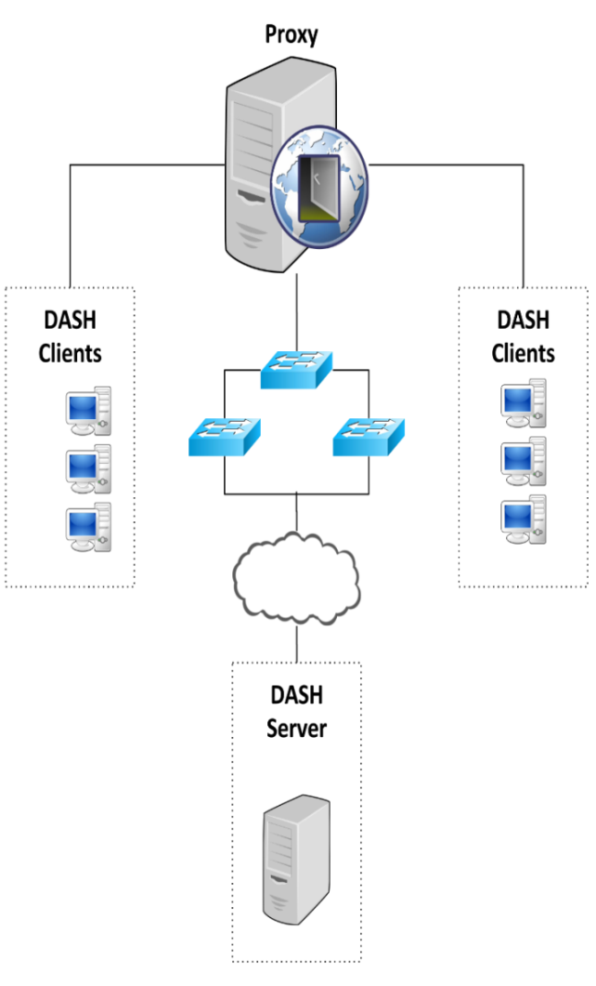
In-network based Bitrate Adaptation
Bitrate adaptation logic is based on in-network decisions.
  In-network process needs a special component.
    Agent and/or proxy deployed in the network
      Offer the required information that allow
      bitrate adaptation algorithm to use
      efficiently the network resources.
      Interesting algorithms
  Mok et al. (2012), Eckert and Knoll (2013),
  Bouten et al. (2015), Petrangeli et al. (2015),
  Thomas et al. (2015), Joseph and de Veciana (2014),
  El Essaili et al. (2013)

Slide 21



Commercial Solution Bitrate Adaptation
Microsoft smooth player (MSS)
  Current available bandwidth, playback windows resolution and CPU load as heuristics for bitrate adaptation logic.
  Apple HTTP Live streaming player (HLS)
  Current available bandwidth, device capabilities as heuristics during the bitrate adaptation logic process.
  Adobe OSMF
  Adapts to the network variations based on the available bandwidth and device processing capabilities.
  Akamai HD
  Adapts to the network variations based on the available bandwidth and CPU load.

Slide 22
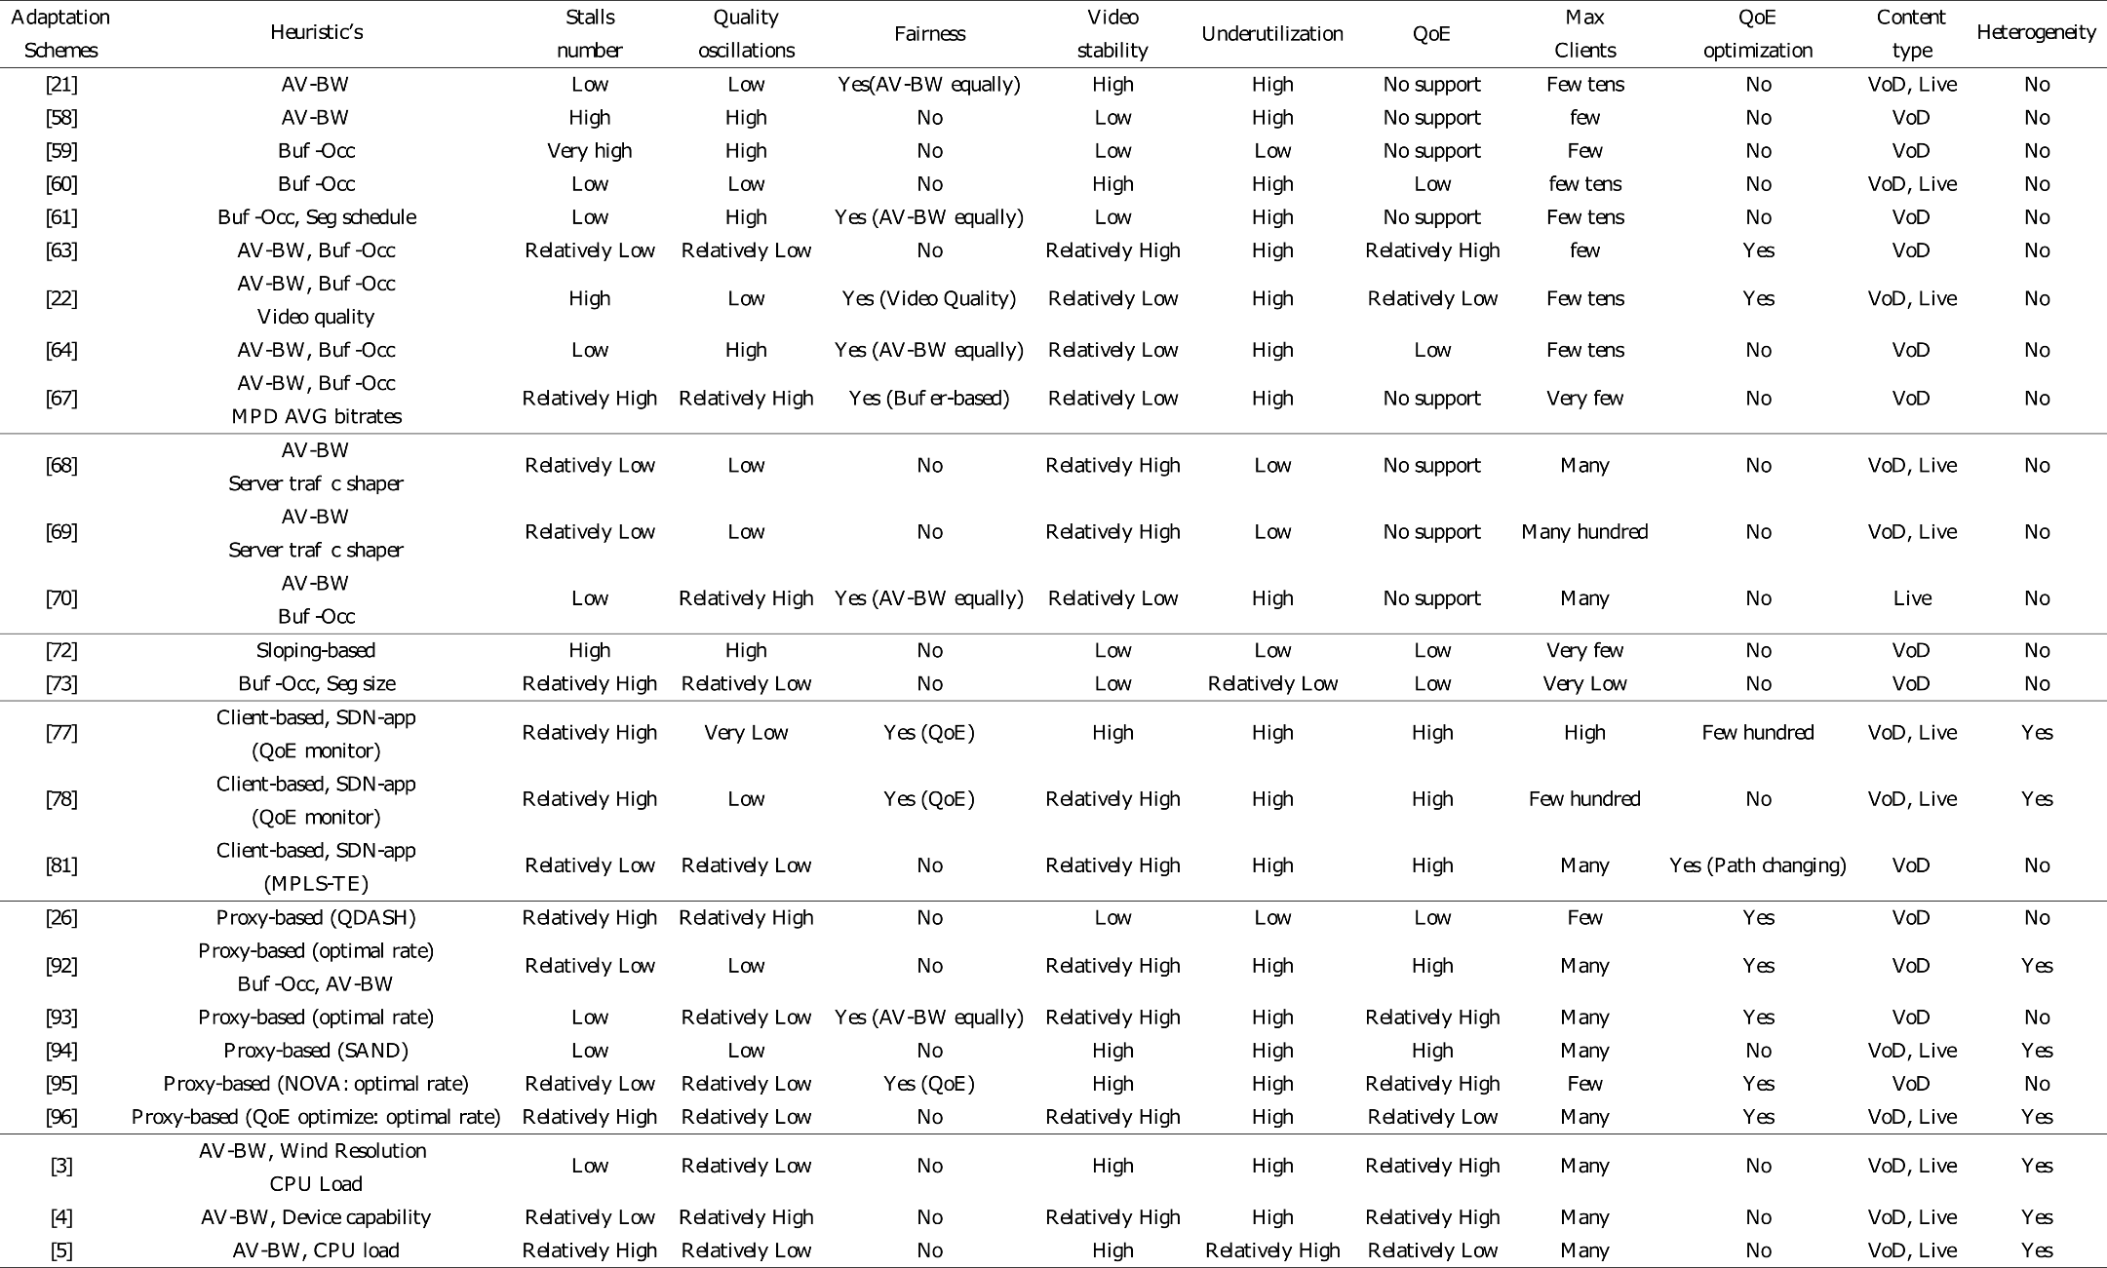
Comparison (Self-Study)
Notes:
heterogeneous systems = different device capabilities with different communication technologies

Slide 23
Server-Side Adaptations
e.g., used with RTP/RTCP/RTSP suite

Slide 24
You are Here
Encoder
Decoder
Middlebox
Sender
Receiver
Network

Slide 25
Sender’s Algorithm
open UDP socket
foreach video frame
chop into packets
add RTP header
send to network

Slide 26
Sender’s Algorithm
open UDP socket
foreach video frame
chop into packets
add RTP header
send to network
wait for 1/fps seconds

Slide 27
Sender’s Algorithm
Send frames at equal time distance.
open UDP socket
foreach video frame
chop into packets
add RTP header
send to network
wait for 1/fps seconds

Slide 28
Sender’s Algorithm
Send data at constant bandwidth.
open UDP socket
foreach video frame
chop into packets
foreach packet
add RTP header
send to network
wait for size/bps seconds

Slide 29
Rules
Transmission rate should match encoding rate
Transmission should not be too bursty

Slide 30
Two Approaches
Just send at a fix rate
  or “I hope the network can handle it” approach

Slide 31
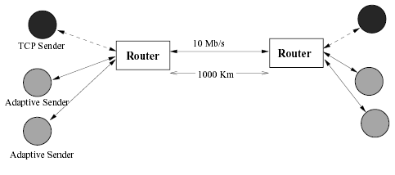
Effects on TCP: Simulation
From Sisalem, Emanuel and Schulzrinne paper on
“Direct Adjustment Algorithm.”

Slide 32
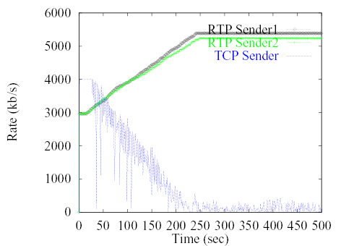
Effects on TCP

Slide 33
DAA Parameters
Adaptive RTP flows
  Additive increase/multiplicative decrease
    50 kb and factor 0.875
  RTCP: min 5 sec inter-report time
  Loss thresholds: 5% and 10%
TCP
  Immediate loss notification
  Transmission window is halved

Slide 34
DAA Parameters
Adaptive RTP flows
  Additive increase/multiplicative decrease
    50 kb and factor 0.875
  RTCP: min 5 sec inter-report time
  Loss thresholds: 5% and 10%
TCP
  Immediate loss notification
  Transmission window is halfed

Slide 35
Two Approaches
Just send at a fixed rate
  or “I hope the network can handle it” approach
Adapt transmission/encoding rate to network condition

Slide 36
How to Adapt?
if network condition is bad
reduce rate
else if network condition is so-so
do nothing
else if network condition is good
increase rate

Slide 37
How to ..
Know “network condition is bad”?
Increase/decrease rate?

Slide 38
Adapting Output Rate
if network condition is bad
else if network condition is so-so
do nothing
else if network condition is good

Slide 39
Adapting Output Rate
Multiplicative
decrease
if network condition is bad
else if network condition is so-so
do nothing
else if network condition is good
Additive
increase

Slide 40
Adapting Output Rate
r_{i}
Additive increase
Multiplicative decrease

Slide 41
Question:
What should μ and ν be?

Slide 42
Observation 1
Should never change your rate more than an equivalent TCP stream.

Slide 43
Observation 2
μ and ν should depend on network conditions and current rate.
Notes:
current rate high,

Slide 44
Goal: Fair Share of Bottleneck
let r : current rate
b : bottleneck bandwidth S : current share
Notes:
current rate high,

Slide 45
Goal: Fair Share of Bottleneck
let r : current rate
b : bottleneck bandwidth S : current share
Notes:
current rate high,

Slide 46
S versus ν
ν
[kb/s]
S
0
1

Slide 47
S versus ν
ν
[kb/s]
S
0
1

Slide 48
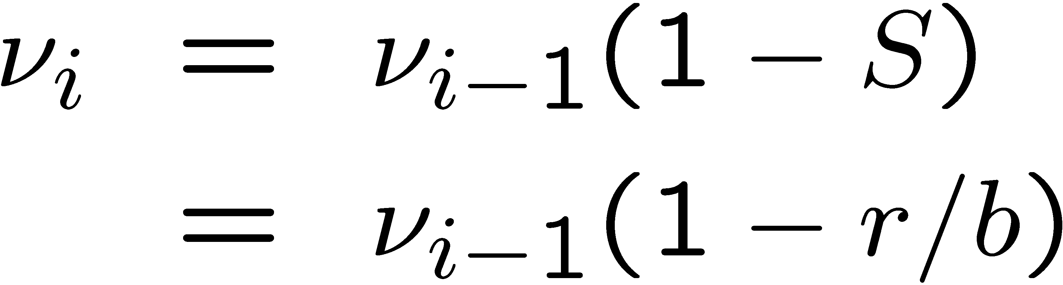
Value of ν
(Assuming one receiver)

Slide 49
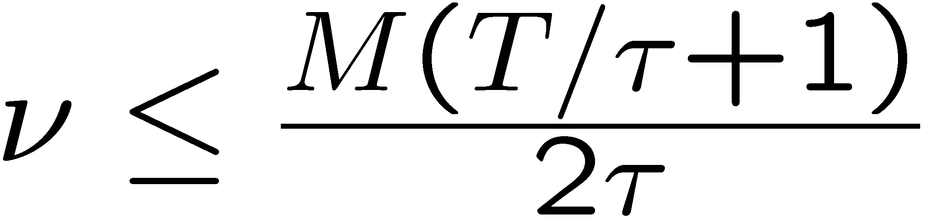
Limit of ν
M : packet size
τ : round trip time
T : period between evaluation of ν
⇒ Limited to the average rate increase a TCP connection
would utilize during periods without losses.

Slide 50
Loss rate versus μ
μ
1
1
0
loss rate

Slide 51
Loss rate versus μ
μ
1
1
0
loss rate

Slide 52


Value of μ
where
is the loss rate
k is a constant
(Assuming one receiver)

Slide 53
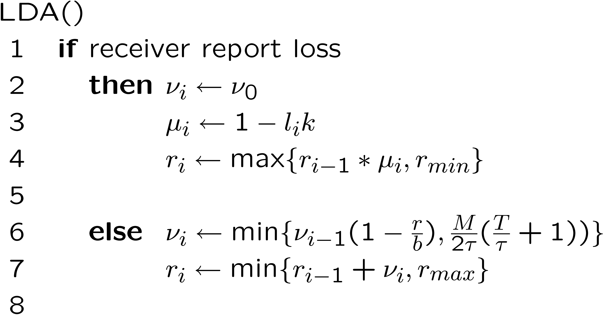
LDA Algorithm

Slide 54
What is Needed?

Slide 55
What is Needed?
We know
v_{i}, r, M, T, τ
But not
b

Slide 56
Estimating b : Packet Pair

Slide 57
Estimating b : Packet Pair

Slide 58
Estimating b : Packet Pair

Slide 59
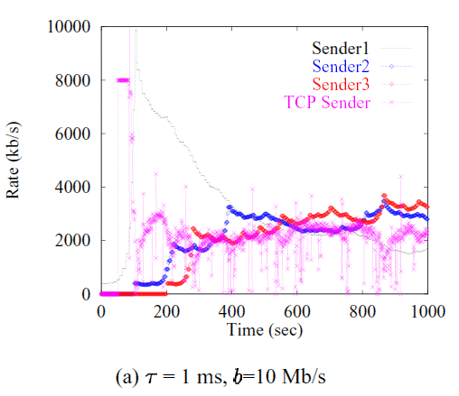
Evaluation

Slide 60
More TCP-Friendly Rate Control

Slide 61
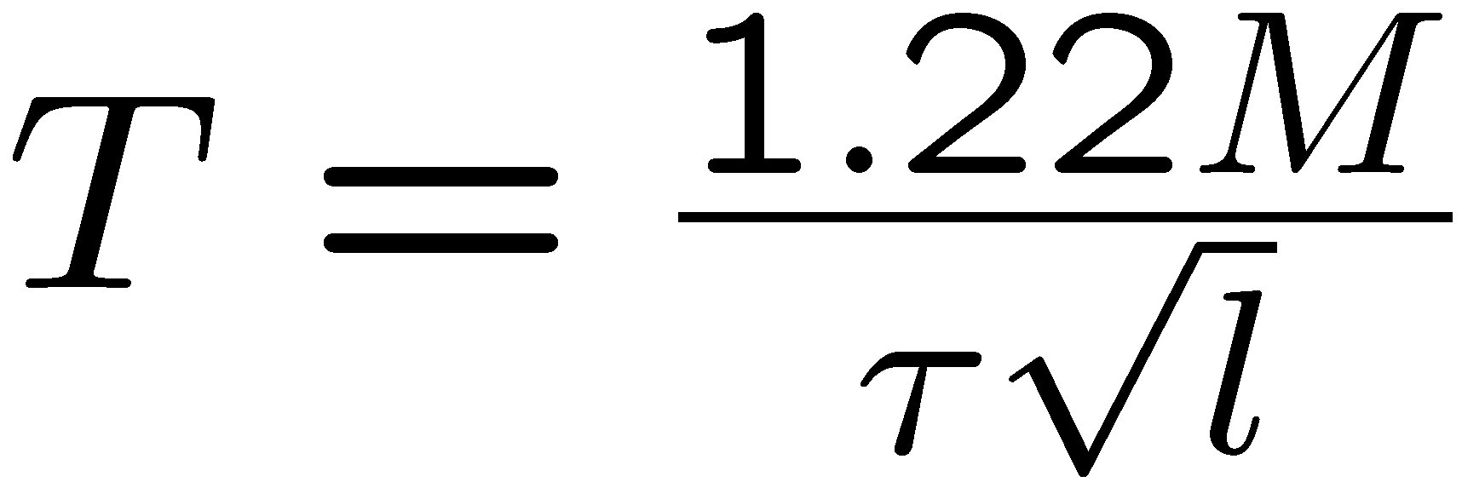
TCP-Equation
Window size behavior in TCP/IP with constant loss probability
T. Ott, J. Kemperman, and M. Mathis
June 1997, HPCS 1997

Slide 62
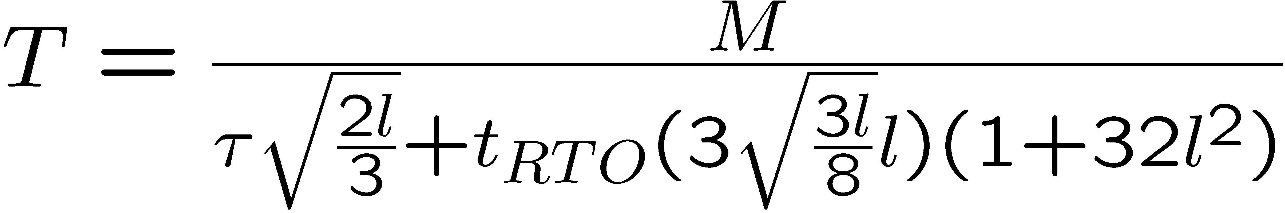
TCP-Equation
Equation-Based Congestion Control for Unicast Applications
Sally Floyd, Mark Handley, Jitendra Padhye, and Joerg Widmer.
August 2000. SIGCOMM 2000

Slide 63
Rules
Transmission rate should match encoding rate
Transmission should not be too bursty

Slide 64
Media Rate Control
Given a rate, how to encode the video with the given rate?

Slide 65
Reduce Frame Rate
Live Video
Stored Video

Slide 66
Reduce Frame Rate
Live Video
  Easy (uncompressed input)
Stored Video
  Difficult (frame dependencies)

Slide 67
Reduce Frame Resolution
Live Video
Stored Video

Slide 68
Reduce Frame Resolution
Live Video
  Easy
Stored Video
  Difficult

Slide 69
Increase Quantization
Live Video
Stored Video

Slide 70
Increase Quantization
Live Video
  Easy
Stored Video
  Difficult

Slide 71
Drop AC components
Live Video
Stored Video

Slide 72
Drop AC components
Live Video
  Easy
Stored Video
  Easy

Slide 73
Trouble with Stored Video
Reducing rate requires partial decoding and re-encoding
Solution: Layered Video

Slide 74
Layered Video
or “Scalable Video”

Slide 75



Layered Video
Layer 1
Layer 2
Layer 3
Notes:
One of the better proposed solution is called RLM or receiver driven layered multicast. The idea is to divide a stream into multiple layers. The base layer encodes the video stream at a low bitrate, and each additional layer on top enhances its quality. The layers are sent onto different multicast channels, and receivers can choose the number of layers to receive based on their available bandwidth.

Slide 76
Layering Scheme
Temporal (Frame Rate) Layering

Slide 77
Layering Scheme
Spatial (Resolution) Layering

Slide 78
Layering Scheme
DCT Layering; SNR (Quality) Layering
30
30
8
2
30
8
2
0
-6
-1
-6
-1
0
0
1
1
0
0
0
0
0
0
0

Slide 79
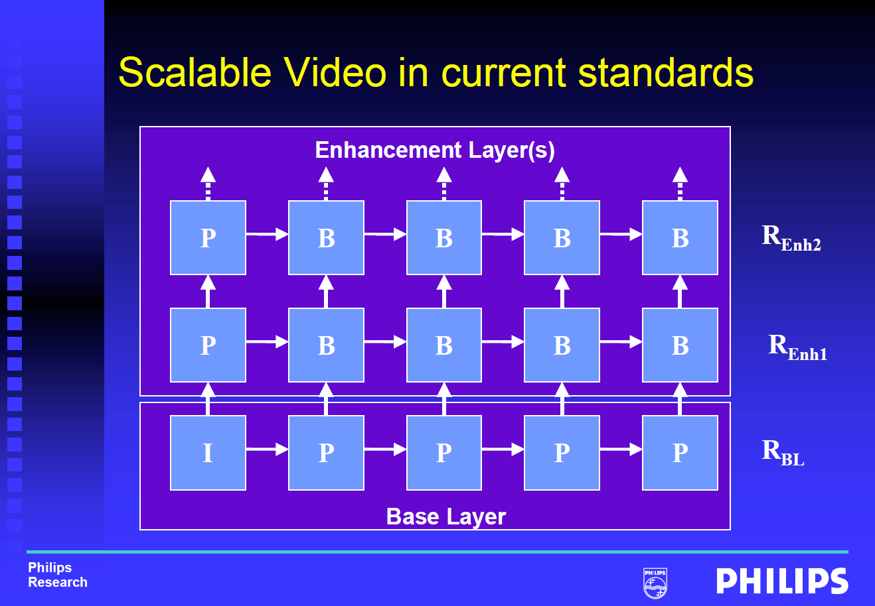
Layering Scheme
Fine Granularity Scalability (FGS): e.g., MPEG-4
© Mihaela van der Schaar

Slide 80
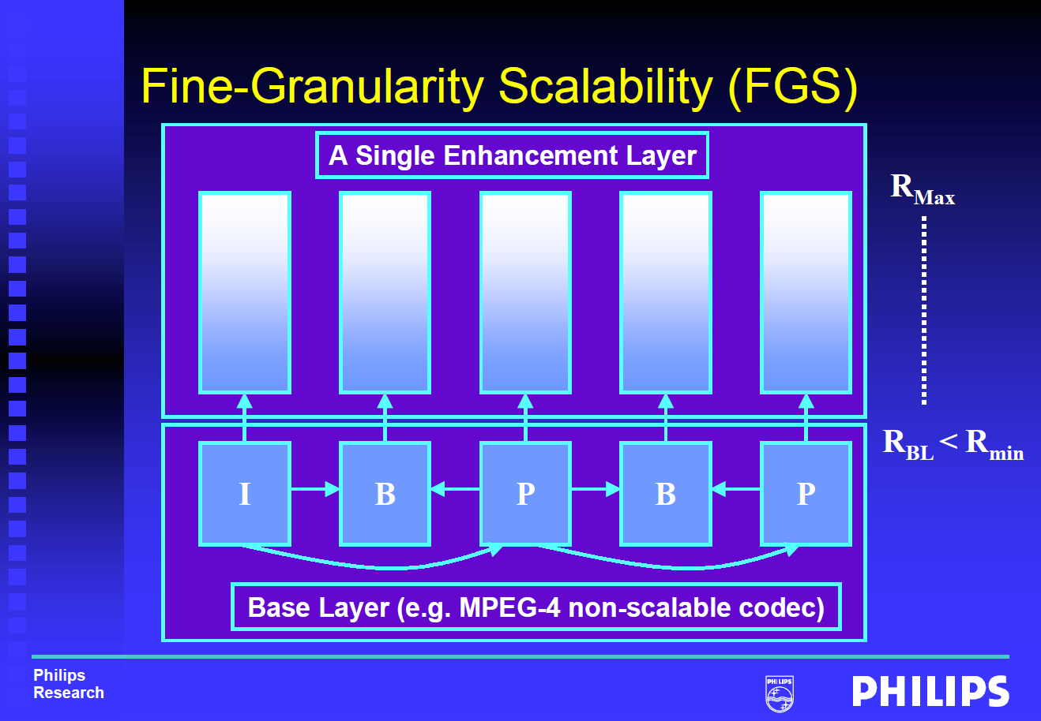
Layering Scheme
Fine Granularity Scalability (FGS): e.g., MPEG-4
© Mihaela van der Schaar

Slide 81
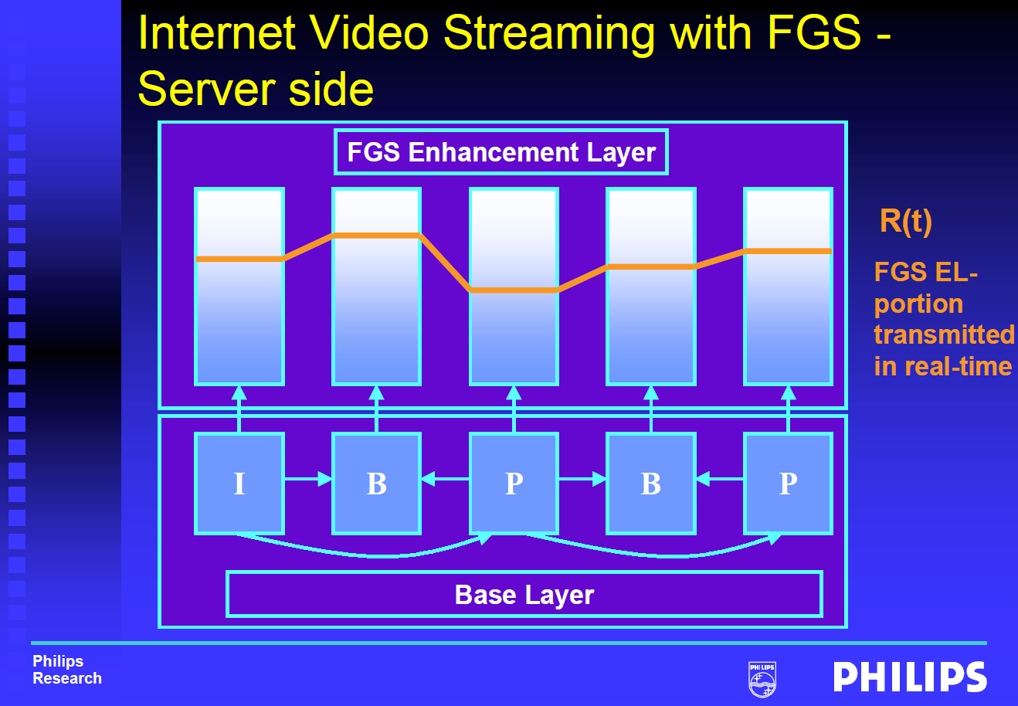
Layering Scheme
Fine Granularity Scalability (FGS): e.g., MPEG-4
© Mihaela van der Schaar

Slide 82
Layered Video
SVC: Scalable Video Coding
  Base-layer plus enhancement layers
  Each received layer improves the quality
  Layer n+1 depends on layer n
MDC: Multiple Description Coding
  Layers are independent
  Each received layer improves the quality

Slide 83
Layered Video
BUT: Layered video codecs are less bandwidth-efficient than single-layer codecs.

Slide 84
Rate Adaptation
To increase rate, send more layers
To decrease rate, drop some layers

Slide 85
MS Windows Streaming Media

Slide 86
Intelligent Streaming
Multiple-Bit-Rate Encoding
Intelligent Bandwidth Control
  bit rate selection
  thinning
Intelligent Image Processing

Slide 87
Intelligent Streaming
How exactly does it work?
Sorry, it’s proprietary

Slide 88
Is WSM TCP friendly?
Measurements of the Congestion Responsiveness of Windows Streaming Media
J. Nichols et. al., NOSSDAV 2004
All figures taken from the original NOSSDAV presentation

Slide 89
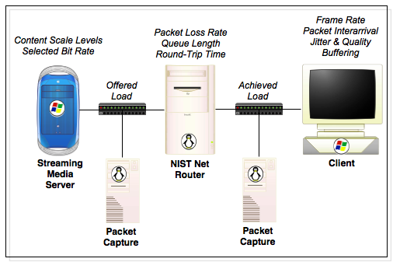

Slide 90
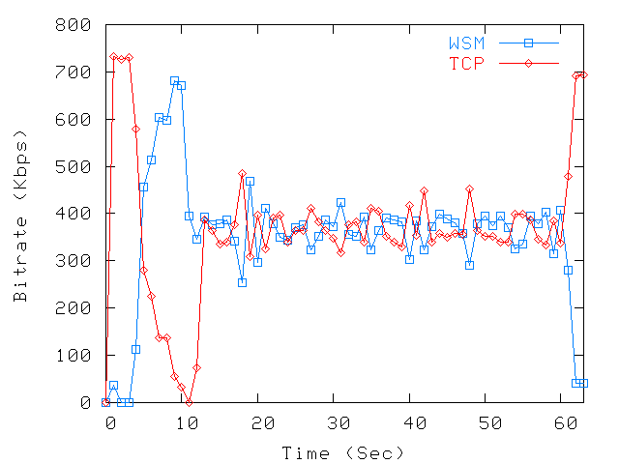
340kbps clip, 725kbps bottleneck

Slide 91
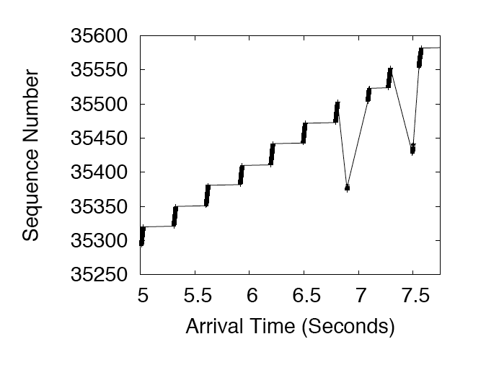
Transmission is Bursty

Slide 92
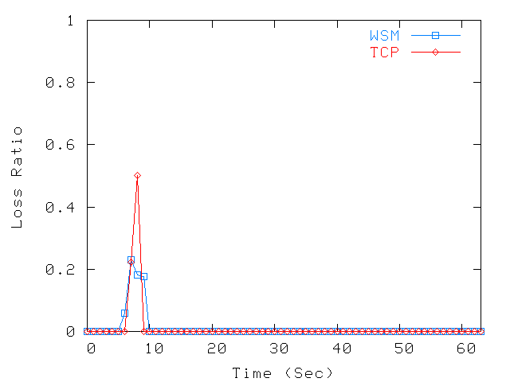
340kbps clip, 725kbps bottleneck

Slide 93
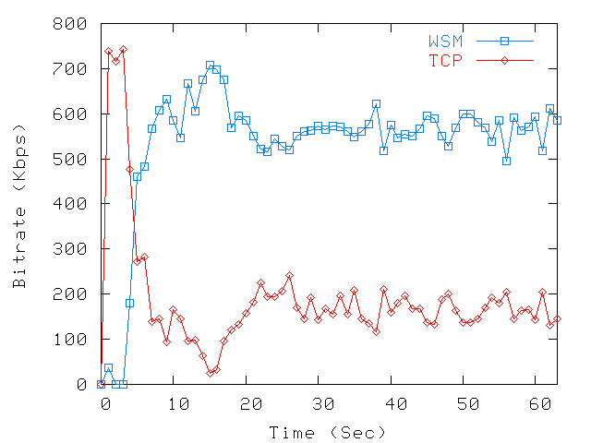
548kbps Clip - 725kbps Bottleneck

Slide 94
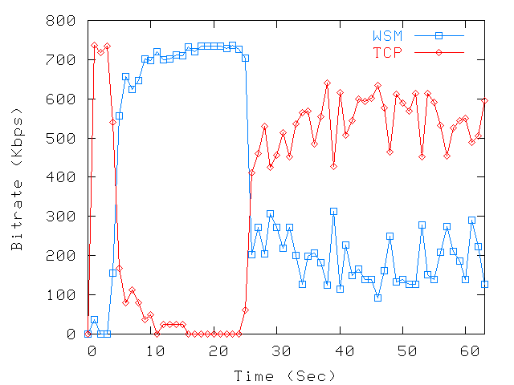
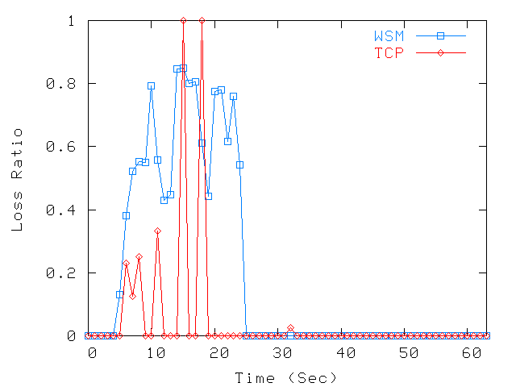
1128kbps Clip - 725kbps Bottleneck

Slide 95
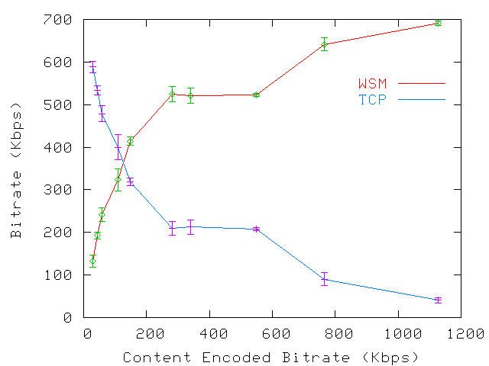
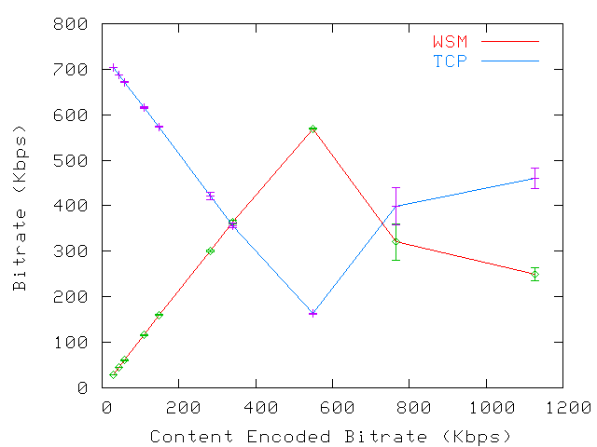
725kbps Bottleneck
Buffering
Playout
Single Encoded Bit Rate

Slide 96
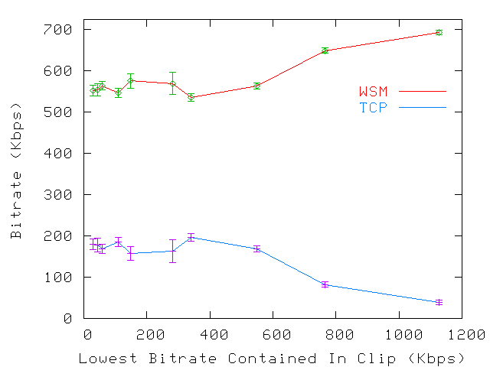
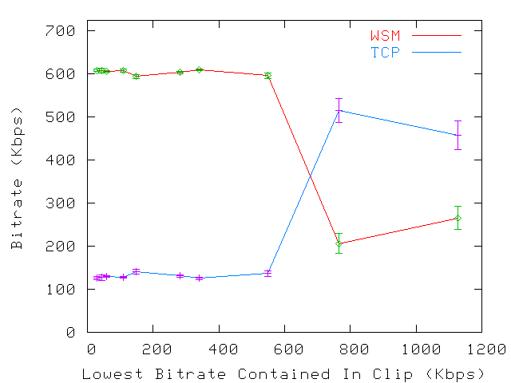
725kbps Bottleneck
Buffering
Playout
Multiple Encoded Bit Rate

Slide 97
Conclusion
Two phases: buffering + playout
Not always TCP-friendly

Slide 98
Summary (1)
Rate Adaptation – Why?
  Adapt data transmission to fluctuating network conditions
Media Rate Control – Why?
  Media data rate must match data transmission rate; otherwise stalls, etc.
  Media data rate can be controlled by encoder (parameters) or via scalable coding (SVC, MDC)

Slide 99
Summary (2)
Client-Side Rate Adaptation
  Used with DASH (i.e., HTTP/TCP)
  Can be based on bandwidth, buffer, or both
Server-Side Rate Adaptation
  Used with RTP/RTCP/RTSP
  Tries to be TCP-friendly at packet level

