Slide 1
Rate Adaptations

Slide 2
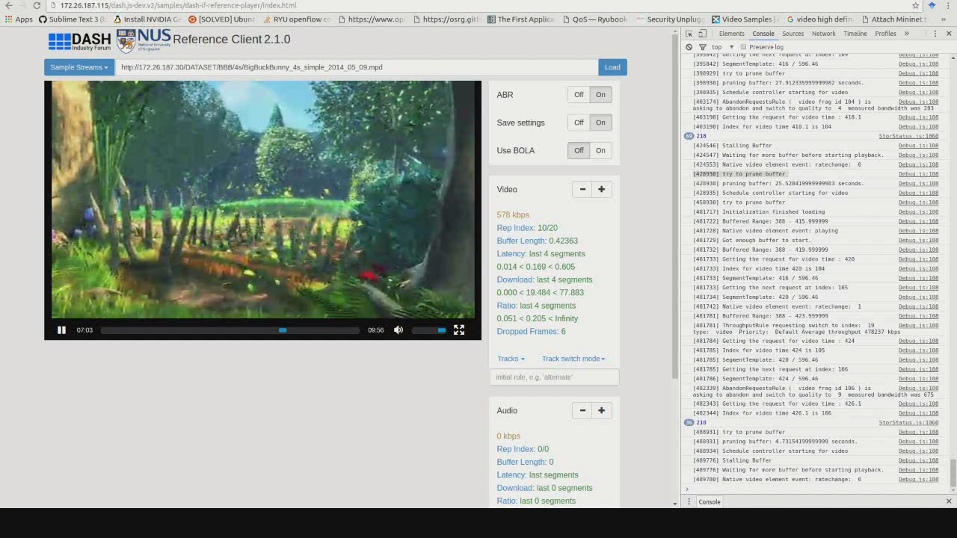
Rate Adaptation – Why?

Slide 3
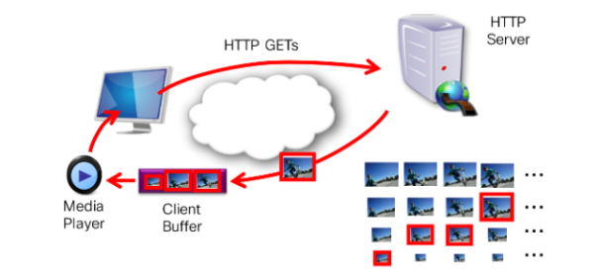

Rate Adaptation – Why?
Adaptation to dynamic network conditions
Adapts to dynamic conditions anywhere on the path through the Internet and/or home network.
Decrease continual connections between S and C’s while increase scalability of clients.
Transmission rate should match encoding rate
Otherwise: non-continuous playback (stalls)
Improved end-user Quality of Experience (QoE)
Enables faster start-up and seeking
Reduces freezes (stalls) and blocking

Slide 4
Types of Rate Adaptation
Transmission Rate Adaptation
Adapt data transmission to fluctuating network conditions
Media Rate Adaptation
Media data rate must match data transmission rate; otherwise stalls, etc.
Media data rate can be controlled by encoder (parameters) or via scalable coding (SVC, MDC)

Slide 5
Transmission Rate Adaptation
Client-side Rate Adaptation
Used with DASH
Server-side Rate Adaptation
Used with RTP/RTCP/RTSP suite (e.g., used in WebRTC)

Slide 6
Client-Side Adaptations
e.g., used with DASH

Slide 7
You are Here
Encoder
Decoder
Middlebox
Sender
Receiver
Network

Slide 8
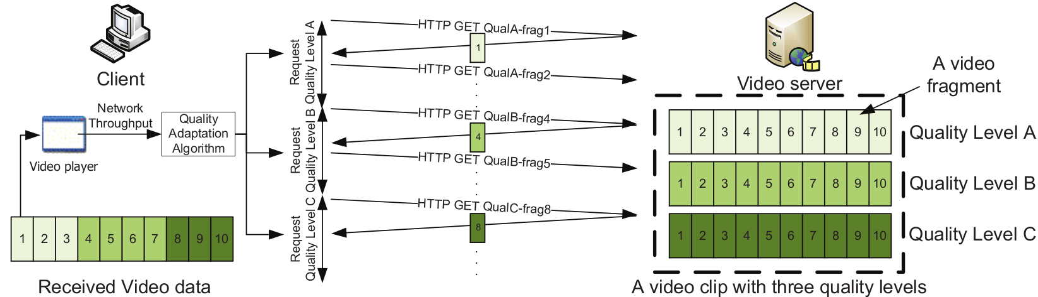
Dynamic Adaptive Streaming over HTTP (DASH)
Fragment the video into small fixed duration (2 to 10s) segments
Encode and store segments at different bitrate and resolution levels
List the encoded segments in a Media Presentation Description (MPD)
Send segments using HTTP POST
Request the MPD
Download segments using HTTP GET
select bitrate based on TCP bandwidth estimation
Adapt to network resources dynamically

Slide 9
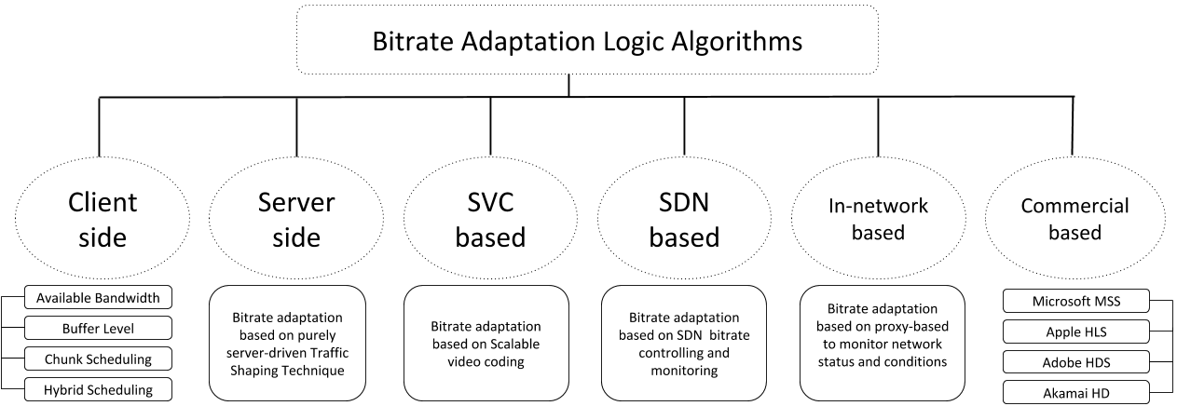
Overview

Slide 10
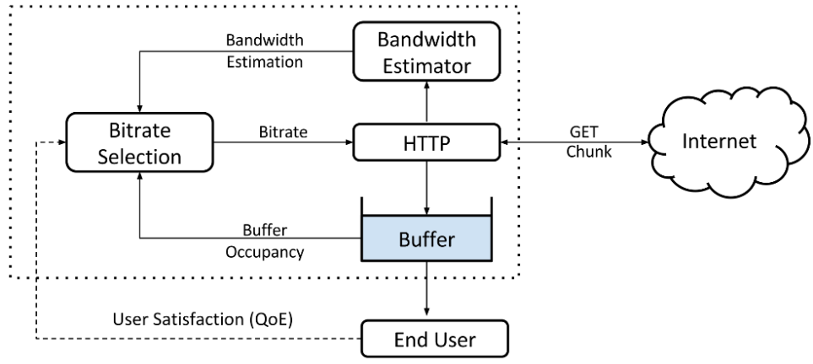
Client-side Bitrate (BR) Adaptation
The bitrate adaptation logic is fully controlled by the client (purely client-driven).
Bitrate adaptation heuristics based on:
Available bandwidth
Playback buffer size
Chunk scheduling
Hybrid-based
Interesting algorithms
Li et al (2014), Liu et al (2011)
Huang et al (2014), Mueller et al (2015)
Jiang et al (2012), Chen et al (2013)
Yin et al (2015), Li et al. (2014), De Cicco et al. (2013), Miller et al. (2012), Zhou et al. (2012)

Slide 11
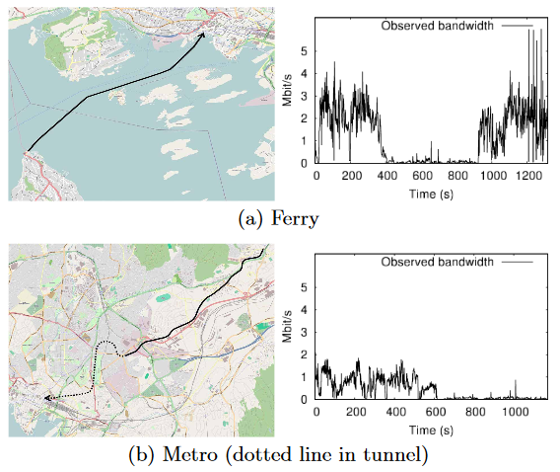
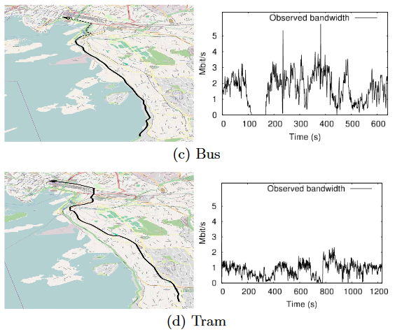
Adaptation Comparison (1)
“A Comparison of Quality Scheduling in Commercial Adaptive HTTP Streaming Solutions on a 3G Network” Haakon Riiser, Håkon S. Bergsaker, Paul Vigmostad, Pål Halvorsen, Carsten Griwodz, ACM MoVid '12, proceedings of the 4th Workshop on Mobile Video, pp. 25-30.
This paper compares four commuter scenarios:

Slide 12
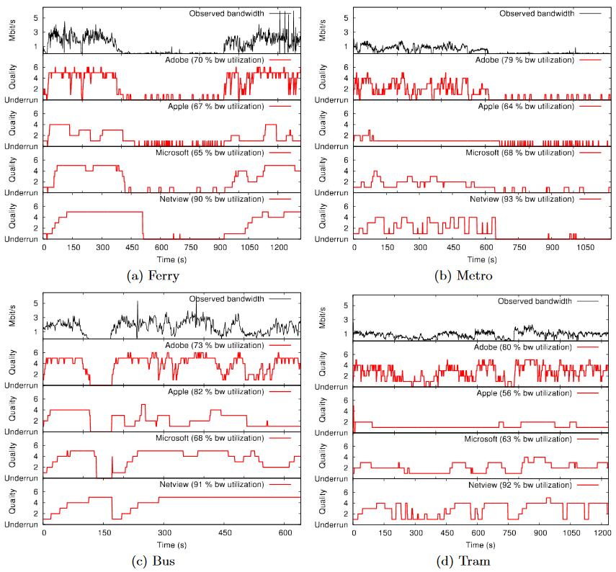






Adaptation Comparison (2)
Netview
Netview

Slide 13
1. Available Bandwidth BR Adaptation
Uses the available bandwidth estimation as an heuristic in the bitrate adaptation logic algorithm.
Interesting algorithms:
Li et al. (2014), Liu et al. (2011)
Challenges and drawbacks:
Blind available bandwidth sharing between competing clients
Each client strives to fetch the high chunk bitrate => unfairness, congestion
Distribute the available bandwidth equally between clients
Heterogeneous devices with various capabilities case?
The bandwidth estimation is not accurate ⇒ DASH scalability issues
Lack of a central manager
May suffer from buffer starvation and undesirable QoE
Worst decisions when number of clients increase

Slide 14
2. Buffer Level Size BR Adaptation
Uses the current buffer level size as an criterion in the bitrate adaptation logic algorithm.
Interesting algorithms:
Huang et al. (2014), Mueller et al. (2015)
Challenges and drawbacks:
Suffer from frequent bitrate switch with a low perpetual quality
Low end-user QoE
Can not deal with rapid and/or sudden bandwidth variations
Very slow detection ⇒ very slow detection, eliminate the available bandwidth estimation
Can not support many clients

Slide 15
3. Chunk Scheduling BR Adaptation
Divides the bitrate adaptation algorithm into many components and uses scheduling approach to select a suitable bitrate level.
Interesting algorithms:
Jiang et al. (2012), Chen et al. (2013)
Challenges and drawbacks:
Is exposed to instability issue when the number of players increases
Inaccurate bandwidth estimation
Ignored responsiveness to bandwidth fluctuations
Buffer undershoot issue and stalls
Achieves unpleasant end-user QoE
Hard to implement in a real word without any central control manager that schedules bitrate decisions for each client

Slide 16
4. Hybrid BR Adaptation
The client makes its bitrate selection based on combination between available bandwidth and buffer level heuristics.
Interesting algorithms:
Yin et al. (2015), Li et al. (2014), De Cicco et al. (2013), Miller et al. (2012), Zhou et al. (2012)
Challenges and drawbacks:
Supports few number of clients
Avoid just one or two of scalability issues
e.g., consistent quality without taking into account fair share of bandwidth
Lack of optimal bitrate decisions
Does not consider any metric of user satisfaction
Suffers from video instability and stalls
Achieves a poor end-user QoE

Slide 17



Commercial Solution Bitrate Adaptation
Microsoft smooth player (MSS)
Current available bandwidth, playback windows resolution and CPU load as heuristics for bitrate adaptation logic.
Apple HTTP Live streaming player (HLS)
Current available bandwidth, device capabilities as heuristics during the bitrate adaptation logic process.
Adobe OSMF
Adapts to the network variations based on the available bandwidth and device processing capabilities.
Akamai HD
Adapts to the network variations based on the available bandwidth and CPU load.

Slide 18
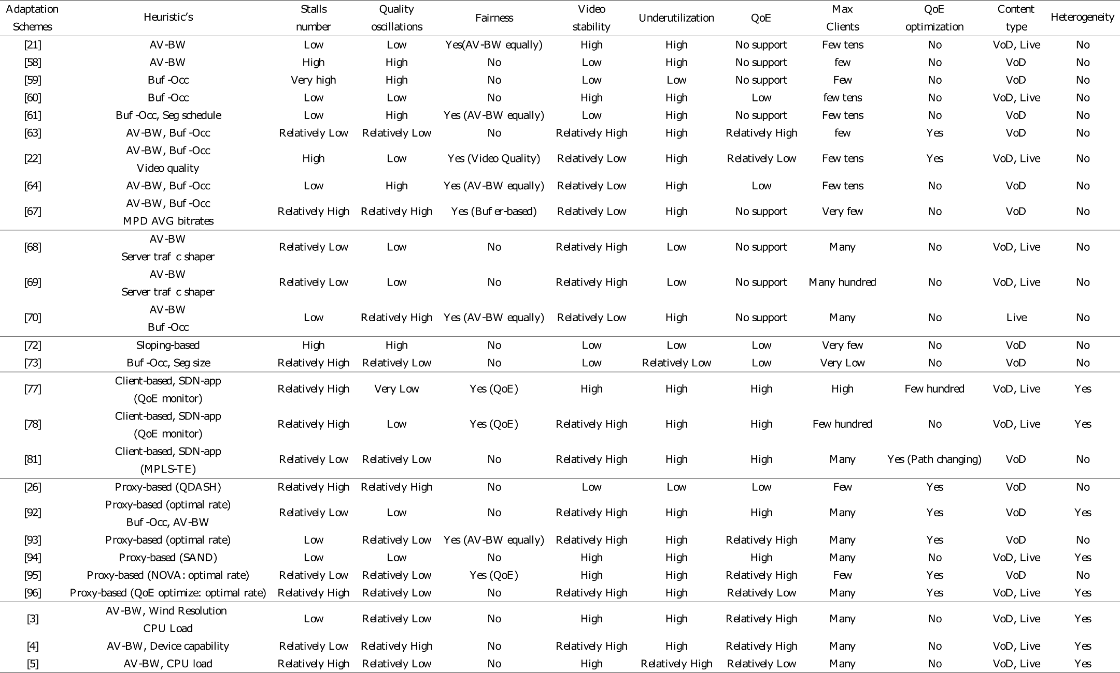
Comparison (Self-Study)
Notes:
heterogeneous systems = different device capabilities with different communication technologies

Slide 19
Server-Side Adaptations
e.g., used with RTP/RTCP/RTSP suite

Slide 20
You are Here
Encoder
Decoder
Middlebox
Sender
Receiver
Network

Slide 21
Sender’s Algorithm
open UDP socket
foreach video frame
chop into packets
add RTP header
send to network

Slide 22
Sender’s Algorithm
open UDP socket
foreach video frame
chop into packets
add RTP header
send to network
wait for 1/fps seconds

Slide 23
Sender’s Algorithm
Send frames at equal time distance.
open UDP socket
foreach video frame
chop into packets
add RTP header
send to network
wait for 1/fps seconds

Slide 24
Sender’s Algorithm
Send data at constant bandwidth.
open UDP socket
foreach video frame
chop into packets
foreach packet
add RTP header
send to network
wait for size/bps seconds

Slide 25
Rules
Transmission rate should match encoding rate
Transmission should not be too bursty

Slide 26
Two Approaches
Just send at a fix rate
or “I hope the network can handle it” approach

Slide 27
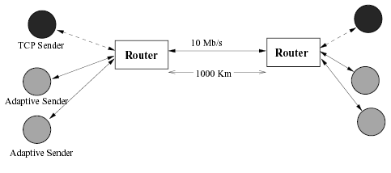
Effects on TCP: Simulation
From Sisalem, Emanuel and Schulzrinne paper on
“Direct Adjustment Algorithm.”

Slide 28
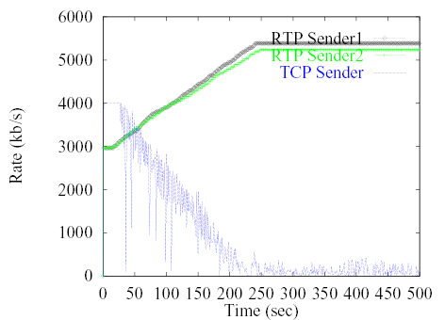
Effects on TCP

Slide 29
DAA Parameters
Adaptive RTP flows
Additive increase/multiplicative decrease
50 kb and factor 0.875
RTCP: min 5 sec inter-report time
Loss thresholds: 5% and 10%
TCP
Immediate loss notification
Transmission window is halved

Slide 30
Two Approaches
Just send at a fixed rate
or “I hope the network can handle it” approach
Adapt transmission/encoding rate to network condition

Slide 31
How to Adapt?
if network condition is bad
reduce rate
else if network condition is so-so
do nothing
else if network condition is good
increase rate

Slide 32
How to ..
Know “network condition is bad”?
Increase/decrease rate?

Slide 33
Adapting Output Rate
if network condition is bad
else if network condition is so-so
do nothing
else if network condition is good

Slide 34
Adapting Output Rate
Multiplicative
decrease
if network condition is bad
else if network condition is so-so
do nothing
else if network condition is good
Additive
increase

Slide 35
Adapting Output Rate
r_{i}
Additive increase
Multiplicative decrease

Slide 36
Question:
What should μ and ν be?

Slide 37
Observation 1
Should never change your rate more than an equivalent TCP stream.

Slide 38
Observation 2
μ and ν should depend on network conditions and current rate.
Notes:
current rate high,

Slide 39
Goal: Fair Share of Bottleneck
let r : current rate b : bottleneck bandwidth S : current share
Notes:
current rate high,

Slide 40
S versus ν
ν
[kb/s]
S
0
1

Slide 41
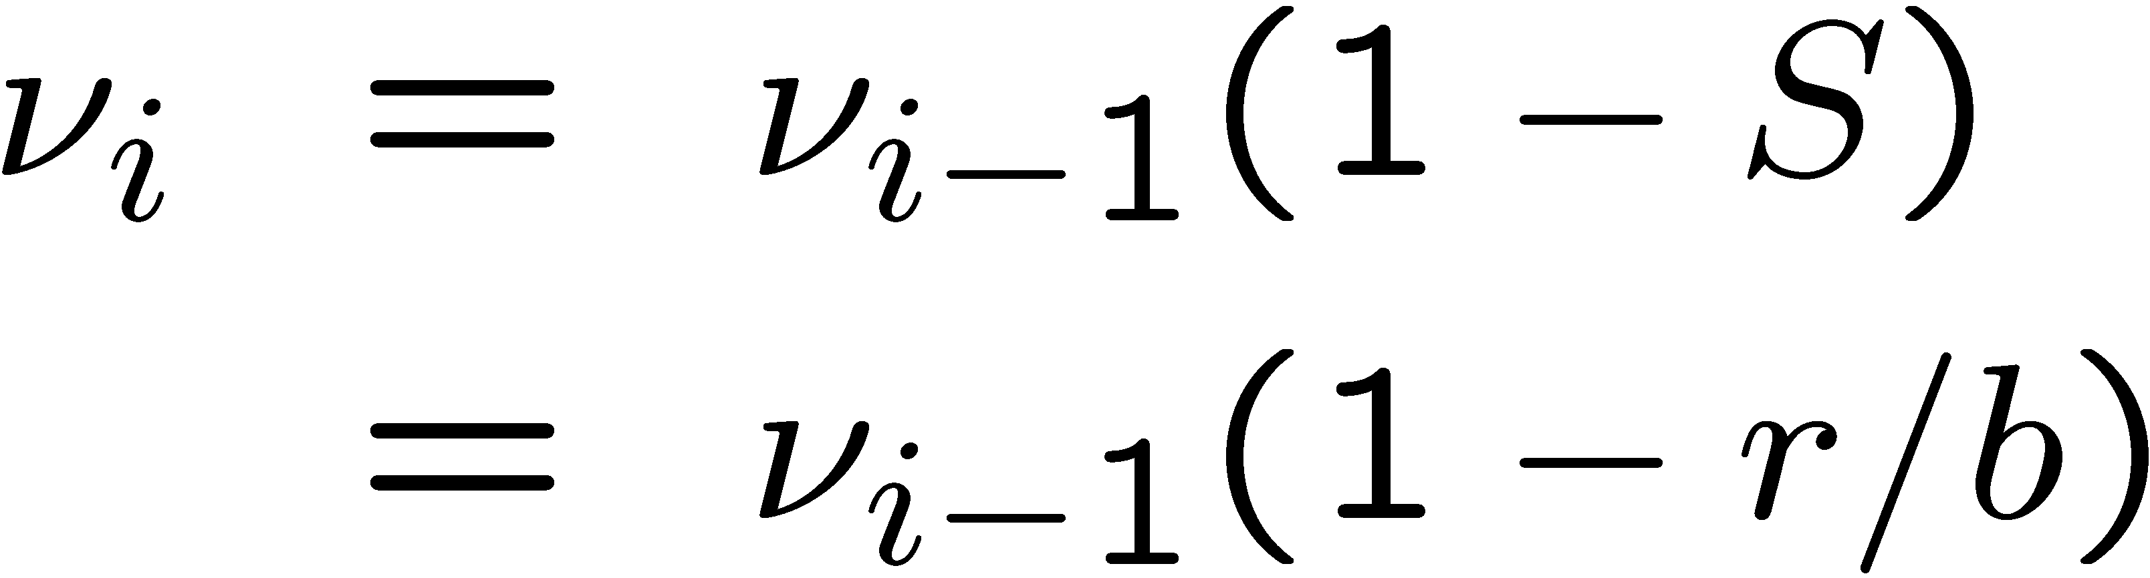
Value of ν
(Assuming one receiver)

Slide 42
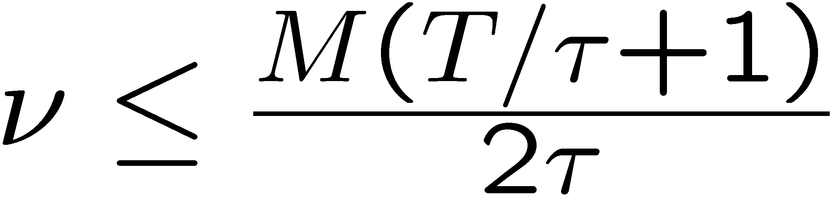
Limit of ν
M : packet size
τ : round trip time
T : period between evaluation of ν
⇒ Limited to the average rate increase a TCP connection
would utilize during periods without losses.

Slide 43
Loss rate versus μ
μ
1
1
0
loss rate

Slide 44


Value of μ
where
is the loss rate
k is a constant
(Assuming one receiver)

Slide 45
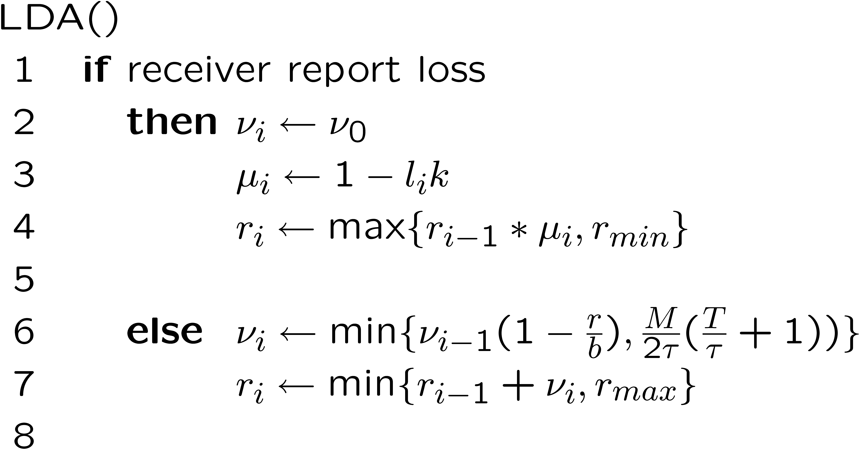
LDA Algorithm

Slide 46
What is Needed?

Slide 47
What is Needed?
We know
v_{i}, r, M, T, τ
But not
b

Slide 48
Estimating b : Packet Pair

Slide 49
Estimating b : Packet Pair

Slide 50
Estimating b : Packet Pair

Slide 51
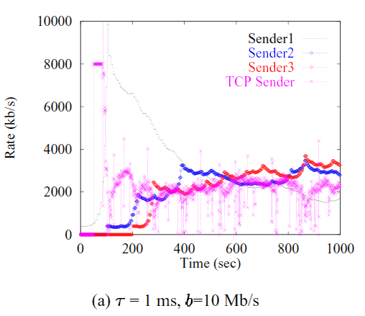
Evaluation

Slide 52
Rules
Transmission rate should match encoding rate
Transmission should not be too bursty

Slide 53
Media Rate Control
Given a rate, how to encode the video with the given rate?

Slide 54
Reduce Frame Rate
Live Video
Stored Video

Slide 55
Reduce Frame Resolution
Live Video
Stored Video

Slide 56
Increase Quantization
Live Video
Stored Video

Slide 57
Drop AC components
Live Video
Stored Video

Slide 58
Trouble with Stored Video
Reducing rate requires partial decoding and re-encoding
Solution: Layered Video

Slide 59
Layered Video
or “Scalable Video”

Slide 60



Layered Video
Layer 1
Layer 2
Layer 3
Notes:
One of the better proposed solution is called RLM or receiver driven layered multicast. The idea is to divide a stream into multiple layers. The base layer encodes the video stream at a low bitrate, and each additional layer on top enhances its quality. The layers are sent onto different multicast channels, and receivers can choose the number of layers to receive based on their available bandwidth.

Slide 61
Layering Scheme
Temporal (Frame Rate) Layering

Slide 62
Layering Scheme
Spatial (Resolution) Layering

Slide 63
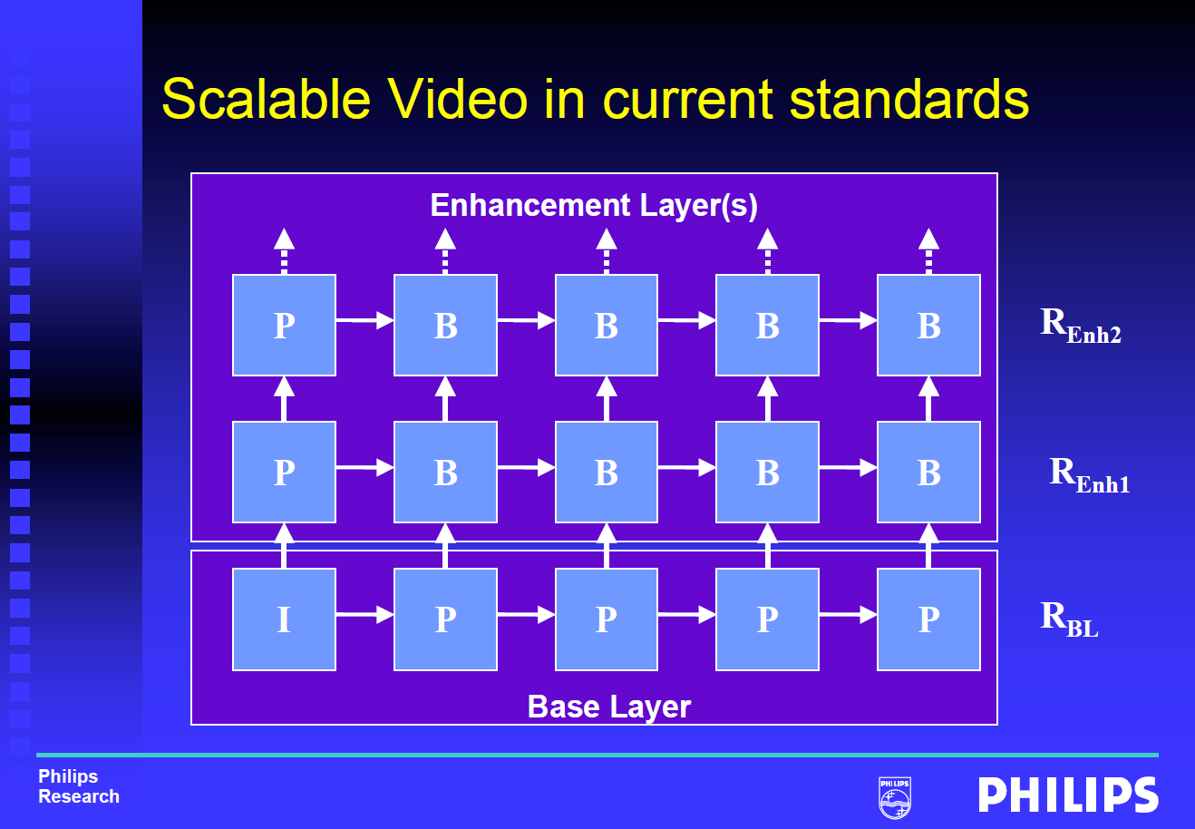
Layering Scheme
Fine Granularity Scalability (FGS): e.g., MPEG-4
© Mihaela van der Schaar

Slide 64
Layered Video
SVC: Scalable Video Coding
Base-layer plus enhancement layers
Each received layer improves the quality
Layer n+1 depends on layer n
MDC: Multiple Description Coding
Layers are independent
Each received layer improves the quality

Slide 65
Layered Video
BUT: Layered video codecs are less bandwidth-efficient than single-layer codecs.

Slide 66
Rate Adaptation
To increase rate, send more layers
To decrease rate, drop some layers

Slide 67
Summary (1)
Rate Adaptation – Why?
Adapt data transmission to fluctuating network conditions
Media Rate Control – Why?
Media data rate must match data transmission rate; otherwise stalls, etc.
Media data rate can be controlled by encoder (parameters) or via scalable coding (SVC, MDC)

Slide 68
Summary (2)
Client-Side Rate Adaptation
Used with DASH (i.e., HTTP/TCP)
Can be based on bandwidth, buffer, or both
Server-Side Rate Adaptation
Used with RTP/RTCP/RTSP
Tries to be TCP-friendly at packet level

