Slide 1
Peer-to-Peer Streaming

Slide 2
Peer-to-Peer Streaming
A type of application-level multicast
But packets are forwarded by end-host (not proxies)

Slide 3
Peer-to-Peer Streaming
ALM with end-hosts as forwarders
End Host
Video Server
S
Overlay Links

Slide 4
Issues with P2P Streaming
Depends on peers to forward packets, but peers can fail/leave anytime
S
Notes:
Bad for tree-based scheme like NICE/Narada

Slide 5
Distribution Topologies (1)
Push Based:
  Distribution tree or DAG
  Data is pushed from the source through the tree
End Host
Video Server
S
Overlay Links
Low latency; good for live streaming

Slide 6
Distribution Topologies (2)
Pull Based:
  Mesh; data is pulled from a number of known neighbors.
  Each node keeps a segment map.
R
High robustness; but longer latency

Slide 7

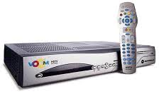
Distribution Topologies (3)
Pull Based:
  Examples (no longer existent):
    PPTV, original P2P version was created by Huazhong University of Science and Technology
    CoolStreaming, similar to BitTorrent, data driven
    overlay network
  There has been some interest to use set-top boxes (STB) for P2P support

Slide 8
Properties of P2P Systems
Pros
  Inherently scalable since each new user brings resources to the system (i.e., bandwidth) ⇒ self-scaling
Cons
  Nodes are unreliable ⇒ disruptions!
  Nodes need to contribute on average as much as they use
  Free-riders/cheaters
  Monitoring of the system state

Slide 9
CoopNet
Resilient Peer-to-Peer Streaming, V. Padmanabhan et. al.
ICNP 2003

Slide 10
Idea
To increase robustness:
Split video into k “parts”, send one part along one tree.

Slide 11
“Smart” Splitting
A node may be able to reconstruct partial data with a subset of the parts.
More parts ⇒ better quality.
“Multiple Description Coding”

Slide 12
Simple Example (Video)
Divide into two descriptions
  1. Even frames
  2. Odd frames
“Multiple State Encoding”
Does not scale to a large number of descriptions.

Slide 13


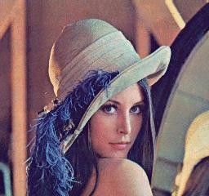
Layered Coding
Layer 1
Layer 2
Layer 3

Slide 14
Layered Coding
One layer one description?
But there are dependencies between the descriptions.

Slide 15
Multiple Description Coding
L1
L2.1
L3.1
D1
L1
L2.2
L3.2
D2
L1
L2.1
XOR
L2.2
L3.3
D3

Slide 16
Multiple Description Coding
D1
L1
L2.1
L2.2
L2.3
L3.1
D2
L1
L2.3
L2.4
L2.1
L3.2
D3
L1
L2.1
L2.2
L2.4
L3.3
D4
L1
L2.3
L2.4
L2.2
XOR

Slide 17
How to Build Tree?
Send one description along one tree only.
A node is internal node in at most one tree, and is leaf node in the rest of the trees.

Slide 18
Example
R
R
1
3
2
4
2
4
5
6
1
3
5
6

Slide 19
Tree Maintenance
The source of video maintains all states.
Isn’t this a centralized design that is not robust?

Slide 20
Node Join
Becomes internal node in a tree with least number of internal nodes.
Becomes leaf node in the rest of the trees.

Slide 21
To join as internal node
Pick highest internal node with enough bandwidth as parent.
If cannot find, pick internal node with leaf node as child, preempt the leaf node.

Slide 22
To join as leaf node
Pick highest internal node with enough bandwidth as parent.
If cannot find, migrate an internal node from another tree.

Slide 23
Network Efficiency
When choosing parents, breaks ties by choosing closer node as parents.

Slide 24
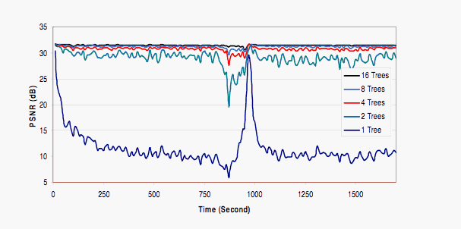
Effects of Number of Trees

Slide 25
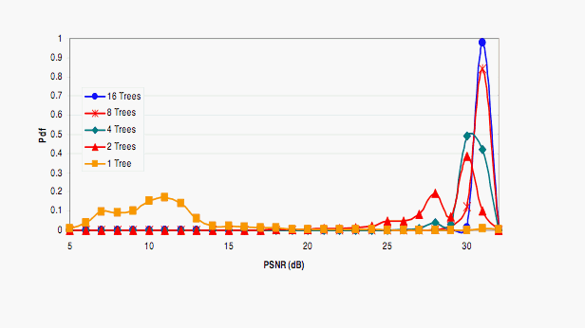
Effects of Number of Trees

Slide 26
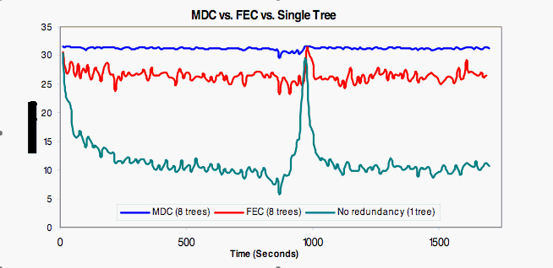
MDC versus FEC

Slide 27
Summary of CoopNet
Robustness through redundancy in
  coding
  network paths

Slide 28
Issues with P2P Streaming
Not all peers are happy to contribute resources — selfish peers exist.
S

Slide 29
Deter Selfish Peers
Add a constraint:
  A peer can only receive at most as much as it is willing to send
  S/R ≥ 1
Notes:
S:R

Slide 30
Practical Issues
Asymmetric Links
Different
downlink
capacity

Slide 31
Dagster
Contributor Aware P2P Streaming in Heterogeneous Environment
MMCN 2005

Slide 32
Goals
Robustness wrt transient peers
Deter selfish users without restricting S:R ratio
Heterogeneous receivers

Slide 33
Issue 1
Heterogeneous receivers
  Solution: Transcoding

Slide 34
Transcoding
D
A
C
E
S
F
B
Notes:
CPU is fast

Slide 35
Issue 2
Improve Robustness
  Solution: Distributed Streaming

Slide 36
Distributed Streaming
D
A
C
E
S
F
B
Notes:
Improve robustness
It’s a DAG

Slide 37
Multiple State Encoding
D
A
1,3,5..
C
E
1,2,3,4..
S
2,4,6..
F
1,2,3,4..
B
2,4,6..

Slide 38
Issue 3
Provide incentives without constraining S:R ratio?
  Solution: give peers that pledge more contributions some benefits
  “contributor-aware”

Slide 39
Providing Incentives
Idea: allow a peer to preempt another peer with smaller contributions
Benefits
  Lower rejection rate
  Closer to source

Slide 40
DAG Construction

Slide 41
Example
15:5
A
0:30
S
15:5
B

Slide 42
Example
15:5
A
0:30
S
15:5
B

Slide 43
Example
15:5
A
0:30
S
15:5
15:15
B
C

Slide 44
Example: Preemption
15:5
A
0:30
S
15:15
15:5
C
B
Notes:
Abandon
Adopt

Slide 45
Example: Rejection
15:5
A
0:30
S
15:5
15:6
B
D
Notes:
reject

Slide 46
Preemption Rules
A can preempt B if
  A is willing to donate more than B
  B can find new parents after preemption

Slide 47
Example
15:5
A
0:30
S
15:5
10:5
B
E

Slide 48
Example
15:5
A
0:30
10:5
S
E
15:5
B

Slide 49
Example
15:5
2:1
A
F
0:30
S
15:5
2:1
10:5
B
H
G

Slide 50
Example: 2 Preemptions
15:5
2:1
A
F
0:30
10:5
S
G
15:5
2:1
B
H

Slide 51
Details
Centralized control at the server to prevent illegal preemption

Slide 52
Details
Minimize number of descendents affected when preempting peers
Find a subset of children to preempt, such that number of descendents affected is minimized, and preempted bandwidth is enough for the new node.
KNAPSACK problem!

Slide 53
Details
Prefer parents who are closer to the source and have large contributions

Slide 54
Details
Peers can cheat by pledging more contributions than they are capable of.
We can only do our best to detect such cheaters :-(

Slide 55
Evaluations

Slide 56
Simulation Setup
Host characteristics based on study of Gnutella and Napster by Saroiu et. al.

Slide 57
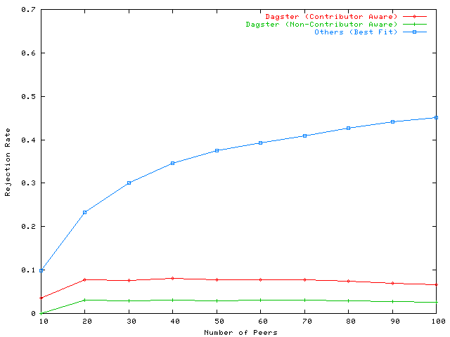
Best Fit (no Preemption)
Rejection Rate
Contributor-Aware (with Preemption)
Non Contributor Aware (with Preemption)
Number of Peers

Slide 58
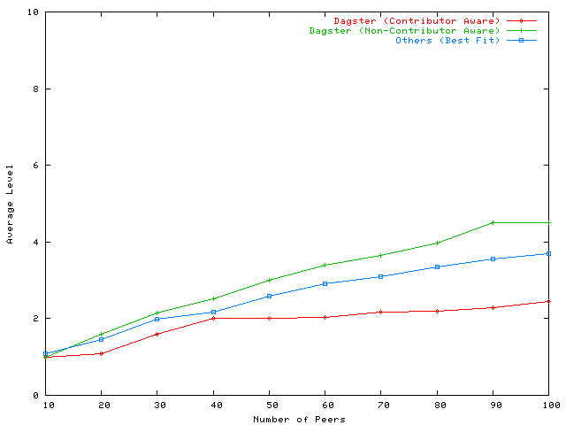
Average Level
Non-Contributor Aware
Contributor Aware
Number of Peers

Slide 59
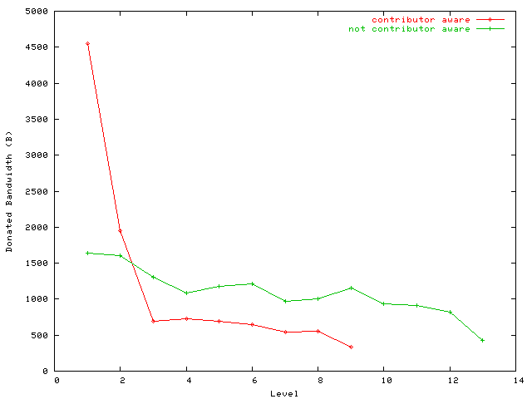
Contributor Aware
Average Donated Bandwidth
Non-contributor Aware
Level

Slide 60
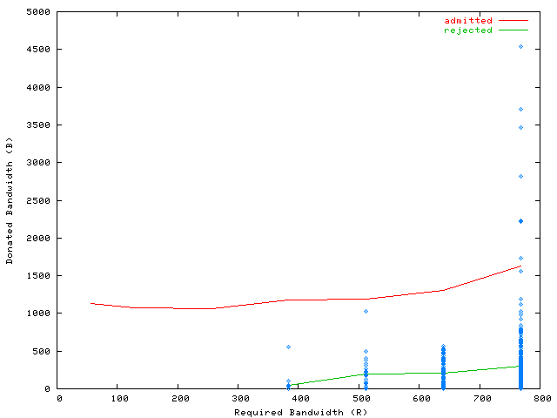
Donated Bandwidth
Admitted
Rejected
Requested Bandwidth

Slide 61
Number of Parents
Dagster limits maximum number of parents a node can have.
How many is ideal?

Slide 62
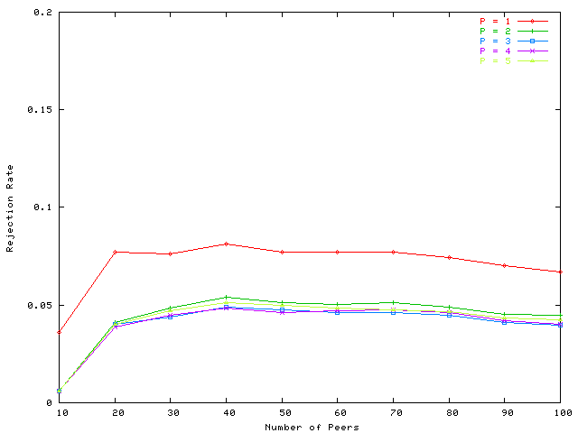
Rejection Rate
P = 1
P > 1
Number of Peers

Slide 63
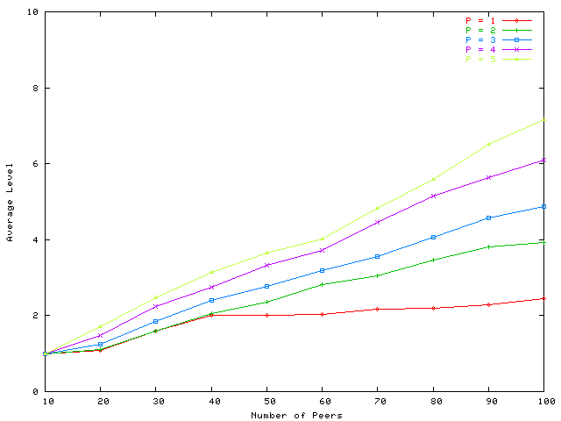
Average Level
P = 2
P = 1
Number of Peers

Slide 64
Robustness with P
Typical frame-rate 24-30 fps.
If P = 3, and one parent fails, then clients can expect to receive 16-20 fps.

Slide 65
Summary (1)
Peer-to-Peer Streaming
  Application-level multicast; node/repeaters are unreliable (end hosts)
  Different distribution topologies:
    Push (usually: distribution trees or DAGs)
    Pull (usually: mesh-based; also called data-driven)

Slide 66
Remaining Tasks
15 November 2017 (end of day): Project reports and software due.
  In-class presentation on 16 & 17 November
Room and schedule will be announced shortly.

