Slide 1
Self-Adaptive Sampling for Efficient Video Question-Answering (on Image—Text Models)

Slide 2

Key Points
An investigation (empirical study) towards “SOTA” (as of Mid 2023) VLMs (CLIP, GIT, AIO, BLIP-2…) to find potential redundancy in ViQA system
Propose two efficient sampling methods through progressively removing the redundancy and making it offline

Slide 3
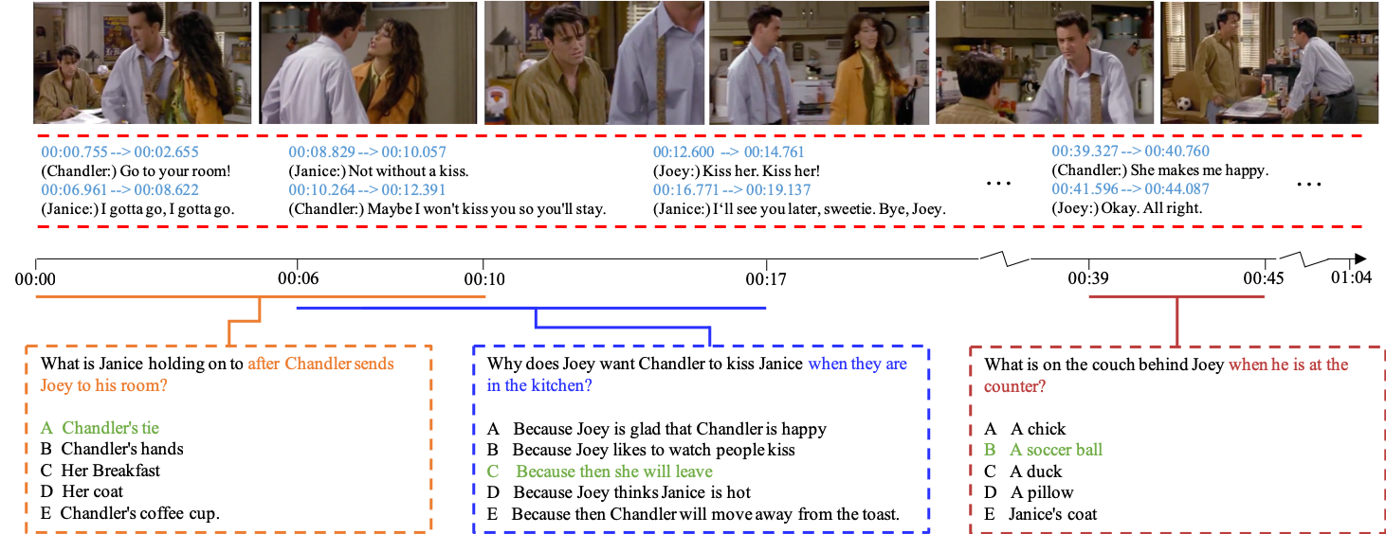
Background: Video Question Answering (ViQA)

Slide 4
Background: Image—Text Models (ITMs)
A subcategory under VLMs (Visual Language Models)
Unified input format: Image sequence (encoded as visual prefix) + Text sequence

Slide 5
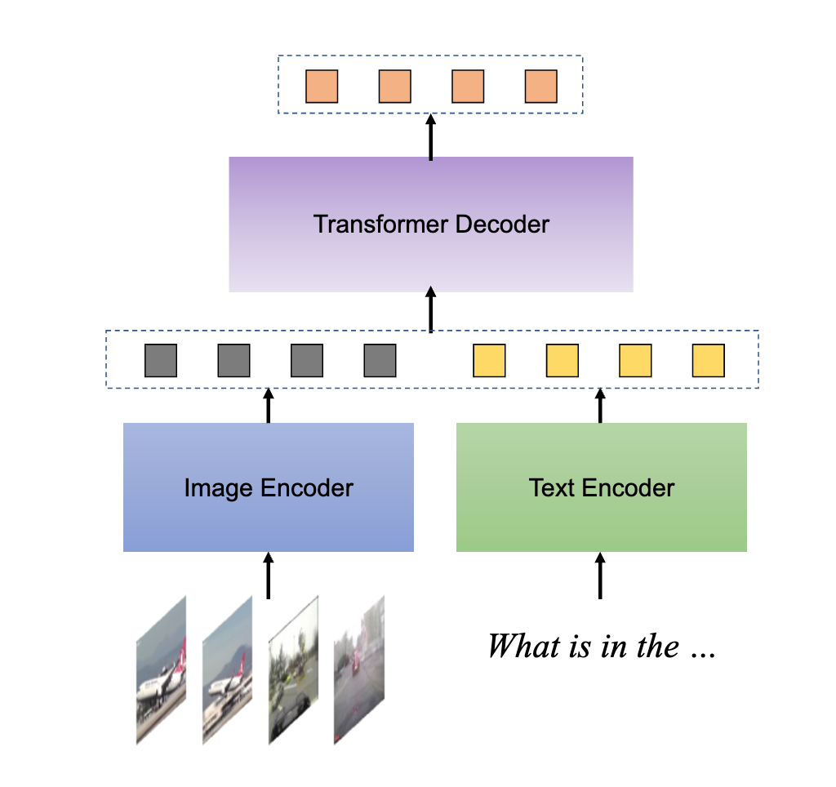
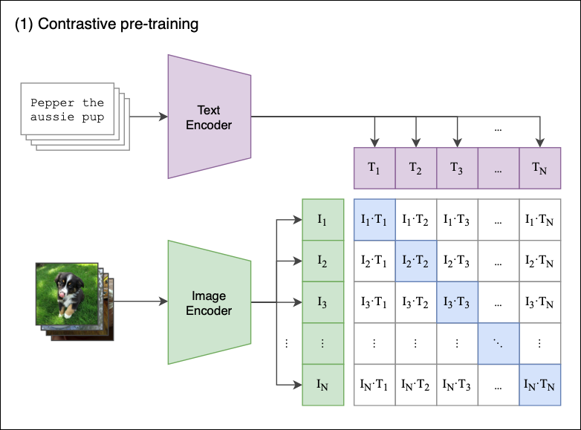

Image—Text Models (CLIP and CLIP-Dec)
$∆acc=$ 3.4-5.9%
CLIP
CLIP-Dec

Slide 6
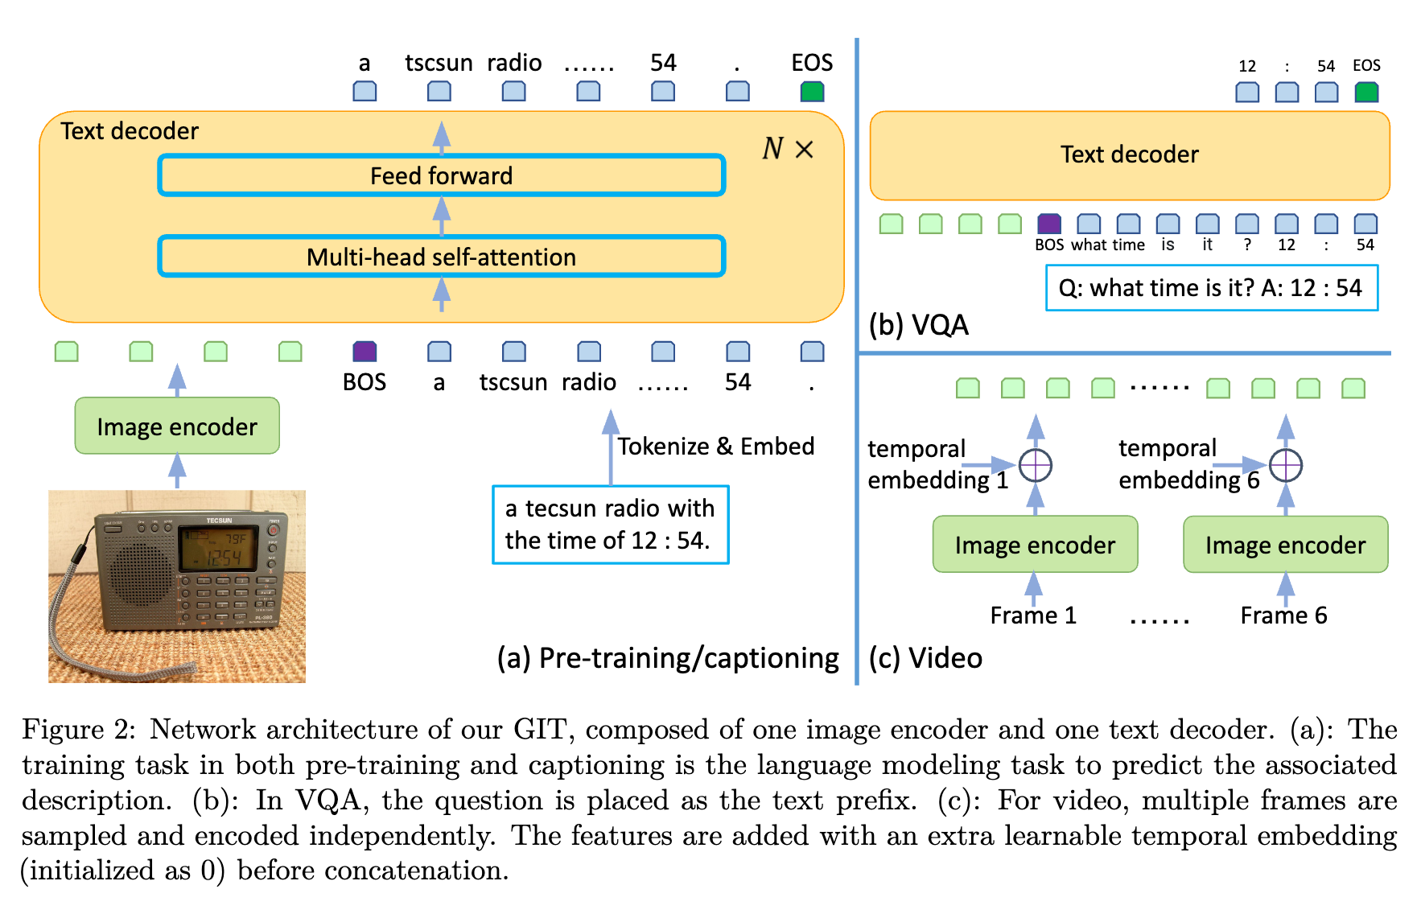
Background: Image—Text Models (GIT)

Slide 7
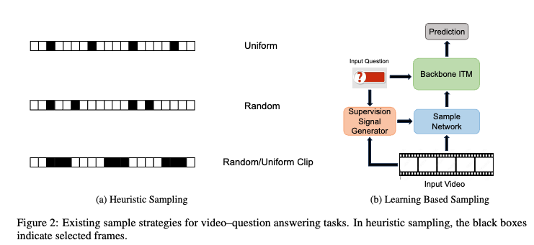
Background: Frame Sampling in ITMs

Slide 8
Motivation: Redundancy in Current ViQA Systems
Why Inefficient?
Slow convergence speed (5~10x more epochs)
Online sampling (Load video into RAM then sample)
Need to compute question-aware score for each frame
Question:
Can we move the sampling stage offline (decouple it from the main network)?
Can we find a simple yet effective formulation for the offline sampling?
Is question-aware sampling always required (can we have a question-agnostic one)?

Slide 9
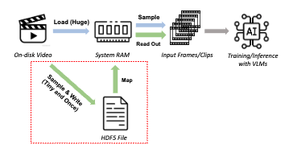
Offline sampling with off-the-shelf VLMs
Can we move the sampling stage offline (decouple it from the main network)?
Can we find a simple yet effective formulation for the offline sampling?
Is question-aware sampling always required (can we have a question-agnostic one)?

Slide 10
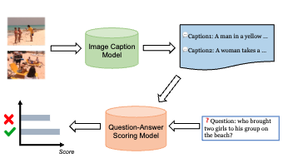
Most Implied Frames (MIF)
Can we move the sampling stage offline (decouple it from the main network)?
Can we find a simple yet effective formulation for the offline sampling?
Is question-aware sampling always required (can we have a question-agnostic one)?

Slide 11
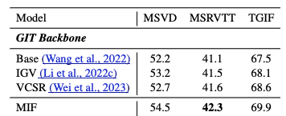
Most Implied Frames (MIF)
Can we move the sampling stage offline (decouple it from the main network)?
Can we find a simple yet effective formulation for the offline sampling?
Is question-aware sampling always required (can we have a question-agnostic one)?

Slide 12
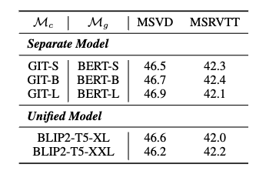
Most Implied Frames (MIF)
Can we move the sampling stage offline (decouple it from the main network)?
Can we find a simple yet effective formulation for the offline sampling?
Is question-aware sampling always required (can we have a question-agnostic one)?
There is no obvious correlation between Captioner-Grader capability and performance
We boldly hypothesize that question–agnostic sampling is feasible

Slide 13
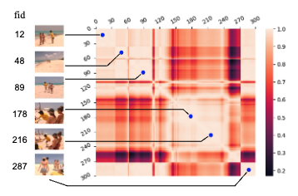
Most Dominant Frames (MDF)
Can we move the sampling stage offline (decouple it from the main network)?
Can we find a simple yet effective formulation for the offline sampling?
Is question-aware sampling always required (can we have a question-agnostic one)?
MDF Highlights
Static frames are more important than transient frames
Find most static frames to maximize the variance of scenes
MDF computes scores only using visual encoder (frame feature similarity)
A fast minima (most static frames) searching algorithm for MDF

Slide 14
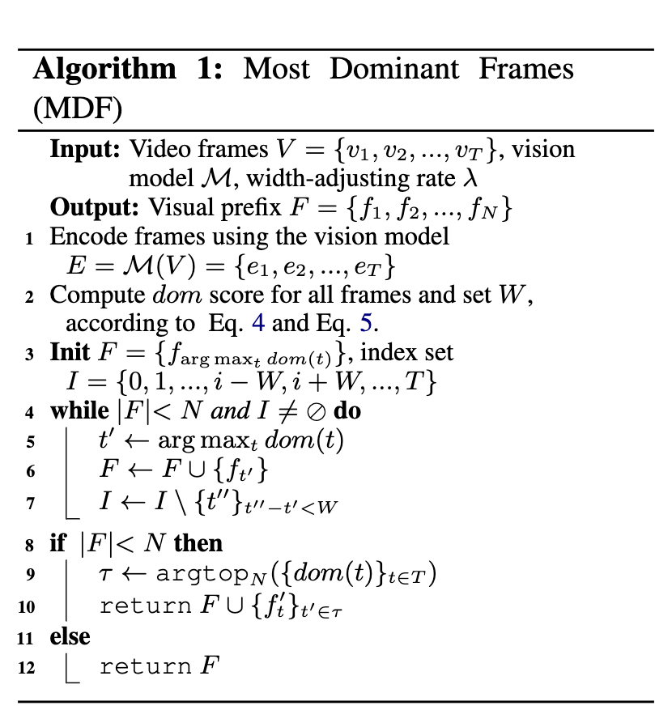
Most Dominant Frames (MDF)
Can we move the sampling stage offline (decouple it from the main network)?
Can we find a simple yet effective formulation for the offline sampling?
Is question-aware sampling always required (can we design a question-agnostic one)?

Slide 15
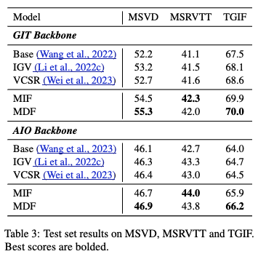
Most Dominant Frames (MDF)
Can we move the sampling stage offline (decouple it from the main network)?
Can we find a simple yet effective formulation for the offline sampling?
Is question-aware sampling always required (can we design a question-agnostic one)?

Slide 16
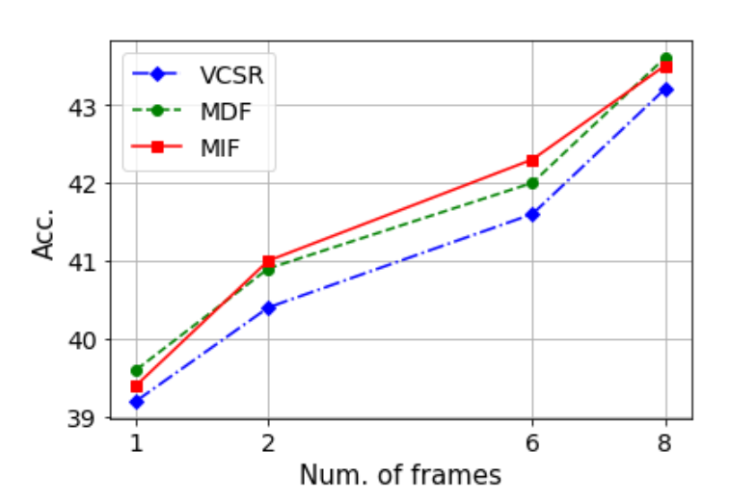
Impact of Input Frame Lengths
Both methods consistently outperform SOTA baseline under different frame lengths
In other words, we can gain competitive results using fewer input frames (and thus faster) combined with MDF/MIF

