Slide 1
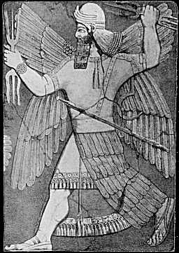




EXTRACTING AND MATCHING AUTHORS AND AFFILIATIONS IN SCHOLARLY DOCUMENTS
Slides Available: http://bit.ly/15Iyb0t
Hoang Nhat Huy Do
Muthu Kumar Chandrasekaran
Philip S. Cho
and Min-Yen Kan

Slide 2

Slides Available: http://bit.ly/15Iyb0t
http://news.sciencemag.org/scienceinsider/2013/07/scienceinsider-japans-science-po.html

Slide 3

Slides Available: http://bit.ly/15Iyb0t
Photo Credits: sc63 @ flickr

Slide 4

Slides Available: http://bit.ly/15Iyb0t
http://thomsonreuters.com/web-of-science/

Slide 5

Macro Level Analysis

Slide 6
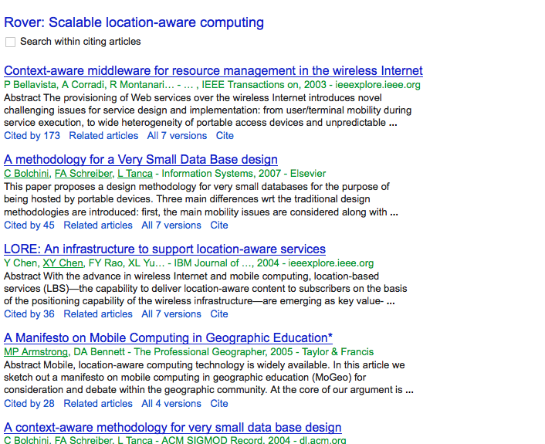

Slide 7
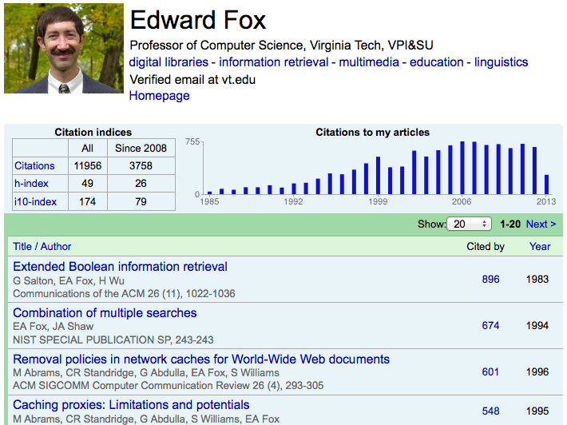
Micro Level Analysis

Slide 8
LET’S TAKE STOCK
Analyses:
Micro level
Macro level
Tools:
Commercial solutions

Slide 9
WHAT’S MISSING?
Analyses:
Meso level
Micro level
Macro level
Tools:
Open-source API / tools for the layman
Commercial solutions
Meso = aggregation over micro level, especially by institution, country

Slide 10
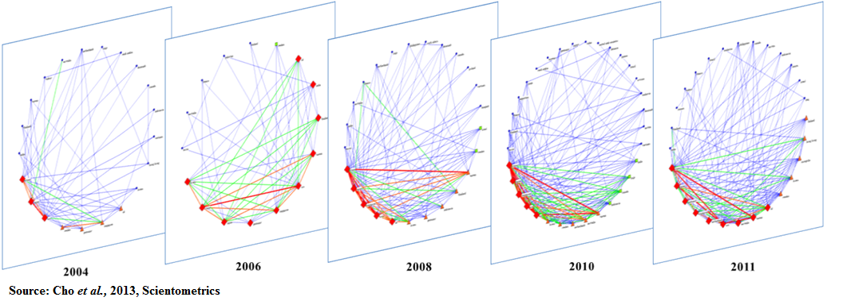
Meso = aggregation over micro level, especially by institution, country
Correct identification of author’s affiliations is crucial for research works that study the impact of location, geography in scholarly collaboration.

Slide 11
PROBLEM STATEMENT
Input: .PDF of a scholarly text
Output: Author and their Affiliations
Released Enlil: Open-source library
integrated with other system

Slide 12
OUTLINE
Motivation
Related Work
System Overview
  Author and affiliation extraction
  Author-affiliation matching
Dataset, experiments and results
Limitations
Conclusion

Slide 13
RELATED WORK
Lots of reference string parsing work
  Cortez et al., 2007, Councill et al.’s ParsCit, 2008
  Gao et al.’s, BibAll, 2012
  Chen et al.’s Bibpro, 2012
Han et al. 's SVM Header Parser (SHP) and SeerSuite
Summary: Only the textual features of the document are used.

Slide 14
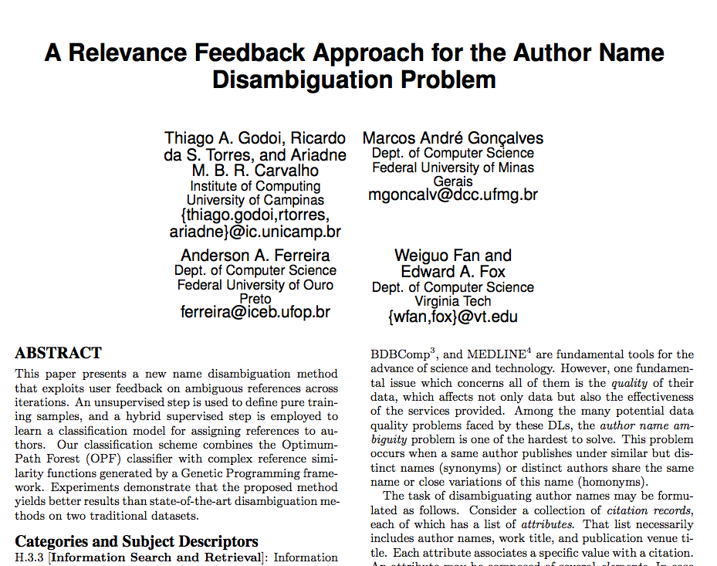
Hypothesis: Layout and Formatting Matter

Slide 15
OVERVIEW OF ENLIL
Author and affiliation extraction
  Cast as Sequence Labelling
  Use Conditional Random Fields
Author-affiliation matching
  Cast as Relation Matching (Classification)
  Use Support Vector Machines

Slide 16
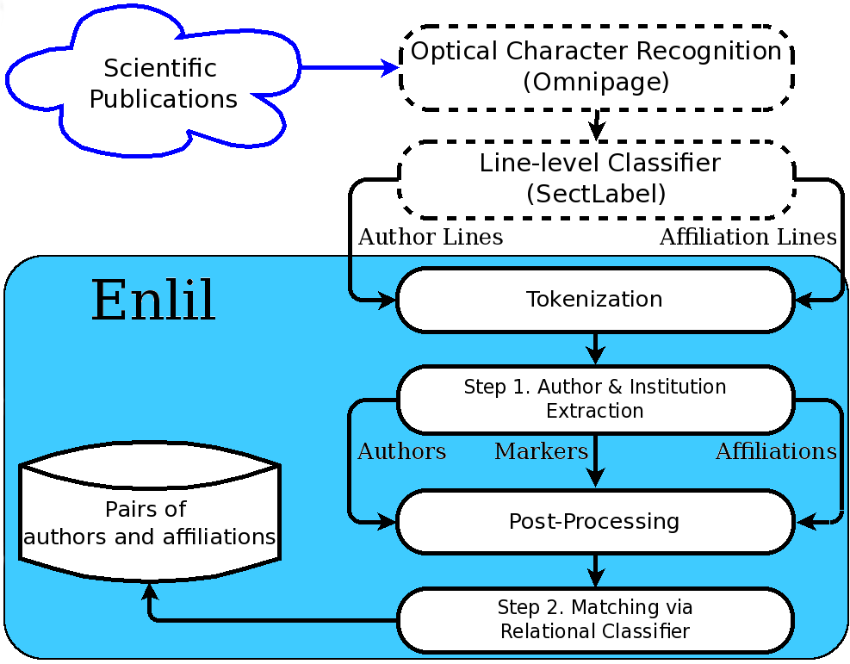
ENLIL ARCHITECTURE
Pre-processing
  Optical Character Recognition
  Line Classification
Author and affiliation extraction
  Tokenization
  Supervised machine learning (CRF)
  Post-processing
Author-affiliation matching
  Supervised machine learning (SVM)

Slide 17
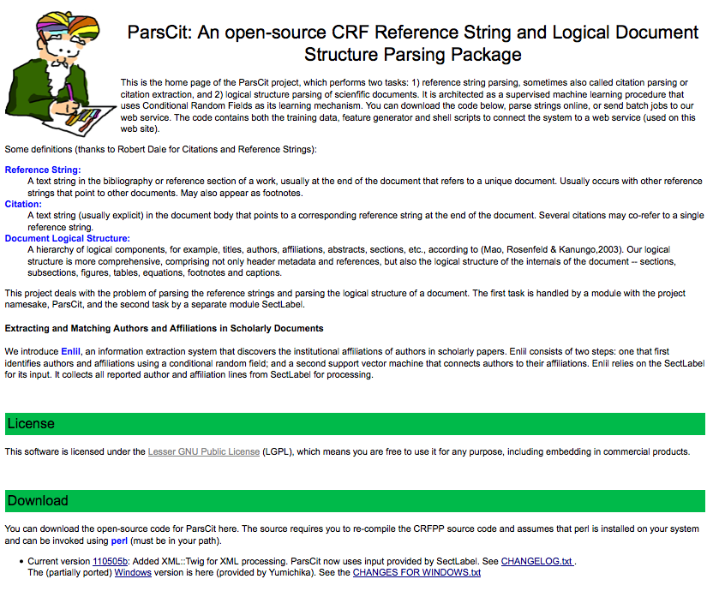
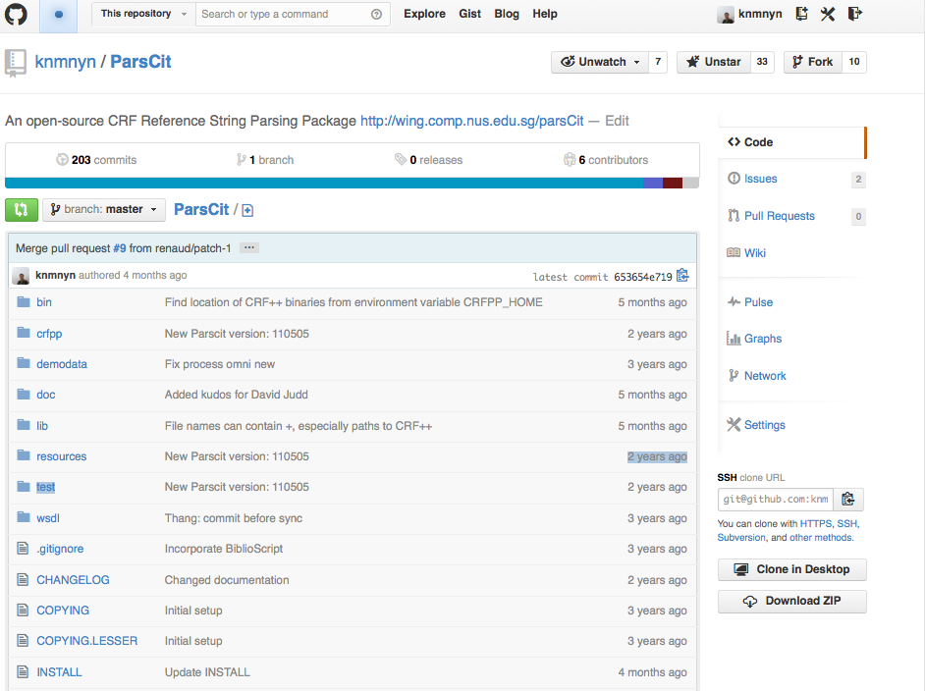
http://wing.comp.nus.edu.sg/parsCit/

Slide 18


PRE-PROCESSING
1. AUTHOR AND AFFILIATION EXTRACTION
OmniPage outputs an XML version of the PDF document that provides both the textual and spatial information.
SectLabel, an open-source module in ParsCit that takes this type of input, to assign one of 23 semantic classes to each line of text, including Author and Affiliation.

Slide 19
TOKENIZATION
1. AUTHOR AND AFFILIATION EXTRACTION
Rule-based tokenization of author and affiliation lines
Example Output:
Seyda Ertekin2, and C. Lee Giles1,2
Seyda Ertekin 2 , and C. Lee Giles 1 , 2

Slide 20
FEATURE CLASSES EMPLOYED
1. AUTHOR AND AFFILIATION EXTRACTION
Content Features
Token Identity
N-gram Prefix / Suffix
Length
Number
Punctuation
Gazetteers
Layout Features
First word in line
Source Section
Orthographic Case
Sub/Super Script
Font Format
Font Size
Format Change
Then magic happens …

Slide 21
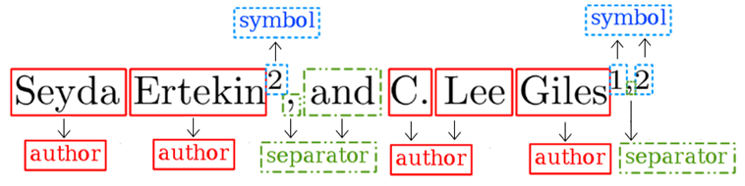
CRF PARAMETERS
1. AUTHOR AND AFFILIATION EXTRACTION
A pair of Conditional Random Field (CRF) models, one each for author and affiliation extractions.
Linear CRF with the window size of 2 (CRF++)
Sample Output:
Similarly done for affiliation lines

Slide 22
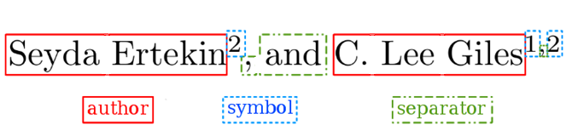
POST-PROCESSING
1. AUTHOR AND AFFILIATION EXTRACTION
Group consecutive tokens with the same class together to form a list of author names and a list of affiliations together with their markers.

Slide 23
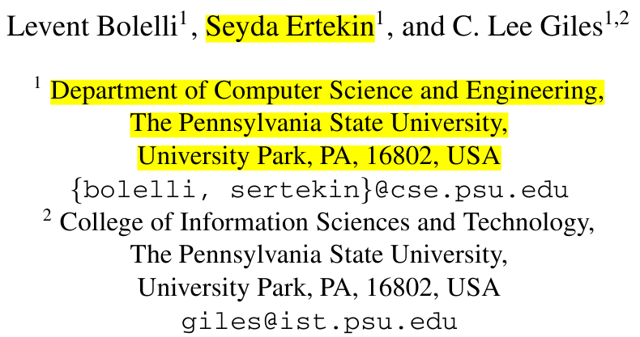
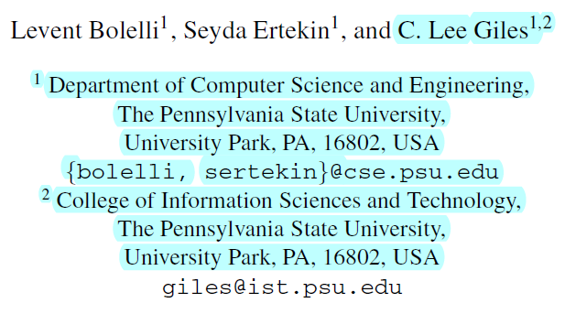
2. AUTHOR-AFFILIATION MATCHING
Use a SVM with Gaussian (Radial Basis Function) Kernel
New features:
  Signal symbol
  Logical distance
  Euclidean distance

Slide 24
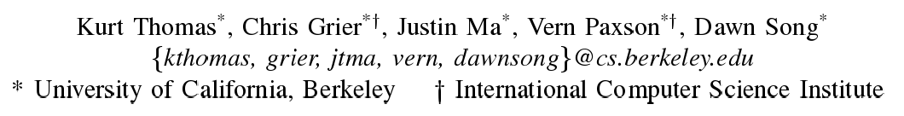
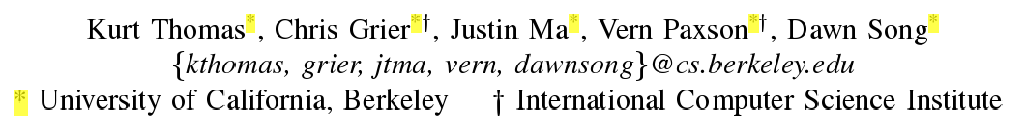
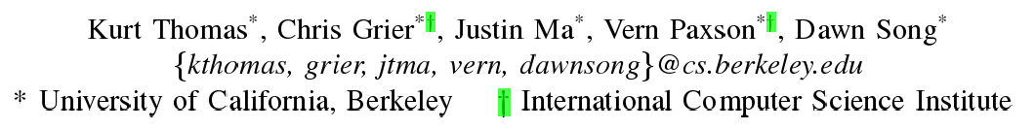
SIGNAL SYMBOL
2. AUTHOR AFFILIATION MATCHING
Check whether the symbol is preserved across author and candidate institution
Only feature of the three computable from flat text.

Slide 25
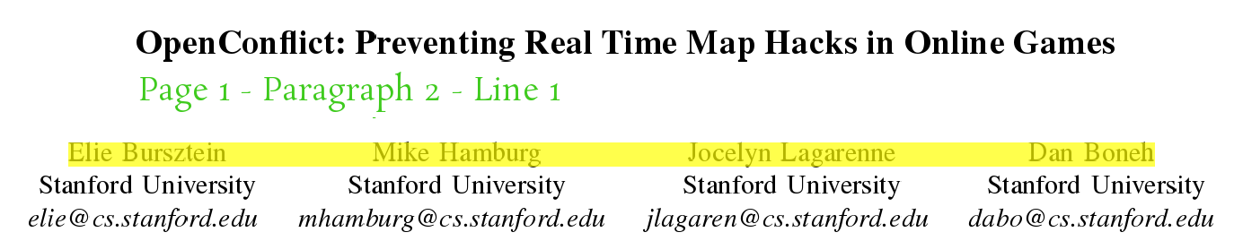
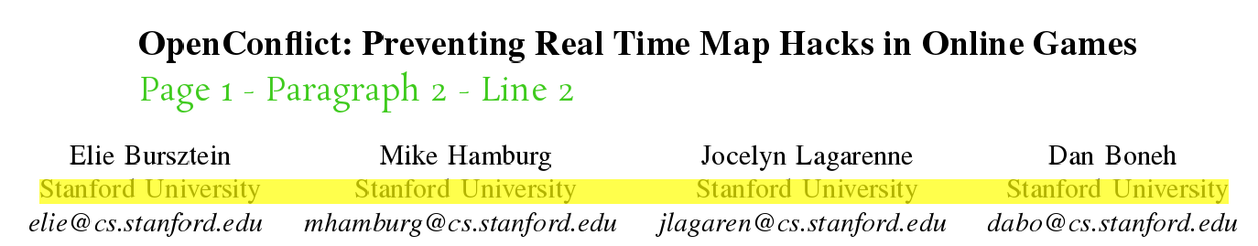
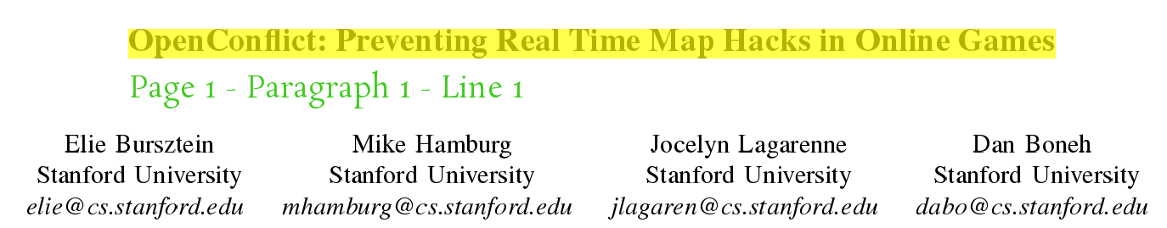
LOGICAL DISTANCE
2. AUTHOR AFFILIATION MATCHING
Logical representation of position in terms of document units (page, paragraph and line)
Provided by XML output from OmniPage and SectLabel

Slide 26
EUCLIDEAN DISTANCE
2. AUTHOR AFFILIATION MATCHING
Computed from X,Y coordinates reported from OmniPage output
Recap: All three features are new, only symbol might be computable from flat text

Slide 27
OUTLINE
Motivation
Related Work
System Overview
  Author and affiliation extraction
  Author-affiliation matching
Dataset, Experiments and Results
Limitations
Conclusion

Slide 28
DATASETS
Depth-wise Evaluation
  ACM (2.2K documents, 6.6K authors)
  ACL Anthology Corpus (23K documents)
Breadth-wise Evaluation
  Cross Domain Corpus
  800 Documents
Branch | # Authors | # Affiliations
Applied | 897 | 507
Formal | 519 | 388
Natural | 813 | 516
Social | 470 | 410
Total | 2621 | 1821

Slide 29
EXPERIMENTS
Performance against baseline
SVM Header Parser (SHP) from SeerSuite
Cross-domain
Clean vs. Noisy input
Effect of features in matching task.
All experiments were evaluated in two modes:
(1) Exact match (2) Relaxed match

Slide 30
Enlil significantly outperforms SVM Header Parser
EXPERIMENTS: 1. PERFORMANCE AGAINST BASELINE
**
Task | Corpus | Mode | Enlil |  |  | SVM Header Parser
 |  |  | Precision | Recall | F₁ | Precision | Recall | F₁
Author Name Extraction | ACM | Exact | 95.7 | 93.5 | 94.6 | 84.1 | 73.5 | 78.4
 |  | Relaxed | 97.9 | 95.5 | 96.7 | 93.2 | 81.3 | 86.8
 | ACL | Exact | 93.4 | 90.1 | 91.8 | 84.8 | 72.7 | 78.3
 |  | Relaxed | 94.7 | 91.3 | 92.9 | 92.2 | 79.1 | 85.1
Affiliation Matching | ACM | Exact | 89.6 | 88.2 | 88.9 | 78.8 | 68.8 | 73.5
 |  | Relaxed | 91.4 | 89.9 | 90.6 | 87.0 | 75.7 | 80.9
 | ACL | Exact | 84.5 | 82.8 | 83.6 | 74.2 | 62.9 | 68.1
 |  | Relaxed | 85.7 | 84.0 | 84.8 | 79.3 | 67.2 | 72.7
 | Cross domain full | Exact | 81.6 | 85.6 | 83.6 | 47.2 | 26.0 | 32.5
 |  | Relaxed | 85.5 | 88.7 | 87.0 | 52.6 | 28.8 | 35.9
 | Cross domain clean | Exact | 95.9 | 93.9 | 93.9 | 47.8 | 29.9 | 35.8
 |  | Relaxed | 97.5 | 96.4 | 96.4 | 51.9 | 32.6 | 38.8

Slide 31
Relaxed evaluation always outperforms Exact Match
EXPERIMENTS: 1. PERFORMANCE AGAINST BASELINE
Task | Corpus | Mode | Enlil |  |  | SVM Header Parser
 |  |  | Precision | Recall | F₁ | Precision | Recall | F₁
Author Name Extraction | ACM | Exact | 95.7 | 93.5 | 94.6 | 84.1 | 73.5 | 78.4
 |  | Relaxed | 97.9 | 95.5 | 96.7 | 93.2 | 81.3 | 86.8
 | ACL | Exact | 93.4 | 90.1 | 91.8 | 84.8 | 72.7 | 78.3
 |  | Relaxed | 94.7 | 91.3 | 92.9 | 92.2 | 79.1 | 85.1
Affiliation Matching | ACM | Exact | 89.6 | 88.2 | 88.9 | 78.8 | 68.8 | 73.5
 |  | Relaxed | 91.4 | 89.9 | 90.6 | 87.0 | 75.7 | 80.9
 | ACL | Exact | 84.5 | 82.8 | 83.6 | 74.2 | 62.9 | 68.1
 |  | Relaxed | 85.7 | 84.0 | 84.8 | 79.3 | 67.2 | 72.7
 | Cross domain full | Exact | 81.6 | 85.6 | 83.6 | 47.2 | 26.0 | 32.5
 |  | Relaxed | 85.5 | 88.7 | 87.0 | 52.6 | 28.8 | 35.9
 | Cross domain clean | Exact | 95.9 | 93.9 | 93.9 | 47.8 | 29.9 | 35.8
 |  | Relaxed | 97.5 | 96.4 | 96.4 | 51.9 | 32.6 | 38.8

Slide 32
Enlil works consistently across different scholarly datasets
EXPERIMENTS: 2. CROSS DOMAIN
Enlil > SHP at p < 0.01
Dataset | Branch | Enlil |  |  | SVM Header Parser
 |  | Precision | Recall | F₁ | Precision | Recall | F₁
Full (w/ Noise) | Applied | 86.3 | 89.7 | 87.9 | 31.1 | 7.9 | 13.2
 | Formal | 87.8 | 87.9 | 87.9 | 57.6 | 41.1 | 47.9
 | Natural | 80.1 | 81.2 | 80.7 | 55.7 | 28.3 | 27.5
 | Social | 70.4 | 83.4 | 76.3 | 37.4 | 26.7 | 31.2
 | Average | 81.6 | 85.6 | 83.6 | 47.2 | 26.0 | 13.8
Clean | Applied | 95.9 | 98.1 | 97.0 | 41.3 | 12.1 | 18.8
 | Formal | 95.6 | 97.3 | 96.4 | 63.9 | 51.9 | 57.3
 | Natural | 95.4 | 96.7 | 96.1 | 47.1 | 26.5 | 33.9
 | Social | 80.4 | 90.9 | 85.3 | 38.7 | 29.3 | 33.3
 | Average | 92.0 | 95.9 | 93.9 | 47.8 | 29.9 | 35.8

Slide 33
Best performance in the Applied and Formal datasets
EXPERIMENTS: 2. CROSS DOMAIN
Dataset | Branch | Enlil |  |  | SVM Header Parser
 |  | Precision | Recall | F₁ | Precision | Recall | F₁
Full (w/ Noise) | Applied | 86.3 | 89.7 | 87.9 | 31.1 | 7.9 | 13.2
 | Formal | 87.8 | 87.9 | 87.9 | 57.6 | 41.1 | 47.9
 | Natural | 80.1 | 81.2 | 80.7 | 55.7 | 28.3 | 27.5
 | Social | 70.4 | 83.4 | 76.3 | 37.4 | 26.7 | 31.2
 | Average | 81.6 | 85.6 | 83.6 | 47.2 | 26.0 | 13.8
Clean | Applied | 95.9 | 98.1 | 97.0 | 41.3 | 12.1 | 18.8
 | Formal | 95.6 | 97.3 | 96.4 | 63.9 | 51.9 | 57.3
 | Natural | 95.4 | 96.7 | 96.1 | 47.1 | 26.5 | 33.9
 | Social | 80.4 | 90.9 | 85.3 | 38.7 | 29.3 | 33.3
 | Average | 92.0 | 95.9 | 93.9 | 47.8 | 29.9 | 35.8

Slide 34
Significantly better performance on clean dataset
EXPERIMENTS: 3. CLEAN VERSUS NOISY
Results more pronounced on Formal and Applied subsets (shown in paper)
Dataset | Exact Precision | Exact Recall | Exact F₁
Author Extraction
Average over Full (w/ Noise) | 82.7 | 95.0 | 88.4
Average over Clean | 92.3 | 99.8 | 95.8
Affiliation Extraction
Average over Full (w/ Noise) | 86.8 | 91.7 | 89.2
Average over Clean | 94.8 | 97.6 | 96.2
Author–Affiliation Matching
Average over Full (w/ Noise) | 81.5 | 85.6 | 83.6
Average over Clean | 92.0 | 95.9 | 93.9
**
**
**

Slide 35
Larger performance gap in matching task
EXPERIMENTS: 3. CLEAN VERSUS NOISY
Cascaded errors also affect matching
Dataset | Exact Precision | Exact Recall | Exact F₁
Author Extraction
Average over Full (w/ Noise) | 82.7 | 95.0 | 88.4
Average over Clean | 92.3 | 99.8 | 95.8
Affiliation Extraction
Average over Full (w/ Noise) | 86.8 | 91.7 | 89.2
Average over Clean | 94.8 | 97.6 | 96.2
Author–Affiliation Matching
Average over Full (w/ Noise) | 81.5 | 85.6 | 83.6
Average over Clean | 92.0 | 95.9 | 93.9

Slide 36
Signals are the most important feature class
EXPERIMENTS: 4. FEATURE EFFECTIVENESS FOR MATCHING
**
Dataset | Branch | Exact F₁ w/ indicated Features
 |  | No Signal | No Euclidean | No Logical | All
Full (w/ Noise) | Applied | 49.4 | 82.4 | 86.9 | 87.9
 | Formal | 73.1 | 68.0 | 87.9 | 87.9
 | Natural | 48.8 | 73.9 | 79.3 | 80.7
 | Social | 58.7 | 66.7 | 75.3 | 76.3
 | Average | 57.5 | 72.8 | 82.4 | 83.6
Clean | Applied | 57.2 | 85.9 | 9.68 | 97.0
 | Formal | 78.7 | 71.6 | 96.4 | 96.4
 | Natural | 68.0 | 85.4 | 95.4 | 96.1
 | Social | 65.1 | 67.4 | 83.6 | 85.3
 | Average | 64.8 | 77.6 | 93.0 | 93.9
W/o Signals
26.1% Exact
29.1% Relaxed

Slide 37
Euclidean Distance is also helpful
EXPERIMENTS: 4. FEATURE EFFECTIVENESS FOR MATCHING
**
Dataset | Branch | Exact F₁ w/ indicated Features
 |  | No Signal | No Euclidean | No Logical | All
Full (w/ Noise) | Applied | 49.4 | 82.4 | 86.9 | 87.9
 | Formal | 73.1 | 68.0 | 87.9 | 87.9
 | Natural | 48.8 | 73.9 | 79.3 | 80.7
 | Social | 58.7 | 66.7 | 75.3 | 76.3
 | Average | 57.5 | 72.8 | 82.4 | 83.6
Clean | Applied | 57.2 | 85.9 | 9.68 | 97.0
 | Formal | 78.7 | 71.6 | 96.4 | 96.4
 | Natural | 68.0 | 85.4 | 95.4 | 96.1
 | Social | 65.1 | 67.4 | 83.6 | 85.3
 | Average | 64.8 | 77.6 | 93.0 | 93.9
W/o Euclidean
10.8% Exact
13.4% Relaxed

Slide 38
…while Logical distance helps as part of a whole
EXPERIMENTS: 4. FEATURE EFFECTIVENESS FOR MATCHING
/
Dataset | Branch | Exact F₁ w/ indicated Features
 |  | No Signal | No Euclidean | No Logical | All
Full (w/ Noise) | Applied | 49.4 | 82.4 | 86.9 | 87.9
 | Formal | 73.1 | 68.0 | 87.9 | 87.9
 | Natural | 48.8 | 73.9 | 79.3 | 80.7
 | Social | 58.7 | 66.7 | 75.3 | 76.3
 | Average | 57.5 | 72.8 | 82.4 | 83.6
Clean | Applied | 57.2 | 85.9 | 9.68 | 97.0
 | Formal | 78.7 | 71.6 | 96.4 | 96.4
 | Natural | 68.0 | 85.4 | 95.4 | 96.1
 | Social | 65.1 | 67.4 | 83.6 | 85.3
 | Average | 64.8 | 77.6 | 93.0 | 93.9
W/o Logical
Insignificant

Slide 39
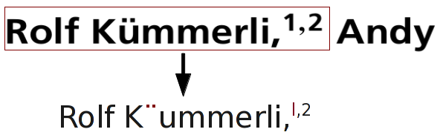
LIMITATIONS
Dependency on OCR for spatial features.
Cascaded errors from off the shelf modules (SectLabel, OmniPage).
Lines that contain author or affiliation data but co-occur with other metadata.

Slide 40
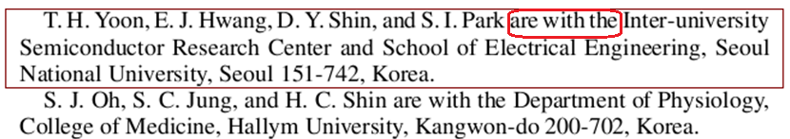
LIMITATIONS
Non-standard author-affiliation formats that deviates greatly from the formats in the training data set.
For example: papers with author affiliation matching expressed in the prose content.

Slide 41
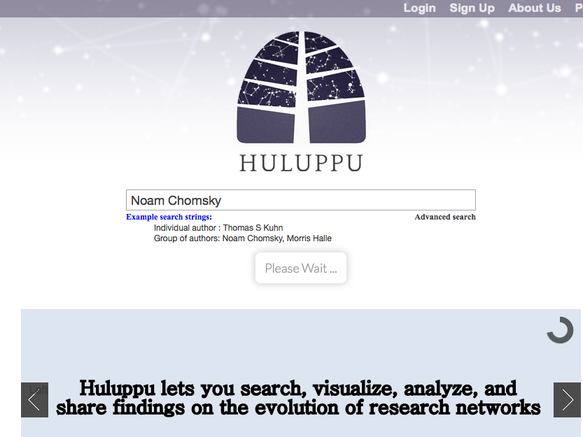
http://huluppu.net

Slide 42


Slide 43
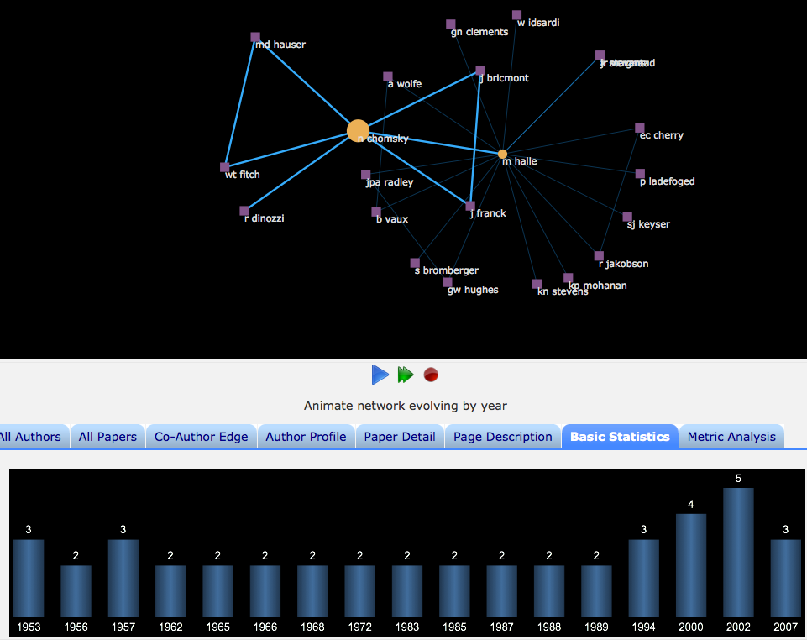

Slide 44
CONCLUSION
Cost effective solution that fills a critical gap in digital library and knowledge management solution for scholarly publications.
  Significantly outperforms the state-of-the-art, SVM Header Parser (SHP)
  Performs well across domains
Failures happen in specific papers; errors are unevenly distributed.
Download / Use as web service with ParsCit at http://wing.comp.nus.edu.sg/parsCit/
also on GitHub
Thanks! Questions?

