Slide 1
CS4221 Project
Relational Database Schema using Bernstein’s Algorithm
Group P01:
Tan Wei Liang Jeremy (A0097876A)
Melvin Lee Zhong Wei (A0097719L)
Shiwani Agarwal (A0105301E)
Sherlyn Goh Shi Hui (A0100848J)

Slide 2
Content
Introduction of features
Implementations
Strength and weakness of our application
Demo
Conclusion

Slide 3
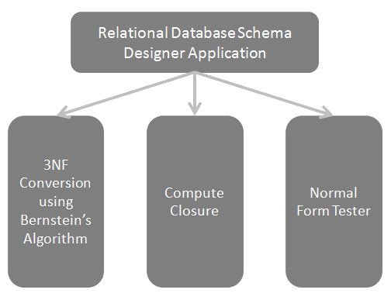
Introduction of features

Slide 4
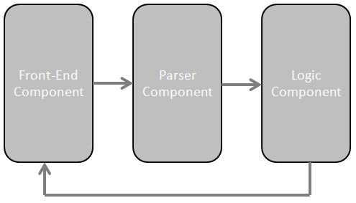
Implementations

Slide 5
3NF Conversion using Bernstein’s Algorithm
Eliminate extraneous attribute
Covering
Partition
Merge equivalent keys
Eliminate transitive dependencies
Construct relations

Slide 6

Shortcomings of Bernstein’s Algorithm removed
Bernstein’s Algorithm does not guarantee reconstructibility (or losslessness)
Bernstein’s Algorithm does not find all the keys

Slide 7



Compute Closure
Using Armstrong axioms
Reflexivity
Augmentation
Transitivity

Slide 8

Normal Form Tester
1st Normal Form
2nd Normal Form
3rd Normal Form
Boyce-Codd Normal Form

Slide 9


Strength & Weakness
Strength:
Good interface for input and editing FDs
Clear explanation
Weakness:
Not all of the Bernstein’s Algorithm’s shortcomings are removed

Slide 10


Slide 11

Questions and Answers

Slide 12


