Slide 1
Database Schema Designer and Tester
CS4221 P04

Slide 2
A web application
that is able to do two things:

Slide 3
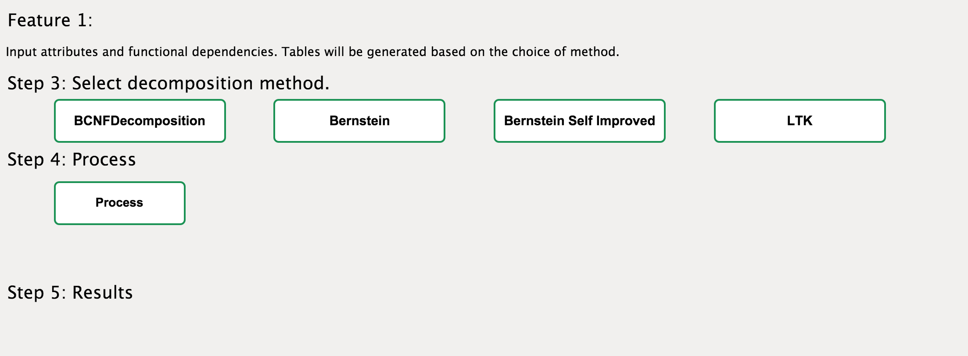
Schema Generator

Slide 4
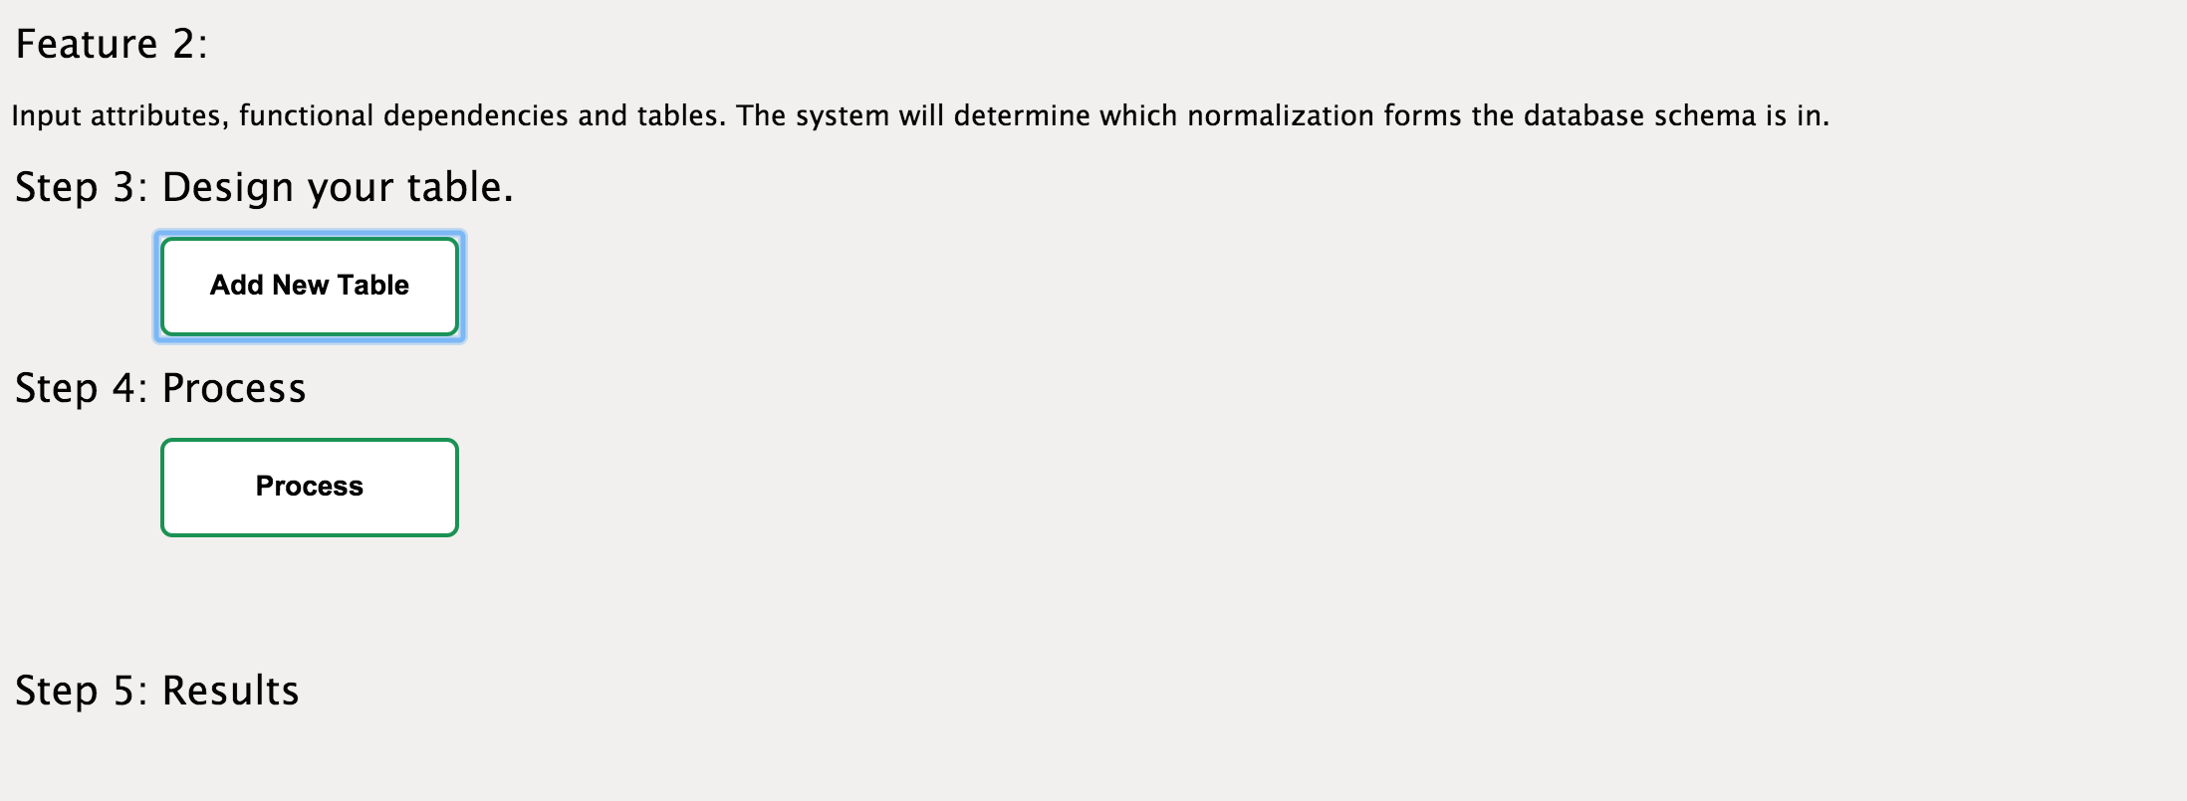
Schema Tester

Slide 5
Algorithms
BCNF decomposition
LTK algorithm
Bernstein algorithm
Bernstein algorithm with variation

Slide 6
BCNF Decomposition
First step is to search for every functional dependency that violates BCNF. When we obtain the list of such functional dependencies
Procedure:
For each FD, check for the closure of LHS
If closure is equal to relation, we do nothing
If closure is not equal to the relation (not a superkey), push into the array that keeps all FDs violating the rule
Return the array

Slide 7
BCNF Decomposition
We choose the first FD in the array returned by the findFDNotInBCNF and decompose the relations
Procedure:
Get the first FD in the array
Get the closure of LHS+RHS of the selected FD
Remove the closure from relation to form a new relation
Add back LHS of FD to relation

Slide 8
LTK
Procedure
Preparatory Algorithm
Superfluous Attribute Detection Algorithm
LTK

Slide 9
LTK - Preparatory
Check the LHS of each FD and compare with the RHS of each FD and the closure of current processing attribute and try every possibility to remove the extraneous attributes and vice versa
Remove all empty FDs
Partition based on same LHS of FDs
Check whether all constructed relations is in all key form
Reconstruct the relation that is not in all key form by add minimal subset of the FD to construct all key form

Slide 10
LTK - Superfluous Attribute Detection
For each relation constructed in step 1, we check all the attributes
Build a for loop, for each attribute, we use setExclude function to construct a set contains all the synthesized keys that does not contain this attribute
If the set is empty or all keys in the set imply the attribute, the attribute is non-superfluous
For each keys in original key set not in constructed key set, we check non- essentiality

Slide 11
Bernstein
removeExtraneousAttrs();
findCovering();
partition();
mergeEquivalentKeys();
eliminateTransitiveDependencies();
generateTables();

Slide 12
Bernstein variation
removeExtraneousAttrs();
findCovering();
partition();
mergeEquivalentKeys();
eliminateTransitiveDependencies();
generateTables();
addBackLostAttrs();

Slide 13
Norm form tester
is2NF(attrs, fds)
is3NF(attrs, fds)
isBCNF(attrs, fds)
isAttrLossless(tables, fds, allAttrs)
isDependencyPreserving(tables, fds)

Slide 14
Demo

Slide 15


