Slide 1
CS4221 Database Design
Group P05
Name Matriculation Number
Jonathan Irvin Gunawan A0113012J
Mun Hui Yi A0101331H
Rey Neo A0111823U
Tan Young Sing A0111824R

Slide 2
Introduction
Web-based Relational Database Schema Designer
Interface to Add/Remove Attributes & FDs
Compute Closure
Normal Form Tester
Normalization using Bernstein Algorithm
Potential Learning Tool for CS2102 students

Slide 3
Implementation
Javascript/ HTML
JSON Objects
Git

Slide 4
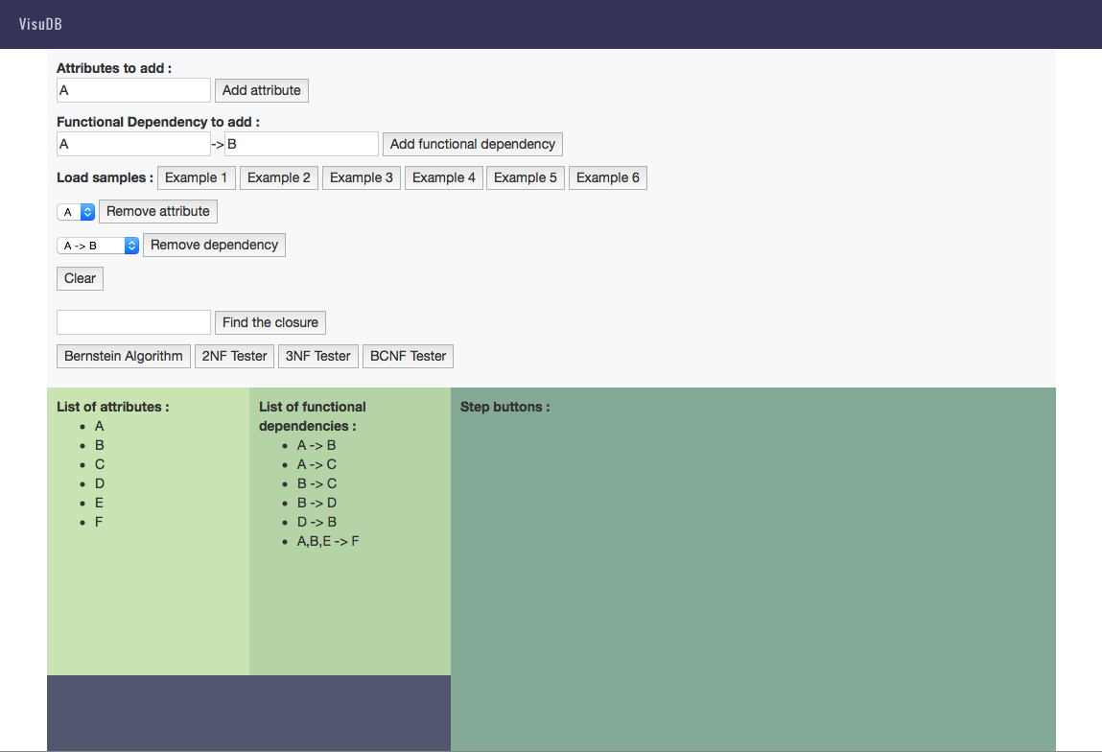
User Interface

Slide 5
Bernstein Algorithm
1.Find the key
2.Check if the relation is in 3NF.
3.1 If the relation is in 3NF, the program ends.
3.2 Otherwise, proceed to execute Bernstein algorithm
3.2.1 Make every functional dependencies singleton
3.2.2 Remove extraneous attributes
3.2.3 Remove redundant functional dependencies

Slide 6
Bernstein Algorithm
3.2.5 Merge equivalent key
3.2.6 Remove transitive dependencies
3.2.7 Create relations
3.2.8 Program ends

Slide 7
Bernstein Algorithm
Reconstructability
Create a new relation consisting of all the attributes in any candidate key if any of the attributes are missing in the constructed relations

Slide 8
Bernstein Algorithm
Finding all keys
All superkeys are found first.
Superkeys that has another superkey as a proper subset are eliminated
Only the candidate keys.

Slide 9
DEMO
http://comp.nus.edu.sg/~irving/visuDB/

Slide 10
Thank you for your kind attention
Q&A

