Slide 1
Case tool
Relational Database Schema Designer
P06
Cai Xinlei
Tang Ning
Xu Chen
Zhang Yichuan
CS4221

Slide 2
Overview
Bernstein’s algorithm
Find closure
Find all keys
Check normal form
Save and load files
Conclusion
Demo

Slide 3
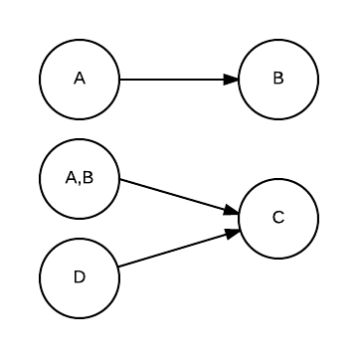
Internal Data Structure
Directed graph
e.g. {A->B, AB->C, D->C}
Advantages:
Easy to find closure of a set of attributes
Easy to eliminate transitive dependencies

Slide 4
Eliminate Extraneous Attributes
Assume the set of attributes in the left/right hand side is represented by X/Y
Conditions to be checked:
A subset S⋤X determines a subset of R⋤X with S∩R=∅
e.g. {A->B, AB->C}
A subset S⋤X determines Y
e.g. {A->BCD, AF->BCD}

Slide 5
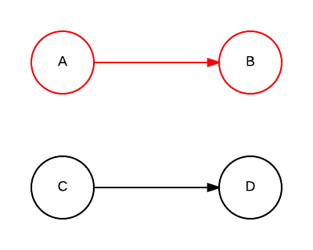
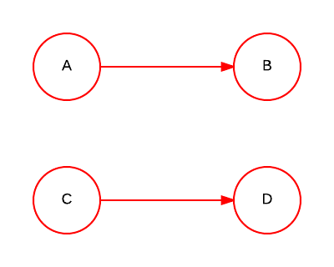
Find Closure
Find starting graph node
Run bfs to add new attributes to closure
Repeat step 2, until no more new attributes can be found
Example: ∑ = {A->B, C->D}, find closure of {A, C}
{A, C}⁺ = {A, B, C} {A, C}⁺ = {A, B, C, D}

Slide 6
Find Minimum Cover
Extraneous attributes have been removed in step 1
Eliminate all transitive dependencies using previous algorithm

Slide 7
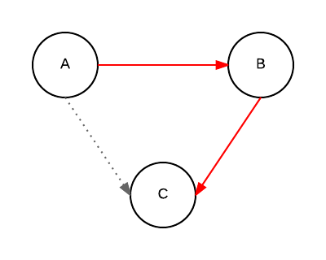
Eliminate Transitive Dependencies
Temprarliy delete edge in between X->Y
Check reachability X to Y
Example: ∑ = {A->B, A->C, B->C}, check A->C

Slide 8
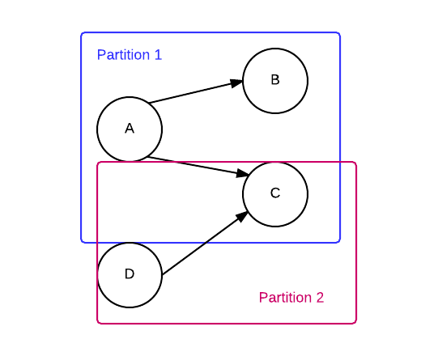
Partition
Partition by identical left hand side node and its neighbours
No additional modification on graph

Slide 9
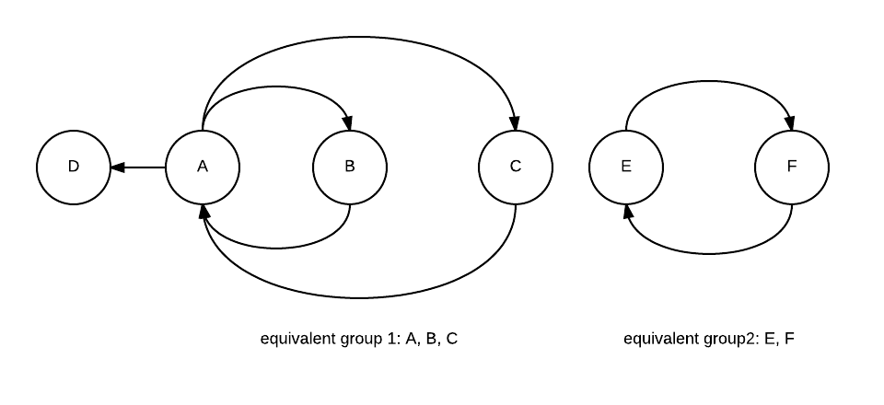
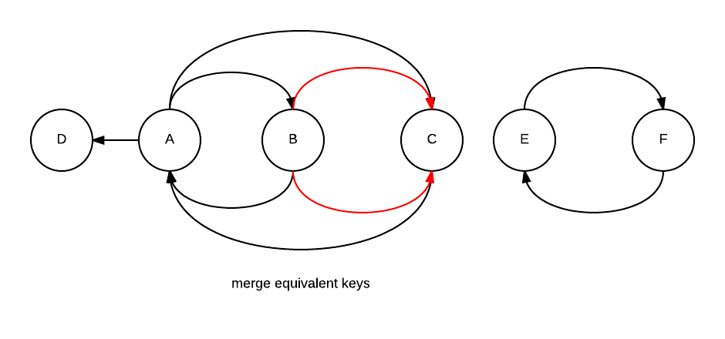
Merge Equivalent Keys
Find equivalent groups
Merge equivalent keys on graph
Print intermediate output

Slide 10
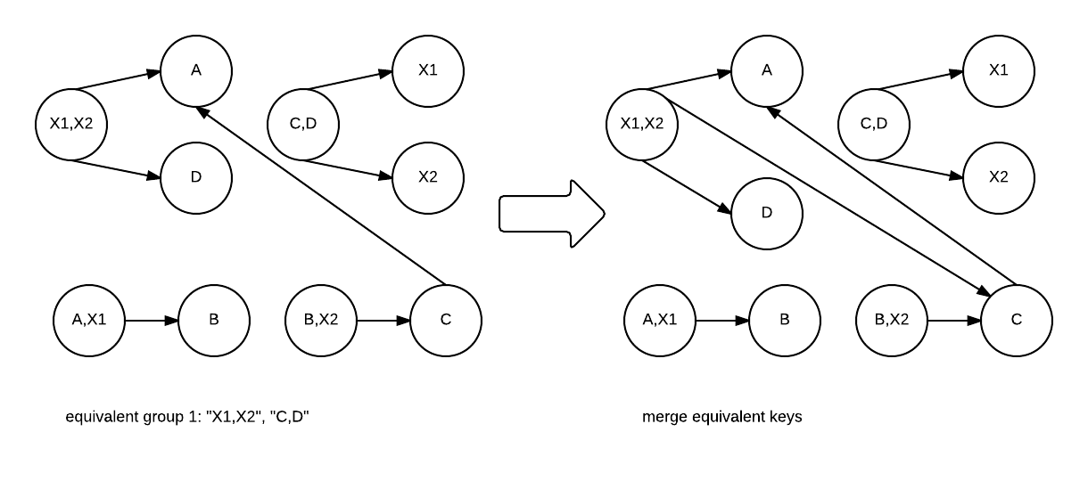
Merge Equivalent Keys

Slide 11
Find All Keys
Full closure - all the attributes in the relation
Check if the closure of any combination of attributes is equal to the full closure.
e.g. ∑ = {A->B, C->D}. Find {A}⁺ ,{B}⁺ ,{C}⁺ … {A,B}⁺, {A,C}⁺....{A,C,D}⁺, {B,C,D}⁺
=> {A,C}⁺ = {A,B,C,D}
Before the above step, if there exists a proper subset of attribute that is a key, skip find closure of that combination.

Slide 12
Normal Form Checker
1NF
2NF
3NF
BCNF

Slide 13
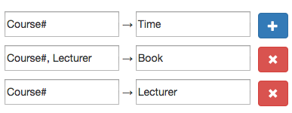
Save and Load File
Format
Convenience

Slide 14
Testing
Unit Testing
Bernstein’s Algorithm Test
Test Normal Form Checker and Find Key

Slide 15
Conclusion
Difficulties encountered
Lessons learned

Slide 16
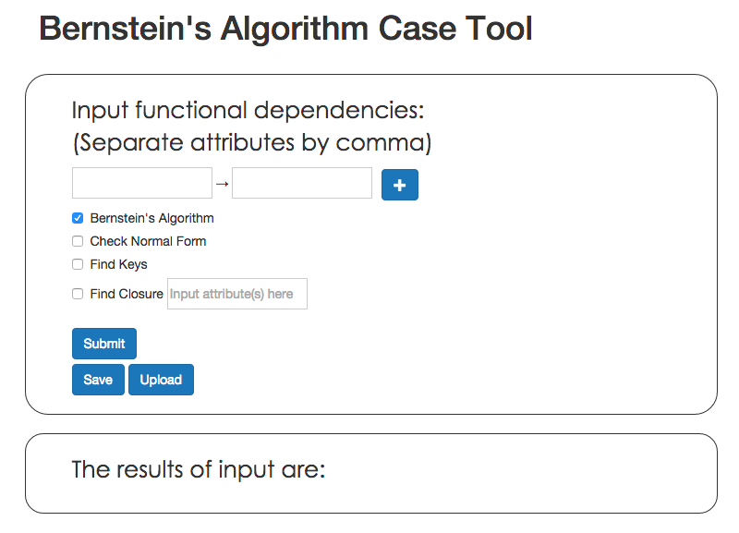
Demo

