Slide 1
CASE tool
For analysing and normalizing relational schemas
Group P08

Slide 2
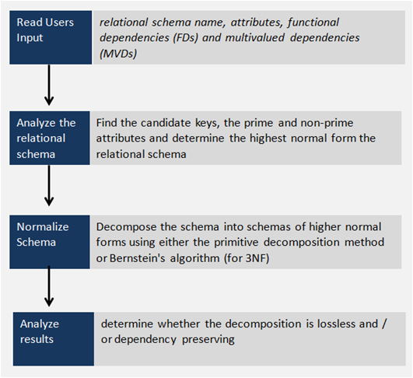
Workflow

Slide 3
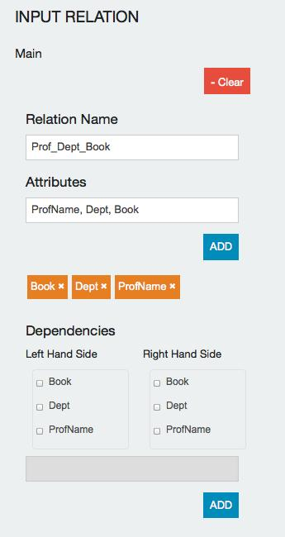
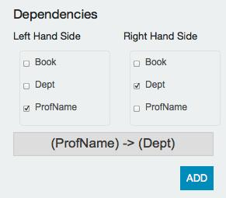
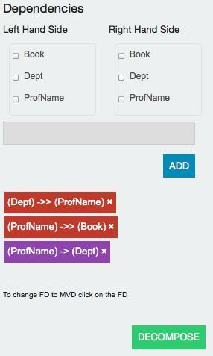
GUI Overview

Slide 4
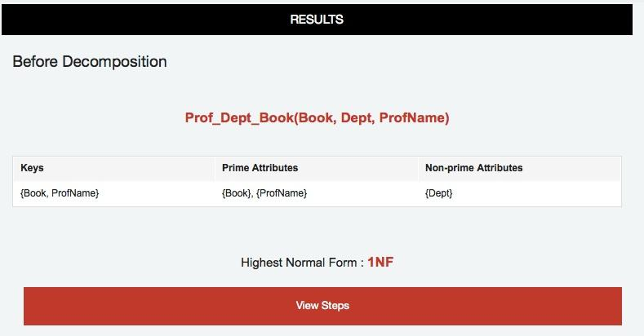
GUI Overview

Slide 5
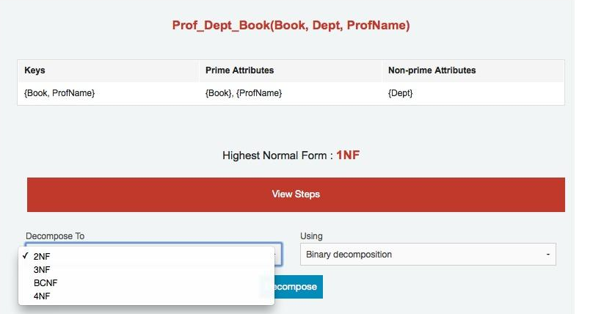
GUI Overview

Slide 6
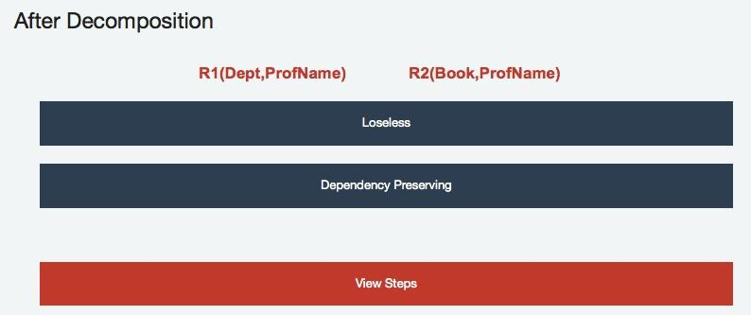
GUI Overview

Slide 7
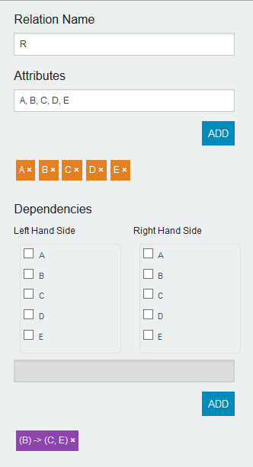
Reading in relational schema
Check the correct attributes on each side of the FD / MVD
FD / MVD added appears here

Slide 8
Reading in relational schema
FD / MVDs
{A, B} → {C, D}
LHS
A, B
RHS
C, D
...

Slide 9
Analysing relational schema
4NF
BCNF
3NF
2NF

Slide 10
Normalization
Methods
Binary Decomposition
Bernstein’s Algorithm
Properties
Losslessness
Dependency Preserving

Slide 11
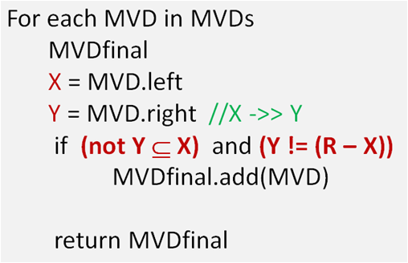
Binary Decomposition
Step 1 : Remove redundant dependencies

Slide 12
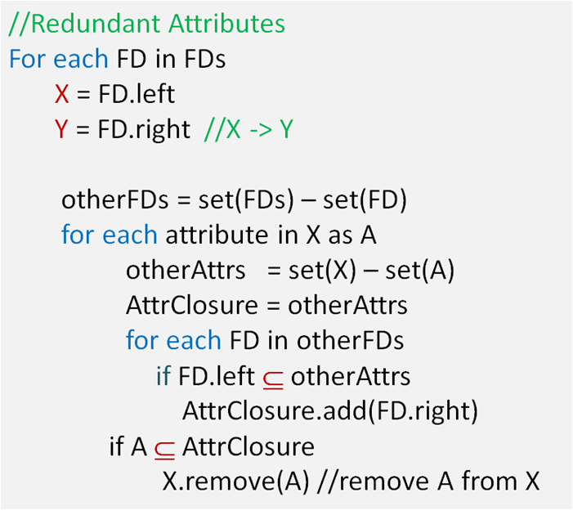
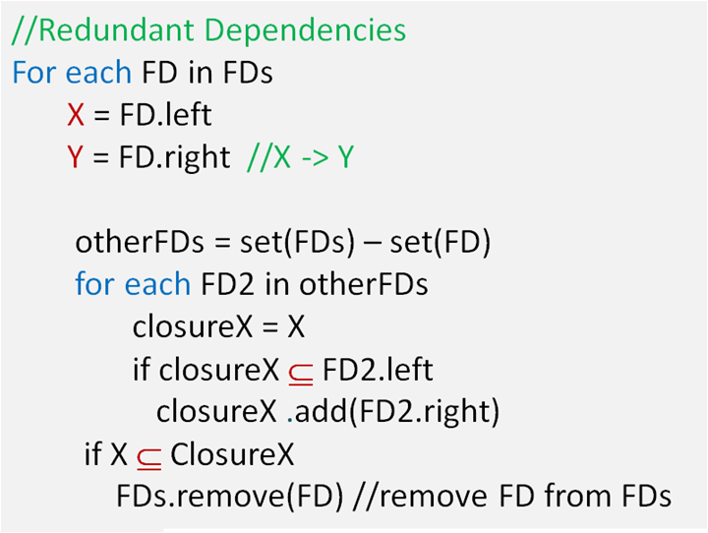
Binary Decomposition
Step 2 : Find minimal cover

Slide 13
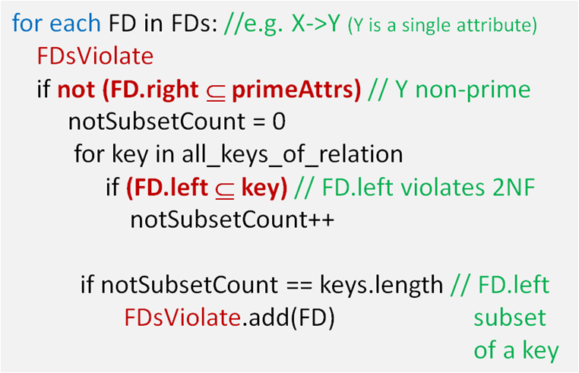
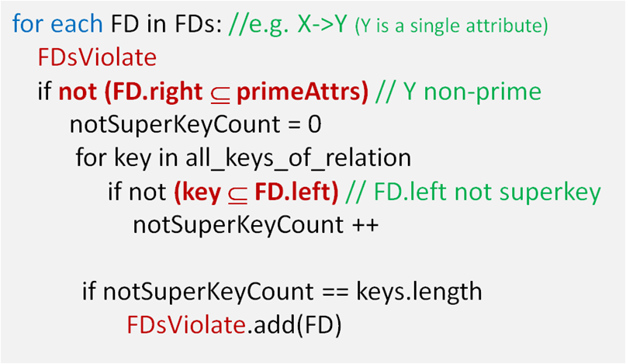
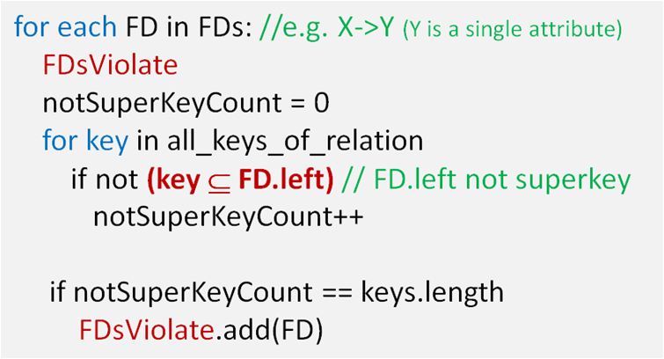
Binary Decomposition
Step 2 : Identify Dependencies that violate

Slide 14
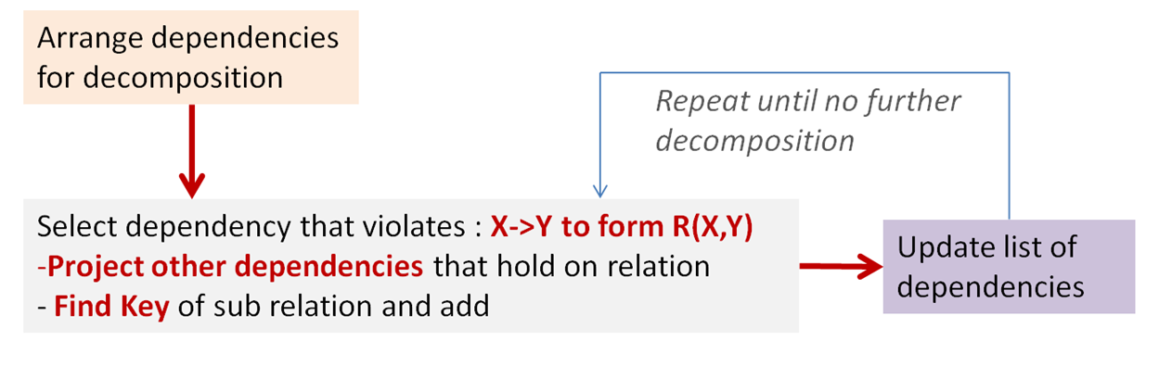
Binary Decomposition
Step 3 : Binary Decomposition

Slide 15
Bernstein Algorithm
Step 1 : Find minimal cover
same algorithm as in binary decomposition
Step 2 : partitioning
group FD with same LHS
F = (X → A), (Y → X), (X,Y → D), (X → B) H =
H₁= (X → A), (X → B)
H₂= (Y → X)
H₃= (X,Y → D)

Slide 16
Bernstein Algorithm
Step 3 : merging row of H with equivalent LHS
Create a new list of set of FDs J :
H = J =
let’s call h = length(H) = length(J)
H₁= (X → A), (X → B)
H₂= (Y → X)
H₃= (X,Y → D)
J₁= { }
J₂= { }
J₃= { }

Slide 17
Bernstein Algorithm
Step 3 : merging row of H with equivalent LHS
For each (i,j) ∈ [1,h]², i≠j :
For each functional dependency F in H_{i} and F’ in H_{j}
X = LHS(F)
Y = LHS(F’)
If X is equivalent to Y then
J_{i} = J_{i}+{X→Y, Y→X}
H_{i} = H_{i}+H_{j}-J_{i}
Remove H_{j} and J_{j} from H and J
i.e X ⊂ Y⁺ and Y ⊂ X⁺

Slide 18
Bernstein Algorithm
Step 3 : example
H = J =
l
H₁= (X → A), (X → B)
Ø
H₃= (X,Y → D)
J₁= (X → Y), (Y → X)
Ø
J₃= { }

Slide 19
Bernstein Algorithm
Step 4 : removing transitive dependencies
Step 4 consists in finding a minimal cover of H+J, except that we do not allow to modify FD from J. Thus, we already described how to compute this step.
Step 5 : construct relations
Each (H_{i},J_{i}) give one relation of the decomposition
l
H₁= (X → A), (X → B), J₁= (X → Y), (Y → X) → R₁(X,A,B,Y)
H₃= (X,Y → D), J₃ = { } → R₂(X,Y,D)

Slide 20
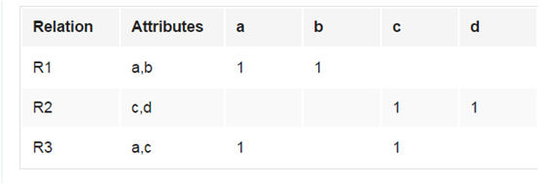
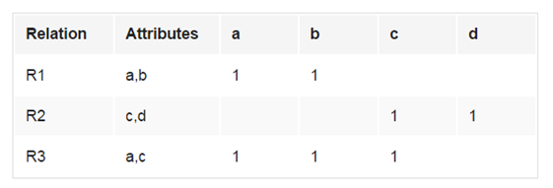
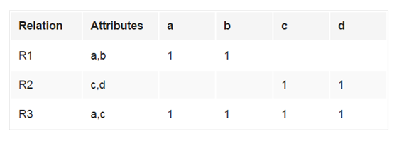
Check for Losslessness
{a -> b}
{c -> d}

Slide 21
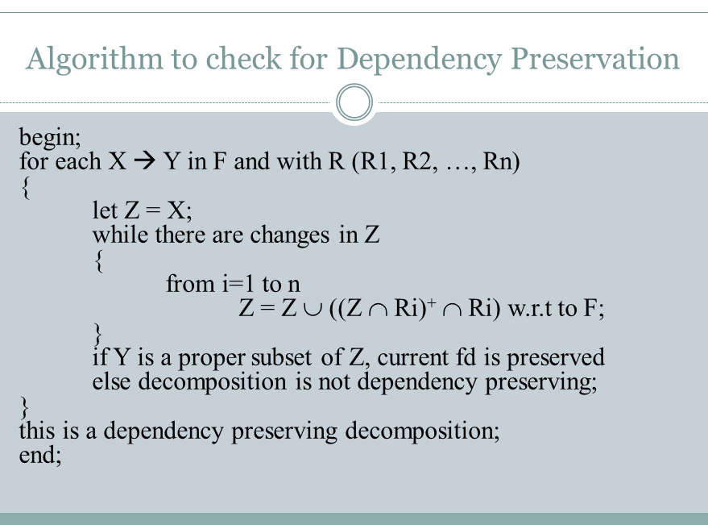
Check for Dependency Preserving

Slide 22
Future Developments
Persistence
Multiple Tables
Input relations via reading from file

Slide 23
THE END

