Slide 1
Relational Database Schema Designer using Bernstein’s Algorithm
Group P11
Aloysius Ang Wooi Kiak
Chan Yee Wei
Han En Chou
Reymond Edlin

Slide 2
Introduction
Web application
Developed using Laravel web application framework
GUI based on HTML, CSS, AngularJS
Backend logic based on PHP

Slide 3
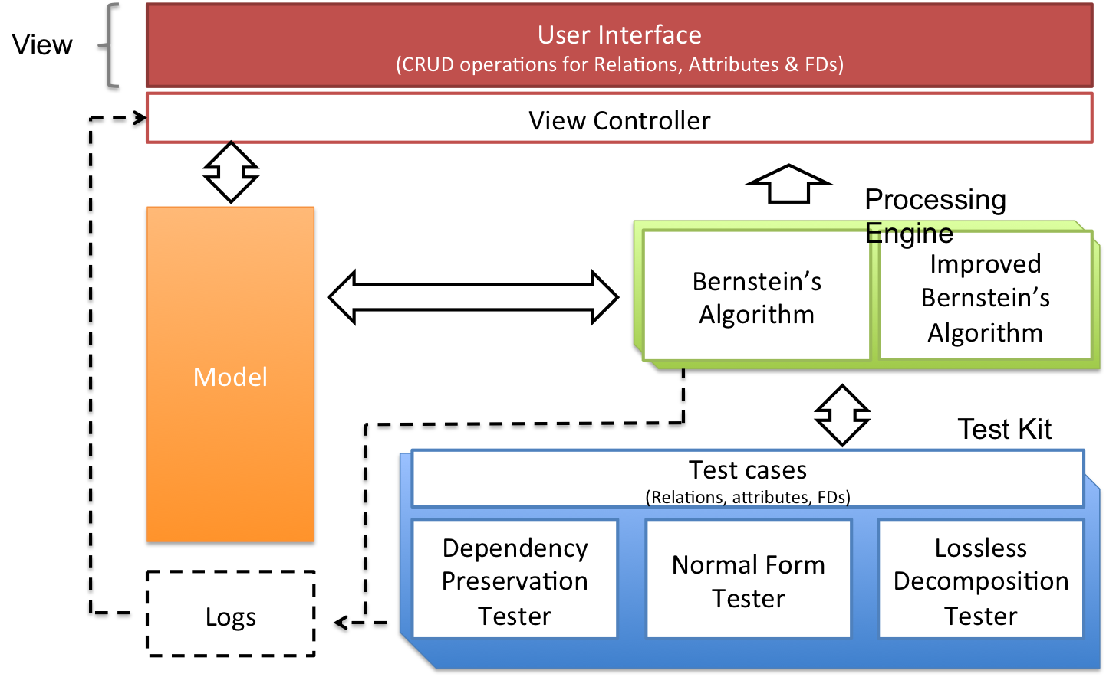
System Overview

Slide 4





Software Architecture:
Technology & Tools
Frontend
Written in Javascript, HTML, CSS
Backend
Written in PHP, MySQL

Slide 5
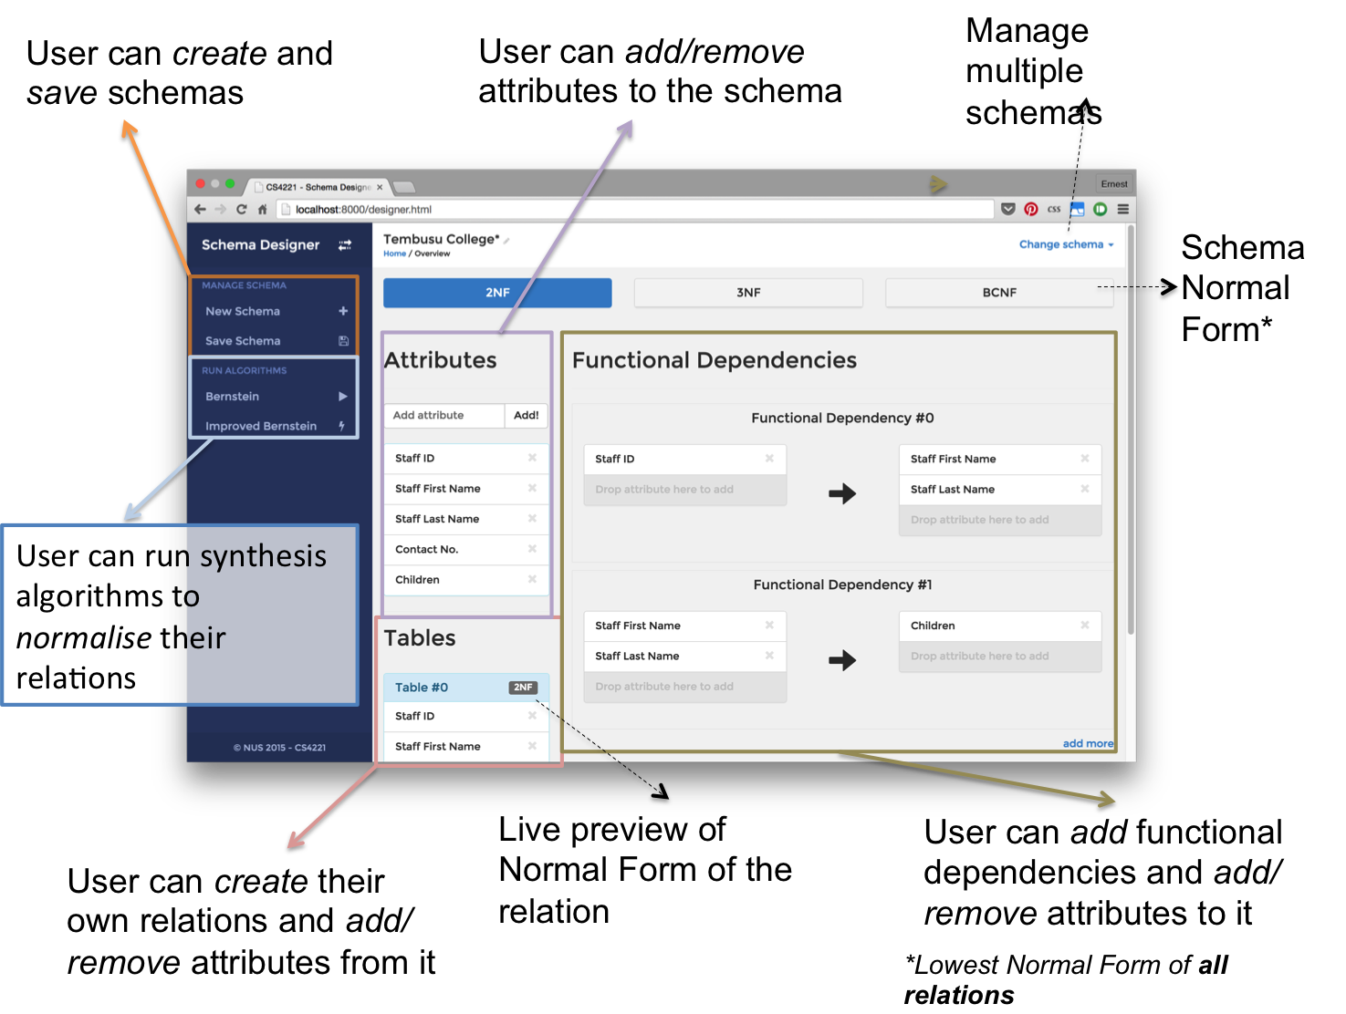
Software Architecture:
Graphical User Interface

Slide 6
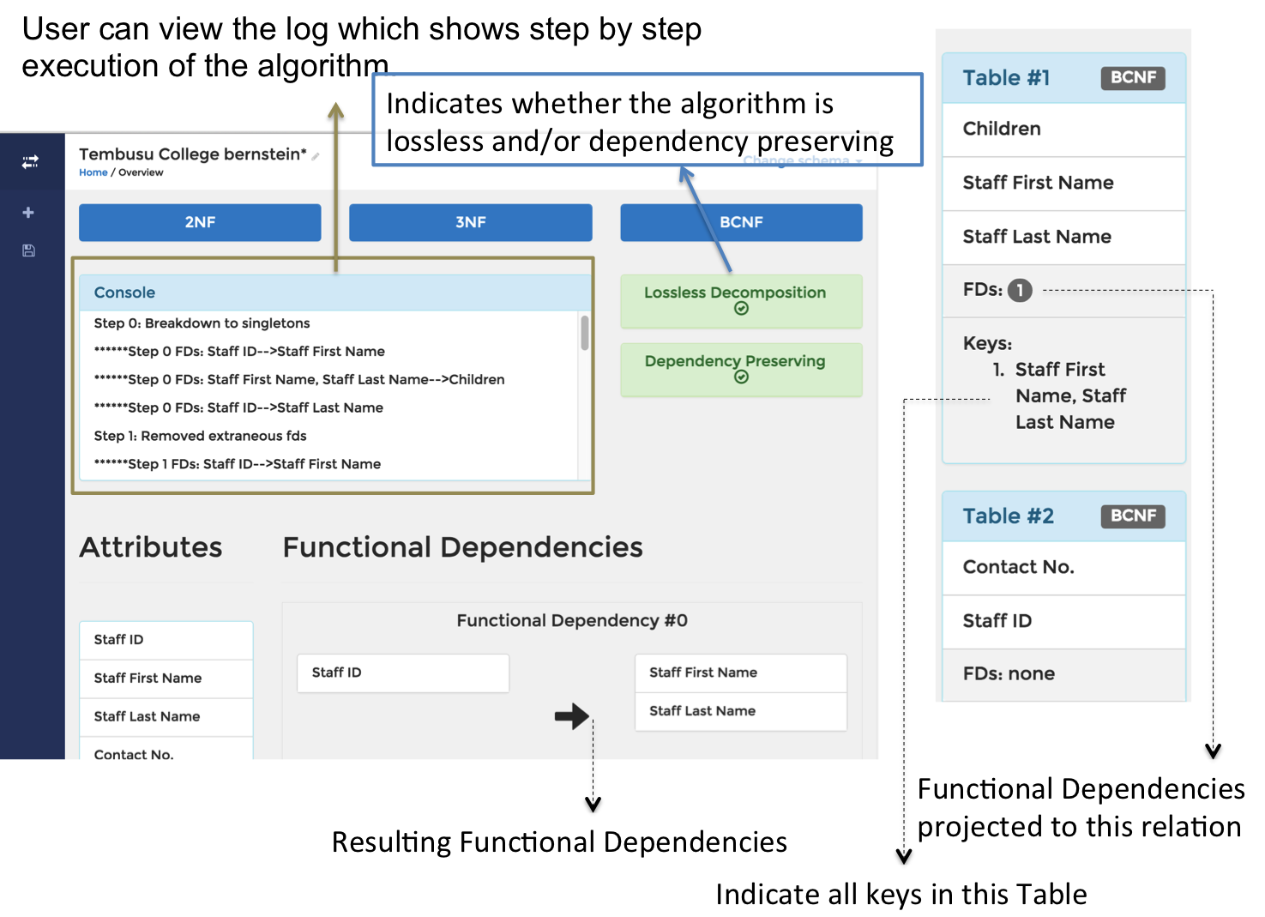
Software Architecture:
Graphical User Interface

Slide 7
Software Architecture:
Functionalities (NF Tester)
Approach:
Determine all possible candidate key(s) using the set of functional dependencies for a given relation
Determine prime attributes
Evaluate the normal form state based on Zaniolo’s definitions

Slide 8
Software Architecture:
Functionalities (Bernstein Algorithm)
6 major steps:
Eliminate extraneous attributes
Obtain a non redundant covering
Partition into groups with similar LHS
Merge equivalent keys
Eliminate transitive dependencies
Construct relations

Slide 9
Software Architecture:
Functionalities (Improved Bernstein)
3 main shortcomings overcomed:
Retain losslessness due to attributes not in any functional dependencies
Finding all keys to all relations
Removing superfluous attributes

Slide 10
Software Architecture:
Functionalities (Lossless)
Determine decomposed relations losslessness
Construct an array of the dimension equals number of relations by number of attributes
Using chase algorithm to fill the table
Decomposition is lossless if at least one row is entirely made up of symbols; a(1), a(2), ... , a(n)

Slide 11
Software Architecture:
Functionalities (Dependency Preserving)
Determine decomposed relations dependency preservation
Using an algorithm to correctly determine the dependency preservation
All FDs has to be checked and proven to be preserving
If at least one FD failed the test, the decomposition is deemed to be not dependency preserving

Slide 12
Demo

