Slide 1
Schema independent XML Keyword Search
Group P14:
Loy Yusong
Mitchelle Jauw
Hadi Sebastian

Slide 2
OUtline
Limitation of LCA based approach
Common Relative Approach
Implementation details
Experiment
Contribution
Limitations and challenges
Demo

Slide 3
LCA limitation
Irrelevant answers
Duplicated answers
Schema dependent

Slide 4
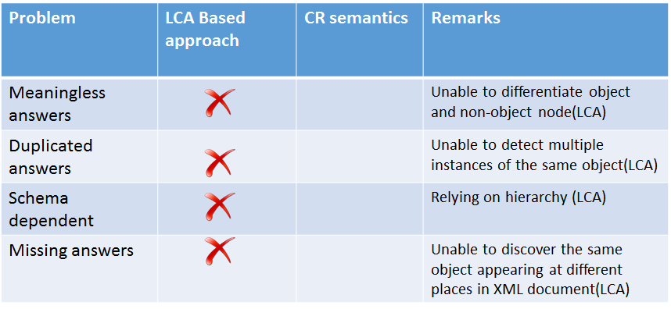

Slide 5
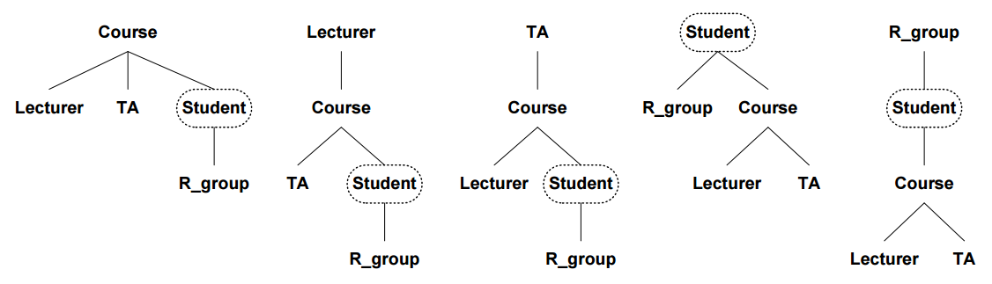
Schema Dependency
Notes:
give eg.

Slide 6
Schema independent proposal
Common Relatives (CR) approach:
Generating IDREF Graph
Labelling object nodes
Finding relatives of object node
Indexing Keywords
Query processing

Slide 7
Assumptions
1. Object classes and object IDs are available.
2. Object IDs are named ‘id’ in object class’s attributes.

Slide 8
Generating IDREF Graph
Create an real object node for each object instance detected in the XML tree
Create a virtual object node for each object being referred by 2 or more real object nodes.

Slide 9
Generating IDREF Graph
Incoming edges represent a parent-child relationship
Virtual nodes have incoming edges from the real object nodes referring to it

Slide 10
2. Labelling Object Nodes
Object nodes are labelled by number
Labelling of virtual nodes happen after the last real object node has been done

Slide 11
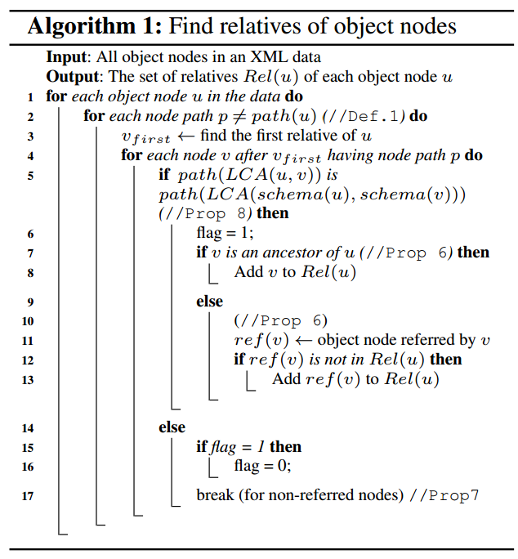
3. Finding Relatives of Object Nodes
Algorithm used:

Slide 12
4. Indexing Keywords
Relative set of keyword is the union of the relative sets of object nodes matching the keyword

Slide 13
5. Query Processing
Simply return the set intersection of relative sets of keywords in query

Slide 14
Experiment
2 datasets created
More than 50 queries tested for each data set
Aim: Ensure that we can find all common ancestors from all equivalent databases by using only one equivalent database

Slide 15
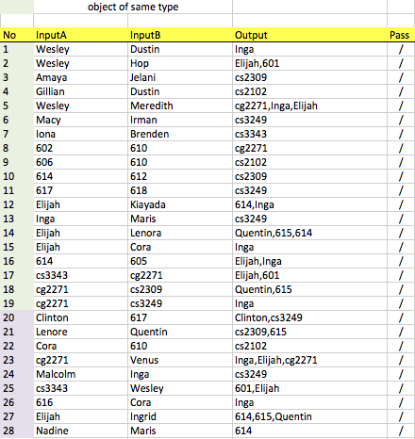
Testing

Slide 16
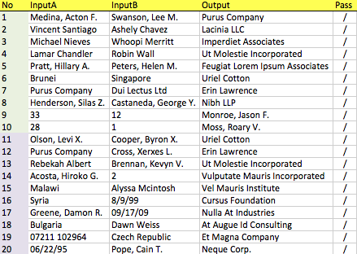
Testing
100%!

Slide 17
Contribution
Implementation of CR-semantics for XML keyword search
Implemented Windows-based GUI for keyword search

Slide 18
Limitations and Challenges
Rigidness of XML structure accepted
Keyword Restrictiveness

Slide 19
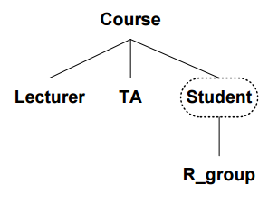
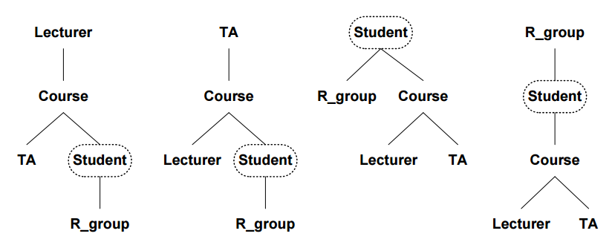
Demo
Dataset schema:
Equivalent Databases:

