Slide 1
DATA SET GENERATOR
P15
TEAM:
Li Xiangqun, Wu Xudong, Wu Dan, Yu Fangzhou

Slide 2



Motivation?
Testing data!
Not support the constrains of database systems!
Datasets are not realistic enough

Slide 3
Goals
Realistic data sets
Sample input: Chinese, 21< age < 41
Data range in South East Asia and East Asia
Enforce the data integrity constraints

Slide 4
Database Design
Assumptions:
the phone number for each country is using different country code,
i.e. country -> country code and country->country code
country may use different languages, and it is possible that one country uses more than one language
language and gender will affect first name and last name
different country may have different email domain

Slide 5
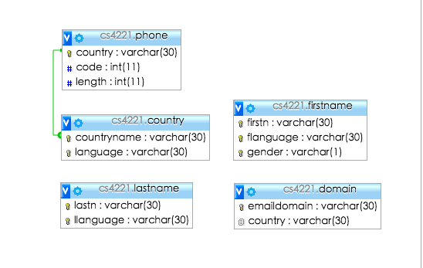
Database Design
3NF
Small relations

Slide 6
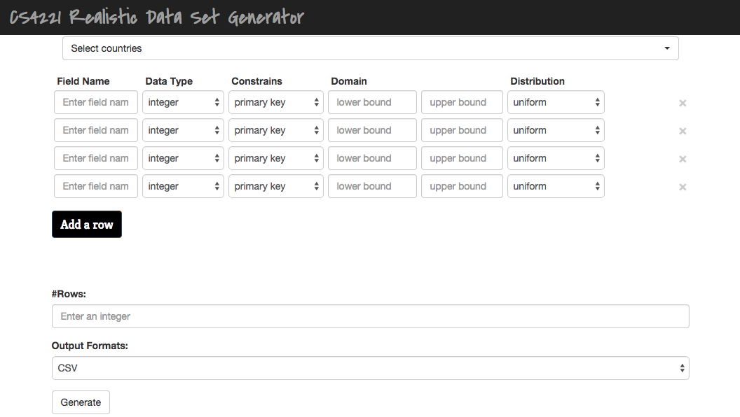
Frontend
Framework: twitter bootstrap front-end framework
Language: HTML and Javascript

Slide 7
Data Types
With Region-Consistency Constraint
Regional | Name, Email, Phone, Country
Non-regional | Name, Email, Phone, Country, Gender, String, Integer, Float, Date
With Uniqueness Constraint
 | Unique | Non-unique
Regional | Name, Email, Phone | Name, Email, Phone, Country
Non-regional | Name, Email, Phone, Country, Gender, String, Integer, Float, Date | Name, Email, Phone, Country, Gender, String, Integer, Float, Date

Slide 8
Constraints
Region-consistency
Regional Data Generator
Non-Regional Data Generator
Randomness and Uniqueness
Randomly generate data and use a hash-table to check uniqueness
Generate permutation of unique data and use shuffle algorithm to ensure randomness
Distribution
Uniform: use random function
Normal Distribution: Box Muller Transform (U1 and U2 uniformly distributed in the interval (0, 1))

Slide 9
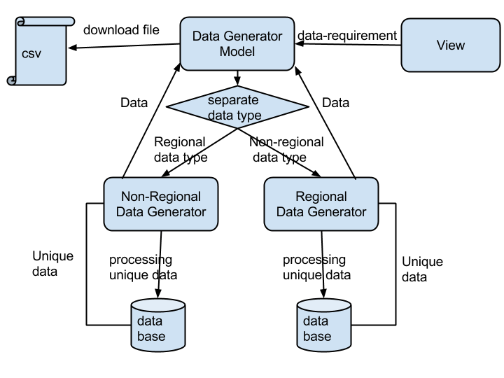
Backend

Slide 10
Backend
Problems：
Inserting data to database is too slow
Processing time is too long
Amount of data is limited to 10 thousand.

Slide 11
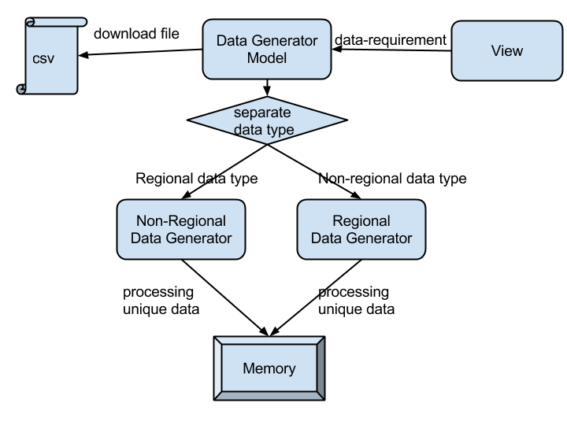
Backend

Slide 12
Backend
Improvements：
Processing speed is faster
Drawbacks:
Cannot generate too much data

Slide 13
Features
User-friendly UI
Performance: runs data very fast! Can reach below 10 sec in present of a poor server
Output CSV format that is popular for many testing programs
Support enforcing database constraints
Realistic data and result

Slide 14
Conclusion
We can generate regional data in several data types
We can ensure uniqueness of data if required
We can generate normal distribution for numeric data
Data generator consume much computing power
Stronger computing power is required for larger data set
More improvement can be made
Multiple tables with foreign key constraint
More format for output files

