Slide 1
Comparison on commercial Object­ Relational Database Systems
P16
Dong Haoxuan A0085279N
Xu Xianan A0084556W
Zhu Jiarui A0091892U
Zhu Wuzhong A0080946X

Slide 2
Introduction
ORDBMS: Composition of both relational database and Object-Oriented Database
RDBMS perform better
OODBMS is user friendly to developers
ORDBMS is a middle ground of both

Slide 3
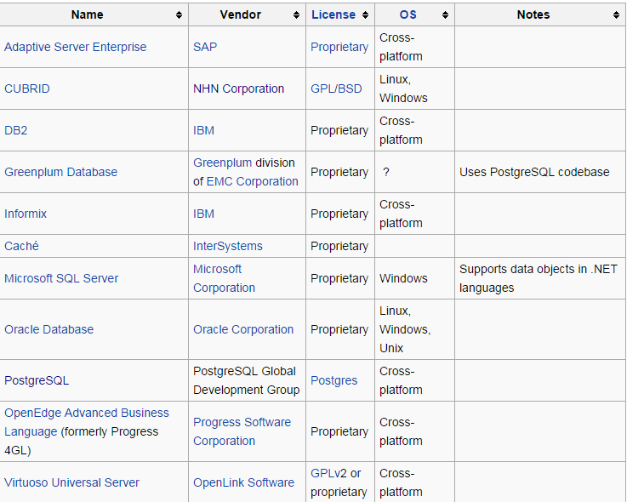
*http://en.wikipedia.org/wiki/Comparison_of_object-relational_database_management_systems

Slide 4
Informix
User-Defined Data Types
UDTs can be either opaque or distinct.
A distinct type has the same internal structure as an existing data type
An opaque type stores a single value and cannot be divided into components by the database server

Slide 5
Informix
Inheritance
CREATE TABLE Employees
( Name PersonName NOT NULL,
DOB DATE NOT NULL,
Salary Currency NOT NULL,
Address StreetAddress NOT NULL PRIMARY KEY ( Name, DOB ) );
CREATE TABLE Temporary_Employees
( Resume DOCUMENT NOT NULL,
LivesAt GEOPOINT NOT NULL,
Booked SET( Period NOT NULL )
) UNDER Employees;
http://infolab.usc.edu/csci585/Spring2010/den_ar/ordb.pdf

Slide 6
Informix
User-Defined Routines
A user-defined routine (UDR) is a routine that you can define and that can be invoked within an SQL statement or within another UDR.

Slide 7
PostgresSQL
User-Defined Data Types
4 kinds of user-defined types : base types, composite type, domains and pseudo-types.

Slide 8
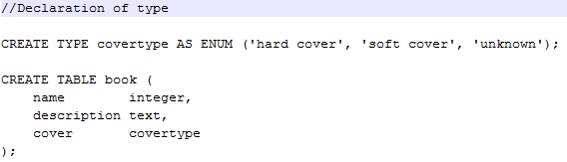
PostgresSQL
Base type

Slide 9
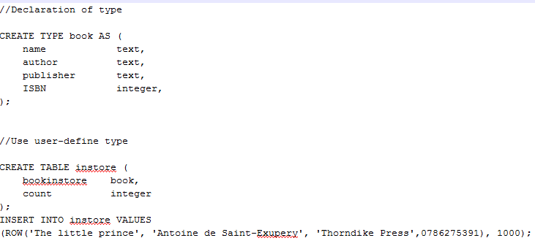
PostgresSQL
Composite type

Slide 10
PostgresSQL
Domain and Pseudo Types
Domains are special base types with constraints.
Pseudo-Types are similar to Object class in java. It is abstract and is declared when a function correspond to non-specific data types.

Slide 11
PostgresSQL
User-Defined Funtions
4 kinds of user-defined functions: Query language functions; Procedural language functions; internal functions and C-language functions

Slide 12
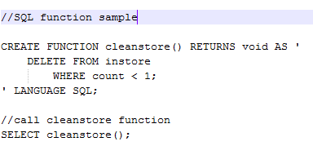
PostgresSQL
Query language functions

Slide 13

PostgresSQL
Composite type

Slide 14
PostgresSQL
Internal Functions and Procedural language functions
Internal functions server inbuilt C-language functions
Procedural language functions are functions in other languages.

Slide 15
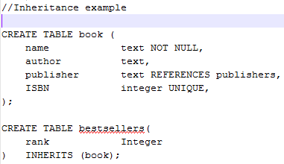
PostgresSQL
Inheritance
Table inheritance

Slide 16
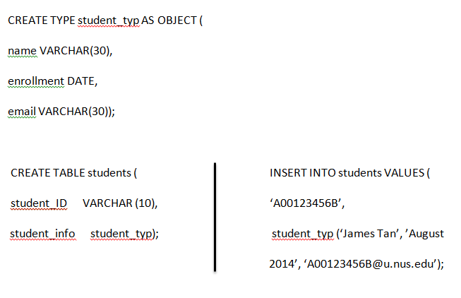
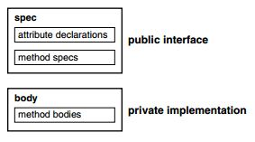
Oracle
Oracle Objects and Types

Slide 17
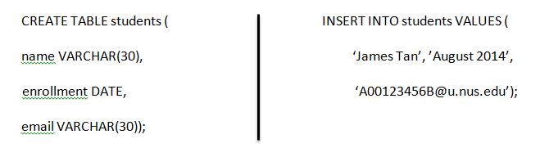
Oracle
Oracle Methods
member methods, static methods,
constructor methods, external implemented methods
Oracle Object Tables

Slide 18
Oracle
Oracle Type Inheritance
Supertype and Subtype
Overriding, overloading and polymorphism
Oracle Collection
varrays and nested tables

Slide 19
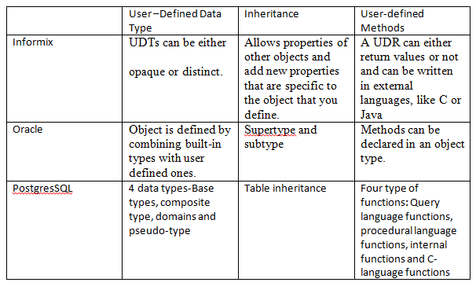
Comparison between the ORDBMS

