Slide 1

Congratulations on installing
Let’s take a quick tour of
the main features.

Slide 2
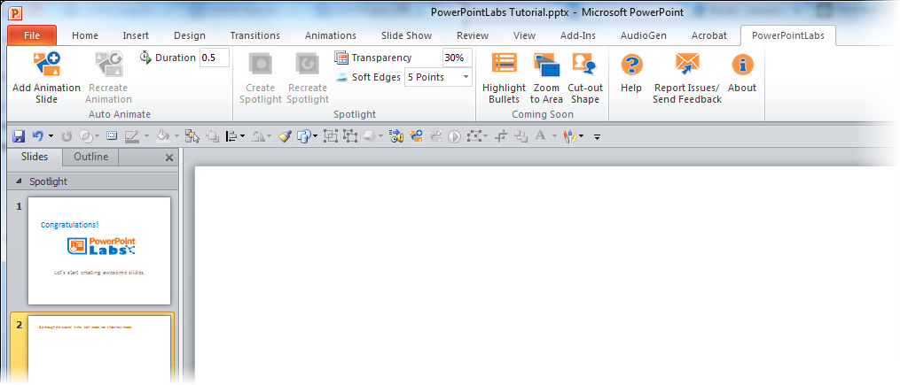
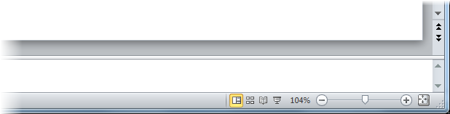
Please go through this tutorial in the ‘edit’ mode, not ‘slideshow’ mode.

Slide 3
This tutorial explains PowerPointLabs’ features at the point you installed the plugin.
If you installed the plugin some time back, please refer to the User Guide page of our website for more up-to-date instructions.

Slide 4

Some buttons may appear to be disabled like this:
You can move the mouse pointer onto the gray buttons and follow the instructions given in their tooltips to activate the features.

Slide 5
First up, let’s try the Highlight Points feature.

Slide 6


1. While this slide is selected, click the button in the ribbon.
A bullet point
Another bullet point
  A sub-bullet point
    A third-level bullet point
One more bullet point
2. ‘Play’ this slide as a slide show (click icon or press Shift+F5) to see how each bullet point is highlighted one at a time.
3. After that, go back to the edit mode (press ESC key) and move to the next slide.

Slide 7

4. While this slide is selected, click the button instead.
A bullet point
Another bullet point
  A sub-bullet point
    A third-level bullet point
One more bullet point
5. ‘Play’ this slide as a slide show ( or Shift+F5) to see how the background of each bullet point is highlighted one at a time.
6. More ways of using this feature – for instance, to highlight arbitrary segments of text – can be found on our website http://PowerPointLabs.info/docs/

Slide 8
Next, let’s try the Spotlight feature.

Slide 9


1. Click on this blue shape
to ‘select’ it.
2. While the shape is selected,
click the button in the ribbon.
Phase A
Phase B
Phase C
Step 1
Step 2
Step 3

Slide 10
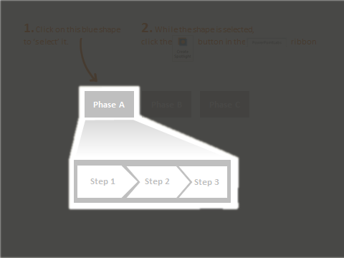
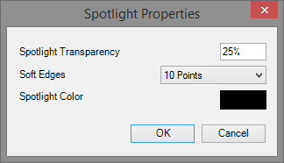
3. Did you notice the new slide with a spotlight? You can press Ctrl+Z (Undo) to reverse the effect.
4. You can also adjust the darkness (transparency) and softness (soft edges) of the spotlight.
a. Adjust these
settings.
b. On the original slide, select the transparent spotlight shape.
c. Click
Create Spotlight again.

Slide 11
Next, let’s try the Auto-Animate feature.

Slide 12

1. Let’s say you want to animate these shapes so that they end up in the positions given in the next slide.
Research
Marketing
Profit
Development
2. While this slide is selected,
click the button. That should insert a new slide
containing the animation.

Slide 13
Research
Marketing
Development
Profit

Slide 14
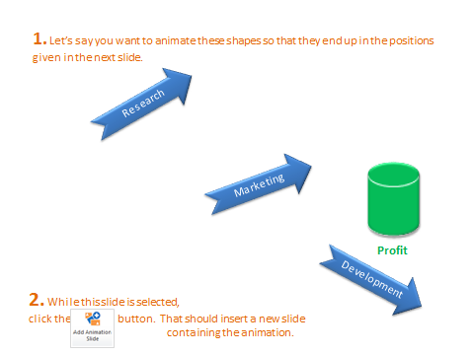
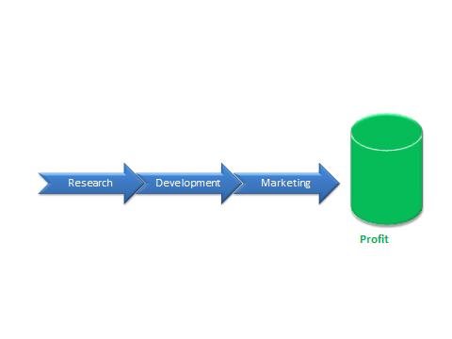
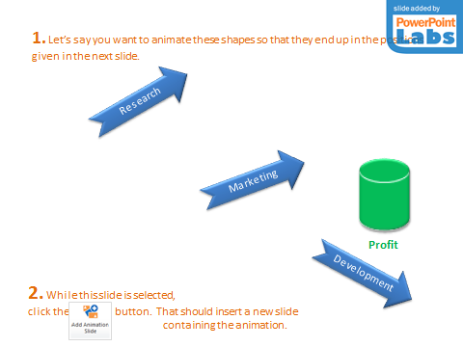

3. To tweak the animation,
a. Adjust the positions on either of these slides.
start slide
end slide
animation slide
b. Select any of the three slides.
c. Click this button.

Slide 15
Next, let’s try the Animate In Slide feature.

Slide 16

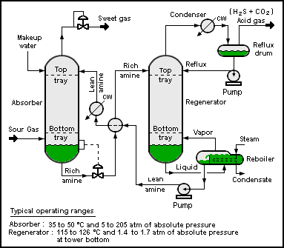
1. Select the four blue circles in any order (Ctrl+click) and click the button.
2. When you ‘play’ the slide show ( ), you should see a single circle animated
in the order you selected the four circles previously.
Notes:
Picture credit: Wikipedia

Slide 17
Auto Zoom features are next.

Slide 18

1. Select the blue rectangles in any order (Ctrl+click) and click the zoom to area button.
2. ‘Play’ the slide show ( ) to see the zooming and panning effects generated by PowerPointLabs. If you would like each zoom/pan effect to be put in a separate slide, click the expand ( ) icon below the Zoom to Area button to access settings and select ‘Put all zoom effects on separate slides’ option.

Slide 19




2. Select the blue rectangle and click the button.
Inputs
Process
Output
Ingredient A (60%)
Ingredient B (25%)
C (15%)
3. ‘Play’ the slide show ( ) to see drill down effect generated by PowerPointLabs. The effect tells the audience which part of this slide corresponds to the content of the next slide. For example, here it gives audience the feeling that you are now drilling down to details about the ‘Process’ part of this slide.

Slide 20
L
X
Y
Z
M

Slide 21

4. Select the blue rectangle and click the button to generate a step back effect from the previous slide.
Inputs
Process
Output
Ingredient A (60%)
Ingredient B (25%)
C (15%)
5. Go back a couple of slides and ‘play’ the slide show to see the step back effect generated. This effect can be used to indicate that you are stepping back to take a look at where the details you have been discussing fit into the ‘big picture’.

Slide 22
Next, let’s try the Auto Crop feature.

Slide 23



1. Select the blue shapes (ctrl + click) and click the button.
It will crop the images behind to match the outlines of the shapes.
Notes:
This will play at the beginning.
[afterClick] This will play after you click.

Slide 24

2. You can apply other default PowerPoint effects such as soft-edges to enhance the resulting cropped image even further.
Your child today is …
… the young adult of tomorrow.
Notes:
This will play at the beginning.
[afterClick] This will play after you click.

Slide 25
Next, let’s try the Narrations Lab and Captions Lab features.

Slide 26

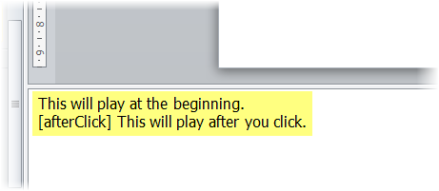

1. Click the button.
It will generate an audio narration for this slide based on the slide notes. Play the slide and listen to the generated audio narration.
2. Click the button to generate subtitles (captions) as well.
Play again to experience both the audio and captions at the same time.
Notes:
This will play at the beginning.
[afterClick] This will play after you click.

Slide 27
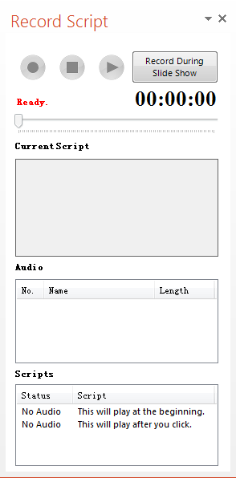
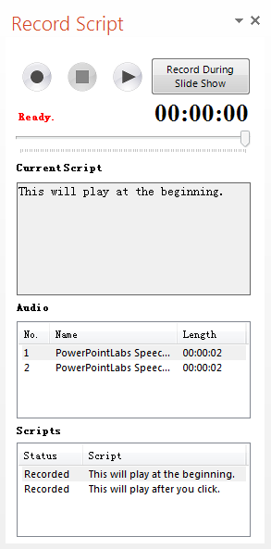



3. To record an audio, click the drop down menu
of button.
It will show Recorder Script Panel at right side of your screen, showing the recording status of the scripts of current slide.
4. Click on the script you want to record and
click to start recording. When you
click , the record will be embedded on the
slide, and can be checked in the panel as well.
Notes:
This will play at the beginning.
[afterClick] This will play after you click.

Slide 28
Next, let’s try the Shapes Lab.

Slide 29

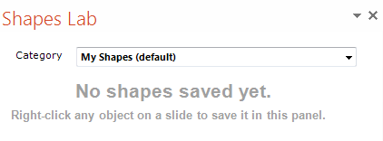
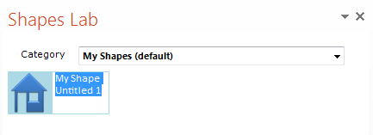
1. Click the button to
bring up the Shapes Lab Panel.
2. Right click the ‘house’ shape below and choose “Add to Shapes Lab”. Then you should see your shape in the panel, waiting for you to give it a name.

Slide 30
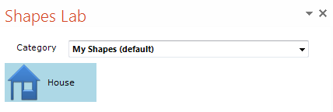
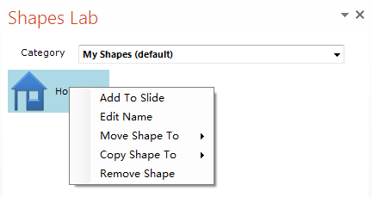
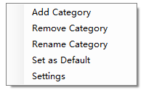
3. After entering a name, press enter to confirm.
4. Double-click the ‘House’ shape in the Shapes Lab panel to add a copy of it to this slide.
5. To delete or rename the saved shape, right-click and choose the appropriate action from the context menu.
Right-click an empty area of the Shapes Lab to change the location where shapes are saved.
Tip: Save shapes in a shared folder (e.g. a Dropbox folder) to share saved shapes among multiple computers.

Slide 31
Let’s try out the Colors Lab now.

Slide 32

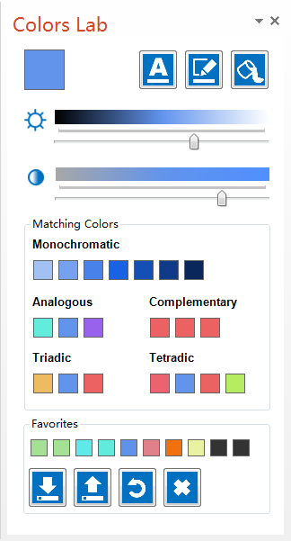




1. Click the button.
It will show the Colors Lab Panel at the right side of
your screen.
2. Select the shape below:
Select me!
3. Drag the button in the panel to change the selected shape’s FONT color.
Drag this button to change its LINE color.
or button to change its FILL color.
3. Drag the button to change the main color of the panel.

Slide 33

Thanks for taking this quick tutorial.
For find more information about these features,
visit the user guide on our website.
To give feedback or ask a question,
contact us at pptlabs@comp.nus.edu.sg
Happy PowerPointing!

Slide 34
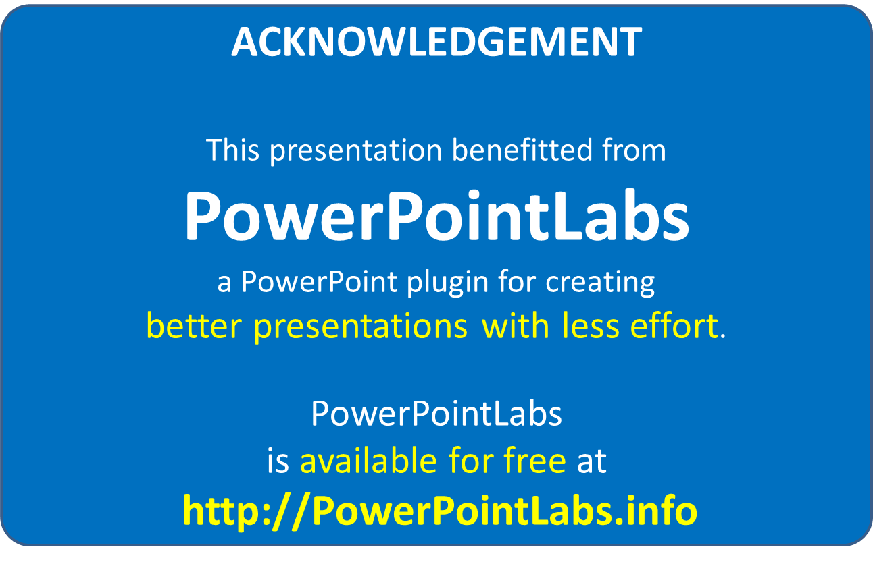
This slide is added by PowerPointLabs. It will not show up during the presentation.

