Slide 1
The Cloud Recording Link
Likely this is not centrally recorded,
So I will manually record via Zoom

Slide 2
CS4234
Optimiz(s)ation Algorithms
v0.5: Seth Gilbert
v1.7: Steven Halim
L12 – Push-Relabel
Max-Flow Algorithm
What if we don’t fixate our thoughts towards finding even better augmenting paths iteratively…

Slide 3
Roadmap
Push-Relabel Algorithm
  Recap about Ford-Fulkerson and its variations…
  Introducing Push-Relabel Algorithm
  Analysis of Push-Relabel Algorithm: O(n² m)
  Implementation note

Slide 4
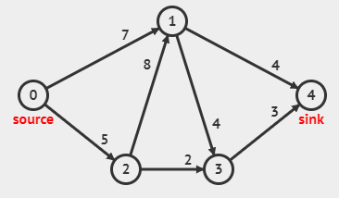
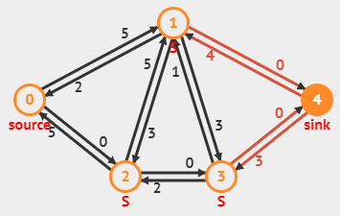
Recap: The Max-Flow Problem
Given a Flow Network
  A directed graph G = (V, E) with n vertices and m edges
  With a distinguished source vertex s and sink vertex t
  With (integer) capacities on edges
Find an st maximum flow on G that satisfies:
  Capacity constraints: f(e) ≤ c(e)
  Flow conservation constraints: Σf(e_{in→v}) = Σf(e_{v→out})
Animation
Notes:
https://visualgo.net/en/maxflow?create={"vl":{"0":{"x":100,"y":160},"1":{"x":250,"y":80},"2":{"x":200,"y":240},"3":{"x":300,"y":240},"4":{"x":400,"y":160}},"el":{"0":{"u":0,"v":1,"w":"7"},"1":{"u":1,"v":4,"w":"4"},"2":{"u":0,"v":2,"w":"5"},"3":{"v":1,"u":2,"w":"8"},"4":{"u":1,"v":3,"w":"4"},"5":{"u":3,"v":4,"w":"3"},"6":{"u":2,"v":3,"w":2}}}

Slide 5
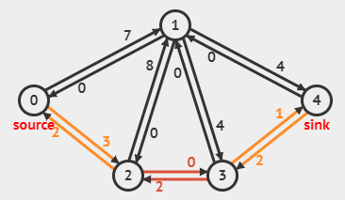
Recap: Ford-Fulkerson (1/2)
Build residual graph R
While ∃ augmenting path P in R
  Let b be the capacity of the bottleneck edge in P
  Add path p with value b to flow
  Update the residual graph R (forward+backward edges)
Build flow incrementally
Max of this iteration
p with b is a legal flow
Example of the residual network of the original input graph after sending a 2-units flow through path 0→2→3→4 with edge 2→3 with capacity 2 as the bottleneck edge

Slide 6
Recap: Ford-Fulkerson (2/2)
Ford-Fulkerson method has several implementations on its augmenting path finding strategies:
"Any augmenting path" (use DFS): O(m² U)
"Fattest Path" (use Dijkstra’s): O(m² log n log F)
Capacity Scaling ("Divide & Conquer"): O(m² log U)
Shortest Path/Edmonds-Karp (use BFS): O(m² n)
  Discussed in details
Level Graph/Dinic’s (use BFS++): O(m n²)
  Discussed in overview
  Notice where the power of 2 resides…

Slide 7
Roadmap
Push-Relabel Algorithm
  Recap about Ford-Fulkerson and its variations…
  Introducing Push-Relabel Algorithm
  Analysis of Push-Relabel Algorithm: O(n² m)
  Implementation note

Slide 8
Research on Max Flow
https://en.wikipedia.org/wiki/Maximum_flow_problem#Algorithms
But Push-Relabel was removed from CLRS 3rd→4th edition…

Slide 9
A New Idea… A Paradigm Shift…
What if we think out of the box and not force our self to always pick legal flow iteratively, as with Ford-Fulkerson methods with various augmenting path finding strategies…
Idea of Push-Relabel:
Push as much flow as possible from the source vertex s
While ∃ vertex with unbalanced flow (flow in > flow out)
  Calculate excess flow in that vertex (flow in - flow out)
  Push some excess flow on an edge in residual graph R
Such flow may not be feasible, so we call it “pre-flow”
Invariant: No s→t path in R
Eventual excess that does not form the final max flow will return to the source vertex s
Idea Summary: This Push-Relabel algorithm thus starts from possibly illegal flows and iteratively make the flows legal
We will see later that when the flow is feasible → we have max flow

Slide 10
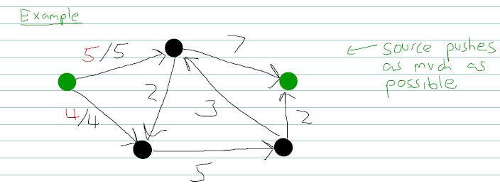
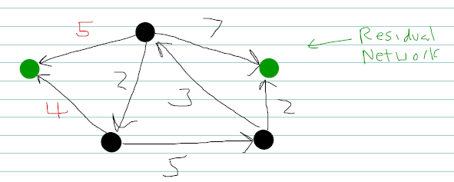
Push-Relabel Preview (1/3)
This algorithm is not yet implemented in VisuAlgo
And this one below is not the full version, so we go manual…
The sum of capacities of all edges that goes out from source s can be the upper bound of max flow value
excess = 5
excess = 4

Slide 11
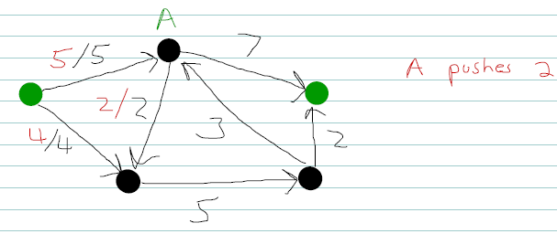
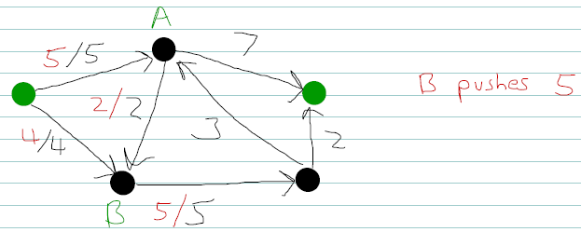
Push-Relabel Preview (2/3)
excess = 5-2 = 3
excess = 4+2 = 6
excess = 3
excess = 5
excess = 6-5 = 1

Slide 12
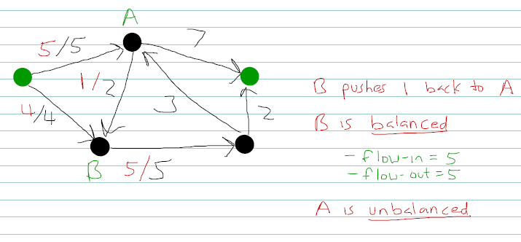
Push-Relabel Preview (3/3)
excess = 3+1 = 4
excess = 5
excess = 1-1 = 0

Slide 13
Definitions
Pre-flow: Assignment flow f(u, v) ≥ 0 to every edge (u, v) ∈ E such that:
∀(u, v) ∈ E, f(u, v) ≤ c(u, v)
// that is, we always satisfy the capacity constraints
∀u ∈ V-{t}, Σ_{z} f(z, u) ≥ Σ_{w} f(u, w)
// that is, flow-in is ≥ flow-out
excess(u) = Σ_{z} f(z, u) - Σ_{w} f(u, w)
Abbreviated as x(u)
If ∀u ∈ V-{s, t}, x(u) = 0, we say the pre-flow is feasible and that is our goal: Push flow (that arrives from source vertex s) around until all x(u) = 0
e(u) in other books but
e and E are too similar

Slide 14
Minor Issue: Cycle
Pushing flow in circle/cycle is problematic…
Try this (A pushes 7 to B, B pushes 7 to C and C pushes 7 back to A):
B
?/8
x(A) = 7
?/1
7/7
A
s
t
?/8
?/8
?/1
C

Slide 15
Another Idea
Cycle is an issue not just in this case Push-Relabel algorithm but also in other various SSSP algorithms,
so can we make it acyclic?
Yes, assign a height h(u) for every vertex u ∈ V and then
use an additional rule so that we can only push a flow
from higher vertices to lower vertices
s
x(A) = 7
This graph is now acyclic, a DAG…, verify!
7/7
?/8
h(s)=5
A
h(B)=2
?/8
B
h(A)=3
?/8
Cannot push flow here
?/1
C
But what if C is unbalanced (x(C) > 0) but its valid outgoing edge (C, t) is already saturated, i.e., f(C, t) = c(C, t)?
h(C)=1
?/1
t
h(t)=0
Notes:
Answer: Relabel that vertex, the second operation of Push-Relabel algorithm
We increase height until that excess can be pushed

Slide 16
Basic Push-Relabel Algorithm (1/3)
Input:
Flow graph G = (V, E) with n vertices and m edges
Source s and sink t
Capacities c
The algorithm (line 1-3 are initializations)
∀u ∈ V, h(u) = 0 // heights start at 0
h(s) = n // source is high, at height n = |V|
∀u ∈ V : (s, u) ∈ E, then f(s, u) = c(s, u)
// source vertex s pushes as much flow
// as possible in order to kick start
// the algorithm

Slide 17
Basic Push-Relabel Algorithm (2/3)
4. while f is not feasible // ∃ u s.t. x(u) > 0
r(u, v) = c(u, v) - f(u, v) + f(v, u) // R
if ∃ u ∈ V-{s, t} and v ∈ V where
x(u) > 0 and // vertex u has excess flow
r(u, v) > 0 and // (u, v) has capacity left
h(u) > h(v) // vertex u is higher than v
then b = min(x(u), r(u, v)) // bottleneck
f(u, v) += b // push b flow, u to v
else choose v : x(v) > 0 // ∃w: r(v, w) > 0
h(v)++ // raise height by 1, a.k.a.
// the relabel operation if we cannot
// push any flow (name is historical)
Notes:
PS: this slide and animation 1-12 is not 100% same as I use queue implementation of unbalanced vertices already? Make it flow a bit

Slide 18
Basic Push-Relabel Algorithm (3/3)
As its name implies, this algorithm has two operations:
Push | Relabel
Line 7-8 There are two possible scenarios in line 7 b = r(u, v), so edge (u, v) in R is at capacity after this saturating push; vertex u becomes balanced only if r(u, v) is also x(u) b != r(u, v) but b = x(u), i.e., all excess flow is pushed by this non-saturating push and vertex u becomes balanced
Line 9-10 Simple, take a vertex with excess flow but which cannot execute line 7-8 and just raise its height by +1 The choice of name of this operation is historical

Slide 19
Full Execution (1/12)
s=0, t=4, Initial flow graph with n=5 vertices and m=7 edges
h(1) = 0
x(1) = 0
0/5
1
0/3
0/6
h(0) = 5
0
0/2
4
0/4
0/2
h(4) = 0
2
0/5
3
h(2) = 0 x(2) = 0
h(3) = 0
x(3) = 0
Notes:
http://static.adrian-haarbach.de/idp-graph-algorithms/maxflow-push-relabel/index_en.html?graph=6

Slide 20
Full Execution (2/12)
s=0, t=4, Residual graph post initialization, Vertex 0 pushes
5+4 units to vertex 1 and 2, both are saturating pushes
Set Unbalanced = {1, 2}
h(1) = 0
x(1) = 5
1
0
0
3
6
5
h(0) = 5
0
0
2
4
4
0
0
2
h(4) = 0
2
5
3
0
0
h(2) = 0 x(2) = 4
h(3) = 0
x(3) = 0

Slide 21
Full Execution (3/12)
Unbalanced = {1, 2}, vertex 1 cannot push anything, relabel 1
Set Unbalanced = {2, 1}
h(1) = 1
x(1) = 5
1
0
0
3
6
5
h(0) = 5
0
0
2
4
4
0
0
2
h(4) = 0
2
5
3
0
0
h(2) = 0 x(2) = 4
h(3) = 0
x(3) = 0

Slide 22
Full Execution (4/12)
Unbalanced = {2, 1}, vertex 2 cannot push anything, relabel 2
Set Unbalanced = {1, 2}
h(1) = 1
x(1) = 5
1
0
0
3
6
5
h(0) = 5
0
0
2
4
4
0
0
2
h(4) = 0
2
5
3
0
0
h(2) = 1 x(2) = 4
h(3) = 0
x(3) = 0

Slide 23
Full Execution (5/12)
Unbalanced = {1, 2}, vertex 1 pushes 5 units to vertex 4
A non-saturating push
Set Unbalanced = {2}
Every non-saturating push will make the excess of the origin vertex back to 0
h(1) = 1
x(1) = 0
1
5
0
3
1
5
h(0) = 5
0
0
2
4
4
0
0
2
h(4) = 0
2
5
3
0
0
h(2) = 1 x(2) = 4
h(3) = 0
x(3) = 0

Slide 24
Full Execution (6/12)
Unbalanced = {2}, vertex 2 pushes 4 units to vertex 3
A non-saturating push
Set Unbalanced = {3}
h(1) = 1
x(1) = 0
1
5
0
3
1
5
h(0) = 5
0
0
2
4
4
0
0
2
h(4) = 0
2
1
3
4
0
h(2) = 1 x(2) = 0
h(3) = 0
x(3) = 4

Slide 25
Full Execution (7/12)
Unbalanced = {3}, vertex 3 cannot push anything, relabel 3
Set Unbalanced = {3}
h(1) = 1
x(1) = 0
1
5
0
3
1
5
h(0) = 5
0
0
2
4
4
0
0
2
h(4) = 0
2
1
3
4
0
h(2) = 1 x(2) = 0
h(3) = 1
x(3) = 4

Slide 26
Full Execution (8/12)
Unbalanced = {3}, vertex 3 pushes 2 units to vertex 4
A saturating push
Set Unbalanced = {3}
h(1) = 1
x(1) = 0
1
5
0
3
1
5
h(0) = 5
0
0
2
4
4
0
0
0
h(4) = 0
2
1
3
4
2
h(2) = 1 x(2) = 0
h(3) = 1
x(3) = 2
A saturating push rarely make the excess of the origin vertex balanced

Slide 27
Full Execution (9/12)
Unbalanced = {3}, vertex 3 cannot push anything, relabel 3
Set Unbalanced = {3}
h(1) = 1
x(1) = 0
1
5
0
3
1
5
h(0) = 5
0
0
2
4
4
0
0
0
h(4) = 0
2
1
3
4
2
h(2) = 1 x(2) = 0
h(3) = 2
x(3) = 2

Slide 28
Full Execution (10/12)
Unbalanced = {3}, vertex 3 pushes 2 unit to vertex 1
A non-saturating push
Set Unbalanced = {1}
h(1) = 1
x(1) = 2
1
5
0
1
1
5
h(0) = 5
0
0
2
4
4
2
0
0
h(4) = 0
2
1
3
4
2
h(2) = 1 x(2) = 0
h(3) = 2
x(3) = 0

Slide 29
Full Execution (11/12)
Unbalanced = {1}, vertex 1 pushes 1 unit to vertex 4
A saturating push
Set Unbalanced = {1}
h(1) = 1
x(1) = 1
1
6
0
1
0
5
h(0) = 5
0
0
2
4
4
2
0
0
h(4) = 0
2
1
3
4
2
h(2) = 1 x(2) = 0
h(3) = 2
x(3) = 0

Slide 30
Full Execution (12/12)
Unbalanced = {1}, vertex 1 cannot push anything and will pushes the last 1 unit excess around cycle 1→2→3,
relabeling the 3 vertices until either {1 or 2} is higher than the source (h(0)=5) to return the unused 1 unit back to source 0
h(1) = 1
x(1) = 1
Some implementations do this part in a more clever way
1
6
0
1
0
5
h(0) = 5
0
0
2
4
4
2
0
0
h(4) = 0
2
1
3
4
2
h(2) = 1 x(2) = 0
h(3) = 2
x(3) = 0

Slide 31
Roadmap
Push-Relabel Algorithm
  Recap about Ford-Fulkerson and its variations…
  Introducing Push-Relabel Algorithm
  Analysis of Push-Relabel Algorithm: O(n² m)
  Implementation note

Slide 32
Analysis Plan
Max height < 2n
# of relabel operations ≤ (2n)*n ≤ 2n²
# of saturating pushes ≤ 2mn
# of non-saturating pushes ≤ 2n²+[2mn]*(2n)
≤ 4n²m
Algorithm terminates after O(n²m) operations and upon termination, ∀u ∈ V-{s,t} has x(u) = 0,
i.e., the flow is feasible
As there is no s→t path left in R, this feasible flow is maximum (proven by Max-Flow/Min-Cut theorem)
Max height
# of relabels
# of saturating pushes
This is the largest,
so it bounds the runtime of Push-Relabel

Slide 33
A1: Max height < 2n
Lemma: If vertex i has excess flow, then there is a path from i to source s in residual network R
This is clearly logical: How else can vertex i get excess flow except from s? But let’s prove it…
Let set A be the set of vertices that can reach back the source vertex s on R
We will show that vertex i that has excess ∈ A
That is, as i is an arbitrary vertex in R, the proof will show that all vertices with excess flow are in set A

Slide 34
Σ_{z∉A} x(z) ≥ 0 // excess flow, if any, cannot be negative
Σ_{z∉A} x(z)
= Σ_{z∉A} (Σ_{u} f(u, z) - Σ_{v} f(z, v)) // by definition of excess
= Σ_{z∉A} Σ_{u} f(u, z) - Σ_{z∉A} Σ_{v} f(z, v) // expansion
= Σ_{z∉A} Σ_{u∉A} f(u, z) + Σ_{z∉A} Σ_{u∈A} f(u, z) // split u to in A/not
- Σ_{z∉A} Σ_{v∉A} f(z, v) - Σ_{z∉A} Σ_{v∈A} f(z, v) // split v to in A/not
= Σ_{z∉A} Σ_{u∈A} f(u, z) - Σ_{z∉A} Σ_{v∈A} f(z, v)
≤ 0
➔ Σ_{z∉A} x(z) = 0, or in another word ∀i : x(i) ≥ 0, i∈A
Flow-in
Flow-out
Cancel each other as u, z, v can be any vertex ∉ A
=0, no flow from u∈A to z∉A by definition, otherwise z∈A
≥0, by definition of flow

Slide 35
Corollaries (1/3)
Push-Relabel algorithm maintains Steepness condition, i.e., for all edges (u, v) ∈ R, we have h(u) ≤ h(v)+1
Corollary: If there is a path from
u to v in R, then h(u) ≤ h(v)+n-1
h(1) = 1
x(1) = 2
1
5
0
3
1
5
h(0) = 5
0
0
2
4
4
0
0
0
h(4) = 0
2
1
3
4
2
h(2) = 1 x(2) = 0
h(3) = 2
x(3) = 0
Longest simple path is at most n-1 edges

Slide 36
Corollaries (2/3)
At all steps, there is no path from s to t in R
Proof by Contradiction
If there were a path, then h(s) ≤ h(t)+n-1
But h(s)=n, h(t)=0, and their height never changes
n ≤ 0+n-1
n ≤ n-1 ?? → contradiction
➔ So once flow f becomes feasible due to Push-Relabel operations, then flow f that disconnects
s from t in R, is a Min Cut = Max Flow
(due to Max Flow/Min Cut Theorem)
Notes:
This can be explained via picture too

Slide 37
Corollaries (3/3)
At all steps, ∀u ∈ V, h(u) ≤ 2n-1
Proof by Contradiction
Let u be a vertex and consider relabel from
h(u) = 2n-1 to h(u) = 2n
Relabel occurs only when x(u) > 0 (and can’t push)
So we know that there is a path from u to s in R
h(u) ≤ h(s)+n-1 ≤ 2n-1
After relabel, h(u) = 2n > 2n-1, but h(u) ≤ 2n-1??
Contradiction, so ∀u ∈ V, h(u) ≤ 2n-1
Of at most n-1 edges

Slide 38
A2: # of relabels ≤ (2n)*n ≤ 2n²
The proof is immediate from A1 and # of vertices n
Initially for any vertex u except u = s, h(u) = 0
From A1, we know that h(u) ≤ 2n-1
So each vertex has at most ≤ 2n-1 relabel operations
There are n vertices in the flow graph
So # of relabel operations is clearly ≤ (2n)*n ≤ 2n²

Slide 39
A3: # of saturating pushes ≤ 2mn
Proof: Consider an arbitrary edge (u, v);
How many saturating pushes can it have?
➔# of saturating pushes for an arbitrary edge (u, v)
≤ 1+(2n-2)/2 ≤ n
➔2m edges in R, so up to ≤ 2mn saturating pushes
r(u, v) = Z
u
v
h(u)=x+1
h(v)=x
Then edge (u, v) can not push anything until a back flow happens that push back flow from v back to u
After a saturating push u→v
r(u, v) = 0
u
v
That back flow can only happen when h(v) is relabeled to x+2
h(u)=x+1
r(v, u) = Z
h(v)=x
h(v)=x+2
First relabel
Max Height (A1)-1 divided by 2 relabels per saturating push

Slide 40
A4: # of non-saturating pushes ≤ 2n²+[2mn]*(2n)
We have now bounded the number of relabel and saturating pushes, but Push-Relabel algorithm may have to do a certain number of non-saturating pushes… Can we bound this too?
Yes, using idea of Potential argument, like in Physics
(also in CS3230 amortised analysis topic)
Show that each non-saturating push makes progress
Define: “Energy” Φ(f) of flow f = Σ_{u: x(u)>0} h(u)
That is, sum of heights of vertices with positive excess
Initially Φ(f) = 0 and after first relabel Φ(f) = 1
But at all times Φ(f) ≥ 0

Slide 41
Charging up Potential Energy Φ(f)
On a relabel, Φ(f) increases by +1 because as we relabel arbitrary vertex u that have x(u)>0, its height h(u) increases by +1, thus Φ(f) increases by +1
On a saturating push, Φ(f) increases by ≤ 2n because a saturating push from edge u to v does not change the height of both u and v, BUT before such push, x(v) = 0 and now x(v) > 0 (and contributes to Φ(f)), but as h(v) ≤ 2n, Φ(f) can only increase by up to 2n
➔ Total increase of Φ(f) due to up to 2n² relabels (A2) and 2mn saturating pushes (A3)
≤ 2n²*1 + 2mn*2n ≤ 2n² + 4n²m

Slide 42
Discharging Potential Energy Φ(f)
On non-saturating push from u to v, we have:
Before:
x(u) > 0 // thus we need to push
x(u) < r(u, v) // as it is non-saturating
h(u) > h(v) // that’s why we can push
After:
x(u) = 0 // vertex u is 'relieved'…
x(v) > 0 // vertex v gets the excess
r(u, v) > 0 // remember, this is non-saturating
h(u) > h(v) // nothing changes here

Slide 43
The Net Effect to Φ(f)
The change in Φ(f):
Increase ≤ h(v) // as x(v) > 0 now and v can be t with h(t)=0
Decrease = h(u) // as x(u) = 0 now
ΔΦ(f) ≤ h(v) - h(u) ≤ -1 // h(u) is taller than h(v)
Φ(f) decreases by at least 1
on every non-saturating push
Since Φ(f) ≥ 0 at all time, and it is initially 0 and increases by ≤ 2n²+4n²m, there are ≤ 2n²+4n²m non-saturating pushes at maximum

Slide 44
Finally….
Corollary: Push-Relabel algorithm will terminate in
O(n² m) – bounded by the max possible non-saturating pushes – as by then ∀u ∈ V-{s,t}, x(u) = 0 and therefore no more pushing or relabeling is needed
When Push-Relabel algorithm terminates, it finds a legal flow f that disconnects source s and sink t in R, so it finds max flow in O(n² m) time

Slide 45
Roadmap
Push-Relabel Algorithm
  Recap about Ford-Fulkerson and its variations…
  Introducing Push-Relabel Algorithm
  Analysis of Push-Relabel Algorithm: O(n² m)
  Implementation note

Slide 46
Implementation
How to efficiently implement Push-Relabel algorithm?
Maintain good data structure for residual graph R (so that we have O(1) updates per push operation)
Maintain a linked list of unbalanced vertices, i.e., those with x(u) > 0 (so that we have O(1) per push)
For each vertex, maintain a circular list of adjacent vertices so that we can push excess flow in a fair manner
  In each step, we start with the first unbalanced vertex in the list. Examine edges in order until we find one with lower height.
  Remember where you stop and restart from there next time.
  If none found, do relabel operation instead.
This is just a sketch… there are other minor technicalities…
There is an O(n³) version of Push-Relabel algorithm
https://en.wikipedia.org/wiki/Push%E2%80%93relabel_maximum_flow_algorithm#Active_node_selection_rules

Slide 47
Sample Implementation
See available sources in the Internet
e.g., refer to Stanford’s ICPC team for O(n³) Push-Relabel implementation
https://github.com/jaehyunp/stanfordacm/blob/master/code/PushRelabel.cc

Slide 48
Roadmap/Summary
Push-Relabel Algorithm
  Recap about Ford-Fulkerson and its variations…
  Introducing Push-Relabel Algorithm
  Analysis of Push-Relabel Algorithm: O(n² m)
  Implementation note
All the best for your Final
PS: there will be some “simple” Push-Relabel questions as MCQs in the final

