Slide 1
A GPU Accelerated Algorithm for 3D Delaunay Triangulation
Thanh-Tung Cao, TODD
Mingcen Gao
Tiow-Seng Tan
National University of Singapore
Ashwin Nanjappa
Bioinformatics Institute Singapore

Slide 2
Outline
→ Background
Background
Related work
Algorithm
Implementation
Result

Slide 3
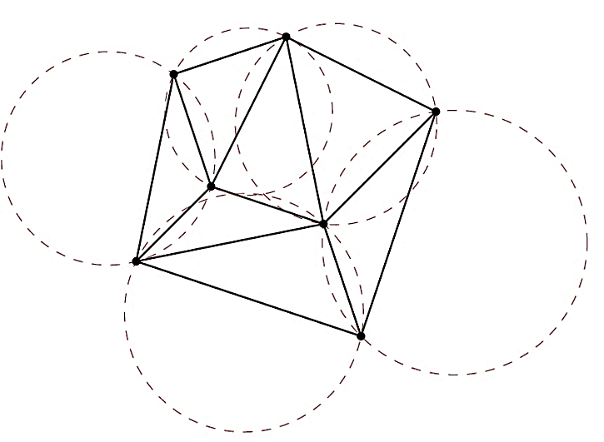
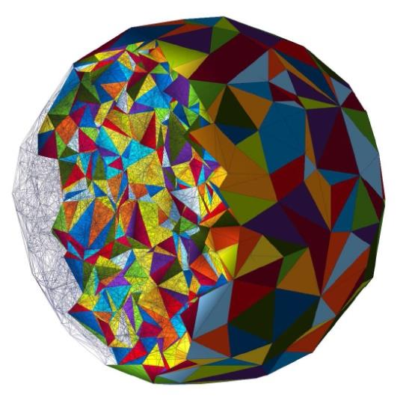
Background
Outline ←
Delaunay Triangulation
Empty ball property
2D
3D
⇒ Applications
Notes:
Input: A point set; Output: A tessellation of the convex hull.

Slide 4
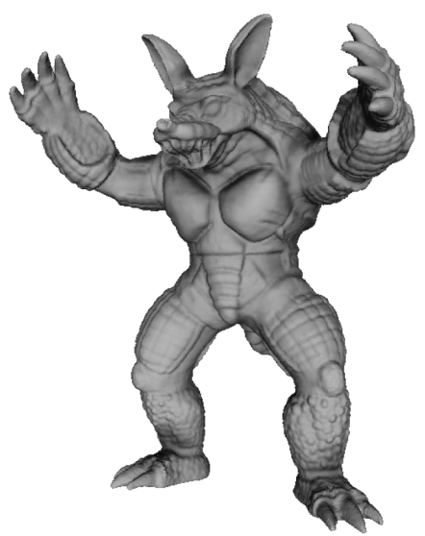
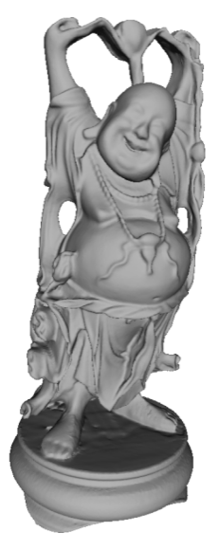
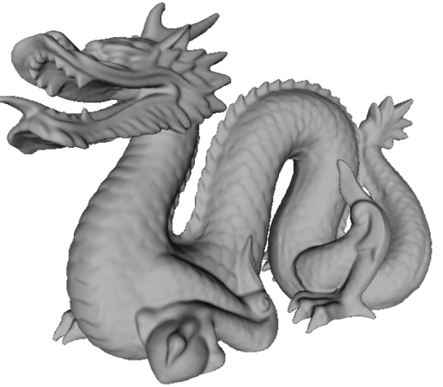
Background
→ Related work
Applications:
Graphics
CAD
Visualization
Scientific computation
⇒ Sequential algorithms
Notes:
Useful for mesh generation

Slide 5
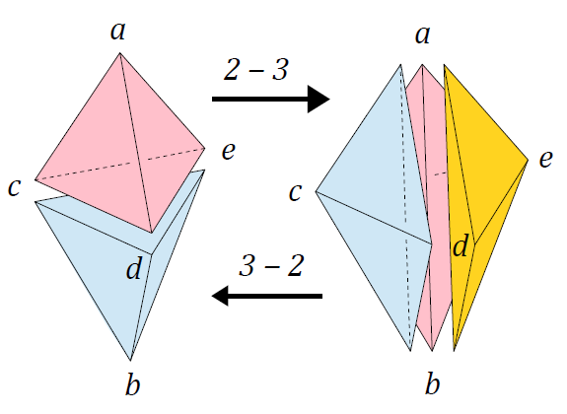
Related work
Background ←
Sequential algorithms:
Incremental construction
Divide-and-conquer
Incremental insertion
Points are inserted one by one
Triangulation is locally fixed after each insertion
Bowyer-Watson’s algorithm [1981]
Flipping algorithm [Joe 1991]
⇒ Parallel algorithms

Slide 6
Related work
Parallel and multi-core algorithms:
Incremental construction → high complexity
Domain partitioning → GPU needs thousands of partitions
Incremental insertion [Batista et al. 2010]
Several points are inserted at a time
Each insertion modifies a small region
Conflict → Rollback
⇒ GPU algorithms
Notes:
Domain partitioning algorithms are used in distributed setting. Incremental insertion: typically 8-16 points are inserted in parallel.

Slide 7
Related work
→ Algorithm
GPU algorithms:
Experiment with Batista et al.’s approach
1 million points
At most 2000-3000 points can be inserted in each round
Digital Voronoi diagram approach [Qi et al. 2012]
Dualization not working in 3D
⇒ Our algorithm
Notes:
Needs too many iterations → Too many CPU-GPU synchronization and communication.

Slide 8
Algorithm
Related work ←
Overall approach:
Insert points in batches, each batch at most one point is inserted into a tetrahedron
Use flipping to get close to the DT
Use star-splaying in CPU to fix [Shewchuk 2005]
Problem: Flipping easily gets stuck!
100K points, ≈ 6,800 bad facets
(non-Delaunay and unflippable).
Worse for real-world data.
⇒ Insert - Flip
Notes:
Only needs around 10-15 rounds of insertion. Not yet feasible for star splaying correction.

Slide 9
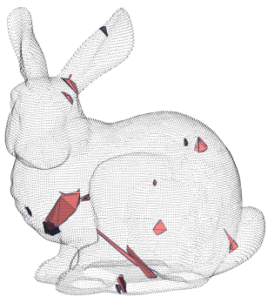
Algorithm
Observation:
Do flipping after each round of point insertion
→ Much better result.
100K points, 96 bad facets (vs. 6,800)
Bunny model (36K points), 92 bad facets
Now correction on CPU is acceptable.
⇒ Star splaying
Notes:
Resulting triangulation is probably good enough for a quality mesh generation algorithm.

Slide 10
Algorithm
CPU correction: star splaying algorithm
Lifting map: w = x² + y² + z²
Each vertex: construct a convex star.
Consistency: If the star of s contains tetrahedron stuv, then the star of t, u, and v must also contain that tetrahedron.
u
u
t
s
s
t
r
v
2D illustration
⇒ Difficulties
Notes:
If inconsistent, insert u and v into the star of t using beneath-beyond algorithm to maintain convexity.

Slide 11
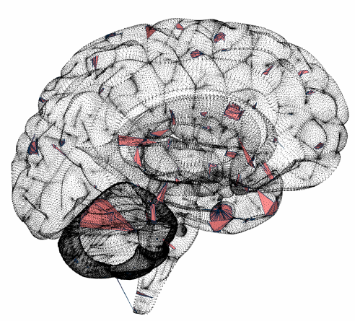
Algorithm
CPU correction: star splaying algorithm
Difficulties: Time consuming
Construct convex stars (incremental insertion)
Check all the stars for inconsistencies
Convert stars back to mesh
representation
⇒ Adaptive star splaying

Slide 12
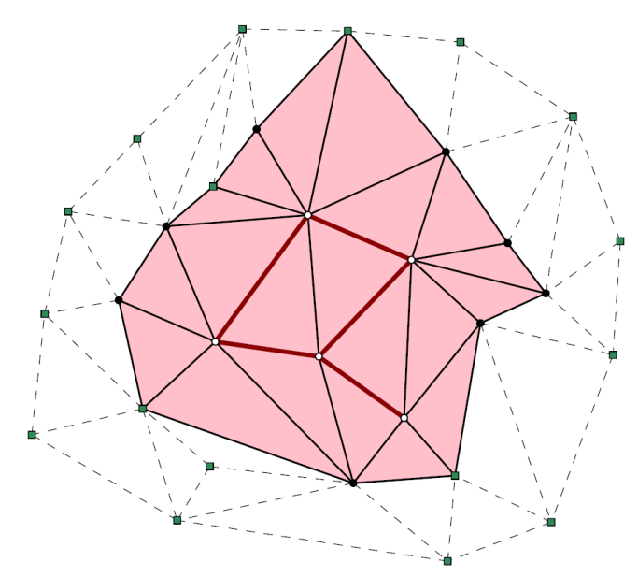
Algorithm
Adaptive star splaying
Only some small regions around the bad facets are processed
Construct stars incident to the bad facets.
Almost convex → use Flip-Flop [Gao et al. 2013]
Need another star → derive from the triangulation.
Almost output sensitive.
Non-Delaunay & unflippable
Non-convex stars
Affected region
2D illustration
⇒ Pseudo-code

Slide 13
GPU Implementation
Algorithm ←
Initialize;
While there are points not inserted
Pick one point per tetrahedron and insert;
While there are modified tetrahedra
Collect the modified tetrahedra;
Process and identify possible flips;
Perform the flips;
Update location of remaining points;
⇒ Divergence

Slide 14
GPU Implementation
Thread divergence:
Compact the list of modified tetrahedra before processing
Exact predicates [Shewchuk 1996]
Use only fast check in 1st kernel
Collect those that require exact computation
Do the exact computation in 2nd kernel
Point location:
Store the flips, build flip history DAG
Trace the DAG to locate
⇒ Memory

Slide 15
GPU Implementation
→ Result
Memory access:
Rearrange the data to improve the GPU cache efficiency.
Sort the input points by the Z-curve
Sort the tetrahedra list by the minimum vertex indices.
⇒ Experiment setting
Notes:
Sorting point list good for point location.

Slide 16
Result
Implementation ←
Experiment settings:
CPU: Intel I7 2600K 3.4Ghz, 16GB RAM
GPU: NVIDIA GTX 580, 3GB VRAM
CUDA 5.0, VS 2012.
CGAL 4.2
⇒ 3D Speedup

Slide 17
Result
3D Speedup:
Synthetic data: Uniform, Gaussian, sphere, grid.
Up to 1.5 million points
8-10 times faster than CGAL
Real models: Armadillo, Angel, Dragon, Happy Buddha…
6-9 times speedup over CGAL
⇒ 2D Speedup

Slide 18
Result
Also implement for 2D DT:
Synthetic data:
10 times over Triangle, 7 times over CGAL
2 times faster than [Qi et al. 2012]
⇒ Time breakdown

Slide 19
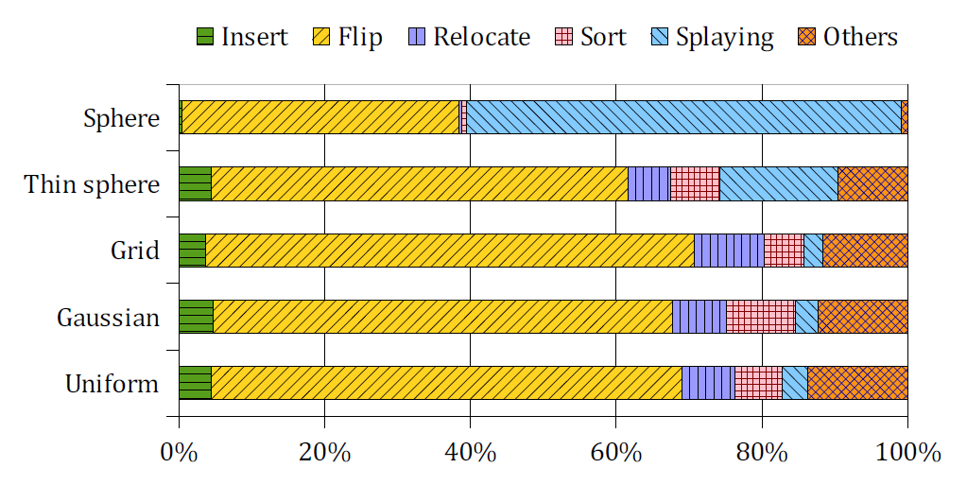
Result
Time breakdown
⇒ Insert-Flip vs. InsAll-Flip
Notes:
Take note on the splaying time.

Slide 20
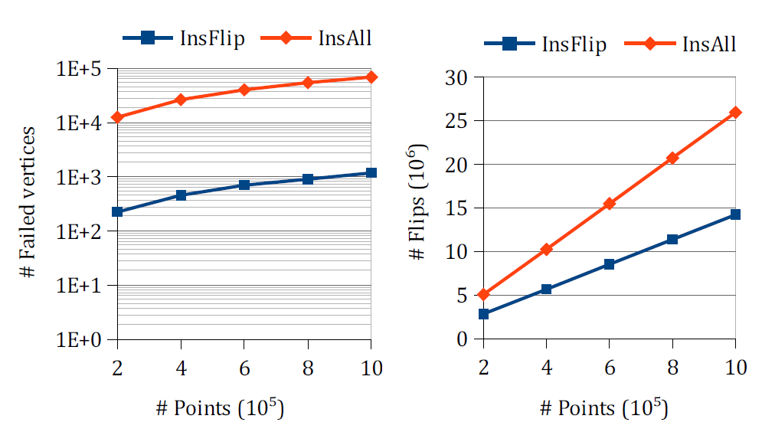
Result
→ Conclusion
Insert-Flip vs. InsertAll-Flip
100 times less bad facets
40% less flips
⇒ Conclusion
Notes:
Consider skipping if out of time.

Slide 21
Conclusion
Result ←
New algorithm for DT construction on GPU
Both 2D and 3D (possibly higher)
Uniform and non-uniform point set
Exact computation, robust.
Limitation:
Needs to copy the result to CPU for splaying
Sequential flipping on some pathological cases
Memory bound implementation
⇒ END

Slide 22
End
Thank you!

Slide 23
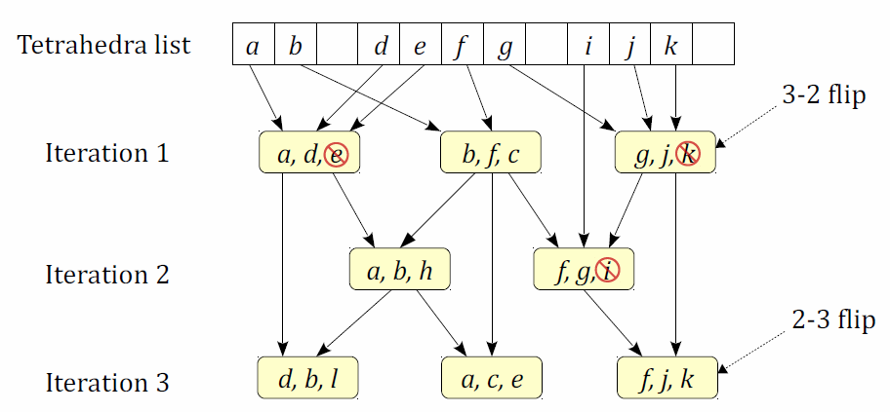
GPU Implementation
Point location:
Store the flips in all the iterations
Construct the history DAG of flips
Update the point location at the end
⇒ Memory access
Notes:
Updating the point location after each round of flipping is not efficient. Use DAG to trace the new location of each point.

Slide 24
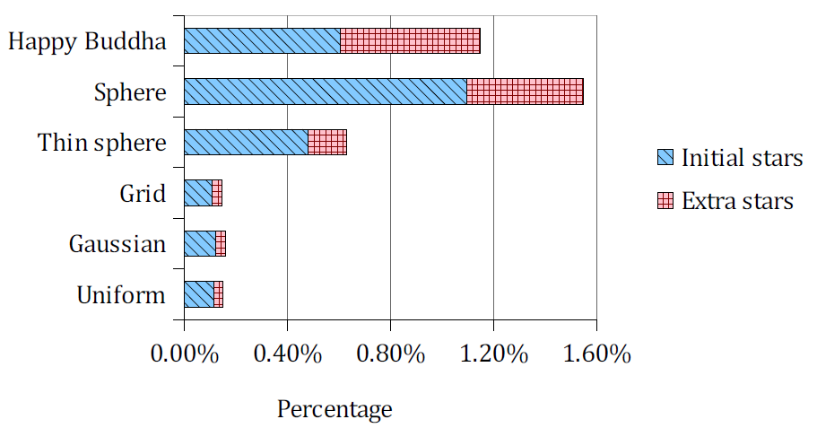
Result
Stars involved in the CPU star splaying
Significantly more for non-uniform point sets
Still reasonably small
⇒ Insert all - Flip

