Slide 1

Computing Delaunay Refinement Using the GPU
Zhenghai CHEN, Meng QI and Tiow-Seng TAN
Feb. 26, 2017
Notes:
1
1

Slide 2
Outline
Introduction
Literature Review
Our Algorithm: gQM
Proof of Termination
Experiment Results

Slide 3
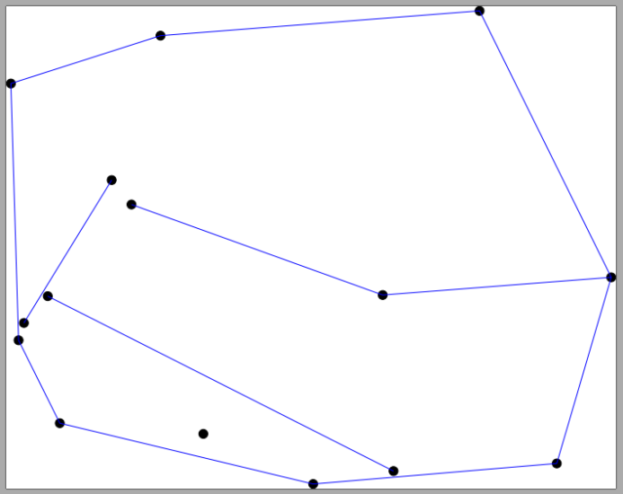
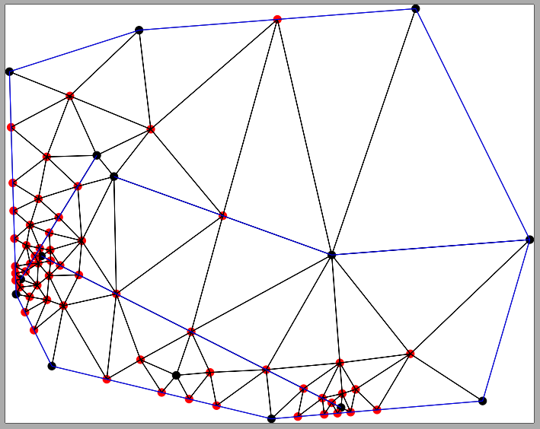
Introduction
Delaunay refinement problem:
Input: a planar straight line graph (PSLG) and an angle 𝛳
Output: a constrained Delaunay triangulation (CDT) with no angles smaller than 𝛳 (by adding Steiner vertices where needed)
Two Issues
Process has to terminate
Manage number of Steiner points

Slide 4
Introduction - contributions
The first GPU Delaunay refinement algorithm with PSLG as input.
A few times to an order of magnitude faster than the best CPU implementation, Triangle [Shewchuk 96].
Output by our algorithm is of a similar size to that by Triangle.

Slide 5
Literature Review
Two famous sequential algorithms
Ruppert’s (1995)
Chew’s (1993)
Two software
Triangle (CPU, by Shewchuk, 1996)
Galois (GPU, by Nasre, 2013)
Current work extends on our previous ones:
gDel2D I3D 2012
Flipflop I3D 2013

Slide 6
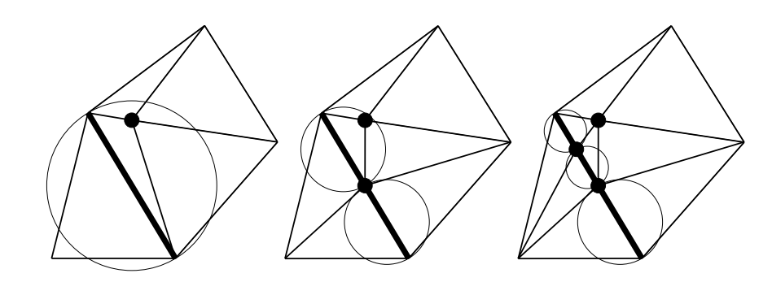
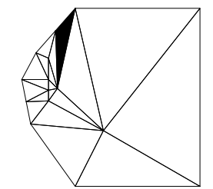
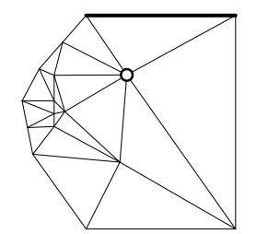
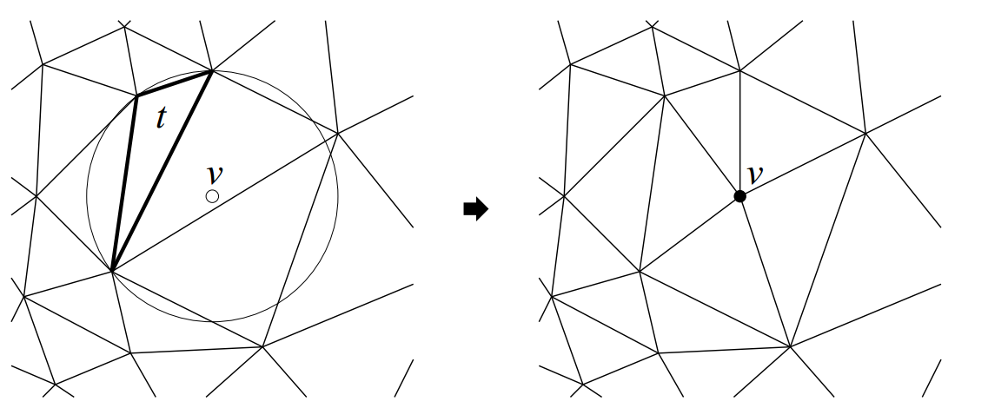
Literature Review
Ruppert’s algorithm (1995) : two main steps
Split encroached (input) segments.
Split bad triangles. Insert and reject points.
a
p
a
p
a
p
d
c
c
b
b
b
a
b
a
b
Split bad triangle t
Reject encroaching point

Slide 7
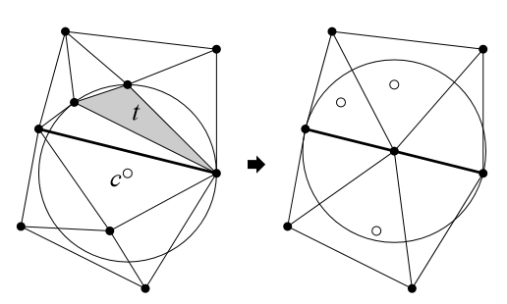
Literature Review
Chew’s algorithm (1993) : two main steps
Split bad triangles. Insert and reject points.
Split segments and remove redundant points.
a
a
b
c is circumcenter
of bad triangle t
redundant points indicated as hollow

Slide 8
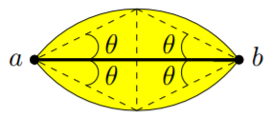
Literature Review
Triangle (CPU, by Shewchuk, 1996)
The fastest CPU Delaunay mesh generator.
Unify Ruppert’s and Chew’s to a certain extent.
Galois (GPU, by Nasre, 2013)
Handle point set as input
a
b
Diametral len for
Chew’s mode
Diametral disk for
Ruppert’s mode

Slide 9
Our Algorithm: gQM
gQM (GPU) and Triangle (CPU) differ in three aspects besides parallel vs sequential:
Unify Ruppert's and Chew's fully
Adapt neatly FlipFlop algorithm [I3D 2013] to discover encroachment and to remove redundant Steiner points
Before insertion, selective in inserting Steiner points to avoid roll back

Slide 10
Our Algorithm: gQM
gQM (GPU)
Split encroached segments and remove redundant points
Split bad triangles with “independent” points
Triangle (CPU)
Split encroached segments. Under Chew's mode, remove redundant points
Split bad triangles. Insert circumcenters and reject encroaching points
The only difference of two modes:
Ruppert’s: Diametral disk
Chew’s: Diametral len

Slide 11
Our Algorithm: gQM
gQM
Split encroached segments and remove redundant points
Triangle
Split encroached segments. Under Chew's mode, remove redundant points
a
b
a
a
b
b

Slide 12
Our Algorithm: gQM
gQM
Split encroached segments and remove redundant points
Triangle
Split encroached segments. Under Chew's mode, remove redundant points
a
b

Slide 13
Our Algorithm: gQM
gQM
Split encroached segments and remove redundant points
Triangle
Split encroached segments. Under Chew's mode, remove redundant points
a
b

Slide 14
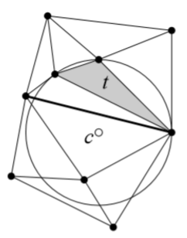
Our Algorithm: gQM
gQM
Split bad triangles with “independent” points
Filter points:
Point location
Compute Delaunay “independent” points
Triangle
Split bad triangles. Insert circumcenters and reject encroaching points
a
b
a
b
Ruppert’s
Chew’s

Slide 15
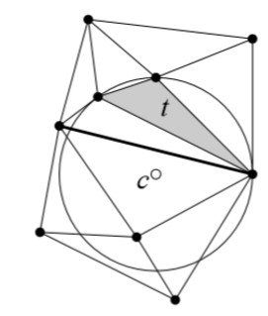
Our Algorithm: gQM
gQM
Split bad triangles with “independent” points
Always insert these points regardless whether encroaching or not
Triangle
Split bad triangles. Insert circumcenters and reject encroaching points
a
a
FlipFlop:
to maintain CDT and mark encroached segments
b
b

Slide 16
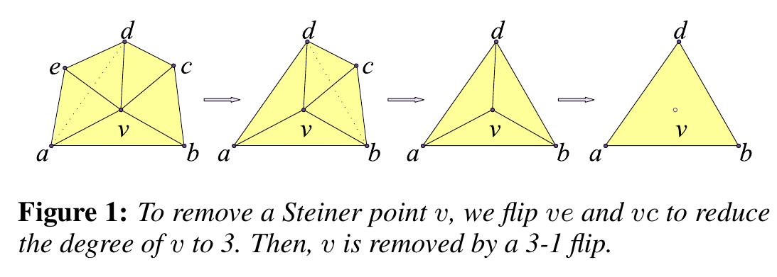
Our Algorithm: gQM
Flipflop [Gao: I3D2013]
Flip to Delaunay; flop to remove point
Maintain CDT, remove redundant points and update encroachment situation using parallel flipping

Slide 17
Proof of Termination
Never introduce an edge shorter than some constant (feature size)
Every iteration inserts at least one point
Finite underlying space
of the triangulation
Terminate
No more bad triangles

Slide 18
Experiment Results
Intel i7-6700 3.4GHz CPU and GTX980 Ti graphics card
Generate random PSLGs on the uniform, Gaussian, disk and circle distributions
The number of points ranges from 50,000 to 100,000
Number of segments ranges from 10 to 50% of number of points
Minimum allowable angle 𝜃 = 15°, 20°, 25°

Slide 19
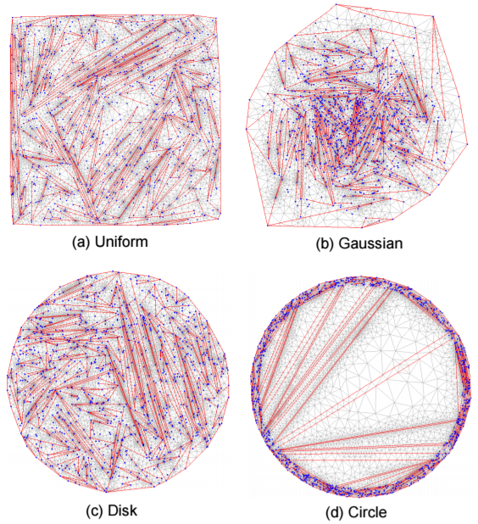
Experiment Results
Output samples of synthetic data
Input segments in red
Steiner points in blue
points lie in the ring formed by two circles
all points lie inside a disk

Slide 20

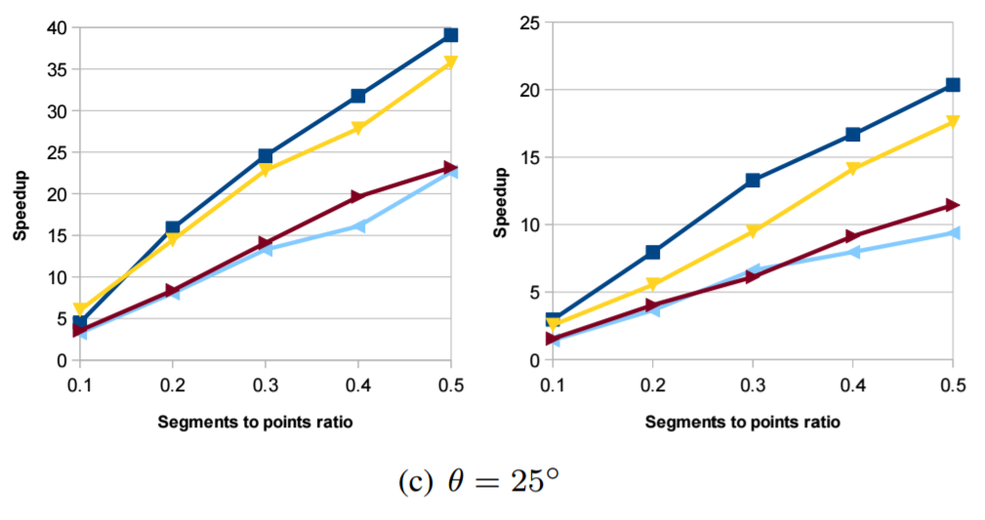
Experiment Results
The speedup of gQM over Triangle for 100K input points
and 10K to 50K input segments
Ruppert’s
Chew’s

Slide 21
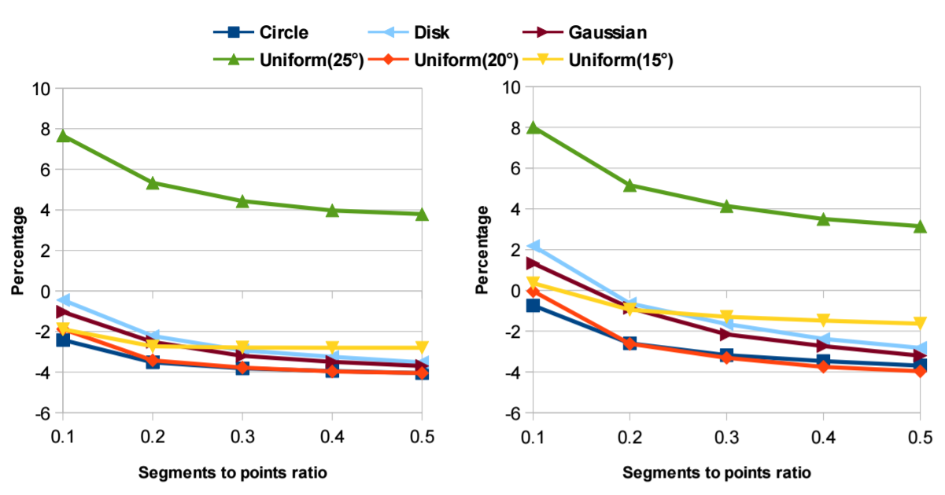
Experiment Results
The percentage of extra points in the output mesh of
gQM compared to Triangle with 100K input points and 10K to 50K segments.
Ruppert’s
Chew’s

Slide 22
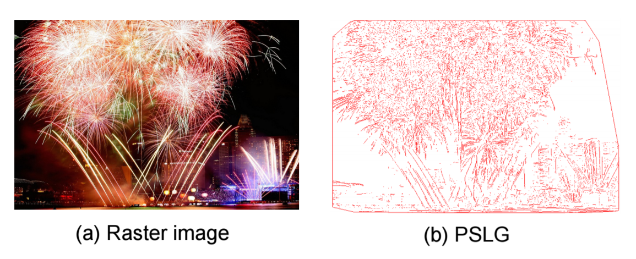
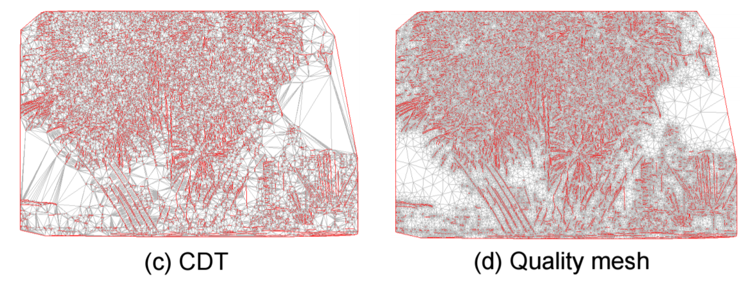
Experiment Results
non-synthetic data:

Slide 23
Project Website
http://www.comp.nus.edu.sg/~tants/gqm.html
Q & A

