Slide 1

Using Throughput-Centric Byzantine Broadcast to Tolerate Malicious Majority in Blockchains
Ruomu Hou Haifeng Yu Prateek Saxena
National University of Singapore
{houruomu, haifeng, prateeks}@comp.nus.edu.sg
presenter: Ruomu Hou

Slide 2
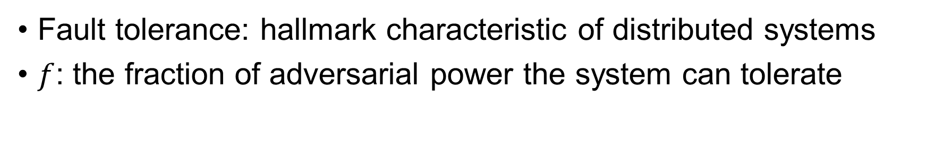
Background on modern blockchains
Fault tolerance: hallmark characteristic of distributed systems
$f$: the fraction of adversarial power the system can tolerate
Proof of Work
Proof of Stake
Permissioned
$
$
✓
✓
$
$
✓
！
% of computational power
% of stake
% of nodes
e.g. Bitcoin: f < 0.5
Algorand: f < 0.33

Slide 3
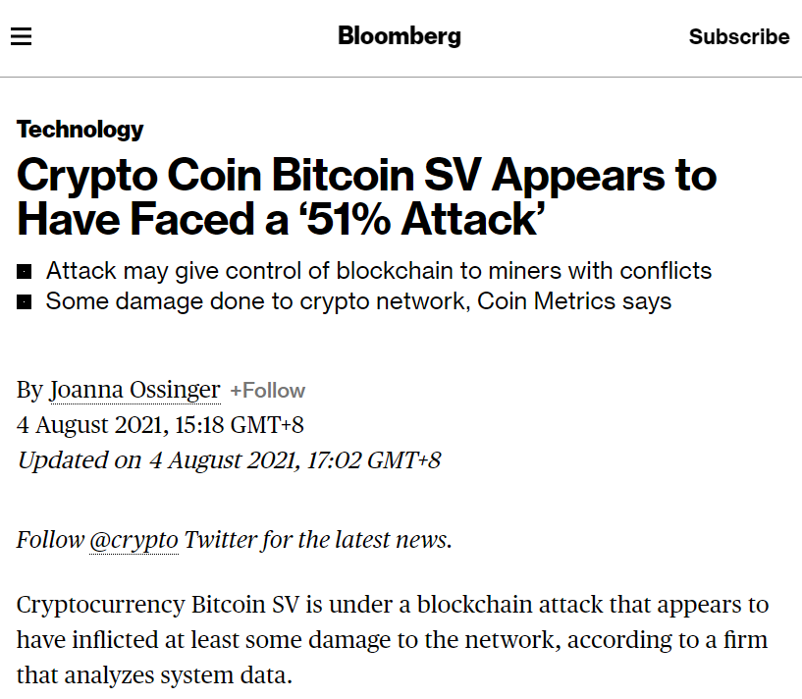
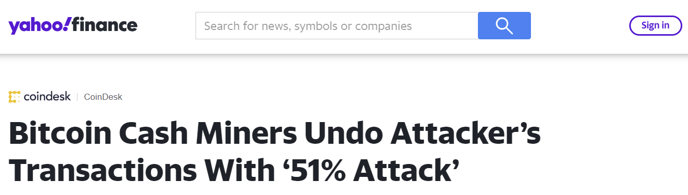
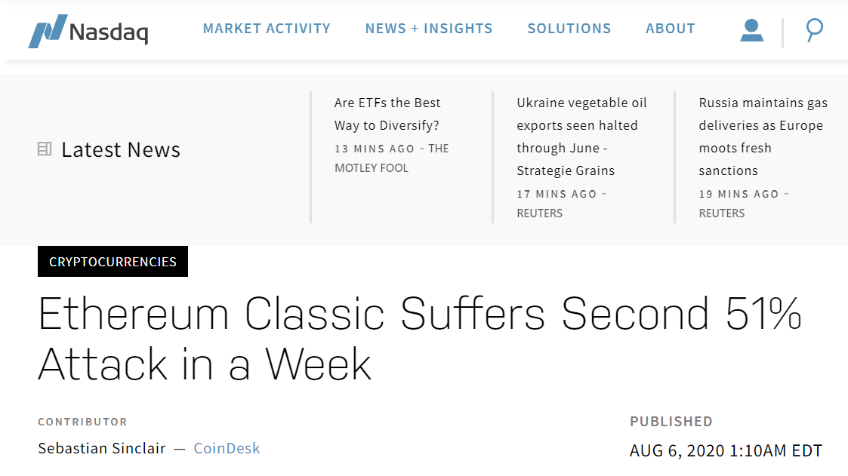
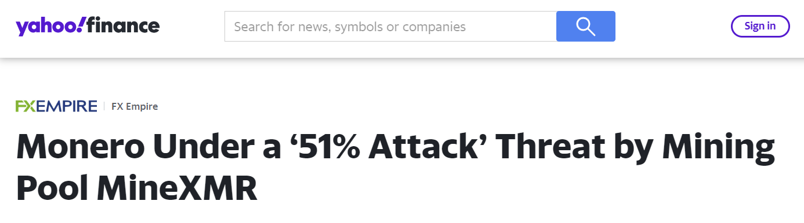

Tolerating malicious majority is desirable
Blockchain systems today are still limited to $f$<0.5
We start to see double-spending attacks, where the adversary manages to have $f$ above 0.5
Centralized miners controlling more than half of the mining power
https://sg.finance.yahoo.com/news/bitcoin-cash-miners-undo-attacker-211718397.html
https://www.bloomberg.com/news/articles/2021-08-04/crypto-coin-bitcoin-sv-appears-to-have-suffered-a-51-attack
https://sg.finance.yahoo.com/news/monero-under-51-attack-threat-182244867.html
https://www.nasdaq.com/articles/ethereum-classic-suffers-second-51-attack-in-a-week-2020-08-06

Slide 4
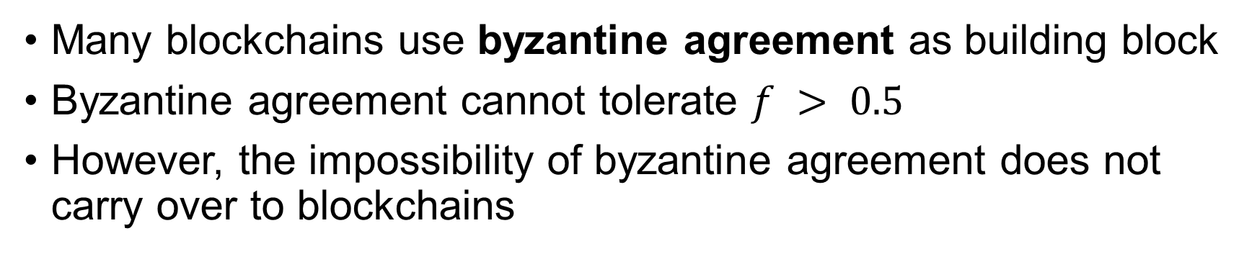
Impossible?
Many blockchains use byzantine agreement as building block
Byzantine agreement cannot tolerate $f > 0.5$
However, the impossibility of byzantine agreement does not carry over to blockchains
X
input
honest node
Y
Byzantine Agreement
X
One-shot game
X
malicious node
Z
…Z X
input
Blockchain
…W Y
…
A sequence of blocks
X
Y
Z
W
…Z X
…W Z

Slide 5

Our work: BCube
First blockchain system that tolerates majority failure (e.g. $f=0.7$) while providing practically-usable performance
Use byzantine broadcast as the core
  A broadcaster (may not be honest) broadcasts a block to all nodes
All honest nodes agree on a block
If the broadcaster is honest, all honest nodes agree on the broadcaster’s block
X
X
Broadcaster
X
X
Byzantine broadcast is solvable even for $f>0.5$

Slide 6
Build a blockchain with byzantine broadcast
1. Choose a random node as block proposer to construct a block
2. Proposer disseminate the block using byzantine broadcast
3. Nodes add the received block into blockchain
A
A
choose
Genesis Block
A
G
A
A
nodes
blockchain

Slide 7
Build a blockchain with byzantine broadcast
1. Choose a random node as block proposer to construct a block
2. Proposer disseminate the block using byzantine broadcast
3. Nodes add the received block into blockchain
B
B
G
A
B
choose
B
B
nodes
blockchain

Slide 8
Key obstacle: Low throughput
Throughput: total transactions/sec
  E.g. 10M-bits block every 1 minute -> 10M/60 = 167Kbps
Low throughput if built with existing protocols
  E.g. using Dolev-Strong byzantine broadcast protocol in our experiment setting, we only get 0.072Kbps

Slide 9
Our technical contributions in BCube
A novel byzantine broadcast protocol OverlayBB
  Orders of magnitude higher throughput than existing protocols
Our BCube blockchain uses OverlayBB as the core
  Experiment with 10000 nodes
  Tolerates majority failure (e.g. f=0.7)
  Practically usable throughput (e.g. 163Kbps)
2000x higher than what we would achieve with the existing protocol

Slide 10
Roadmap
System and attack model
Overview of BCube
OverlayBB
Security analysis
Experimental results

Slide 11
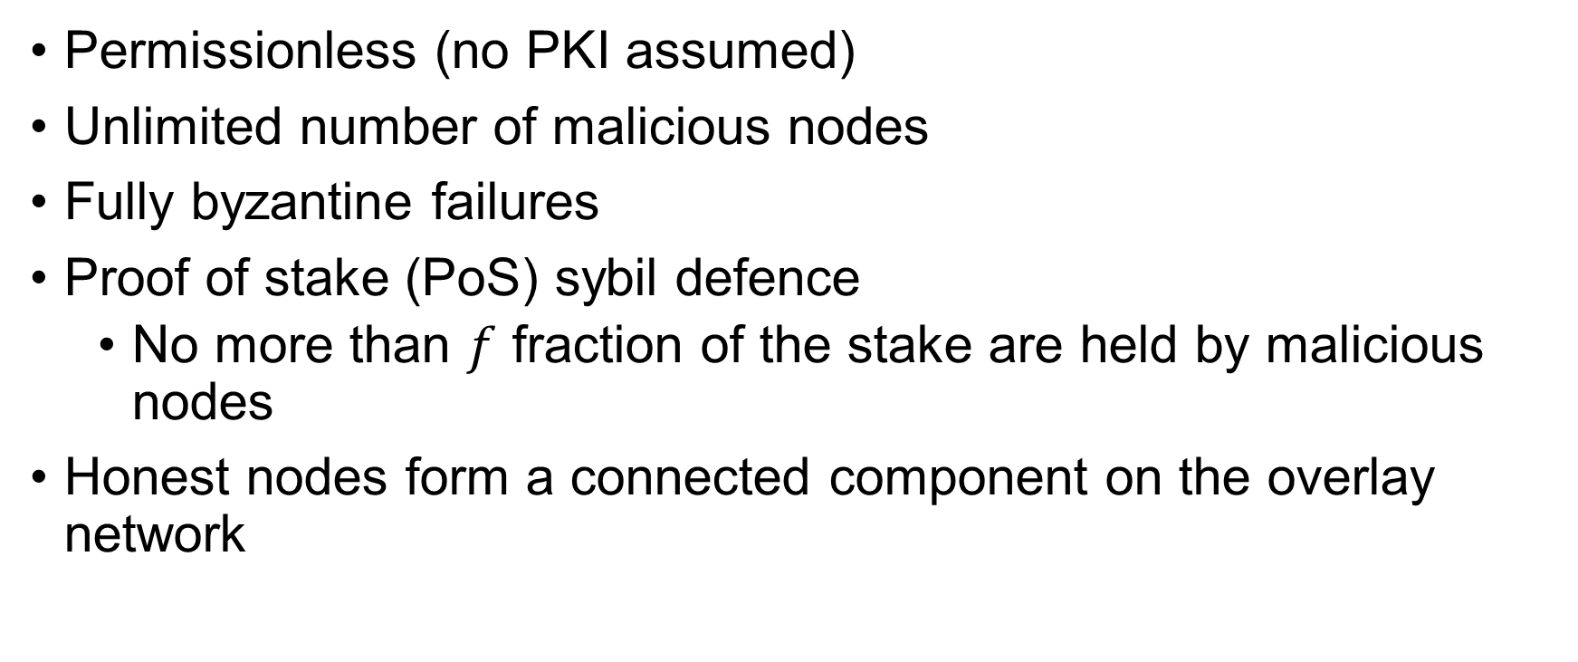
System and attack model
Permissionless (no PKI assumed)
Unlimited number of malicious nodes
Fully byzantine failures
Proof of stake (PoS) sybil defence
  No more than $f$ fraction of the stake are held by malicious nodes
Honest nodes form a connected component on the overlay network

Slide 12

Overview of BCube
1. form the next block
2. disseminate the block using OverlayBB
wait some time (e.g. 1 minute)
3. nodes add the received block into blockchain
wait some time (e.g. 1 minute)
wait some time (e.g. 1 minute)
A
C
A
B
owner
owner
choose
choose
choose
Random
Beacon
Random
Beacon
Random
Beacon
owner
C
A
C
C
Genesis
A
B
C
A
B
B
B
stake
nodes
blockchain
OverlayBB (byzantine broadcast) gives:
Security of BCube (safety and liveness)
All honest nodes agree on a block
If the broadcaster is honest, all honest nodes agree on the broadcaster’s block

Slide 13






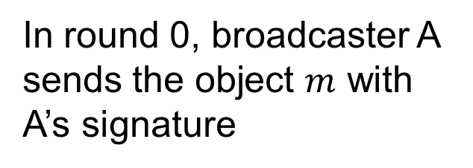


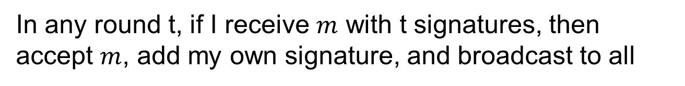

Example BB protocol prior to OverlayBB
Dolev-Strong protocol
In round 0, broadcaster A sends the object $m$ with A’s signature
In any round t, if I receive $m$ with t signatures, then accept $m$, add my own signature, and broadcast to all
t signatures
$$m$$
$$σ_{A}$$
By forwarding, the node ensures all other nodes accept the object
$$m$$
$$σ_{A}$$
…
$$σ_{X}$$
A
B
$$m$$
$$σ_{A}$$
…
$$σ_{X}$$
$$σ_{B}$$
Round 0
Round t
t+1 signatures

Slide 14
Problem of the existing protocols
execution of byzantine broadcast on a given node
Any given honest node only utilizes 1 round to send the object
If there are 500 rounds, then the bandwidth in the other 499 rounds are wasted
Naïve parallelization wouldn’t work
a single instance
many parallel instances
e.g. 500 rounds
Adversary align the utilized rounds
utilized round
…………
Most rounds are wasted
Most rounds are utilized now
Most rounds are not utilized !!

Slide 15




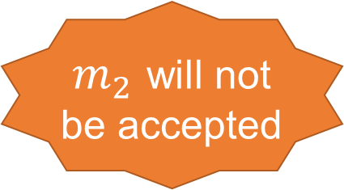

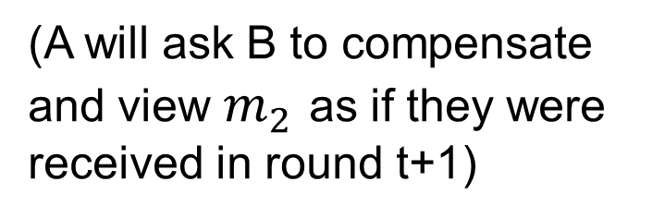




OverlayBB’s idea: delay and compensate
Idea: when multiple instances utilize the same round, delay the send in some instances
Observation: sender can ask the receiver to compensate for the delay, because sender is busy sending other pieces.
…
$m_{2}$ will not be accepted
t+1 signatures
t+1 signatures
$$m_{1}$$
t signatures each
$$m_{2}$$
$$m_{3}$$
$$m_{2}$$
…
…
(A will ask B to compensate and view $m_{2}$ as if they were received in round t+1)
…
$$m_{1}$$
$$m_{9}$$
$$m_{9}$$
$$m_{2}$$
$$m_{9}$$
A
B
A
B
A
B
round t
round t+1
round t+2

Slide 16











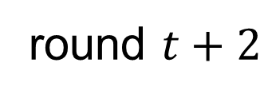





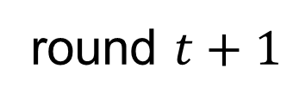


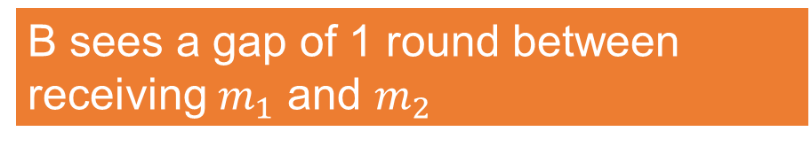



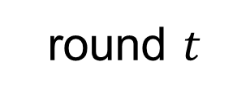
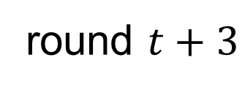
OverlayBB’s idea: delay and compensate
Compensation gets complicated on the general topology
$$C_{1}$$
$$m_{1}$$
$$C_{1}$$
$$m_{1}$$
$$C_{1}$$
$$C_{1}$$
$$m_{2}$$
$$A$$
$$B$$
$$A$$
$$B$$
$$A$$
$$B$$
$$A$$
$$B$$
$$C_{2}$$
$$C_{2}$$
$$m_{1}$$
$$C_{2}$$
$$m_{2}$$
$$C_{2}$$
round $t$
round $t+1$
round $t+2$
round $t+3$
Apply theoretical results in network propagation to compensation properly
B sees a gap of 1 round between receiving $m_{1}$ and $m_{2}$

Slide 17
More challenges in delay/compensation
To lower overheads, OverlayBB runs over a committee
The delay / compensation behaviour of non-committee nodes need to be treated carefully on the overlay network
malicious, non-committee
honest, non-committee
malicious, committee
honest, committee
See our paper for more details

Slide 18
Some other technical highlights
[Injection attack] To avoid certain injection attack, the relaying nodes in OverlayBB filter the objects using prediction
[Commit to 1 object] The adversary may broadcast more than one object in an instance. We have a novel way for the broadcaster to commit to one object
[Beacon generation] Under malicious majority, it is easier to do a “grinding attack” that bias the beacon. We use a novel beacon generation mechanism that deals with the attack
See our paper for details

Slide 19
Security analysis
Theorem [Informal] OverlayBB is a correct Byzantine Broadcast:
In OverlayBB, if the committee has at least 1 honest node:
[Safety] All honest nodes must return the same object.
[Validity] If the broadcaster is honest, then all honest nodes must return the object broadcast by the broadcaster.
[Termination] all honest nodes terminate
Theorem [Informal] BCube is a correct Blockchain:
[Safety] All nodes agree on each block in the blockchain, except with negligible probability
[Liveness] New blocks are added to the blockchain regularly

Slide 20
Experimental setting
Implemented in Go, using TCP for communication
Real experiment, not a simulation
10000 BCube nodes
20Mbps bandwidth for each node
Overlay: each node forming 20 random outgoing edges

Slide 21
Experiment results
BCube has practically usable performance under $f=0.7$
Baseline: replacing OverlayBB with state-of-the-art byzantine broadcast protocol
f = 0.4
f = 0.5
f = 0.6
f = 0.7
baseline

Slide 22
Conclusion
BCube: the first blockchain system that can tolerate majority failure while achieving practically-usable performance
Prototype implementation and experiments
Formal security analysis
OverlayBB: a byzantine broadcast protocol that achieves much higher throughput than the state-of-the-art

