Slide 1
The Cost of Fault Tolerance in
Multi-Party Communication Complexity
Binbin Chen Advanced Digital Sciences Center
Haifeng Yu National University of Singapore
Yuda Zhao National University of Singapore
Phillip B. Gibbons Intel Labs Pittsburgh

Slide 2
The Central Question
Multi-party communication complexity:
  Minimum communication (# of bits) needed to compute f () over inputs held by distributed players connected by some topology
  Focus is usually on lower bounds
Fault-tolerant (multi-party) communication complexity: Allow player crash failures
If we want to compute f in a fault-tolerant way, what will the communication complexity be?
While natural, this question has never been formally posed/ studied – see paper for possible reasons…

Slide 3
Make the Question Meaningful
Restriction 1: Some special root player never fails and only the root needs to know the answer
Restriction 2: Allow the computation to ignore inputs held by players that have failed or disconnected from the root
All these restrictions make our lower bounds stronger…

Slide 4
One-Sentence Summary of Our Result
Our result: Exponential communication complexity blowup in order to tolerate failures, for some functions
  E.g, Sum, Median, etc, …
  Other functions (e.g., Max) do not have any blowup
Implications: Fault-tolerant communication complexity needs to be studied separately
  New topic ripe with interesting open questions

Slide 5
The Sum Function
Each non-root node may experience crash failure
  Total up to failures – see paper for further relaxation of this assumption
  No messages losses
  Ignore collision here -- paper considers collision
  Synchronous timing model
root
(never fails)
Wireless networks with arbitrary N-node topology,
topology known to all nodes

Slide 6
The Sum Function
root
(never fails)
0
1
Each node has a bit, root wants to know sum
Allow randomization, allow public coins
0
1
1
1
0
1
Given a protocol for computing Sum, let a_{i} be the number of bits sent by node i.
Protocol’s CC is the maximum a_{i} across all i’s, when running the protocol over the worst-case N-node topology.
Sum’s CC is the minimum CC, taken across all protocols’ CC.

Slide 7
Non-Fault-Tolerant
Communication Complexity of Sum
root
(never fails)
0
1
1
1
Correctness Definition
zero-error sum: 5
(ε, δ)-approximate sum: any s
where Pr[ |s − 5| > ε∙5 ] < δ
2
0
0
3
1
1
1
1
0
1
1
Well-known tree-aggregation protocol can generate
zero-error sum, incurring O(logN) CC
(ε, δ) sum, incurring O(log(1/ε)) CC
  (for constant δ and ignoring loglog term)

Slide 8
Fault-Tolerant
Communication Complexity of Sum
root
(never fails)
0
Correctness Definition
zero-error sum: any r between 3 and 5
(ε, δ)-approximate sum: any s
where Pr[ |s − r| > ε∙r ] < δ
1
×
0
×
1
×
1
1
0
1
disconnected
Existing work mostly focus on fault-tolerant protocol designs (i.e., upper bounds)

Slide 9
Existing Fault-tolerant Protocols For Zero-Error Sum
Each node floods its value and id
  id has logN bits
Total N parallel floodings
  Each node sends up to NlogN bits
We are not aware of any protocol with smaller CC
Sharp contrast with O(logN) non-fault-tolerant CC…
Can we do better than NlogN ?

Slide 10
Existing Fault-tolerant Protocols for (ε, δ) Sum
[Bawa07, JCSS] [Considine04, ICDE] [Mosk-Aoyama06, PODC] [Nath04, SenSys] …
(Average consensus protocols usually not fault-tolerant in our sense)
All these protocols use duplicate-insensitive counting
  E.g., each node with a value of 1 chooses an integer from an exponentially distribution, use flooding to find the max integer, and then convert back to sum
  Each node sends O(1/ε²) bits (after omitting log terms)
(Duplicate-insensitivity is not the only way to tolerate failures …)
Sharp contrast with O(log(1/ε)) non-fault-tolerant CC…
Can we do better than O(1/ε²) ?

Slide 11
Lower Bounds on Fault-Tolerant
Communication Complexity of Sum?
No lower bounds have ever been obtained
From communication complexity perspective, we want to focus on lower bounds
Our central contribution: The first lower bounds on the fault-tolerant CC of Sum

Slide 12
Our result: Three lower bounds for zero-error Sum
Communication complexity (in bits)
Lower bound for
fault-tolerant protocols
Implying that the trivial flooding protocol is optimal
Upper bound for
non-fault-tolerant protocols
b
Time complexity = (b × eccentricity) rounds

Slide 13
Our result: Three lower bounds for zero-error Sum
Communication complexity (in bits)
exponential gap
exponential gap
exponential gap
b
Time complexity = (b × eccentricity) rounds

Slide 14
Our result: 3 lower bounds for (ε,δ)-approximate Sum
Communication complexity (in bits)
Lower bound for
fault-tolerant protocols
Implying that the existing protocols based on duplicate-insensitive techniqeus are optimal
Upper bound for
non-fault-tolerant protocols
b
Time complexity = (b × eccentricity) rounds

Slide 15
Our result: 3 lower bounds for (ε,δ)-approximate Sum
Communication complexity (in bits)
exponential gap
exponential gap
exponential gap
b
Time complexity = (b × eccentricity) rounds

Slide 16
Roadmap
Summary of our results √
Our proof techniques depend on the value of b
(recall Time complexity = (b × eccentricity) rounds)
: Simple but interesting reduction from UnionSize – identifies the role of failures in reduction
: Reduction from a new UnionSizeCP problem, which has a novel cycle promise
: Reduction from an interesting probing game

Slide 17
UnionSize
The UnionSize two-party CC problem
  Alice and Bob each has some subset of an n-element universal set
  Want to compute the size of the union of the two sets
Example: n = 4, Alice has 0011, Bob has 0101 ⇒ union is 0111 and UnionSize = 3
Recent lower bounds [Chakrabarti11, STOC] on CC of UnionSize:
  Zero-error UnionSize: Ω(n)
  (ε,δ)-approximate UnionSize: Ω(1/ε²)

Slide 18
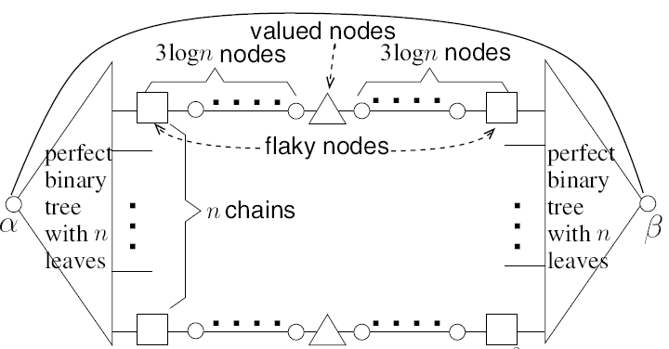
Reduction from UnionSize to Sum
Given a fault-tolerant Sum protocol
Alice/Bob can solve UnionSize, by simulating Sum protocol on topology below with certain failure pattern
root
Haifeng Yu, National University of Singapore

Slide 19
UnionSizeCP_{n,q}
Take n = 5 and q = 4
Alice’s input X = 00221
Bob’s input Y = 01132
X and Y must satisfy the cycle promise (e.g., X₅ = 1 and Y₅ = 2)
  This promise is not ad hoc --- it can actually be derived --- see paper
UnionSizeCP defined as
# of i’ where X_{i} ≠ 0 or Y_{i} ≠ 0,
In our example, UnionSizeCP = 4
X_{i}
Y_{i}
0
1
2
3
0
1
2
3
The novel cycle promise
When q = 2, UnionSizeCP degrades to UnionSize.

Slide 20
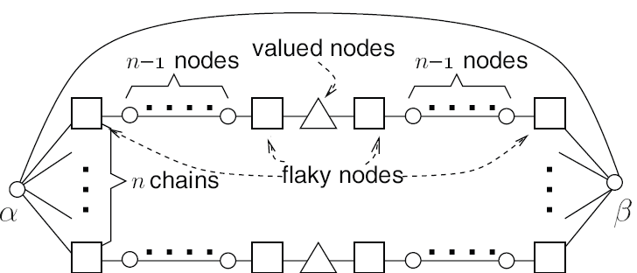
Reduction from UnionSizeCP to Sum
Given a fault-tolerant Sum protocol
Alice/Bob can solve UnionSizeCP, by simulating Sum protocol on topology below with certain failure pattern
root
Haifeng Yu, National University of Singapore

Slide 21
Communication Complexity of UnionSizeCP
No prior results…
Our lower bound: Ω(n/q²) and Ω(1/(εq²))
  Obtained via information cost techniques
  Our upper bound: O(n/q)
We also prove a strong completeness result:
  UnionSizeCP is complete among all two-party problems that can be reduced to Sum via oblivious reductions
  No “better” problems to reduce from…

Slide 22
Conclusions
If we want to compute f in a fault-tolerant way, what will the communication complexity be?
As first effort on fault-tolerant CC, our central contribution is the first lower bounds on the fault-tolerant CC of Sum
  Exponential gap from non-fault-tolerant CC
  Answering the open question on the optimality of some existing protocols as well
Some of the key novel aspects in our proof:
  Formalizing the role of failure
  Cycle promise and UnionSizeCP to deal with some key challenges in reduction
  The reduction from the probing game

Slide 23
Future Work
Our exponential gap attests
  Impact of failures on CC is large
  Fault-tolerant CC needs to be studied separately from existing research on non-fault-tolerant CC
A new topic ripe with many interesting open questions…
  Extending our lower bounds to other topologies?
  Improving the degrees of the polynomials in our lower bounds?
  “Early stopping” protocols?
  Characterize the set of functions with exponential gaps?
  …

