Slide 1
OHIE:
Blockchain Scaling Made Simple
Haifeng Yu, Ivica Nikolic, Ruomu Hou, Prateek Saxena
National University of Singapore

Slide 2
Throughput of blockchains
Bitcoin
(Nakamoto Consensus)
Modern blockchains
thousands of transactions/second
Some example modern Blockchain | transactions/second (observed in experiments)
RSCoin (NDSS‘16) | ~2,000
ByzCoin (USENIX Sec‘16) | ~1,000
Algorand (SOSP‘17) | ~1,000
Omniledger (SP‘18) | ~3,000
RapidChain (CCS‘18) | ~8,000
7
transactions/second

Slide 3
Simplicity is important
Nakamoto consensus is remarkably simple
  Can be fully described in a few dozens of lines of pseudo-code
Simplicity is always good!
More reliable implementation
Easy re-parametrization in different deployments
Formal proofs and cross validations
  Critical! Consensus protocols are notoriously difficult to analyze in the presence of byzantine failures

Slide 4
Can we have both?
Simplicity of Nakamoto consensus
Throughput of
state-of-the-art blockchain protocols
and

Slide 5

Our contribution: OHIE
OHIE composes many parallel instances of Nakamoto consensus
  E.g. 1000x instances -> 1000x throughput
  Permissionless, PoW
Security proof by reduction to Nakamoto Consensus*
  Provably secure with $f<0.5$
  “Analysis of the blockchain protocol in asynchronous networks.” PASS, R.et al.(EUROCRYPT17)
  “A Better Method to analyze Blockchain Consistency.” KIFFER, L. et al. (CCS18)
*:

Slide 6
OHIE: Performance
Experiment on up to 50,000 nodes
Throughput
  Scales linearly with available bandwidth
  E.g. 20Mbps bw/node -> 10 Mbps throughput (2,500 transactions/sec)
Confirmation latency
  Below 10min
  (Bitcoin: ~60min, Ethereum ~3min)
Decentralization factor
  # Distinct blocks / sec
  At least an order of magnitude higher than prior blockchains

Slide 7

Problem statement
Blockchain problem:
  Node agree on a growing list of blocks
  Safety: The order is consistent on all the nodes
  Liveness: Honest blocks are included at a healthy rate
Total ordering leads to:
  No double-spending
  State-machine replication
  Smart contract
  etc.
…….
B1
B2
B3
B4
B5
B6
B7
B8
Blockchain Protocol
B1
B4
B5
B8
B2
B6
B7
B3
…….
Slot 1
Slot 2
Slot 3
Slot 4
Slot 5
Slot 6
Slot 7
Slot 8
Replicated List of Blocks

Slide 8
Security model
Permissionless, Proof-of-Work
Peer-to-peer overlay (for broadcast)
Security analysis follows the existing models*
  “Analysis of the blockchain protocol in asynchronous networks.” PASS, R.et al.(EUROCRYPT17)
  “A Better Method to analyze Blockchain Consistency.” KIFFER, L. et al. (CCS18)
*:

Slide 9
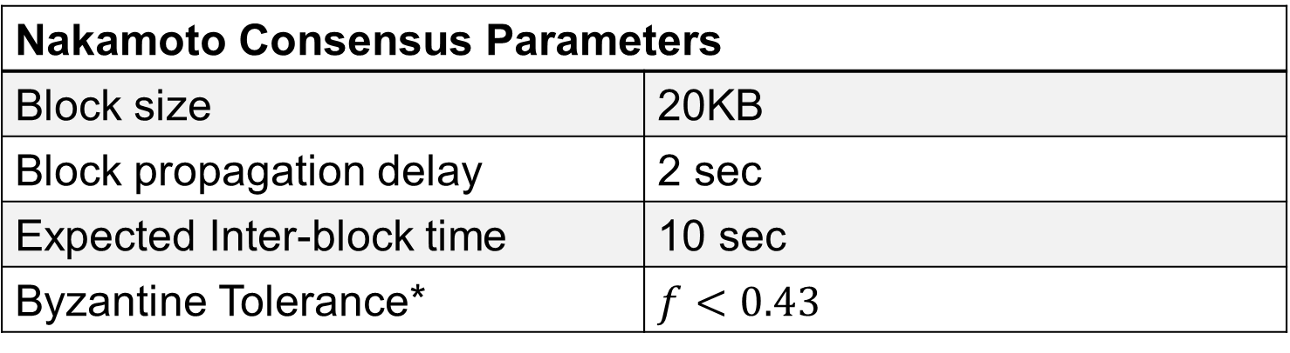

Mining: Single Nakamoto Consensus instance
1 block every 10 seconds $→$ 2KB/s throughput
Assume system hash power: $2^{60}$ / 10 sec
Valid block hash: $60$ leading zeroes (in binary)
Nakamoto Consensus Parameters
Block size | 20KB
Block propagation delay | 2 sec
Expected Inter-block time | 10 sec
Byzantine Tolerance* | $f<0.43$
  “Analysis of the blockchain protocol in asynchronous networks.” PASS, R.et al.(EUROCRYPT17)
*:

Slide 10


Mining on 1024 instances simultaneously
Previously, valid block hash requires 60 leading zeros
OHIE instead requires 50 leading zeros with 1024 chains.
Another 10 bits of the hash indexes to one of the chains
  E.g. last 10 bits
Not a sharding design
For any given chain, the probability of adding a block to it is the same as before
  Formalized in our reduction
OHIE now generated 1024 blocks / 10 seconds $→$ 2048KB/sec throughput
Instance 0
Instance 1
Instance 2
…
New Block
Hash Value = 000…000XX….XX0000000010
Instance 1023
50 leading 0’s
e.g. Last 10 bits $→$ 2

Slide 11
How many parallel instances to use?
Use as many instances as possible without significantly affecting the propagation delay.
Using more parallel instances consumes more bandwidth
Experiment: using about half of the bandwidth does not increase propagation delay significantly
Propagation Delay (sec)

Slide 12
Use a Merkle tree to bind to many blocks
How does a block commit to a parent
Use Merkle tree to commit to all 1024 frontier blocks simultaneously
  Tree root included in the block
Instance 0
…
Instance 1
Merkle
Tree
…
Tree root
Instance 1023
Block
Hash Value = 000…000XX….XX0000000001
The last block on the longest chain

Slide 13
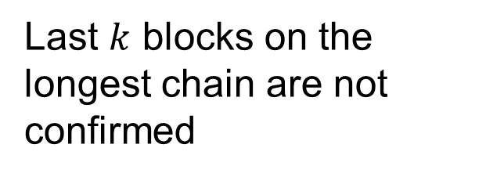
Ordering blocks on 1 instance
Last $k$ blocks on the longest chain are not confirmed
Partially-confirmed blocks

Slide 14
Order partially confirmed blocks across instances
Goal: Total order on the partially confirmed blocks
baseline design: loop over instances and take the lowest indexed partially confirmed block each time
  Stops when an instance runs out of partially confirmed blocks
E.g. 3 instances
Instance 0
1
4
7
Instance 1
2
5
Instance 2
3
6
Partially-confirmed blocks
Fully-confirmed blocks

Slide 15
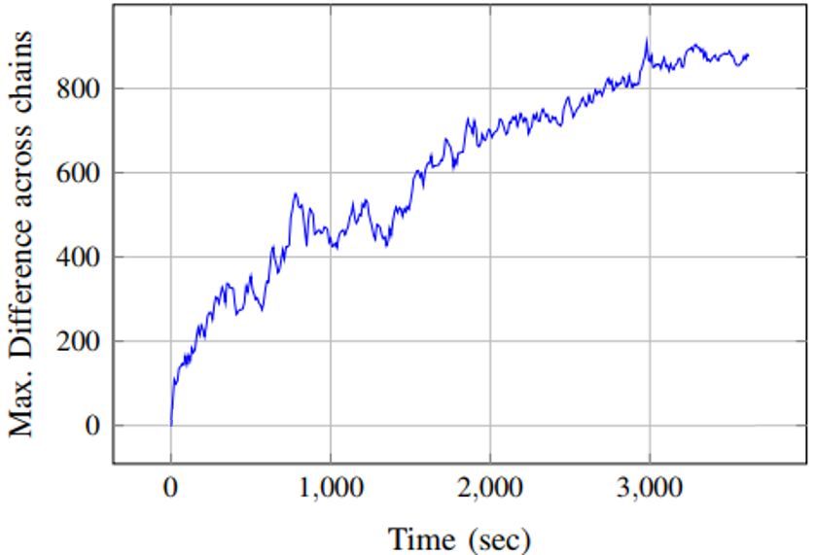
Problem of the baseline design
Chains grow at different speed
  Although the expected growth rates are the same
Fast instances waiting for the slower instances ‘catch up’
  Cause long confirmation delay
  Delay can be unbounded
E.g. baseline ordering
Instance 0
1
4
7
Instance 1
2
5
Instance 2
3
6
Long Confirmation Delay
Partially-confirmed blocks
Fully-confirmed blocks

Slide 16
Dealing with slow instances
Solution: Give a larger ‘virtual size’ to blocks on slower instances so it ‘catches up’ immediately
  View a block on slower instances as multiple block worth
  Choose virtual size that helps to match the fastest instance
E.g. Virtual Size
Instance 0
1
4
7
9
Instance 1
2
5
Instance 2
3
6
8
10
11
12
Long Confirmation Delay
Partially-confirmed blocks
Fully-confirmed blocks

Slide 17
Assign virtual size in a distributed way
Instance no.
Virtual length
Mining a new Block
Commit to all frontier blocks
Mine a valid nonce
Assign to an instance
Miner assigns a virtual size
10
1
9
0
1
4
8
6
7
3
2
3
1
2
5
7
8
8
7
4
8
5
1
3
2
3
6
9
10
11
6
Hash Value = 000…000XX….XX0000000010
Nonce
Hash Value = 000…000XX….XX0000000001
Tree Root
Merkle
Tree
Many partially-confirmed blocks awaiting ordering
With 3 new blocks mined to instance 0, all these will be fully confirmed
Longest chain virtual length: 3
Chain 2 virtual length: 1
Block virtual size: 3 – 1 = 2
50 leading 0’s
Last 10 bits -> 1
Vsize
V.size=2
V.size=1
Chain 1 already have the biggest virtual length, assign min size 1
Data
New Block
Partially-confirmed blocks
Fully-confirmed blocks

Slide 18
Virtual sizes chosen by the adversary
Virtual size is determined by the miner
Adversary has freedom in choosing the virtual size:
  Choose a small value: It will not help the slow instance to ‘catch up’, but it’s okay because later honest blocks will still help
  Choose a big value: prevented by requiring a pointer to the head of the longest chain

Slide 19
Conclusions
OHIE: A simple blockchain protocol with state-of-the-art throughput
  Composes as many Nakamoto consensus instances as permitted by available bandwidth
  Ensure that the adversary splits its power evenly across all the chains
  Orders blocks across multiple chains into a total order
Admits a modular security proof based on reduction from Nakamoto consensus – details in paper
  Safety and liveness proofs
  Chain consistency, chain growth, chain quality proofs

