Slide 1
Warning
Make sure you are viewing the correct slide deck (yellow highlights) that is applicable to the semester for which you are considering starting UROP, as requirements may change.
This deck is for AY 25/26 Sem 1, presented on 1 October 2025, for prospective UROP students formally starting in January 2026.

Slide 2



NUS SoC UROP Briefing
From: uiowa.edu
From: vumc.com
For AY 2025/2026 Sem 1
Presented by Dr Zhao Jin
Assisted by Ms Ivy
(Revised 1 October 2025)

Slide 3
A typical Research Project
Problem formulation
Literature survey
Evaluation
Documentation and presentation of results
Proposal and implementation of solutions

Slide 4

Objectives of UROP
Allows undergraduates to
participate in a year-long, active research project
experience first hand the challenges and exhilaration of research, discovery and invention
learn from a faculty member, who is an expert researcher doing cutting-edge research.
pick up new technologies, knowledge and skills
(ahead of other students)

Slide 5

Feedback from UROP students
…UROP provides a unique opportunity for students to explore their research interests and get a first-hand taste of what research feels like during their undergraduate years.
This experience has allowed me to understand the importance of asking good questions, communicating ideas, and deciding which problems are worth pursuing and which wants are not.
These skills will come in handy in or outside of an academic setting, and I strongly recommend first year students to plan for potentially including a UROP in their academic plan.
Computations with Addition Machines
Tan Matthew Simon Castaneda
Supervised by: Frank Stephan

Slide 6
Feedback from UROP students
The UROP program has been an enriching and enlightening experience, providing a valuable insight into what research involves and offering deep insights into research methodology and the application of advanced techniques. It allowed me to engage intensively with my areas of interest, bridging theoretical knowledge with practical application.
The invaluable mentorship from my supervisor, coupled with the supportive and educational environment fostered by a PhD student in the research group, significantly enriched my learning experience.
The UROP program is a highly recommended initiative for those aspiring to delve deeper into academia or research, equipping participants with essential skills for rigorous research and innovation.
Domain Generalized Semantic Segmentation in 3d Urban Scene
Student: Huang Yuqi
Supervised by Lee Gim Hee

Slide 7
Feedback from UROP students
The UROP programme is an amazing opportunity for anyone interested in pursuing further studies or a career in academia.
The programme gave me the chance to choose a topic that I was genuinely interested in and to study it in-depth. It also helped me to better understand the non-technical skills needed to make a good researcher such as what makes a good research paper and how to present the results of your research.
During the entire course of the programme, I was given a great deal of guidance and support from not only my supervisor but also from the postdocs and phd students in the research group.
You Only Spike Once: Improving Energy-Efficient Neuromorphic Inference to ANN-Level Accuracy
Kyle Timothy Ng Chu
Supervised by Trevor Erik

Slide 8
Feedback from UROP students
This UROP programme provided me an exceptional opportunity to explore advanced topics in harmonic analysis, Strichartz estimates, and their role connecting with differential geometry and general relativity.
Under the guidance of my supervisor, I gained a deep understanding of the in-depth theory of partial differential equations (PDEs) and advanced analysis, particularly in relation to wave equations in curved spacetime settings.
Automated Machine Learning in Language Models
Yu Zongmin
Supervised by: Low Kian Hsiang

Slide 9
Feedback from UROP students
UROP gives me the opportunity to learn many things that are yet not covered in the lectures, such as multimodal llms. These are the HOTS topics nowadays out there but it is barely touched by the curriculum, so I have the time to self-learnt and dig further my interest in the field.
UROP is also a good opportunity for me to know what I would like to do in my FYP, as I have the prerequisite knowledge now of now the field of llm works.
Sports Analytics using Probabilistic Model Checking, Computer Vision and Machine Learning
Yeoh Zhong Han Ervin
Supervised by Akshay Narayan

Slide 10
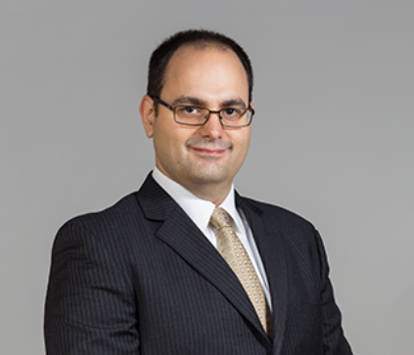
Feedback from Faculties
We have been extremely happy with the work that we have done with our UROP students.
Together, I work to treat our researchers as close member of our team, and through collaboration and drive by the students, we have published papers and our work has formed the basis of new research projects. Together, we have built new AI accelerator hardware and designed new AI algorithms to improve the speed and efficiency of AI systems.
Overall, I’ve been very impressed by the work the students can accomplish, and they have, and will continue to make an impact as a part of our research group.
Prof. Trevor Erik Carlson

Slide 11
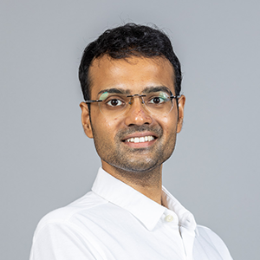
Feedback from Faculties
My experience has been very positive and fulfilling; UROP is a great opportunity for both students and their supervisors.
Personally, it has been amazing to work with enthusiastic undergraduate students. I have been fortunate to work with students who are enthusiastic and excited to learn and discover new things, think carefully about how to formulate and solve problems, and work hard towards findings the best way to present their findings.
Prof. Umang Mathur

Slide 12
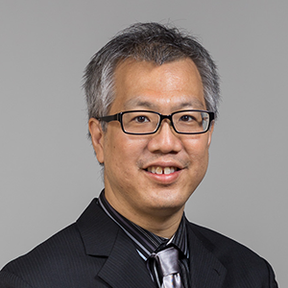
Feedback from Faculties
UROP gives you an opportunity to study specific topics in computer, science and information systems research rigorously. In my area (natural language processing), this takes the concrete form of annotating data, formulating scientific hypotheses and testing computational models that you devise to test the hypothesis.
To succeed in UROP, students need to be fully committed to conduct high-quality research and invest sufficient time. Only with such internal motivation can they overcome the learning curve, which requires much independence: task decomposition, grasp new knowledge in a new field, formulate scientific hypotheses, and prove them using state-of-the-art methods.
We recommend that UROP in a specific area (e.g., AI and NLP) have taken or are going to concurrently take the corresponding general courses in NUS: CS2109S Intro to AI/ML, CS3244 Machine Learning and CS4248 (preferably excelling in the project components), so that they can be familiar with the background.
Prof. Kan Min-Yen

Slide 13

Feedback from Faculties
The UROP projects give me an opportunity to closely work with the students and guide them in their effort to make a significant improvement on the systems that I'm developing. The nature of UROP allows exploration of new directions that might otherwise remain unexplored. Students enjoy these explorations and the freedom to be independent of operational requirements from existing users.
In our work on Source Academy, our projects are developing entirely new prototypical language implementations that can then be further developed in FYP.
I'd like to highlight the option to "upgrade" UROP using the REx scheme, which my current two UROP students are taking advantage of, which allows them to visit conferences and research and development labs overseas that are related to their work.
Prof. Martin Henz

Slide 14
Funding Support
From SoC: Up to S$200 per student for small amounts of computational resources, hardware, software or stationery.
Readily available on a first-come-first basis.
From NUS: Up to S$2500 per student to reimburse costs for the proposed research
Part of the Research Experience Programme (REx rolled out in this semester)
Additional application, workshop attendance and evaluation required.

Slide 15
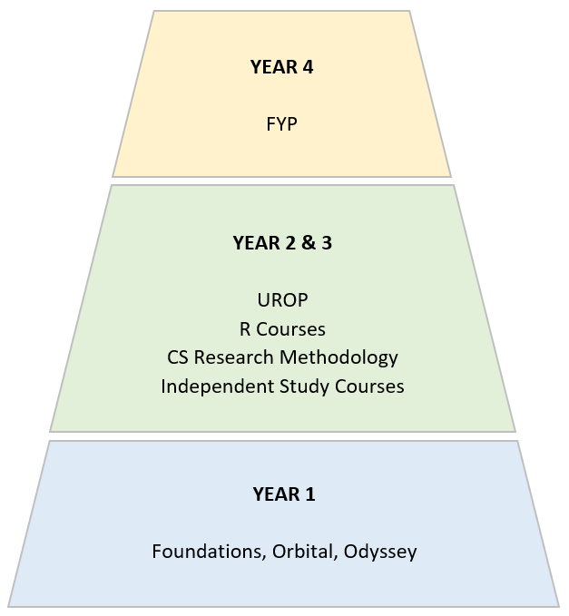
The Bigger Picture…

Slide 16
Important Considerations
The UROP is challenging with a substantial workload.
UROP must be done in 2 consecutive semesters.
UROP students are not allowed to go for internships / exchange during UROP.
Alternatives to UROP
  CP3106 Independent Project (one semester / summer)

Slide 17
Prerequisites
Be an SoC student
Have at least 60 (in-progress / completed) Units at the point of applying
Attain a minimum GPA of 3.8.

Slide 18
Application Process
Apply one semester in advance
  Apply this semester to start your UROP in AY25/26 Semester 1.
Secure a research project and a supervisor
Submit your application between 6 October to 8 October 2025 (by 6pm) via the Project Administration System at https://mysoc.nus.edu.sg/~projadm/
(You will be notified via email once your application is processed.)

Slide 19
Application Timeline
Project Selection Exercise: 2 rounds, Weeks 7-9 and 10-12
Discussion with potential supervisors
Indication of project online
Notification of outcome
Manual Registration Exercise: Week 13 to Week 1 of next semester
Round 1
Week 7: 29 Sep – 3 Oct
Week 8: 6 – 8 Oct (by 6pm)
Week 9 (Fri): By 17 Oct
Round 2
a. Week 10: 20 ‐ 24 Oct
b. Week 11: 27 ‐ 29 Oct (by 6pm)
c. Week 12 (Fri): By 31 Oct

Slide 20
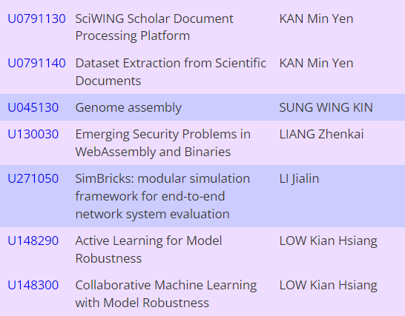
Past Year Examples

Slide 21
Finding a Project and a Supervisor
Browse the UROP proposals via the Project Administration System at https://mysoc.nus.edu.sg/~projadm/
(Presentation Sem: AY2026/2027 Semester 1)
Shortlist a few projects based on your interests and background
Talk to the faculties for more details and get an approval from them

Slide 22
If You Can’t Find a Suitable Project…
Look through all project lists (UROP / FYP / CP4106, any semester)
Find faculties whose projects / research areas are you are interested in.
Talk to them to see if they can propose something suitable for you.

Slide 23
If You Can’t Find a Suitable Project…
Alternatively, propose your own project or reach out to an external party (e.g., a professor from a different faculty)
AND find a faculty from SoC to supervise you (together with the external party, if applicable)
Bottom line: Take the initiative to find the best project and supervisor that fits your interests and advising style

Slide 24
Project Timeline
Activity | Deadlines
1. Continuous Assessment
CA Report Submission | Wed, Week 12, Sem 1
Presentation | Reading Week, Sem 1
2. Final Assessment
Final Report Submission | Wed of Week 12, Sem 2
Presentation | Reading Week, Sem 2
3. Additional Submissions
Feedback of UROP Guidance and Evaluation | First Mon after Exams, Sem 2
e-copy of Final Report

Slide 25
Evaluation
30% Continuous Assessment (Interim Progress Report)
15% Supervisor | 30% Understanding of the problem 40% Technical Achievement 10% Project and Resource Management 20% Report and Discussion
15% Main Evaluator
70% Final report & Oral Presentation
35% Supervisor | 20% Understanding and formulation of the problem 10% Extension of knowledge 30% Methodology, Implementation and Analysis 20% Report 20% Effort & Initiative
35% Main Evaluator
If the supervisor and main evaluator agrees that the student can continue the project, you will be automatically registered for CP3209 next semester; and will receive an 'IP' grade for this semester.

Slide 26
Contact Information
SoC UROP Website: https://www.comp.nus.edu.sg/programmes/ug/project/urop/details/
FAQ: https://www.comp.nus.edu.sg/programmes/ug/project/urop/faq/
Coordinator: Dr Zhao Jin
<zhaojin@comp.nus.edu.sg>, COM2 #02-10
Administrator: Ms Ivy
<ivyng@nus.edu.sg>, COM1 Level 2
Thank you!
Reminder: Applications close 8 October 2025

