Slide 1

CS1010: Intro Workshop

Slide 2
Topics
Login to UNIX operating system
……………………………………
……………………………………
……………………………………
……………………………………
Intro Workshop - 2

Slide 3



Sunfire UNIX server
Intro Workshop - 3

Slide 4
Logging into UNIX System (1/3)
To login to sunfire server, you need your SoC UNIX account user-name and password.
If you don’t have it yet, create your account here:
  https://mysoc.nus.edu.sg/~newacct
We will start at _______
In the meantime, please read the document “Getting Started with UNIX and CodeCrunch” on this CS1010 web page:
  http://www.comp.nus.edu.sg/~cs1010/3_ca/labs.html
Intro Workshop - 4
Notes:
For students who forgot their UNIX password, they can go to https://mysoc.nus.edu.sg/~myacct/iforgot.cgi to reset their password.

Slide 5
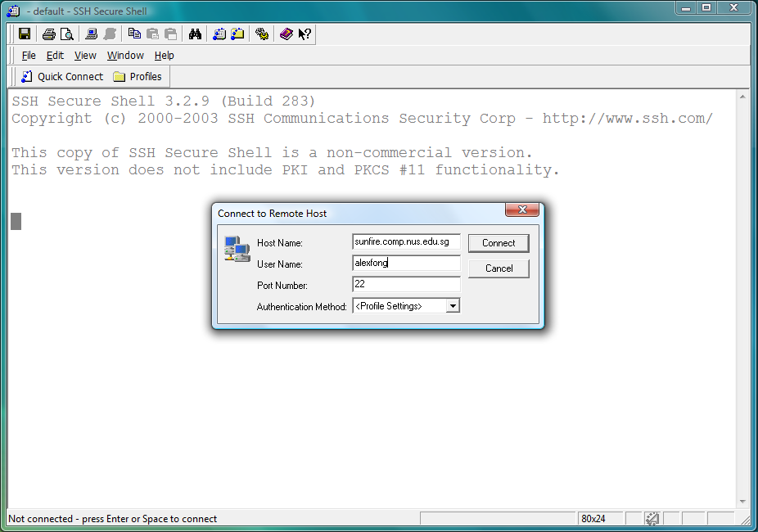
Logging into UNIX System (2/3)
1. Look for the SSH Secure Shell Client icon on your desktop, and double click on it.
Click on “Quick Connect” to get the pop-up window.
Enter “sunfire” for Host Name if connecting within campus or “sunfire.comp.nus.edu.sg” if connecting from off campus
Enter your UNIX id as User Name.
Intro Workshop - 5

Slide 6
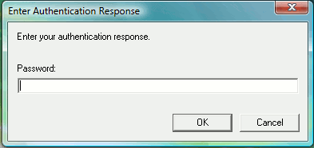
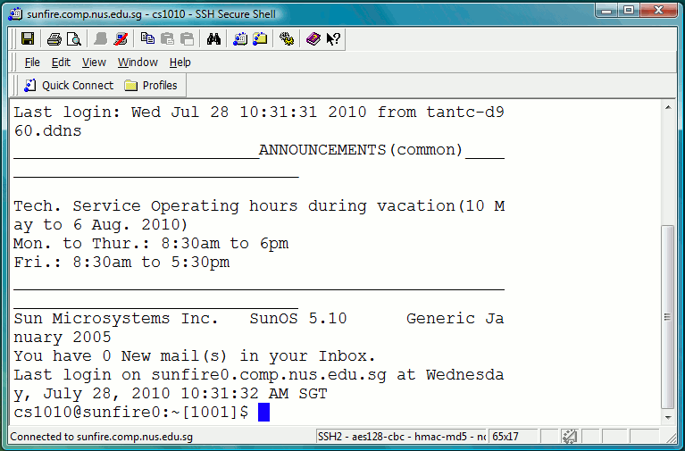
Logging into UNIX System (3/3)
3. Enter your UNIX password.
4. Once you log in successfully into your UNIX account, you will see this screen (actual display may vary).
Intro Workshop - 6

Slide 7
Topics
Login to UNIX operating system
Setup your Sunfire account
……………………………………
……………………………………
……………………………………
Intro Workshop - 7

Slide 8
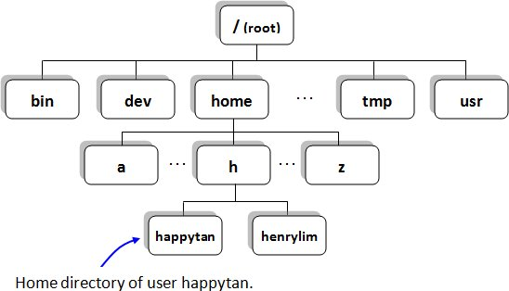
Set up Your Sunfire Account (1/3)
Now you are successfully connected to sunfire.
  What happened indeed?
Intro Workshop - 8

Slide 9
Set up Your Sunfire Account (2/3)
Every SoC student has an account on sunfire.
You can do many interesting things with your sunfire account.
  e.g., I treat my sunfire account as a thumb drive!
Intro Workshop - 9

Slide 10
Set up Your Sunfire Account (3/3)
If this is your first time logging in
  Type the following two commands one by one to configure your account for programming:
    ~cs1010/workshop/setup
    (enter y when prompted)
    source .bash_profile
    (no response from the system is good news!)
Intro Workshop - 10

Slide 11
Topics
Login to UNIX operating system
Setup your Sunfire account
Basic UNIX commands
……………………………………
……………………………………
Intro Workshop - 11

Slide 12
Basic UNIX commands (1/5)
Tree structure
Intro Workshop - 12

Slide 13
Basic UNIX commands (2/5)
In a UNIX shell (like sunfire), you need a lot of typing but much less mouse clicking, compared with Windows operating system which you might be more familiar with.
There are a few useful commands that you need to remember which will facilitate your navigation in the UNIX world.
Practice is the best way to recognize UNIX commands. Gradually you will be more and more familiar with UNIX commands – so don’t worry too much at the beginning.
Intro Workshop - 13

Slide 14
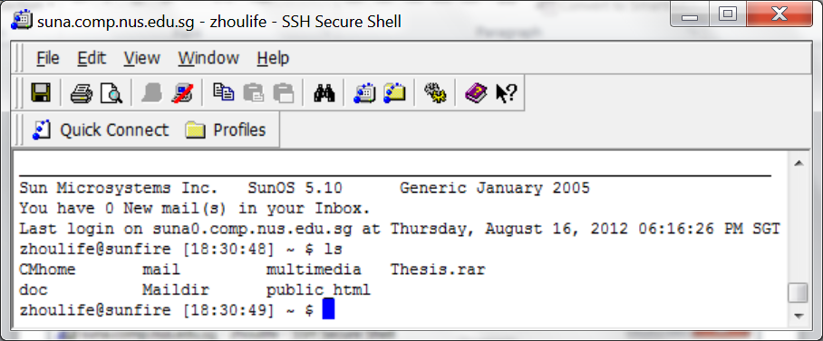
Basic UNIX commands (3/5)
ls command (means list directory contents) will enable you to see all the files and subfolders in current folder.
There are a few more complex usage of ls, but first of all, be familiar with the simplest one – just “ls”.
Intro Workshop - 14

Slide 15
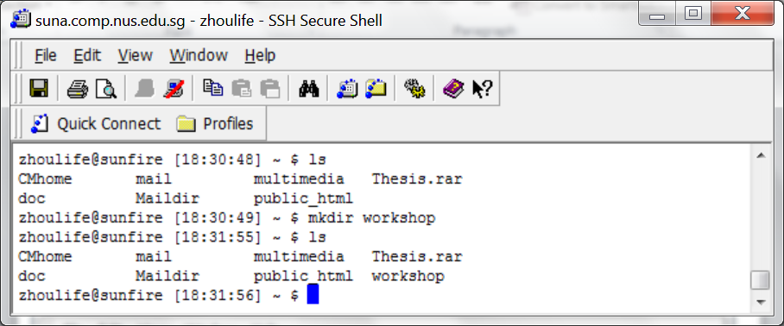
Basic UNIX commands (4/5)
mkdir (means make directory) will create a sub-directory.
rmdir (means remove directory) will delete an empty directory.
make a new directory
the new directory just created
Intro Workshop - 15

Slide 16
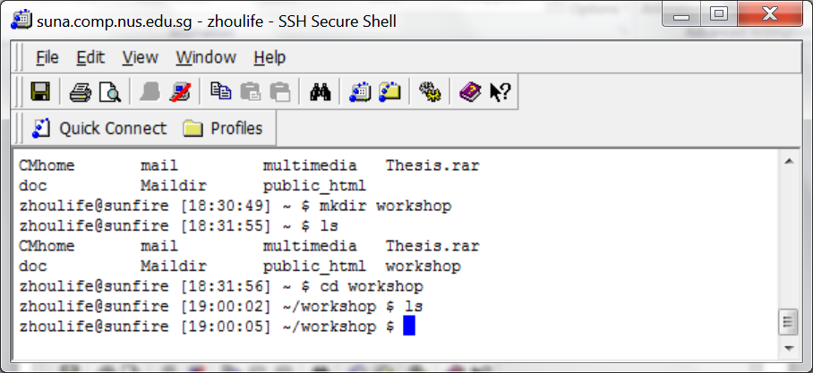
Basic UNIX commands (5/5)
cd command allows you to enter a designated directory.
  cd workshop will bring you to workshop directory
  cd .. will bring you back to the parent directory (note space between cd and ..)
Enter this directory
Intro Workshop - 16

Slide 17
Topics
Login to UNIX operating system
Setup your Sunfire account
Basic UNIX commands
Coding: Edit – Compile – Run
……………………………………
Intro Workshop - 17

Slide 18
Programs: Edit, Compile and Execute
Source code
Editor
produces
welcome.c
eg: vim welcome.c
Executable code
Compiler
produces
a.out
eg: gcc welcome.c
Sample output
Execution
produces
Hello, welcome to CS1010!
eg: a.out
Intro Workshop - 18

Slide 19
Write a C Program using vim
Vim is a powerful text editor
  Command Mode is used to issue vim commands.
  Insert Mode is used to type in text.
  Switch back and forth between two modes:
    i
    <Esc>
Intro Workshop - 19

Slide 20
Write a C Program using vim
Now use vim to type in the follow program:
  vim hello_world.c
// this program prints out "Hello World!" on the screen
#include <stdio.h>
int main(void) {
printf("Hello World!\n");
return 0;
}
When finished:
Switch back to command mode
Save and quit vim by pressing key combination :wq
Hint: different color implies different meaning…
  If you get a wrong color, it means something is wrong!
Intro Workshop - 20

Slide 21
Compile a Program with gcc
gcc is a compiler to translate your C source code into machine code.
  gcc –Wall hello_world.c
  gcc may report compilation (syntax) error to you if any. Correct your program till it is free of syntax errors.
  If there is no error, an output file a.out will be created on the harddisk - ls to look for it.
Run the executable version of your program:
  a.out
Intro Workshop - 21

Slide 22
File Processing
cp command makes a copy of a file.
mv command moves a file to another folder.
  mv command is also used to rename a file.
rm command deletes a file.
Check the lab document or consult your DL for details
  http://www.comp.nus.edu.sg/~cs1010/labs/2013/intro_lab/gettingStarted.html#section3
Intro Workshop - 22

Slide 23
Topics
Login to UNIX operating system
Setup your Sunfire account
Basic UNIX commands
Coding: Edit – Compile – Run
File transfer between your Sunfire account and your own computer/laptop
Intro Workshop - 23

Slide 24
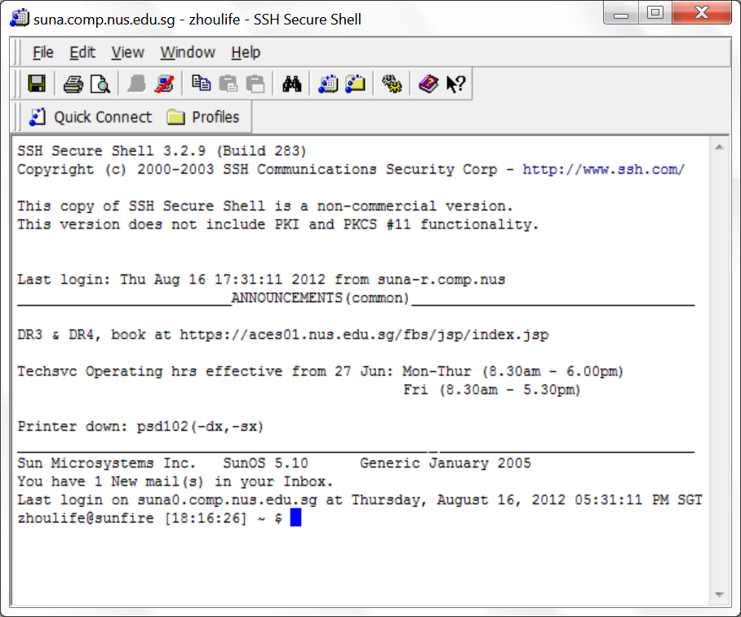
File Transfer from/to Sunfire
Intro Workshop - 24

Slide 25
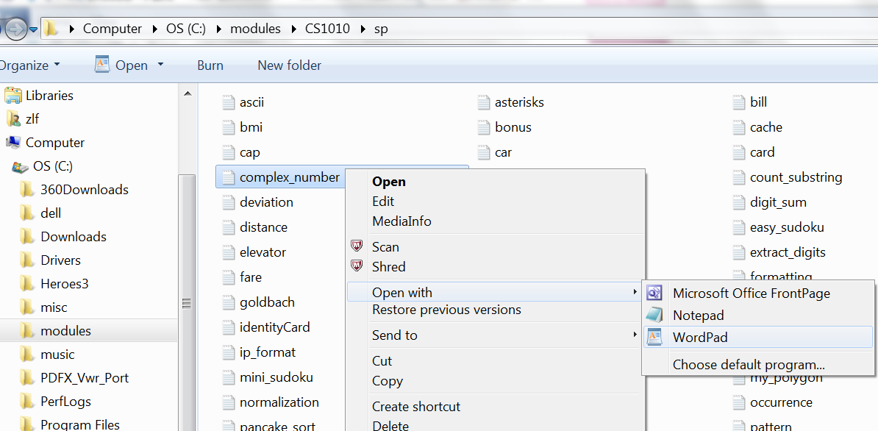
Open a C Program in Windows
Intro Workshop - 25

Slide 26
Congratulations!
You have cleared this UNIX workshop (no certificate will be issued though…)
You will gain more experience after days and weeks.
Now you may want to disconnect from sunfire.
The command is quite simple: exit or logout
Try it and say “bye-bye”!
Intro Workshop - 26

Slide 27
End of File

