Slide 1


http://www.comp.nus.edu.sg/~cs1010/
UNIT 2
Algorithmic Problem Solving

Slide 2
Unit 2: Algorithmic Problem Solving
Problem Solving Process
Algorithm
Control Structures
Examples of Pseudocodes
Euclid’s Algorithm

Slide 3
Problem Solving Process
Analysis
Iterative process
Design
Implementation
Testing

Slide 4

Problem Solving Process
Analysis
Iterative process
Design
Implementation
Testing

Slide 5
Problem Solving Process
Algorithmic
Determine problem features
Analysis
Iterative process
Write algorithm
Design
Produce code
Implementation
What is an algorithm?
Check for correctness and efficiency
Testing

Slide 6
Algorithm (1/3)
An algorithm is a well-defined computational procedure consisting of a set of instructions, that takes some value or set of values as input, and produces some value or set of values as output.
Input
Algorithm
Output
‘Algorithm’ stems from ‘Algoritmi’, the Latin form of al-Khwārizmī, a Persian mathematician, astronomer and geographer.
Source: http://en.wikipedia.org/wiki/Algorithm

Slide 7
Algorithm (2/3)
An algorithm has these properties:
Exact
Terminate
Effective
General
The algorithm must terminate.
(Or no solution will be obtained.)
Each step must be exact. (Or it will not be precise.)
The algorithm must be effective.
(i.e. it must solve the problem.)
The algorithm must be general.
(Within the constraints of the system/language.)

Slide 8
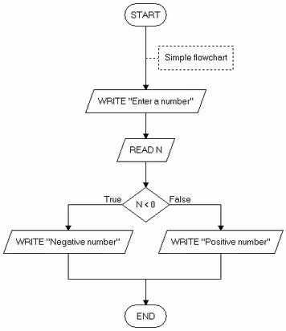
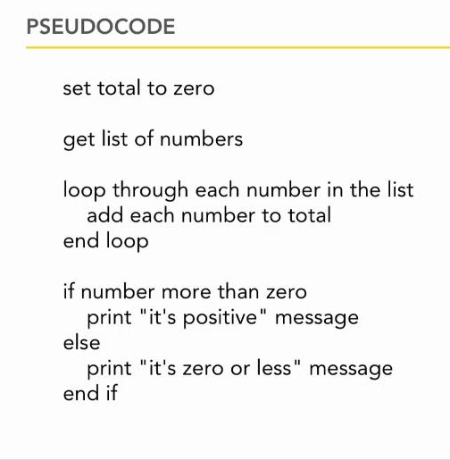
Algorithm (3/3)
Ways of representing an algorithm:
Flowchart
Pseudocode
lynda.com

Slide 9
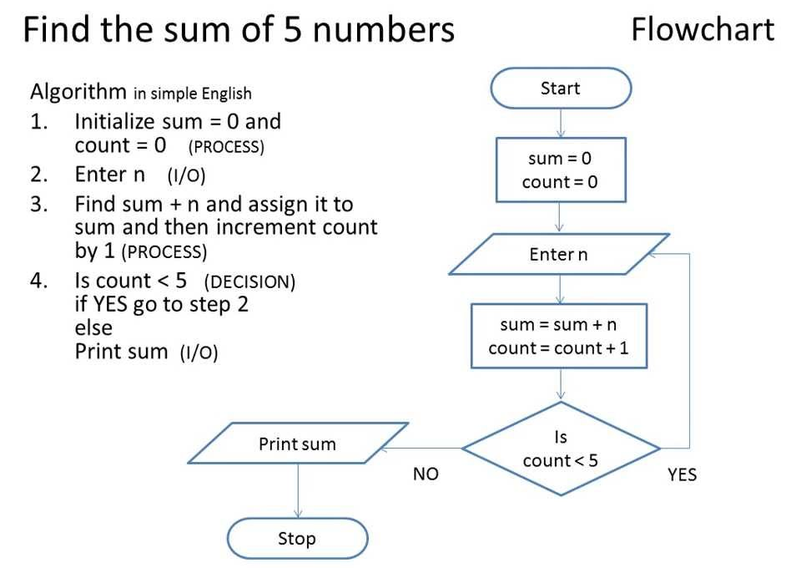
Algorithm: Example #1

Slide 10
Algorithm: Example #2 (1/2)
Find maximum and average of a list of numbers:
Terminator box
Flowchart
start
Process box
sum ← count ← 0
max ← 0
Decision box
Yes
end of input?
No
Enter num
increment count
sum ← sum + num
ave ← sum/count
print max, ave
num > max?
Yes
max ← num
No
end

Slide 11
Algorithm: Example #2 (2/2)
Find maximum and average of a list of numbers:
Pseudocode
The need to initialise variables.
sum ← count ← 0 // sum = sum of numbers
// count = how many numbers are entered?
max ← 0 // max to hold the largest value eventually
for each num entered,
count ← count + 1
sum ← sum + num
if num > max
then max ← num
ave ← sum / count
print max, ave
The need to indent.
Are there any errors in this algorithm?

Slide 12
Algorithm: Pseudocode
We will write algorithms in pseudocode instead of flowchart as the former is more succinct
However, there are no standard rules on how pseudocodes should look like
General guidelines:
  Every step must be unambiguous, so that anybody is able to hand trace the pseudocode and follow the logic flow
  Use a combination of English (keep it succinct) and commonly understood notations (such as ← for assignment in our previous example)

Slide 13
Control Structures (1/2)
An algorithm is a set of instructions, which are followed sequentially by default.
However, sometimes we need to change the default sequential flow.
We study 3 control structures.

Slide 14
Control Structures (2/2)
Sequence
Default
Selection
Also called branching
Repetition
Also called loop
True
False
?
False
?
True

Slide 15
Data Representation
Internal representation: bits (binary digits) 0 and 1
1 byte = 8 bits
In programming, we need variables to hold data. A variable has an associated data type and occupies memory space. In the following slides, variables are shown as boxes.
Some data types in C (list is not exhaustive)
  Integers: int, short, long (int is most common)
  Real numbers: float, double
  Characters: char
Self-reading: Lesson 1.4 in reference book

Slide 16

Control Structures: Sequence (1/2)
Task: Compute the average of three integers
A possible algorithm:
enter values for num1, num2, num3
ave ← ( num1 + num2 + num3 ) / 3
print ave
Variables used:
num1
num2
num3
ave
Another possible algorithm:
enter values for num1, num2, num3
total ← ( num1 + num2 + num3 )
ave ← total / 3
print ave
Variables used:
num1
num2
num3
total
ave
Each box represents a variable.
Important concepts: Each variable has a unique name and contains a value.

Slide 17
Control Structures: Sequence (2/2)
Task: Compute the average of three integers
How the program might look like
Unit2_prog1.c
// This program computes the average of 3 integers
#include <stdio.h>
int main(void) {
int num1, num2, num3;
float ave;
printf("Enter 3 integers: ");
scanf("%d %d %d", &num1, &num2, &num3);
ave = (num1 + num2 + num3) / 3.0;
printf("Average = %.2f\n", ave);
return 0;
}

Slide 18
Control Structures: Selection (1/3)
True
False
?
Task: Arrange two integers in ascending order (sort)
Algorithm A:
enter values for num1, num2
// Assign smaller number into final1,
// and larger number into final2
if (num1 < num2)
then final1 ← num1
final2 ← num2
else final1 ← num2
final2 ← num1
// Transfer values in final1, final2 back to num1, num2
num1 ← final1
num2 ← final2
// Display sorted integers
print num1, num2
Variables used:
num1
num2
final1
final2

Slide 19
Control Structures: Selection (2/3)
True
False
?
Task: Arrange two integers in ascending order (sort)
Algorithm B:
enter values for num1, num2
// Swap the values in the variables if necessary
if (num2 < num1)
then temp ← num1
num1 ← num2
num2 ← temp
// Display sorted integers
print num1, num2
Variables used:
num1
num2
temp
Compare Algorithm A with Algorithm B.

Slide 20
Control Structures: Selection (3/3)
True
False
?
How the program might look like for Algorithm B
Unit2_prog2.c
// This program arranges 2 integers in ascending order
#include <stdio.h>
int main(void) {
int num1, num2, temp;
printf("Enter 2 integers: ");
scanf("%d %d", &num1, &num2);
if (num2 < num1) {
temp = num1; num1 = num2; num2 = temp;
}
printf("Sorted: num1 = %d, num2 = %d\n", num1, num2);
return 0;
}

Slide 21
Control Structures: Repetition (1/3)
False
?
True
Task: Find sum of positive integers up to n (assume n>0)
Algorithm:
enter value for n
// Initialise a counter count to 1, and ans to 0
count ← 1
ans ← 0
while (count <= n) do
ans ← ans + count // add count to ans
count ← count + 1 // increase count by 1
// Display answer
print ans
Variables used:
n
count
ans
Initialisation is very important!

Slide 22
Control Structures: Repetition (2/3)
False
?
True
Important to trace pseudocode to check its correctness
Algorithm:
enter value for n
count ← 1
ans ← 0
while (count <= n) do
ans ← ans + count
count ← count + 1
// Display answer
print ans
Assume user enters 3 for n.
(count <= n)?
count
ans
1
0
true
2
1
true
3
3
true
4
6
false
Output: 6

Slide 23
Control Structures: Repetition (3/3)
False
?
True
How the program might look like
Unit2_prog3.c
// Computes sum of positive integers up to n
#include <stdio.h>
int main(void) {
int n; // upper limit
int count=1, ans=0; // initialisation
printf("Enter n: ");
scanf("%d", &n);
while (count <= n) {
ans += count;
count++;
}
printf("Sum = %d\n", ans);
return 0;
}

Slide 24
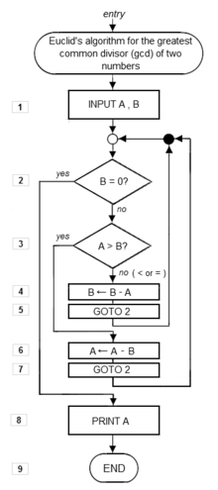
Euclid’s Algorithm (1/3)
To compute the greatest common divisor (GCD) of two integers
  First documented algorithm by Greek mathematician Euclid in 300 B.C.
  Also known as Euclidean Algorithm
1. Let A and B be integers with A > B ≥ 0.
2. If B = 0, then the GCD is A and algorithm ends.
3. Otherwise, find q and r such that
A = q.B + r where 0 ≤ r < B
4. Replace A by B, and B by r. Go to step 2.

Slide 25
Euclid’s Algorithm (2/3)
q is not important;
r is the one that matters.
r could be obtained by A modulo B (i.e. remainder of A / B)
1. Let A and B be integers with A > B ≥ 0.
2. If B = 0, then the GCD is A and algorithm ends.
3. Otherwise, find q and r such that
A = q.B + r where 0 ≤ r < B
4. Replace A by B, and B by r. Go to step 2.
Assumption on A > B unnecessary
We will rewrite the algorithm

Slide 26
Euclid’s Algorithm (3/3)
Euclid’s algorithm rewritten in modern form
// Assume A and B are non-negative
// integers, but not both zeroes.
Algorithm GCD(A, B) {
while (B > 0) {
r ← A modulo B
A ← B
B ← r
}
result is A
}
Let’s trace GCD(12, 42)
(B > 0)?
r
A
B
12
42
true
12
42
12
true
6
12
6
true
0
6
0
false
Result: 6

Slide 27
Summary
In this unit, you have learned about
  The process of algorithmic problem solving
  The properties of an algorithm
  The three control structures
  How to write algorithms in pseudocode
  Tracing algorithms to verify their correctness

Slide 28
End of File

Slide 29


