Slide 1


http://www.comp.nus.edu.sg/~cs1010/
Welcome and Administrative Matters

Slide 2



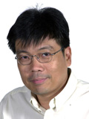
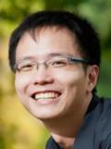



Slide 3
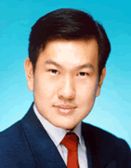
Lecturers
Mr Tan Tuck Choy, Aaron Sectional groups: SG3, SG31 Office: COM1 #03-12 tantc@comp.nus.edu.sg | Prof. Wynne Hsu Sectional groups: SG1, SG2 Office: COM2 #03-05 whsu@comp.nus.edu.sg
A/P Tan Soon Huat, Gary Sectional group: SG33 Office: COM2 #03-50 gtan@comp.nus.edu.sg | Dr Zhao Jin Sectional group: SG32 Office: COM2 #02-50 zhaojin@comp.nus.edu.sg

Slide 4













Discussion Leaders
Ang Civics (COM3)
Bai Xuefeng (COM3)
Chan Hou Cheng (COM3)
Han En Chou (COM3)
Hui Hui (COM3)
Jeffrey Effendy (COM2)
Jonathan Darryl Widjaja (COM3)
Liu Rensheng (COM3)
Shubhendra Agrawal (CEG3)
Supraja Bhavani Sekhar (COM3)
Wang Chao (COM2)
Xia Lu (COM2)
Zhao Pengran (COM3)

Slide 5


Graders
An Jiangze
Gu Junchao

Slide 6
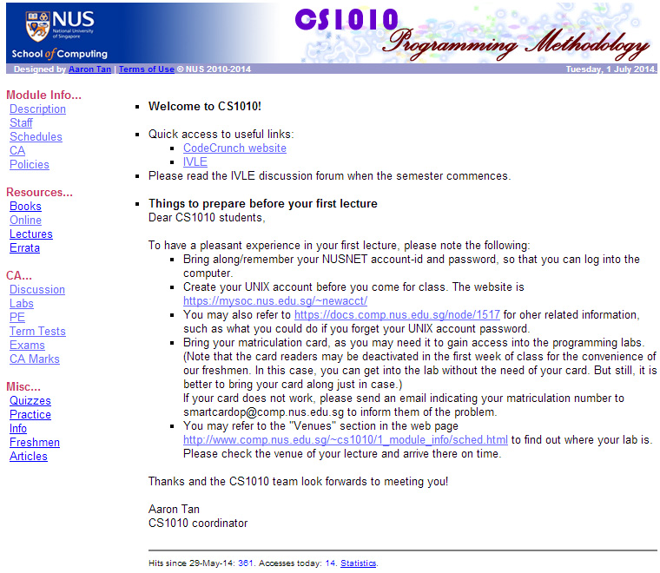

Module Website
http://www.comp.nus.edu.sg/~cs1010
Visit this website after class if you have not done so.

Slide 7
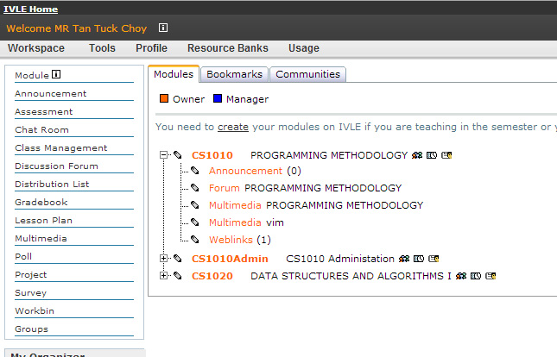
IVLE
https://ivle.nus.edu.sg
Watch out for announcements
Participate in the forums
Multimedia videos

Slide 8
Description and Objectives
Introduces the fundamental concepts of problem solving by computing and programming using an imperative programming language.
Outcomes
Solve simple algorithmic problems
Write good small programs
C as a tool
Not just about C

Slide 9






Skills
Language constructs
Problem solving
Coding

Slide 10
Schedules and Workload
Lectures:
  3 hours/week.
Discussion sessions:
  2 hours/week from week 3.
Continual assessments:
  Take-home lab assignments
  2 Practical Exams (Saturdays)
  Mid-Semester Test (Saturday)
  Final Exam
Refer to module website http://www.comp.nus.edu.sg/~cs1010/1_module_info/sched.html
Please mark down the dates of all the tests!
Inform us of clashes in advance!

Slide 11
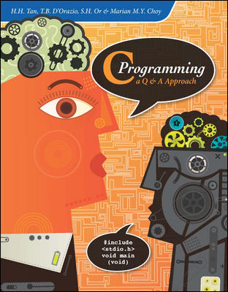
Reference Book
C Programming:
A Q&A Approach
by H.H. Tan and T.B. D’Orazio, S.H. Or and Marian M.Y. Choy, McGraw-Hill
See module website for more information
  http://www.comp.nus.edu.sg/~cs1010/2_resources/books.html

Slide 12
Mathematics in Programming
Some common concepts encountered in programming
  Prime numbers
  Complex numbers
  Polynomials
  Matrices
Mathematical maturity desirable

Slide 13
sunfire Account
You need a UNIX account on the sunfire server
If you haven’t got one, create one at
  https://mysoc.nus.edu.sg/~newacct
This account is different from your NUSNET account

Slide 14
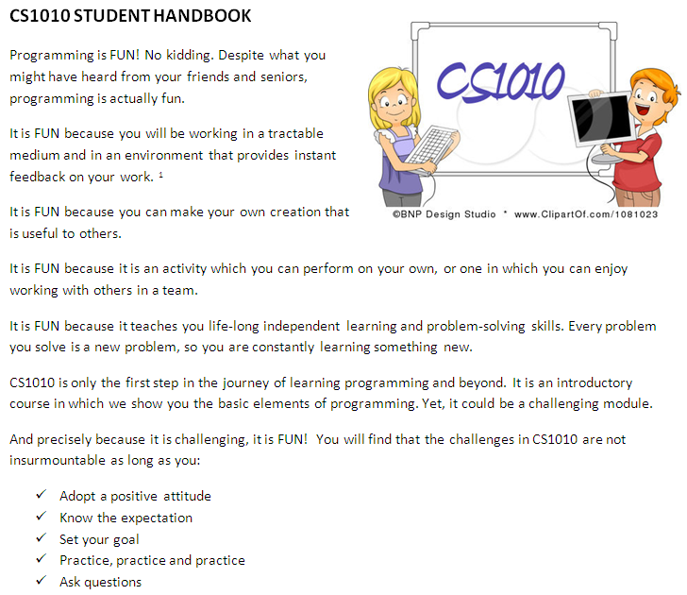

CS1010 Student Handbook
Tracking your own progress.

Slide 15
Messages for CS1010 Students
Be prepared to work Really Really HARD!
  Lots of self-practice (we will provide you with many practice exercises)
  A lot of doubts can be answered by yourself, by writing programs and testing them out by yourself
  Explore and ask questions, a lot of them, in class and outside class (IVLE forums)
Clear your doubts as soon as you can
Be open-minded
Do your own work, do not plagiarise

Slide 16
CS1010 Grading
CS1010 grading is NOT by bell curve
  Every student who deserves an A will get it; there is no quota
  On the other hand, we are also free to fail students who do not meet the standard as there is no quota too
Gradeless first semester – you still need to work hard in CS1010 for 2 reasons
  To get a Satisfactory grade for SU, you must attain at least a C grade (not D grade)
  A solid foundation in the programming is important, as CS1010 is the pre-requisite to CS1020 module, which is very much tougher and uses a different programming language (Java)

Slide 17
Quotes for CS1010 Students
Before you succeed, you must fail many times.
Don’t ask me what this code does, trace it yourself!
Think! Think! Think!
Practise! Practise! Practise!
It’s all about logic. Every step must be clear to you and whoever is reading your code.

Slide 18
End of File

