Slide 1
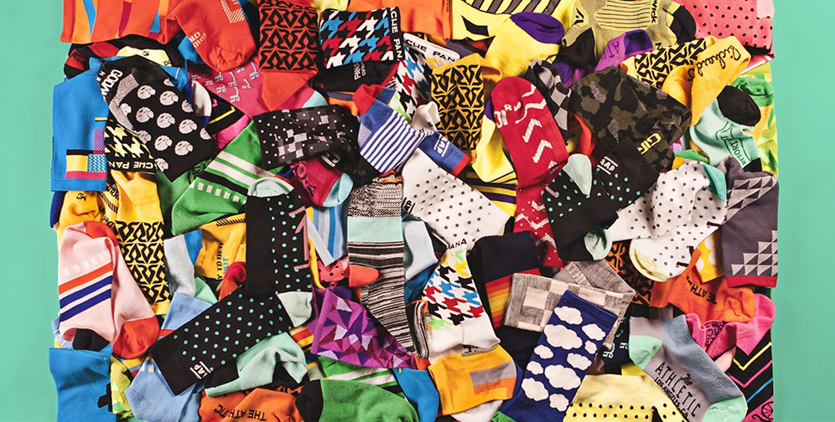
Sorting Socks

Slide 2
Sort these 6 socks
How to determine which comes first?

Slide 3
Compare 2 at a time
Draw arrows from an “earlier” sock to a “later” one.
As many arrows as you wish to show the sorting order you have decided.

Slide 4
Sorting as a Binary Relation

Slide 5
Sorting as a Binary Relation
You don’t want Symmetry

Slide 6
Sorting as a Binary Relation
This sort of Symmetry is ok though

Slide 7
Sorting as a Binary Relation
We want self loops

Slide 8
Sorting as a Binary Relation

Slide 9
Sorting as a Binary Relation
We want Transitivity

Slide 10
Sorting as a Binary Relation
With these properties:
Reflexive
Anti-symmetric
Transitive
A binary relation with said properties is called a partial order.
Sorting requires at least a partial order; better still a total order.

