Slide 1
Lecture 1: Speaking Mathematically
Variables and Important Sets Mathematical Statements Proofs
Aaron Tan
AY2025/26 Semester 1

Slide 2
Variables and Important Sets Mathematical Statements Proofs
1. Speaking Mathematically
1.1 Variables and Important Sets
Variables; writing sentences using variables
1.2 Some Important Kinds of Mathematical Statements
Universal statement, conditional statement, existential statement
Important Sets and their Notations
1.3 Proofs
What is a proof?
Terminology: Definition, Axiom, Theorem, Lemma, Corollary, Conjecture
Combination of universal, conditional and existential statements
Proof methods: Direct Proof, Proof by Construction, Disproof by counterexample, Proof by Exhaustion, Proof by Contradiction
Reference: Epp’s Chapter 1 Speaking Mathematically

Slide 3

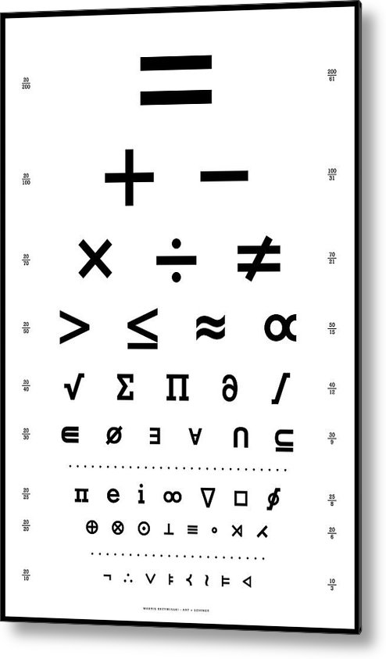


1. Speaking Mathematically
Variables and Important Sets Mathematical Statements Proofs
1. Speaking Mathematically
The language of mathematics is the systems used by mathematicians to communicate mathematical ideas among themselves.
Symbols, vocabulary, grammatical structures, conventions, abbreviations.

Slide 4
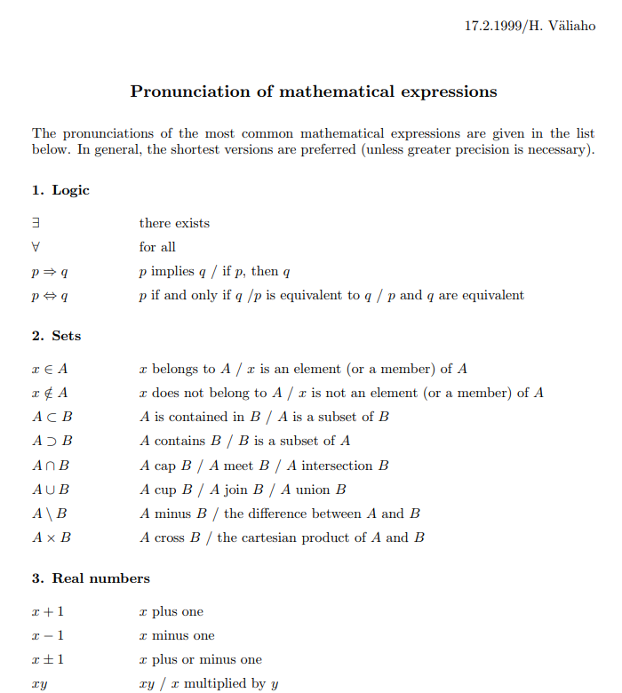
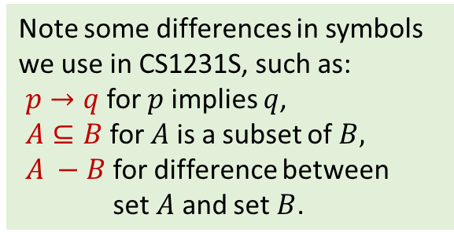
Variables and Important Sets Mathematical Statements Proofs
1. Speaking Mathematically
Pronunciation of mathematical expressions
https://par.cse.nsysu.edu.tw/link/math-pronunciation.pdf
Note some differences in symbols we use in CS1231S, such as:
$p→q$ for $p$ implies $q$,
$A⊆B$ for $A$ is a subset of $B,$
$A −B$ for difference between
set $A$ and set $B$.
A more comprehensive resource:
Handbook for Spoken Mathematics
chrome-extension://efaidnbmnnnibpcajpcglclefindmkaj/https://librivox.org/uploads/xx-nonproject/Handbook%20for%20Spoken%20Mathematics.pdf

Slide 5
Variables and Important Sets Mathematical Statements Proofs
1.1 Variables and Important Sets

Slide 6
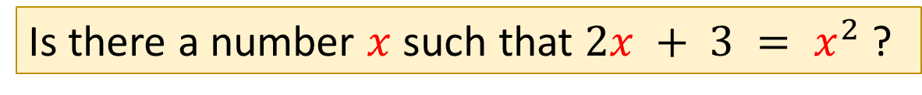
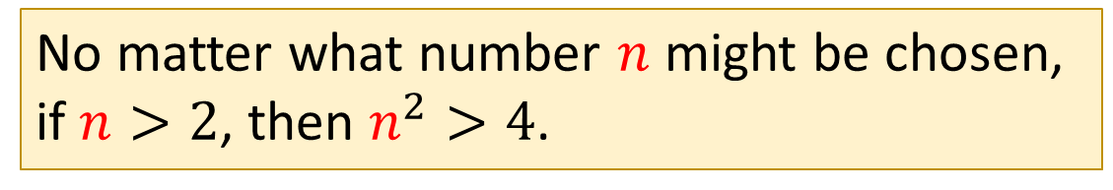
Variables and Important Sets Mathematical Statements Proofs
Variables
1.1.1 Variables
To give names to what you are seeking, and to maintain generality.
Is there a number with the following property:
doubling it and adding 3 gives the same result as squaring it?
Is there a number $x$ such that $2x + 3 = x^{2}$ ?
No matter what number might be chosen, if it is greater than 2, then its square is greater than 4.
Variables
No matter what number $n$ might be chosen, if $n>2$, then $n^{2}>4$.

Slide 7
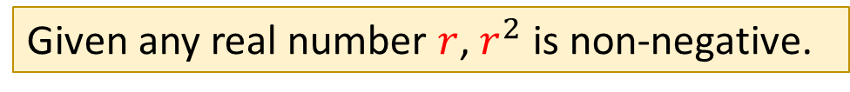
Variables and Important Sets Mathematical Statements Proofs
Writing Sentences Using Variables
1.1.2 Writing Sentences Using Variables
Rewrite the following sentences using variables:
a. Are there two numbers such that the sum of their squares equals the square of their sum?
Are there numbers $a$ and $b$ such that $a^{2}+b^{2}={(a+b)}^{2}$?
b. Given any real number, its square is non-negative.
Given any real number $r$, $r^{2}$ is non-negative.


Slide 8
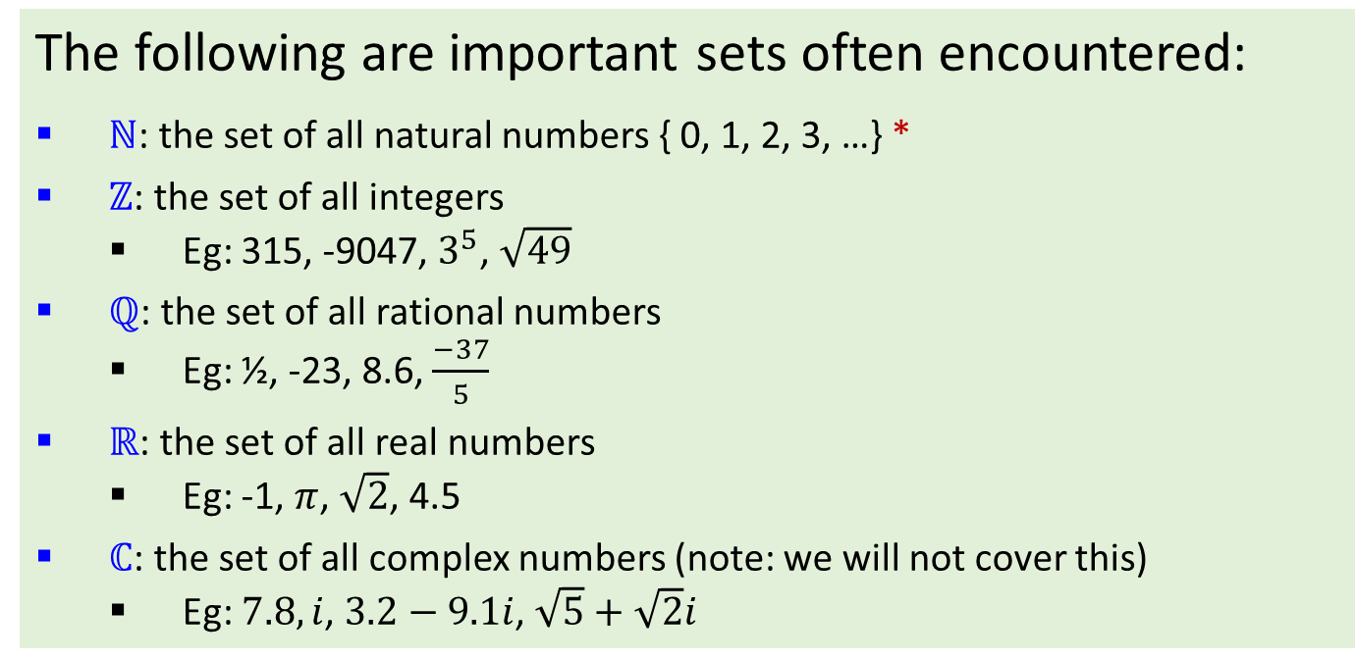
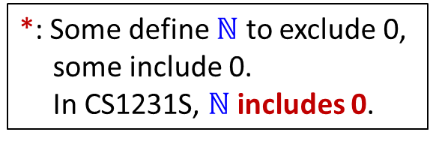
Variables and Important Sets Mathematical Statements Proofs
Important Sets
1.1.3 Important Sets
The following are important sets often encountered:
$ℕ$: the set of all natural numbers { 0, 1, 2, 3, …} *
$ℤ$: the set of all integers
  Eg: 315, -9047, $3^{5}$, $\sqrt{49}$
$ℚ$: the set of all rational numbers
  Eg: ½, -23, 8.6, $\frac{−37}{5}$
$ℝ$: the set of all real numbers
  Eg: -1, $π$, $\sqrt{2}$, 4.5
$ℂ$: the set of all complex numbers (note: we will not cover this)
  Eg: $7.8, i$, $3.2−9.1i$, $\sqrt{5}+\sqrt{2}i$
*: Some define $ℕ$ to exclude 0, some include 0.
In CS1231S, $ℕ$ includes 0.
It is well-known that all integers are rational numbers, and all rational numbers are real numbers.

Slide 9
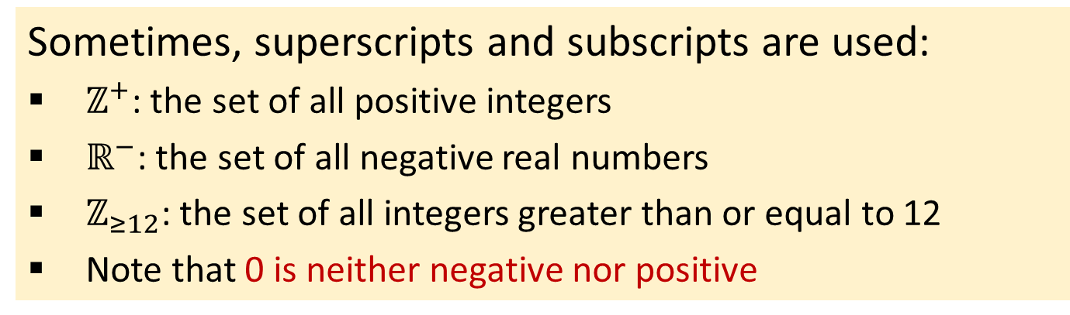
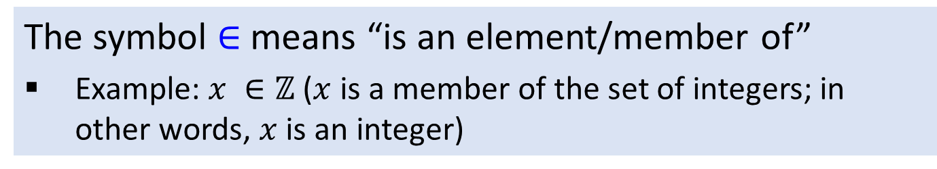
Variables and Important Sets Mathematical Statements Proofs
Important Sets
Sometimes, superscripts and subscripts are used:
$ℤ^{+}$: the set of all positive integers
$ℝ^{−}$: the set of all negative real numbers
$ℤ_{≥12}$: the set of all integers greater than or equal to 12
Note that 0 is neither negative nor positive
The symbol $∈$ means “is an element/member of”
Example: $x ∈ℤ$ ($x$ is a member of the set of integers; in other words, $x$ is an integer)

Slide 10
Variables and Important Sets Mathematical Statements Proofs
1.2 Some Important Kinds of Mathematical Statements

Slide 11
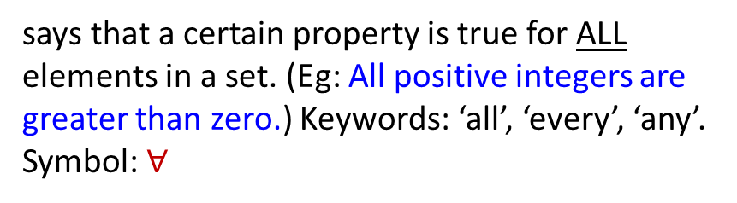
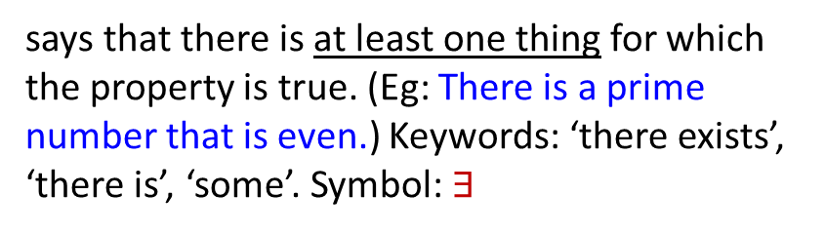
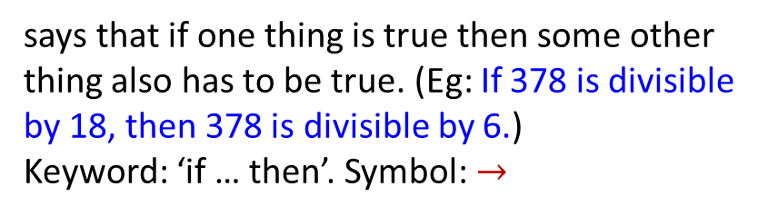
Variables and Important Sets Mathematical Statements Proofs
Some Important Kinds of Mathematical Statements
2.1.1 Some Important Kinds of Mathematical Statements
Three of the most important kinds of sentences in mathematics:
says that a certain property is true for ALL elements in a set. (Eg: All positive integers are greater than zero.) Keywords: ‘all’, ‘every’, ‘any’. Symbol: $∀$
Universal statement
says that if one thing is true then some other thing also has to be true. (Eg: If 378 is divisible by 18, then 378 is divisible by 6.)
Keyword: ‘if … then’. Symbol: $→$
Conditional statement
says that there is at least one thing for which the property is true. (Eg: There is a prime number that is even.) Keywords: ‘there exists’, ‘there is’, ‘some’. Symbol: $∃$
Existential statement

Slide 12
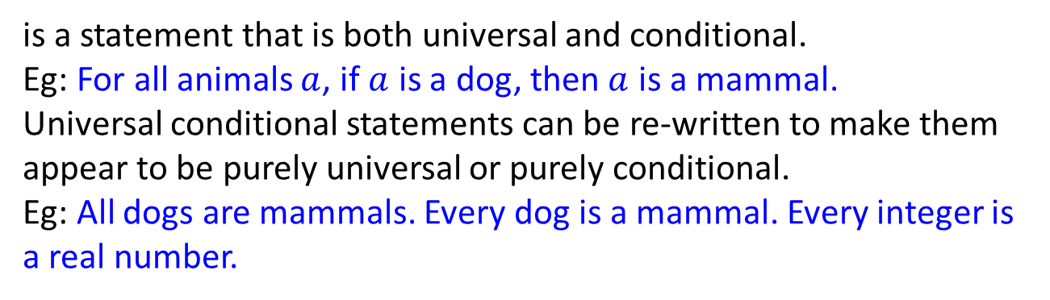
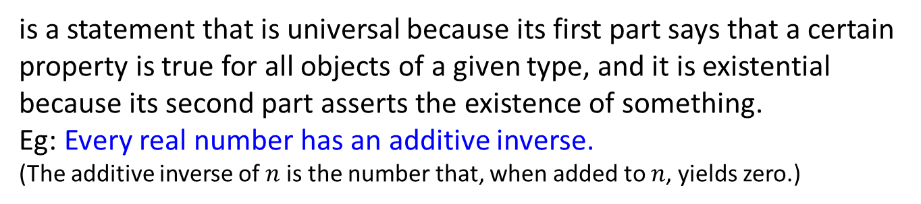
Variables and Important Sets Mathematical Statements Proofs
Some Important Kinds of Mathematical Statements
Others:
Universal conditional statement
is a statement that is both universal and conditional.
Eg: For all animals $a$, if $a$ is a dog, then $a$ is a mammal.
Universal conditional statements can be re-written to make them appear to be purely universal or purely conditional.
Eg: All dogs are mammals. Every dog is a mammal. Every integer is a real number.
Universal existential statement
is a statement that is universal because its first part says that a certain property is true for all objects of a given type, and it is existential because its second part asserts the existence of something.
Eg: Every real number has an additive inverse.
(The additive inverse of $n$ is the number that, when added to $n$, yields zero.)

Slide 13
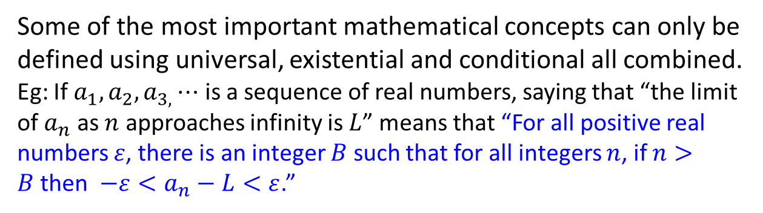
Variables and Important Sets Mathematical Statements Proofs
Some Important Kinds of Mathematical Statements
Others:
Existential universal statement
is a statement that is existential because its first part asserts that a certain object exists and is universal because its second part says that the object satisfies a certain property for all things of a certain kind.
Eg: There is a positive integer that is less than or equal to every positive integer.
Combination
Some of the most important mathematical concepts can only be defined using universal, existential and conditional all combined.
Eg: If $a_{1},a_{2},a_{3,}⋯$ is a sequence of real numbers, saying that “the limit of $a_{n}$ as $n$ approaches infinity is $L$” means that “For all positive real numbers $ε$, there is an integer $B$ such that for all integers $n$, if $n>B$then $−ε<a_{n}−L<ε$.”

Slide 14

Variables and Important Sets Mathematical Statements Proofs
Some Important Kinds of Mathematical Statements
Peeking ahead
Universal, Existential and Conditional Statements
  Chapter 2 The Logic of Compound Statements
  Chapter 3 The Logic of Quantified Statements

Slide 15
Variables and Important Sets Mathematical Statements Proofs
1.3 Proofs

Slide 16
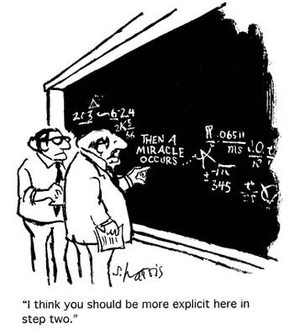
Variables and Important Sets Mathematical Statements Proofs
Introduction
1.3.1 Introduction
A mathematical proof is an inferential argument for a mathematical statement. In the argument, other previously established statements, such as theorems, can be used.
In principle, a proof can be traced back to self-evident or assumed statements, known as axioms, along with accepted rules of inference.

Slide 17
Variables and Important Sets Mathematical Statements Proofs
Introduction
Proof methods
Direct proof
Proof by construction
Disproof by counterexample
Proof by exhaustion
Proof by contradiction
Proof by contraposition
Proof by mathematical induction
Combinatorial proof
etc…
This section shows only a few examples. More to come in subsequent lectures.

Slide 18
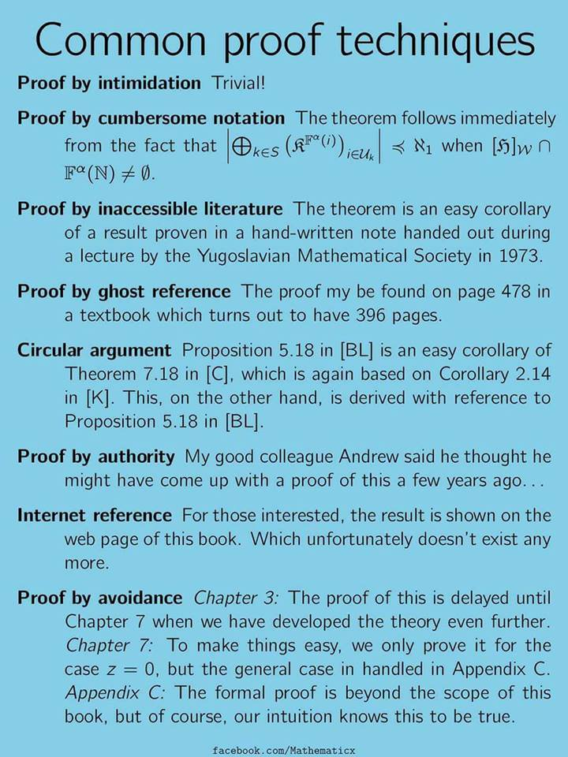
Variables and Important Sets Mathematical Statements Proofs
Introduction
Not these!

Slide 19
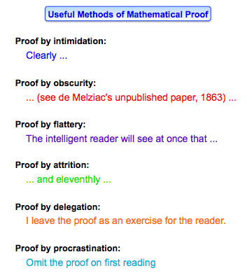

Variables and Important Sets Mathematical Statements Proofs
Introduction
Nor these!

Slide 20
Variables and Important Sets Mathematical Statements Proofs
Introduction
Study this “proof” of 2 = 1:
Let a and b be nonzero integers such that a = b.
a = b
a² = ab
a² – b² = ab – b²
(a – b)(a + b) = (a – b)b
(a – b)2b = (a – b)b
2(a – b) b = (a – b)b
2 = 1

Slide 21
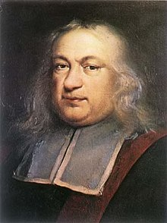
Variables and Important Sets Mathematical Statements Proofs
Introduction
“The essential quality of a proof is to compel belief.”
Pierre de Fermat,
1601 – 1665

Slide 22
Variables and Important Sets Mathematical Statements Proofs
Introduction
A proof is a concise, polished argument explaining the validity of a statement to a skeptic (usually, you).
Concise means there are no irrelevant details. It also means to use few words. (Don’t be long-winded!)
Polished means it should be the final draft, i.e. you should have revised it (possibly several times) to make it understandable, like writing an essay.
Argument means every step should follow logically from all previous steps. (We will study logical argument next week.)

Slide 23

Variables and Important Sets Mathematical Statements Proofs
Terminology
1.3.2 Terminology
Credit: Prof Dave Richeson
Definition
A precise and unambiguous description of the meaning of a mathematical term. It characterizes the meaning of a word by giving all the properties and only those properties that must be true.
Examples:
(Chapter 2) A statement is either true or false but not both.
(Chapter 4) For any $x∈ℝ$, the absolute value of $x$, denoted $\left|x\right|$, is defined as follows:
$|x|=\left\{\begin{aligned}&x, if x≥0 \\ &−x, if x<0\end{aligned}\right.$
Axiom/Postulate
A statement that is assumed to be true without proof. These are the basic building blocks from which all theorems are proved.
Examples: Euclid’s five postulates, Peano axioms.

Slide 24
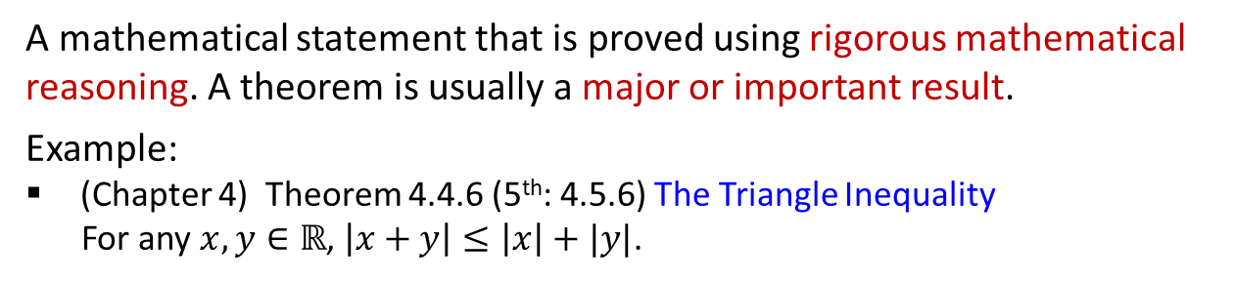
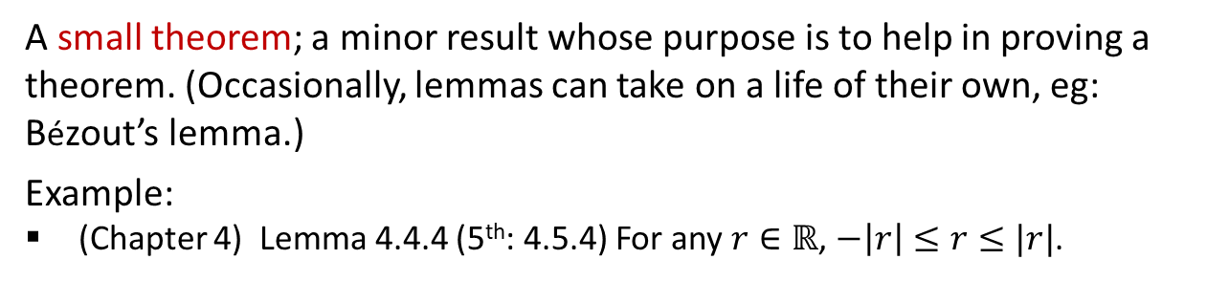
Variables and Important Sets Mathematical Statements Proofs
Terminology
Theorem
A mathematical statement that is proved using rigorous mathematical reasoning. A theorem is usually a major or important result.
Example:
(Chapter 4) Theorem 4.4.6 (5th: 4.5.6) The Triangle Inequality
For any $x,y∈ℝ$, $\left|x+y\right|≤\left|x\right|+|y|$.
Lemma
A small theorem; a minor result whose purpose is to help in proving a theorem. (Occasionally, lemmas can take on a life of their own, eg: Bézout’s lemma.)
Example:
(Chapter 4) Lemma 4.4.4 (5th: 4.5.4) For any $r∈ℝ$, $−\left|r\right|≤r≤|r|$.

Slide 25
Variables and Important Sets Mathematical Statements Proofs
Terminology
Corollary
A result that is a simple deduction from a theorem.
Example:
(Chapter 4)
Theorem 4.2.2 (5th: 4.3.2) The sum of any two rational numbers is rational
Corollary 4.2.3 (5th: 4.3.3) The double of a rational number is rational.
Conjecture
A statement believed to be true, but for which there is no proof (yet).
Example:
Goldbach’s conjecture: Every even integer greater than 2 can be expressed as the sum of two primes.

Slide 26
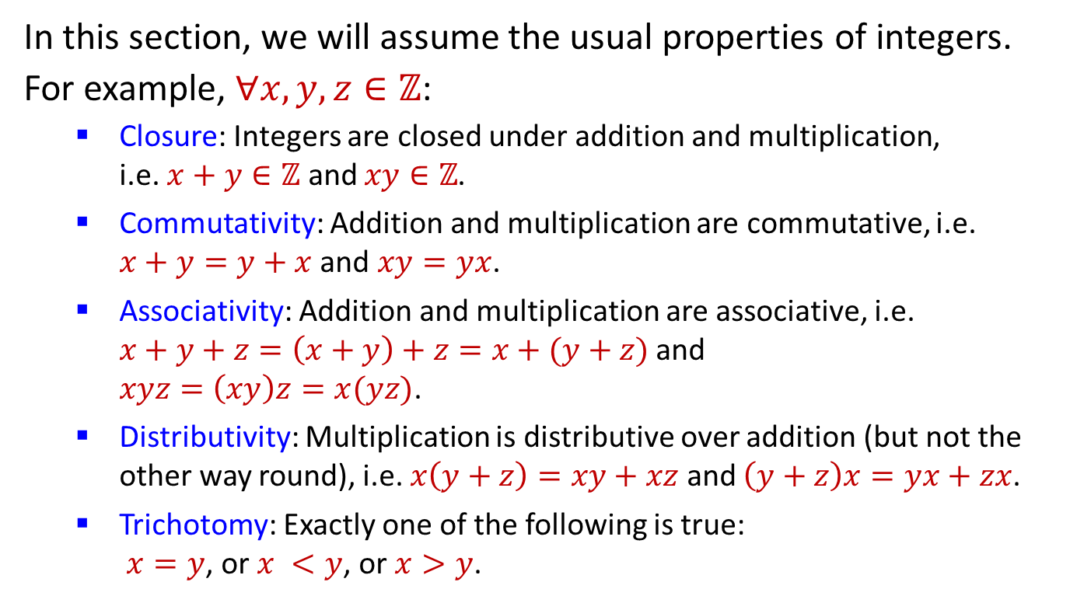
Variables and Important Sets Mathematical Statements Proofs
Basic Properties of Integers
1.3.3 Basic Properties of Integers
In this section, we will assume the usual properties of integers.
For example, $∀x,y,z∈ℤ$:
Closure: Integers are closed under addition and multiplication,
i.e. $x+y∈ℤ$ and $xy∈ℤ$.
Commutativity: Addition and multiplication are commutative, i.e.
$x+y=y+x$ and $xy=yx$.
Associativity: Addition and multiplication are associative, i.e.
$x+y+z=\left(x+y\right)+z=x+(y+z)$ and
$xyz=\left(xy\right)z=x(yz)$.
Distributivity: Multiplication is distributive over addition (but not the other way round), i.e. $x\left(y+z\right)=xy+xz$ and $\left(y+z\right)x=yx+zx$.
Trichotomy: Exactly one of the following is true:
$x=y$, or $x <y$, or $x>y$.
(See Appendix A of Epp’s book for properties of real numbers.
You may quote them in your work.)

Slide 27
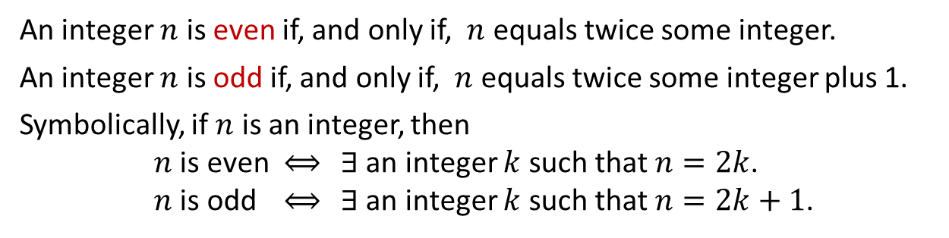
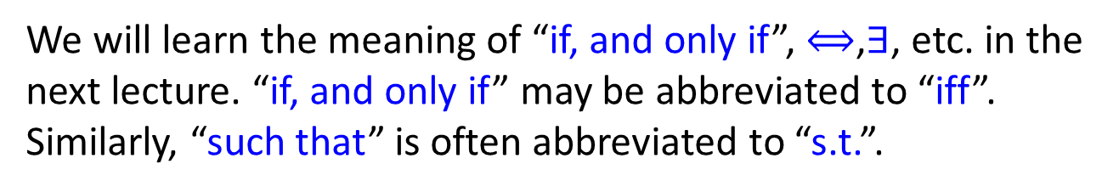
Variables and Important Sets Mathematical Statements Proofs
Examples
1.3.4 Examples
Definitions: Even and Odd integers
An integer $n$ is even if, and only if, $n$ equals twice some integer.
An integer $n$ is odd if, and only if, $n$ equals twice some integer plus 1.
Symbolically, if $n$ is an integer, then
$n$ is even $⟺$ $∃$ an integer $k$ such that $n=2k$.
$n$ is odd $⟺$ $∃$ an integer $k$ such that $n=2k+1$.
We will learn the meaning of “if, and only if”, $⟺$,$∃$, etc. in the next lecture. “if, and only if” may be abbreviated to “iff”. Similarly, “such that” is often abbreviated to “s.t.”.
Assumption 1: For CS1231S, you may assume that every integer is even or odd, but not both.

Slide 28
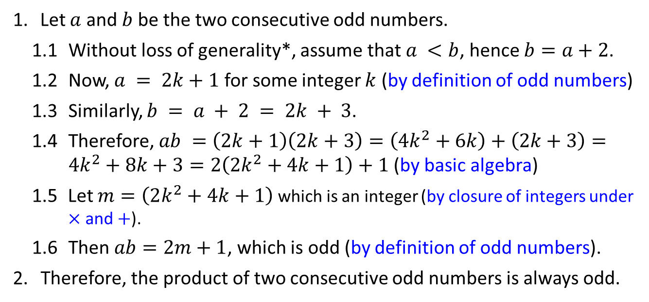
Variables and Important Sets Mathematical Statements Proofs
Example of Direct Proof
Example #1: Prove that the product of two consecutive odd numbers is always odd.
Justification. (Important!)
Let $a$ and $b$ be the two consecutive odd numbers.
1.1 Without loss of generality*, assume that $a <b$, hence $b=a+2$.
1.2 Now, $a = 2k+1$ for some integer $k$ (by definition of odd numbers)
1.3 Similarly, $b = a + 2 = 2k + 3$.
1.4 Therefore, $ab =\left(2k+1\right)\left(2k+3\right)=\left(4k^{2}+6k\right)+\left(2k+3\right)=4k^{2}+8k+3=2\left(2k^{2}+4k+1\right)+1$ (by basic algebra)
1.5 Let $m=\left(2k^{2}+4k+1\right)$ which is an integer (by closure of integers under $×$ and $+$).
1.6 Then $ab=2m+1$, which is odd (by definition of odd numbers).
2. Therefore, the product of two consecutive odd numbers is always odd.
Numbering and indentation.
“Without loss of generality” may be abbreviated to WLOG. This is used before an assumption in a proof which narrows the premise to some special case, and implies that the proof for that case can be easily applied to all other cases.

Slide 29

Variables and Important Sets Mathematical Statements Proofs
Example of Direct Proof
Previous slide: Prove that the product of two consecutive odd numbers is always odd.
Would the proof be very different if we change the task to the following?
Prove that the product of any two odd numbers is always odd.
2. If we have proven the above as a theorem, what can we say about the original task “Prove that the product of two consecutive odd numbers is always odd”?
Corollary


Slide 30
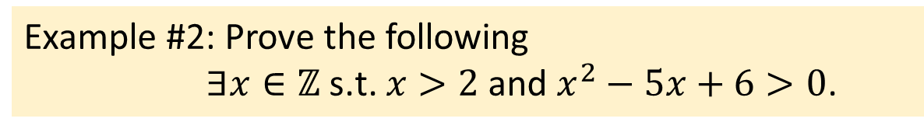
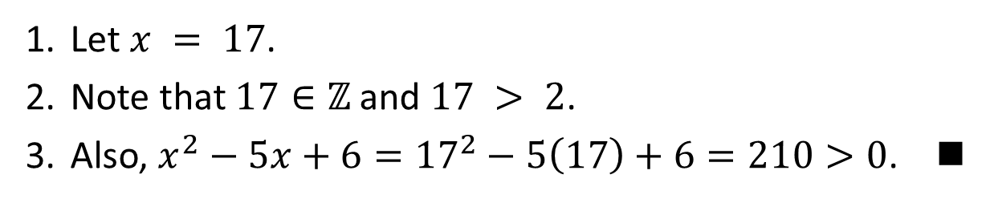
Variables and Important Sets Mathematical Statements Proofs
Example of Proof by Construction
Example #2: Prove the following
$∃x∈ℤ \text{s}\text{.}\text{t}\text{.} x>2$ and $x^{2}−5x+6>0$.
Let $x = 17$.
Note that $17∈ℤ$ and $17 > 2$.
Also, $x^{2}−5x+6={17}^{2}−5\left(17\right)+6=210>0$. 
In the proof above, there is no need to explain how 17 as obtained. You just need to show that 17 has the required properties. Of course, many integers satisfy the same properties and any of these will suffice for the proof.
This style of proof – where you explicitly find the value with the correct properties – is called a proof by construction. It is a form of direct proof and it is the most direct way to prove that something exists.

Slide 31
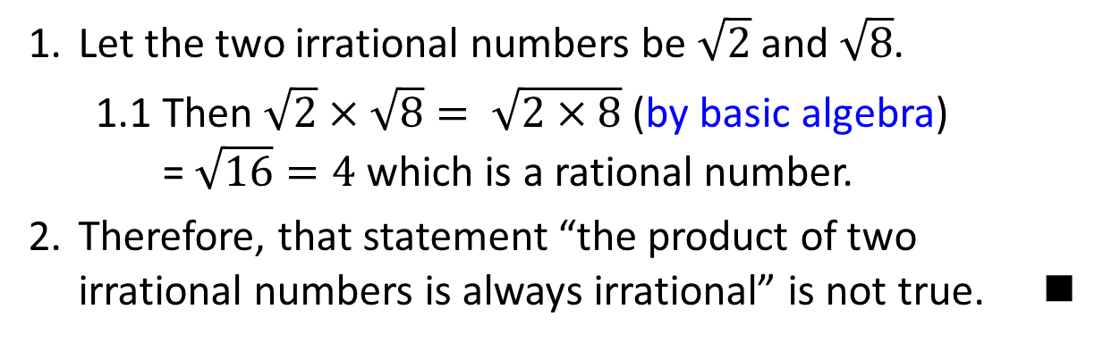
Variables and Important Sets Mathematical Statements Proofs
Example of Disproof by Counter Example
A counter-example is an example that shows that a statement is not always true.
Prove that the following statement is not true:
The product of two irrational numbers is always irrational.
Let the two irrational numbers be $\sqrt{2}$ and $\sqrt{8}$.
  1.1 Then $\sqrt{2}×\sqrt{8}= \sqrt{2×8}$ (by basic algebra)
  = $\sqrt{16}=4$ which is a rational number.
Therefore, that statement “the product of two irrational numbers is always irrational” is not true. 
Note that one counter-example is sufficient.

Slide 32

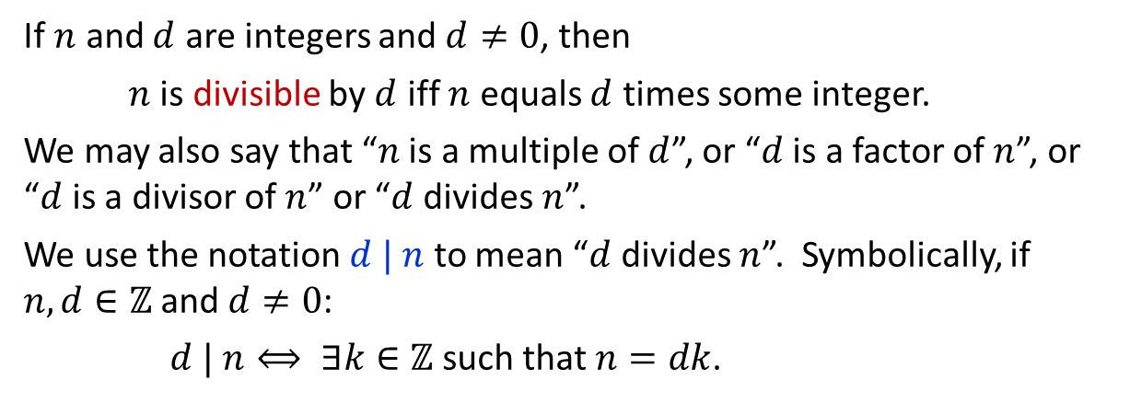
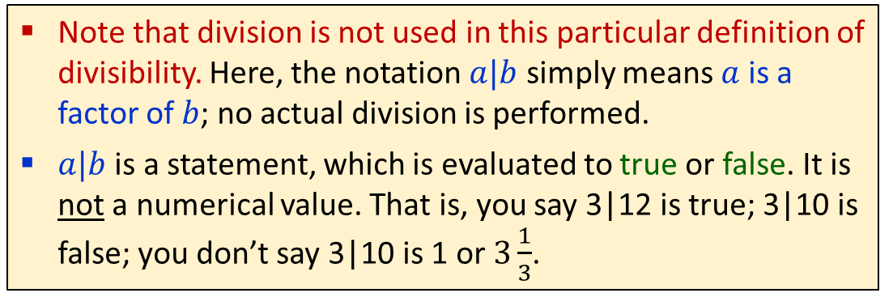
Variables and Important Sets Mathematical Statements Proofs
Example of Proof
Definition: Divisibility
If $n$ and $d$ are integers and $d≠0$, then
$n$ is divisible by $d$ iff $n$ equals $d$ times some integer.
We may also say that “$n$ is a multiple of $d$”, or “$d$ is a factor of $n$”, or “$d$ is a divisor of $n$” or “$d$ divides $n$”.
We use the notation $d | n$ to mean “$d$ divides $n$”. Symbolically, if $n, d∈ℤ$and $d≠0$:
$d | n⟺ ∃k∈ℤ$ such that $n=dk$.
A more general definition will be introduced later.
Note that division is not used in this particular definition of divisibility. Here, the notation $a|b$ simply means $a$ is a factor of $b$; no actual division is performed.
$a|b$ is a statement, which is evaluated to true or false. It is not a numerical value. That is, you say 3|12 is true; 3|10 is false; you don’t say 3|10 is 1 or $3\frac{1}{3}$.

Slide 33
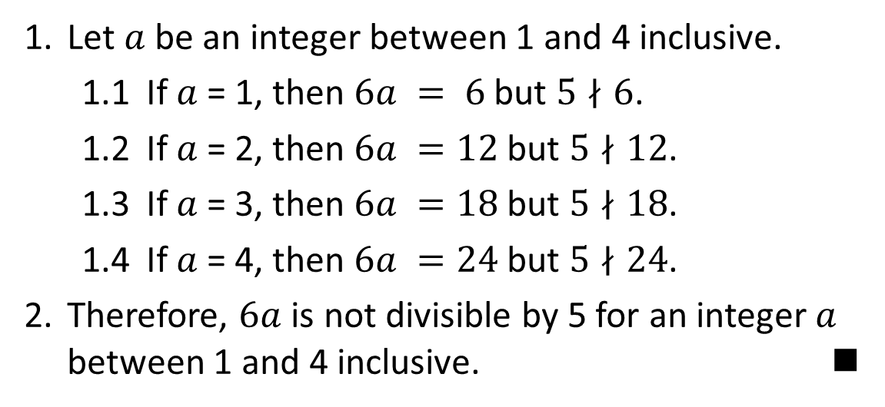
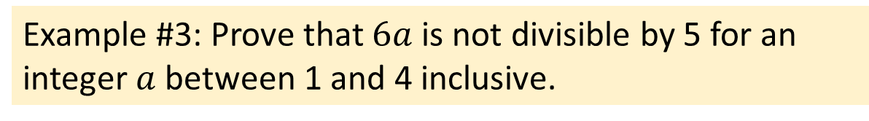
Variables and Important Sets Mathematical Statements Proofs
Example of Proof by Exhaustion
Example #3: Prove that $6a$ is not divisible by 5 for an integer $a$ between 1 and 4 inclusive.
Let $a$ be an integer between 1 and 4 inclusive.
  1.1 If $a$ = 1, then $6a = 6$ but $5∤6$.
  1.2 If $a$ = 2, then $6a =12$ but $5∤12$.
  1.3 If $a$ = 3, then $6a =18$ but $5∤18$.
  1.4 If $a$ = 4, then $6a =24$ but $5∤24$.
Therefore, $6a$ is not divisible by 5 for an integer $a$ between 1 and 4 inclusive. 

Slide 34
Variables and Important Sets Mathematical Statements Proofs
Example of Proof by Exhaustion
Example #4: Prove that the difference of two consecutive squares between 30 and 100 is odd.
The squares between 30 and 100 are 36, 49, 64 and 81.
  1.1 Case 1: 49 – 36 = 13 which is odd.
  1.2 Case 2: 64 – 49 = 15 which is odd.
  1.3 Case 3: 81 – 64 = 17 which is odd.
Therefore, the difference of two consecutive squares between 30 and 100 is odd. 
Proof by exhaustion, also called proof by cases, or proof by brute force, is suitable when the number of cases is finite.

Slide 35
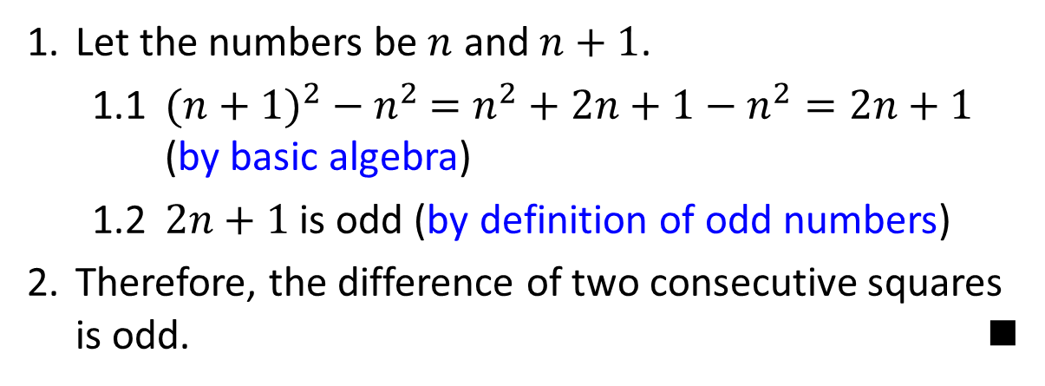
Variables and Important Sets Mathematical Statements Proofs
Example of Proof by Deduction
What if we need to prove a general problem where the number of cases is infinite?
We may then use proof by deduction, a type of direct proof.
Example #5: Prove that the difference of two consecutive squares is always odd.
Let the numbers be $n$ and $n+1$.
  1.1 ${(n+1)}^{2} −{ n}^{2} =n^{2}+2n+1−n^{2}=2n+1$ (by basic algebra)
  1.2 $2n+1$ is odd (by definition of odd numbers)
Therefore, the difference of two consecutive squares is odd. 

Slide 36
Variables and Important Sets Mathematical Statements Proofs
More Examples
1.3.5 More Examples
The preceding examples are straight-forward. Let’s try something more interesting.
Sometimes a direct proof is difficult. For example, to prove Theorem 4.7.1 (5th: 4.8.1) below:
Theorem 4.7.1 (5th: 4.8.1) Irrationality of $\sqrt{2}$
$\sqrt{2}$ is irrational.
Direct proof in this case is difficult because irrationality has an absence of a form. We know how a rational number “looks like”, but we can’t say the same for irrationals.

Slide 37
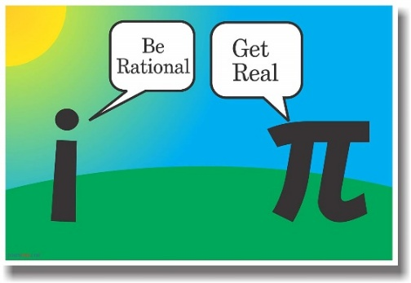
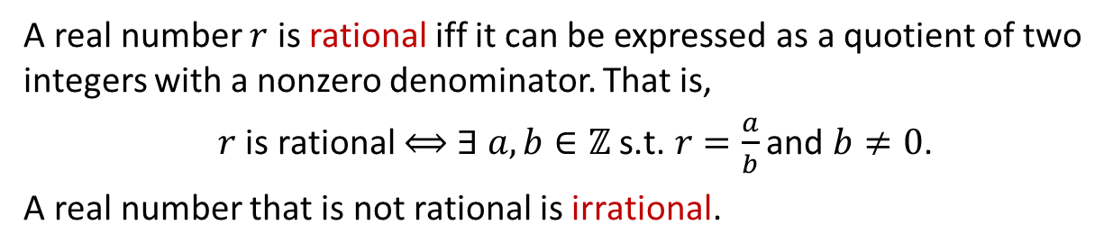
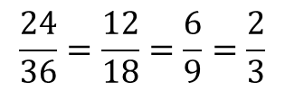
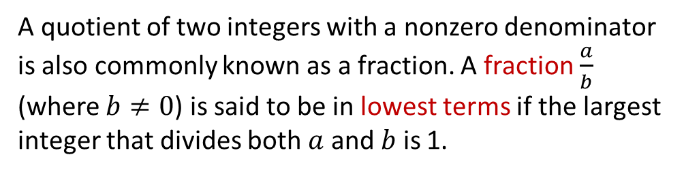
Variables and Important Sets Mathematical Statements Proofs
More Examples
Definition: Rational and irrational numbers
A real number $r$ is rational iff it can be expressed as a quotient of two integers with a nonzero denominator. That is,
$r$ is rational $⟺$ $∃ a,b∈ℤ \text{s}\text{.}\text{t}\text{. }r=\frac{a}{b}$ and $b≠0$.
A real number that is not rational is irrational.
Definition: Fraction in lowest term (simplest form)
A quotient of two integers with a nonzero denominator is also commonly known as a fraction. A fraction $\frac{a}{b}$ (where $b≠0$) is said to be in lowest terms if the largest integer that divides both $a$ and $b$ is 1.
Assumption 2: Every rational can be reduced to a fraction in its lowest term.
$$\frac{24}{36}=\frac{12}{18}=\frac{6}{9}=\frac{2}{3}$$

Slide 38
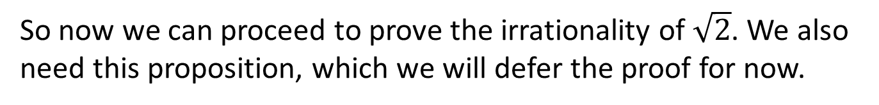
Variables and Important Sets Mathematical Statements Proofs
Example of Proof by Contradiction
In this case we need to do an indirect proof. One type of indirect proof is proof by contradiction.
To prove a statement S by contradiction, you first assume that ~S (not S) is true. Based on this, you use known facts and theorems to arrive at a logical contradiction.
Since every step of your argument thus far is logically correct, the problem must lie in your assumption (that ~S is true).
Thus, you conclude that ~S is false, that is, S is true.
So now we can proceed to prove the irrationality of $\sqrt{2}$. We also need this proposition, which we will defer the proof for now.
Proposition 4.6.4 (5th: 4.7.4)
For all integers $n$, if $n^{2}$ is even then $n$ is even.

Slide 39
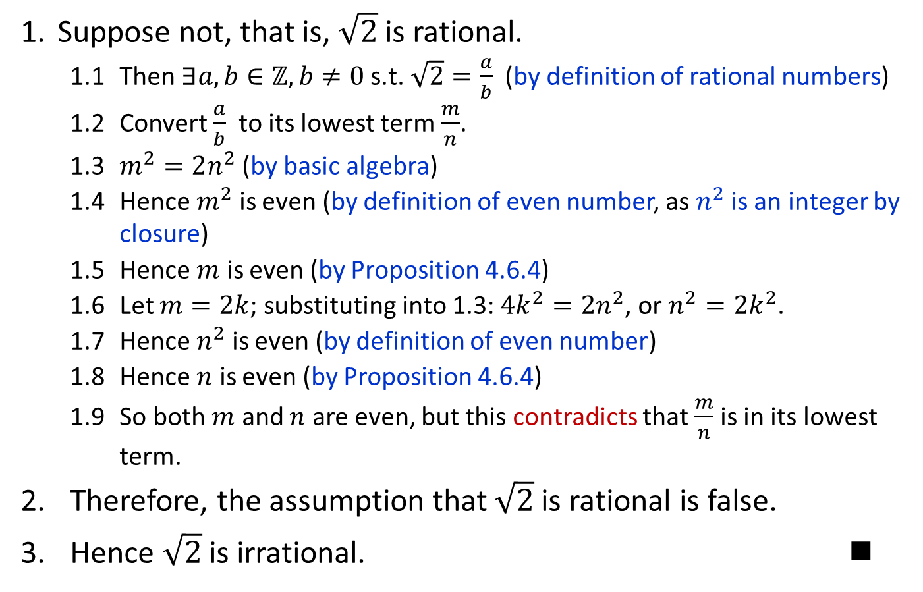
Variables and Important Sets Mathematical Statements Proofs
Example of Proof by Contradiction
Example #6: Prove Theorem 4.7.1 (5th: 4.8.1) $\sqrt{2}$ is irrational.
Suppose not, that is, $\sqrt{2}$ is rational.
  1.1 Then $∃a,b∈ℤ, b≠0 \text{s}\text{.}\text{t}\text{.} \sqrt{2}=\frac{a}{b}$ (by definition of rational numbers)
  1.2 Convert $\frac{a}{b}$ to its lowest term $\frac{m}{n}$.
  1.3 $m^{2}=2n^{2}$ (by basic algebra)
  1.4 Hence $m^{2}$ is even (by definition of even number, as $n^{2}$ is an integer by closure)
  1.5 Hence $m$ is even (by Proposition 4.6.4)
  1.6 Let $m=2k$; substituting into 1.3: ${4k}^{2}=2n^{2}$, or $n^{2}=2k^{2}$.
  1.7 Hence $n^{2}$ is even (by definition of even number)
  1.8 Hence $n$ is even (by Proposition 4.6.4)
  1.9 So both $m$ and $n$ are even, but this contradicts that $\frac{m}{n}$ is in its lowest term.
  Therefore, the assumption that $\sqrt{2}$ is rational is false.
  Hence $\sqrt{2}$ is irrational. 

Slide 40
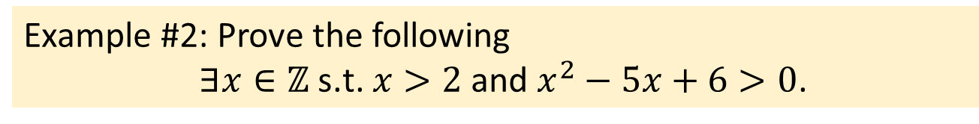
Variables and Important Sets Mathematical Statements Proofs
Example of Proof
In example #2, for proof by construction, the proof is rather straight-forward as the right value (eg: 17) can be found easily.
Example #2: Prove the following
$∃x∈ℤ \text{s}\text{.}\text{t}\text{.} x>2$ and $x^{2}−5x+6>0$.
However, sometimes finding the right thing takes some cleverness, as the next example illustrates.

Slide 41

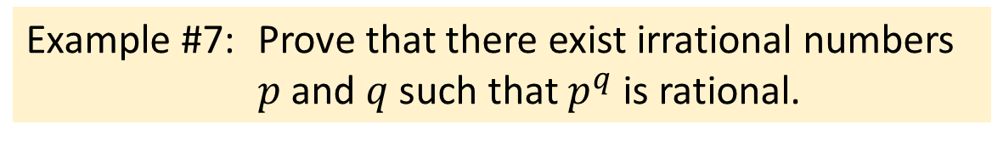
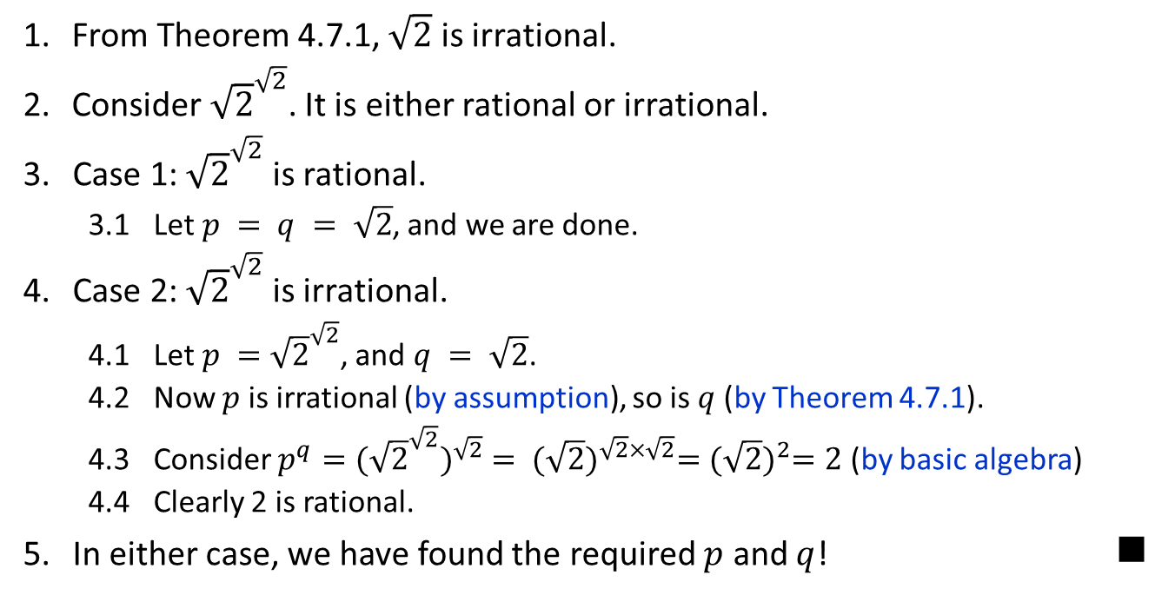
Variables and Important Sets Mathematical Statements Proofs
Example of Proof by Cases
Example #7: Prove that there exist irrational numbers $p$ and $q$ such that $p^{q}$ is rational.
From Theorem 4.7.1, $\sqrt{2}$ is irrational.
Consider ${\sqrt{2}}^{\sqrt{2}}$. It is either rational or irrational.
3. Case 1: ${\sqrt{2}}^{\sqrt{2}}$ is rational.
  3.1 Let $p = q = \sqrt{2}$, and we are done.
4. Case 2: ${\sqrt{2}}^{\sqrt{2}}$ is irrational.
  4.1 Let $p ={\sqrt{2}}^{\sqrt{2}}$, and $q = \sqrt{2}$.
  4.2 Now $p$ is irrational (by assumption), so is $q$ (by Theorem 4.7.1).
  4.3 Consider $p^{q}={({\sqrt{2}}^{\sqrt{2}})}^{\sqrt{2}} = {(\sqrt{2})}^{\sqrt{2}×\sqrt{2}}={(\sqrt{2})}^{2}=2$ (by basic algebra)
  4.4 Clearly 2 is rational.
  5. In either case, we have found the required $p$ and $q$! 


Slide 42
Variables and Important Sets Mathematical Statements Proofs
How to Write Proofs
1.3.6 How to Write Proofs
We introduced the format which includes numbering and indentation to help organize your proof. But how do you fill in the content of the proof? Which proof method should you use?
In this section we will show a general approach. However, writing proofs require insight and ingenuity at times, so the more you practice on your own and study others’ proofs, the more skillful you will get.
As you examine more examples in class and the book, and solve more problems in tutorials, you will gain the experience you need.

Slide 43

Variables and Important Sets Mathematical Statements Proofs
How to Write Proofs
Doing a proof is like solving a jigsaw puzzle*. No two jigsaws are alike: no two proofs are alike.
Sometimes you solve large chunks quickly, other times you get stuck. You don’t have to solve from top to bottom.
Some strategies are used, eg. fixing the border of the puzzle first. Likewise, there are useful strategies for proofs.
*: Adapted from D. Velleman, How to Prove It, 2nd Edition, 2006.

Slide 44
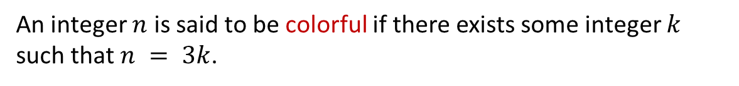
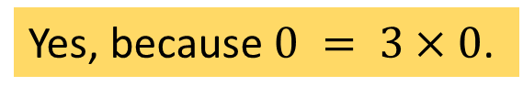
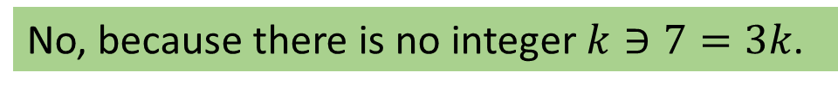
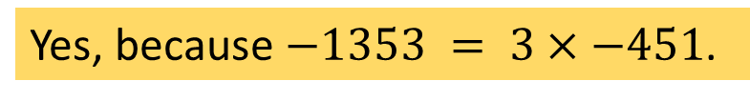
Variables and Important Sets Mathematical Statements Proofs
How to Write Proofs
We introduce the definition of colorful for this section. Note that this terminology is non-standard and is used only in this class.
Definition of Colorful (only for CS1231S)
An integer $n$ is said to be colorful if there exists some integer $k$ such that $n = 3k$.
Are the following colorful?
-1353
7
0
Yes, because $−1353 = 3×−451$.
No, because there is no integer $k∋7=3k$.
Yes, because $0 = 3×0$.


Slide 45
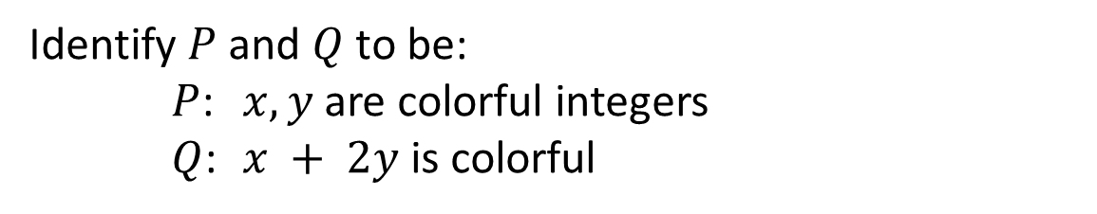
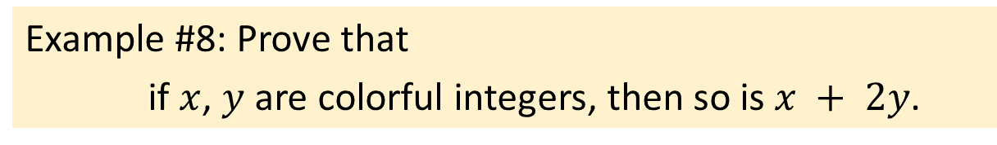

Variables and Important Sets Mathematical Statements Proofs
How to Write Proofs
Example #8: Prove that
if $x$, $y$ are colorful integers, then so is $x + 2y$.
Identify $P$ and $Q$ to be:
$P$: $x, y$are colorful integers
$Q$: $x + 2y$is colorful
We can immediately write down the start and end of the proof, as follows:
Draft proof:
Let $x,y$ be colorful integers.
…
And thus $x+2y$ is colorful. 

Slide 46

Variables and Important Sets Mathematical Statements Proofs
How to Write Proofs
Example #8: Prove that
if $x$, $y$ are colorful integers, then so is $x + 2y$.
The next logical thing is to use the definition of colorful.
Draft proof:
Let $x,y$ be colorful integers.
1.1 Then $∃a,b∈ℤ \text{s}\text{.}\text{t}\text{. }x=3a$ and $y=3b$ (by definition of colorful).
…
3. So $∃c∈ℤ \text{s}\text{.}\text{t}\text{.} x+2y=3c$.
4. And thus $x+2y$ is colorful (by definition of colorful). 
Draft proof:
Let $x,y$ be colorful integers.
…
And thus $x+2y$ is colorful. 

Slide 47



Variables and Important Sets Mathematical Statements Proofs
How to Write Proofs
Example #8: Prove that
if $x$, $y$ are colorful integers, then so is $x + 2y$.
This means we need to connect $c$ to $a$ and $b$. Obviously, we should try writing $(x+2y)$in terms of $a, b$:
Draft proof:
Let $x,y$ be colorful integers.
1.1 Then $∃a,b∈ℤ \text{s}\text{.}\text{t}\text{.} x=3a$ and $y=3b$ (by definition of colorful).
…
3. So $∃c∈ℤ \text{s}\text{.}\text{t}\text{. }x+2y=3c$.
4. And thus $x+2y$ is colorful (by definition of colorful). 
$$x+2y=3a+2\left(3b\right)=3(a+2b)$$

Slide 48

Variables and Important Sets Mathematical Statements Proofs
How to Write Proofs
Example #8: Prove that
if $x$, $y$ are colorful integers, then so is $x + 2y$.
So our final proof:
Proof:
Let $x,y$ be colorful integers.
1.1 Then $∃a,b∈ℤ \text{s}\text{.}\text{t}\text{. }x=3a$ and $y=3b$ (by definition of colorful).
1.2 Now, $x+2y=3a+2\left(3b\right)=3(a+2b)$ (by basic algebra)
2. Let $c=a+2b$. Note that $c∈ℤ$ (by closure)
3. So $∃c∈ℤ \text{s}\text{.}\text{t}\text{.} x+2y=3c$.
4. And thus $x+2y$ is colorful (by definition of colorful). 

Slide 49

Extra: Thinking Mathematically
Reasoning
Observing structures
Working systematically
Visualising
Modelling
No rote learning!

Slide 50

Extra: Thinking Mathematically
Back to the basic: Understanding definitions.
Definition: Rational number
$r$ is rational $⟺$ $∃ a,b∈ℤ \text{s}\text{.}\text{t}\text{.} r=\frac{a}{b}$ and $b≠0$.
Is every integer a rational number?
Let $n$ be an integer.
1.1 Let $a = n$and $b = 1$.
1.2 Then $n =\frac{a}{b}$.
2. Therefore, every integer is a rational number.


Slide 51

Extra: Thinking Mathematically
No rote learning!
In AY2017/18 Semester 1 exam paper, the following new definitions are given and 7 questions are based on them!

Slide 52


Extra: Thinking Mathematically

Slide 53




Next lecture
2. The Logic of Compound Statements
$$∼$$
$$∧$$
$$∨$$
$$→$$

Slide 54
END OF FILE

